Slide 1
kob
A tiny, self-discovering Parquet query server —
served, read-only, as Apache Arrow — fast.
Drop Parquet in a folder → a discoverable, filterable, blazing-fast Arrow API.
Apache Arrow Flight · DuckDB · FastAPI / Swagger github.com/iyedexe/kob

Slide 2
MOTIVATION
Serving Parquet shouldn't be hard — or slow
A producer writes Parquet to a folder. You must serve it, read-only, to Python / C# / C++ / Excel clients. Every usual option is overkill or slow:
A warehouse / broker
A hand-written API
A JSON / Protobuf API
Heavy infrastructure in front of an already-queryable, columnar file format.
Declare a schema + catalog in code; redeploy on every new dataset or column.
Pays the serialization tax — Arrow's FAQ: (de)serialization is 80–90% of compute.
What we actually want: self-discovering (no hardcoded schema) · minimal (tiny footprint) · blazing fast (no serialization tax).
kob · self-discovering Parquet → Apache Arrow 2 / 10

Slide 3
OVERVIEW
What kob is
Point it at a directory; it discovers your datasets, tells clients what they can filter on per folder and per column, and streams results as Apache Arrow. ~750 lines of core server.
Tiny
Self-configuring
Four dependencies — DuckDB, PyArrow, FastAPI, uvicorn. No DB, no broker, no config, no schema.
Drop new files / partitions / datasets — they appear live. Discovery reads folder names + one file's metadata; never scans data.
Fast
Safe
DuckDB pushes partition/predicate/projection pruning into the scan; results stream as Arrow over Flight — nothing to deserialize.
Read-only. Dataset names sandboxed to the root; columns/ops validated; every value a bound parameter (no SQL injection).
kob · self-discovering Parquet → Apache Arrow 3 / 10

Slide 4
DATA LAYOUT
List of dicts vs. columns — the same data, two shapes
Before the speed story — the SAME little table, in the two shapes a server can hand you.
[
{"symbol":"AAPL", "strike":200, "bid":5.20},
{"symbol":"AAPL", "strike":205, "bid":3.10},
{"symbol":"MSFT", "strike":300, "bid":8.40}
]
symbol : ["AAPL", "AAPL", "MSFT"]
strike : [ 200, 205, 300 ]
bid : [ 5.20, 3.10, 8.40 ]
Row-oriented — JSON, a list of dicts. Keys repeat on every row; values stored field-by-field. To read one column you walk every row and pull that field — decode all of it, then rebuild columns.
Columnar — a DataFrame / Arrow. Each column is one contiguous array; keys stored once. A whole column is already laid out for vectorized ops, compression, and zero-copy transfer.
Why it matters: pandas, Polars and Arrow are all columnar in memory — so kob serving Arrow is that exact layout, nothing to translate; JSON forces a row-by-row encode on the way out and a decode + column-rebuild on the way in.
kob · self-discovering Parquet → Apache Arrow 4 / 10

Slide 5
THEORY
Why Apache Arrow — the 30-second theory
Row vs. columnar is the whole story:
● JSON & Protobuf are row-oriented. The sender encodes every value field-by-field; the receiver decodes every value and rebuilds columns.
● Cost scales with rows × cols — and grows super-linearly with result size.
● Arrow's columnar wire layout IS its in-memory layout. Reading a result is a header parse + buffer-pointer setup — essentially nothing to deserialize.
● Arrow Flight uses Protobuf only for its tiny control envelope (tickets), never for the bulk data.
Format | Layout | Verdict
JSON | row, text | slowest
Protobuf | row, binary | binary ≠ fast
Arrow IPC | columnar | near-zero
Arrow Flight | columnar + gRPC | the default
“(De)serialization can represent 80–90% of computing costs.”
— Apache Arrow FAQ. That is exactly the cost Arrow removes.
kob · self-discovering Parquet → Apache Arrow 5 / 10

Slide 6
HOW IT WORKS
Architecture: Flight + Swagger, one command
One straight line, folder → Arrow stream:
● core — discover (catalog), validate the query (contract), execute on DuckDB → Arrow (engine).
● server — the kob entry point: Flight + a Swagger HTTP control plane, one process, one engine.
● demos — Arrow-over-HTTP / JSON / Protobuf servers, only to demonstrate the alternatives.
● tools — sample-data generator, reference client, benchmark.
 | Arrow Flight | Swagger HTTP
for | machines, fast | humans, discovery
port | 8815 (gRPC) | 8000 (/docs)
payload | Arrow, zero-decode | JSON / CSV
$ uv run kob
data (fast) Flight grpc://…:8815
docs (Swagger) HTTP http://…:8000/docs
kob · self-discovering Parquet → Apache Arrow 6 / 10

Slide 7
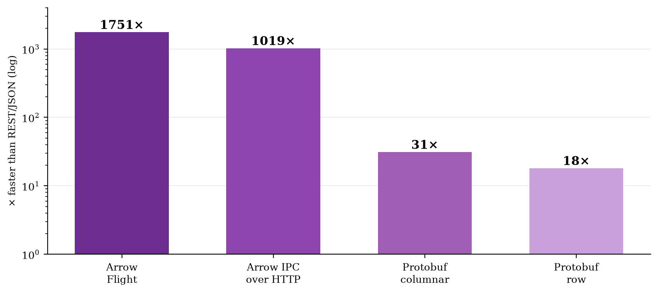
RESULTS
Key findings
● Arrow wins by 1–3 orders of magnitude — 150–1750× faster than JSON, 5–56× faster than the best Protobuf.
● Binary ≠ fast. Protobuf is binary and still 5–56× slower — it must parse every value.
● The gap grows with result size — ~150× on 29k rows → ~1750× on 1.75M rows.
● JSON is a bandwidth hog too — 8× heavier on the wire than Arrow + zstd.
● Same engine throughout. Only the wire format changes — so the wire is the cause.
Speedup vs REST/JSON, 1.75M-row pull (medium dataset).
kob · self-discovering Parquet → Apache Arrow 7 / 10

Slide 8
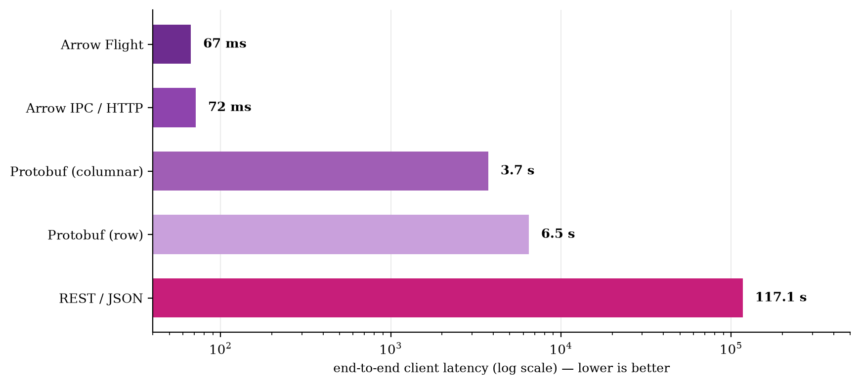
BENCHMARK
Performance: same query, five wire formats
1.75M rows
one query, one engine
Flight 67 ms
JSON 117 s
Same result, ~1750× apart.
Pushdown happens before serialization — and compounds with picking a fast wire.
Medium dataset · Apple M4 · localhost loopback (understates Arrow's win on a real network).
Source: docs/PERFORMANCE_REPORT.md
kob · self-discovering Parquet → Apache Arrow 8 / 10

Slide 9
SEE IT
Demo: one query, every transport
A runnable notebook spins up all four transports, runs the SAME query over each, checks they return identical data, and times them.
● Arrow Flight · Arrow-over-HTTP · REST/JSON · gRPC/Protobuf
● Result: all four return the identical 14,006 rows — Flight fastest by far.
● Discovery, filtering and serialization are all kob's job — zero schema config.
# install + launch the demo
uv sync --extra demo
make notebook
{
"dataset": "optionmetrics",
"columns": ["date","strike","impl_vol","delta"],
"filters": [
{"column":"underlying","op":"=","value":"AAPL"},
{"column":"delta","op":">=","value":0.4}
]
}
notebooks/kob_transports_demo.ipynb
kob · self-discovering Parquet → Apache Arrow 9 / 10

Slide 10
Takeaways
● Use Arrow on the wire, default to Flight. Not JSON (150–1750× slower, 8× heavier), not Protobuf (5–56× slower).
● Self-discovering beats configured. Point kob at a folder; new data appears live, no restart, no schema.
● Minimal & safe by construction. Four deps, ~750-line core, read-only, parameterised, sandboxed.
● It's the wire, not the engine. Hold DuckDB constant and the format alone moves latency by 1750×.
README.md · docs/DESIGN.md · docs/PERFORMANCE_REPORT.md github.com/iyedexe/kob

