Slide 1






IEEE AESS Sustainabilty
Hackathon
Les Talelas
Theme 4 : Sustainable Space Systems & Orbital Lifecycle
Because the sky shouldn't wait
for someone on the ground to fix it.

Slide 2
IEEE AESS Sustainabilty
Hackathon
Les Talelas
Theme 4 : Sustainable Space Systems & Orbital Lifecycle
Because the sky shouldn't wait
for someone on the ground to fix it.

Slide 3
IEEE AESS Sustainabilty
Hackathon
Problem Statement
Low Earth orbit is under severe pressure.
There are more than 1,2 million debris objects!

Slide 4
IEEE AESS Sustainabilty
Hackathon
Problem Statement
Low Earth orbit is under severe pressure.
There are more than 1,2 million debris objects!
More than 40% of small satellites launched between 2000 and 2016 experienced failure.

Slide 5
IEEE AESS Sustainabilty
Hackathon
Problem Statement
Low Earth orbit is under severe pressure.
There are more than 1,2 million debris objects!
More than 40% of small satellites launched between 2000 and 2016 experienced failure.
Sensor Degradation
Faulty Data
Loss of Trust
Early Decommission

Slide 6
IEEE AESS Sustainabilty
Hackathon
Proposed Solution

Slide 7

IEEE AESS Sustainabilty
Hackathon
Proposed Solution
We don’t need more hardware in space. We need smarter software.

Slide 8
IEEE AESS Sustainabilty
Hackathon
Proposed Solution
We don’t need more hardware in space. We need smarter software.
Keep satellites useful for longer, so we replace fewer of them
NUWA, the first complete, autonomous, self-healing ecosystem for satellite constellations.
NUWA transforms a group of fragile, isolated spacecraft info a cooperative, resilient network.

Slide 9
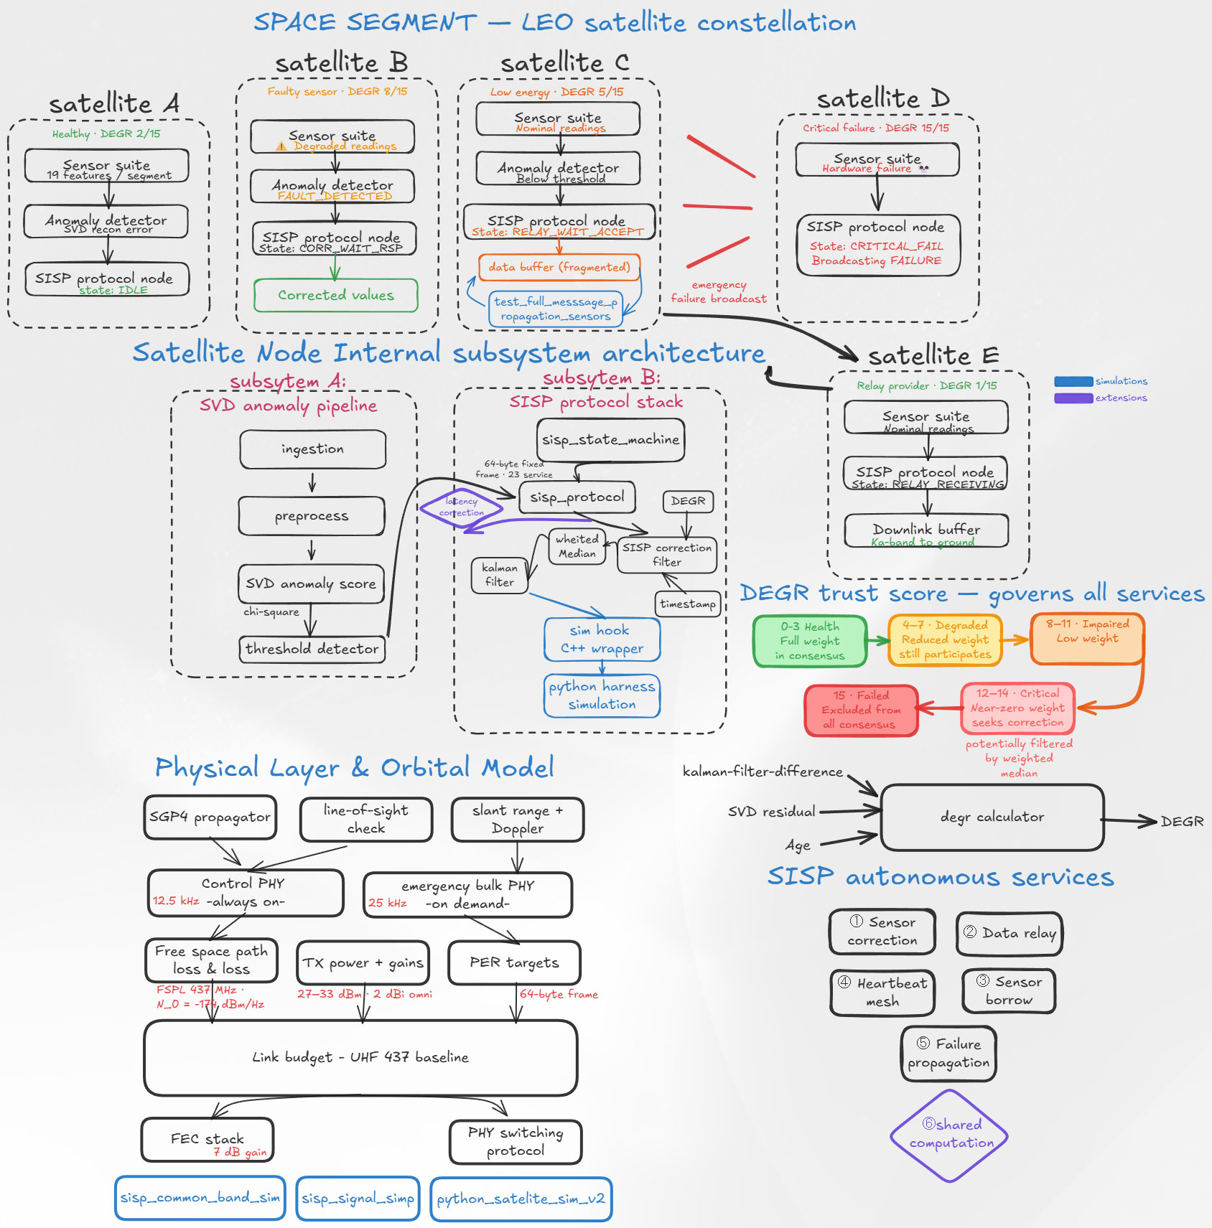
The Ecosystem & Core Services

Slide 10
IEEE AESS Sustainabilty
Hackathon
The Ecosystem & Core Services
Deterministic C++ state machine with 21 states & 24 events
Correction
Relay
Borrow
1
2
3

Slide 11
IEEE AESS Sustainabilty
Hackathon
The Ecosystem & Core Services
Deterministic C++ state machine with 21 states & 24 events
Correction
Relay
Borrow
2
3
DEGR wheighting & median-Kalman filter
1

Slide 12
IEEE AESS Sustainabilty
Hackathon
The Ecosystem & Core Services
Deterministic C++ state machine with 21 states & 24 events
Correction
Relay
Borrow
1
3
Route vital data through neighbours
2

Slide 13
IEEE AESS Sustainabilty
Hackathon
The Ecosystem & Core Services
Deterministic C++ state machine with 21 states & 24 events
Correction
Relay
Borrow
1
2
Failed sensors are bypassed by streaming a neighbors' healthy data
3

Slide 14
IEEE AESS Sustainabilty
Hackathon
The Ecosystem & Core Services
Deterministic C++ state machine with 21 states & 24 events
Correction
Relay
Borrow
1
2
3
-SVD Anomaly Detector Pipeline
-Validation on the European Space Agency’s OPSSAT-AD dataset
-Achieving 0,99 accuracy : Under a 437 MHz UHF link model
-Maintains 9dB of link margin at around 1000 km.
-Estimated usable range of 2800 km.
Preventing
Saving
Reduces unnecessary
mass sent to orbit
27,8
8,3m
Replacement Satellites
Or future debris-risk
Tons of CO² equivalent
launch emissions

Slide 15
IEEE AESS Sustainabilty
Hackathon
Impact
Across a 50-year reference industry growth-model
Preventing
Saving
Reduces unnecessary
mass sent to orbit
27,8
8,3m
Replacement Satellites
Or future debris-risk
Tons of CO² equivalent
launch emissions

Slide 16



IEEE AESS Sustainabilty
Hackathon
SDG Alignment

Slide 17
IEEE AESS Sustainabilty
Hackathon
Scalability
Shared computation
Faster fault detection
Multi-band communication
Encryption layer

Slide 18
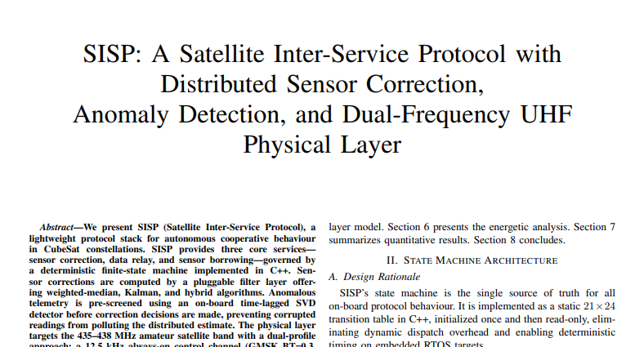
IEEE AESS Sustainabilty
Hackathon
We are already within the process of forming a scientific paper for SISP

Slide 19




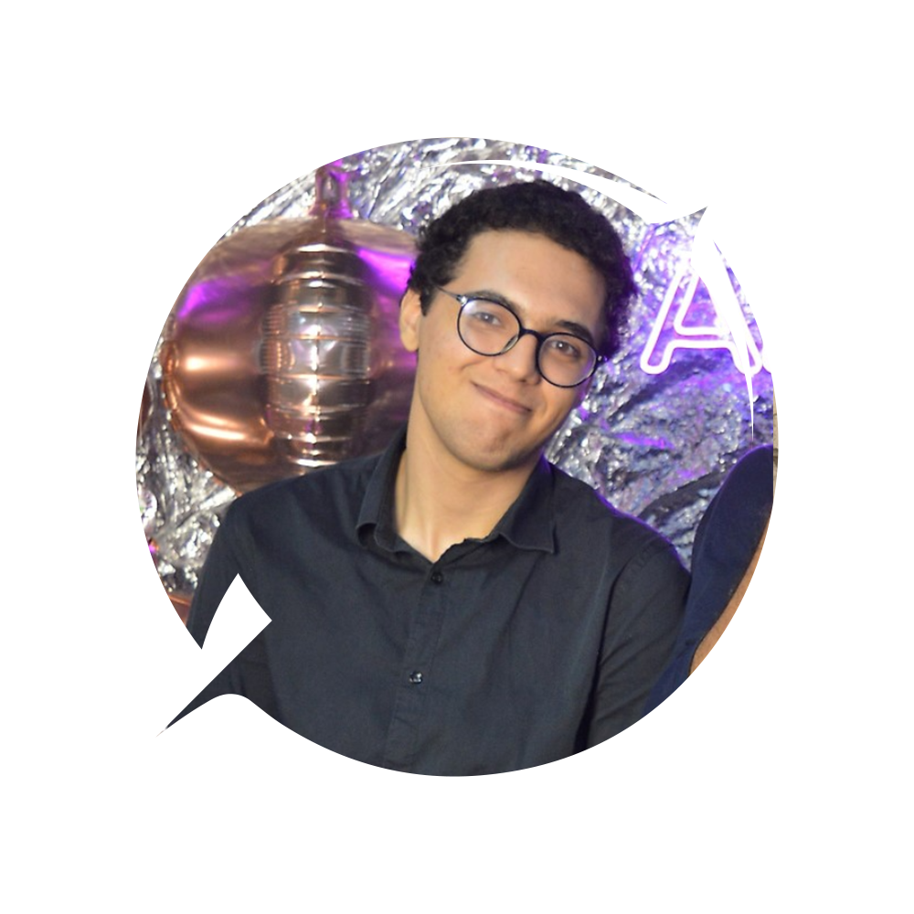
IEEE AESS Sustainabilty
Hackathon
Conclusion
->We don’t need to launch more backup hardware into space. Like the myth, our project NUWA patches the collapsing orbital architecture from within, replacing physical debris risks with intelligent, cooperative software.

Slide 20
IEEE AESS Sustainabilty
Hackathon
Meet Our Team
Iyed Mdimegh
Rayen Khammar
Adem Bhouri
Akrem Medimagh
Talel Laarif

Slide 21
IEEE AESS Sustainabilty
Hackathon
Thank you
for your attention !

Slide 22
IEEE AESS Sustainabilty
Hackathon
The Empirical Validation
Protocol Boundedness
Correction Integrity
Relay Resilience
273/273 assertions passed
94,3% RMSE improvement
100% payload reconstruction

Slide 23
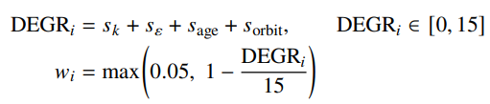
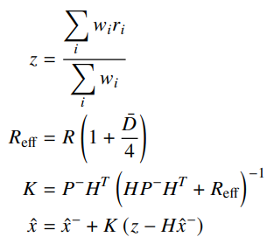
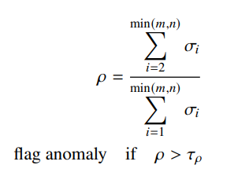
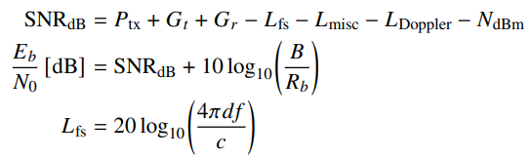
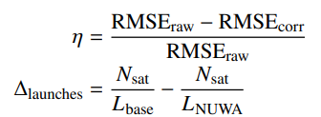
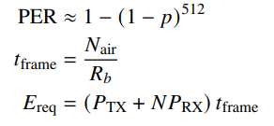
IEEE AESS Sustainabilty
Hackathon
Mathematical Calculations
1-DEGR Trust Score & Correction Weight :
4-DEGR-Wheited Kalman Correction :
2-SVD Anomaly Detection :
5-Link Budget :
3-Mission Life Extension :
6-Packet Error Rate and Frame Energy :

Slide 24
Pitch fact / claim | Resource or calculation | Credibility
Low Earth orbit is crowded: over 1.2 million debris objects larger than 1 cm and over 50,000 larger than 10 cm. | ESA Space Environment Report 2025 states those debris population estimates. Source: ESA. | External, official agency source.
Small satellites are fragile: 41.3% of small satellites launched from 2000 to 2016 had total or partial mission failure. | NASA/NTRS technical report "Small-Satellite Mission Failure Rates". Source: NASA NTRS PDF. | External, NASA technical report.
Ground contact is limited; single-ground-station LEO access can be only a few contacts per day lasting minutes. | NASA report: fixed ground station can give 2-4 meaningful contacts/day with up to 5 minutes/contact. Source: NASA NTRS PDF. | External, NASA technical report.
NUWA uses real satellite telemetry for anomaly-detection validation. | OPSSAT-AD is an AI-ready anomaly-detection benchmark from ESA OPS-SAT telemetry. Source: Nature Scientific Data. | External, peer-reviewed dataset paper.
NUWA detects anomalies on-board using SVD-style telemetry modeling. | External basis: OPSSAT-AD benchmark validates satellite-telemetry anomaly detection. NUWA implementation: Hankel-SVD detector in HankelSVDDetector.js. | Mixed: peer-reviewed dataset plus project implementation.
SISP is a deterministic protocol layer with correction, relay, and borrow services. | State machine and protocol implementation in sisp_state_machine.cpp and sisp_protocol.cpp. | Project-specific, reproducible from source.
SISP uses a 21-state / 24-event C++ state machine and fixed 64-byte frames. | Design documented in SISP_RESEARCH_PAPER.md; code backed by state-machine and frame tests. | Project-specific, test-backed.
Protocol boundedness claim: 273/273 C++ assertions pass. | Test suite source in c++ implemnetation/tests; runner: run_cpp_tests.ps1. | Project-specific, reproducible test evidence.
Correction KPI: 94.3% RMSE improvement under 30-day drift. | Calculation: (8.909 - 0.504) / 8.909 = 94.3%; documented in SISP_RESEARCH_PAPER.md. | Project-specific, simulation/test result.
Packet-loss KPI: 85.6% RMSE improvement under 10% packet loss. | Calculation: (8.290 - 1.197) / 8.290 = 85.6%; documented in SISP_RESEARCH_PAPER.md. | Project-specific, simulation/test result.
Relay resilience: 109/109 bytes reconstructed through corruption, reordering, retry, and replay disruption. | Relay test source: test_relay_text_resilience.py. | Project-specific, reproducible integration test.
Energy overhead: 8-neighbor correction takes about 1.10 s and 3.66 J; daily overhead is about 317 mWh. | Calculation: (10 W + 8*2.5 W)*0.122 s = 3.66 J; daily model documented in SISP_KPI_SNAPSHOT.md. | Project-specific engineering model.
Link assumption: 437 MHz UHF dual profile with 9,600 bps control and 19,200 bps bulk. | Link-budget study and formulas in SISP_RESEARCH_PAPER.md. Hardware realism cross-check: official SDR list prices from Ettus B210 and Ettus N310. | Project model plus real hardware market check.
Launch replacement cost floor starts at public rideshare pricing. | SpaceX official rideshare pricing: $350K for 50 kg to SSO plus $7K/kg additional mass. Source: SpaceX Rideshare. | External, official commercial pricing.
Ground-station operations can be treated as pay-per-use in cost models. | AWS Ground Station uses on-demand and reserved antenna access, paid by antenna time used. Source: AWS Pricing and AWS FAQ. | External, official commercial pricing model.
Sustainability impact: fewer premature replacements reduce launch emissions, mass to orbit, and future debris pressure. | Transparent scenario model: baseline 100 / 3 = 33.33 replacements/yr; improved 100 / 4.35 = 22.99 replacements/yr; avoided 10.34/yr. CO2 and mass results scale from avoided replacements. | Model estimate, not flight measurement.
Rocket launches have climate and atmospheric impact. | Review source: Dallas et al., "The environmental impact of emissions from space launches"; broader NASA atmospheric impact review also supports concern. Sources: ADS abstract, NASA TM. | External scientific literature.
NUWA is not yet flight-qualified. | Project limitation in evidence sheet and research paper: current validation is simulation, unit/integration tests, and hardware-in-loop roadmap. | Honest limitation; needs flight/hardware validation.
Refrences

Slide 25
IEEE AESS Sustainabilty
Hackathon
Cost Structure
CREDIBLE VALIDATION
FLIGHT-DEMO READINESS
OPTIONAL HOSTED DEMO
$250K-$700K
$900K-$2.5M
$150K-$750K+
software, simulation, COTS-radio lab
partner testbed, security, mission docs
depends on mission partner access
Cost area | What we buy | Lean | Strong validation
Core engineering | C++ flight stack, SVD detector, simulation, CI | $80K-$180K | $250K-$600K
RF / HIL lab | COTS UHF radios, SDRs, attenuators, power tools | $20K-$70K | $100K-$300K
Mission testing | flatsat work, partner telemetry, operator review | $30K-$100K | $150K-$500K
Security + reliability | auth frames, replay defense, FMEA, QA hardening | $10K-$40K | $50K-$150K
Cloud + tooling | dashboards, scenario runners, data storage | $5K-$20K | $25K-$80K
Legal / compliance | IP, contracts, export-control review | $10K-$50K | $50K-$150K

Slide 26
IEEE AESS Sustainabilty
Hackathon
Deployment Cost / Partner
Commercial target
Ongoing support
Value floor
$150K-$400K
$50K-$150K/yr
$350K+
our first-year delivery cost per normal operator
updates, validation, dashboards, mission support
public SSO rideshare slot before satellite build cost
Buyer type | Typical scope | Our first-year cost | Our annual cost
Research / university | 1-5 satellites; simulation-first | $8K-$30K | $3K-$12K
Small operator | 5-20 satellites; pre-flight integration | $50K-$160K | $20K-$70K
Commercial constellation | 20-100+ satellites; mission adapters | $180K-$600K | $60K-$220K
Agency / high-assurance | security review, audit, formal validation | $500K-$1.5M+ | $150K-$500K
Recommended offer
Setup/integration: $250K-$1M depending on assurance level
Recurring license: $2K-$10K per satellite per year
100-satellite buyer: $500K-$900K first year; $300K-$700K/year after

