Slide 1
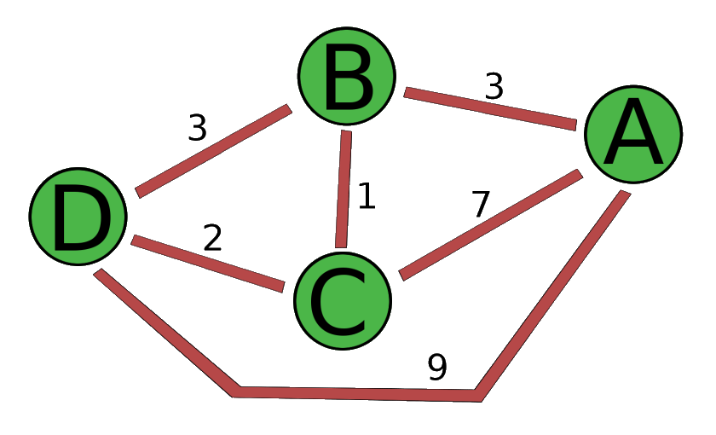
The shortest path with python (PERT)
Pr.Khalid OUNACHAD
Realized by :
JIYDH Abdulmajeed

Slide 2
Content
Abstract
Objective and Principe
URL (Uniform Resource Locator)
User Guide
Conclusion and Perspectives

Slide 3
Abstract
PERT is a statistical tool used in project management, which was designed to analyze and represent the tasks involved in completing a given project.
Dijkstra's algorithm is a path finding algorithm, like those used in routing and navigation.
so we will use Dijkstra's algorithm to find the shortest path instead of using method PERT

Slide 4
Objective and Principe
Dijkstra's algorithm is used to solve the shortest path problem. It allows, for example, to determine a shorter route to get from one city to another knowing the road network of a region. More precisely, it calculates the shorter paths. It can also be used to calculate a shorter path between a starting vertex and an ending vertex.

Slide 5
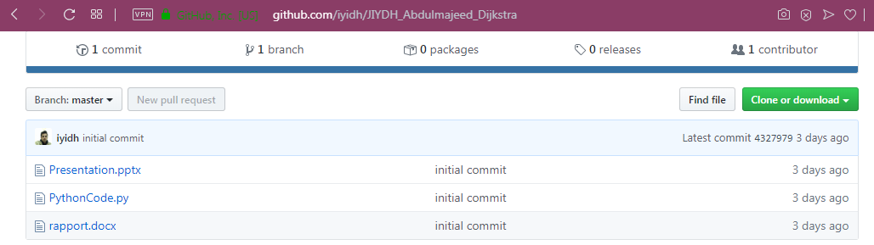
URL (Uniform Resource Locator)
https://github.com/iyidh/JIYDH_Abdulmajeed_Dijkstra

Slide 6
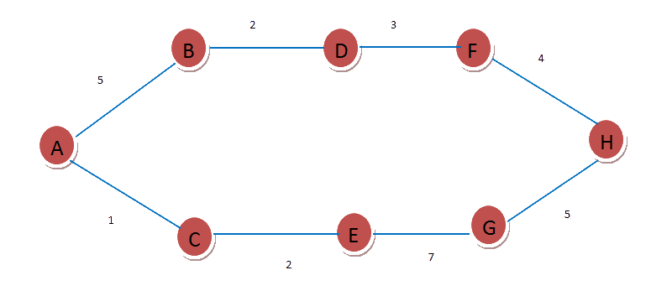
User Guide
The Pert diagram as Example
2
3
4
5
1
5
2
7

Slide 7
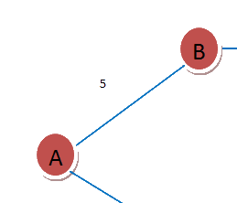
User Guide
Extract the nodes and the distance between them
=
5
A -- B -- 5

Slide 8
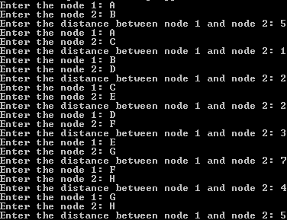
User Guide
Insert the nodes and the Distances

Slide 9
Conclusion and Perspectives
Open Source denoting software for which the original source code is made freely available and may be redistributed and modified, Dijkstra Algorithm may be redistributed and modified as well.

