Slide 1
Holmusk - Healthcare Dataset Challenge
Mohammad Iylia Haziq

Slide 2
Data Cleaning

Slide 3

Approach
Problem Statement
Analyze clinical and financial data of patients
Find insights about drivers of cost of care
Initial findings:
4 different .csv files
Join files on common columns
13,600 rows
13,600 rows
3,400 rows
3,000 rows

Slide 4
Data Cleaning
13,600 rows
bill_id
13,600 rows
bill_id
patient_id
date_of_admission
3,400 rows
patient_id
date_of_admission
3,000 rows
patient_id
13,600 bill_id ⇒ 3,400 patients x 4 split bills
Hence, only 3,400 appointments were made
3,000 unique patients
Some patients visited more than once.

Slide 5

Data Cleaning
13,600 rows
bill_id
13,600 rows
bill_id
3,400 rows
patient_id
3,000 rows
patient_id
13,600 rows
patient_id
date_of_admission
3,400 rows
patient_id
date_of_admission
Notes:
13,600 bill_id ⇒ 3,400 patients x 4 split bills
Hence, only 3,400 appointments were made
3,000 unique patients
Some patients visited more than once.

Slide 6
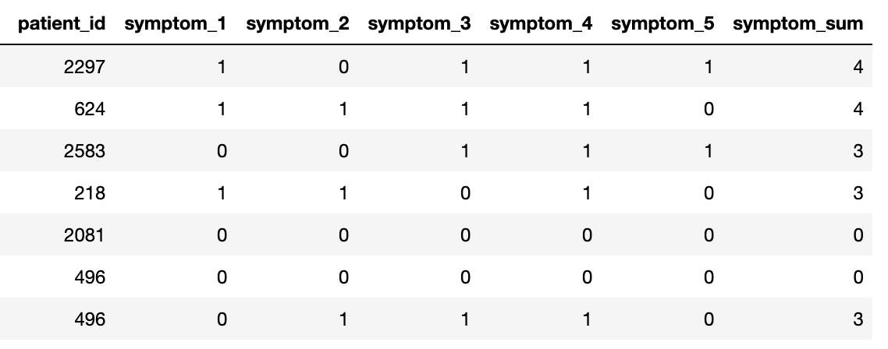
Feature Engineering
age, month, year
BMI = height/weight^2
medical_sum, symptom_sum, preop_medication_sum

Slide 7
Data Analysis

Slide 8
Approach
For each categorical columns (gender, race, resident_status)
Analyse against numerical columns
Goal: identify Financial and Clinical analysis of patient data
Analyse all columns w.r.t. Cost
Goal : identify driver of cost

Slide 9
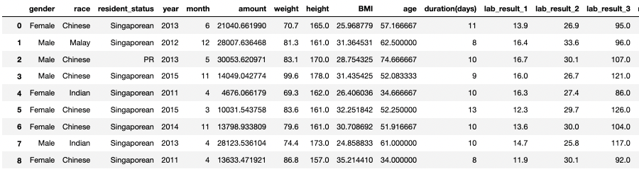
Data Types
Categorical columns
Numerical columns

Slide 10
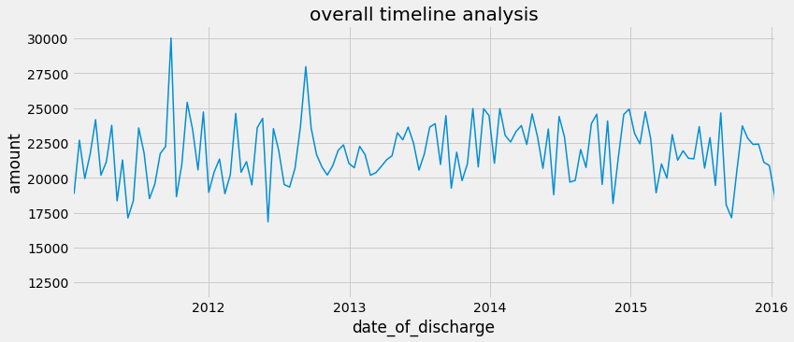
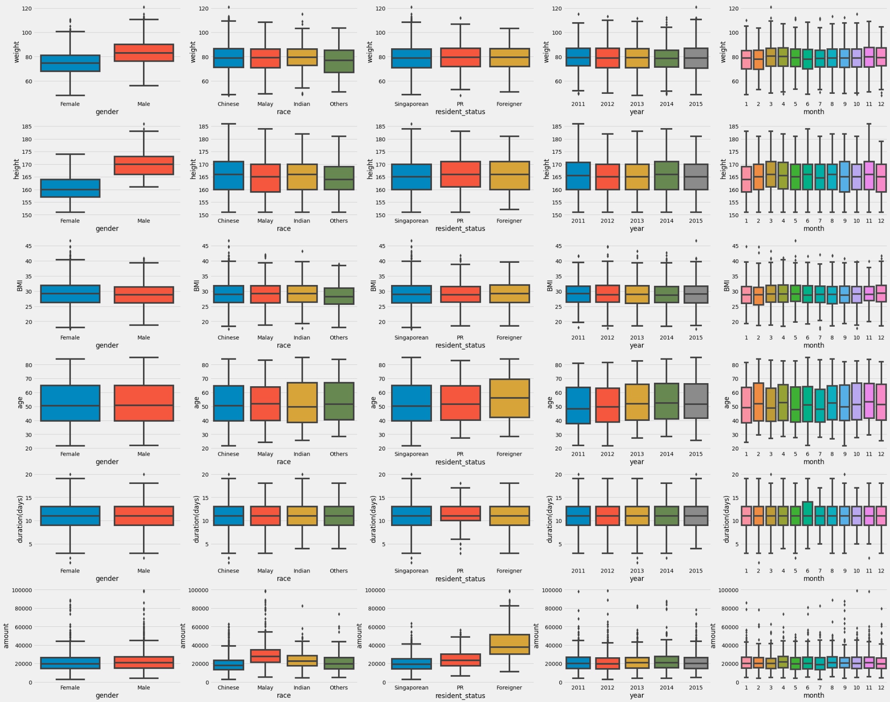
Average cost throughout the years…
No evidence of rising cost throughout the years

Slide 11
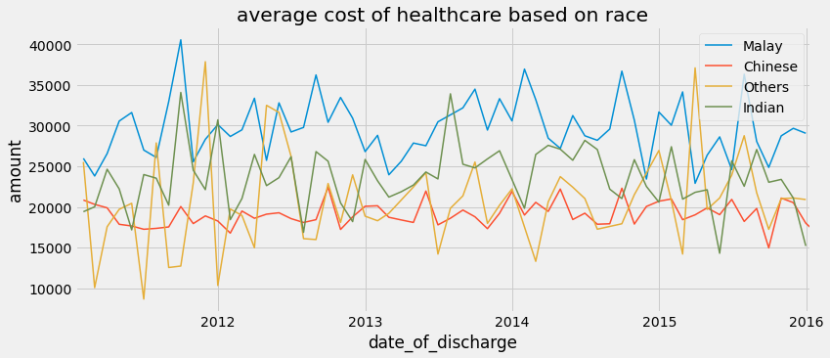
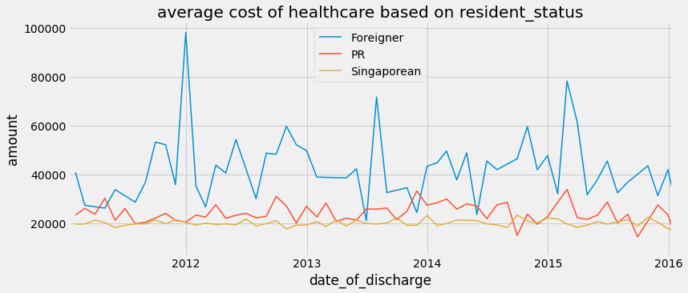
Average cost throughout the years…

Slide 12
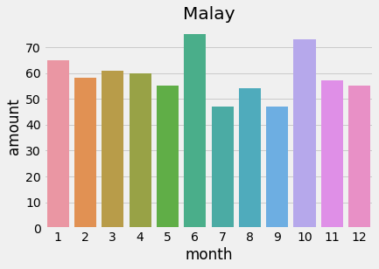
Hari raya on 2012-2016 were in July/August.
Perhaps people are more reluctant to go to hospital during festive period.

Slide 13
Each categorical group

Slide 14
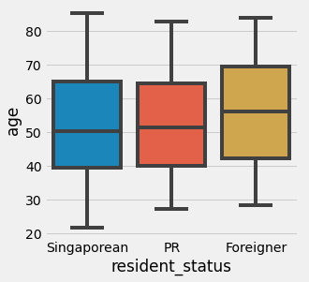
Categorical column: resident_status
Median Age
Foreigner: 56
PR: 51
Singaporean: 50
Median cost
Foreigner: $ 37.6k
PR: : $ 23.3k
Singaporean: $ 19.2k
Notes:
Foreigners age is older. And foreigner pays close to twice that of Singaporean and PR.
This shows that Foreigners tend to come to Singapore for medical help later, possbly as they accummulate enough wealth in the later years, since it is more expensive for them to treat the condition.

Slide 15
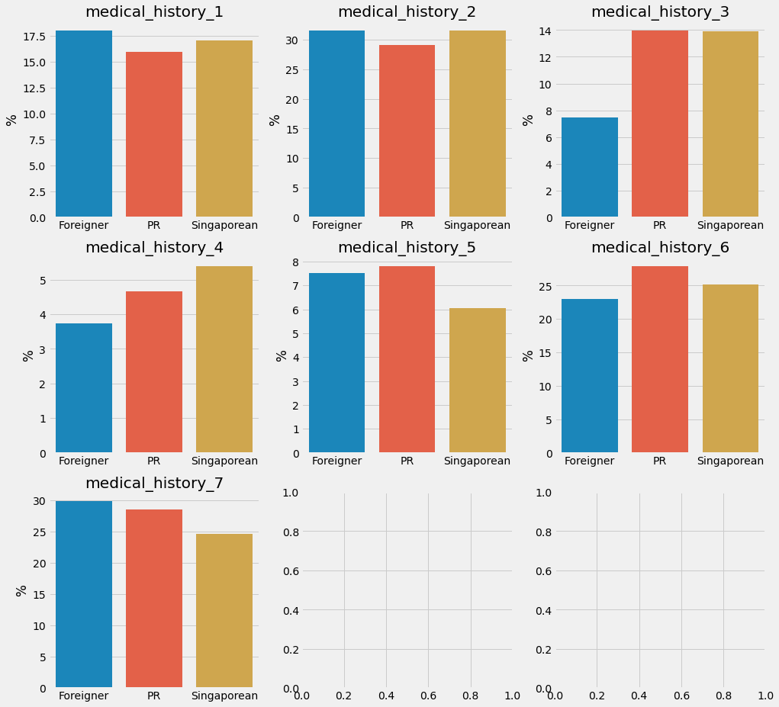
Categorical column: resident_status
Percentage of people with certain medical_history
Most variations between different resident_status:
medical_history_3
medical_history_4

Slide 16
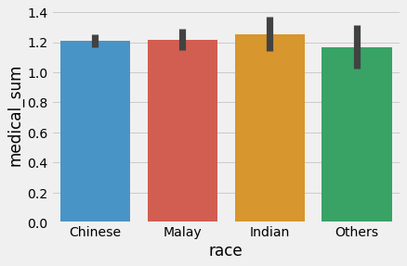
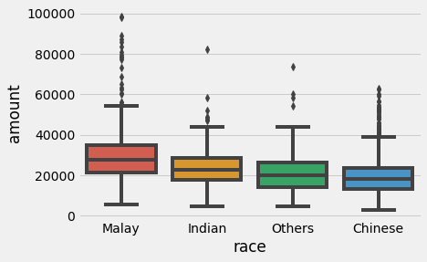
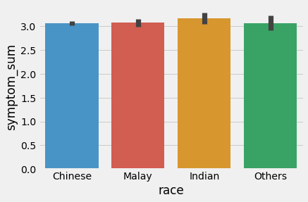
Categorical column: race
Median cost
Malay: $28k
Indian: $23k
Others: $20k
Chinese: $18k
No evidence of higher cost for patients with more symptoms or medical conditions.
Notes:
Malays seem to have much higher cost and with more variance in their outliers too.
This could possibly be due to more complex issues (e.g multiple health conditions) they are facing or that it may be due to other underlying problem related to cost such as lack of insurance that leads to higher cost.

Slide 17
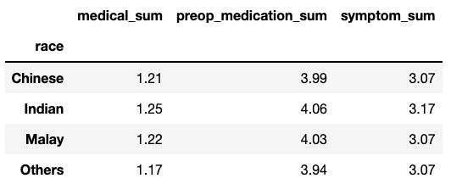
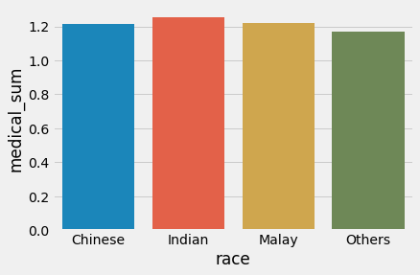
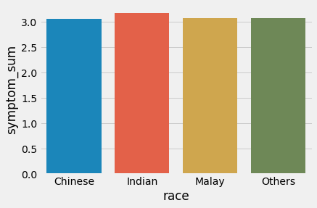
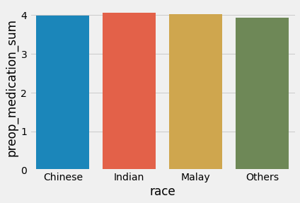

Slide 18
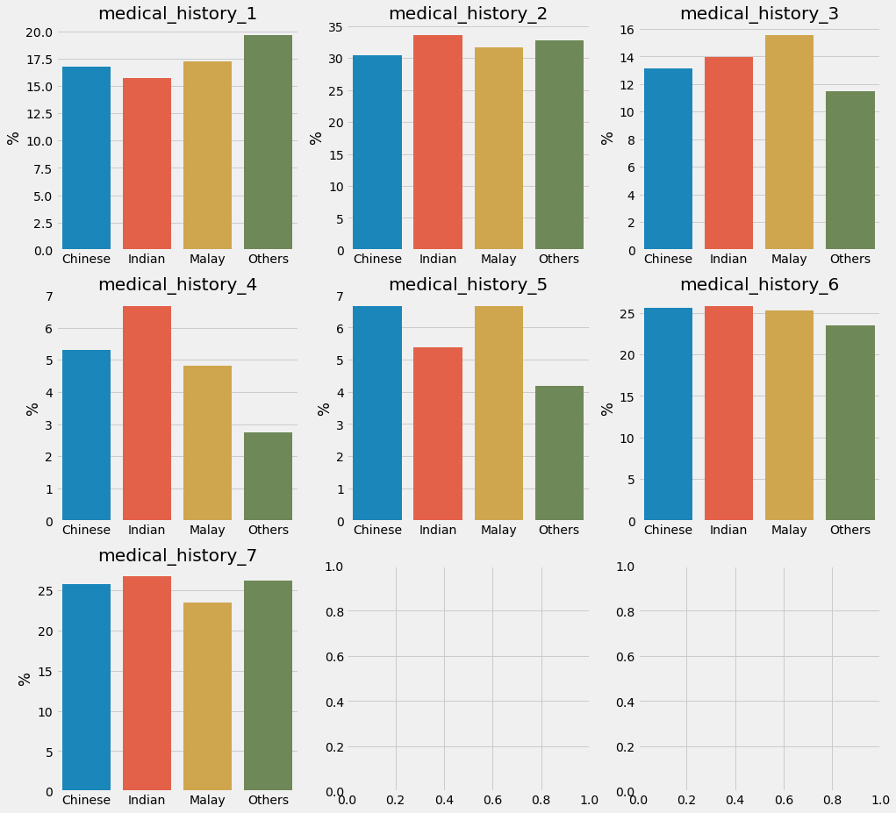
Categorical column: race
Percentage of people with certain medical_history
Most variations between different resident_status:
medical_history_1
medical_history_3
medical_history_4
medical_history_5

Slide 19
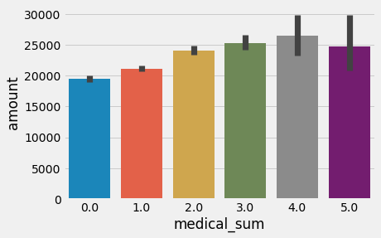
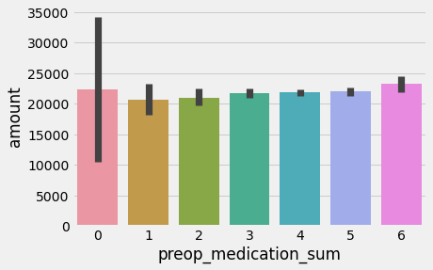
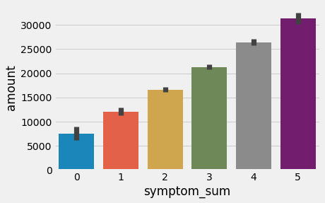
Categorical columns:
medical_sum, symptom_sum, preop_medication_sum
As number of medical conditions and symptoms increase, the cost also increases.
However this is not the same for preop medication, probably because it is not a significant percentage of the total cost.
Notes:
we use the 3 feature engineered columns of `medical_sum`, `symptom_sum`, `preop_medication_sum` to check if cost is affected by these
from the barplot below, there is a distinct relationship in that as `medical_sum` and `sumptom_sum` inreases, the cost also increases, which is justified since more complex health conditions usually cost more to treat.
However this is not the same for preop medication, probably because it is not a significant percentage of the total cost.

Slide 20
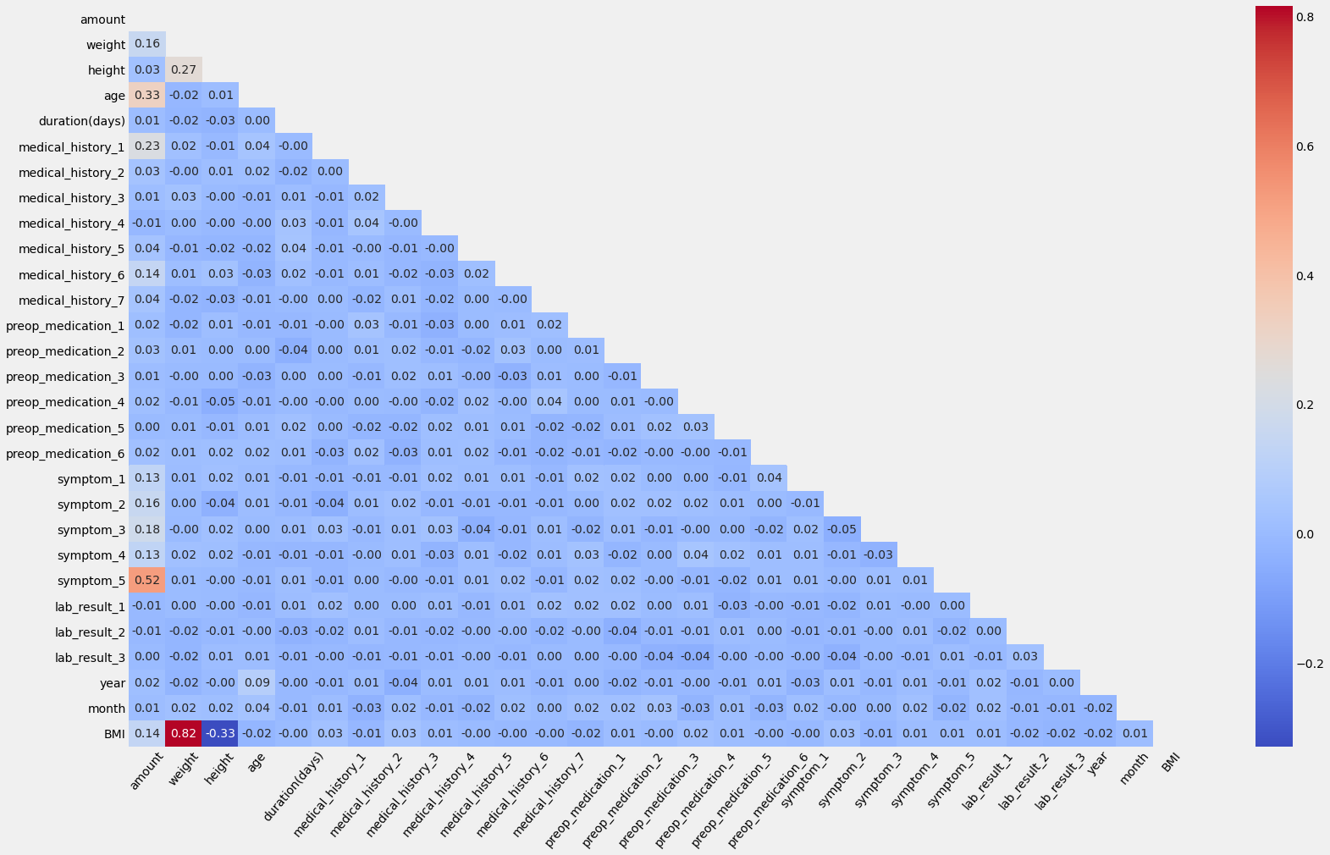
Correlation heatmap
Top 3 drivers of cost based on correlation are:
symptom_5 (0.52)
age (0.33)
medical_history_1 (0.23)

Slide 21
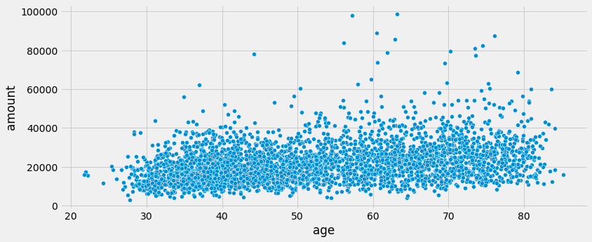
Numerical column:
age
Correlation = 0.33
Notes:
There is a slightly positive correlation of 0.33

Slide 22
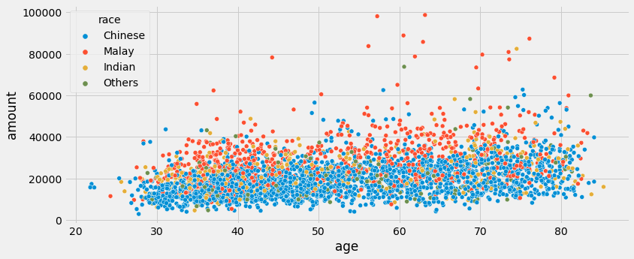
Numerical column:
age
Notes:
There seems to be a very distinct cost difference between race.
Again, this follows the relationship which we saw earlier where malays then to pay more for their treatments.

Slide 23
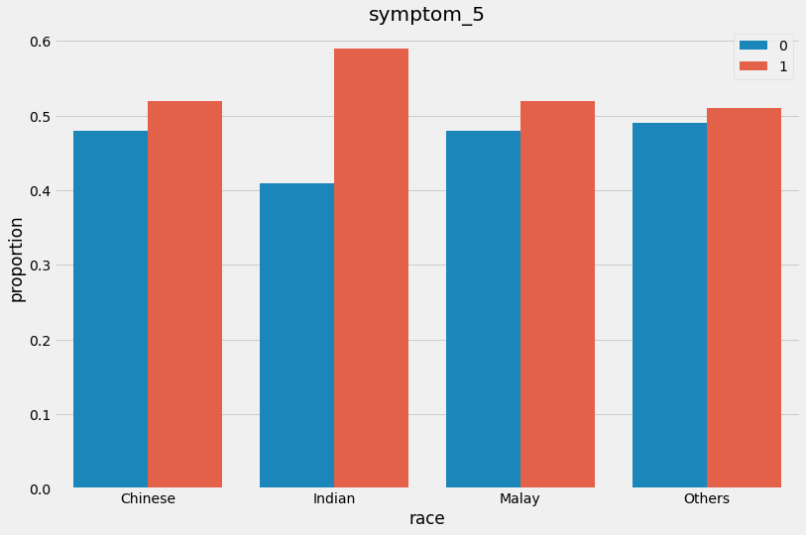
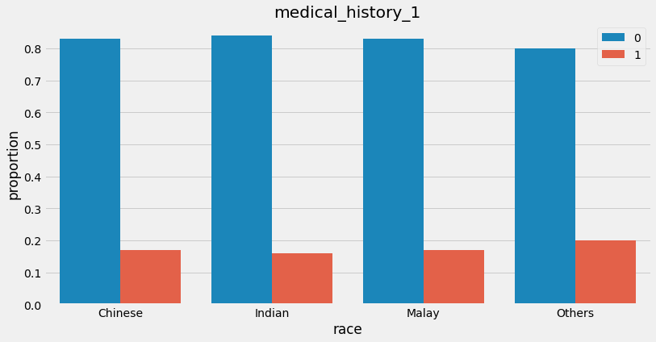
Numerical columns:
symptom_5 and medical_history_1
symptom_5: Indians may be more susceptible.
medical_history_1: No distinct difference between races.
Notes:
There seems to be a very distinct cost difference between race.
Again, this follows the relationship which we saw earlier where malays then to pay more for their treatments.

Slide 24
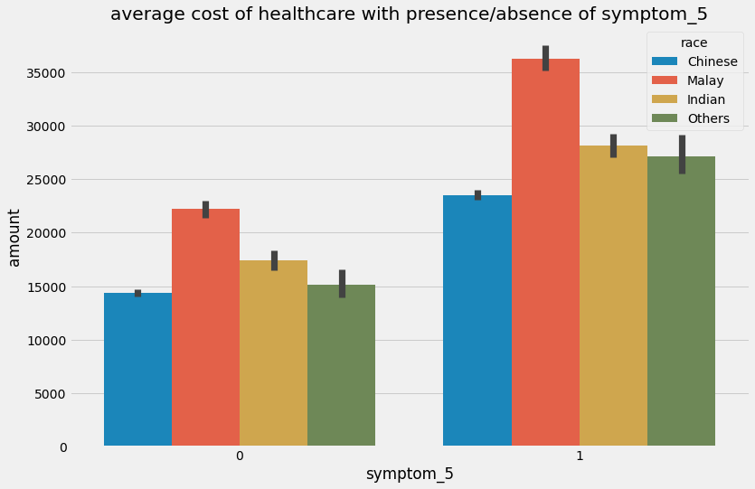
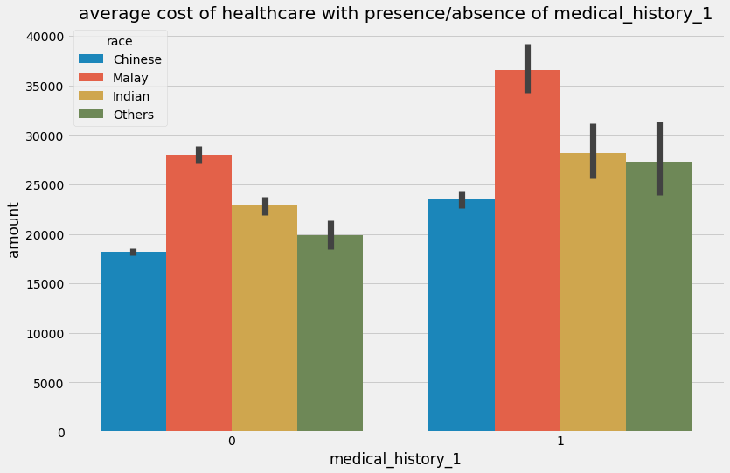
Numerical columns:
symptom_5 and medical_history_1
In general, cost increases with the presence of symptom_5 and medical_history_1
Notes:
There seems to be a very distinct cost difference between race.
Again, this follows the relationship which we saw earlier where malays then to pay more for their treatments.

Slide 25
Conclusion
Key analysis:
Foreigners pay the highest
Cost was descending in the order Malays, Indians, Others, Chinese
Cost was not correlated with the total number of conditions / symptoms / medication.
Key drivers of cost:
symptom_5, age, medical_history_1
Recommendation:
More research required to find underlying reason for higher cost for certain groups.

Slide 26
Recommendations

Slide 27
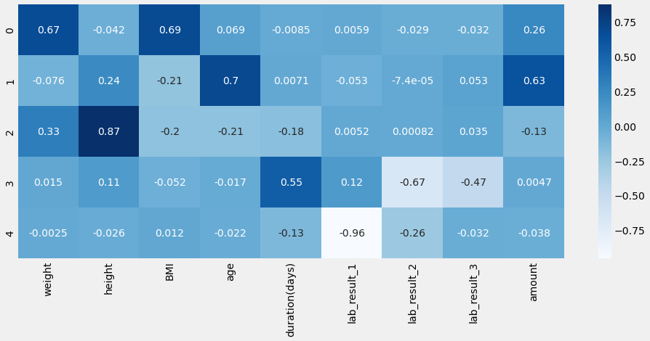
PCA

