Slide 1

COVID PLANET
ANNA
INGRID
YANIS

Slide 2
Description of your Project (Planning, ER, DataBase Schema, Queries, Methodoloy for the composite indicator)

Slide 3
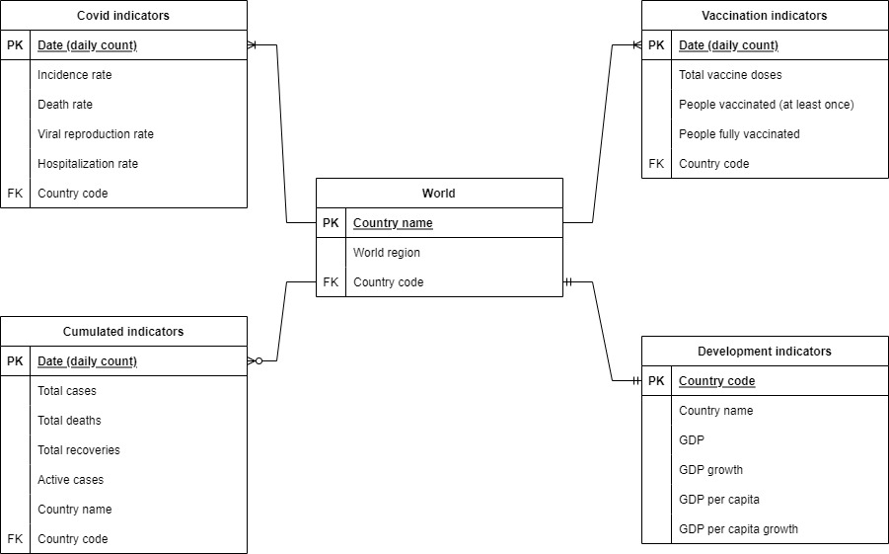
ER

Slide 4
Challenges
Difficulty finding French dataset due to lack of census later than 2018

Slide 5
Process

Slide 6
Highlights

Slide 7
Main results

Slide 8
Demo (ONE MINUTE)

