Slide 1

Data Cleaning Shore Pollution
Radek DEBEK
Paris, IronHack 03/01/2022

Slide 2
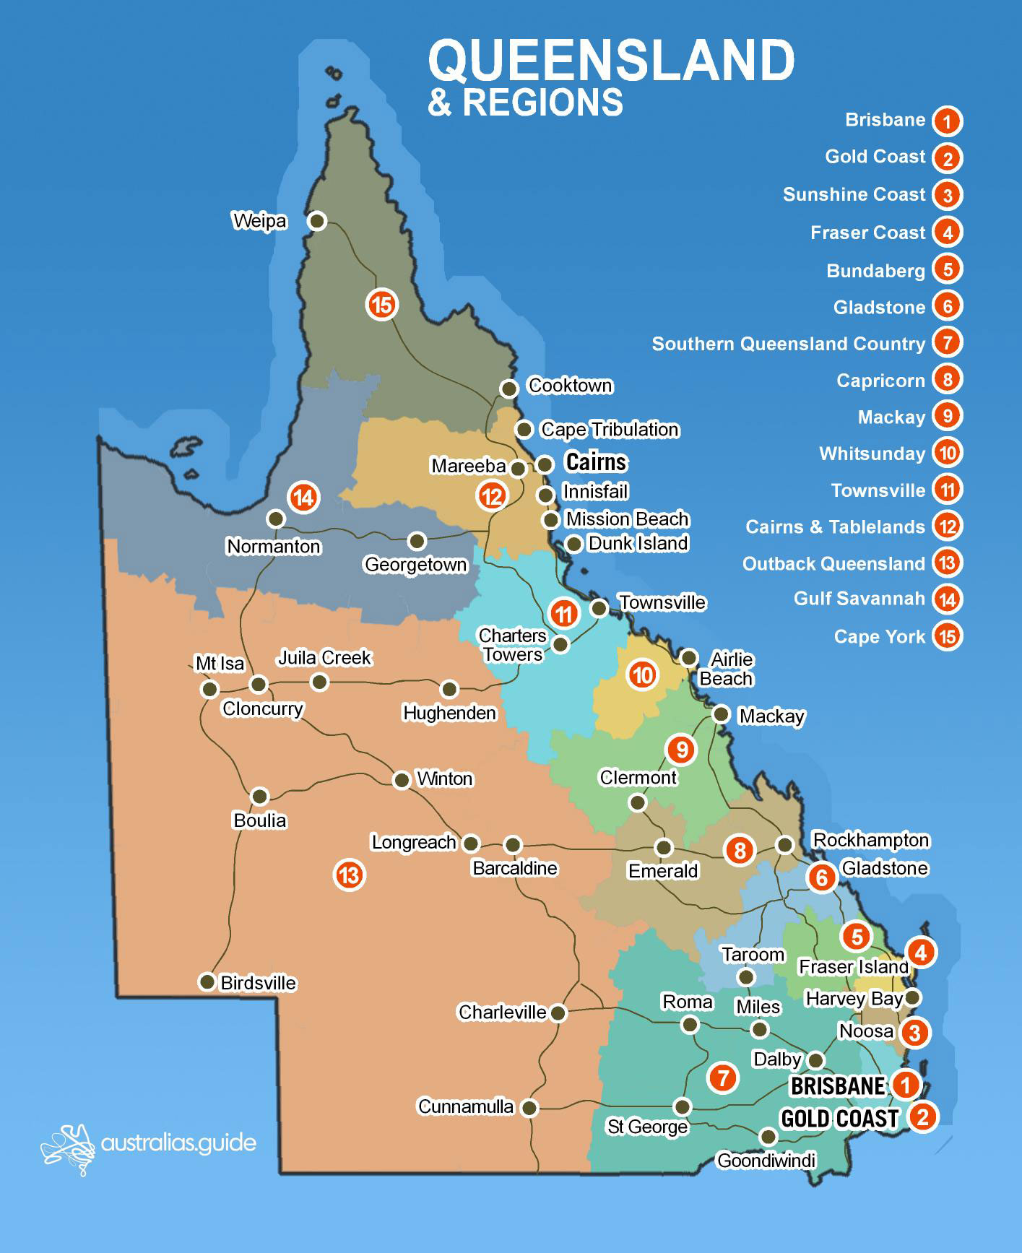
Data SET
Shape: 1098, 8
8 Columns:
Date : DD/MM/YYYY
Region : 5 values
Source, : 3 values
Ship Type : 3 values
Area : 2 Values
Location : exact location
Pollutant : name of pollutant
Estimated Litres : Number

Slide 3
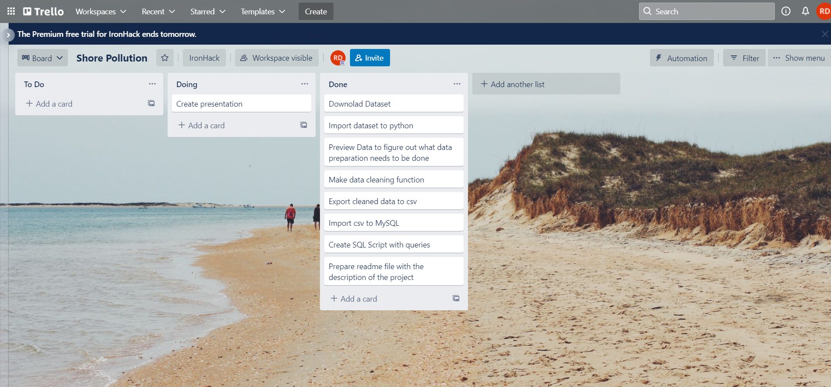
WorK Organisation

Slide 4
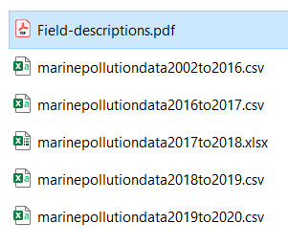
START
DataSet to Pandas

Slide 5

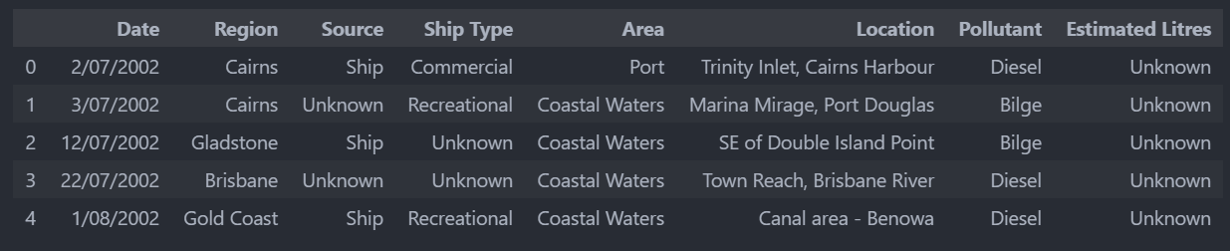

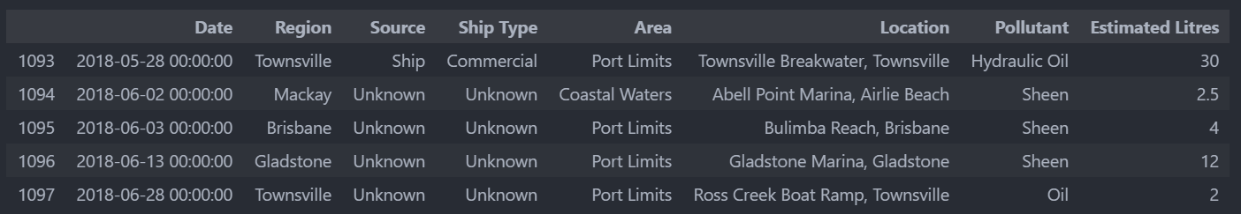
START
DataSet to Pandas
DataSet Description

Slide 6

START
DataSet to Pandas
DataSet Description
Data Cleaning
Drop columns

Slide 7

START
DataSet to Pandas
DataSet Description
Data Cleaning
Drop columns
Date Format

Slide 8

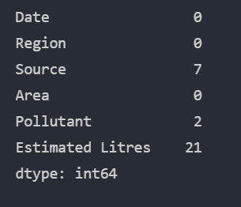
START
DataSet to Pandas
DataSet Description
Data Cleaning
Drop columns
Date Format
Missing values
Fill with ‚Unknown’
Drop rows
Drop rows

Slide 9
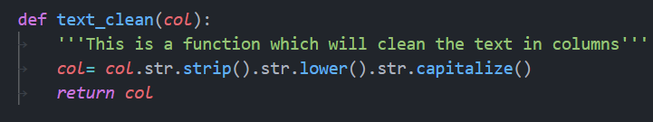
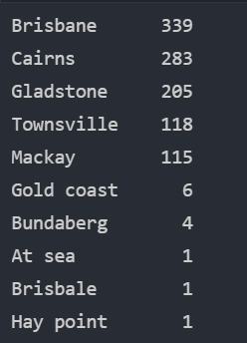
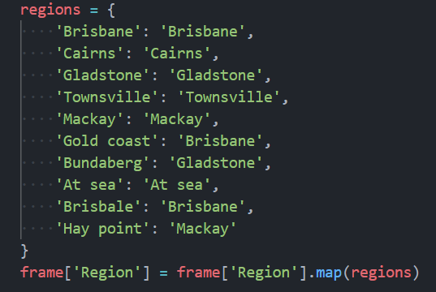
START
DataSet to Pandas
DataSet Description
Data Cleaning
Drop columns
Function to clean the text:
Date Format
Missing values
Columns: Region, Source, Area
Cleaning the text

Slide 10
START
DataSet to Pandas
DataSet Description
Data Cleaning
Drop columns
Pollutant:
Before: 88 unique values
Function using regex to look for patters
After: 11 unique values
Date Format
Missing values
Cleaning the text

Slide 11
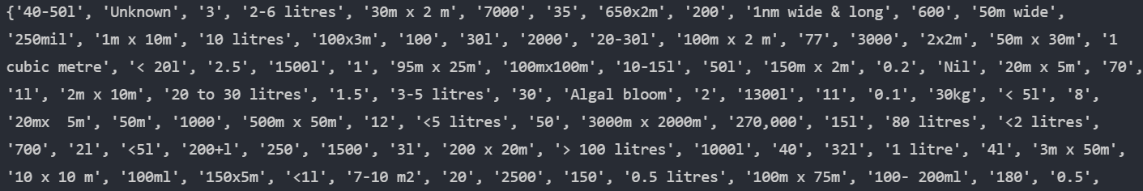
START
DataSet to Pandas
DataSet Description
Data Cleaning
Drop columns
Estimated Litres → Volume:
Function to converst strings to float numbers:
converts unknown to 0.
removes all the letters and the special characters from the strings
if there was an incorrect unit m, g or kg then these values were converted to 0.
if the range was given, the mean value was calculated
Finally, when there were only numbers left.
All of the values were converted to floats.
Date Format
Missing values
Cleaning the text

Slide 12
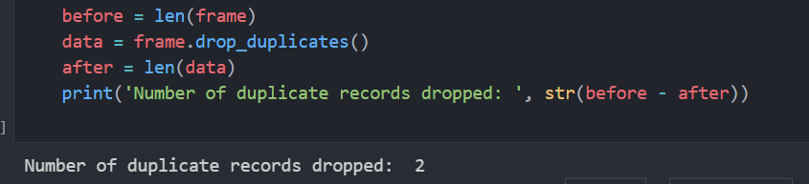
START
DataSet to Pandas
DataSet Description
Data Cleaning
Drop columns
Date Format
Missing values
Cleaning the text
Remove duplicates

Slide 13
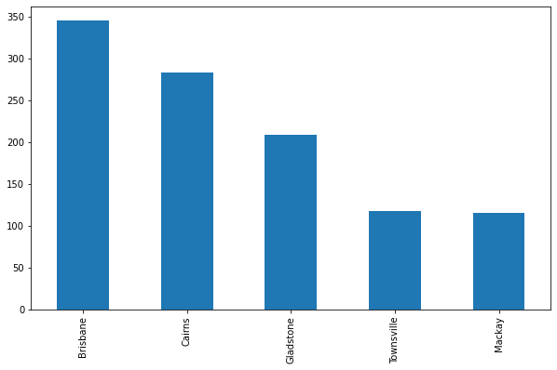
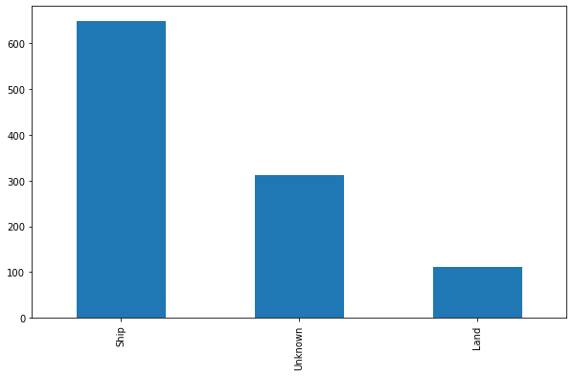
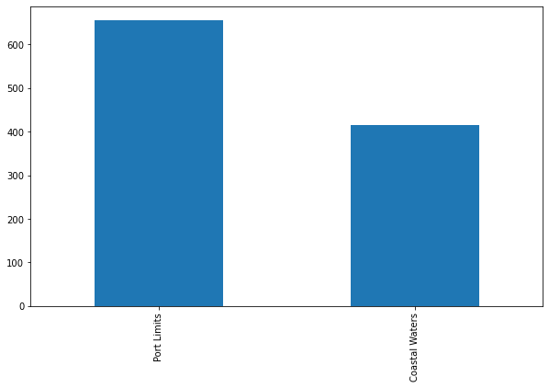
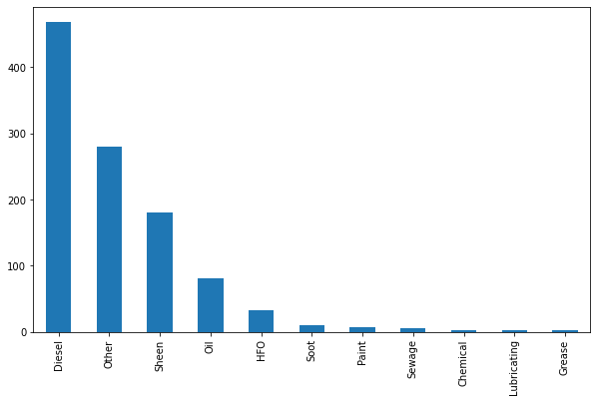
START
DataSet to Pandas
DataSet Description
Data Cleaning
Drop columns
Categorical Data: Regions, Source, Area, Pollutant
Date Format
Region
Source
Missing values
Cleaning the text
Remove duplicates
Area
Pollutant
Outliers

Slide 14
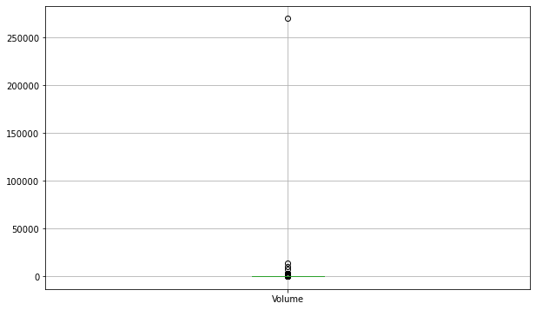
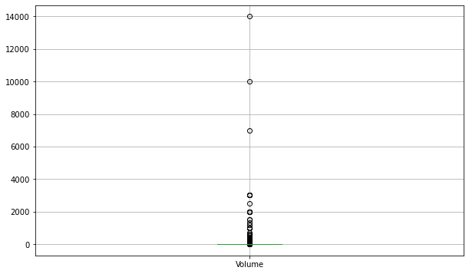
START
DataSet to Pandas
DataSet Description
Data Cleaning
Drop columns
Numerical Data: Volume
Date Format
Before
Missing values
Cleaning the text
Remove duplicates
After
Outliers

Slide 15
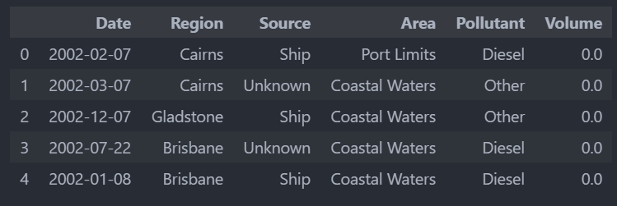
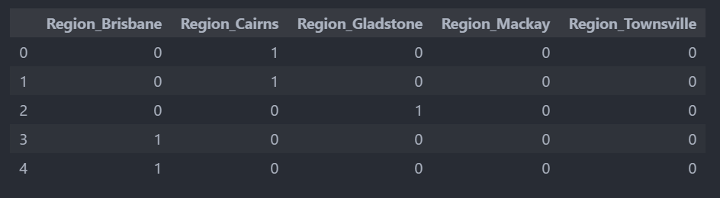
START
DataSet to Pandas
DataSet Description
Data Cleaning
Data Encoding
Drop columns
Date Format
Missing values
Cleaning the text
Remove duplicates
One Hot Encoding
Outliers
Final result: shape 1073x23

Slide 16
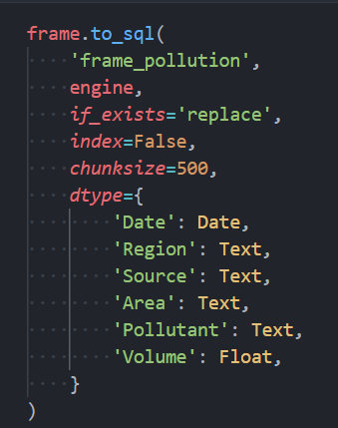
START
DataSet to Pandas
DataSet Description
Data Cleaning
Data Encoding
Connect SQL
Drop columns
Date Format
Missing values
Cleaning the text
Remove duplicates
Outliers

Slide 17
START
DataSet to Pandas
DataSet Description
Data Cleaning
Data Encoding
Connect SQL
Drop columns
SQL Queries
Year | No_accidents | Total_pollution
2002 | 45 | 0
2003 | 84 | 0
2004 | 86 | 1148
2005 | 53 | 2725
2006 | 35 | 4426
2007 | 63 | 8551
2008 | 56 | 1168
2009 | 34 | 3772
2010 | 36 | 1911
2011 | 56 | 1859
2012 | 75 | 17944
2013 | 79 | 14894
2014 | 59 | 2891
2015 | 43 | 11924
2016 | 68 | 1283
2017 | 46 | 1357
2018 | 36 | 498
2019 | 71 | 6484
2020 | 46 | 966
Region | Total_pollution
Cairns | 25207
Townsville | 20691
Brisbane | 17629
Gladstone | 10344
Mackay | 9931
Date Format
Missing values
Cleaning the text
Remove duplicates
Source | No_accidents | Total_Pollution
Ship | 648 | 69819
Unknown | 312 | 1686
Land | 111 | 12297
Outliers

Slide 18
START
DataSet to Pandas
DataSet Description
Data Cleaning
Data Encoding
Connect SQL
Drop columns
SQL Queries
CHALLANGES:
Working alone
Data cleaning (wrong names, missing values,
wrong values)
Date Format
Missing values
END
Cleaning the text
Remove duplicates
Outliers

Slide 19
START
DataSet to Pandas
DataSet Description
Data Cleaning
Data Encoding
Connect SQL
Drop columns
SQL Queries
CHALLANGES:
Working alone
Data cleaning (wrong names, missing values,
wrong values)
Date Format
Missing values
END
Cleaning the text
HIGHLIGHTS:
Process takes long time, but once done its fast.
Don’t be affraid to re-run the code.
Remove duplicates
Outliers

Slide 20
START
DataSet to Pandas
DataSet Description
Data Cleaning
Data Encoding
Connect SQL
Drop columns
SQL Queries
Date Format
Missing values
END
THANKS!
Cleaning the text
Remove duplicates
Outliers

