Slide 1


Slide 2
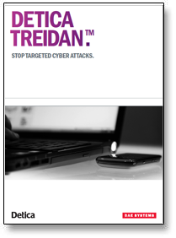
Who are Detica Treidan?
Treidan is an organization with the aim to detect sophisticated cyber attacks which pose any risks to client information technology assets.

Slide 3


How do they work? Overview
Treidan take a different approach into dealing with hackers. They analyse targeted attack techniques in order to resolve how to deal with them.

Slide 4
Why do they do it?
Cyber crime costs the UK economy on average £27 billion.
The majority of this damage is through industrial espionage and IP theft.
Treidan Detica is there to prevent damage and protect large organizations against cyber crime.

Slide 5
How do they do it? Overview
They first identify the threats to client information and then develop and test analytic techniques. Once this is done they the correlate data from a variety of sources to determine the level of risk. Finally they present these results and make it accessible to non-experts.

Slide 6
Identifying a potential threat
Any act which affects the Confidentiality, Integrity and/or the availability of any information or systems within the cyber domain.
Confidentiality: Ensuring only the right people have access to assets.
Availability: Ensuring the assets remain in an accurate and correct state.
Integrity: Ensuring the right people can access the asset when they need it.

Slide 7
Correlating Data
They monitor and analyse given data using a variety of specifically designed software. From which they can compare and identify the level of risk. They can then arrange and present the results found.

Slide 8
Why do they do it in that way? Overview
Because traditional approaches such as intrusion detection and firewalls are usually ineffective, as they are based on signatures and simple heuristics; They only detect known malware and low sophistication attacks. So Treidan needed to take a different approach to resolving these problems as hackers could easily change the signatures of the tools in their attacks.

Slide 9
Why do they do it that way?
Because an attacker can easily hide their tracks but the behaviour of their tools and how they “attack” can be very distinctive. Detica use this and apply analytic techniques to define the severity of the attack.

Slide 10

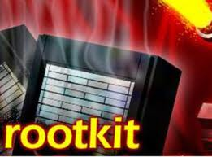
Rootkits
“Root” is a term used on Linux systems which is the equivalent to administrator on windows pc’s.
The “kit” installs and hides a backdoor into a system.
It is in basic terms a maliciously-modified set of administrative tools

Slide 11
What are they?
A "rootkit" is a set of software tools intended to make it easier for a hacker to return to a system once they have gained initial access.
Rootkits work using a simple concept called modification. In general, software is designed to make specific decisions based on very specific data. A rootkit locates and modifies the software so it makes incorrect decisions.

Slide 12
What they are not
A Rootkit Is Not an Exploit
Rootkits may be used in conjunction with an exploit, but the rootkit itself is a fairly straightforward set of utility programs. A Rootkit Is Not a Virus
A virus program is a self-propagating automaton. In contrast, a rootkit does not make copies of itself, and it does not have a mind of its own. A rootkit is under the full control of a human attacker, while a virus is not.

Slide 13
Common misconception
A rootkit is not a virus because in definition a “virus” is a malicious self-propagating automaton and is not controlled by the attacker, a rootkit on the other hand is fully controlled by the hacker and is more seen as a set of utility tools the hacker is using. A rootkit modifies how the computer initially runs or performs tasks so that it is done incorrectly or for the hacker advantage.

Slide 14
History of the rootkit
The first documented computer to be targeted by this type of malware and using stealthy techniques to hide itself was in 1986.
The first malicious rootkit for the Windows NT operating system appeared in 1999 it was simply called the NTRootkit and was created by Greg Hoglund. It was followed by HackerDefender in 2003.
The first rootkit targeting Mac appeared in 2009.
The stuxnet worm was the first to target programmable controllers.

Slide 15
History of the rootkit
Rootkits are not a new concept. In fact, many of the methods used in modern rootkits are the same methods used in viruses in the 1980s—for example, modifying key system tables, memory, and program logic.
In the late 1980s, a virus might have used these techniques to hide from a virus scanner.

Slide 16
How do they work? Overview
A rootkit typically consists of 3 pieces of code the “dropper” the “loader” and the rootkit itself. Rootkits are installed from at user-level access and exploit a known vulnerability. Once the rootkit is installed it allows the attacker to gain root or privileged access to the computer.

Slide 17
How do they run?
At first the “dropper” is run which initiates the rootkit installation. Activating the dropper program is usually as a result of human intervention, such as clicking on a malicious e-mail link. Once initiated, the dropper launches the loader program and then deletes itself. Once active, the loader typically causes a buffer overflow, which loads the rootkit into memory.

Slide 18
What is commonly found in a rootkit?
Even a simple rootkit has very long lines of coding.
One part of the rootkit is usually to avoid detection so it has to filter searches so it doesn’t the rootkit itself doesn’t appear.
Hide process listing (from Task Manager, etc.)
Hide files in Explorer (Folders, Files, Common Dialog Boxes)
Hide entries in the Registry Editor (Regedit)

Slide 19

What is commonly found in a rootkit? Rootkits commonly have a menu for the attacker to use
Example 1-1. Menu for a kernel rootkit.
Win2K Rootkit by the team rootkit.com Version 0.4 alpha ----------------------------------------- command description ps show process list help this data buffertest debug output hidedir hide prefixed file or directory hideproc hide prefixed processes debugint (BSOD)fire int3 sniffkeys toggle keyboard sniffer
echo <string> echo the given string *"(BSOD)" means Blue Screen of Death if a kernel debugger is not present! *"prefixed" means the process or filename starts with the letters '_root_'. *"sniffer" means listening or monitoring software.

Slide 20
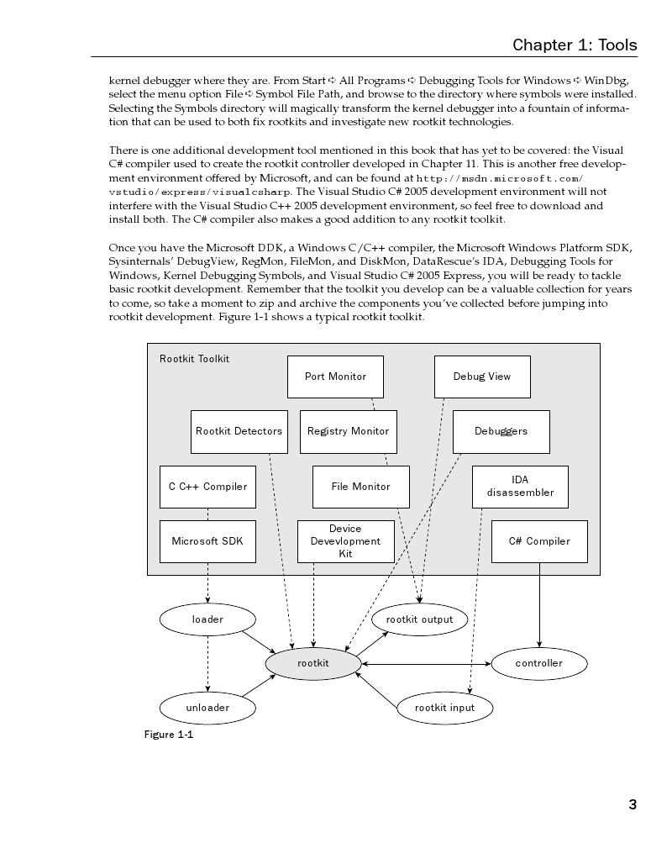
How a rootkit is originally made
When broken down, a rootkit is shown to be a relatively simple programme. It just needs to install itself as deep into the system as possible.
Other additional parts are sometimes added to the rootkit itself such as search filters but this isn't always vital. As rootkit in definition is just a utility tool used by the hacker.

Slide 21
How are people infected by rootkits?
There are many ways which can allow the attacker to install a rootkit onto a computer, the attacker initially looks for the vulnerabilities in the system for example an open network port, an unpatched system, a weak administrator password or even a blank administrator password.
However, you can expose yourself to rootkits by opening unsafe email attachments. So the rootkit is installed by the user themselves.

Slide 22
What can a Attacker do with a rootkit?
Install a backdoor for future access to the system
Destroy/Steal sensitive data
Log sensitive information generated by applications
Filter out information shown to the user
Manipulate configuration files
Use the machine as a zombie/botnet
Use the machine as a gateway to internal networks

Slide 23
What can a Attacker do with a rootkit?
Use the machine as a proxy, providing anonymity to the attacker, or to impersonate the victim.
Execute OS commands using the users identity
Upload a keylogger to record and monitor the users activity
To set up internal or external attacks

Slide 24
Where can they hide? Overview
Firmware-They actually embed themselves within the firmware of devices such as network devices. The root kit would always be available as long as the device is. And can be harder to detect. That's why its good to let your anti virus scan every device that you plugin.
Kernel-A kernel rootkit is embedded within the operating system core itself. People mostly find these form of rootkit when they are using an illegal copy of an operating system.
Persistent-When the system starts up the rootkit starts up and stays running until the system is shutdown, and even if the system process is ended it will restart the process.

Slide 25
Where can they hide? Overview
Hypervisor level- This type of rootkit runs in Ring -1 and hosts the target operating system as a virtual machine.
Library-In software applications that use code library files such as windows dlls. The rootkit can intercept specific systems and API calls and replace them with its own code. Application-When a specific program is run the rootkit will start up, and when the program is ended the rootkit is ended.

Slide 26
Where would you have to look to find the infected file(s)?
The kernel rootkit can be found using explorer.exe
Path name: C:\Windows\system32\kernel32.dll
Modification of this file requires Administrator-level status
If a rootkit is installed within an application the best way to uninstall the application and reinstall a clean version
Path name is commonly : C:\ProgrammeFile(x64)\...
Modification of these files does not necessarily require administrator level status.
Firmware rootkits will embed themselves within the firmware for example in the BIOS. To access your system BIOS you would have to know the command for your operating system and use it on start-up.

Slide 27
How do Persistent rootkits survive a reboot?
Once a rootkits process has been ended the rootkit would have to be executed again. Persistent rootkits will restart there process automatically by embedding themselves within specific parts of the system:
Registry keys
Start-up files
Using a custom master boot record
Patching binaries on disk ( Boot loader, Kernel , drivers)

Slide 28


Virtual Rootkits
Virtual rootkits are very complex but as a result are almost undetectable. The “Blue Pill” is one example of this type of rootkit.

Slide 29
The Blue Pill
Joanna Rutkowska, a security researcher for a Singapore-based IT security firm developed the Blue Pill rootkit as proof that it can be made.
She demonstrated it at the 2006 Black Hat Briefings conference. Rutkowska also developed Red pill (a series of techniques used to detect a blue pill hypervisor).

Slide 30
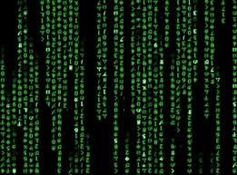
The Blue Pill
The blue pill is a reference from the matrix series from were Neo has to choose between a blue pill and a red pill. The blue pill allowing him to live in virtual reality and the red pill allowing him to know the truth.

Slide 31
The Blue Pill
The blue pill rootkit is malware that executes as a hypervisor to gain control of computer resources. The hypervisor installs without requiring a restart.
Upon installation the computer still functions normally; it does not decrease any performance on the computer being the speed or services, which therefore make it very hard to detect.

Slide 32
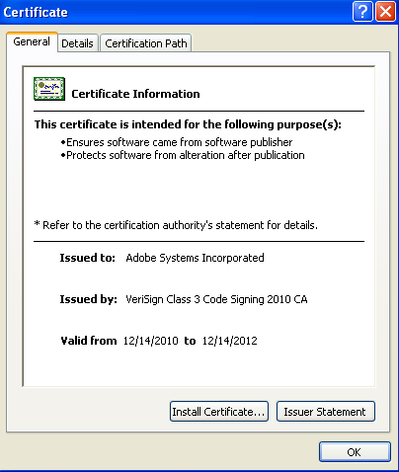
ZeroAccess Rootkit
The ZeroAcess rootkit was one of the first rootkits built purely for malicious reasons.
The zeroaccess rootkit appeared to be a legitimate programme to the victim with a legitimate certificate however upon execution the rootkit disables almost every action the user could take.

Slide 33
Firmware Rootkits
These type of rootkits are the next level in sophistication and hide in the firmware of the computer. Whenever the computer is restarted the rootkit is reinstalled, so even when the rootkit is detected and removed from the computer the rootkit is again reinstalled after the next restart.

Slide 34
Firmware Rootkits
Firmware rootkits flash themselves onto the firmware in a system.
They create a malicious code in the hardware such as in keyboards, network cards or the system BIOS.
Reimaging the disk would do nothing to remove them.
The reason why Firmware rootkits are so affective is because not many people expect a rootkit to embed itself within the Firmware.

Slide 35
Polymorphism
Polymorphism techniques allow malware such as rootkits to rewrite core assembly code, which makes using antivirus/anti-spyware signature-based defences useless. The best way of finding a rootkit using polymorphism is to look deep into the operating system and compare it to a good known one.
polymorphic viruses actually mutates over time or after every execution, changing the code used to deliver its payload.

Slide 36
The Law
Writing a virus is not illegal however publishing and releasing it to the public is and could result in large fine or a jail sentence. It ultimately depends on the severity of the damage caused from the virus.
The Maximum sentence for distributing a virus is 5-20 years behind bars.

Slide 37
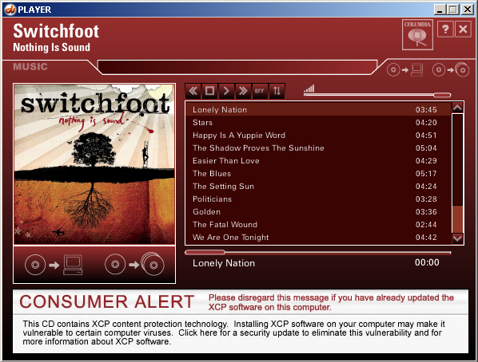
Previous cases
Sony BMG’s newest Extended Copy Protection technology XCP, developed by First4Internet was built to stop unauthorized copying of music files.
Sony BMG secretly included Extended Copy Protection (XCP) and MediaMax CD-3 software on millions of music CDs from artists such as Celine Dion, Neal Diamond and Santana in the mid-2000s that was designed to keep music owners from making too many copies of the music.
This rootkit was automatically installed on Windows desktop computers when customers tried to play the CDs. The software interferes with the normal way in which the Microsoft Windows operating system plays CDs by installing a rootkit which creates vulnerabilities for other malware to exploit. This was discovered and publicly revealed by Mark Russinovich on the Sysinternals blog.

Slide 38
Other viruses
All types of viruses/malicious programmes usually come under one or more of these categories:
Resident virus | Direct Action Viruses | Overwrite Viruses | Boot Sector Virus | Macro Virus
Directory Virus | Polymorphic Virus | File Infector Virus | Companion Viruses | FAT Virus
Multipartite Virus | Web Scripting Virus | Worms | Trojan Horses | Logic Bombs

Slide 39
Resident Viruses Basics
These viruses stay in the RAM of the system from in the RAM it can overwrite and interrupt any operations executed by the system.
Examples of this type of virus: Randex, CMJ, Meve, and MrKlunky

Slide 40
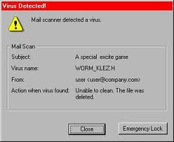
Direct Action Viruses Basics
This virus replicates and is run when a specific condition is met. The virus will infect files and spread once it is run.
Example of this type of virus: Vienna Virus

Slide 41
Overwrite Virus Basics
These type of viruses deletes all information in the files it infects rendering them partially or totally useless. The files must be deleted after they are infected however all original information would be lost.
Examples of this type of Virus: Way, Trj.Reboot, Trivial.88.D

Slide 42
Boot sector Virus Basics
This type of virus affects the boot sector of a floppy or hard disk. This is were crucial information is stored to protect against this type of virus you must ensure that that all floppy disks are write-protected.
Examples of this type of virus: Polyboot.B, AntiEXE

Slide 43
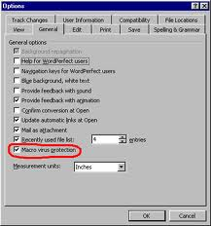
Macro Virus Basics
Macro viruses infect files that are created using certain applications or programs that contain macros.
Examples: Relax, Melissa.A, Bablas, O97M/Y2K

Slide 44
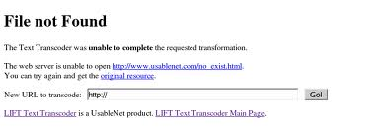
Directory Virus Basics
Directory viruses change the path that indicate the location of a file.
Example: Dir-2 virus

Slide 45
File Infector Virus Basics
These viruses replace files so when an infected file is run the user is unknowingly executing the virus.
Examples: Cleevix and Cascade

Slide 46
Companion Virus Basics
These viruses embed themselves among other files that already exist. The virus is executed when the programme is run.
Examples: Stator, Asimov.1539 and Terrax.1069

Slide 47
Multipartite Virus Basics
The way in which these viruses spread is dependant on the operating system used.
Examples: Invader, Flip and Tequila

Slide 48
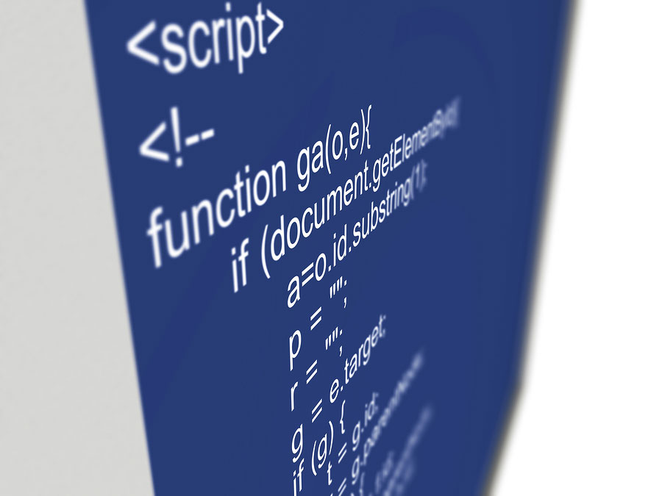
Web scripting Virus Basics
Most websites run complex codes to run interactive content these exploit this to bring about undesirable actions.

Slide 49
Worms Basics
A worm is a program very similar to a virus; it has the ability to self-replicate and can lead to negative effects on your system. But they can be detected and eliminated by anti-viruses.
Examples: PSWBugbear.B, Lovgate.F, Trile.C, Sobig.D, Mapson

Slide 50
Trojan horses Basics
These do not self replicate nor do they infect other files, but they are controlled by the attacker and disguise themselves as useful programmes.
Trojan-Spy.HTML.Smitfraud.c [Kaspersky], Phish-BankFraud.eml.a [McAfee], Trj/Citifraud.A [Panda Software],

Slide 51
Logic Bombs Basics
They are executed when a certain predefined condition is met. They destroy data on the computer once certain conditions have been met. Logic bombs go usually go undetected until launched and the results can be destructive.
examples of logic bombs: antivirus programs, masquerades, Trojan horses and utility program.

Slide 52
What is the most destructive virus ever recorded?
The most damaging virus ever recorded was the loveletter virus It originated from the Philippines and managed to cause $15billion worth of damage worldwide.
The virus was a worm variant and had a variety of functions:
It copied itself several times and hid the copies in several folders on the victim's hard drive.
It added new files to the victim's registry keys.
It replaced several different kinds of files with copies of itself.
It sent itself through Internet Relay Chat clients as well as e-mail.
It downloaded a file called WIN-BUGSFIX.EXE from the Internet and executed it. This programme did not fix bugs but send secret information to the hackers email address.

Slide 53
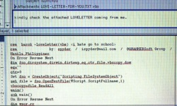
The loveletter virus
It is said that Onel de Guzman of the Philippines created and distributed this virus however there was not enough evidence and the charges were dropped.
This virus may not have caused the most damage globally but I personally think is the most destructive as it affects almost every file on a system.
There are other viruses that have caused a lot more damage globally for example “W32.MyDoom” which caused $38 billion worth of damage but this is because this virus was so affective at spreading and infecting other systems.

Slide 54
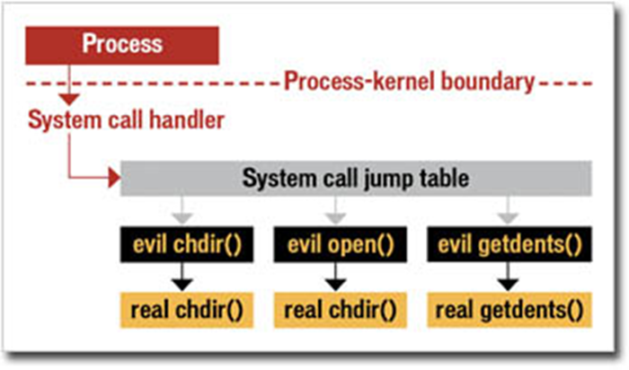
How can they be detected?
As Rootkits can sometimes embed themselves in the firmware or the kernel of the computer it can be very hard for the user to find it and noticing the affect of the rootkit can be also be close to impossible.
There are a number of programmes specially designed to detect rootkits present such as Sophos Anti-Rootkit and Avira AntiRootkit.
However, this is only for known rootkits or low sophisticated rootkits.

Slide 55
Steps the hacker takes
Initially the Attacker has to crack the user passwords. As the hacker needs at least user-level access to install the rootkit on the victims computer.
However, a rootkit can also be installed on a computer as a result of human intervention from social engineering or from phishing attempts.
Once the rootkit is installed and running the hacker can be granted administrator access therefore giving the hacker close to no restrictions on the victims computer. The attacker could execute files, modify system data or just monitor the users activity.

Slide 56
Why are some so hard to detect?
Even the most sophisticated antivirus software can struggle to find were a rootkit is hidden. Sometimes antivirus software directly compares the sizes of individual files deep within the operating system. However, rootkits can replace certain files with the same amount of disk space. Therefore making it seem as though there is no change.

Slide 57
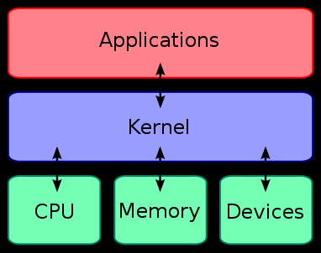
Why are some so hard to detect?
Some specific types of rootkits install themselves deep within the computer. For example some install within the Kernel of the PC. The kernel is the bridge between applications and data processing. For example the rootkit could modify any updates to be made on the computer to avoid detection.

Slide 58
What is an exploit?
An exploit is a piece of software that takes advantage of a bug, glitch or vulnerability.
As of 2006, there were at least 60 known security exploits targeting a the base installation of Mac OS X (with a Unix-based file system and kernel).
Exploits are often used alongside rootkits to give the hacker an advantage.

Slide 59
Rootkits and exploits
Attackers commonly use exploits to deploy their rootkits and as software exploits are in great supply the threat of rootkits is increasing.
Many exploits that have been publicly known for more than a year are still being widely exploited today. Even if there is a patch available, most system administrators don't apply the patches.
Although a rootkit is not an exploit, it may be employed as part of an exploit tool.

Slide 60
Rootkits and exploits
Some exploitable software bugs are found by independent researchers and never reported to the software vendor. This means that nobody knows about them except the hacker, so there will be little to no defence against them.
Automated code-scanning tools can catch some bugs, but not all of them. Most computer programs are very complex, and it can be difficult to test them thoroughly enough.

Slide 61
They are becoming even more sophisticated?
An attacker would want to try and install a rootkit as deep into the computer as possible, as the further in the more power and less detectable it is.
Recently some hackers have exploited the Intel chips in computers. The rootkit can hide itself within the SMM space. The SMM is more privileged than the hypervisor and is not controlled by the operating system and cannot be disabled by it. The only way to get into the SMM is by physically opening up your computer. So when the rootkit is embedded in the SMM it would be undetectable and would not be able to be removed using any software.

Slide 62
Attacking SMM Memory via Intel CPU Cache Poisoning
The main notable point regarding SMM rootkit is the SMRAM can only be accessed if D_LCK is set to 0. But after having infecting the SMRAM the Rootkit, if D_LCK is previously equal to 0, SMM Rootkit locks the SMRAM by setting D_LCK bit to 1 to stop access to it including from the Kernel.
This rootkit is installed using an exploit in the Intel chips at the moment Intel DQ35 are still vulnerable however the very recent Intel DQ45 is not known to be vulnerable to this exploit.

Slide 63
Why aren’t these types of rootkits found in the wild?
Because, currently existing rootkits are already so effective there is no sense in creating a virtual rootkit ,which of course may be less detectable, but is infinitely harder to deploy.
Kernel rootkits are also only just at their peak, there are some types of malicious packages that can jump processors and reboot back into the kernel at BIOS.

Slide 64
Why are they not commonly used by hackers?
Rootkits are commonly written up as proof-of concepts in academy's or in gameguards in online gameguards. There use for malicious attacks are not very common. Most that are used by hackers are often widely available on the internet and therefore will have a known signature making even basic antimalware programmes able to detect them as a threat.

Slide 65
How could Treidan detect them?
There are many approaches to be able to detect rootkits for example:
Behavioural-based: Searching for rootkit-like behaviour within a system.
Signature-based: This can be affective against well-published rootkits as their signature would be more known and easier to detect; this method is however, useless against sophisticated or custom made rootkits
Difference-based: This method involves directly comparing trusted raw data with “tainted” data
Integrity checking: A cryptographic hash function can be used to compute a "fingerprint", or digital signature, that can help detect subsequent unauthorized changes to on-disk code libraries.
Memory dumps: Forcing a complete dump of virtual memory will capture an active rootkit (or a kernel dump in the case of a kernel-mode rootkit),

Slide 66
How could Treidan detect them?
Upon having control of one computer the hacker would want to infect other computers to be “safe” (to have more control).
The hacker could and would want to extract sensitive information off the victims computer.

Slide 67
How could Treidan detect them?
However, rootkits can be used to monitor a users activity. To be able to detect this would be a lot harder.
The more specifically designed the rootkit is the harder it is to detect as they will have less functions and will be smaller in size.

Slide 68
How could Treidan detect them? Behavioural-based
The rootkit may open a listening port on a machine in order to receive instructions over the net, or it may connect to a particular port on a controlling machine.
Using the network probe Treidan could identify and analyse how specific ports are behaving on different computers to see if there is any unusual behaviour (inhuman).

Slide 69
How could Treidan detect them? Behavioural-based
Rootkits usually generate more network traffic than usual. Sometimes rootkits are set up as botnets so as a result would create a lot more traffic and the computer would run slower.
To identify a computer used by the attacker as a botnet can be done by comparing the average network traffic to the most recent. Or leaving a computer on but not active and seeing if it still generates large amounts of network traffic.

Slide 70
How could Treidan detect them? Behavioural-based
A way of detecting a rootkit using the behavioural approach would be by looking at rootkit-like behaviour.
Profiling a system could be one way to detect a present rootkit, any differences in the timing and frequency of API calls or in overall CPU utilization could mean a rootkit is embedded within your system.

Slide 71
How could Treidan detect them? Behavioural-based
One other way could be to log packets being sent out from different systems and analyse and compare them.
A rootkit would be often sending out packets of information to the hacker so carefully inspecting them through a packet sniffer could tell you whether a rootkit is present.

Slide 72
How could Treidan detect them? Signature-based
In order to detect a rootkit using this approach the rootkit would have to of been rather basic and/or have a well published or known signature. This detection can easily be carried out using antimalware programmes as they can already scan for any blacklisted signatures.

Slide 73
How could Treidan detect them? Difference-based
To take this approach you must directly compare the binaries present on the disk to an exact image of a clean one using your operating system. Doing this you will be able to notice if there are any unauthorized changes, it was this approach which was used Russinovich to find the Sony DRM rootkit.

Slide 74
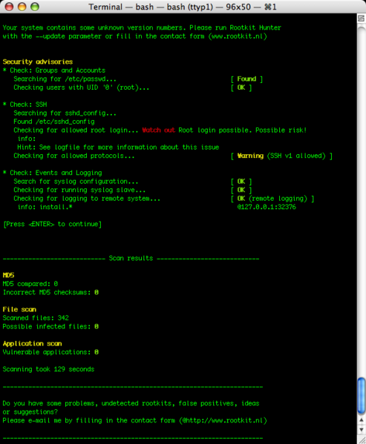
How could Treidan detect them? Integrity checking
A cryptographic hash function can be used and will detect any unauthorized changes to the system.
There are many programmes which carry out this check, they scan through system files and verify the integrity of them for example the rkhunter utility and Xintegrity Professional

Slide 75
How could Treidan detect them? Memory dump
Despite the fact that this technique is highly specialized in detecting rootkits this approach is useless against hypervisor-based rootkits as they can intercept and subvert even the lowest level attempts to read memory.
Detection using this method would involve forcing a complete dump of virtual memory. Doing this will detect any active rootkits.

Slide 76
How can you force a memory dump?
In order to carry out this process you must have administrator level status on the system.
Start the registry editor (regedit.exe)
Locate the following key if you have a PS2 keyboard: HKEY_LOCAL_MACHINE\SYSTEM\CurrentControlSet\Services\i8042prt\Parameters
In the Edit menu, click Add Value and add the following registry entry:
Name: CrashOnCtrlScroll Data Type: REG_DWORD Value: 1 Exit the registry editor, then reboot.
After the reboot, you can now manually trigger a crash by pressing the SCROLL keyboard key twice while pressing the right CTRL key.

Slide 77
How could Treidan detect them?
There are many specifically built root scanners which check for irregularities. These types of root scanners are:
Very fast, (an almost instant result)
Able to run on a live system and therefore changes the integrity of system

Slide 78
Extra information about rootkit scanners
They are different to antivirus software as they specifically look for anything suggesting a rootkit is installed. They check commonly used files and areas within the system and can run numerous types of tests like:
MD5 hash compare
Look for default files used by rootkits
Wrong file permissions for binaries
Look for suspected strings in LKM and KLD modules
Look for hidden files
Optional scan within plaintext and binary files

