Slide 1
Presented by:
Muhammad Yousuf Jusani
Usama Khalid
Nir Haramati
Detecting Unauthorized Remote Access (SSH, RDP, Telnet)
Group 10

Slide 2

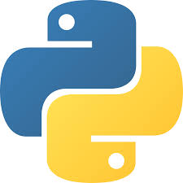
Project Synopsis
Detect unauthorized remote access using SSH, RDP, Telnet
Analyze captured network traffic for suspicious activity.
Identify brute-force login attempts.
Generate a forensic security report
System Architecture
Network Traffic → Capture (Wireshark) → Filter → Analyze → Detect → Report
Tech Stack
Wireshark , Pyshark , Snort
01

Slide 3
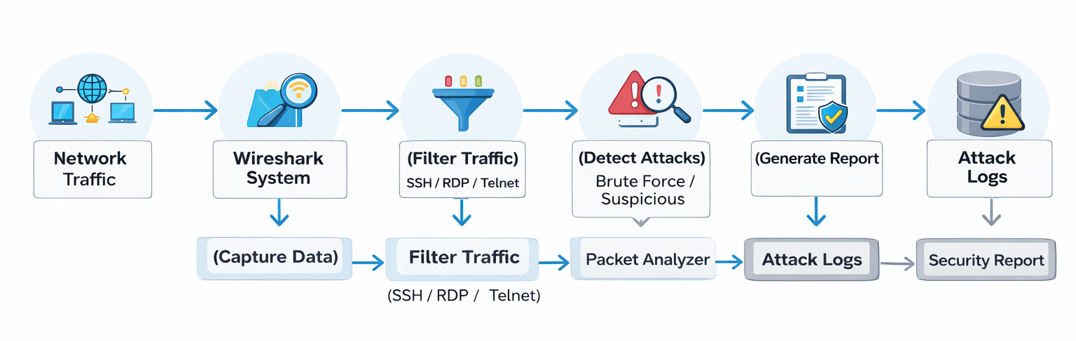
DFD (Unit/Modules & Integrations)
Modules
Capture Module (Wireshark)
Filter Module (Ports 22, 3389, 23)
Analysis Module
Detection Module
Reporting Module
Integration Flow
02

Slide 4
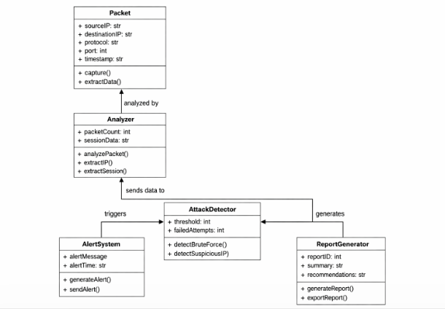
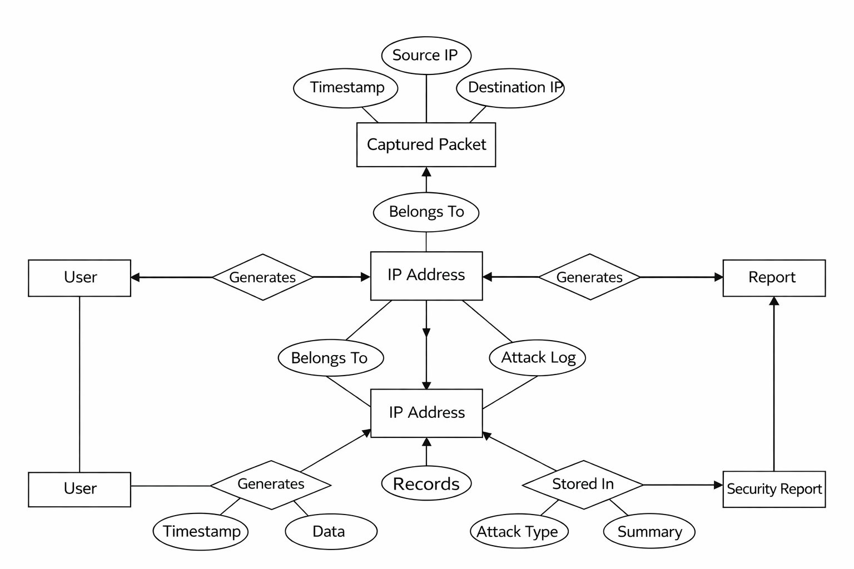
Class Diagram
ER Diagram
03

Slide 5
Implementation, Integration & Results
Implementation
Captured traffic using Wireshark
Applied filters:
SSH (22)
RDP (3389)
Telnet (23)
Integration
Wireshark → PCAP → Python Script
Python → Detection → Output
Results
Detected multiple login attempts
Identified suspicious IP addresses
Flagged brute-force behaviour
04

Slide 6

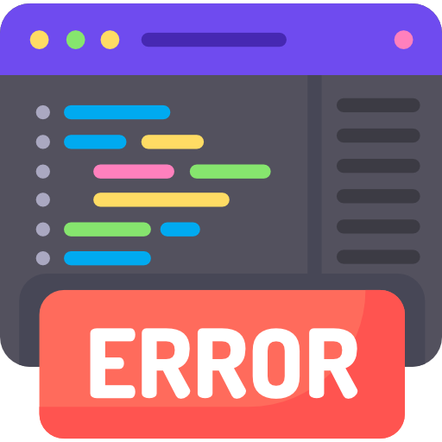
Exception / Error Handling
Handled missing packet attributes.
Checked packet structure before processing.
Ignored invalid packets.
Used try-except blocks in Python.
Prevented system crashes during analysis
05

Slide 7

Risk Assessment
Risks
Brute-force attacks
Unauthorized remote access
Data leakage
Management
Threshold-based detection
Monitor suspicious Ips
Use of IDS (Snort)
Blocking malicious IPs
06

Slide 8
References
References
https://www.wireshark.org
https://github.com/KimiNewt/pyshark
https://www.snort.org
References
Code: https://github.com/iyousufjusani/NetworkForensic-Project.git
07

Slide 9
Voice – Over Video Demo
08

Slide 10
Presented by:
Muhammad Yousuf Jusani
Usama Khalid
Nir Haramati
Thank You!
Any Questions?

