Slide 1


FEST
Ilia Petrov № 62520

Slide 2








dependencies

Slide 3




External services

Slide 4
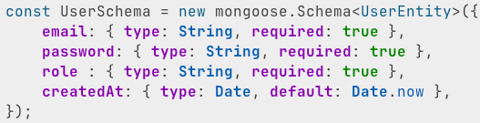
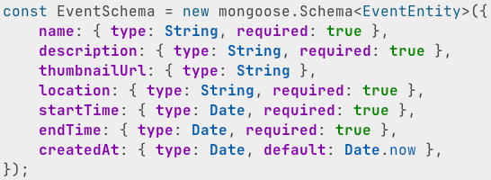
Database schema

Slide 5
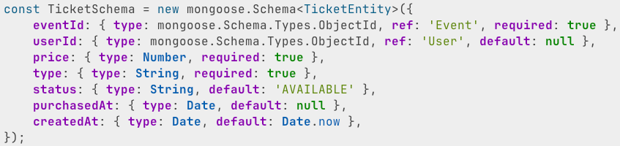
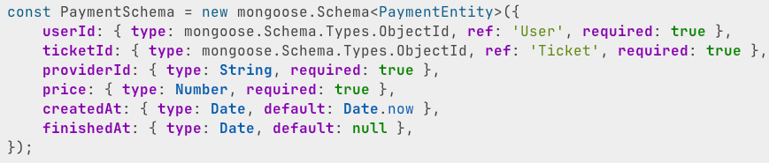
Database schema

Slide 6
demo

