Slide 1
GOPIZZA
Ilia Petrov № 62520

Slide 2










dependencies

Slide 3




External services

Slide 4
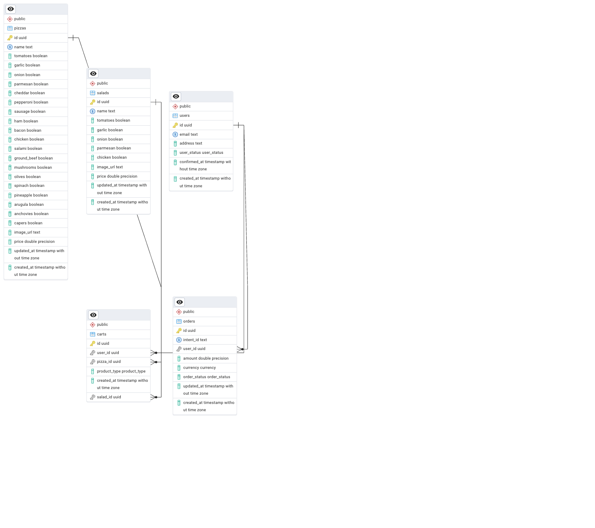
Database schema

Slide 5
demo

