Slide 1
A Deep Inspection of High-Performance Bandwidth Scheduling Algorithm Complexity and Design
By:
Karan Kohli
Michael Mar
Ibraheem Saleh

Slide 2
Introduction
In recent years, alot of science, engineering and business entities have begun to generate colossal amounts of data.
We’re talking hundreds of terabytes, petabytes or, in the near future, even exabytes of data that needs to be transferred between data centers at rapid speeds.
The internet is great for connectivity but is slow to evolve, has bandwidth constraints and can be expensive at high data quantities and speeds!
In recent years, dedicated high-bandwidth links have begun to be laid my numerous organizations and wide-area-networks are being created that run apart from the Internet. For example...
The Department of Energy maintains an “UltraScience Net” that runs Dual 10Gbps lines between Seattle, Chicago, Sunnyvale, Atlanta
Among other things, they use it to run Environment Simulations that can utilize datasets that can be over 20TB in size. These simulations often need to rapidly transfer data between nodes or are controlled remotely from different parts of the country.

Slide 3
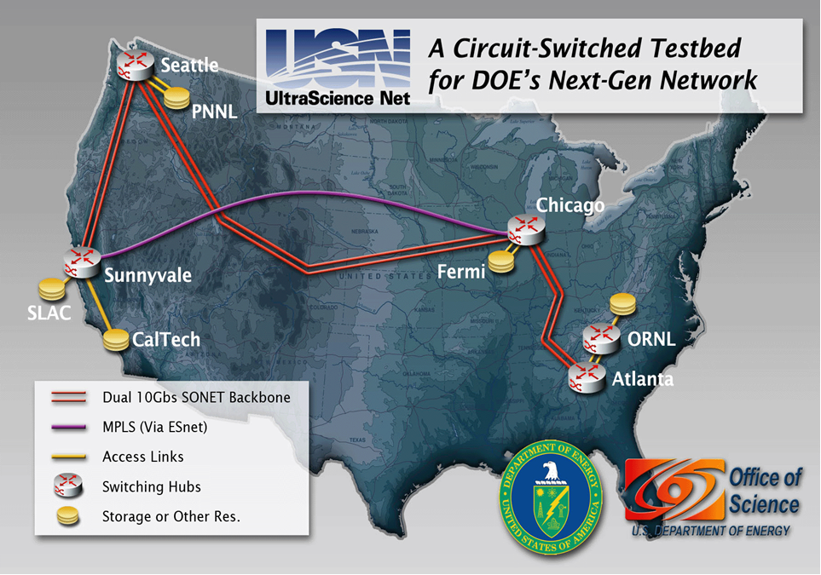
Introduction

Slide 4
Introduction
Where else are these networks being used?
In several projects such as User-Controlled Light Controlled Path (UCLP), Circuit-Controlled High-speed End-to-End Transport ArcHitecture (CHEETAH) and On-demand Secure Circuits and Advance Reservation System (OSCARS), Japanese Gigabit Network II, etc.
How do these High Bandwidth connections work
Scheduling
“Scheduling is concerned with the allocation of scarce resources to activities so as to optimize one or more performance measures”
In this problem, the scarce resources are dedicated network bandwidth links
The activity is a data transfer task
The performance measure is how quickly we can achieve this task.
This is established generally through a management framework layer, a “control plane”, that exist above the edge devices, core switches, etc. This area is responsible for reserving link bandwidth, setting up end-to-end network paths, and releasing resources when tasks are completed.
Inside the control plane, we have a bandwidth scheduler that computes the network paths and allocates link bandwidth to meet specific user requests based on network topology and bandwidth availability.
Data transfers are requested to be scheduled through “Advanced Bandwidth Reservation”
You know ahead of time the size of your transfer and you can put constraints about when it needs to be completed by.

Slide 5
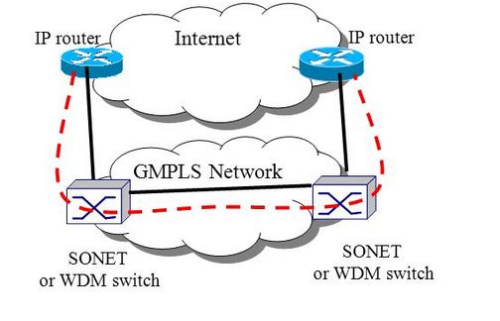
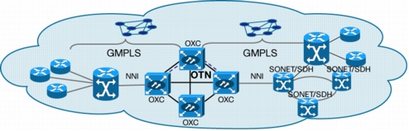
Introduction

Slide 6
Problem Space Nomenclature
A dedicated network is represented as a graph G=(V,E) with n nodes and m links with V representing the nodes and E representing the edges. Each link has a dedicated bandwidth list with the the bandwidths with the time constants.
V_{s} represents the source.
V_{d} represents the destination.
TB stands for the time bandwidth.
A TB list holds the list of all links which is shown as a three-tuple equation (t_{i}[i],t_{i}[i+1],b_{l}[i]). The t_{i}[i],t_{i}[i+1] represents the time interval with i=1,2,...,T_{l}-1, where T_{l} is the total number of time-slots in link l. The equation t_{l}[T_{l}]=+∞ indicates that there is no bandwidth reservation on link l after t_{l}[T_{l}-1].
An ATB stands for Aggregated Time Bandwidth which holds all the residual bandwidths of all links in each intersected time-slot.
When switching bandwidth, the symbol tau (𝜏) is used to represent the switching delay.
Notes:
MM- Emphasize this shows up in the pseudocode from the paper.

Slide 7
Problems
Six Problems
FPFB : Fixed Path Fixed Bandwidth
FPVB: Fixed Path Variable Bandwidth
VPFB-0: Variable Path Fixed Bandwidth-0
VPFB-1: Variable Path Fixed Bandwidth-1
VPVB-0: Variable Path Variable Bandwidth-0
VPVB-1: Variable Path Variable Bandwidth-1
The Optimization Goal
Transfer file from Source Node to Destination Node in the fastest possible way given the problem constraints.
Let’s show the constraints through examples!

Slide 8
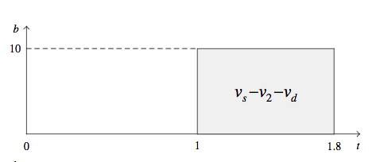
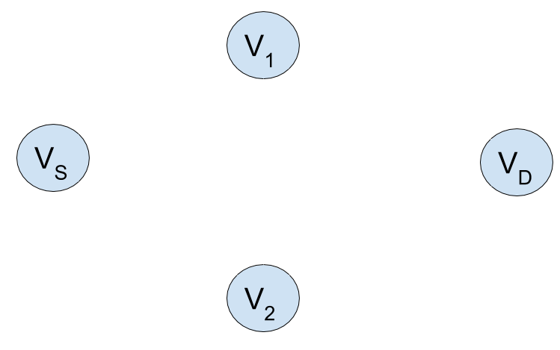
Fixed Path Fixed Bandwidth (Example)
Compute a fixed path from Vs to Vd with a constant (fixed) bandwidth)
Takes the as graph G=(V,E) with ABT list for all links l ∑ e, source Vs and destination Vd.
The transfer should start from time point 1 instead of 0 because the available time slot 10 is much larger than the first.
The Optimal Path is Vs-V2-Vd with the minimum transfer end time 1+8\10= 1.8.

Slide 9
Fixed Path Variable Bandwidth (FPVB) Example
Compute a fixed path from Vs to Vd with varying bandwidths across multiple time slots.
𝛿 = 8 units (data size)
𝜏 = 0.1 unit of time
Current time = 0
There is NO queuing data at nodes!

Slide 10
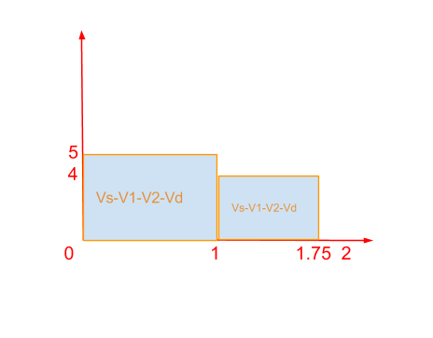
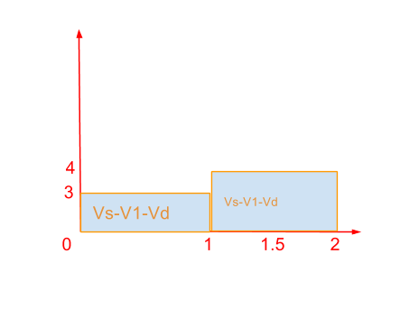
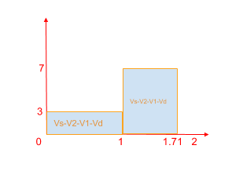
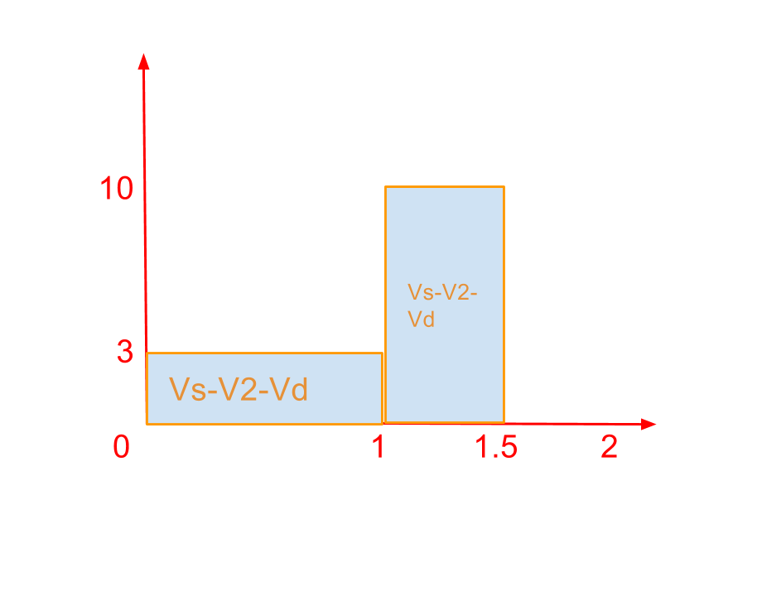
Fixed Path Variable Bandwidth (FPVB) Example (IS)
(𝛿=8,𝜏=0.1,t=0)
Optimal Answer!

Slide 11
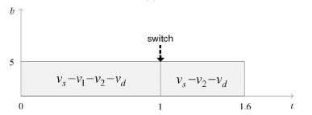
Variable Path with Fixed Bandwidth (VPFB-0) Example
-VPFB stands for Variable Path, Fixed Bandwidth. The “-0” indicates when the switching is negligible (i.e., 𝛕=0)
-The widest bandwidth in the first time-slot would go through v_{s}-v₁-v₂-v_{d} with the bandwidth of 5. The widest bandwidth in the second time-slot in v_{s}-v₂-v_{d} with the bandwidth of 10. The maximum available fixed bandwidth spanning for both is 5. This results in a minimal data transfer end time of 8/5=1.6 with the transfer start time at 0.
Notes:
MM-Remember that the maximum bandwidth is the shortest number because it is choked by this speed.

Slide 12
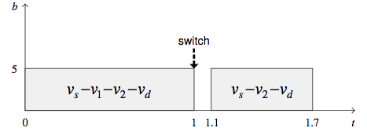
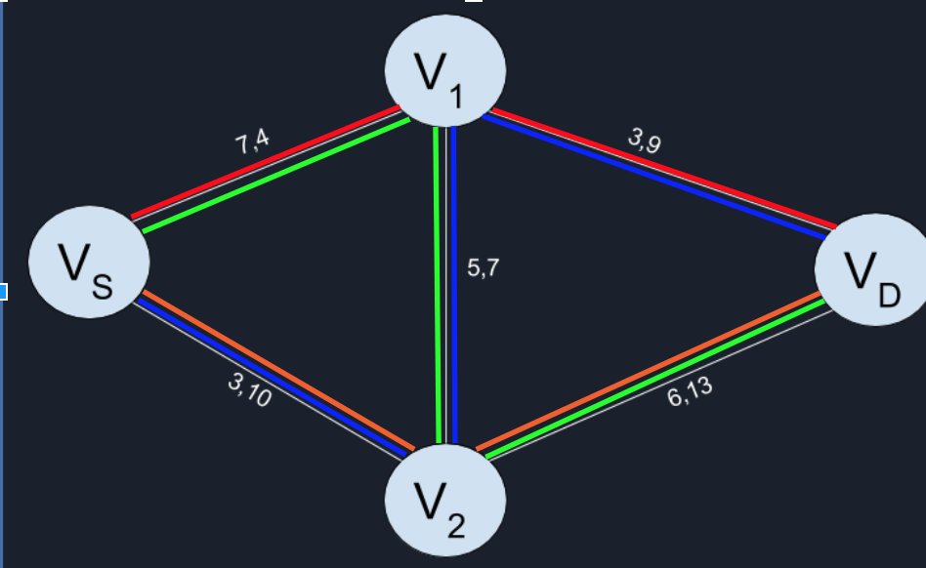
Variable Path Fixed Bandwidth -1 (VPFB-1) Example
The problem reduces to FPFB if no path switching is performed.
Data transfer is 1.8 if no path switching is performed
If the paths are switched, the data transfer is equals to data transfer end time of VPFB-0 + the path switching delay, 1.6+ 𝛕 =1.7
The path switching is profitable in this case

Slide 13
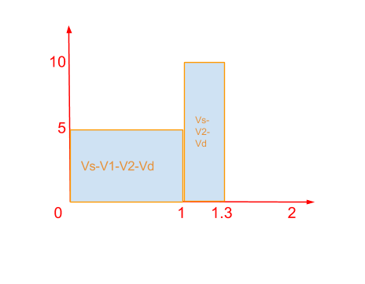
Variable Path Variable Bandwidth-0 (VPVB) Example
(𝛿=8,𝜏=0.1,t=0)
Compute a set of paths from Vs to Vd with varying bandwidths at different time slots.
Assume 𝜏 is negligible.

Slide 14
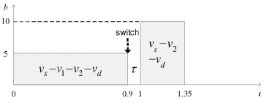
Variable Path with Variable Bandwidth (VPVB-1) Example
-VPVB stands for Variable Path, Variable Bandwidth. The “-1” indicates when the switching is not negligible.
-Since the bandwidth of the widest path in the widest path is smaller than the that in the second time-slot (see below graph), the path switching is performed at the end of the first time-slot [0.9, 1] and the data transfer end time is 1+ 3.5/10=1.35.
Notes:
MM- from Figure 3(f) from the paper

Slide 15
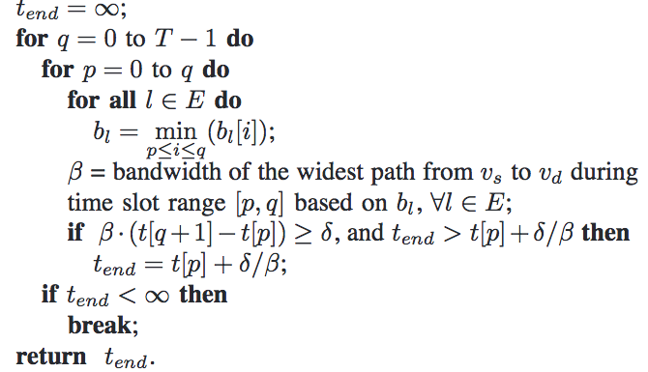
FPFB Optimal Scheduling Algorithm
The output of this Algorithm is the minimal data transfer end time slot p from 0 to q. It checks if there is any existence of feasible p such that the data of size of 𝛿 can be transferred during the slot range {p,q}. If there is no feasible path the algorithm repeatedly increase q by 1. Otherwise the algorithm computes the optimal start time p and data transfer end time t by considering all the possible values of p.
Complexity of the algo is
O(T² .m.logn+T³.m)

Slide 16
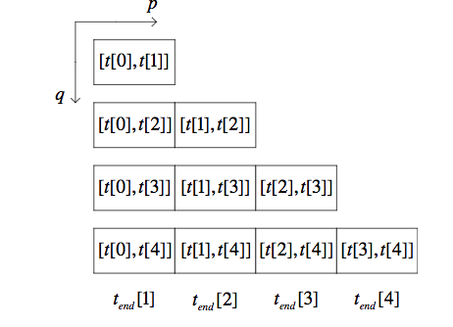
Example For FPFB Complete Start Time Search Algorithm
In the shown table the cell in the first row only contains the first time slot. If the data can not be completely transferred during the time interval [t[0],t[1]], We increase data transfer end time slot q by 1 and advanced to the second row, where each cell is considered as the data transfer end time slot. If the data cannot be completely transferred before t[2], we again increase q by 1 and advanced to the third row. This search process continues until we reach a row where the transfer request is satisfied and an optimal solution with minimal data transfer end time can be obtained

Slide 17
FPVB Scheduling Algorithms

Slide 18
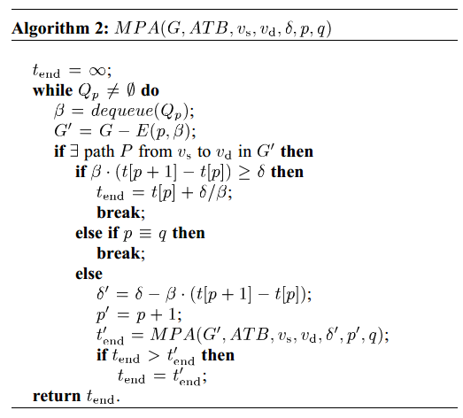
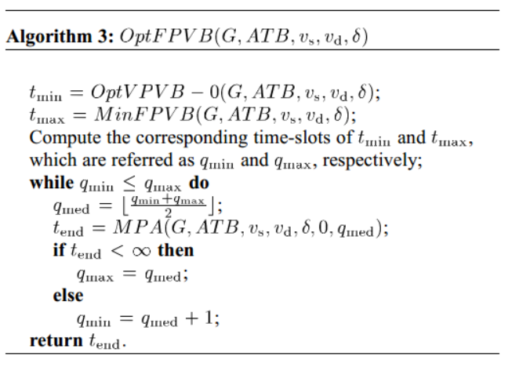
FPVB Scheduling Algorithms - Optimal
Max Permutation Algorithm (MPA): A function that takes as input a graph G=(V,E) with an ATB list for all links l ∈ E, source Vs and destination Vd, data size 𝛿, and a time-slot range [p,q] determines if there is a path from Vs to Vd such that data of size 𝛿 can be transferred within the time-slot range [p,q]
Loop through the input Graph for each node--for each time-period, finding the maximum possible bandwidth that can be covered for each path that goes from the source to the destination… Recursively call MPA for each path which does not provide enough bandwidth to complete the transfer. Return infinity if file size transfer is not met.

Slide 19
FPVB Scheduling Algorithms - Optimal
OptFPVB: Do a Binary Search of the graph domain and call MPA on the sub-graphs that meet the time-slot requirements. Normally it returns an optimal path, but we are only returning optimal time for these examples.
MPA: O(m.m^{q-p}): Each iteration through the function is O(m). You must run through this function once per each time-period (q-p)!
OptFPVB: O(LogT) :: It calls MPA at most Log T times.
Overall Runtime: O (m^{T .} logT)

Slide 20


Slide 21
FPVB Scheduling Algorithms
Maybe the FPVB is NP-Hard? Maybe it’s even NP-Complete?
What is the decision version of FPVB?
Input: Given a graph G = (E,V) with an ATB list for all links l ∈ E, source V_{s}, destination V_{d}, and data size 𝛿… We assume the data transfer starts at t[0]
Question: Does there exist a fixed path from V_{s} to V_{d} with varying bandwidths across multiple time-slots such that the data can be completely transferred along the path during the time interval [0,t_{end}]
Is the decision version in NP?
For Every ${Path} in G: guess_max_data_size_transferrable(${Path},0,t_{end}) >= 𝛿
Can we reduce it to a known NP-Complete problem?
Easy! Just reduce it to the 0/1 Total Bandwidth problem!

Slide 22
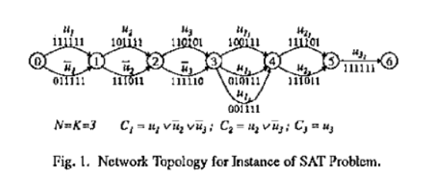
FPVB Scheduling Algorithms -- 0/1 Total Bandwidth Problem
0/1 Total Bandwidth problem:
Available bandwidth on a link at each time slot is either 1 or 0. When presented with a connection request at time t = 0, the question is whether there is a path for the connection such that during the interval [0,T], the number of time slots for all links have a value 1 is atleast 𝛽 for some given 𝛽 > 0.
In the paper “Networks with Advance Reservations: The Routing Perspective”[2], this problem is proven to be NP-Complete by reduction to the SAT problem.

Slide 23
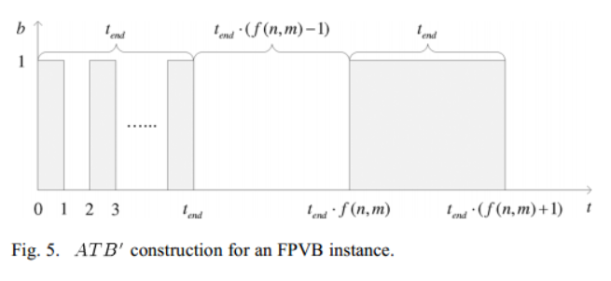
FPVB Scheduling Algorithms -- 0/1 Total Bandwidth Problem
Decision 0/1 Total Bandwidth problem:
Input: Given a graph G=(E,V) with an ATB list of either 0 or 1 available bandwidth for all links l 𝜖 E, source V_{s}, detination V_{d}
Question: Does there exist a path from V_{s} to V_{d} such that during the time interval [0,t_{end}], the number of time-slots all have a bandwidth value 1 is atleast 𝛽?
Reduction:
Let (G,ATB,V_{s},v_{d},t_{end},𝛽) be an arbitrary instance of 0-1 TB. Construct an instance of FPVB as (G’,ATB’,V’_{s},v’_{d},t’_{end},𝛿) from the 0-1 TB instance in polynomial time such that:
Data file 𝛿 can be completely transferred along V’_{s} to V’_{d} during the time interval [0,t’_{end}] if and only if there exists a path from V_{s} to V_{d} in G that the number of time-slots in which all path links have a bandwidth value of 1 is at least 𝛽 during the time interval [0,t_{end}]
Set G’=G, TB’=TB, V’_{s}=V_{s},V’_{d}=V_{d},t’_{end}=t_{end},𝛿=𝛽
It’s obvious that this instance construction can be done in polynomial time.

Slide 24
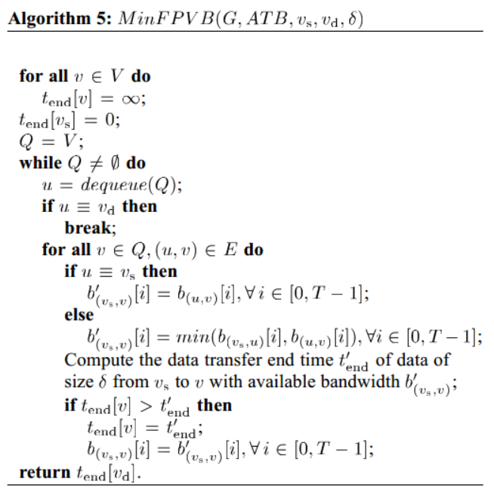
FPVB Scheduling Heuristic Algorithm
Q is a queue of nodes sorted by their data transfer time t_{end}[v] in an increasing order.
b(v_{s},v)[i]: Bandwidth of the computed path from V_{s} to V in the ith time-slot, which is the bottleneck bandwidth of all component links on the path.
How the algorithm works
Set all nodes to have infinite end times, set source node to 0.
It’s a modified Dijkstra’s algorithm that looks at the bottleneck of each path and fills in the chart with thsoe values instead of each individual link.
Run-Time Complexity: O(m*(T+log(n))

Slide 25
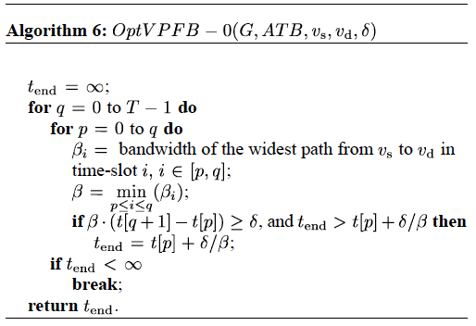
Variable Path with Fixed Bandwidth (VPFB-0) Optimal Scheduling Algorithm
A dat transfer end time slot q, starting at 0, the algorithm varies the transfer start time-slot p from 0 to q and computes the bandwidth of the widest path from v_{s} to v_{d} in each time slot range [p,q]. It then computes the minimal bandwidth, which is the bottleneck bandwidth across these time slots and is considered as the fixed bandwidth for data transfer. The algorithm increases q by 1 until the amount of data transferred up to time-slot q is greater than the data size δ (delta), and computes the minimal data transfer end time by all possible p values.
The complexity of using this when computing is
O(T*m*lg n) for finding widest path while the
total time complexity is
O(T*m*lg n + T^3).
Notes:
MM-Algorithm 6 from paper.

Slide 26
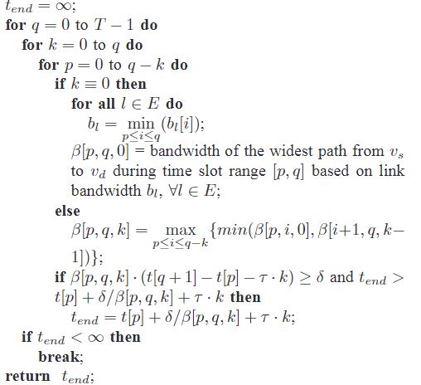
VPFB-1 Optimal Scheduling Algorithm
It considers the non-eligible positive path switching delay 𝜏 > 0.
B[p,q,k] be the maximum available bandwidth during the time slot range [p,q] with k path switching. The maximum amount of transferred data will be : B[p,q,k].(t[q+1]-t[p]-𝜏.k0
If the above max amount of time is greater than or equal to the size 𝛿, the data transfer end time is obtained : t_{end}=t[p]+𝛿/B[p,q,k]+𝜏 .k
Following the concept of the dynamic programming, the recursive form of the optimal solutions to the subproblem, divide the problem of computing B[p,q,k] by the time slot after which the path switching is scheduled : B[p,q,k] = max { min(B[p,i,0], B[i+1, q, k-1])}
The time for computing the optimal solution to all base entries (K=0) O(T².m.logn).
When K>0 time is O(t⁴) total time O(T².(m.lgn+T²)) in the worst case.
Notes:
KK-

Slide 27
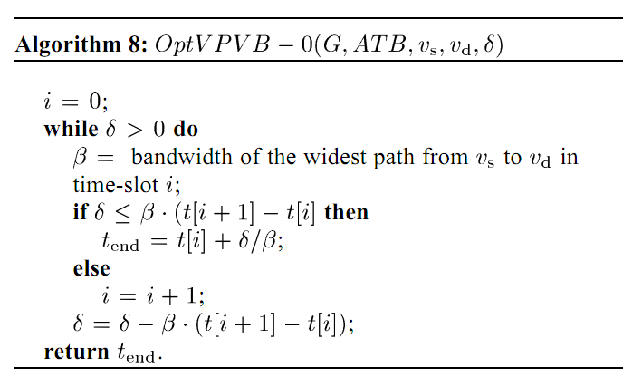
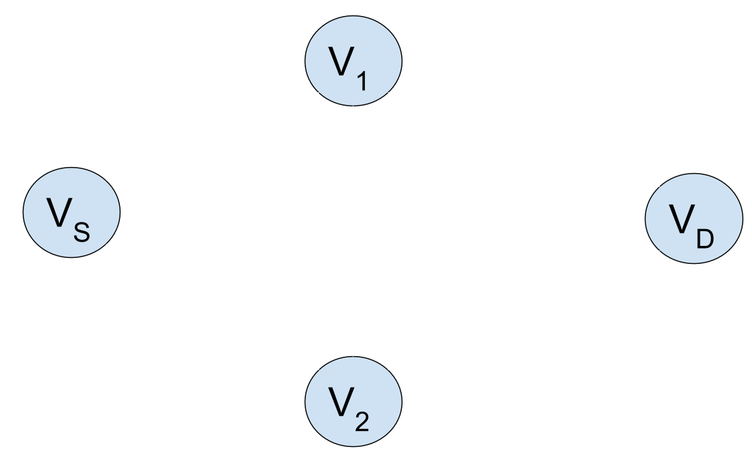

VPVB-0 Optimal Scheduling Algorithm
max
max
The solution is to just loop through each time-period and call a modified dijkstras on the graphs.
Complexity is O(T.m.log(n))
T[0,1)
T[1,2)
Notes:
IS-

Slide 28
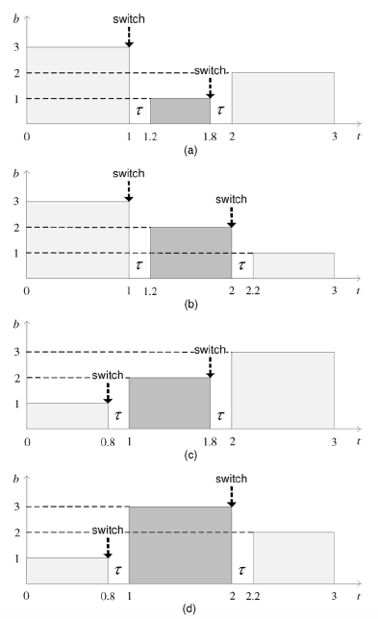
Variable Pathway Variable Bandwidth (VPVB-1) Optimal Scheduling Algorithm
VPVB-1 (Variable Path Variable Bandwidth with time delay) is the last variant algorithm and the most unique.
It can have a delay so large that it can be reduced to FPVB. It is NP-complete by proof by restriction.
VPVB-1 is also nonapproximable since it is similar to FPVB.
Optimal Scheduling is done by either at the end of the a time-slot
or at the beginning of the next time-slot. (See graph)
Another variant is the Greedy VPVB-1 which decides whether to
switch to either the widest path or continue on the FPVB path. The
time delay grows as switching occurs between the time slots.
Notes:
MM-The proof for NP complete is too big to be placed here but can referenced from Computers and Intractability: A Guide to the Theory of NP-Completeness. It’s the book with the same illustration of the man talking to the boss behind the desk about finding an algorithm from the start of the class.

Slide 29
Conclusion
We have demonstrated the complexity and run-time for the best algorithms relative to the problem constraints for any given Advanced Bandwidth Reservation problem.
Problem | Complexity | Algorithm | Big O Time
FPFB | P | OptFPFB | O(T² .m.logn+T^{3.}m)
FPVB | NP-Complete | OptFPVB MinFPVB | O(m^{T}logT) O(m.(T+log(n))
VPFB-0 | P | OptVPFB-0 | O(T*m*lg n + T^3)
VPFB-1 | P | OptVPFB-1 | O(T^{2.}m.logn)
VPVB-0 | P | OptVPVB-0 | T.m.log(n)
VPVB-1 | NP-Complete | OptVPVB-1,MinVPVB-1 | O(m^{T}+T⁴), O(T²*m*(T+lg n)+T⁴
Notes:
IS

Slide 30
Questions?

Slide 31
Primary References
Lin, Y., & Wu, Q. (2013). “Complexity Analysis and Algorithm Design for Advance Bandwidth Scheduling in Dedicated Networks”. IEEE/ACM Transactions on Networking, 21(1), 14-27. doi:10.1109/tnet.2012.2189127
R. Guerin and A. Orda, “Networks with advance reservations: The routing perspective,” in Proc. 19th IEEE INFOCOM, 2000, vol. 1, pp.118–127.

