Slide 1
A Categorization of Real-Time Multiprocessor Scheduling Problems and Algorithms
Elinor Huntington
Ibraheem Saleh

Slide 2
Introduction
Focus of the Chapter
“We analyze the trade-offs involved in scheduling independent, periodic real-time tasks on a multiprocessor”
Terminology
Real-Time System
: “A real-time system is a system required to complete its work and deliver its services on a timely basis”[ref]
Traffic Light Regulation
Airplane Runway System
Managing the Breaks/Acceleration on Modern Cars
Real-Time Task
The collection of real-time jobs that must be scheduled in the above type system. These have an associated deadline and usually a penalty for lateness.
Periodic Real-Time Task
A Real-Time Task that repeats at a specified interval.

Slide 3
Introduction
Focus of the Chapter
“We analyze the trade-offs involved in scheduling independent, periodic real-time tasks on a multiprocessor”
Terminology
Multiprocessor
A computer system with more than one CPU in which a shared pool of tasks can distributed.
A Single Chip architecture with numerous physical processors
Multiple cores on one die
Virtual Cores Hypervisor Systems, Etc
Challenges
Synchronization Costs
System Overheads
Job Distribution

Slide 4
Liu & Layland Periodic Task Model
T
A periodic task
A task is a job scheduled periodically by the processor within the restrictions supplied by e and p
e
The worst case execution requirement of T
Each task requires at most e units of processor time
p
The period of T
Each task must complete execution within p units of processor time
𝞽
A periodic task system
A collection of tasks T
Notes:
Obvious things to note, p >= e

Slide 5
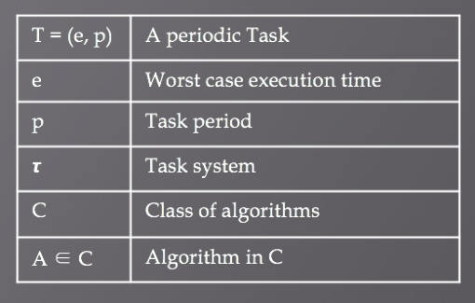
T₃ ₌ (e_{3,} p₃)
𝞽
T₁ ₌ (e_{1,} p₁)
J₃, J₃, J₃, …
J₁, J₁, J₁, …
T₂ ₌ (e_{2,} p₂)
T₄ ₌ (e_{4,} p₄)
J₂, J₂, J₂, …
J₄, J₄, J₄, …
Notes:
not sure how I feel about the p=1, p=2 part.

Slide 6
Schedulability, Feasibility & Optimality
A task system 𝞽 is
Schedulable by an algorithm A if A ensures that the timing constraints e_{i}, p_{i} are met by all tasks T_{i} in 𝞽
Feasible under a class of algorithms C if 𝞽 is schedulable by some algorithm A in C
An algorithm A is Optimal with respect to a class C if A is in C and A correctly schedules every task system that is feasible under C.

Slide 7
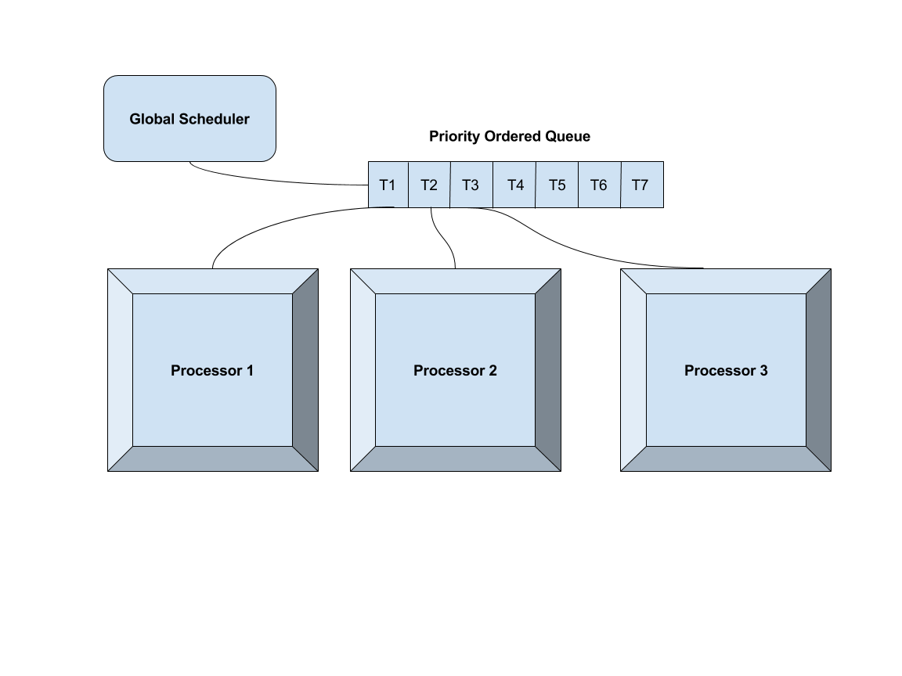
Global Scheduling
There are two traditional approaches for scheduling periodic task systems on multiprocessors.
Global Scheduling
“In global scheduling, all eligible tasks are stored in a single priority ordered queue; the global scheduler selects for execution the highest priority tasks from this queue.”
Notes:
1 minute

Slide 8
Global Scheduling
Negatives
Using optimal uniprocessor scheduling algorithms often results in low processor utilization.
Earliest-Deadline-First (EDF)
Rate-Monotonic (RM)
This is sometimes because tasks with large jobs which don’t migrate processors often lock the system
Positives
Proportionate-Fair scheduling algorithm has produced an optimal method for scheduling periodic tasks on multiprocessors
Not the focus of this chapter (That’s the next chapter)

Slide 9
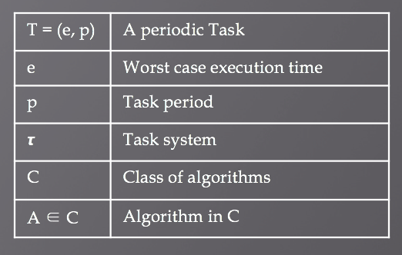
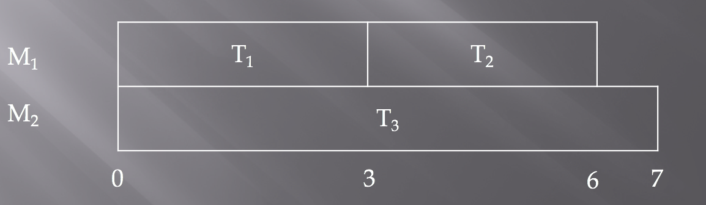
Partitioning
Each task T is assigned to a single processor
All jobs in T will execute on that processor
The processors are scheduled independently
Given 2 processors and 3 Tasks
M₁ = (T₁, T₂); M₂ = (T₃)
T₁ = (3, 6); T₂ = (3, 6); T₃ = (6, 7)
One schedule cycle that accounts for all task periods

Slide 10
Partitioning Pros and Cons
One significant advantage
Partitioning simplifies the multiprocessor problem to a set of uniprocessor problems
Since each processor is scheduled independently, a partitioning algorithm only has to consider that processor and its assigned tasks
Two significant disadvantages
The optimal assignment of tasks to processors is a bin-packing problem, thus NP-Hard
There are task systems that cannot be scheduled under partitioning
Notes:
Should I do an example here of one that cannot be scheduled via partitioning, or should we leave that til later

Slide 11
“Middle” approach
The “Middle” Approach
“Each job is assigned to a single processor, while a task is allowed to migrate. In other words, interprocessor task migration is permitted only at job boundaries.”
The difficulty of this is knowing the cost of this migration. When is it actually beneficial to migrate a task to a different processor?
This approach ranks scheduling schemes along two degrees of complexity:
Complexity of the priority scheme
Degree of migration allowed
“The primary motivation of this work is to provide a better understanding of the trade-offs involved when restricting the form of a system’s scheduling algorithm.
Most of the algorithms that are used in real-time scheduling are work conserving.
“At each instant a priority is associated to an active job and the highest priority jobs that are eligible to execute are executed on the first processor that becomes available to process a job.”
This means we do not manually create arbitrary wait-idle times on a processor even if that is required to produce the optimal schedule (example later!)
Notes:
1 minute

Slide 12
Migration-Based Classification
The migration classification determines whether a task or job needs to be scheduled completely on one processor or if it can be shared among them.
Traditionally, migration has been forbidden on real time systems
The cost of transferring a job’s context from one processor to another was prohibitive
The problem of migration hadn’t been well studied within real time scheduling theory; thus partitioning was the default due to lack of viable alternatives

Slide 13
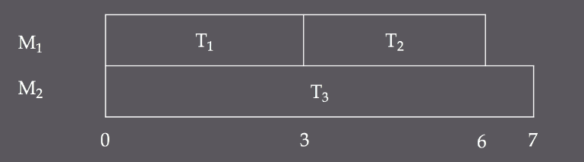
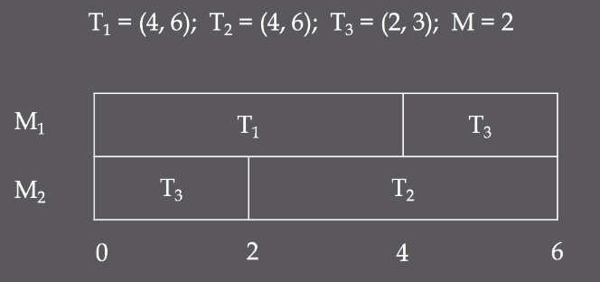
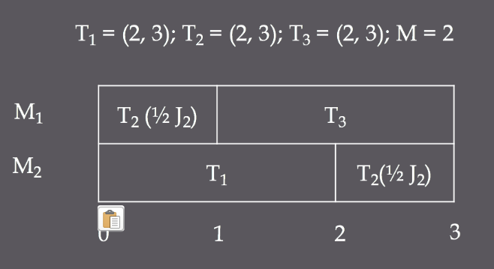
Three Migration Classes
No migration
AKA Partitioning
The set of tasks is partitioned among processors and all jobs in a task must execute on their designated processors
Restricted Migration
Each job must complete its execution on one processor but different jobs within one task may execute on different processors
Full Migration
There are no restrictions placed on interprocessor migration

Slide 14
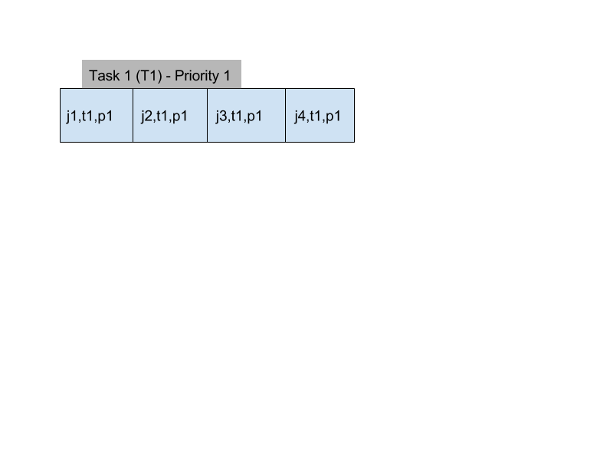

Priority-Based Classifications
The complexity of the priority scheme that is used to differentiate scheduling algorithms can be broken into 3-different categories.
Static Priorities:
A unique priority is associated with each task, and all jobs generated by a task have the priority associated with that task.
Every job in Task 1 has priority over every job in Task 2 because the priority of Task 1 is higher than the priority of Task 2.
Notes:
2 minutes

Slide 15
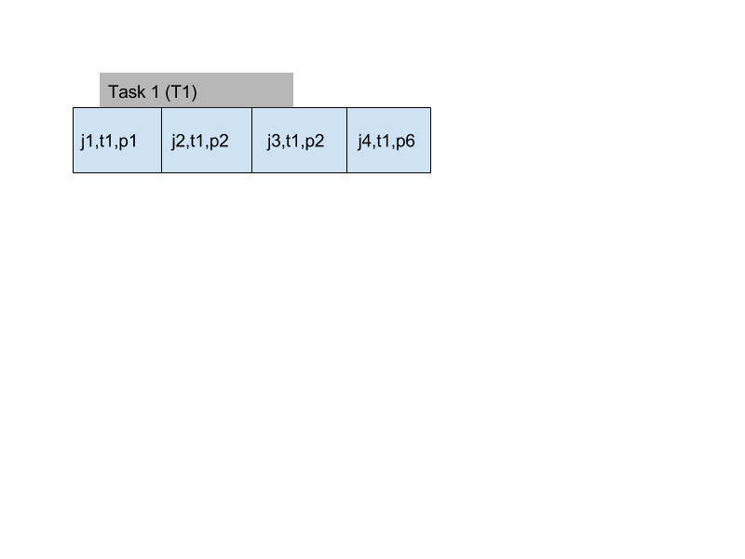

Priority Based Classifications
Job-level dynamic priorities
For every set of jobs, Ji Jj, if Ji has higher priority than Jj at some instant in time, then Ji always has a higher priority than Jj. The Job priorities themselves are static but not related or bound to other job or task priorities.

Slide 16
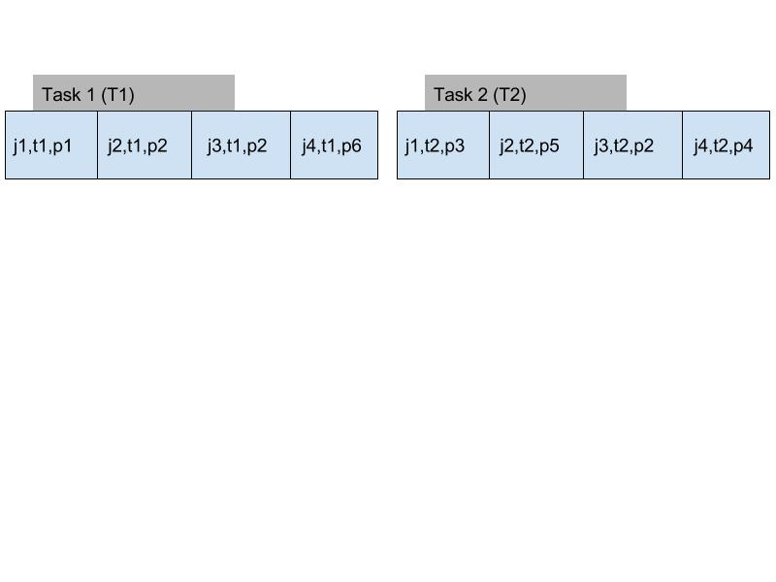
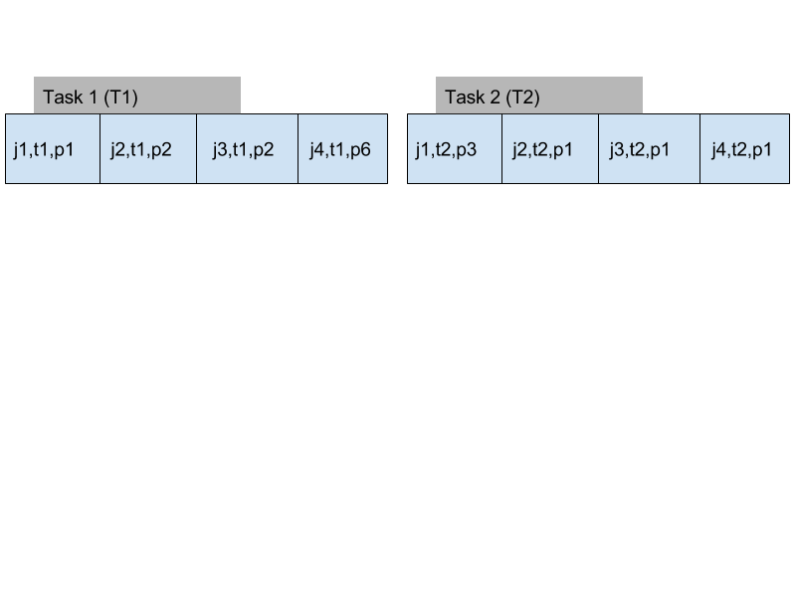
Priority Based Classifications
Unrestricted Dynamic Priorities
“No restrictions are places on the priorities that may be assigned to jobs and the relative priority of two jobs may change at any time.”[ref]
Time 1
Time 2

Slide 17
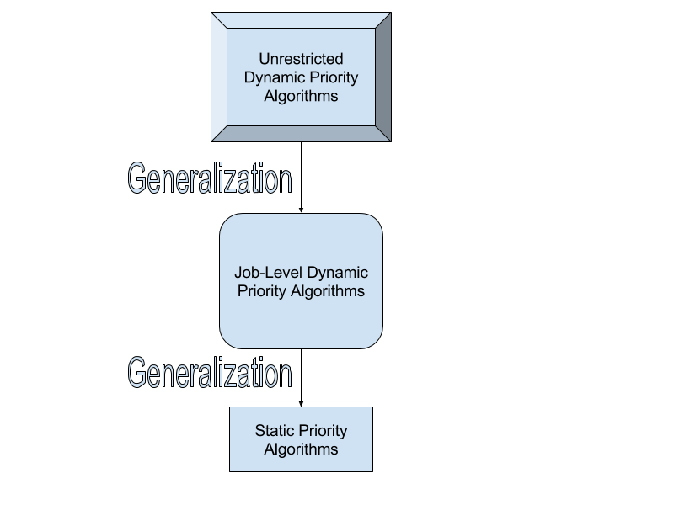
Priority Based Classifications
Unrestricted dynamic-priority algorithms are a generalization of job-level dynamic-priority algorithms which are a generalization of static-priority algorithms.
In the single processor case, there is no difference between Unrestricted Dynamic and Job-Level Dynamic because the same optimal algorithm exists for both (EDF), but in multiprocessor cases, unrestricted Dynamic is strictly more powerful!

Slide 18
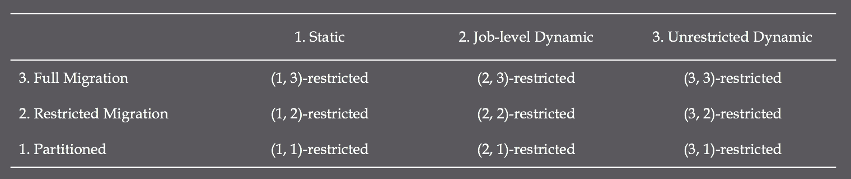

(x, y)-restricted classification
A scheduling algorithm is called (x, y)-restricted for $x ∈\left\{1, 2, 3\right\}$ and y$∈\left\{1, 2, 3\right\}$ if it is in priority class x and migration class y.

Slide 19
<x, y> feasibility
An ordered pair <x, y> denotes the set of task systems that are feasible under (x, y)-restricted scheduling
Recall that a task system is feasible under a class of algorithms C if the task system is schedulable by some algorithm A in C

Slide 20

Runtime overhead relationship
If $y ≥w ∧z ≥x$, the runtime overhead of a (w, x)-restricted algorithm is at most that of a (y, z)-restricted algorithm
Generally, runtime overhead is higher for more general algorithms than less general ones
(3, 3)-restricted algorithms are the most general, while (1, 1)-restricted algorithms are the least general
Any task system that is feasible under any (x, y)-restricted class is also feasible under (3, 3)-restricted algorithms, but the runtime of the (3, 3)-restricted algorithms may be unacceptably high.
⬆ generality
⬆ generality

Slide 21
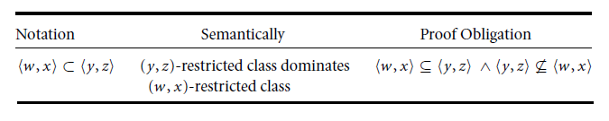
Schedulability Relationships
Possible Relationships
The class of (w₁,x₁)-restricted algorithms is strictly more powerful than the class of (w₂,x₂)-restricted algorithms.
Any task system that is feasible under the (w₂,x₂)-restricted algorithms is also feasible under the (w₁,x₁)-restricted algorithms.
There exists at least one task system that is feasible under the (w₁,x₁)-restricted class but is not feasible under the (w₂,x₂)-restricted class.
Notes:
(X,Y) is ::: (COLUMN,ROW)

Slide 22
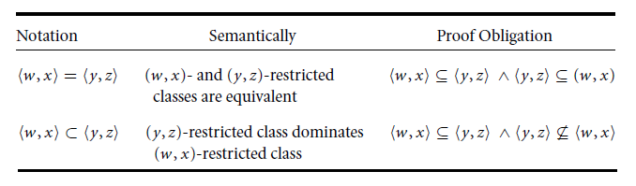
Schedulability Relationships II
Possible Relationships
The class of (w,x)-restricted algorithms and the class of (y,z)-restricted algorithms are equivalent.
A task system is feasible under the (w,x)-restricted class if and only if it is feasible under the (y,z)-restricted class.

Slide 23
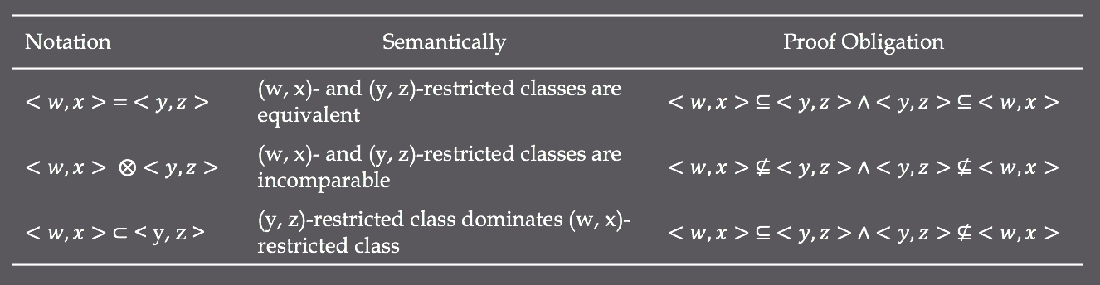
Schedulability Relationships III
The class (w, x)-restricted algorithms and the class (y, z)-restricted algorithms are incomparable
There exists at least one task system that is feasible under the first class that is not feasible under the second class , and vice versa

Slide 24

Class Relationships I
 | <1,1> | <2,1> | <3,1> | <1,2> | <2,2> | <3,2> | <1,3> | <2,3> | <3,3>
<1,1> | =
<2,1> |  | =
<3,1> |  |  | =
<1,2> |  |  |  | =
<2,2> |  |  |  |  | =
<3,2> |  |  |  |  |  | =
<1,3> |  |  |  |  |  |  | =
<2,3> |  |  |  |  |  |  |  | =
<3,3> |  |  |  |  |  |  |  |  | =
Since every static-priority algorithm is, by definition, a job-level dynamic-priority algorithm, and every job-level dynamic-priority algorithm is an unrestricted dynamic-priority algorithm. We can trivially observe the following relationships:
<1,1> $⊆$ <2,1> $⊆$ <3,1>
<1,2> $⊆$ <2,2> $⊆$ <3,2>
<1,3> $⊆$ <2,3> $⊆$ <3,3>

Slide 25
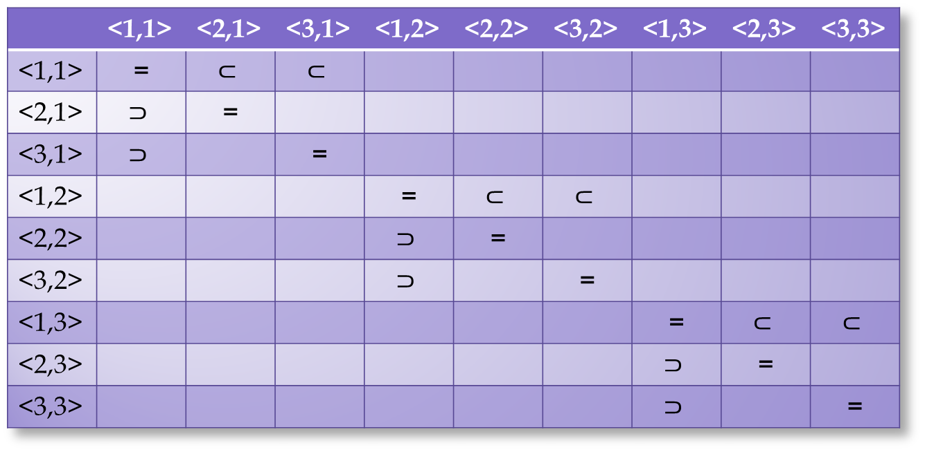
Class Relationships I
 | <1,1> | <2,1> | <3,1> | <1,2> | <2,2> | <3,2> | <1,3> | <2,3> | <3,3>
<1,1> | = | $$⊂$$ | $$⊂$$
<2,1> | $$⊃$$ | =
<3,1> | $$⊃$$ |  | =
<1,2> |  |  |  | = | $$⊂$$ | $$⊂$$
<2,2> |  |  |  | $$⊃$$ | =
<3,2> |  |  |  | $$⊃$$ |  | =
<1,3> |  |  |  |  |  |  | = | $$⊂$$ | $$⊂$$
<2,3> |  |  |  |  |  |  | $$⊃$$ | =
<3,3> |  |  |  |  |  |  | $$⊃$$ |  | =
Since every static-priority algorithm is, by definition, a job-level dynamic-priority algorithm, and every job-level dynamic-priority algorithm is an unrestricted dynamic-priority algorithm. We can trivially observe the following relationships:
<1,1> $⊆$ <2,1> $⊆$ <3,1>
<1,2> $⊆$ <2,2> $⊆$ <3,2>
<1,3> $⊆$ <2,3> $⊆$ <3,3>

Slide 26
Class Relationships II
 | <1,1> | <2,1> | <3,1> | <1,2> | <2,2> | <3,2> | <1,3> | <2,3> | <3,3>
<1,1> | = | $$⊂$$ | $$⊂$$
<2,1> | $$⊃$$ | =
<3,1> | $$⊃$$ |  | =
<1,2> |  |  |  | = | $$⊂$$ | $$⊂$$
<2,2> |  |  |  | $$⊃$$ | =
<3,2> |  |  |  | $$⊃$$ |  | =
<1,3> |  |  |  |  |  |  | = | $$⊂$$ | $$⊂$$
<2,3> |  |  |  |  |  |  | $$⊃$$ | =
<3,3> |  |  |  |  |  |  | $$⊃$$ |  | =
We know that job-level dynamic and unrestricted-dynamic task systems on uniprocessors have the same optimal solution using EDF (EarliestDeadlineFirst). Because of that, we can infer the following relationship:
<2,1> = <3,1>
Remember, the 1 is referring to a partitioned scheduling scheme which utilizes multiple processors but lets each individual processor schedule the processing.

Slide 27

Class Relationships II
 | <1,1> | <2,1> | <3,1> | <1,2> | <2,2> | <3,2> | <1,3> | <2,3> | <3,3>
<1,1> | = | $$⊂$$ | $$⊂$$
<2,1> | $$⊃$$ | = | =
<3,1> | $$⊃$$ | = | =
<1,2> |  |  |  | = | $$⊂$$ | $$⊂$$
<2,2> |  |  |  | $$⊃$$ | =
<3,2> |  |  |  | $$⊃$$ |  | =
<1,3> |  |  |  |  |  |  | = | $$⊂$$ | $$⊂$$
<2,3> |  |  |  |  |  |  | $$⊃$$ | =
<3,3> |  |  |  |  |  |  | $$⊃$$ |  | =
We know that job-level dynamic and unrestricted-dynamic task systems on uniprocessors have the same optimal solution using EDF (EarliestDeadlineFirst). Because of that, we can infer the following relationship:
<2,1> = <3,1>
Remember, the 1 is referring to a partitioned scheduling scheme which utilizes multiple processors but lets each individual processor schedule the processing.

Slide 28

Class Relationships III
 | <1,1> | <2,1> | <3,1> | <1,2> | <2,2> | <3,2> | <1,3> | <2,3> | <3,3>
<1,1> | = | $$⊂$$ | $$⊂$$
<2,1> | $$⊃$$ | = | =
<3,1> | $$⊃$$ | = | =
<1,2> |  |  |  | = | $$⊂$$ | $$⊂$$
<2,2> |  |  |  | $$⊃$$ | =
<3,2> |  |  |  | $$⊃$$ |  | =
<1,3> |  |  |  |  |  |  | = | $$⊂$$ | $$⊂$$
<2,3> |  |  |  |  |  |  | $$⊃$$ | =
<3,3> |  |  |  |  |  |  | $$⊃$$ |  | =
We know that (1,1)-restricted classes and (1,3)-restricted classes are incomparable.
In other words, the following relationship holds true:
<1,1> $⨂$ <1,3>
This is trivial and doesn’t need to be proven. A static-partition scheduling system is obviously not equivalent to a full-migration scheduling system

Slide 29


Class Relationships III
 | <1,1> | <2,1> | <3,1> | <1,2> | <2,2> | <3,2> | <1,3> | <2,3> | <3,3>
<1,1> | = | $$⊂$$ | $$⊂$$ |  |  |  | $$⨂$$
<2,1> | $$⊃$$ | = | =
<3,1> | $$⊃$$ | = | =
<1,2> |  |  |  | = | $$⊂$$ | $$⊂$$
<2,2> |  |  |  | $$⊃$$ | =
<3,2> |  |  |  | $$⊃$$ |  | =
<1,3> | $$⨂$$ |  |  |  |  |  | = | $$⊂$$ | $$⊂$$
<2,3> |  |  |  |  |  |  | $$⊃$$ | =
<3,3> |  |  |  |  |  |  | $$⊃$$ |  | =
We know that (1,1)-restricted classes and (1,3)-restricted classes are incomparable– we won’t prove this here [see Leung and Whitehead --REF]
In other words, the following relationship holds true:
<1,1> $⨂$ <1,3>

Slide 30
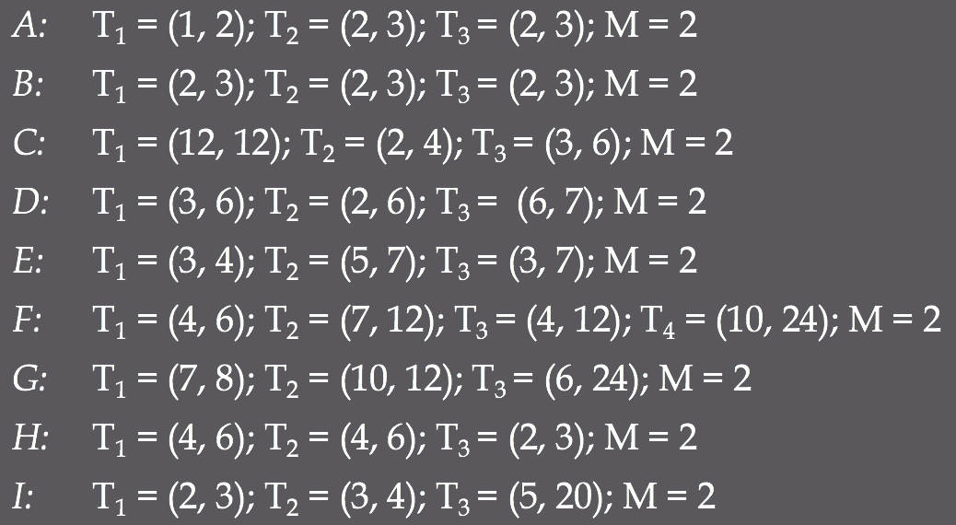
Task Systems For Proofs
Recall that a task T is described by
the its worst case execution time e and
its period p

Slide 31
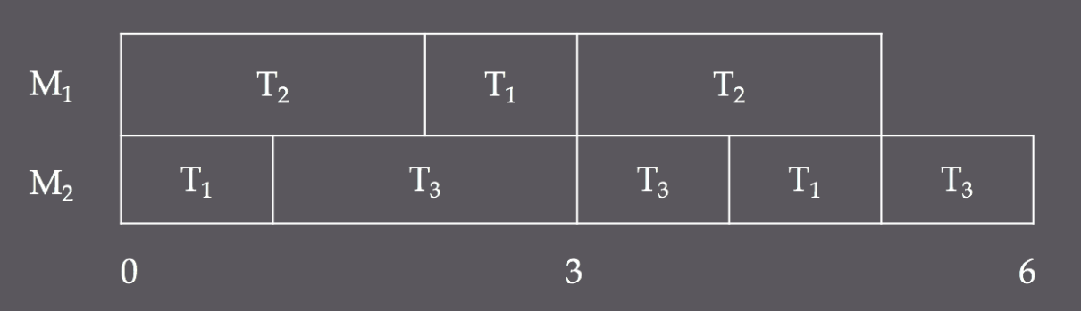

A: | T₁ = (1, 2); T₂ = (2, 3); T₃ = (2, 3); M = 2
$A ∈ <1, 2>$
Static priority, restricted migration
By Theorem 30.1 also $A ∈ <2, 2>$ and $A ∈ <3, 2>$
Let T₂ have higher priority than T₁ and let T₁ have higher priority than T₃
6 is LCM of all task periods
Lemma 30.1

Slide 32
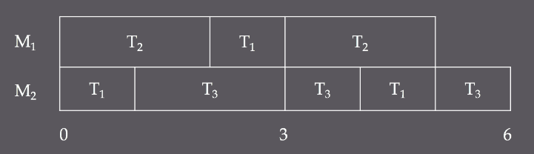
A: | T₁ = (1, 2); T₂ = (2, 3); T₃ = (2, 3); M = 2
$A ∉ <1, 1>$
Static priority, no migration
By Theorem 30.1 also $A∉ <2, 1>$ and $A∉ <3, 1>$
The tasks cannot be partitioned so that they fulfill the restrictions placed on them by their execution times and periods
Without T₁ capable of migrating between processors, the tasks are not schedulable within the first three time units
Lemma 30.2

Slide 33
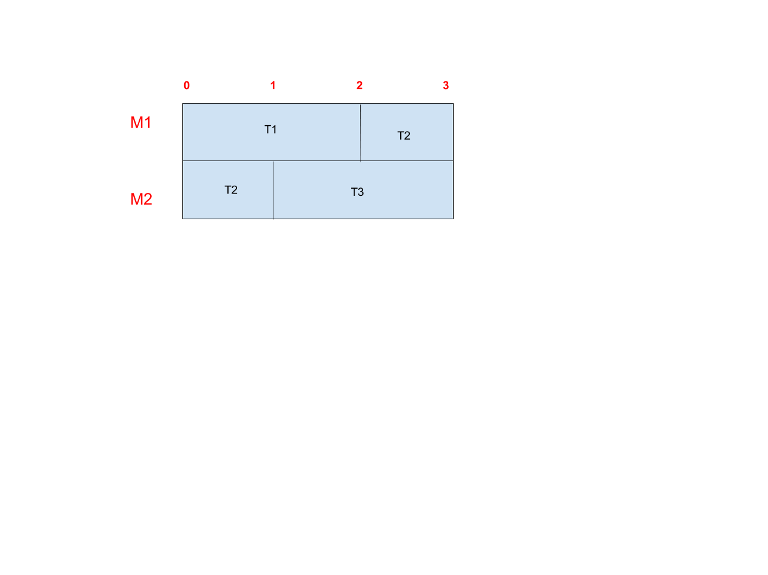
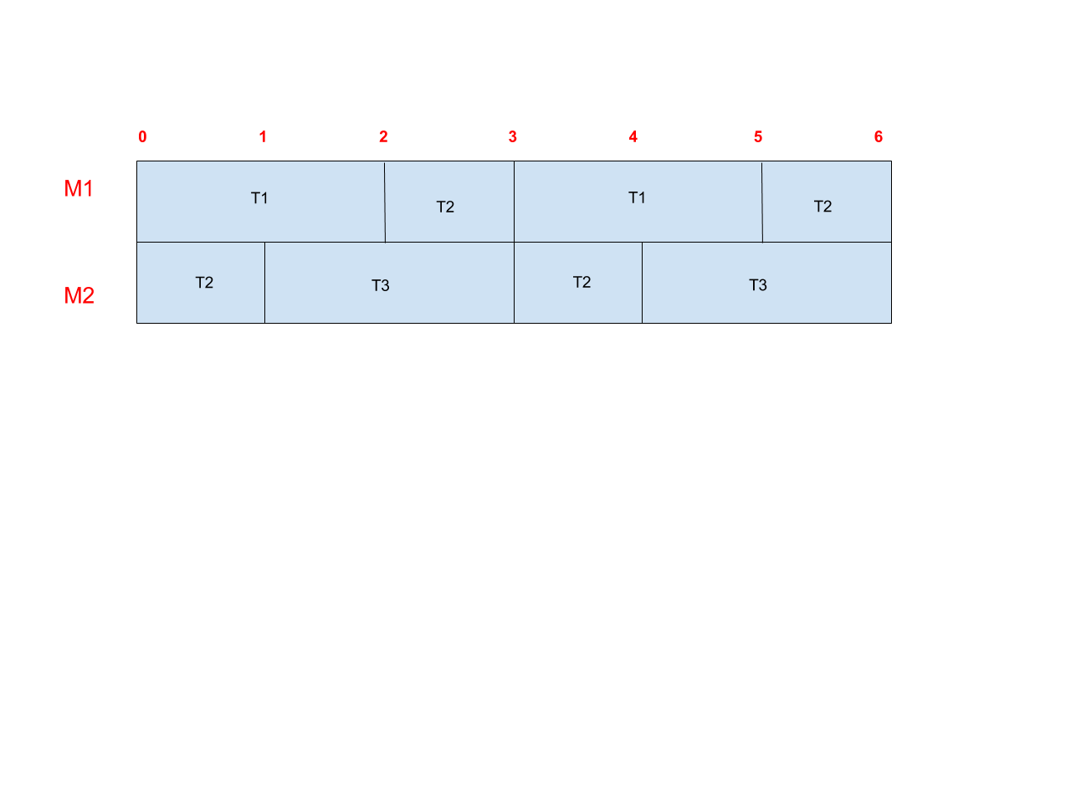
Task System B Schedulability Derivations
B: T₁ = (2,3), T₂ = (2,3), T₃ = (2,3); M=2
Lets assume B is feasible using a (3,3)-restricted algorithm (Try the most general case first!)

Slide 34
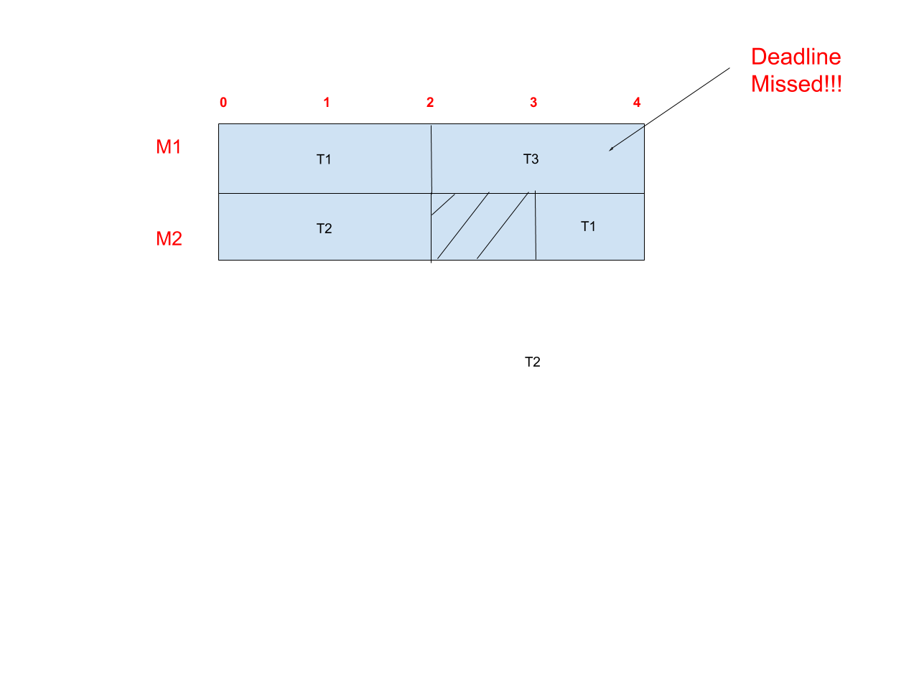
Task System B Schedulability Derivations
B: T₁ = (2,3), T₂ = (2,3), T₃ = (2,3); M=2
Now lets try this task under a (2,3)-restricted scheduling system
Remember: This means Job-level Dynamic Priority and Full Migration allowed!
Because all jobs are released at time 0, and must finish by the deadline of 3, if the priority is fixed, the lowest-priority job cannot start execution before time 2 so it will miss it’s deadline!
The same thing happens with a (3-2)-restricted version of this problem where jobs are not allowed to migrate but can have dynamic priority. By our previous theorem, it’s trivial to deduce that (3-1),(1,3),(2,2),(2,1),(1,2),(1,1) restricted algorithms will also not work

Slide 35
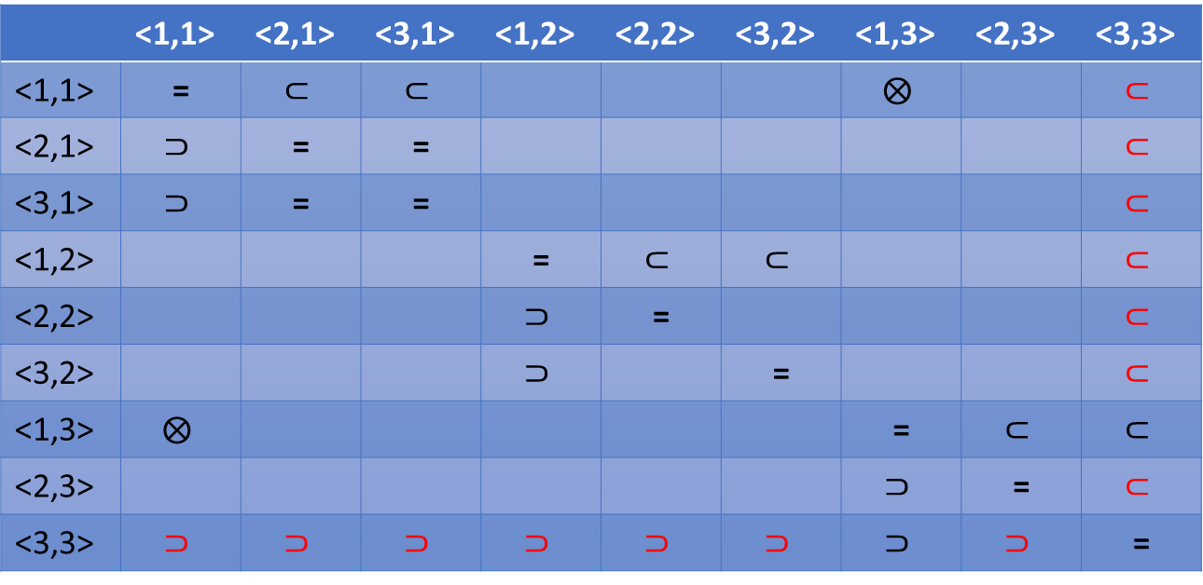
Task System B Schedulability Derivations
B: T₁ = (2,3), T₂ = (2,3), T₃ = (2,3); M=2
Therefore, we’ve shown that B can only be solved only by (3,3)-restricted algorithm classes. So this proves that (3,3)-restricted algorithms are strictly more powerful than all other algorithms!
 | <1,1> | <2,1> | <3,1> | <1,2> | <2,2> | <3,2> | <1,3> | <2,3> | <3,3>
<1,1> | =
<2,1> |  | = | =
<3,1> |  | = | =
<1,2> |  |  |  | =
<2,2> |  |  |  |  | =
<3,2> |  |  |  |  |  | =
<1,3> |  |  |  |  |  |  | =
<2,3> |  |  |  |  |  |  |  | =
<3,3> |  |  |  |  |  |  |  |  | =

Slide 36
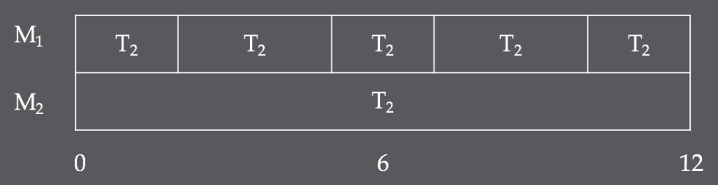
C: | T₁ = (12, 12); T₂ = (2, 4); T₃ = (3, 6); M = 2
$C ∈ <2, 1>$, $C ∈ <2, 2>$, $C ∈ <2, 3>$
Job level dynamic priority, all migration levels
By Theorem 30.1, also $C ∈ <3, 1>$, $C ∈ <3, 2>$, $C ∈ <3, 3>$
Let all jobs of T₁ have highest priority and let jobs of T₂ and T₃ be scheduled using the job level dynamic algorithm EDF
Since T₁ has utilization of 1 (e = p), it will solely occupy one processor.
Since EDF is optimal on uniprocessors, T₂ and T₃ will be correctly scheduled on the other processor
Seems as if it is partitioned into sets {T₁} and {T₂, T₃}, but that is a function of the priority given to T₁
Lemma 30.5
Notes:
Make sure EDF has been discussed earlier, as it is basis for this proof

Slide 37
C: | T₁ = (12, 12); T₂ = (2, 4); T₃ = (3, 6); M = 2
$C ∉ <1, 1>, C ∉ <1, 2>,C ∉ <1, 3>$
Static priority, any migration class
In a static priority scheme, T₁ must still be scheduled solely on one processor, regardless of its priority in relation to the other two tasks, but T₂ and T₃ cannot be statically scheduled on the other
If T₂ has higher priority, it will interrupt T₃ at time 4 and T₃ will overreach its period
If T₃ has higher priority, it will interrupt T₂ at time 6 and T₂ will overreach its period
Lemma 30.6

Slide 38
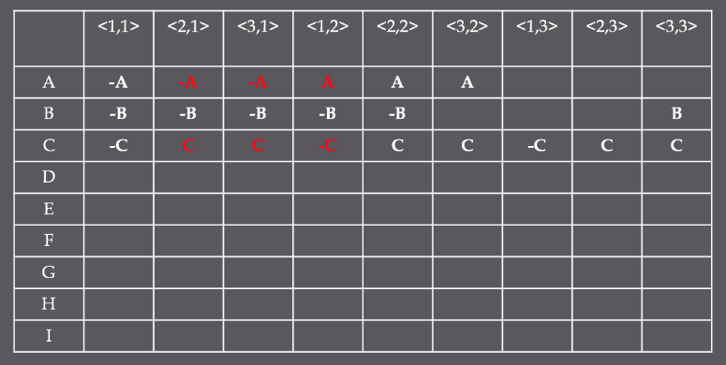
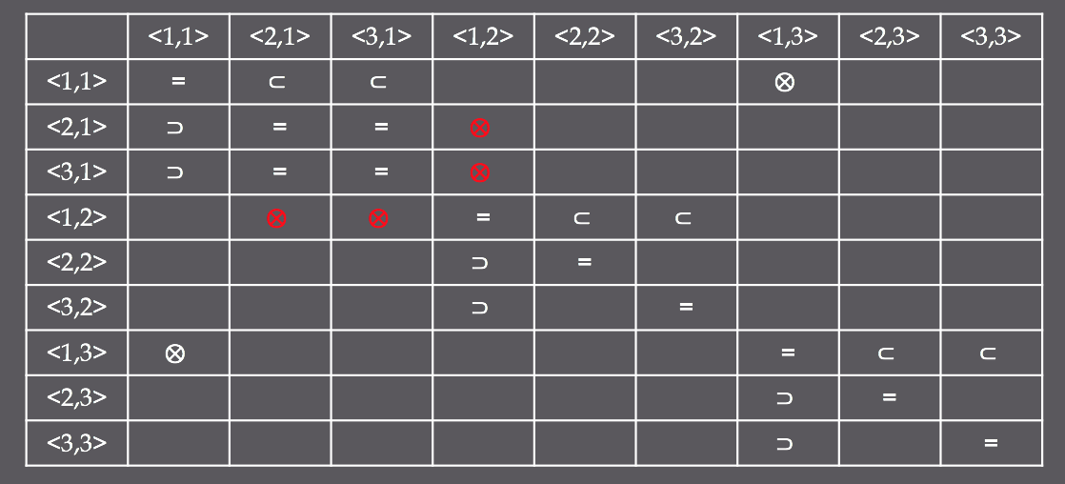

Slide 39
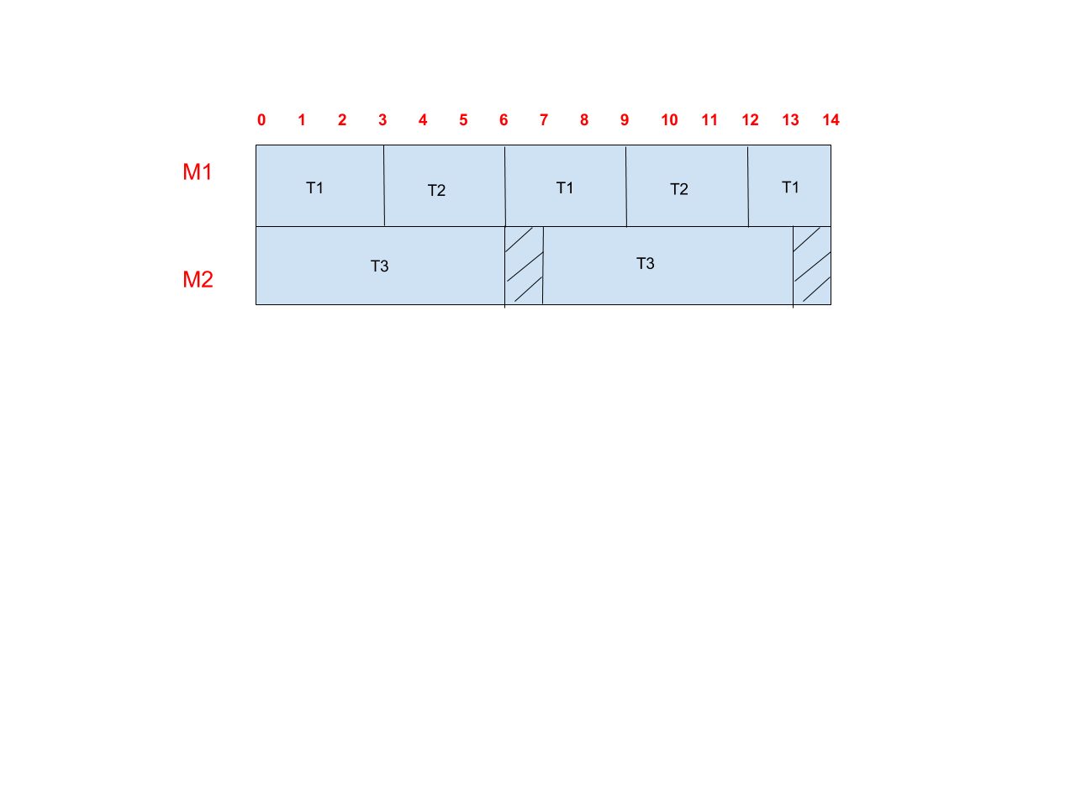
Task Systems (30.7,8,9)
D: T₁ = (3,6), T₂ = (3,6), T₃ = (6,7); M=2
We can easily show that D is a (1,1)-restricted task system by showing that it is correctly scheduled by partition which is a <1,1> class algorithm. This implies that D also belongs in the <2,1> and <3,1> restricted algorithm classes (using the properties we’ve shown before).
Schedule tasks T1 and T2 on M1, with T1 getting higher priority, and schedule T3 on M2. All deadlines are met!

Slide 40
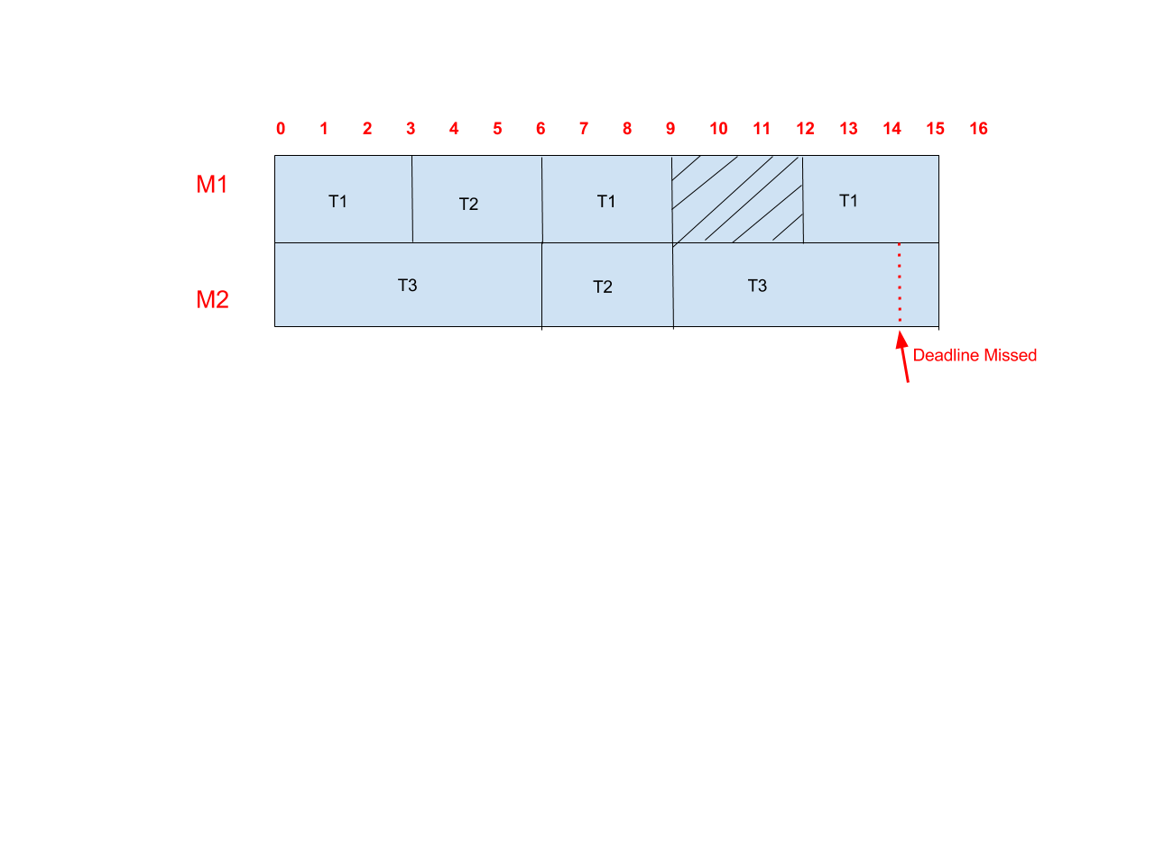
Task System D Schedulability Derivations
D: T₁ = (3,6), T₂ = (3,6), T₃ = (6,7); M=2
We can also show that D cannot be scheduled using a (3,2)-restricted algorithm (Unrestricted-Dynamic Priorities with Restricted Migration)
Given the generalizations that we’ve demonstrated previously, this means that D also cannot be scheduled using a (2,2) or (1,2)-restricted algorithm.
Consider the jobs released at time 0. Regardless of how these jobs are prioritized to each other, if deadlines are met, they will all finish at time 6. At that instant, Tasks 1 & 2 are ready with their next job so, because these are work-conserving algorithms, they are executed on M1 & M2. Because restricted-migration algorithms are not allowed to migrate jobs once they have commenced execution, T1 & T2 must finish while T3, once it is released at time 7, will begin to wait. Once it starts at time 9, T3 is certain miss it’s deadline!

Slide 41
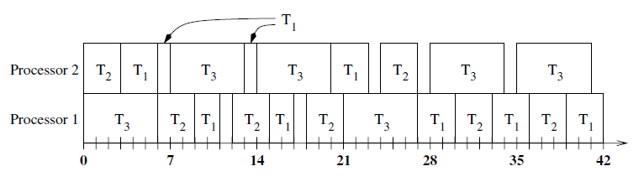
Task System D Schedulability Derivations
D: T₁ = (3,6), T₂ = (3,6), T₃ = (6,7); M=2
We can also show that D is schedulable using a (1,3)-restricted algorithm (Static Priority with Full Migration)
Given the generalizations that we’ve demonstrated previously, this means that D can also be scheduled using (2,3) or (3,3)-restricted algorithms.
Consider an algorithm that assigns T3 the highest priority and T1 the lowest priority. T3 can only ever execute over 6 consecutive units and since jobs may freely migrate between processors, there are 6 consecutive units of processor time available for T1 and T2 over any given interval. All deadlines will be met.

Slide 42
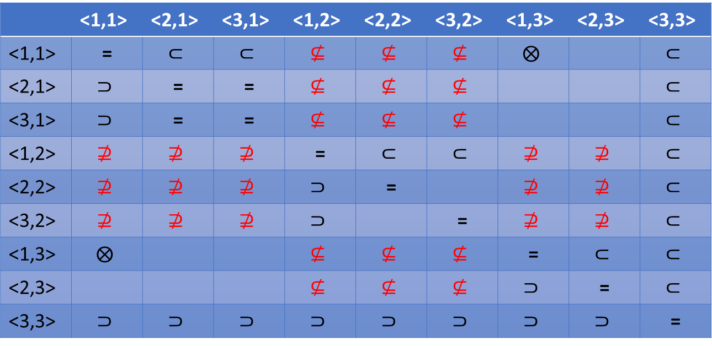
Task System D Schedulability Derivations
D: T₁ = (3,6), T₂ = (3,6), T₃ = (6,7); M=2
Given the schedulability relationships that we just derived, we can now see the following relationships between the (x,y)-restricted classes.
 | <1,1> | <2,1> | <3,1> | <1,2> | <2,2> | <3,2> | <1,3> | <2,3> | <3,3>
<1,1> | =
<2,1> |  | = | =
<3,1> |  | = | =
<1,2> |  |  |  | =
<2,2> |  |  |  |  | =
<3,2> |  |  |  |  |  | =
<1,3> |  |  |  |  |  |  | =
<2,3> |  |  |  |  |  |  |  | =
<3,3> |  |  |  |  |  |  |  |  | =

Slide 43
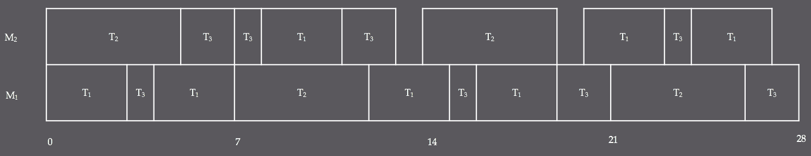
E: | T₁ = (3, 4); T₂ = (5, 7); T₃ = (3, 7); M = 2
$E ∈ <1, 3>$
Static priority, full migration
By Theorem 30.1, also $E ∈ <2, 3>$and $E ∈ <3, 3>$
If priority from highest to lowest is T_{1,} T₂, T₃, then all jobs can be scheduled as such
Lemma 30.10

Slide 44
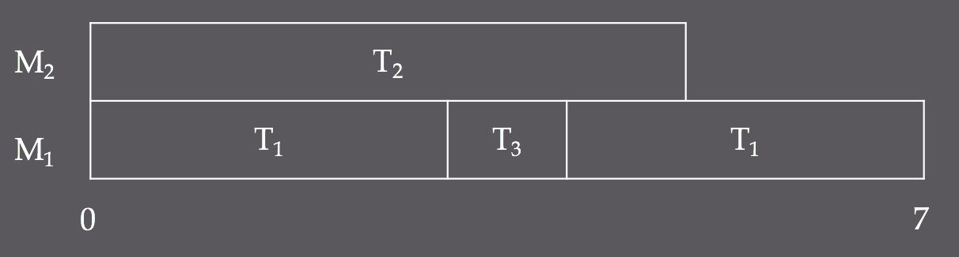

E: | T₁ = (3, 4); T₂ = (5, 7); T₃ = (3, 7); M = 2
$E ∉ <1, 2>$
Static priority, restricted migration
For each of the 6 possible static priority assignments, some task in E will miss a deadline.
Deadline miss
(priority T_{1,} T₂, T₃)
Lemma 30.11

Slide 45
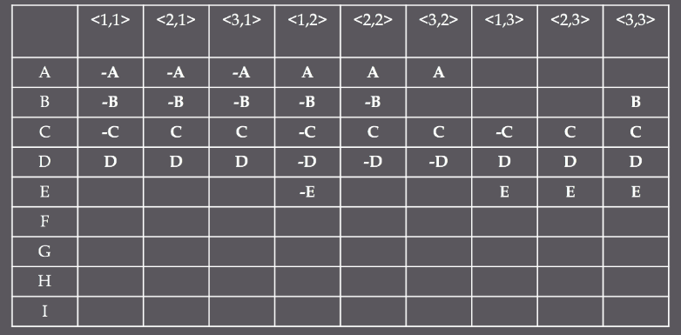
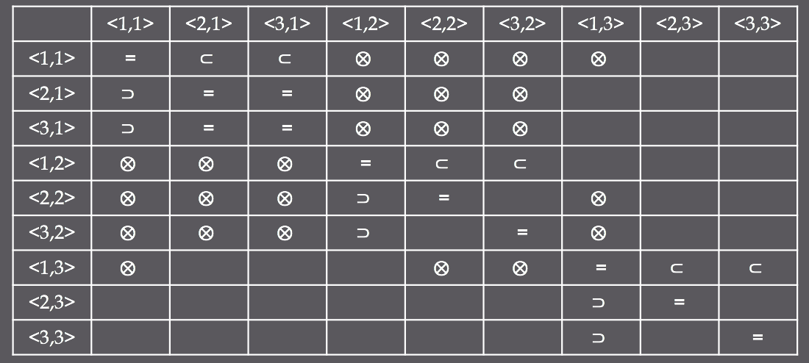

Slide 46
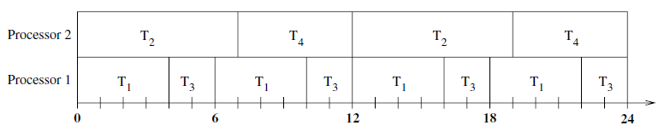
Task System F Schedulability Derivations
F: T₁ = (4,6), T₂ = (7,12), T₃ = (4,12), T₄=(10,24), M=2
We can show that F is solvable by the class of (1,2)-restricted scheduling algorithms (Static Priority with Job-Restricted Migration)
This implies that F is also solvable by the class of (2,2) and (3,2) restricted scheduling algorithms.
Order the tasks with highest-lowest priority as T1,T2,T3,T4. T3 does not preempt T4 at time [7,10) despite it having higher priority because jobs can not migrate once they’ve started!

Slide 47
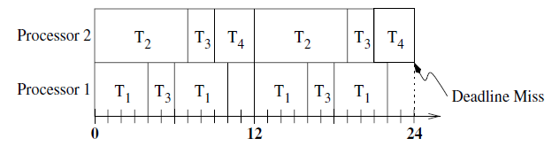
Task System F Schedulability Derivations
F: T₁ = (4,6), T₂ = (7,12), T₃ = (4,12), T₄=(10,24), M=2
We can show that F is not schedulable by (1,3)-restricted algorithms. (Static Priority with Full Migration)
There are 24 different possible priority assignments which must be enumerated. Lets just go through one with the same ordered priority (highest-lowest) of T1,T2,T3,T4.
See how T1 and T2 have small periods relative to T4. Because they also have higher priority, they constantly preempt T4 causing it to miss its deadline!

Slide 48
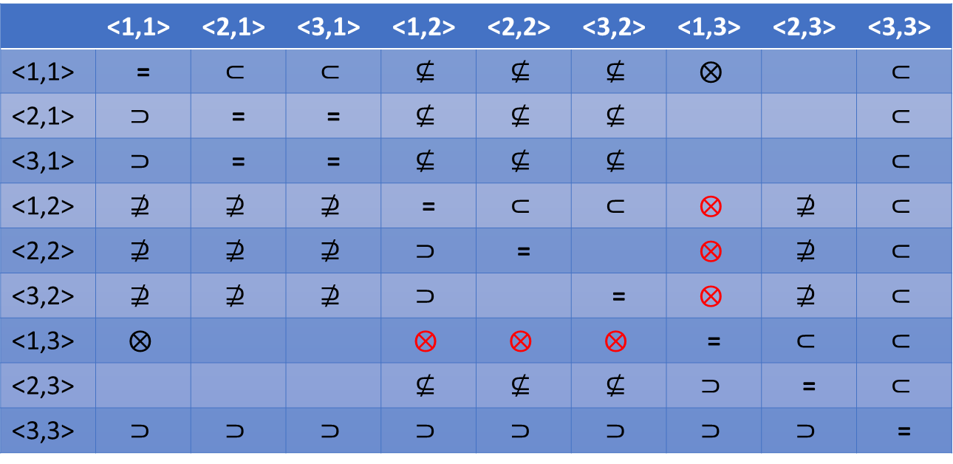
Task System F Schedulability Derivations
F: T₁ = (4,6), T₂ = (7,12), T₃ = (4,12), T₄=(10,24), M=2
With Task System F, we have demonstrated a system that can be scheduled by <1,2>,<2,2>, and <3,2> restricted algorithms but not <1,3>-restricted algorithms. Thus we have the following relationship.
 | <1,1> | <2,1> | <3,1> | <1,2> | <2,2> | <3,2> | <1,3> | <2,3> | <3,3>
<1,1> | =
<2,1> |  | = | =
<3,1> |  | = | =
<1,2> |  |  |  | =
<2,2> |  |  |  |  | =
<3,2> |  |  |  |  |  | =
<1,3> |  |  |  |  |  |  | =
<2,3> |  |  |  |  |  |  |  | =
<3,3> |  |  |  |  |  |  |  |  | =

Slide 49
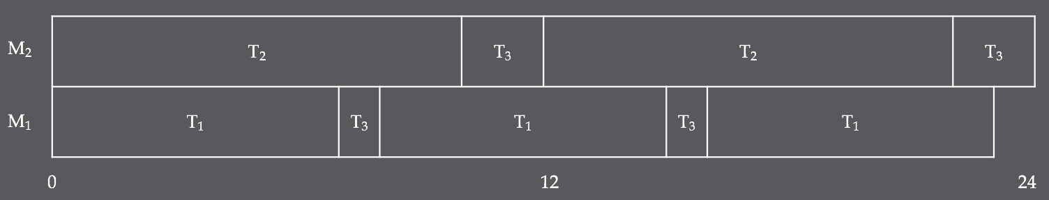

G: | T₁ = (7, 8); T₂ = (10, 12); T₃ = (6, 24); M = 2
$G ∈ <1, 3>$
Static priority, Full migration
By Theorem 30.1, also $G ∈ <2, 3>$ and $G ∈ <3, 3>$
Let priority be T₁, T₂, T₃ (highest to lowest)
Lemma 30.14

Slide 50
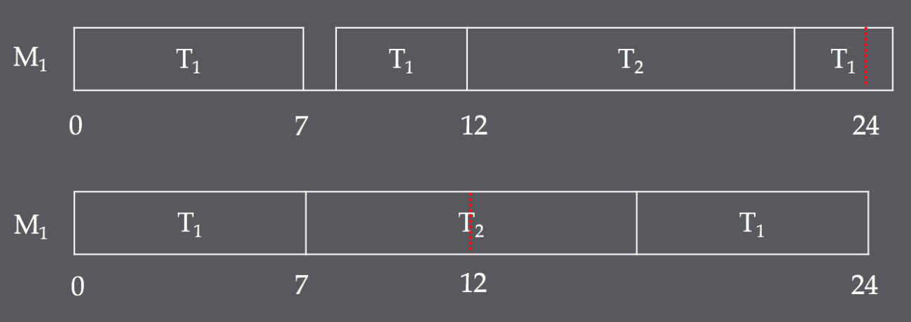

G: | T₁ = (7, 8); T₂ = (10, 12); T₃ = (6, 24); M = 2
$G ∉ <3, 2>$
Unrestricted dynamic priority, restricted migration
Also $G ∉ <2, 2>$ and $G ∉ <1, 2>$
The LCM of this system is 24
G releases 6 jobs in [0, 24) with execution times 7, 7, 7, 10, 10, 6
Since jobs cannot migrate, the execution times of the jobs must be partitioned among the 2 processors so that each group does not exceed 24
Must be 7,7,10 and 6,7,10; only need to consider 7,7,10 to see that it is unschedulable
Deadline miss
Lemma 30.15

Slide 51
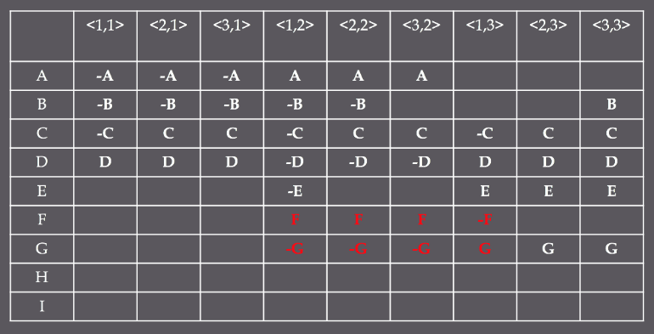
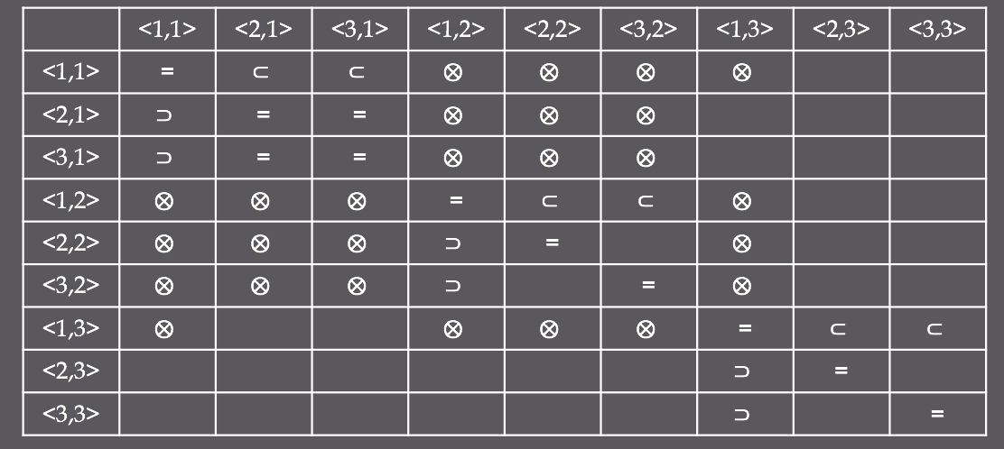

Slide 52
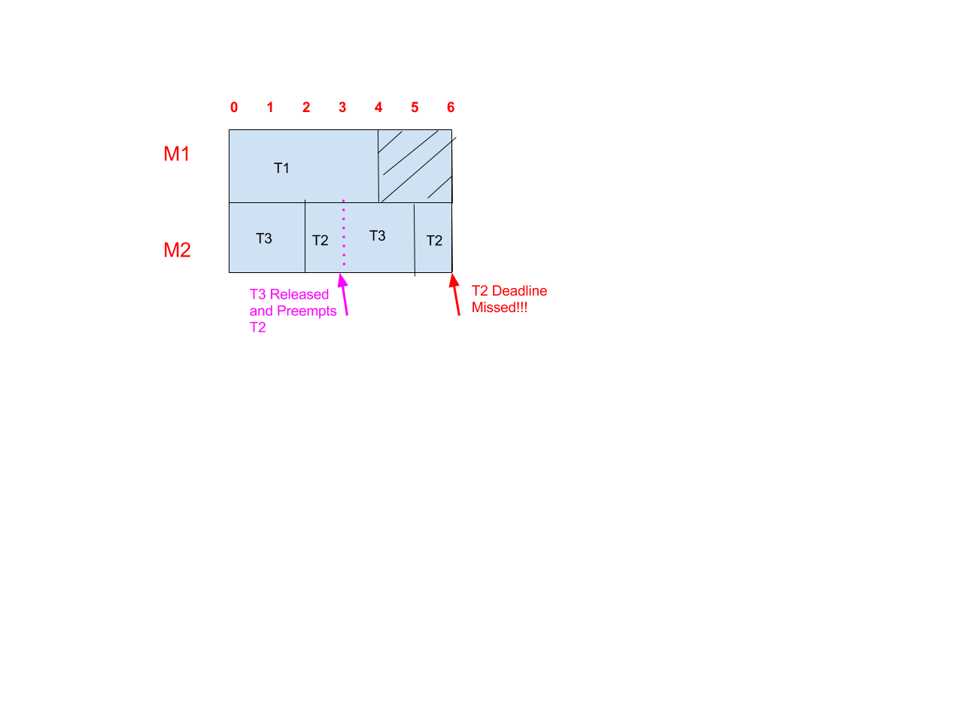
Task System F Schedulability Derivations
H: T₁ = (4,6), T₂ = (4,6), T₃ = (2,3); M=2
We can show that H is not schedulable by (3,1)-restricted algorithms. (Unrestricted-Dynamic Priority with No Migration [partition])
This also proves that H is not schedulable by (2,1) or (1,1) restricted algorithms.
Easy to Prove – No matter what you do, you cannot partition these 3 tasks between 2 processors and still meet their deadlines!

Slide 53
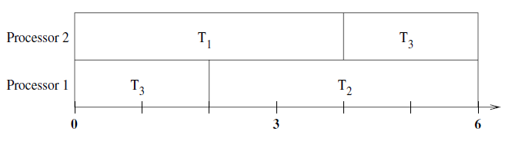
Task System F Schedulability Derivations
H: T₁ = (4,6), T₂ = (4,6), T₃ = (2,3); M=2
We can also show that H is schedulable by (3,2) and (2,3)-restricted algorithms. (Unrestricted-Dynamic Priority with Restricted Migration and Job-level-Dynamic Priority with Full Migration)
This ends up with the same resulting schedule for both types of algorithms!
With (3,2)-restricted constraints, T3 has higher priority but cannot preempt T2 once it starts so it migrates to the next processor when T1 finishes.
With (2,3)-restricted constraints, the priority of T3 changes each time it executes the job. The priority is as follows T1, T3’s 1st Job, T2, T3s Second Job…this repeats for subsequent period blocks.

Slide 54
Task System F Schedulability Derivations
H: T₁ = (4,6), T₂ = (4,6), T₃ = (2,3); M=2
With Task System H, we have demonstrated a system that can be scheduled by <3,2> and <2,3> restricted algorithms but not <3,1>, <2,1> or <1,1>-restricted algorithms. We will show the relationship chart after the final proofs.

Slide 55

I: | T₁ = (2, 3); T₂ = (3, 4); T₃ = (5, 15); T₄ = (5, 20); M = 2
$I ∉ <2, 3>$
Job-level dynamic priority, full migration
Nine jobs (3, 3, 3, 3, 4, 4, 4, 5, 5) are released in the interval [0, 12), which means there are 9! possible priority arrangements in that interval, all of which cause a deadline miss or underutilize the time and will cause a future deadline miss
Lemma 30.18

Slide 56
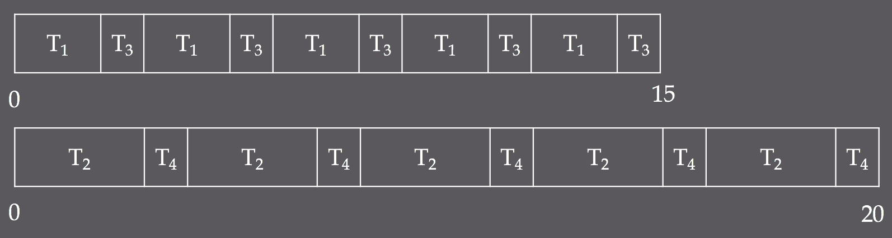

I: | T₁ = (2, 3); T₂ = (3, 4); T₃ = (5, 15); T₄ = (5, 20); M = 2
$I ∈ <1, 1>$
Static priority, no migration
By Theorem 30.1, also $I ∈ <2, 1>$ and $I ∈ <3, 1>$
Let the tasks be partitioned into {T₁, T₃} and {T₂, T₄}, with the higher priority given to the first tasks in each set
Lemma 30.18

Slide 57

I: | T₁ = (2, 3); T₂ = (3, 4); T₃ = (5, 15); T₄ = (5, 20); M = 2
$I ∈ <3, 2>$
Unrestricted dynamic priority, restricted migration
This can be scheduled exactly as the previous schedule by simply setting the highest priority to the appropriate job at each time interval – only the first 2 matter for this
[0, 2) → {T₁, T₂}; [2, 3) → {T₂, T₃}; [3, 4) → {T₄, T₁}, etc
M₂
M₁
Lemma 30.18

Slide 58
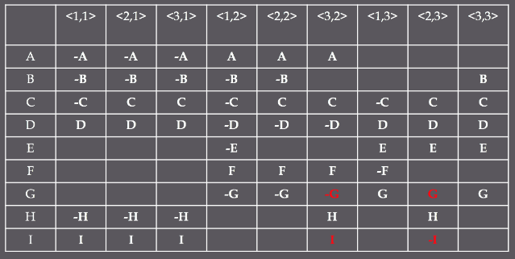
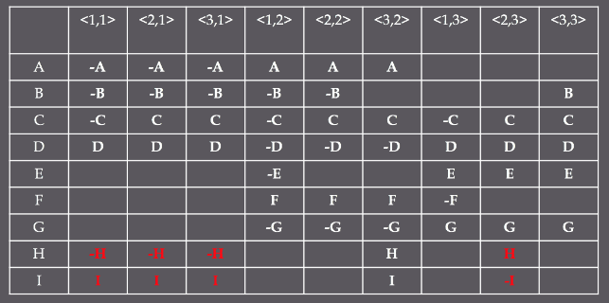
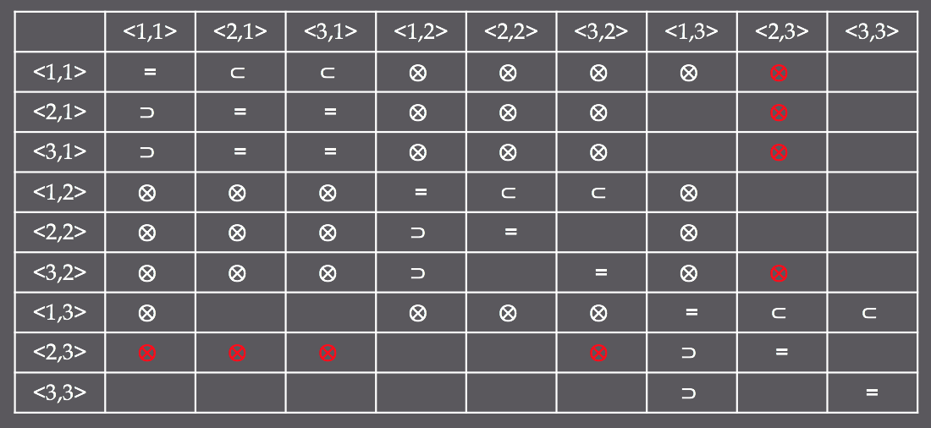

Slide 59
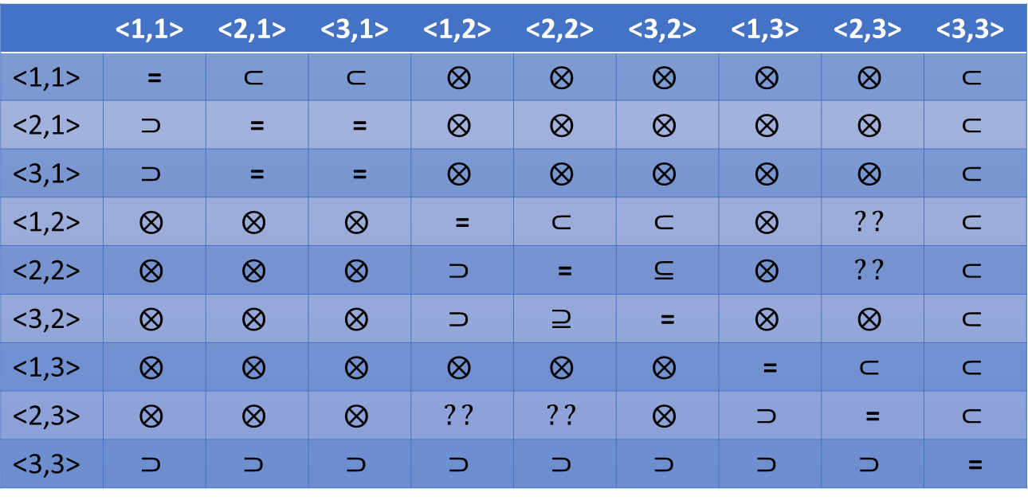
Relationships Among the Various Classes
By going through all these task systems, we have proven the following schedulability relationships.
There are still some relationships that are open
 | <1,1> | <2,1> | <3,1> | <1,2> | <2,2> | <3,2> | <1,3> | <2,3> | <3,3>
<1,1> | =
<2,1> |  | = | =
<3,1> |  | = | =
<1,2> |  |  |  | =
<2,2> |  |  |  |  | =
<3,2> |  |  |  |  |  | =
<1,3> |  |  |  |  |  |  | =
<2,3> |  |  |  |  |  |  |  | =
<3,3> |  |  |  |  |  |  |  |  | =

Slide 60


Real-Time Scheduling Kung-Fu
Tasks (Task System)
Proportionate-fair
Scheduling Algorithm
(3-2)-Restricted
Multi
Processor

Slide 61
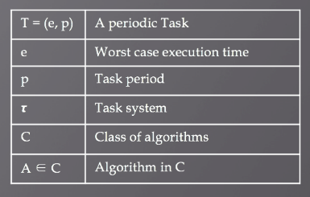


Conclusion
Task system model
Traditional scheduling for real time periodic task systems
3 x 3 Priority-Migration classification
Schedulability relationships
Utilization Bounds based on Feasibility
Global priority, partitioning

Slide 62
References
Carpenter, John, Shelby Funk, Philip Holman Anand Srinivasan, James Anderson, and Sanjoy Baruah. "A Categorization of Real-Time Multiprocessor Scheduling Problems and Algorithms." CRC Press, LLC. University of North Carolina at Chapel Hill, 2004. Web.
D.O.T, U.S, Joseph Leung, and Hairong Zhao. "Real-Time Scheduling Analysis." Office of Aviation Research and Developmen (n.d.): 227-43. DOT FAA. Federal Aviation Administration, Nov. 2005. Web. May 1017.
Leung, Joseph Y-T. Handbook of Scheduling: Algorithms, Models, and Performance Analysis. Boca Raton, Fla.: Chapman & Hall/CRC, 2004. Print.

Slide 63
Questions

