Slide 1
Salvage Value System
Shri Shankaracharya Institute of Professional Management & Technology, Raipur
Minor Project Report on
CSE 7th Semester
Department of Computer Science and Engineering,
Batch 2018-2022
Session July – Dec 2021
Presentation Date:
Project Guide
Prof. Anand Tamrakar
(Assistant Professor, CSE)
Project Group Members:
Ayushi Sharma -303302218006
Piyush Singhania-303302218017
Devansh Khandelwal- 303302218020

Slide 2
INDEX:
1. Project Overview
2.Application Area
3.Project Requirements (Developer)
4. Project Requirements (End-user)
5. Front end Details
6.Database Details
7.Back-end Details
8.Project Flow Diagram
9.Data Flow Diagram
10.Result and Conclusion
11. References

Slide 3
Project Overview
According to the Vehicle Scrappage Policy 2021, heavy commercial vehicles older than 15 years will be phased out from April 1, 2023, whereas personal vehicles older than 20 years will be phased out from June 1, 2024.
Noting that the number of vehicles older than 15 years will reach over ₹2.1 crores in India.
There could be one more economic alternative that is fragmentation and recycling of scrap vehicle. With this idea, we would be proceeding with our project named Salvage Value System.
After an overall evaluation of the vehicle, a fair report will be provided and the value of vehicle would be on the basis of fragmented evaluation not as a scrap which will be higher than the value provided by scrapping the vehicle.

Slide 4
Application Area
Why did you opt to work on this project?
Unlike the vehicle scrappage policy our project will not only scrap the vehicle but also make reuse various parts thereby giving more value to the customer.
What are the Applications and Benefits of this project?
This Project will give the owner of the vehicle a fair value for his car and it will have a additional advantage of being environmentally sustainable by getting the old polluting cars off the roads.
Who are the End Users of this project?
Anyone who wants to scrap his old vehicle.

Slide 5
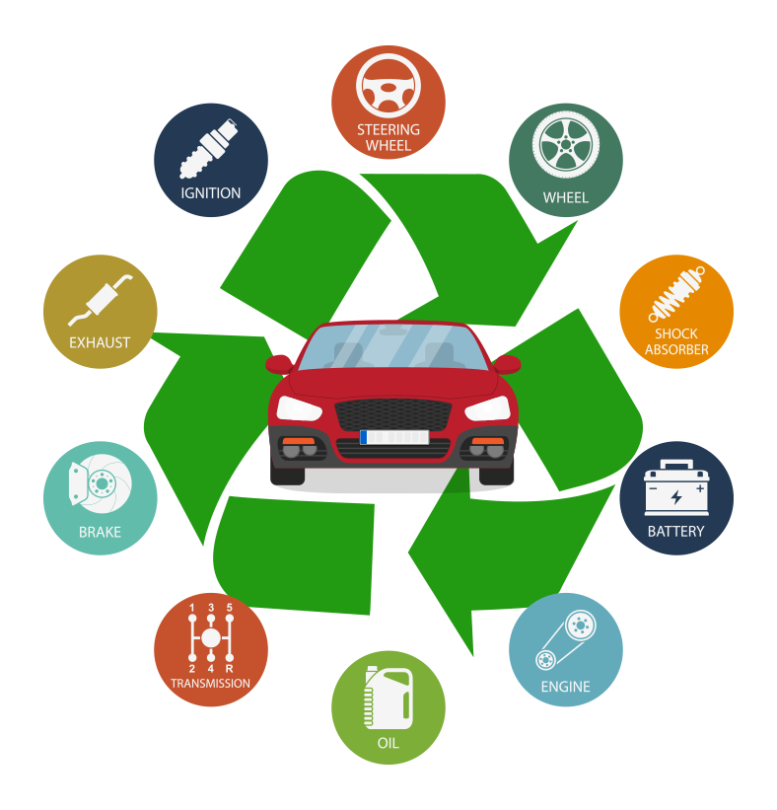

Slide 6
Project Requirements (Developer)
Software’s Required :
Operating systems: Windows*7 or later, Linux
Compatible tools: XAMPP 1.7.3.2
Front-end: HTML, CSS, Bootstrap
Server: PHP, MySQL
Hardware Required:
Processors: Ryzen 5 or Intel 3 or above versions
Disk Space: 1 GB
Processor Speed: 2.0 GHz

Slide 7
Project Requirements (End User)
Software’s Required (With Versions duly mentioned)
- Active Internet Connection
- Web browser
Hardware Required:
Android , iPhone or Laptop

Slide 8
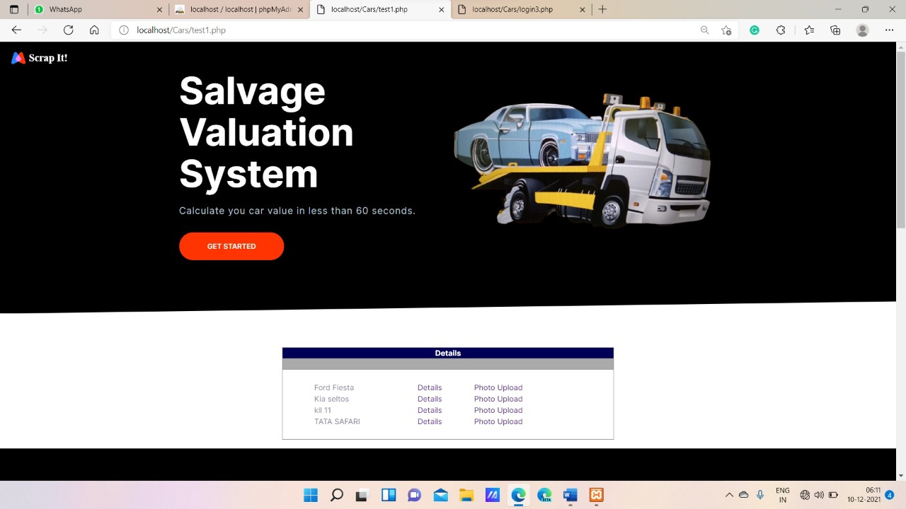
Front End Details

Slide 9
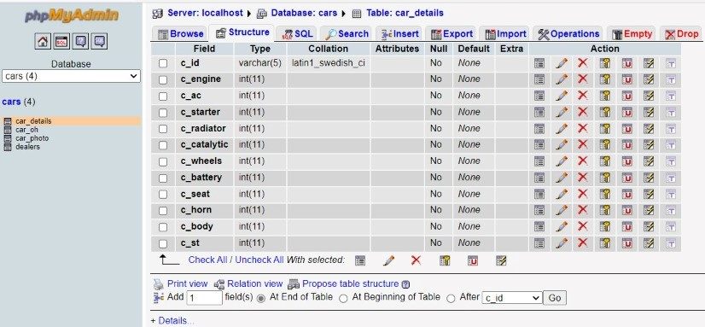
Database Details
Database Name, Structure and Attributes Required:
MySQL
Tables Name, Structure and Attributes Required:

Slide 10
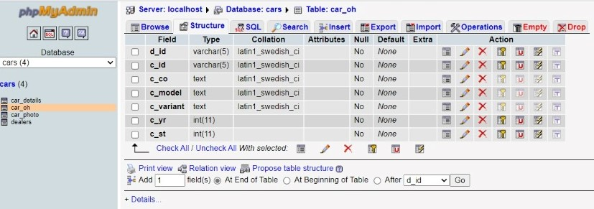
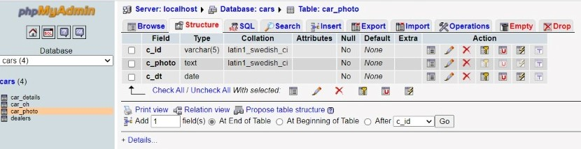

Slide 11
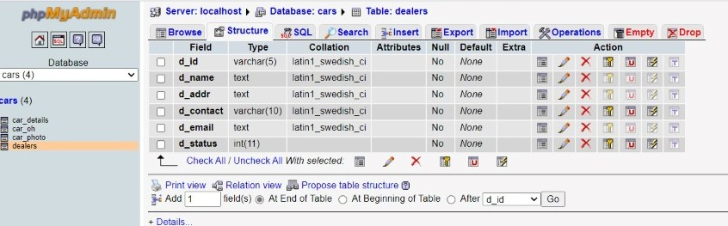
Back End Details
What Back End your project is using?
PHP
How Many Databases?
ONE
How Many Tables?
FOUR

Slide 12
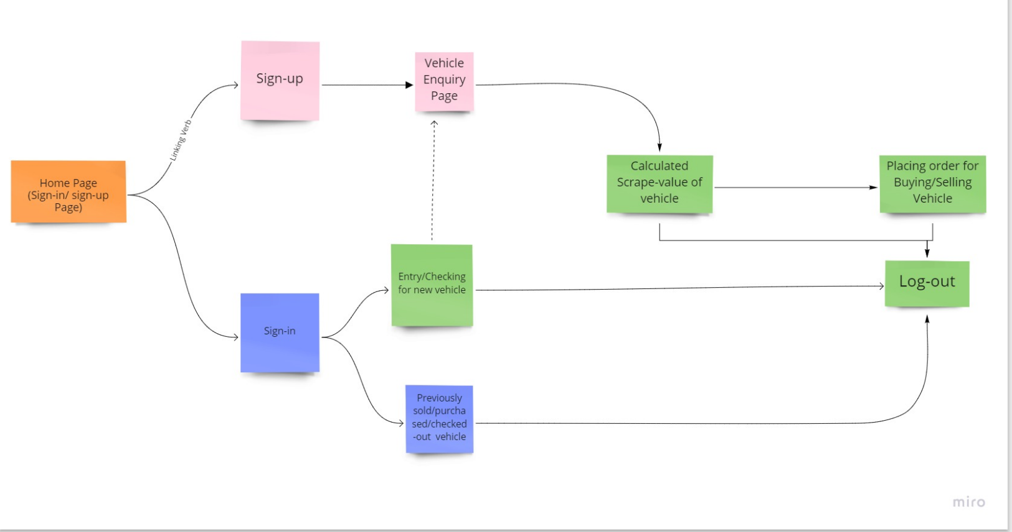
Project Flow Diagram

Slide 13
Data Flow Diagram
Registration/Login
Vehicle Registration
Home-Page
Vehicle Details
[Database]
Evaluated Result
Image Upload

Slide 14
Result & Conclusion
Shows your Project outcomes:
Any one may sell his vehicle at relatively higher price than market by individual part evaluation.
How this Project is going to help your Institute or Society or any specific group of people?
Fair value evaluation to the customer.
Recycling and Reuse of old non-reusable vehicles.
Digital and quick comparison of price for customer.

Slide 15
References
Web Resources
http://www.stackoverflow.com
https://developer.android.com/guide
https://medium.com/
https://www.javatpoint.com/
https://developer.mozilla.org/en-US/
https://en.wikipedia.org/
https://www.geeksforgeeks.org/
THANK YOU !!

