Slide 1
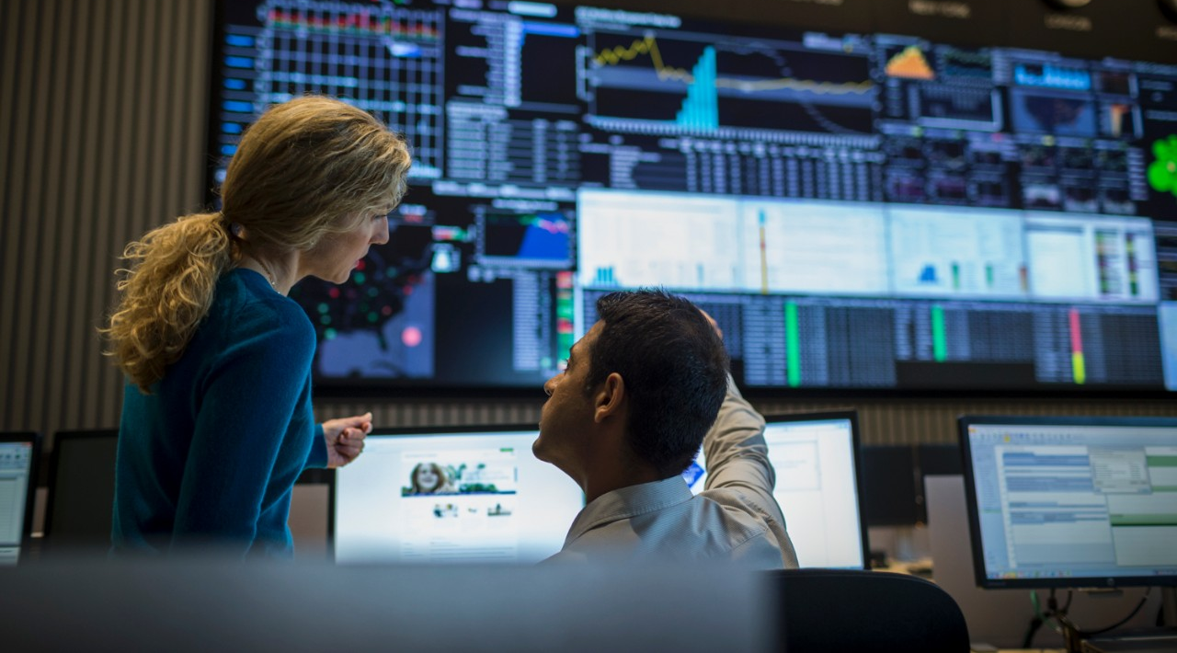
Optum Overview
Speaker/Date
Data science from the trenches
Pietro Mascolo | 13.02.2018
Notes:
Greetings and thanks.
Thank s to Optum and team for letting me do this. Thanks for having been invited.

Slide 2
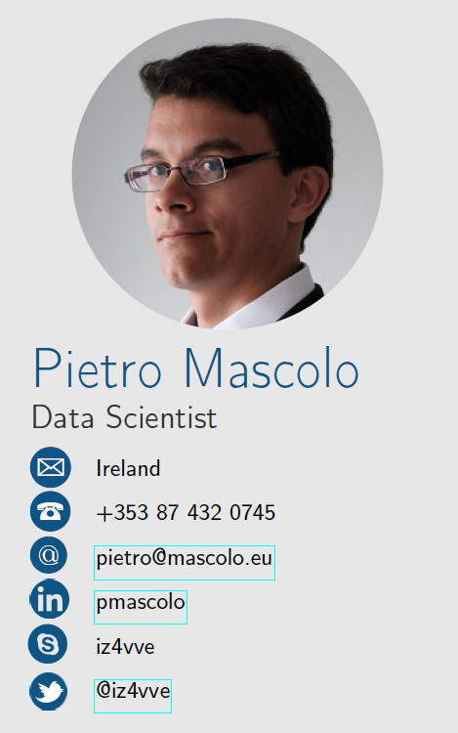





About me – Who I am
Who I am and why I am here…
Physicist, Data Scientist, Python Enthusiast, Kotlin/Scala practitioner, Golang padawan, Ham Radio Operator (EI/IZ4VVE), Hiker, Karateka and Amateur Photographer…
I have been a data professional in a few different places ☺
UNIMORE
Energee3 srl
Intel Labs Europe
Optum / UnitedHealth Group
Notes:
45 s.
Generic Introduction.
Personal experience, examples of projects (Energy load forecasting, Traffic analysis and prediction, causal inference in data centres, ….)

Slide 3




OPTUM - Our mission
Ranked 6th of the Fortune 500
~$200B FY17E revenue
A diversified enterprise with complementary but distinct business platforms
Health Benefits
Health Services
OUR MISSION
Helping people live healthier lives and helping make the health system work better for everyone
OUR VALUES
Integrity | Compassion | Relationships | Innovation | Performance
© 2017 Optum, Inc. All rights reserved. As of Q3, 2017.
Notes:
45 s.
UHG’s core business is health insurance (~100M customers in US)
Optum is driving tech and innovation for UHG.
270K employees globally (2018)
200Bn USD revenue 2017
6th Fortune 500

Slide 4
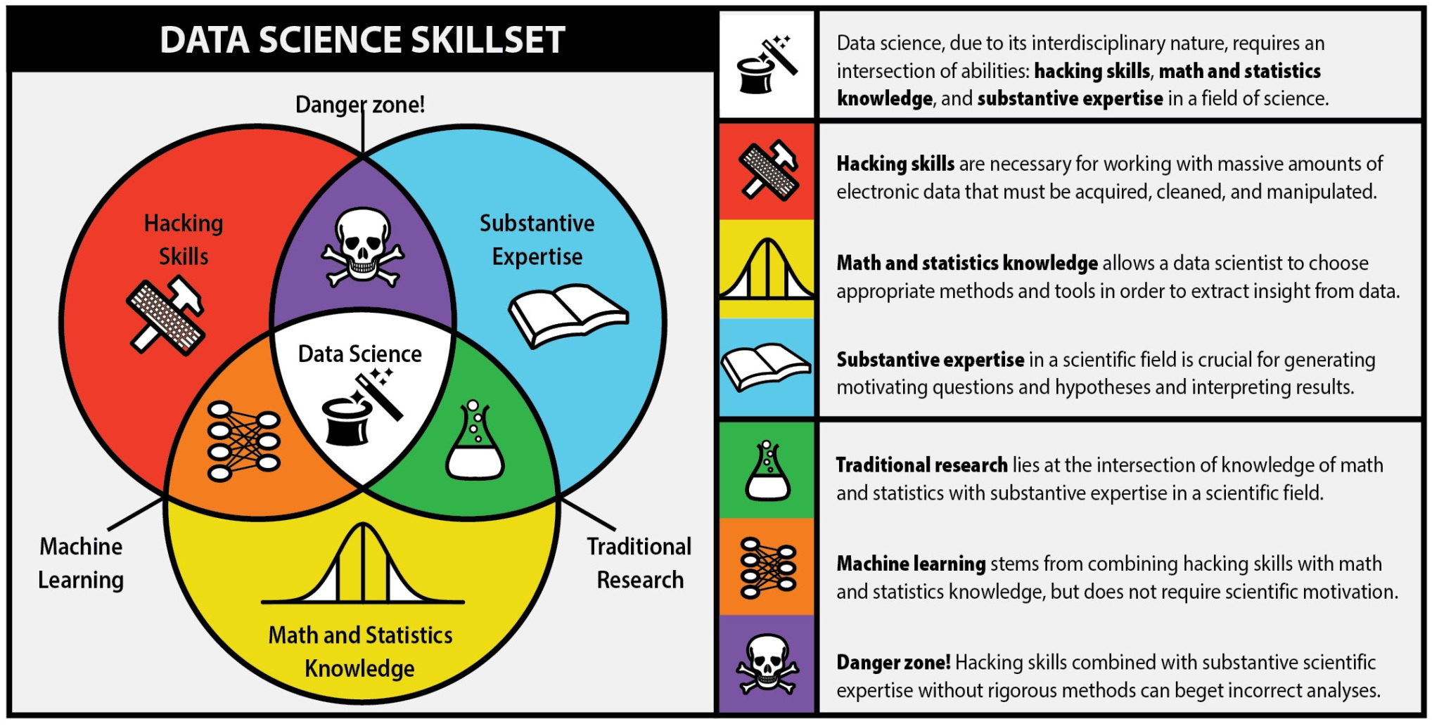
What is Data Science?
Programming
Domain expertise
Maths and statistics
Notes:
2 Min Data science is multidisciplinary.
You have probably seen this before…
Skills needed by data scientists:
Maths, statistics, modeling, experimental design, Bayesian analysis, ML, Optimization, Software development, CS,
Scripting, databases (SQL + NoSQL), Linear Algebra, M/R, Big Data tools, AWS, Business acumen, strategy, product management,
Problem solving, communication with stakeholders, senior management interface, Visualization, Story telling

Slide 5

Danger!
Programming
Domain
Maths and statistics
Notes:
2 Min Data science is multidisciplinary.
You have probably seen this before…
Dangers of improvising without statistics and maths and formalism

Slide 6
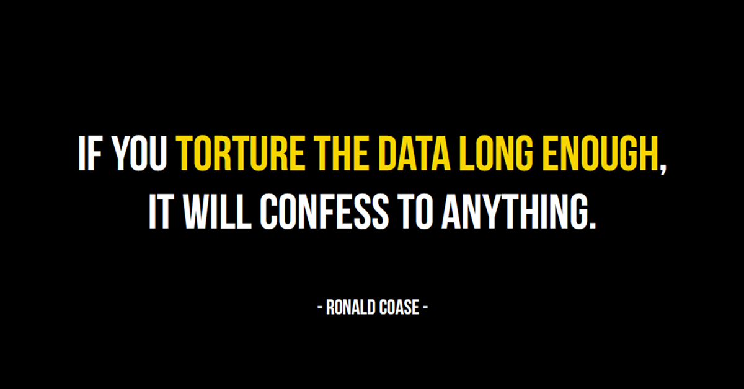
Data Scientists – You have to be prepared
Notes:
Ronald Coase: Nobel for Science of Economy in 1991. Known for eponymous theorem on property rights.

Slide 7
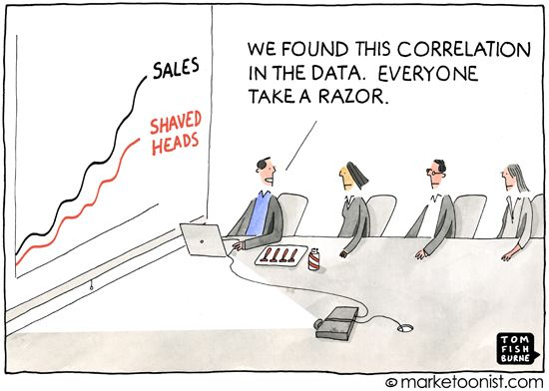
Data Scientists - Pitfalls
If you don’t have solid basics, causing damage is really easy!
Notes:
False positive paradox
Simpson’s paradox
Meaningful metrics (accuracy and error types)
Accuracy vs. predictive power
Correlation vs. Causality
False positive paradox:
HIV probability IF tested positive (low incidence population):
1000 tests, 2% infected, FPR 5% (95% accuracy) → 1000 * 0.02 = 20 TP, 1000 * (100 - 2) / 100 * 0.05 = 49 FP
Prob of positive if tested positive = 20 / (20 + 49) = 29%
Simpson’s paradox: a trend appearing in different groups might change when groups are combined.
99% results on 95% requirements: Naïve model.

Slide 8

Data Scientists – Cui bono?
Yeah, sure… But what can they do?
Notes:
OK, now we know that they act in a team and that you should know your stuff before doing anything, but…

Slide 9
Data Scientists – What (some examples…)
Business | Goal | Some big examples
Entertainment / Social | Recommend products / contacts | Amazon, Netflix, Facebook, Linkedin
Search Engine Ranking | Rank elements | Google Pagerank
Banking / insurance | Fraud detection | UHG ☺, any bank…
Banking | Loan application adjudication | Most banks
Insurance | Auto-adjudication | UHG ☺
Media companies / data centres | Machine translation | Facebook, Google
Sport teams | Reduce risk of injuries | NFL, NBA, …
ANY company | Data driven decision-making | Google, Amazon, Facebook, Tesla, Apple
Sky is the limit…
Notes:
Some examples at big scale. Most companies would benefit from some data science!

Slide 10
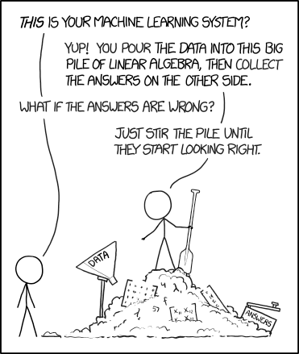
Data Scientists – What (some experiences…)
XKCD 1838: Machine Learning
Notes:
Some projects I worked on in the past 3 years

Slide 11
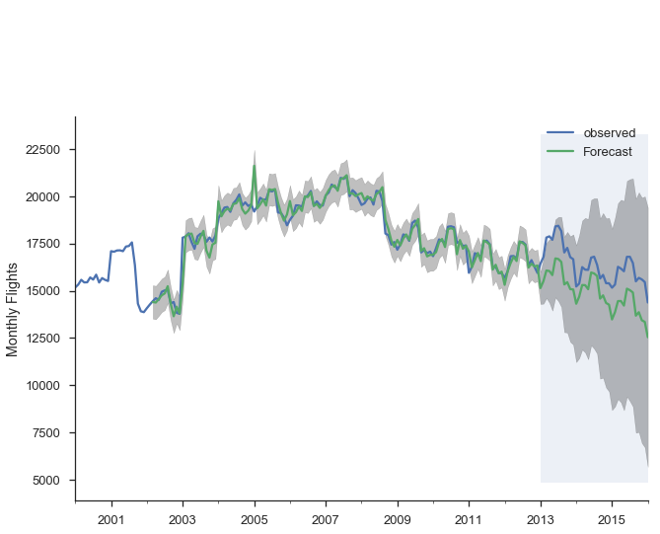
Some real world examples I worked on - Energy
The ones I can tell you, anyway ☺
Energy load forecasting for Energy Suppliers
Forecasted and observed values (sorry I had to hide the axes labels…)
Notes:
MAIN FOCUS HERE!!!
Energy load forecasting
Workload interaction assessment in data centres
Anomaly detection in server behaviour
Intelligent agents in data centres (preventive maintenance, near-real-time corrective actions)
Call centre optimization (optimizer engine and feature extraction, repeat callers, auth rate, IVR optimization, Population segmentation)
Early diagnosis suggestions

Slide 12
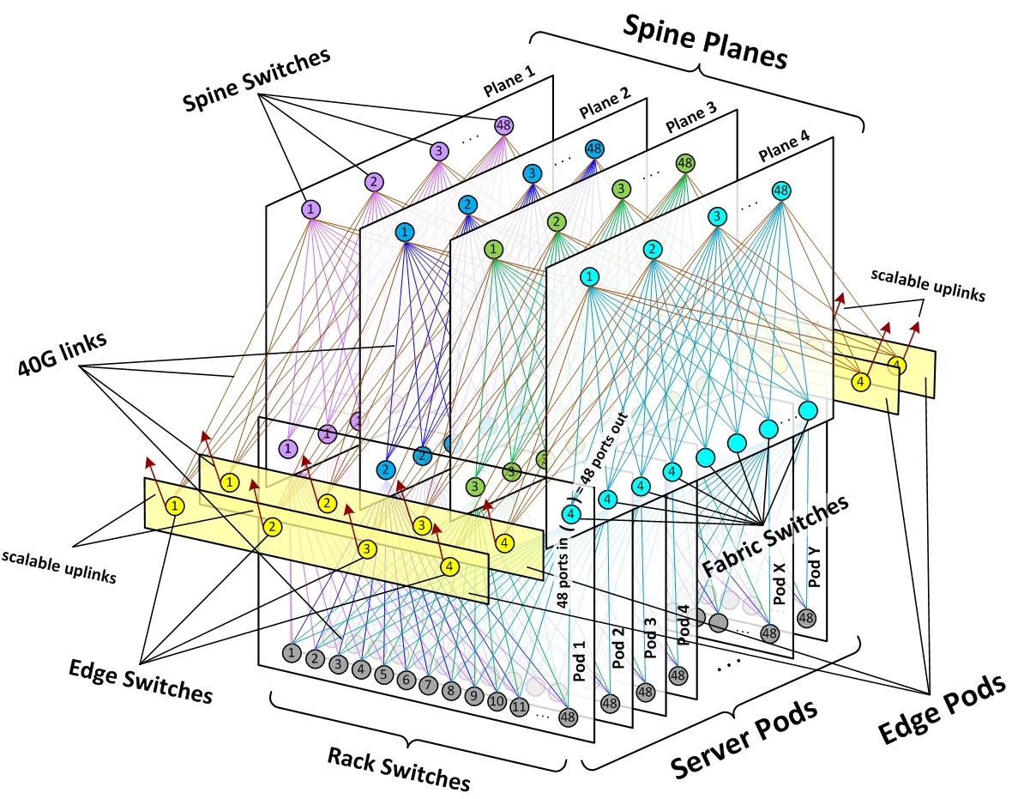
Some real world examples I worked on – DC WL
The ones I can tell you, anyway ☺
Workload interaction analysis in data centres
Components interaction in a Server cluster (schema)
Notes:
MAIN FOCUS HERE!!!
Energy load forecasting
Workload interaction assessment in data centres
Anomaly detection in server behaviour
Intelligent agents in data centres (preventive maintenance, near-real-time corrective actions)
Call centre optimization (optimizer engine and feature extraction, repeat callers, auth rate, IVR optimization, Population segmentation)
Early diagnosis suggestions

Slide 13
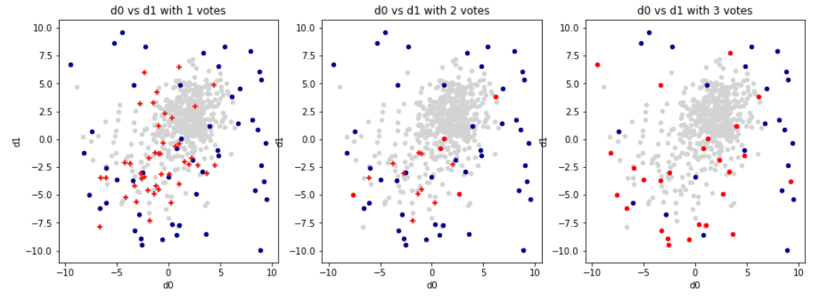
Some real world examples I worked on - Anomalies
The ones I can tell you, anyway ☺
Anomaly detection in server behaviour
Problem: What is an anomaly?
How do you define it in a simple and unambiguous way?
Notes:
MAIN FOCUS HERE!!!
Energy load forecasting
Workload interaction assessment in data centres
Anomaly detection in server behaviour
Intelligent agents in data centres (preventive maintenance, near-real-time corrective actions)
Call centre optimization (optimizer engine and feature extraction, repeat callers, auth rate, IVR optimization, Population segmentation)
Early diagnosis suggestions

Slide 14
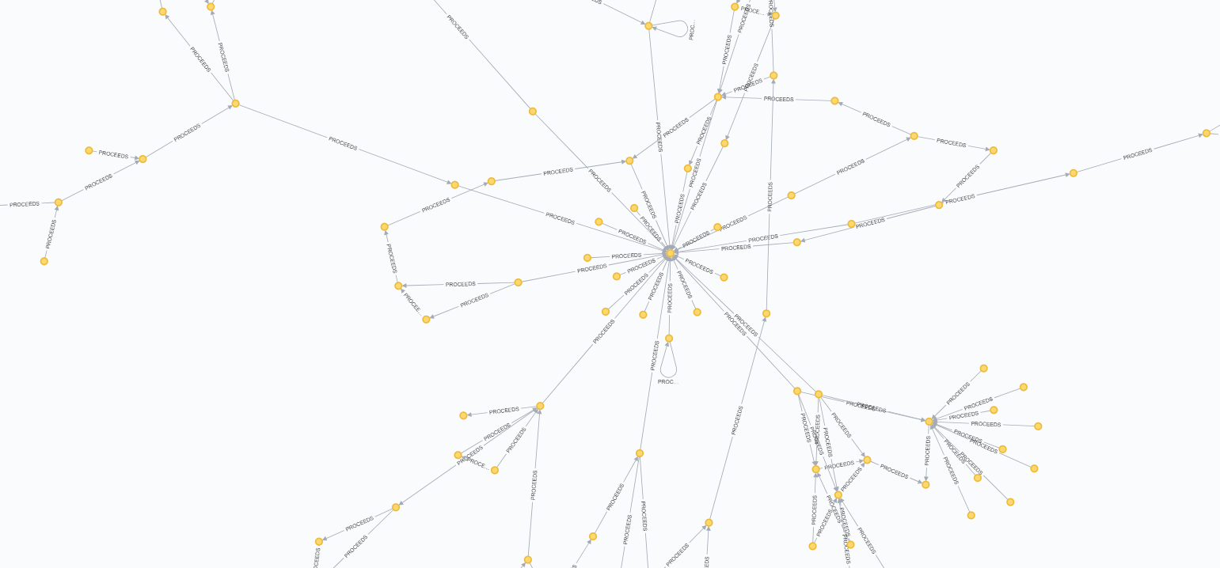

Some real world examples I worked on - Calls
The ones I can tell you, anyway ☺
Repeat calls, auth rate, system optimisation
Virtual assistance
Assist operations by keeping track of important items
Determine ways to optimise the system
Notes:
MAIN FOCUS HERE!!!
Energy load forecasting - +1% accuracy means M$ saved per year
Workload interaction assessment in data centres – Optimal first placement can reduce energy use and faults significantly
Anomaly detection in server behaviour - reduce faults
Intelligent agents in data centres (preventive maintenance, near-real-time corrective actions) - automated near-real-time response
Call centre optimization (optimizer engine and feature extraction, repeat callers, auth rate, IVR optimization, Population segmentation) – better NPS, faster response time, more calls handled, reduced risk of misundertanding, suggestion of questions to ask
Early diagnosis suggestions

Slide 15
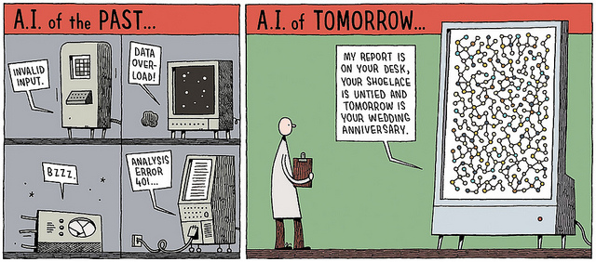
Conclusions
It’s a Brave New World!
Notes:
Data Science is about finding value and opportunities (even unknowns)
Data Science is a team sport
No one can just start dong data science: danger!
Data science has REAL VALUE!

Slide 16

Q/A

Slide 17
Thanks for your attention!
pietro_mascolo@optum.com
Slides: http://bit.ly/2EkHtHP

Slide 20
What is Data Science?
The Data Science process involves many different disciplines and goes through many delicate steps…
You should really know what you’re doing before touching anything…
Notes:
2 Min Data science is multidisciplinary.
Skills needed by data scientists:
LOTS of different skills. One cannot hope to know them all: TEAMS!!!
Maths, statistics, modeling, experimental design, Bayesian analysis, ML, Optimization, Software development, CS,
Scripting, databases (SQL + NoSQL), Linear Algebra, M/R, Big Data tools, AWS, Business acumen, strategy, product management,
Problem solving, communication with stakeholders, senior management interface, Visualization, Story telling

Slide 21
Backup

Slide 22
What is Data Science?
ASK a question
What is the goal?
GET the data
What data are needed?
EXPLORE the data
Are there anomalies?
MODEL the data
Build a model.
Fit the model.
VALIDATE THE MODEL!
COMMUNICATE results
What did we learn?
What would you do if you had all the data?
WHAT IS THE BUSINESS GOAL?
Which are relevant?
Are there privacy/usage issues?
Are there patterns?
Are all elements interesting?
Do we need additional/different data?
Do the results make sense?
What is the business impact?
Notes:
1 min.
Initial description by how it works. This is what DS does!
Research questions: you need to set a course before you set out.
Just a generic description on methodologies.

Slide 23

What is Data Science?
Notes:
10 s.
The process looks easy…

Slide 24
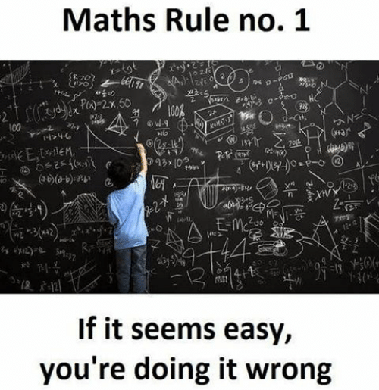
What is Data Science?
Notes:
20 s.
If you don’t use rigorous techniques and evaluation, you risk missing the mark completely.
We’ll see some examples later in the presentation.

Slide 25

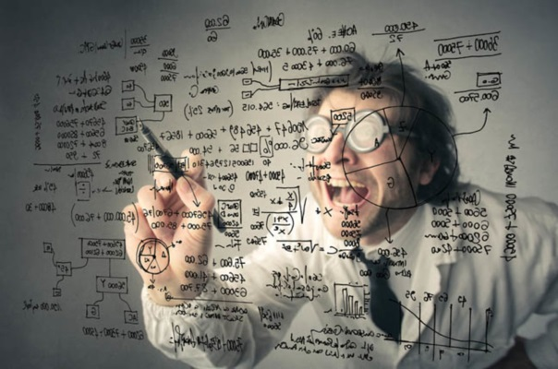
Data Science or Data Analytics?
Data analyst
Data scientist
Skills:
Descriptive Modeling, Business Analysis,
Data Manipulation, Statistics
Focus:
Business Rules, Data Relationships, Data Attributes, Sources and Targets, Data quality
Skills:
Advanced Statistics, Programming, Data Management, Big Data, Machine Learning
Focus:
Predictive Modeling, Data Mining, Unstructured Data, Big Data, Research, Solving Business Problems, Identifying Business Opportunities
Notes:
2 min
Difference in focus

Slide 26
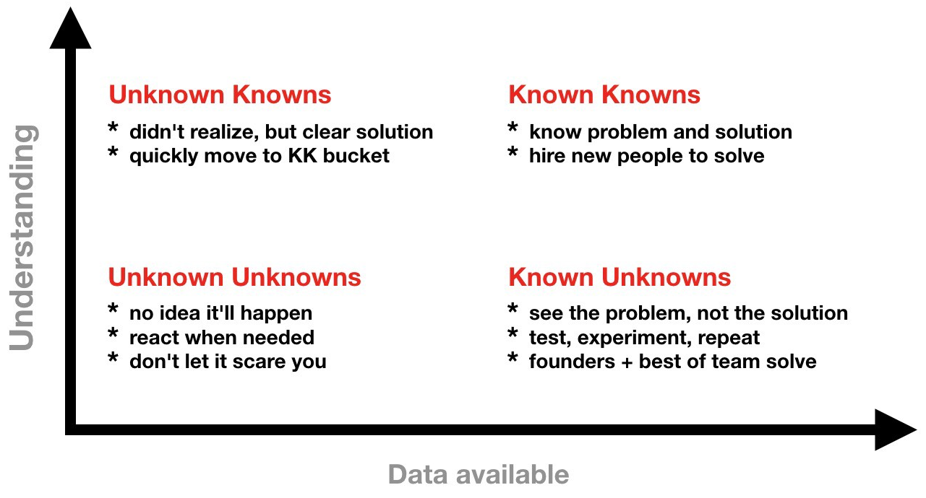
Data Science or Data Analytics?
Notes:
2 min
Difference in focus and environments:
Known knowns: simple/obvious
Easy to understand, simple cause/effect relationships, repeatable results, just follow the script
Known Unknowns: Complicated
Use good practices, get experts, multiple cause/effect relationship, fairly repeatable results, multiple solutions (need to find optimal)
Unknown Unknowns: Complex
Emergent practices, open large groups discussions. Cause/effect known only after the fact, not always repeatable (at that point in time), looking for patterns
DA -> known knowns
DS reaches out to other quadrants

Slide 27
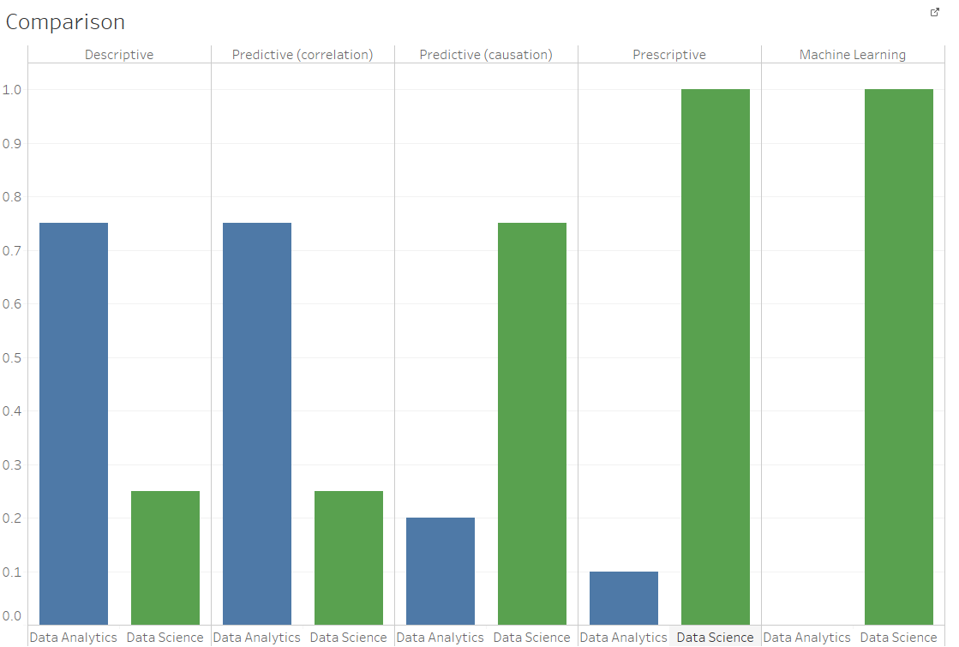
Data Science or Data Analytics?
Known knowns
Unknown knowns
Unknown unknowns
Notes:
1 min
Difference in focus

Slide 28
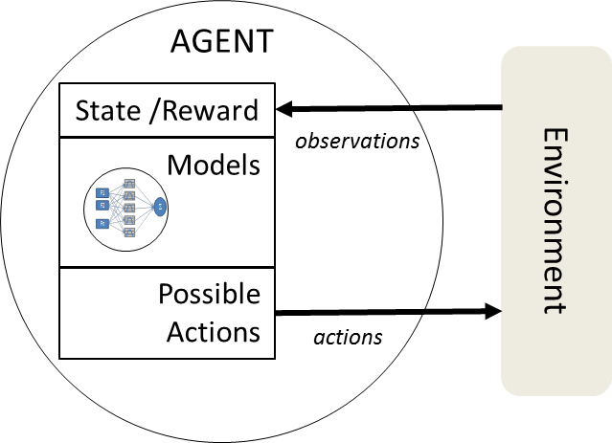
Some real world examples I worked on - IA
The ones I can tell you, anyway ☺
Intelligent agents in Data Centers
Automate complex tasks using intelligent cognitive agents
Notes:
MAIN FOCUS HERE!!!
Energy load forecasting
Workload interaction assessment in data centres
Anomaly detection in server behaviour
Intelligent agents in data centres (preventive maintenance, near-real-time corrective actions)
Call centre optimization (optimizer engine and feature extraction, repeat callers, auth rate, IVR optimization, Population segmentation)
Early diagnosis suggestions

Slide 29
Case studies

