Slide 1
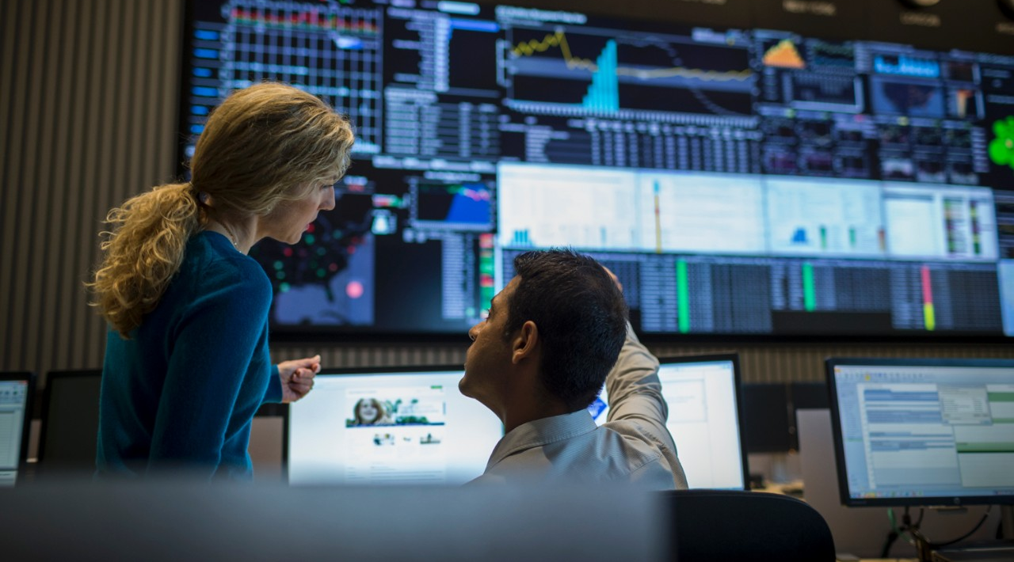
Optum Overview
Speaker/Date
Data science from the trenches
Pietro Mascolo | 13.02.2018

Slide 2





About me
Who I am and why I am here…
Physicist, Data Scientist, Python Enthusiast, Kotlin/Scala practitioner, Golang padawan, Ham Radio Operator, Hiker, Karateka and Amateur Photographer…
I have been a data professional in a few different places ☺
UNIMORE
Energee3 srl
Intel Labs Europe
Optum / UnitedHealth Group
I am here to show how you can harness the power of data!
Notes:
45 s.
Generic Introduction.
Personal experience, examples of projects (Energy load forecasting, Traffic analysis and prediction, causal inference in data centres, ….)

Slide 3




Our mission
Ranked 6th of the Fortune 500
~$200B FY17E revenue
A diversified enterprise with complementary but distinct business platforms
Health Benefits
Health Services
OUR MISSION
Helping people live healthier lives and helping make the health system work better for everyone
OUR VALUES
Integrity | Compassion | Relationships | Innovation | Performance
© 2017 Optum, Inc. All rights reserved. As of Q3, 2017.
Notes:
45 s.
250K employees globally
200Bn USD revenue 2017
6th Fortune 500

Slide 4
What is Data Science?
ASK a question
What is the goal?
GET the data
What data are needed?
EXPLORE the data
Are there anomalies?
MODEL the data
Build a model.
Fit the model.
VALIDATE THE MODEL!
COMMUNICATE results
What did we learn?
What would you do if you had all the data?
WHAT IS THE BUSINESS GOAL?
Which are relevant?
Are there privacy/usage issues?
Are there patterns?
Are all elements interesting?
Do we need additional/different data?
Do the results make sense?
What is the business impact?
Notes:
1 min.
Initial description by how it works. This is what DS does!
Research questions: you need to set a course before you set out.
Just a generic description on methodologies.

Slide 5

What is Data Science?
Notes:
10 s.
The process looks easy…

Slide 6

What is Data Science?
Notes:
20 s.
If you don’t use rigorous techniques and evaluation, you risk missing the mark completely.
We’ll see some examples later in the presentation.

Slide 7
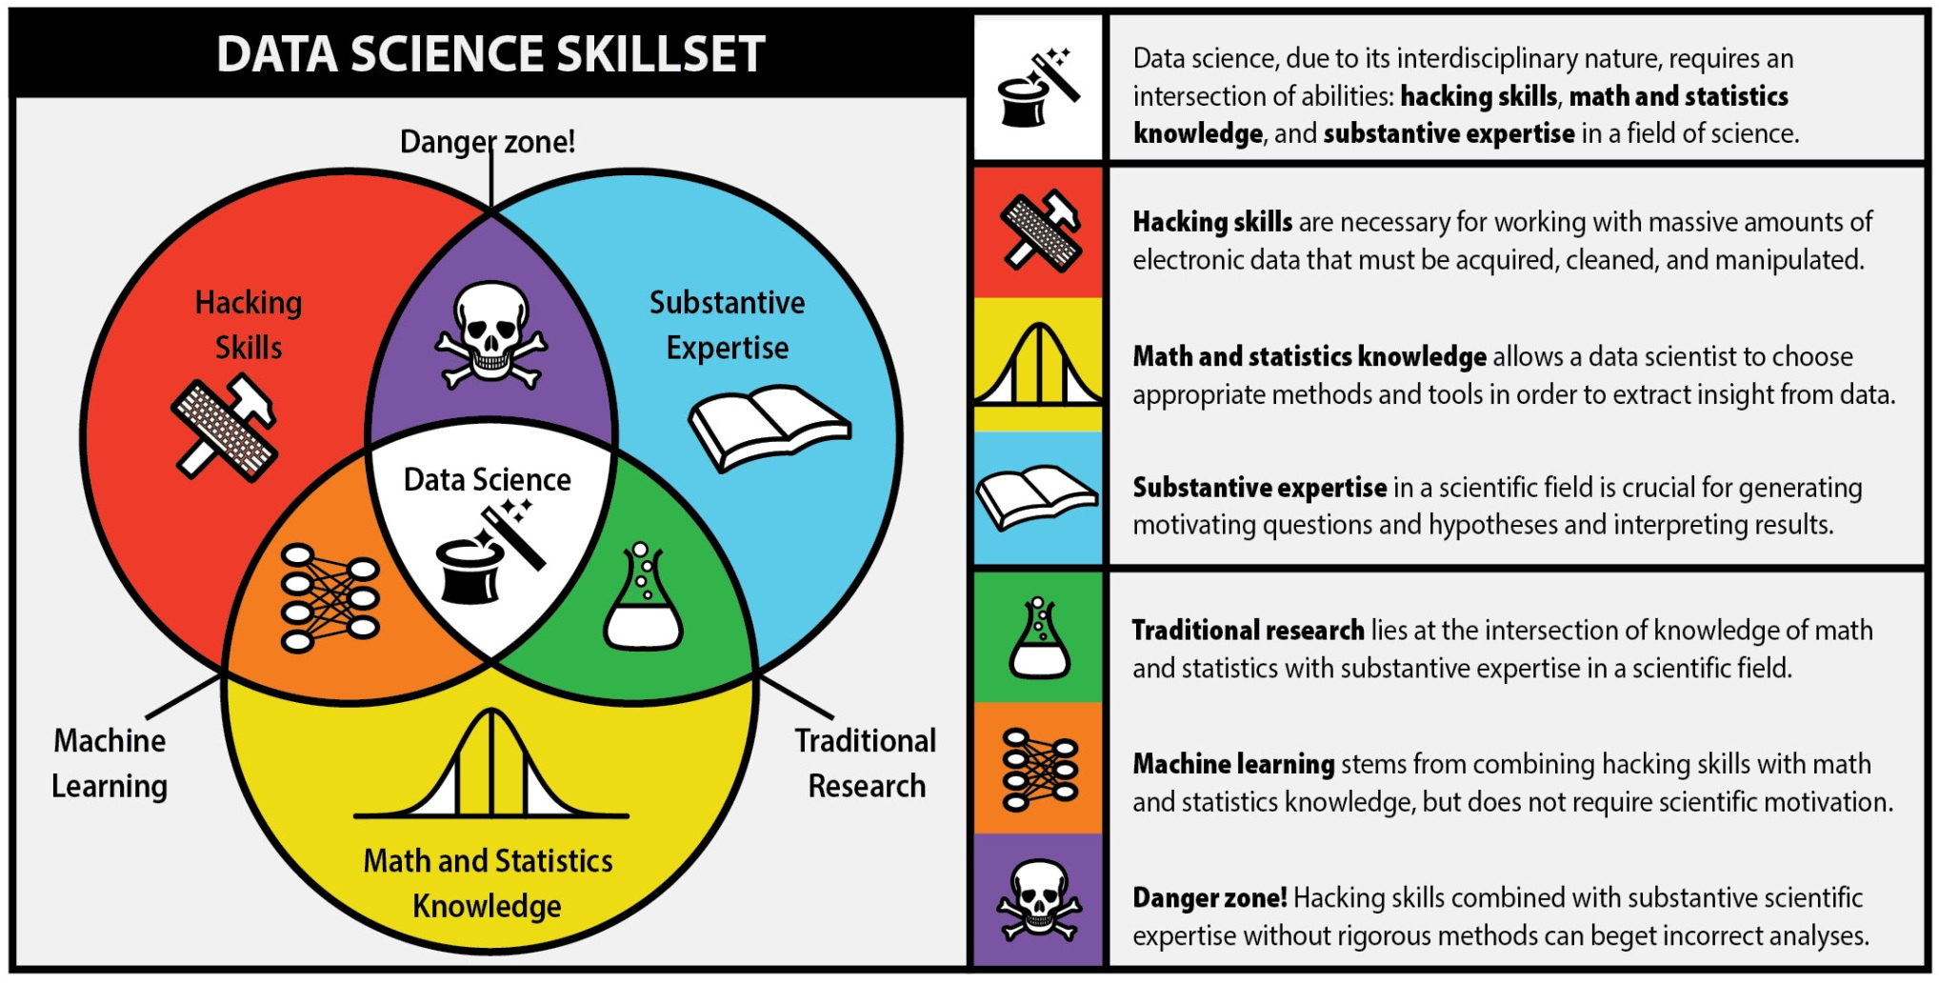
What is Data Science?
The Data Science process involves many different disciplines and goes through many delicate steps…
You should really know what you’re doing before touching anything…
Notes:
Data science is multidisciplinary.

Slide 8

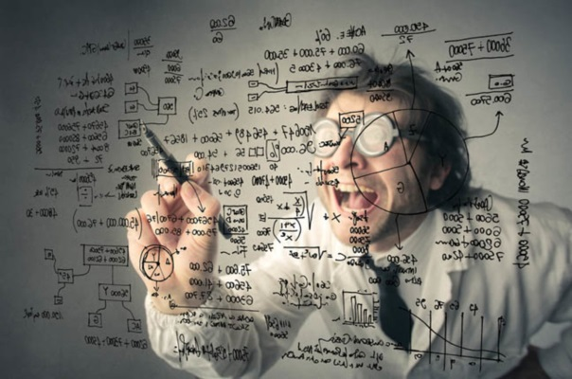
Data Science or Data Analytics?
Data analyst
Data scientist
Skills:
Descriptive Modeling, Business Analysis,
Data Manipulation, Statistics
Focus:
Business Rules, Data Relationships, Data Attributes, Sources and Targets, Data quality
Skills:
Advanced Statistics, Programming, Data Management, Big Data, Machine Learning
Focus:
Predictive Modeling, Data Mining, Unstructured Data, Big Data, Research, Solving Business Problems, Identifying Business Opportunities
Notes:
2 min
Difference in focus

Slide 9
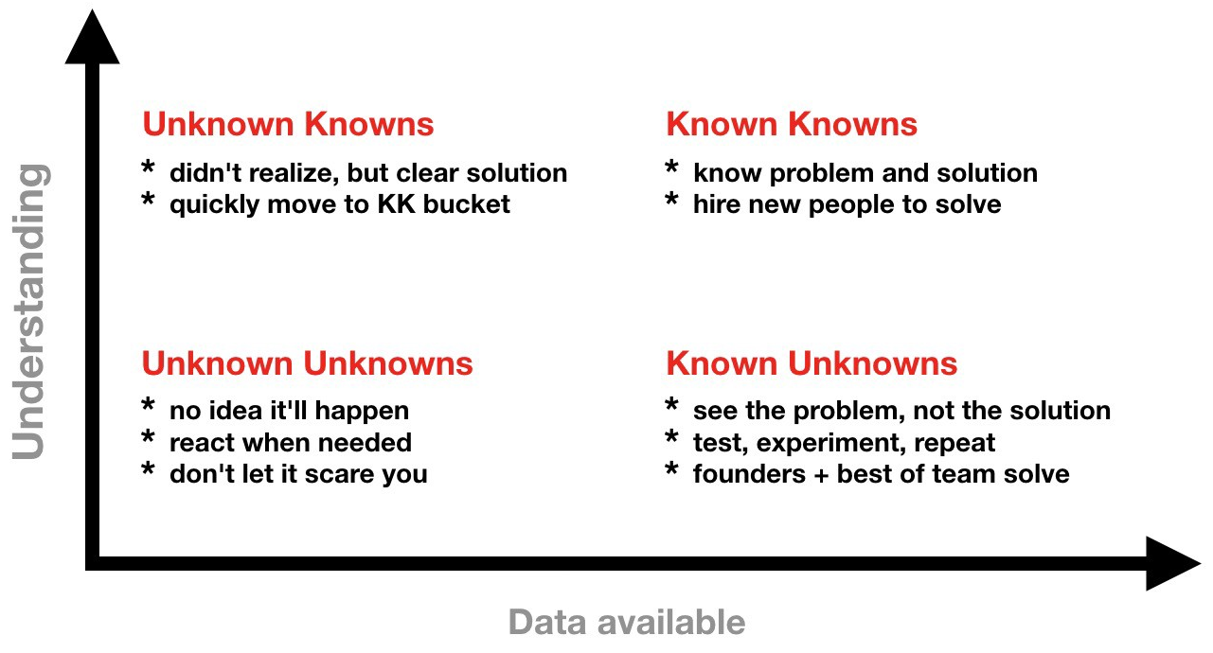
Data Science or Data Analytics?
Notes:
1 min
Difference in focus and environments:
Known knowns: simple/obvious
Easy to understand, simple cause/effect relationships, repeatable results, just follow the script
Known Unknowns: Complicated
Use good practices, get experts, multiple cause/effect relationship, fairly repeatable results, multiple solutions (need to find optimal)
Unknown Unknowns: Complex
Emergent practices, open large groups discussions. Cause/effect known only after the fact, not always repeatable (at that point in time), looking for patterns
DA -> known knowns
DS reaches out to other quadrants

Slide 10
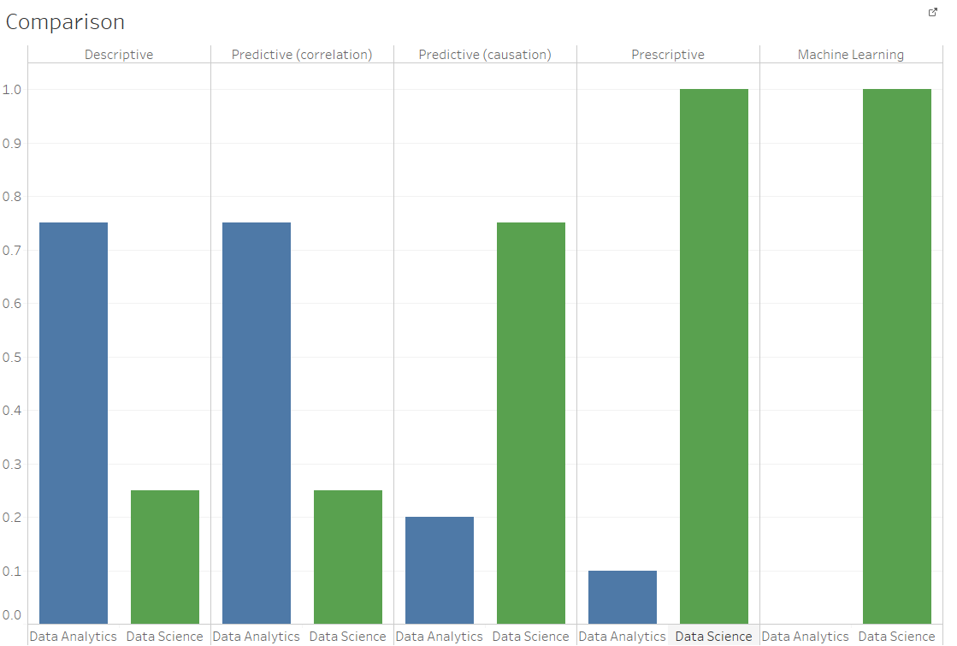
Data Science or Data Analytics?
Known knowns
Unknown knowns
Unknown unknowns
Notes:
1 min
Difference in focus

Slide 11
Data Scientists - Who

Slide 12
Data Scientists - What

Slide 13
Data Scientists - Why

Slide 14
What can be achieved

Slide 15
Real world examples

Slide 16
Conclusions

Slide 17
Q/A

Slide 18
Thanks

Slide 19
Cardiovascular risk cohort
 | Total
Members | 720,621
Unique codes (Dx, Rx, CPT) | 26,905
 | Train | Test
% of Total Members | 80% | 20%
Members | 576,512 | 144,108
Cases At risk, visited ER | 294,177 | 73,520
Controls At risk, no ER visit | 282,335 | 70,588
Claims | 194.2 M | 48.6 M

Slide 20
Cardiovascular risk cohort
 | Total
Members | 720,621
Unique codes (Dx, Rx, CPT) | 26,905
 | Train | Test
% of Total Members | 80% | 20%
Members | 576,512 | 144,108
Cases At risk, visited ER | 294,177 | 73,520
Controls At risk, no ER visit | 282,335 | 70,588
Claims | 194.2 M | 48.6 M

Slide 21








Medical Codes in claims
Diagnosis Codes
Procedure Codes
Prescription Medication Codes
26,905 unique codes
circa. 1000 grouped codes

Slide 22
Data Structuring
Cardiac Emergency Visit
X, Predictor variables
y, Response [1, 0]
Member 1
1
Member 2
0
Member 3
1
Member Level Attributes
Age
M/F
Span Length
Visit Level Sequential Attributes
Time
Visit Level Sequential Lists
Diag_cd
Proc_cd
Prescriptions
Member …
Code groupings
0 …

Slide 23
Recurrent Neural Networks

Slide 24
Recurrent Neural Network
Modelling single events as time steps
Member
Sequential Events
Cough [0,0,0,0,0,1,0,0,0] [5]
Fever [0,0,1,0,0,0,0,0,0] [2]
Lorazepam [0,0,0,0,0,0,1,0,0] [6]
…
Pneumonia [0,1,0,0,0,0,0,0,0] [1]
Cough [0,0,0,0,0,1,0,0,0] [5]
[1]
Yes ER
JaneDoe
[5]
[2]
[6]
[1]
[5]
Time Step 1
Time Step 2
Time Step 3
Time Step t-1
Time Step t

Slide 25
Recurrent Neural Network
Modelling single events as time steps
Hidden layer
from previous member
Member
Sequential Events
Cough [0,0,0,0,0,1,0,0,0] [5]
Fever [0,0,1,0,0,0,0,0,0] [2]
Lorazepam [0,0,0,0,0,0,1,0,0] [6]
…
Pneumonia [0,1,0,0,0,0,0,0,0] [1]
Cough [0,0,0,0,0,1,0,0,0] [5]
Hidden
Layer
Matrix
300
x200
[1]
Yes ER
JaneDoe
[5]
[2]
[6]
[1]
[5]
Step 1
Step 2
Step 3
Step t-1
Step t

Slide 26
Recurrent Neural Network
Modelling single events as time steps
Hidden layer
from previous member
Member
Sequential Events
Cough [0,0,0,0,0,1,0,0,0] [5]
Fever [0,0,1,0,0,0,0,0,0] [2]
Lorazepam [0,0,0,0,0,0,1,0,0] [6]
…
Pneumonia [0,1,0,0,0,0,0,0,0] [1]
Cough [0,0,0,0,0,1,0,0,0] [5]
Hidden
Layer
Matrix
300
x200
…
[1]
Yes ER
Sigmoid
Output
JaneDoe
Matrix
Multiply
[5]
[2]
[6]
[1]
[5]
Hidden layer
Passed to next member
Step 1
Step 2
Step 3
Step t-1
Step t

Slide 27
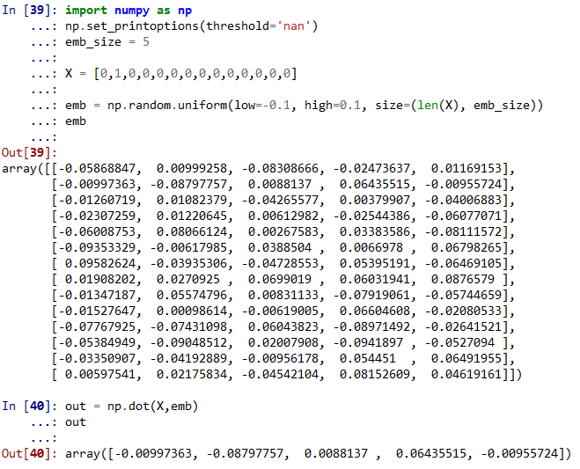
Embeddings as input to RNN
Pneumonia one hot
Size out
Size in
Pneumonia
Embedding
Recurrent Neural Network

Slide 28
Embeddings as input to RNN
Pneumonia one hot
Short side out
Long side in
Pneumonia
Embedding
Recurrent Neural Network

Slide 29
Practical Limitations
Traditional RNNs have short memories
“LSTM/GRU is a great solution for relatively short sequences, up to 100-300 items. On longer sequences LSTM/GRU still works, but can gradually forget information from the oldest items.”
Arthur Suilin (1st in Kaggle Wikipedia Forecasting Competition)

Slide 30
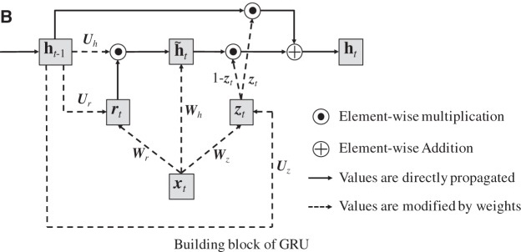
GRU, Gated Recurrent Unit
How does a GRU come together
x is our input, or one hot-event
h is our memory cell, a single large matrix passed from step to step getting updated at each step
[6]
Step 3
@Cough
@Fever
@Lorezapam

Slide 31
GRU, Gated Recurrent Unit
How does a GRU come together
x is our input, or one hot-event
h is our memory cell, a single large matrix passed from step to step
r is a forget gate – how much to forget all previous h updates
Z is a forget gate – how much to forget this current h update
[6]
Step 3
@Cough
@Fever
@Lorezapam

Slide 32
GRU, Gated Recurrent Unit
How does a GRU come together
x is our input, or one hot-event
h is our memory cell, a single large matrix passed from step to step
r is a forget gate – how much to forget all previous h updates
Z is a forget gate – how much to forget this current h update
U, W are weight matrices which are multiplies by x to get r, Z
[6]
Step 3
@Cough
@Fever
@Lorezapam

Slide 33
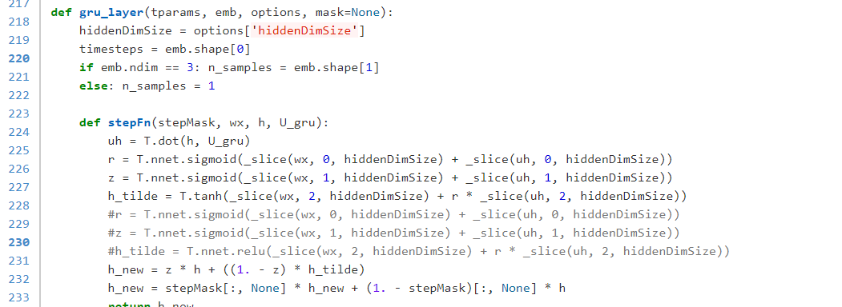
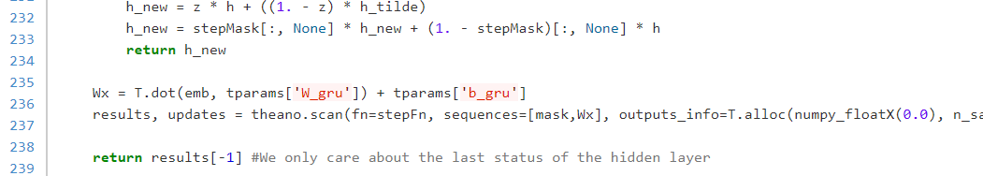
Recurrent Neural Network
Theano is explicit – everything coded, everything can be changed

Slide 34
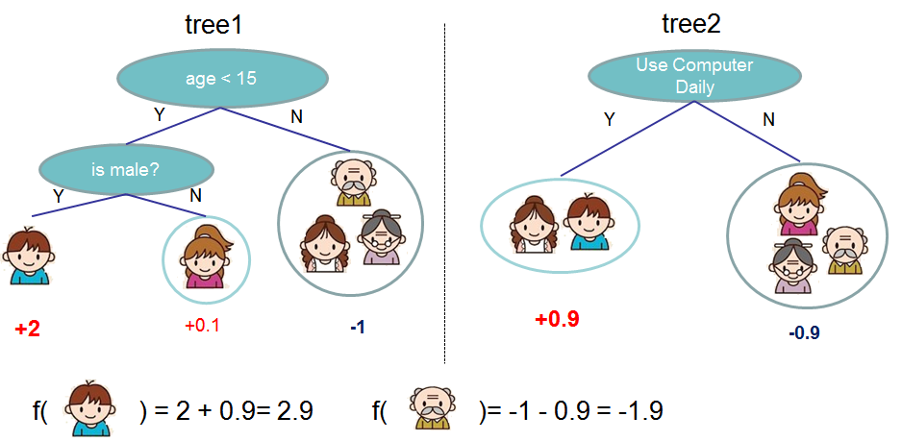
Decision Trees with Xgboost
GBM worked surprisingly well
Tianqi Chen and Carlos Guestrin. XGBoost: A Scalable Tree Boosting System. In 22nd SIGKDD Conference on Knowledge Discovery and Data Mining, 2016

Slide 35
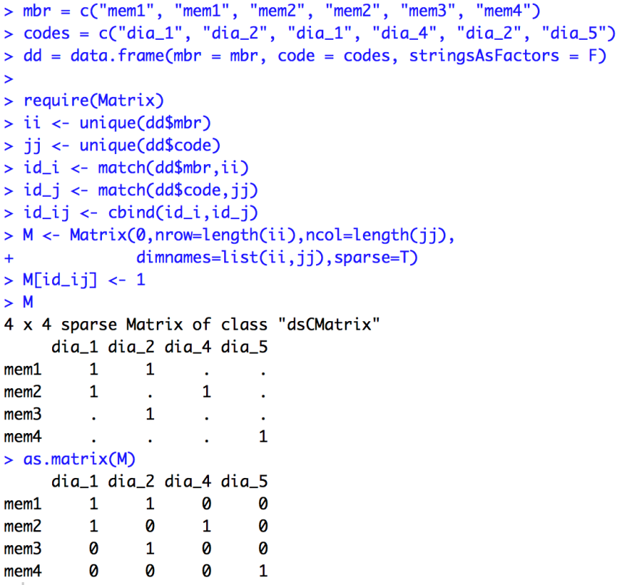
Decision Trees with Xgboost
“Extreme gradient boosting” is a fast implementation of GBM,
GBM works well with,
sparse matrix format - our data is very sparse.
one hot encoding
continuous features
GBM cannot model sequence well.
Our sparse matrix had ~ 42K columns and 576K members.
As dense this would take 1.9TB RAM!!
Sparse
Dense

Slide 36
Results
 | Case | Controls
Training | 294,177 | 282,335
Test | 73,520 | 70,588
Model | Hardware | Software | Test AUC | Time (min)
GBM | Xeon E4 v4 14 cores | XGBoost | 81.1% | 25
RNN, GRU Epochs = 1300 | P100 GPU | Theano | 78.5% | 333
Baseline RNN-GRU Ref: Choi et al, 2016 | P100 GPU | Theano | 77.7%
RNN-LSTM Epochs = 360 | P100 GPU | Keras, Tensorflow | 75.0% | 54
Ensemble (1/4 GRU + 3/4 XGBoost) |  |  | 81.5%

Slide 37
Keep Learning.

Slide 38
Data Structuring
Worked well in RNN
Challenging for RNN
Worked well in trees
Which model works well on which data
Challenging for trees
X, Predictor variables
y, Response [1, 0]
Member 1
1
Member 2
0
Member 3
1
Member Level Attributes
Age
M/F
Span Length
Visit Level Sequential Attributes
Time
Visit Level Sequential Lists
Diag_cd
Proc_cd
Prescriptions
Member …
Code aggregations
0 …

