Slide 1
Static Analysis with LLM
2024.4.15 BaiJun Cheng

Slide 2
Contents
1. KernelGPT: Enhanced Kernel Fuzzing via Large Language Models
2. When Dataflow Analysis Meets Large Language Models
Notes:
我本次会从两方面介绍基于LLM的程序分析，第一个是基于LLM的CFG生成方法；第二个是LLM在反编译中的应用

Slide 3
1.KernelGPT: Enhanced Kernel Fuzzing via Large Language Models
Chenyuan Yang, Zijie Zhao, Lingming Zhang
University of Illinois Urbana-Champaign

Slide 4
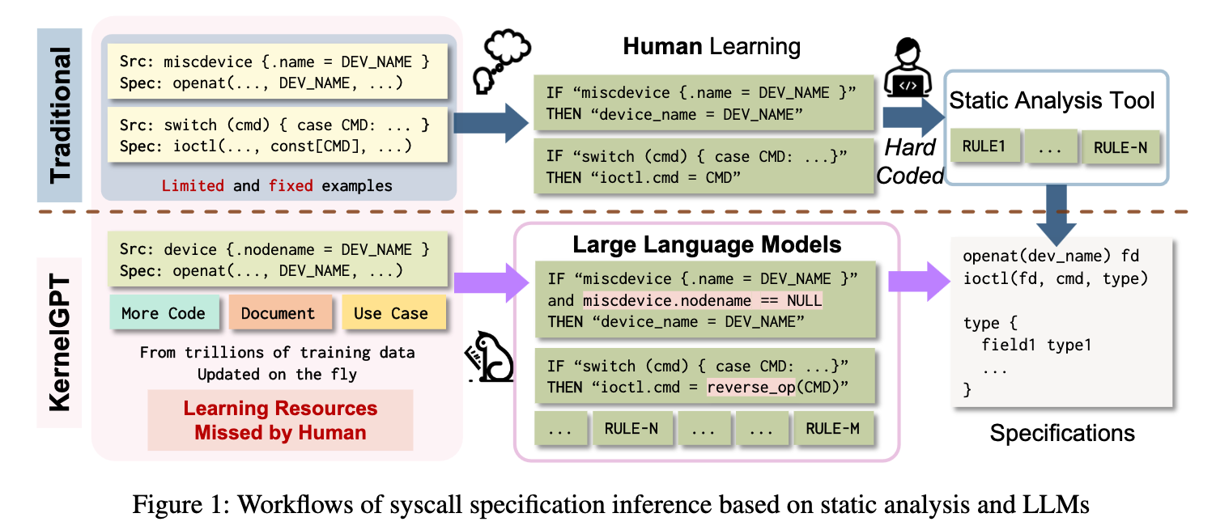
1-1.intro
kernel fuzzing techniques Syzkaller can be enhanced via seed generation, seed selection, guided mutation, syscall specification generation. the syscall descriptions written in syzlang.
requiring human-defined rules
more flexible
Notes:
kernel fuzzing相比normal fuzz，除了通过种子变异等操作外，还可以通过系统调用规约来优化。但是现在许多规约是手动编写的，自动化生成规约的工具目前主要依赖人工定义的启发式规则。

Slide 5
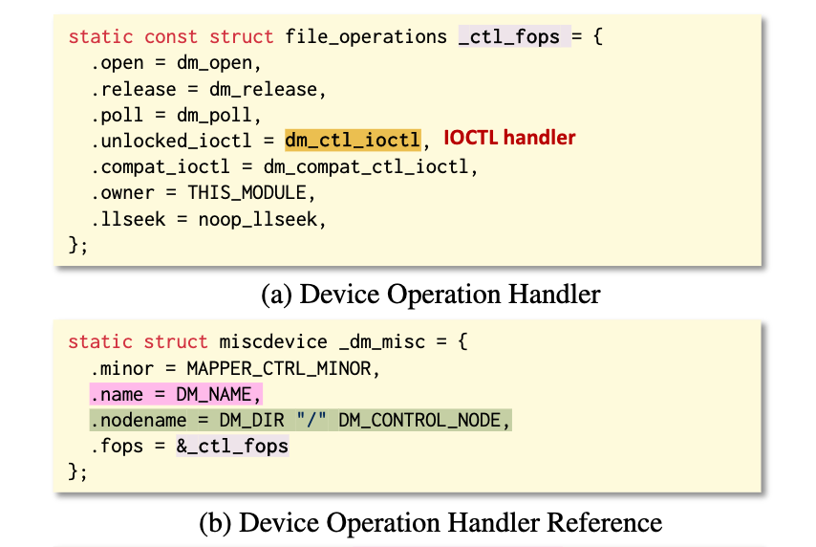
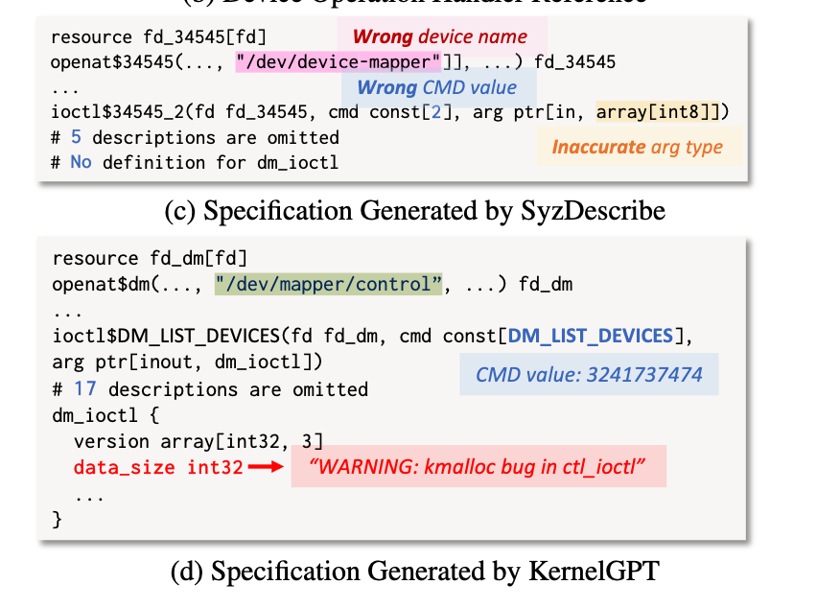
1-1.intro
SyzDescribe typically rely on the .name field in struct miscdevice to determine the device name for driver inter-action, which is a conventional use case.
Solution-LLM:
1.deduce the device name and its initialization descriptions
2. recover the command values, argument types, and type definitions
3. validates and repairs the generated specification
Notes:
这里给出了一个用启发式规则生成规约的示例，基于规则的方法生成设备名时依赖编程规范，当出现例外时，会生成错误的device name以及command value。因此作者提出了基于LLM的规约生成方案，分为3步：1.推测设备名和初始规约，恢复命令值、参数类型。3.验证并修复规约。

Slide 6
1-1.intro
SyzDescribe typically rely on the .name field in struct miscdevice to determine the device name for driver inter-action, which is a conventional use case.
Solution-LLM:
1.deduce the device name and its initialization descriptions
2. recover the command values, argument types, and type definitions
3. validates and repairs the generated specification
Notes:
这里给出了一个用启发式规则生成规约的示例，基于规则的方法生成设备名时依赖编程规范，当出现例外时，会生成错误的device name以及command value。因此作者提出了基于LLM的规约生成方案，分为3步：1.推测设备名和初始化描述，恢复命令值、参数类型。3.验证并修复规约。

Slide 7
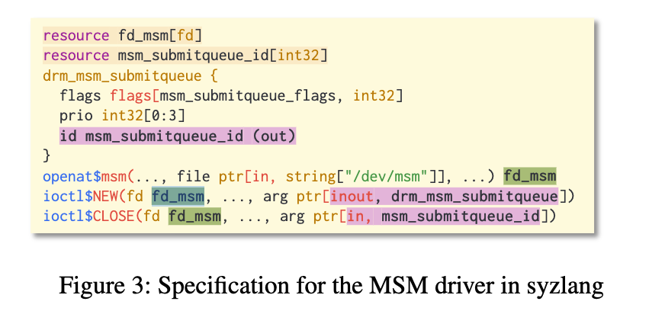
1-2.Background
KernelGPT focus on testing devices. Each device is a file in Linux. Developer will implement "ioctl(int fd, unsigned long request, void *argp) ” syscall to invoke kernel functions like open, close. fd is file descriptor of device, request is command identifier to select operation. argp is cast to driver-specific data types to carry information in and out.
name of MSM device.
type of argument of syscall ioctl.
Challenges:
1. Extract expected parameter values and type definitions
2. Infer dependencies among syscalls and encode the dependencies in parameter
Notes:
这里简单介绍下background，首先KernelGPT目标是测试设备，在linux下设备是用文件表示。这里给出了一个MSM设备对应的规约，其中关键的包括设备名，以及ioctl对应的参数类型。如果想要自动生成规约这两个参数肯定是要自动推断的。现在面临的2个挑战是提取参数名、类型定义以及syscall之间的依赖关系。

Slide 8
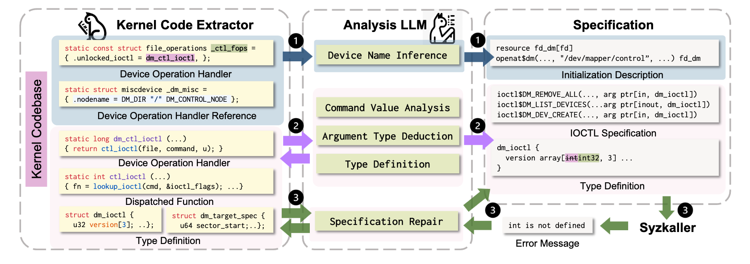
1-3.Approach
Critical Components: Device Name, Command Value, Argument Type
Notes:
KernelGPT的workflow在这张图中，需要LLM做的是推断一些关键属性。包括设备名、命令值、参数类型

Slide 9
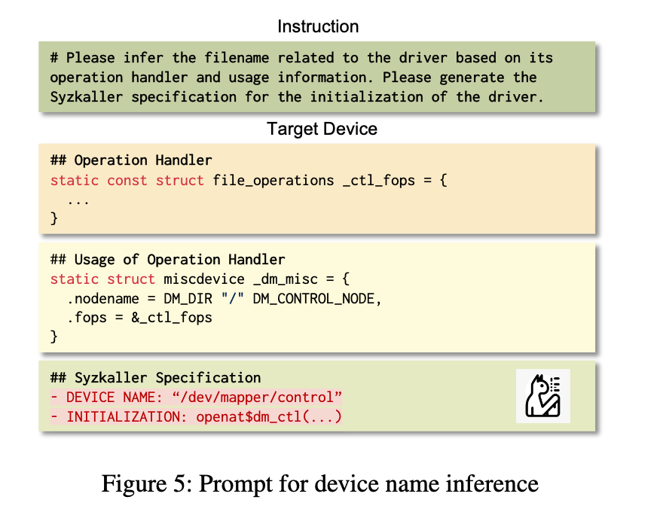
1-3-1. Device Name
Requiring:
- Operation Handler: The initialization of struct variable including file operation.
- Usage: The refered site of the file operation struct variable.
Notes:
这幅图是推断设备名用的prompt，需要输入文件操作对应结构体变量的初始化部分以及该结构体变量被引用的位置的代码。

Slide 10
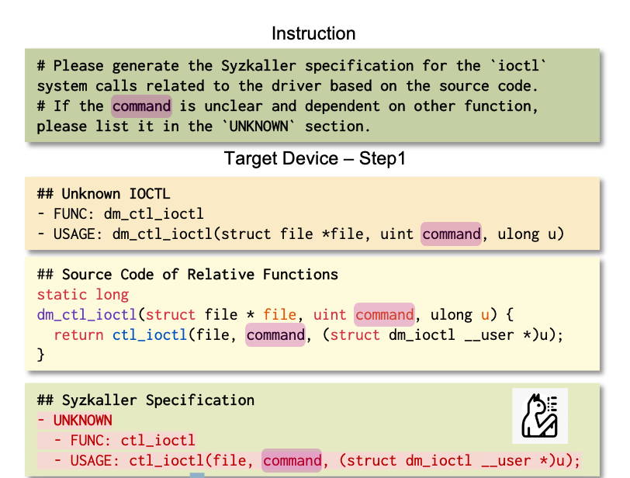
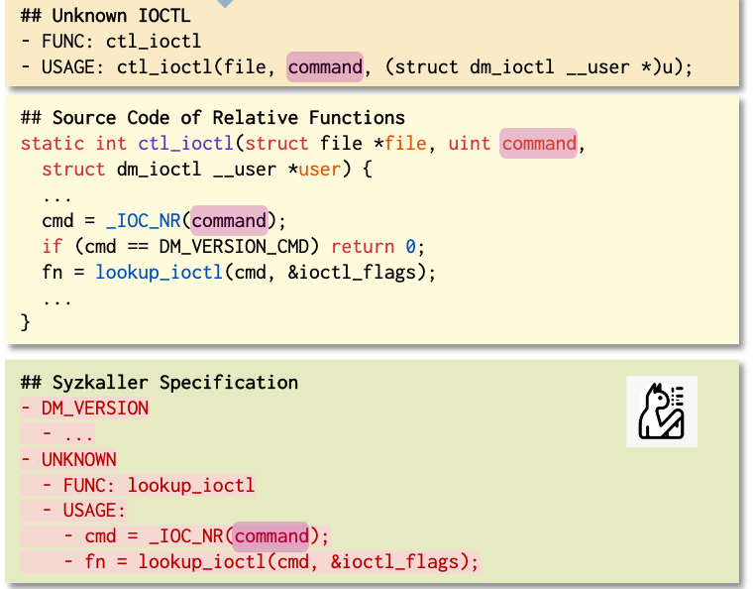
1-3-2. Command Value
Continue analyzing through a call-chain to extract command value. In this step, KernelGPT extract command value DM_VERSION while baseline SyzDescribe wrongly extract DM_VERSION_CMD.
Notes:
这幅图是推断命令值用的prompt，需要输入文件操作对应函数的代码，LLM会递归分析该函数涉及的调用链提取相应命令值。比如实例中LLM分析了dm_ctl_ioctl的代码并提取出了命令值DM_VERSION

Slide 11
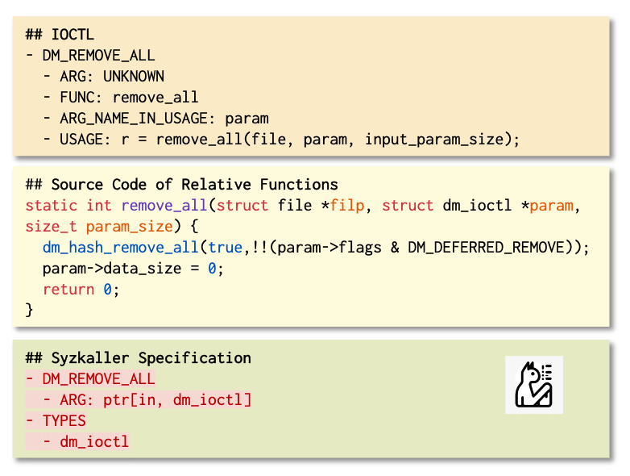
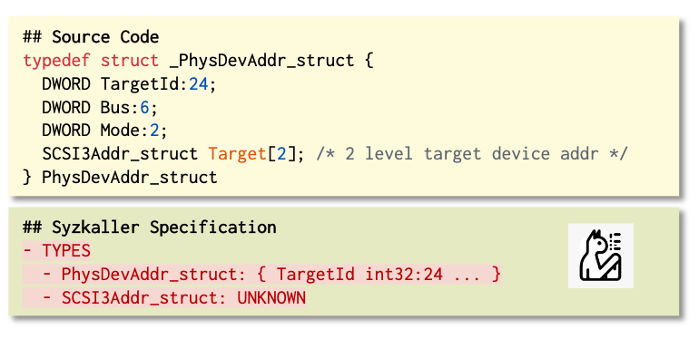
1-3-3. Argument Type
After identify command value, the corresponding handler function is determined. LLM could analyze the argument type of syscall ioctl with the definition of handler function. After identify corresponding type, LLM could be used to translate the type definition from C into syzlang.
Notes:
这幅图是推断参数类型用的prompt，LLM首先根据命令值找到相应处理函数，并分析该函数提取关键数据的具体类型名字。随后根据类型名找到c语言的类型定义并用LLM翻译成szlang规约

Slide 12
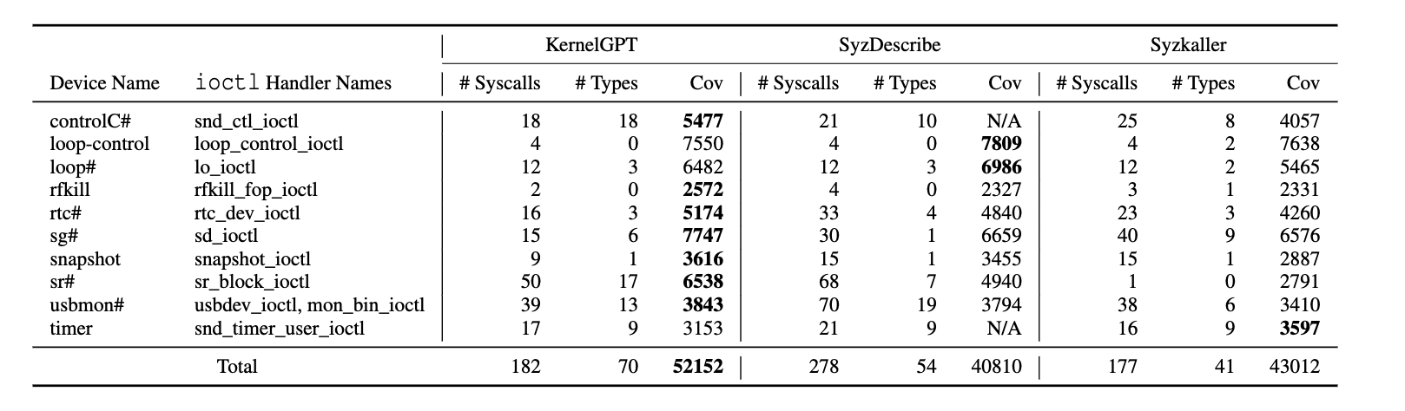
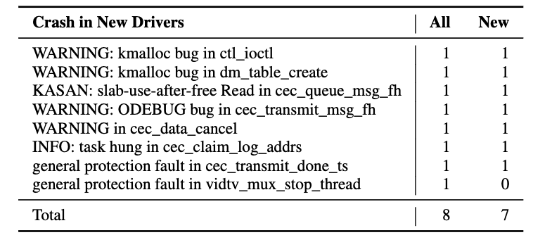
1-4. Evaluation
RQ1: What is the number and quality of the specifications for undescribed kernel drivers generated by KernelGPT?
RQ2: What is the quality of the syscall descriptions generated by KernelGPT compared to the baselines?
RQ3: Can specifications generated by KernelGPT detect real-world bugs in the kernel?
RQ1: Integrating specifications synthesized by KernelGPT for the undescribed drivers resulting in 28.6% more crashes being triggered with an additional 1.5K lines covered compared to manually written specifications.
RQ2: coverage is higher than baseline
RQ3: detect 8 bugs with 7 previously unknown
Notes:
最后就是实验，这里RQ1和RQ2是衡量KernelGPT生成的规约质量如何，只要通过kernelFuzz的覆盖率以及触发的crash来衡量。相比纯手写的规约，kernelGPT生成的规约多触发了28.6%的crash以及额外覆盖了1500行代码。相比SyzDescribe覆盖率也更高。检测bug时发现了8个bug，其中7个是新发现的。

Slide 13
2.When Dataflow Analysis Meets Large Language Models
Chengpeng Wang^{[1]}, Wuqi Zhang^{[2]}, Zian Su^{[1]}, Xiangzhe Xu^{[1]}, Xiaoheng Xie^{[2]}, Xiangyu Zhang^{[1]}
1.Purdue University
2.The Hong Kong University of Science and Technology
Notes:
这篇工作是基于LLM来做数据流分析的工作

Slide 14
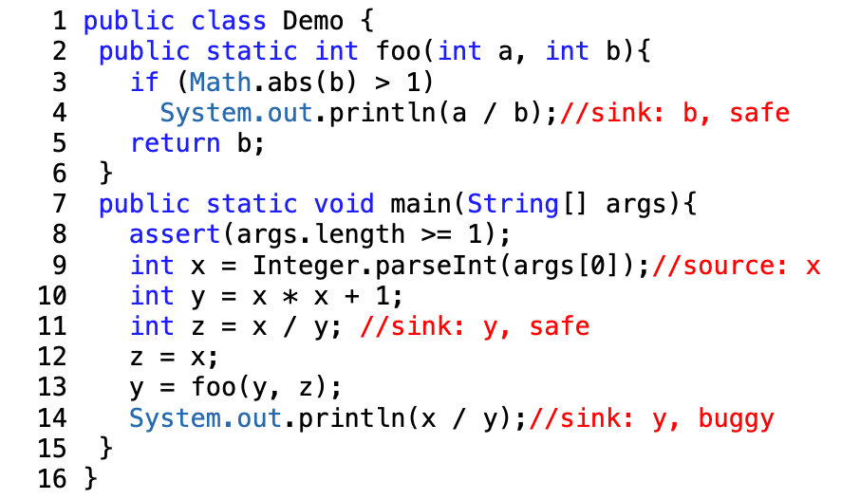
2-1.intro
Limitation of current data-flow engines:
1. rely on program intermediate representations (IRs) generated by semantic analyzers in the frontends of compilation infrastructures, limited in analyzing incomplete
2. requires expert knowledge and manual effort.
Challenge:
1. path feasibility validation
2. Incorrect dataflow facts in single functions can accumulate and magnify
Notes:
他们想做的是一个无需编译环境以及人工规则的数据流分析工具。做这样的工具存在的challenge是：1.如何合理的验证路径条件。2.如何避免data- flow fact传播时被放大。

Slide 15
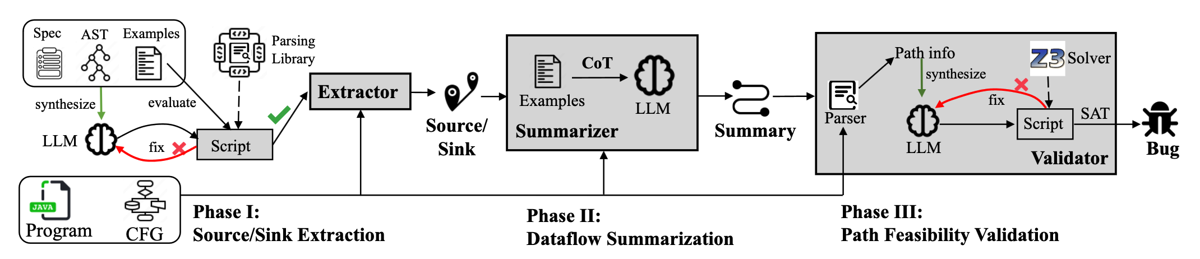
2-2.method
1. Source/Sink Extraction
2. Dataflow Summarization: identifies the dataflow facts from v ∈ V_{src} ∪ V_{par} ∪ V_{out} to v′ ∈ V_{sink} ∪ V_{arg} ∪ V_{ret}
3. Path feasibility Validation: validates the path feasibility by generate SMT queries.
Notes:
作者的工具LLMDFA可分为3个步骤：1.souce/sink提取：这部分是为了减少人工制定source/sink规则的工作量。2.dataflow总结：之前的静态分析工作依赖于人工制定的dataflow分析规则，在source/code上许多复杂表达式通常难以用规则描述。这里作者用LLM直接判断，克服challenge2。3.路径条件分析，这是为了克服challenge1.

Slide 16
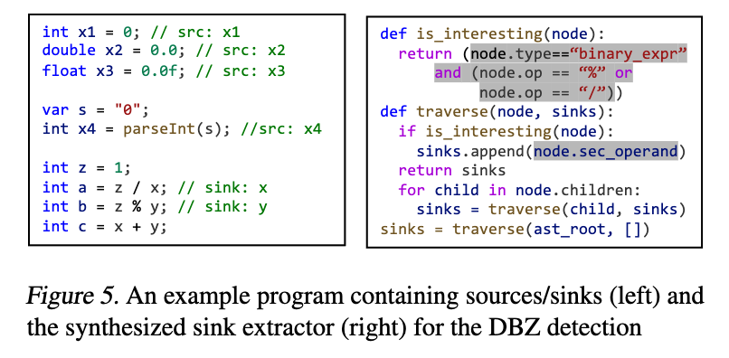
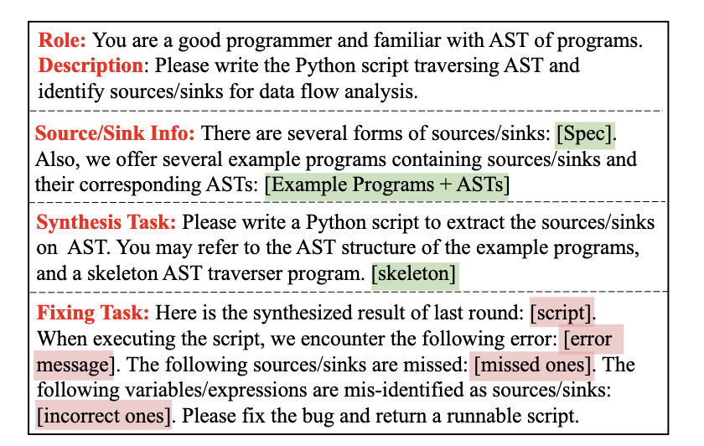
2-2-1.Source/Sink Extraction
synthesizing source/sink extractors with specific patterns by LLM. Input:
Specification
Notes:
source/sink分析主要是通过LLM生成一个AST遍历脚本，这个跟之前工作的本质区别就是之前工作每出现一个新的source/sink pattern就需要专家手动编写脚本。这里把脚本编写自动化。提高可扩展性。

Slide 17
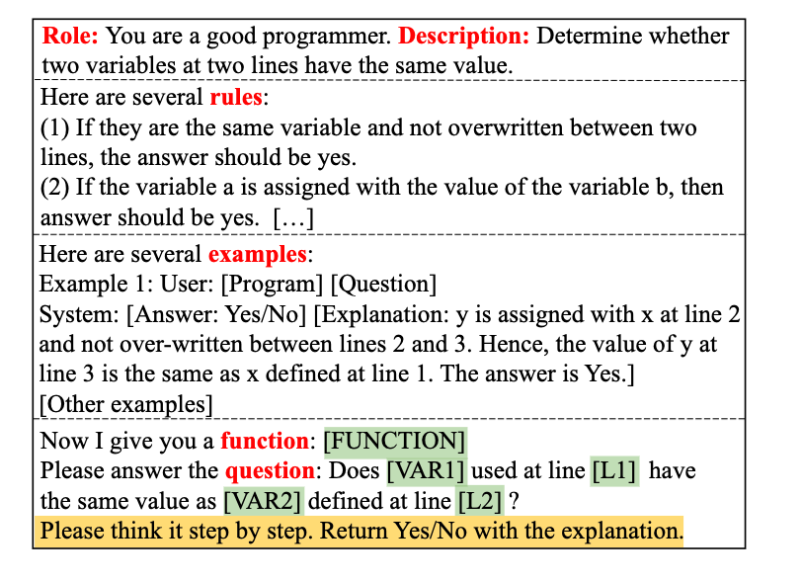
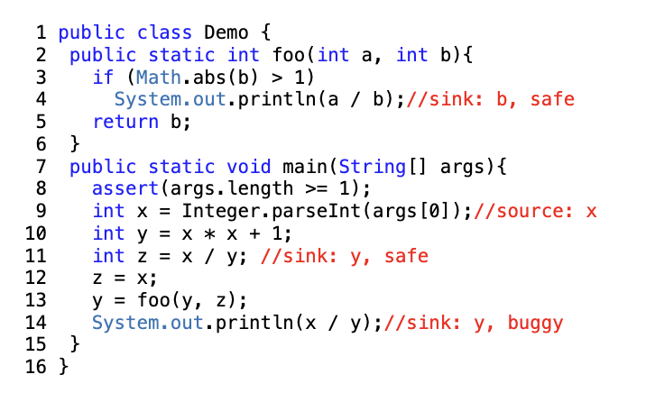
2-2-2.Dataflow Summarization
Determing whether two values are reachable. Input:
function (main)
line1-var1 (line9-x)
line2-var2 (line13-z)
Notes:
dataflow分析，这里作者直接输入两个变量以及相关语句交给大模型分析，通过few-shot promt让LLM判断是否具有数据流关系。不过作者没有说这么做相比纯静态分析好处在哪。我认为的话这么做如果分析一些涉及复杂表达式的变量，比如说数组引用这些可能是大模型的一个优势。

Slide 18
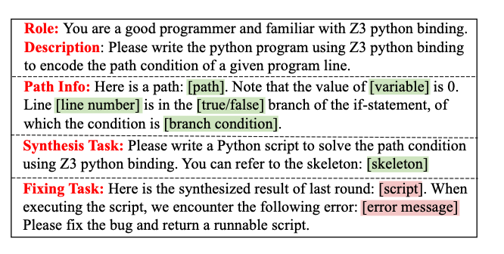
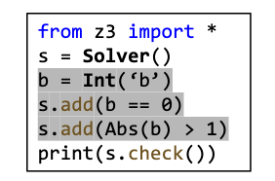
2-2-3. Path Feasibility Validation
LLMs cannot achieve adequate performance on constraint solving. Hence, LLMDFA prompt LLM to synthesize a Python script program to solve the constraint. Input:
1.Data Flow Path (lines of code)
2.Branch conditions
a script for expression: Math.abs(b) > 1
Notes:
为了克服LLM的幻觉问题，这里作者针对一个data-flow路径首先提取路径对应的分支条件，然后交给LLM生成一个路径条件对应的smt脚本，并求解。

Slide 19
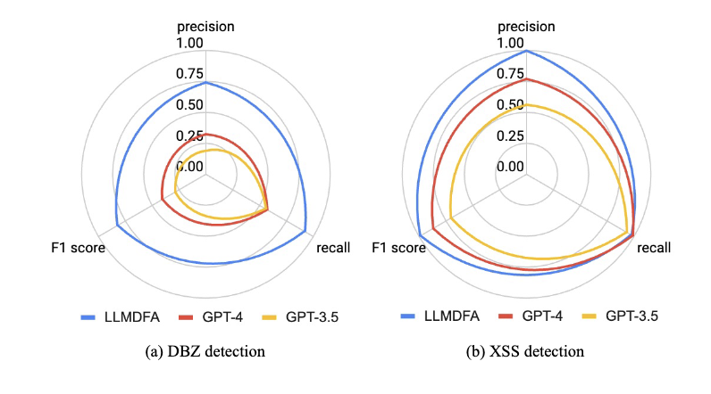
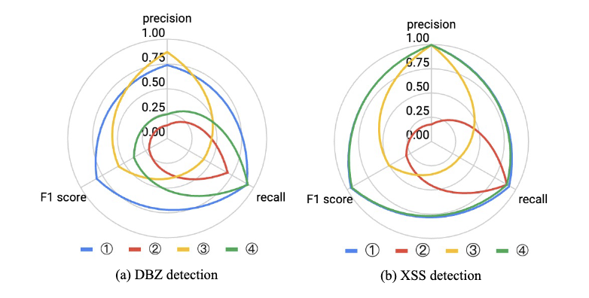
2-3. Evaluation
LLM: gpt-3.5-turbo-1106
benchmark: Juliet Test Suite (XSS and DBZ(division by zero)), including 1,850 DBZ and 666 XSS bugs
Comparison with Baselines
Comparison with end-to-end analysis
Approach | Bug Type | Precision | Recall | F1
LLMDFA | DBZ | 0.74 | 0.92 | 0.82
 | XSS | 1 | 0.92 | 0.96
CodeFuseQuery | DBZ | 0.29 | 0.81 | 0.43
 | XSS | 0.92 | 0.80 | 0.86
Ablation
Notes:
在实验部分，作者用LLMDFA来检测两种source/sink类bug，除零异常以及XSS漏洞。作者用到的LLM是GPT-3.5，用到的benchmark是Juliet测试套件。作者在检测bug时进行了3组实验，第一组是跟静态分析方法CodeFuseQuery的比对，第二组是跟直接用LLM进行端到端检测的比对，第三组是消融实验，也就是跳过3个步骤中的其中一步。从效果上来看LLMDFA比其它方法好，但是这里数据集选的有点弱了。

Slide 20
Thanks

