Slide 1


Data Structures and Algorithms II
Hash Tables

Slide 2
1. Associative Arrays
2. Hash Tables and applications
3. Hash functions
4. Collision Resolution
5. Load factor and implications
Hash Tables
Notes:
- Montserrat or Verdana fonts
- 2 Options for Intro Slide

Slide 3
Associative Arrays
An associative array is an abstract data type that represents a collection of key, value pairs.
Each key appears at most only once.
The associative array has the following operations:
Insert a key value pair
Update a value belonging to a key
Remove a key value pair belonging to a key
Get the value associated with a key
The hash table is often used to implement associative arrays.

Slide 4
Hash tables and applications
Hash tables are a data structure that are useful because they offer a very efficient implementation of the associative array.
While many operations have a worst case of O(n), in practice, Hash tables have an average speed for the Insert, Update, Remove and Get operations of O(1).
In a lot of cases (especially those that do not require to sort the data), hash tables are faster in practice than trees, and can be used in a lot of situations like:
Caching
Implementing associative arrays
Implementing indexes
Or as parts of more complex data structures.

Slide 5
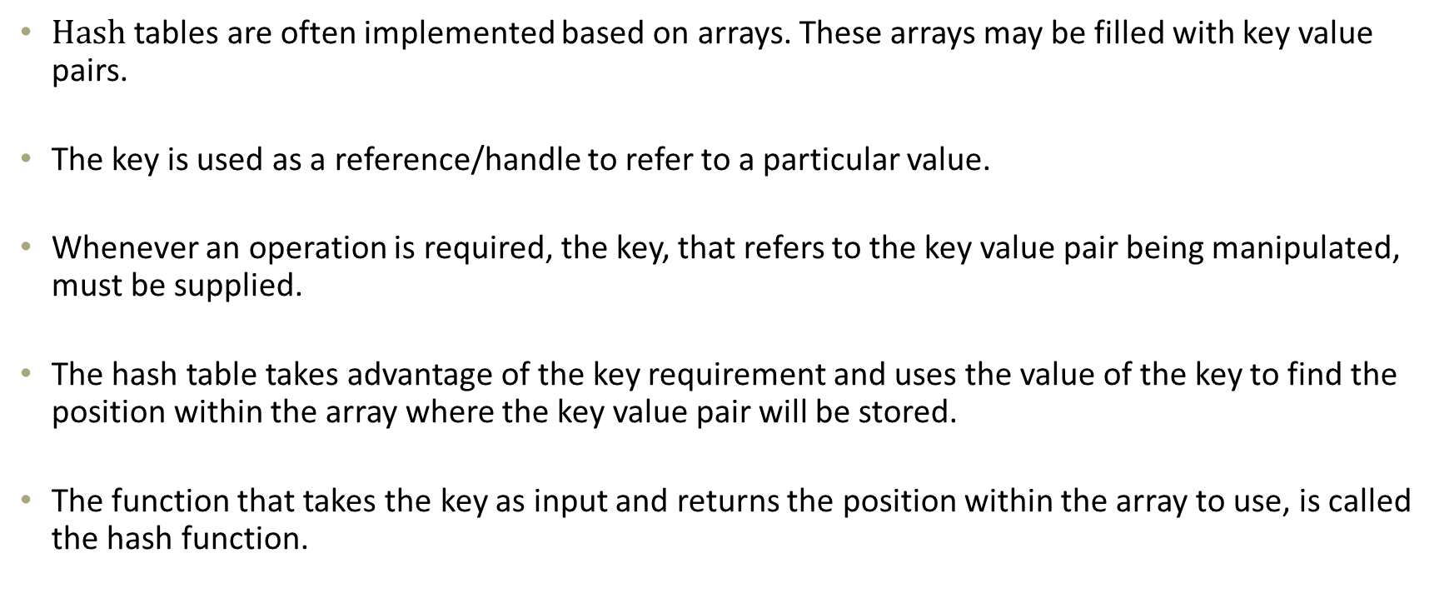
Hash tables and applications
$Hash$tables are often implemented based on arrays. These arrays may be filled with key value pairs.
The key is used as a reference/handle to refer to a particular value.
Whenever an operation is required, the key, that refers to the key value pair being manipulated, must be supplied.
The hash table takes advantage of the key requirement and uses the value of the key to find the position within the array where the key value pair will be stored.
The function that takes the key as input and returns the position within the array to use, is called the hash function.

Slide 6
Hash tables and applications
// Insert the key value pair, <k, v> into the hash table Insert(k, v)
// Apply the hash function, h, on the key, to obtain the position h(k)
// Place the key value pair in the identified position within the array
h(k)
 |  | <k, v>
// When manipulating the entry related to key k, h(k), will once again be used // to get the same position where the key value pair is stored.

Slide 7
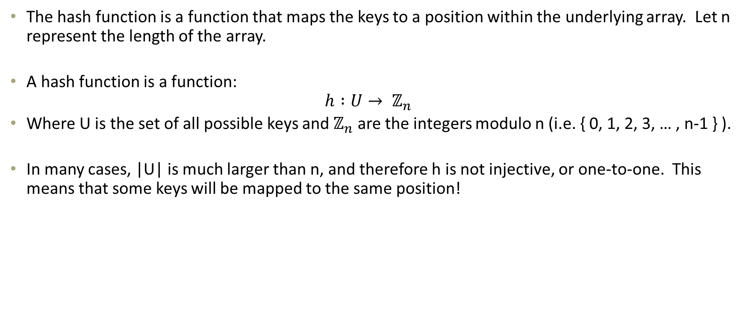
Hashing functions
The hash function is a function that maps the keys to a position within the underlying array. Let n represent the length of the array.
A hash function is a function:
$$h :U→ ℤ_{n}$$
Where U is the set of all possible keys and $ℤ_{n}$ are the integers modulo n (i.e. { 0, 1, 2, 3, … , n-1 } ).
In many cases, |U| is much larger than n, and therefore h is not injective, or one-to-one. This means that some keys will be mapped to the same position!

Slide 8
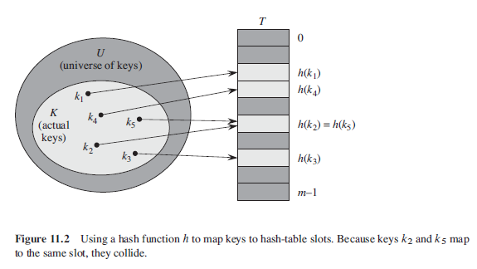
Hashing functions
In many cases, |U| is much larger than n, and therefore h is not injective, or one-to-one. This means that different keys, may have the same hash value and multiple keys may point towards the same array position.
If this happens, it is called a collision.

Slide 9
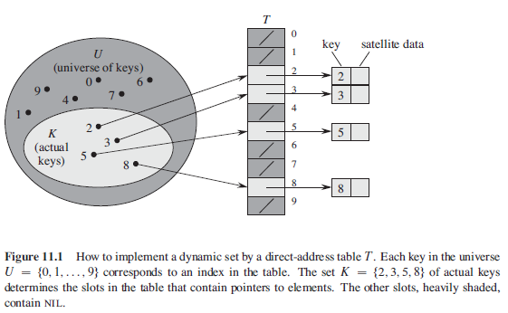
Hashing functions
It is possible to avoid collisions altogether by setting |U| = n. In this case, a hash function can be created that maps each key to a unique position within the array.
In this case, instead of a hash table, a direct-address table is created. The drawback of this structure is the space requirement if only few of the keys are used.

Slide 10
Hashing functions
In practice, the size of the array used should be around the same size as the number of elements being stored.
Ideally, a hashing function that can minimize the number of collisions should be found. However, unless specialized data structures are used, collisions are inevitable and need to be handled.
There are multiple ways of handling collisions. The act of handling collisions and deciding what happens in the event of a collision is called collision resolution.
Hash functions are deterministic. That is, h(k) always produces the same position for the input k. However, hash function might appear to allocate positions of the keys in what seems to be a random manner. This will minimize the number of collisions.

Slide 11
Hashing functions
Consider the situation where around 100 students in a hash table with an array of size 366 (one for each day of the year in a leap year).
The hash function will take the students day and month and map them to the positions as follows:
h(1st January) = 0
h(2nd January) = 1
…
h(31st December) = 365
Two students with the same birthday, whether they were born on the same year, will cause a collision.
Is this a valid hash function?
Assuming that each date is an equally likely to be a student’s birthday. Is this a good hash function? Why?
What is the probability that we have a collision?

Slide 12
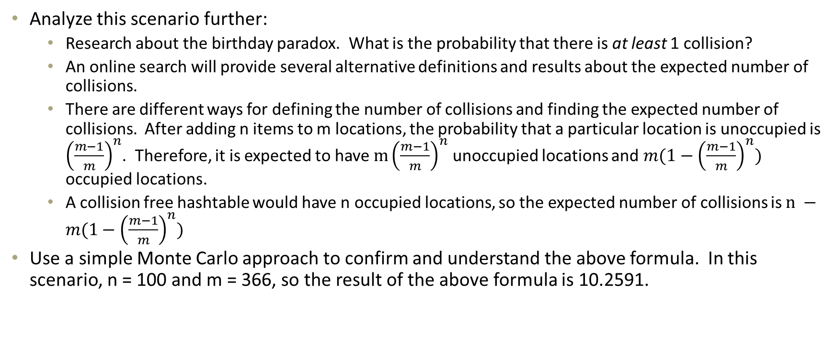
Hashing functions
Analyze this scenario further:
Research about the birthday paradox. What is the probability that there is at least 1 collision?
An online search will provide several alternative definitions and results about the expected number of collisions.
There are different ways for defining the number of collisions and finding the expected number of collisions. After adding n items to m locations, the probability that a particular location is unoccupied is ${\left(\frac{m−1}{m}\right)}^{n}$. Therefore, it is expected to have $m{\left(\frac{m−1}{m}\right)}^{n}$ unoccupied locations and ${m(1−\left(\frac{m−1}{m}\right)}^{n})$ occupied locations.
A collision free hashtable would have n occupied locations, so the expected number of collisions is $n −{m(1−\left(\frac{m−1}{m}\right)}^{n})$
Use a simple Monte Carlo approach to confirm and understand the above formula. In this scenario, n = 100 and m = 366, so the result of the above formula is 10.2591.

Slide 13
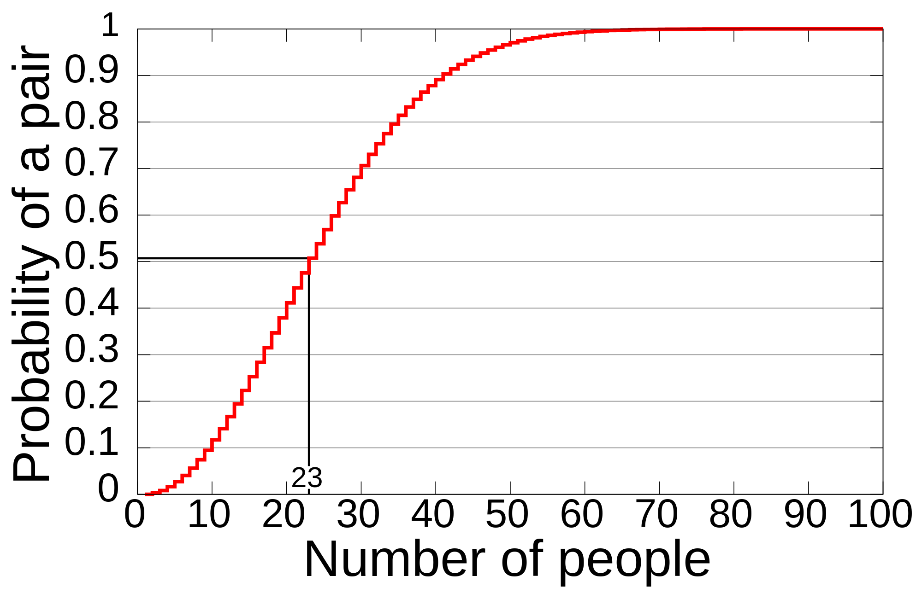
Hashing functions
The following picture shows the probability of 2 people sharing a birthday.

Slide 14
Hashing functions
When dealing with objects, a common approach, as in C# and Java is to use the object’s memory location.
This approach works well with most objects, but it can cause problems in cases when two instances of an object represent the same key!

Slide 15
Hashing functions
Consider an alternative scenario with String valued keys.
One possible hash function is to:
convert all the characters of the strings to an integer value and sum them
take the sum modulo n (where n is the size of the array) as the result.
For example the key “algorithm”, and an array size of 100, would produce the following key: (97 + 108 + 103 + 111 + 114 + 105 + 116 + 104 + 109) mod 100 = 967 mod 100 = 67

Slide 16
Hashing functions
Consider another example key, “logarithm” (and the same array size), what hash value would this key produce?

Slide 17
Hashing functions
One common mistake in typing is the transposition error. Consider the following misspelled key: “alogrithm”
What is the hash value of this key?
In many situations, changing the order of the “elements” of the key, or simple manipulations can lead to a lot of collisions, making this hash algorithm a poor choice in general.
In English, short words tend to have a lot of anagrams. These will cause collisions, no matter the table size. Example: “table”, “bleat”, “blate” and “ablet” all produce the same hash value.
The problem is that even though the position of the letters are important, the hash value does not consider it at all.

Slide 18
Hashing functions
A hash function can be defined as the composition of two functions:
The first part is called the hash code map. This function attempts to “spread out” the keys as much as possible.
The second part is called the compression map. The function will map the results of the hash code map to the available locations in the table.
h₁
h₂
keys
integers
[0, N-1]
k
h₁(k)
h₂(h₁(k))

Slide 19
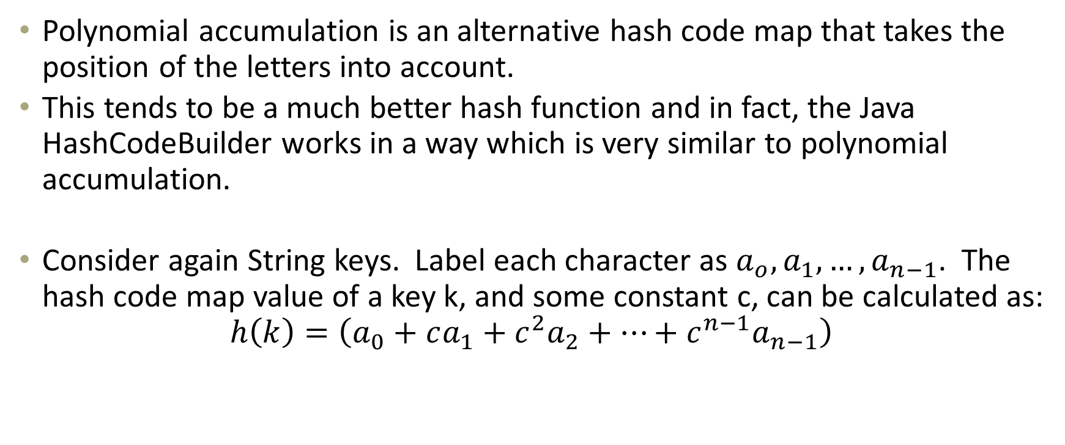
Hashing functions
Polynomial accumulation is an alternative hash code map that takes the position of the letters into account.
This tends to be a much better hash function and in fact, the Java HashCodeBuilder works in a way which is very similar to polynomial accumulation.
Consider again String keys. Label each character as $a_{o}, a_{1}, …, a_{n−1}$. The hash code map value of a key k, and some constant c, can be calculated as:
$$h\left(k\right)=\left(a_{0}+ca_{1}+c^{2}a_{2}+…+c^{n−1}a_{n−1}\right)$$

Slide 20
Hashing functions
For example, given the key “table”, c = 37 (c is often chosen to be prime) and n = 100, the hash code map value would be:
$$\left(116+37×97+{37}^{2}×98+{37}^{3}×108+{37}^{4}×101\right)=$$
$$222454276$$
Using polynomial accumulation with a good value of c, and a dictionary of 50,000 English words results in less than 10 collisions!

Slide 21
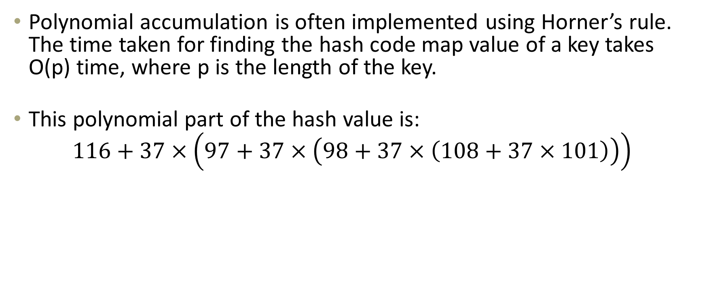
Hashing functions
Polynomial accumulation is often implemented using Horner’s rule. The time taken for finding the hash code map value of a key takes O(p) time, where p is the length of the key.
This polynomial part of the hash value is:
$$116+37×\left(97+37×\left(98+37×\left(108+37×101\right)\right)\right)$$

Slide 22
Hashing functions
It is possible to further improve the hashing function, by modifying the compression function.
One improvement would be to select a table size (n) which is a prime number. This tends to reduce the number of collisions.

Slide 23
Hashing functions
It is also possible to again improve the hashing function by replacing the “mod n” with a Multiple, Add and Divide (MAD) compression function.
In this case, the hash function is defined as:
$$h_{2}\left(h_{1}\left(k\right)\right)=\left( a×h_{1}\left(k\right)+b \right) mod n$$

Slide 24

Collision Resolution
There are two basic techniques for handling conflicts:
Chaining; and
Open addressing
In chaining, each location in the table, contains a linked list. When an element is added to this location of the table, it is inserted into the linked list. To retrieve an element, the linked list is traversed, until the key is found.

Slide 25
Collision Resolution
In open-addressing, when a collision occurs, the item is moved to a different location in the table. To retrieve an element, the table needs to be searched in order to find the key. The method used to search for the key depends on what type of open-addressing technique is used.

Slide 26
Collision Resolution
Chaining is simple to implement, but has the following disadvantages:
it requires an extra data structure to store the elements;
extra space for storing the same amount of data; and
retrieving the element, typically requires an extra read operation.

Slide 27
Collision Resolution
Open-addressing on the other hand, is harder to implement.
It can perform faster on average, but it can perform poorly under a heavy load factor. That is, if the underlying table is very full, open-addressing can quickly lead to a worst case.
Two open-addressing techniques are:
Linear Probing: where the new item causing a collision is moved to the next available space. Linear probing tends to create groups of elements near each other, creating a tendency for a long list of “probes” (check for the element in the next space).
Double Hashing: if the hash result causes a collision, a series of alternative hash results are calculated, until an available space is found.

Slide 28
Collision Resolution
Linear Probing example:
h(x) = x mod 13
insert 18, 41, 22, 44, 59, 32, 31, 73, in this order

Slide 29
Collision Resolution
To find an element in Linear Probing, the following algorithm can be used:
FindElement(k)
position = h(k)
count = 0;
while (V[position] != null && count < V.Length) { If (V[position].key == k) { return V[position]; } position++; count++; }
Exception: k is not found!

Slide 30
Collision Resolution
Exercise:
What could happen if an element is deleted?
One common technique is to replace a deleted element with a special placeholder, called AVAILABLE.
When an insertion operation, finds an AVAILABLE, it can replace the placeholder with the new element.
While searching, an AVAILABLE placeholder is treated just as if there is an element still present.
Exercise:
Implement a hashtable with linear probing and the delete functionality.

Slide 31
Collision Resolution
Double hashing uses a secondary hash function d(k) and handles collisions by placing an item in the first available cell of the series
(i + j·d(k)) mod N for j = 0, 1, … , N − 1
The secondary hash function d(k) cannot have zero values
The table size N must be a prime to allow probing of all the cells
A common choice of compression map for the secondary hash function:
d₂(k) = q−(k mod q)
where
q < N
q is a prime
the possible values for d₂(k) are 1, 2, … , q

Slide 32
Collision Resolution
Example: consider a hash table storing integer keys that handles collision with double hashing
N = 13
h(k) = k mod 13
d(k) = 7−(k mod 7)
insert 18, 41, 22, 44, 59, 32, 31, 73, in this order

Slide 33
Collision Resolution

Slide 34
Load Factor and Implications
Recall that a hash table can have a worst case, which is O(n).
The load factor affects the expected running time of a search. The load factor is defined as α = n/N, where n is the number of elements in the hash table and N is the number of positions available.
The higher the load factor, the more likely that a lot of collisions will occur and the longer lookups will take.

Slide 35
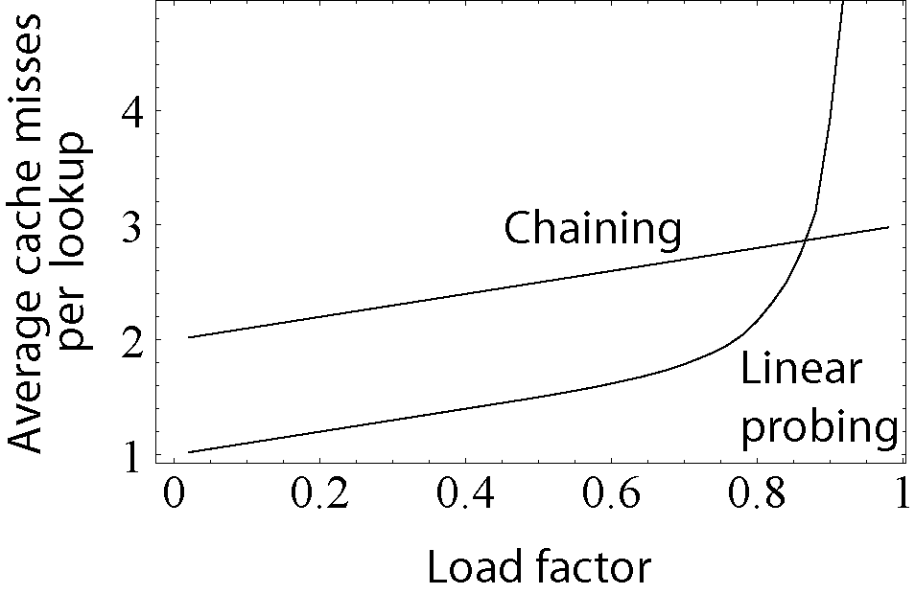
Load Factor and Implications

Slide 36
End of lesson
Any Questions?

