Slide 1
Drag-Race API
An API to data from a Drag Race.

Slide 2






Environment used
JDK 18 :
Database :
Dependency management :
Containerization :
Web dev framework:
Documentation :

Slide 3
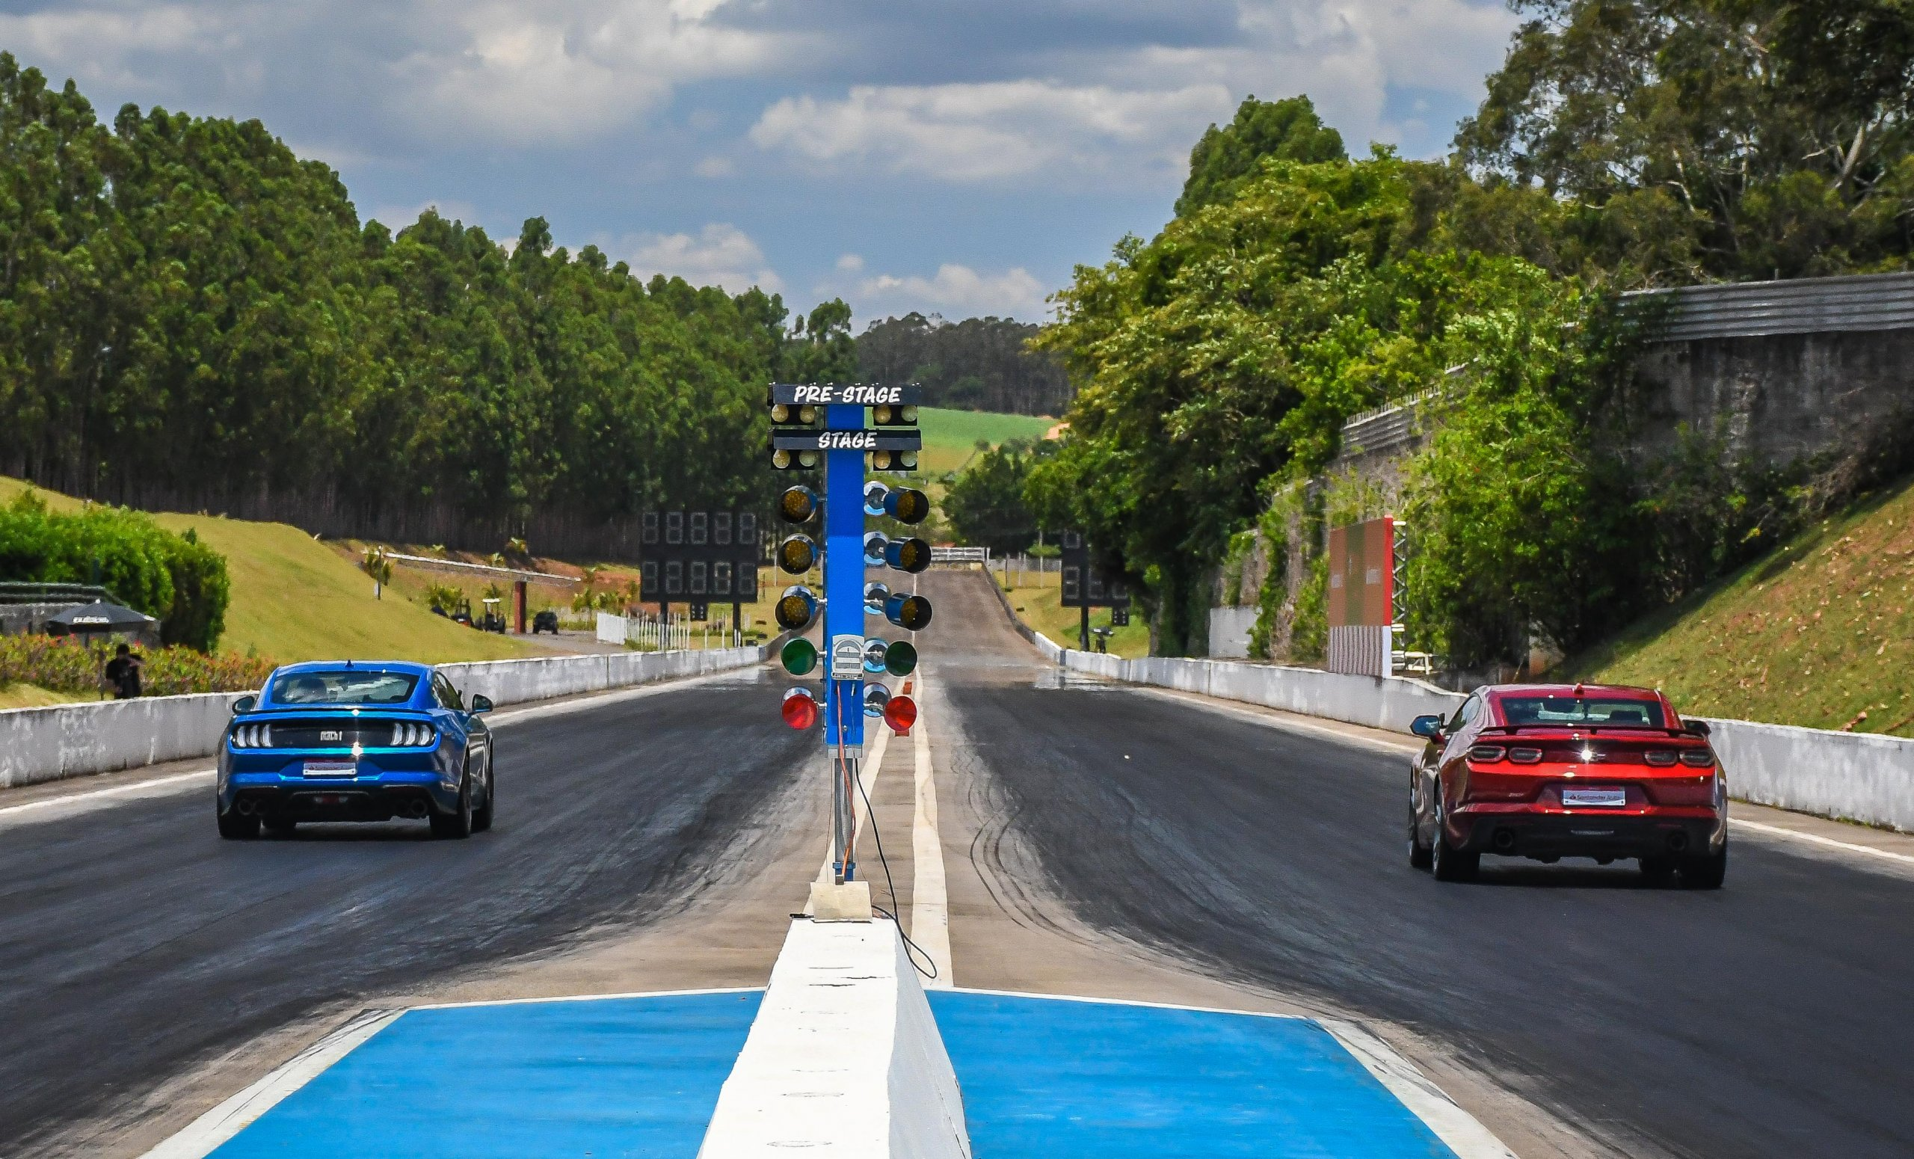
What it is a drag race ?

Slide 4
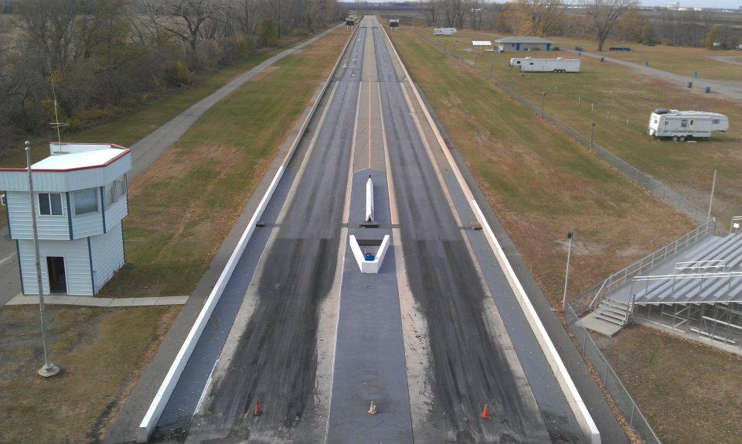


What it is ?
Faster speed at the speed trap
Faster time in the whole track
2 winners for each race

Slide 5
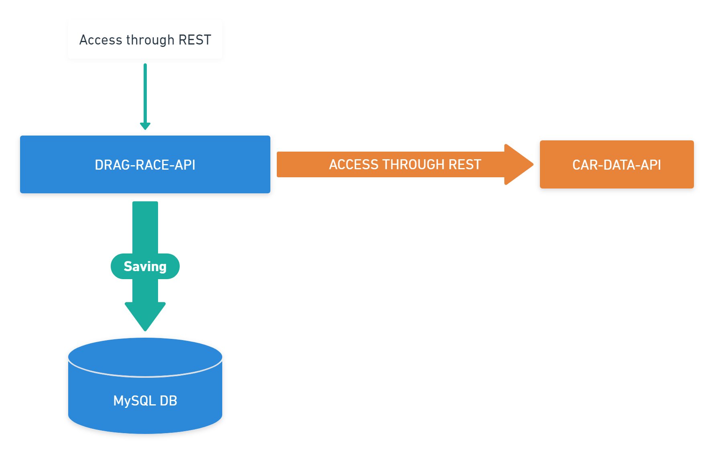
How it works ?

Slide 6
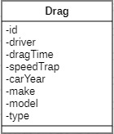
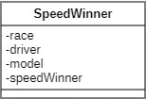
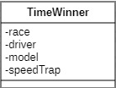
Model

Slide 7


Where is running?
DRAG-RACE-API
MYSQL 8 DB

Slide 8
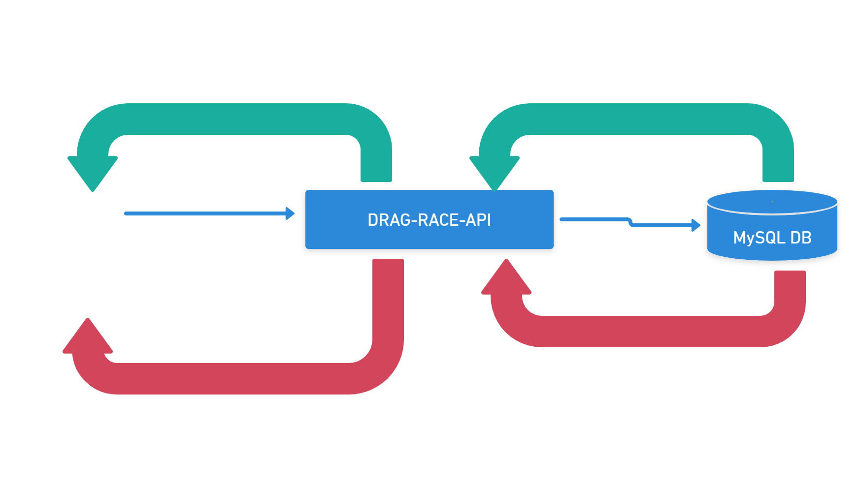
The API in action:

Slide 9
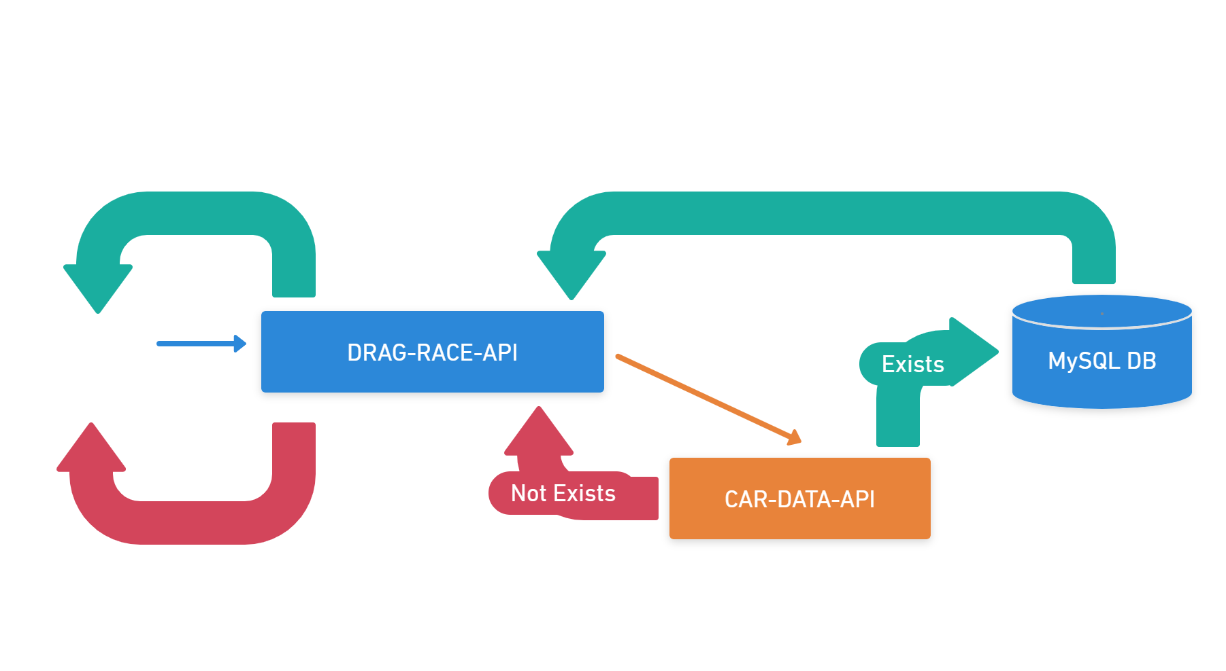
The API in action:

Slide 10
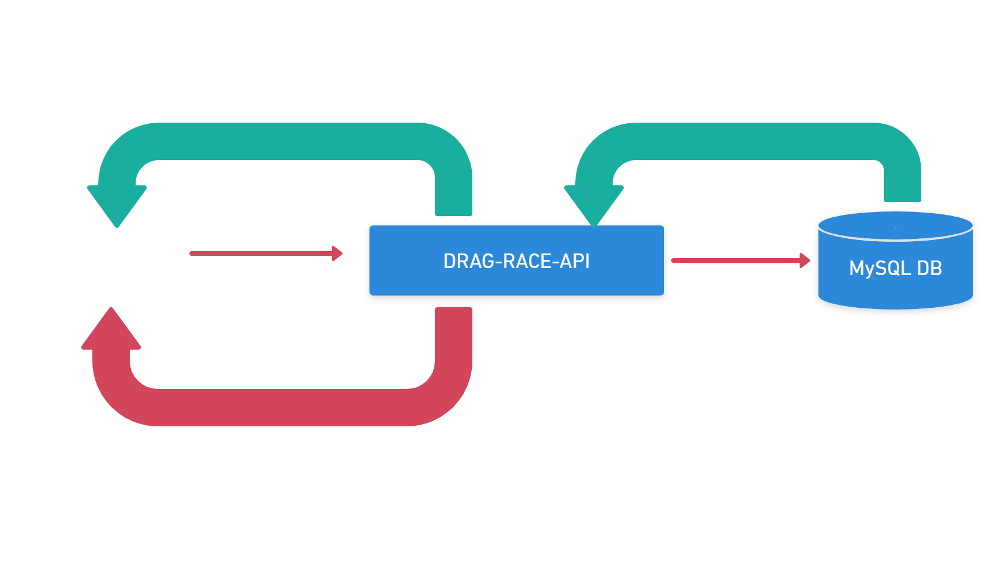
The API in action:

