Slide 1


SMART INDIA HACKATHON 2024
TITLE PAGE
Problem Statement ID – SIH1684
Problem Statement Title- Agent-less Windows System Vulnerability and Network Scanner
Theme- Blockchain & Cybersecurity
PS Category- Software
Team ID-
Team Name- DeadBoltt

Slide 2
IDEA TITLE
Dead Boltt
Proposed Solution
Our Software solution Includes comprehensive system and network analysis
Enhanced by integration of Splunk’s in real-time data collection, monitoring, and reporting
Integrates PowerShell-based file rescanning for up-to-date vulnerability checks
Uses a security database API for accurate and timely vulnerability identification
Can be deployed as an executable in System32/BIOS for automatic startup or scheduled via Task Scheduler
Features a user-friendly GUI for easy installation and configuration
Adaptable solution for various security needs and compatible with modern Windows systems
We use differnt type of python scripts to automate the system scanning.
Bash script’s are also used when found necessary .

Slide 3
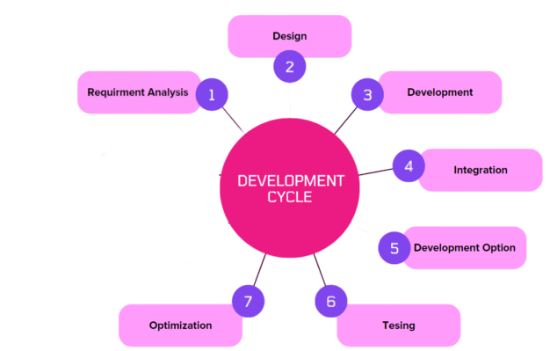
TECHNICAL APPROACH
Dead
Boltt
Technologies Implemented:
Splunk: For real-time data collection, monitoring, and advanced reporting.
PowerShell: For file rescanning and automated scripting tasks.
Security Database API: For cross-referencing vulnerabilities with up-to-date threat intelligence.
Windows Task Scheduler: For scheduling scans and tasks.
System32/BIOS: For deploying the tool for automatic startup.
GUI Framework: For creating an intuitive and user-friendly interface.
Python: For scripting and automation tasks.
Bash: For scripting and executing commands in Unix-like environments

Slide 4
FEASIBILITY AND VIABILITY
Dead
Boltt
Feasibility Analysis :
Technical Feasibility: Use standard protocols and tools like WMI, SMB, PowerShell, and Nmap.
Operational Feasibility: CLI or web interface development and reporting are manageable.
Financial Feasibility: Mainly involves development time; minimal cost for tools.
Challenges and Risks:
Technical: Remote access issues and performance impact.
Security: Risk of unauthorized access and data breaches.
Scalability: Handling large or distributed environments.
Strategies for Overcoming Challenges
Technical: Manage permissions and optimize performance and Implement modular design and load balancing.
Scalability: Security: Use encryption and access controls
User Experience: Test interfaces and provide thorough documentation.

Slide 5
IMPACT AND BENEFITS
Dead
Boltt
Potential Impact on the Target Audience :
Enhanced Security: Provides organizations with the ability to identify and address vulnerabilities without installing agents, improving overall system security.
Compliance Assurance: Helps ensure systems meet security compliance standards, reducing legal and regulatory risks.
Operational Efficiency: Simplifies vulnerability assessment processes, saving time and resources compared to traditional methods.
Benefits of the Solution :
Social: Improves cybersecurity awareness and practices, contributing to safer digital environments for users.
Economic: Reduces costs associated with security breaches and compliance fines by proactively identifying vulnerabilities.
Environmental: By minimizing the need for physical installations and maintenance, the solution can contribute to reduced resource consumption and waste.

Slide 6
RESEARCH AND REFERENCES
Dead Boltt
Books and Articles :
"Windows Internals" by Mark Russinovich, David Solomon, and Alex Ionescu: In-depth guide on Windows OS internals, security, and management.
"Network Security Assessment: Know Your Network" by Chris McNab: Analysis and methods for network security assessments, tools, and techniques.
Online Resources :
Nmap Documentation :Comprehensive guide on network scanning and security assessments using Nmap.
CVE Details :Provides detailed information on common vulnerabilities and exposures (CVEs).
Research Paper :
Security Assessment of Windows Operating Systems: Vulnerabilities and Mitigations" by H. V. N. Kumar .
A Survey of Vulnerability Scanning Tools for Network Security" }by R. Alazab, et al.Reviews various tools and techniques for network vulnerability scanning.

