Slide 1
Digital Image Processing Chapter 1: Introduction to Digital Image Processing
Notes:
1

Slide 2
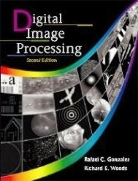
References
Digital Image Processing, Rafael C. Gonzalez & Richard E. Woods, Addison-Wesley, 2002
Digital Image Processing textbook, PTIT, 2018
Notes:
2

Slide 3
Contents
Chapter 1: Introduction to Digital Image Processing - DIP
Chapter 2: Fundamentals of DIP
Chapter 3: Image Transformation
Chapter 4: Color Schemes and Image Printing
Chapter 5: Edge Detection
Chapter 6: Image Segmentation
Chapter 7: Image Compression
Chapter 8: Image Pattern Classification

Slide 4
Assessments
3 credits = 45 class hours
Lecture attendance: 10%
Assignment: 20%
Midterm test: 10%
Final test: 60%

Slide 5
Contents
This lecture will cover:
What is a digital image?
What is Digital Image Processing - DIP?
History of DIP
Some important applications of DIP
Main steps in DIP
Notes:
5

Slide 6
What is a Digital Image?
An image may be defined as a two-dimensional function, f(x,y): x and y are spatial (plane) coordinates; the amplitude of f at any pair of coordinates (x, y) is called the intensity or gray level of the image at that point.
When x, y, and the intensity values of f are all finite, discrete quantities, we call the image a digital image.
A digital image is composed of a finite number of elements, each of which has a particular location and value. These elements are called picture elements, image elements, pels, and pixels.
Pixel is the term used most widely to denote the elements of a digital image.

Slide 7
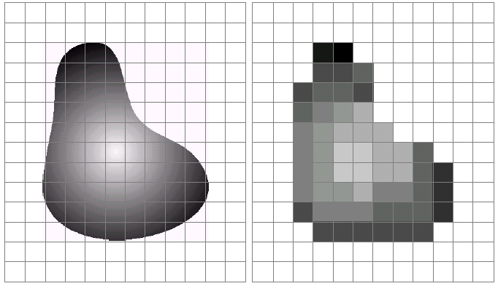
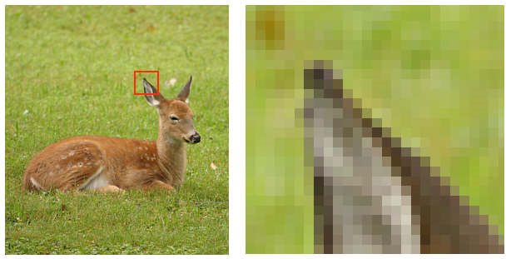
What is a Digital Image?
A pixel value shows the light intensity - brightness, color, some intensity level etc.
Note that digitization implies that a digital image is an approximation of the real scene.
1 pixel
Notes:
7

Slide 8
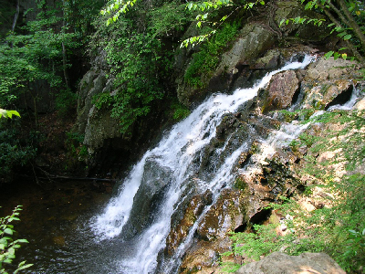
What is a Digital Image?
Typical image formats:
1 sample per pixel - B&W or Grayscale images
3 samples per pixel - Red, Green, and Blue or RGB images
For most of the course, we mainly focus on grayscale images.
Notes:
8

Slide 9
What is a Digital Image?
The field of DIP refers to processing digital images by means of a digital computer.
DIP encompasses processes whose inputs and outputs are images and, in addition, includes processes that extract attributes from images up to, and including, the recognition of individual objects.
DIP has two main tasks:
Improvement of pictorial information for human interpretation
Processing of image data for storage, transmission, representation for autonomous machine perception
Notes:
9

Slide 10
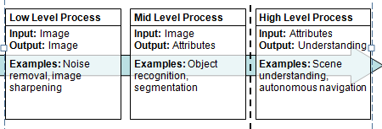
What is a Digital Image?
The continuum from image processing to computer
vision can be broken up into low-, mid- and high level processes
Notes:
10

Slide 11
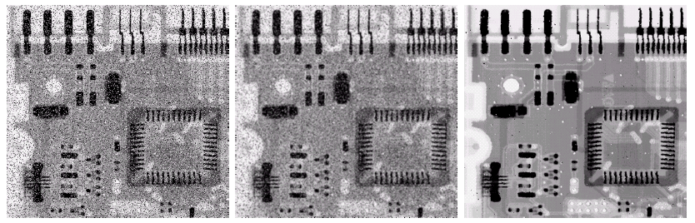
What is a Digital Image?
An example of low level process:
Original Image With Noise
Image After Averaging Filter
Image After Median Filter

Slide 12


What is a Digital Image?
An example of mid level process:
Original Image
Thresholded Image

Slide 13
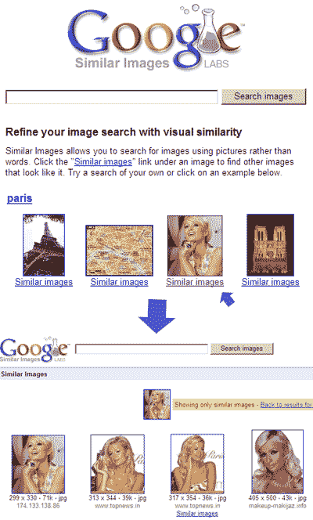
What is a Digital Image?
An example of high level process:

Slide 14
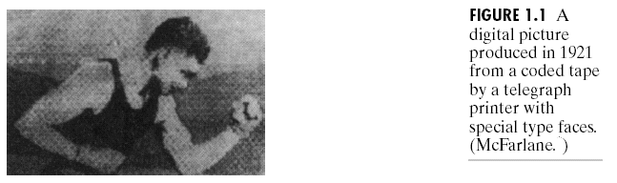
History of Digital Image Processing
Early 1920s: One of the first applications of digital imaging was in the newspaper industry
The Bartlane cable picture transmission service
Images were transferred by submarine cable between London and New York
Pictures were coded for cable transfer and reconstructed at the receiving end on a telegraph printer
Early digital image
Notes:
14

Slide 15
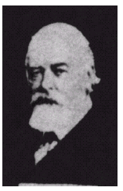
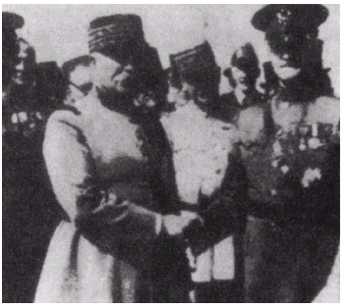
History of Digital Image Processing
Mid to late 1920s: Improvements to the Bartlane system resulted in higher quality images
New reproduction processes based on photographic techniques
Increased number of tones in reproduced images
Improved digital image
Early 15 tone digital image
Notes:
15

Slide 16
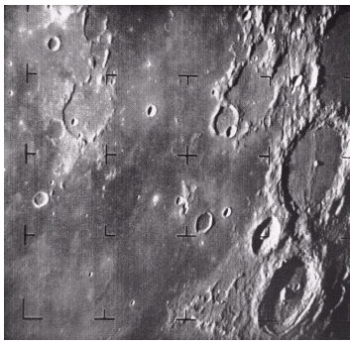
History of Digital Image Processing
1960s: Improvements in computing technology and the onset of the space race led to a surge of work in DIP
1964: Computers used to improve the quality of images of the moon taken by the Ranger 7 probe
Such techniques were used in other space missions including the Apollo landings
A picture of the moon taken by the Ranger 7 probe minutes before landing
Notes:
16

Slide 17
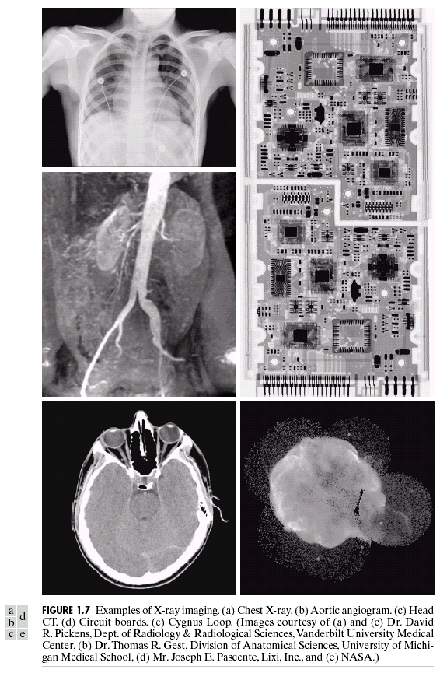
History of Digital Image Processing
1970s: DIP used in medical applications
1979: Sir Godfrey N. Hounsfield & Prof. Allan M. Cormack share the Nobel Prize in medicine for the invention of tomography, the technology behind Computerized Axial Tomography - CAT scans
Typical head slice CAT image
Notes:
17

Slide 18
History of Digital Image Processing
1980s - Today: The use of DIP techniques has exploded and they are now used for all kinds of tasks, in all kinds of areas
Image enhancement/restoration
Artistic effects
Medical visualization
Industrial inspection
Law enforcement
Human computer interfaces
Notes:
18

Slide 19
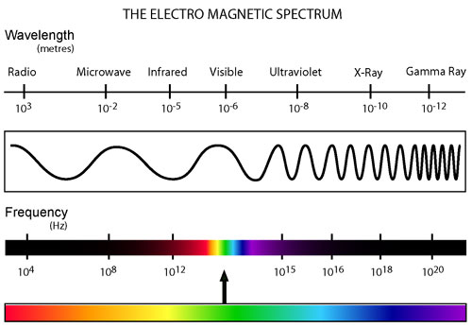
Some areas of applications of DIP
DIP applications can be categorized according to their source (X-ray, visual, infrared, etc.).
Notes:
19

Slide 20
Some areas of applications of DIP
The principal energy source for images in use today is the electromagnetic energy spectrum.
Other important sources of energy include acoustic, ultrasonic, and electronic (in the form of electron beams used in electron microscopy).
Notes:
20

Slide 21
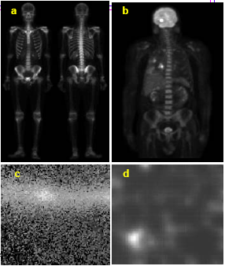
Gamma-Ray images
Major uses of imaging based on gamma rays include nuclear medicine and astronomical observations.
Bone Scan
Position Emission Tomography (PET) scan showing tumours in brain and lung
Cygnus Loop: A superheated stationary gas cloud
Gamma radiation from reactor valve
Notes:
21

Slide 22
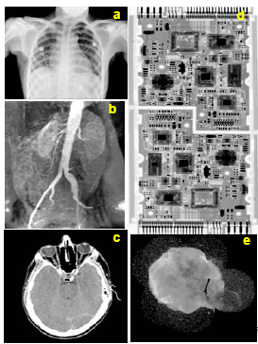
X-Ray images
X-rays images are generated using an X-ray tube, a vacuum tube with a cathode and anode. The cathode is heated, causing free electrons to be released. These electrons flow at high speed to the positively charged anode. When the electrons strike a nucleus, energy is released in the form of X-ray radiation.
Chest X-ray.
Aortic angiogram
Head CT
Circuit boards
Cygnus Loop

Slide 23
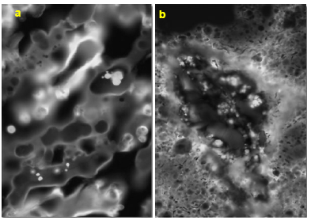
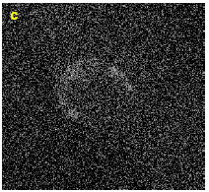
Ultraviolet images
Applications of ultraviolet “light” are varied. They include lithography, industrial inspection, microscopy, lasers, biological imaging, and astronomical observations.
Normal corn
Corn infected by smut
Cygnus Loop
Notes:
23

Slide 24
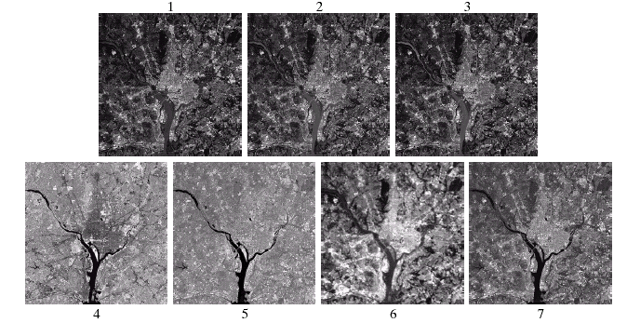
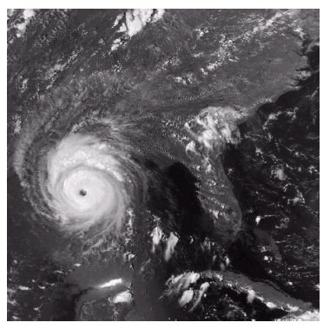
DIP in GIS
Typical areas of applications:
Satellite images
Terrain classification
Meteorology
GIS
Geographic Information Systems
Notes:
24

Slide 25
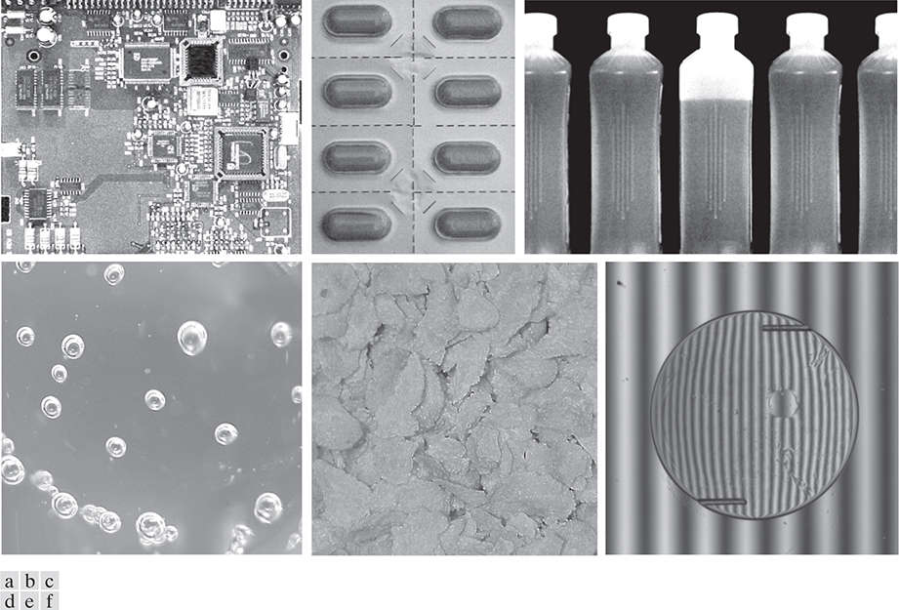
DIP in Industrial Testing
Automated Visual Inspection of manufactured goods
(a) Circuit board controller. (b) Packaged pills. (c) Bottles. (d) Air bubbles in a clear plastic product. (e) Cereal. (f) Image of intraocular implant
Notes:
25

Slide 26
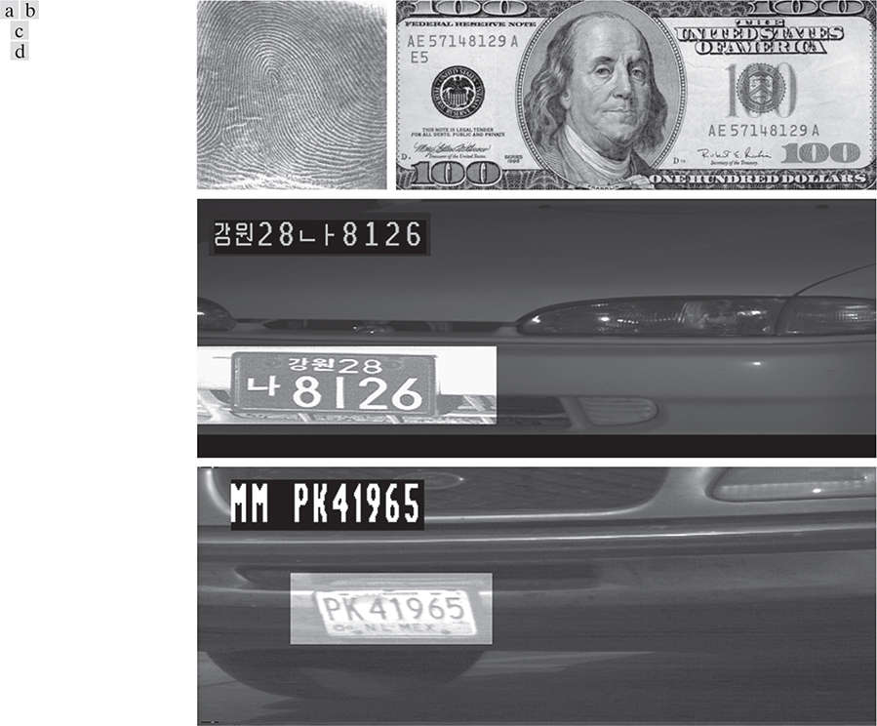
DIP in Law Enforcement
(a) Thumb print
(b) Paper currency
(c) and (d) Automated license plate reading
Notes:
26

Slide 27
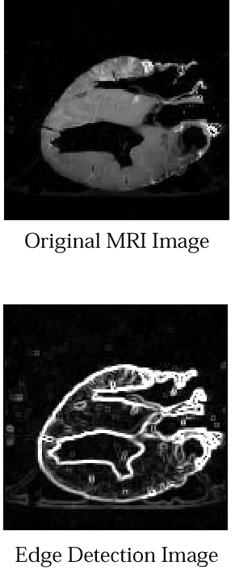
DIP in Medicine
The major applications of imaging in the radio band are in medicine, astronomy etc. The technique is Magnetic Resonance Imaging - MRI. It places a patient in a powerful magnet, passes radio waves through the patient’s body in short pulses, captures the emitted radio waves. The location from which these signals originate, their strength are determined by a computer, which produces a 2D image of a section of the patient.
MRI of a heart
The detected heart edge with DIP
Notes:
27

Slide 28
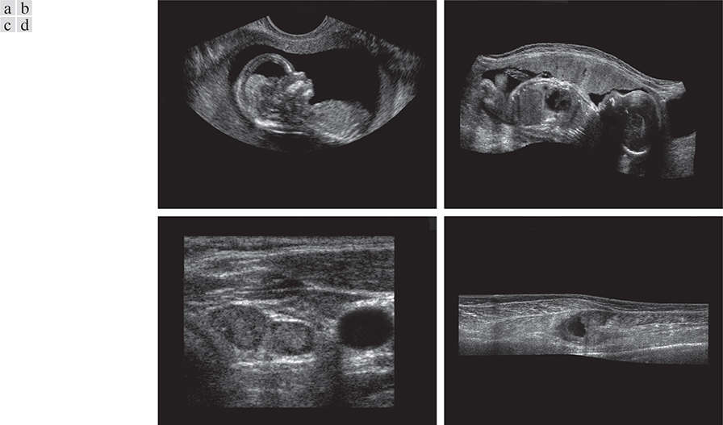
DIP in Medicine
Example of Ultrasound Imaging
(a) A fetus.
(b) Another view of the fetus
(c) Thyroids.
(d) Muscle layers showing lesion.
Notes:
28

Slide 29
Fundamental Steps in DIP
Image Restoration
Morphological Processing
Image Enhancement
Segmentation
Object Recognition
Image Acquisition
Representation & Description
Problem Domain
Colour Image Processing
Image Compression
Notes:
29

Slide 30
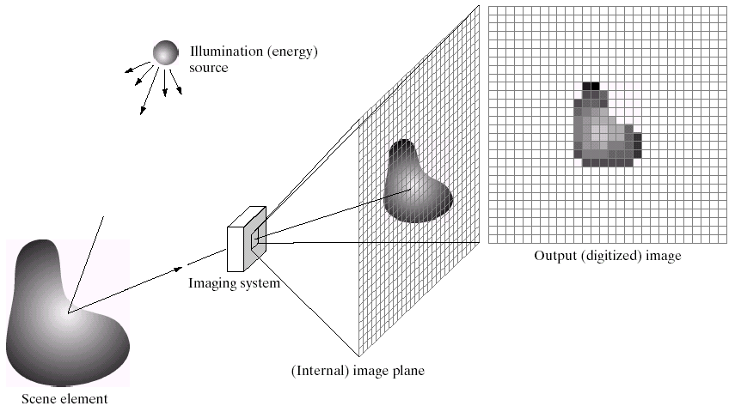
Fundamental Steps in DIP
Image Restoration
Morphological Processing
Image Enhancement
Segmentation
Object Recognition
Image Acquisition
Representation & Description
Problem Domain
Colour Image Processing
Image Compression
Notes:
30

Slide 31
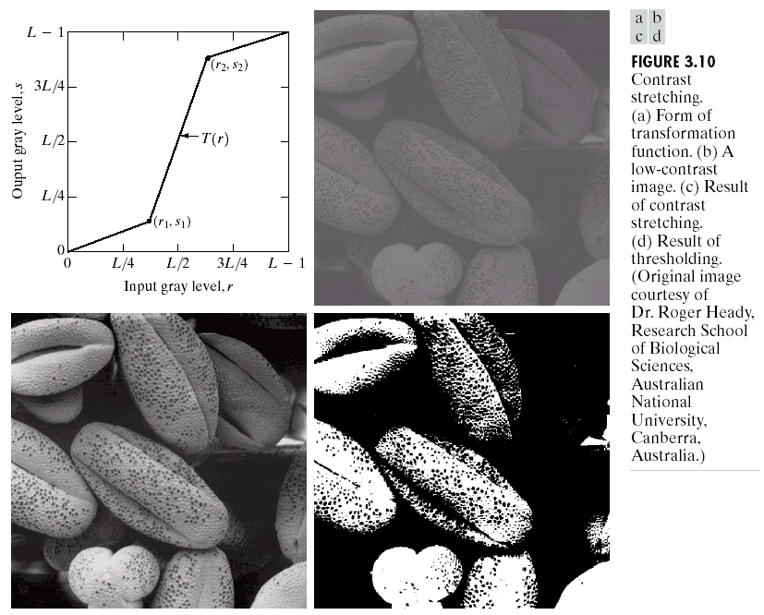
Fundamental Steps in DIP
Image Restoration
Morphological Processing
Image Enhancement
Segmentation
Object Recognition
Image Acquisition
Representation & Description
Problem Domain
Colour Image Processing
Image Compression
Notes:
31

Slide 32
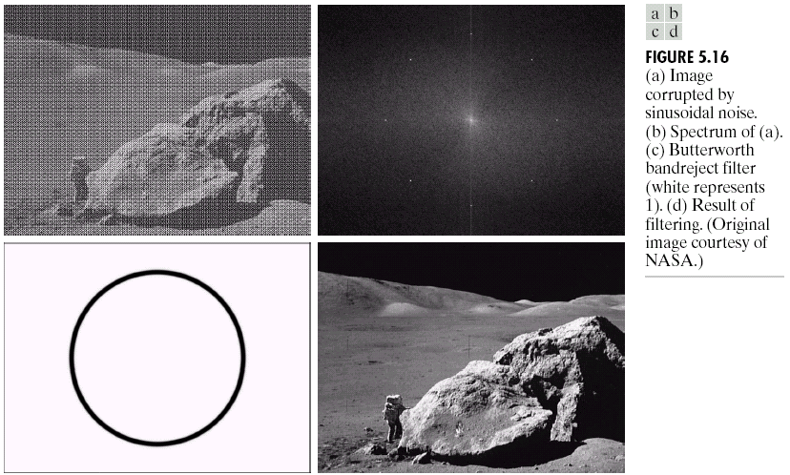
Fundamental Steps in DIP
Image Restoration
Morphological Processing
Image Enhancement
Segmentation
Object Recognition
Image Acquisition
Representation & Description
Problem Domain
Colour Image Processing
Image Compression
Notes:
32

Slide 33
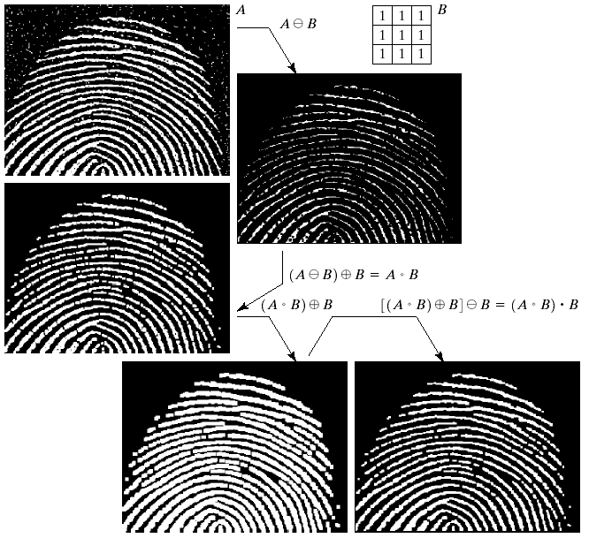
Fundamental Steps in DIP
Image Restoration
Morphological Processing
Image Enhancement
Segmentation
Object Recognition
Image Acquisition
Representation & Description
Problem Domain
Colour Image Processing
Image Compression
Notes:
33

Slide 34
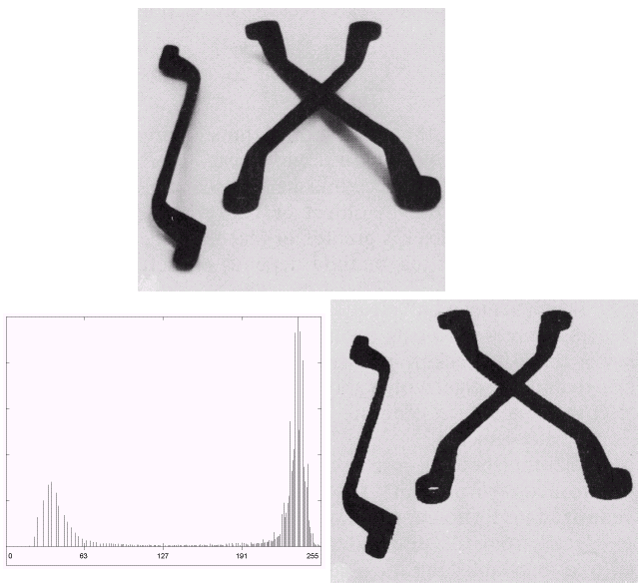
Fundamental Steps in DIP
Image Restoration
Morphological Processing
Image Enhancement
Segmentation
Object Recognition
Image Acquisition
Representation & Description
Problem Domain
Colour Image Processing
Image Compression
Notes:
34

Slide 35
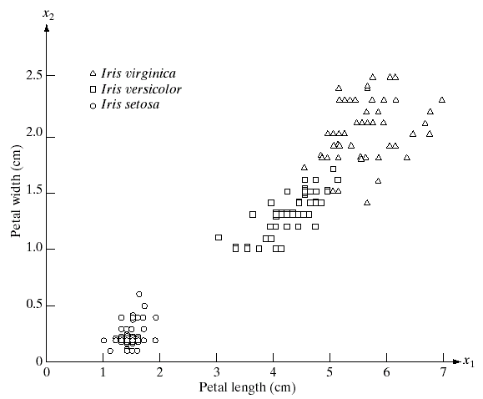
Fundamental Steps in DIP
Image Restoration
Morphological Processing
Image Enhancement
Segmentation
Object Recognition
Image Acquisition
Representation & Description
Problem Domain
Colour Image Processing
Image Compression
Notes:
35

Slide 36
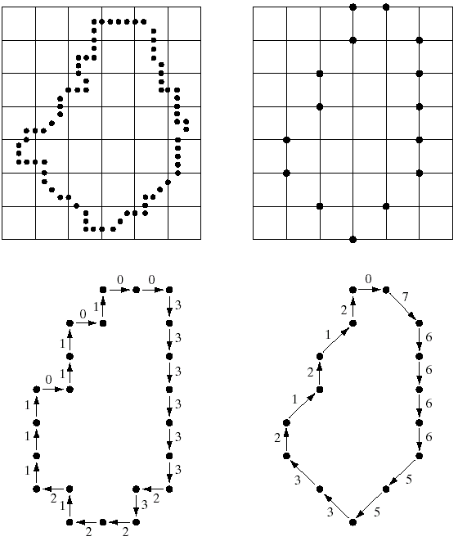
Fundamental Steps in DIP
Image Restoration
Morphological Processing
Image Enhancement
Segmentation
Object Recognition
Image Acquisition
Representation & Description
Problem Domain
Colour Image Processing
Image Compression
Notes:
36

Slide 37
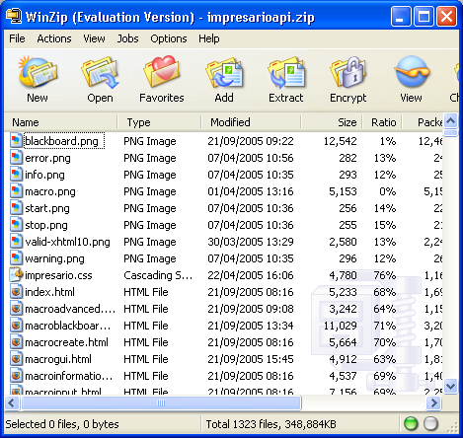
Fundamental Steps in DIP
Image Restoration
Morphological Processing
Image Enhancement
Segmentation
Object Recognition
Image Acquisition
Representation & Description
Problem Domain
Colour Image Processing
Image Compression
Notes:
37

Slide 38
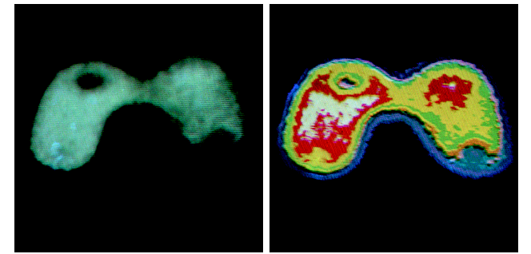
Fundamental Steps in DIP
Image Restoration
Morphological Processing
Image Enhancement
Segmentation
Object Recognition
Image Acquisition
Representation & Description
Problem Domain
Colour Image Processing
Image Compression
Notes:
38

Slide 39
Summary
Subjects covered:
Digital Image
Digital Image Processing
Digital Image History
DIP Applications
Fundamental Steps in DIP
Notes:
39

