Slide 1
Digital Image Processing Chapter 2: Fundamentals of Digital Image Processing

Slide 2
Contents
This lecture will cover:
Elements of Visual Perception
Light and the Electromagnetic Spectrum
Image Representation
Image Sensing and Acquisition
Image Sampling, Quantization and Digital Image Resolution

Slide 3
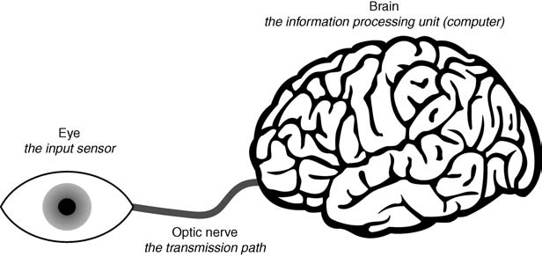
Human Visual Perception
3 main parts:
Eyes
Optic nerve
Brain
Simplified view of the connection from the eye to the brain via the optic nerve

Slide 4
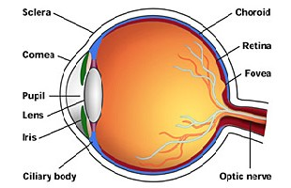
Structure of the Human Eye
The eye: nearly a sphere, diameter ~ 20 mm
Enclosed by 3 membranes: the cornea and sclera outer cover; the choroid; the retina.
The cornea: a tough, transparent tissue that covers the anterior surface of the eye.
Continuous with the cornea, the sclera is an opaque membrane that encloses the remainder of the optic globe.
The choroid lies directly below the sclera, contains a network of blood vessels that serve as the major source of nutrition to the eye. At its anterior extreme, it is divided into the ciliary body and the iris. The iris contracts or expands to control the amount of light that enters the eye. The central opening of the iris (the pupil) varies in diameter from ~2 to ~8 mm.
The lens consists of concentric layers of fibrous cells and is suspended by fibers that attach to the ciliary body. It is composed of 60% to 70% water, ~6% fat, and more protein than any other tissue in the eye.

Slide 5
Structure of the Human Eye
Retina: the innermost membrane of the eye. When the eye is focused, light from an object is imaged on the retina. Pattern vision is afforded by discrete light receptors distributed over the surface of the retina.
2 types of receptors: cones and rods. There are between 6 and 7 million cones in each eye. They are located primarily in the central portion of the retina, i.e. the fovea, and are highly sensitive to color.
Each cone is connected to its own nerve end. Muscles rotate the eye until the image of a region of interest falls on the fovea. Cone vision is called photopic or bright-light vision. The number of rods is ~75 to ~150 million, distributed over the retina. The larger area of distribution, several rods are connected to a single nerve ending. Rods capture an overall image of the field of view. They are not involved in color vision, and are sensitive to low levels of illumination.

Slide 6
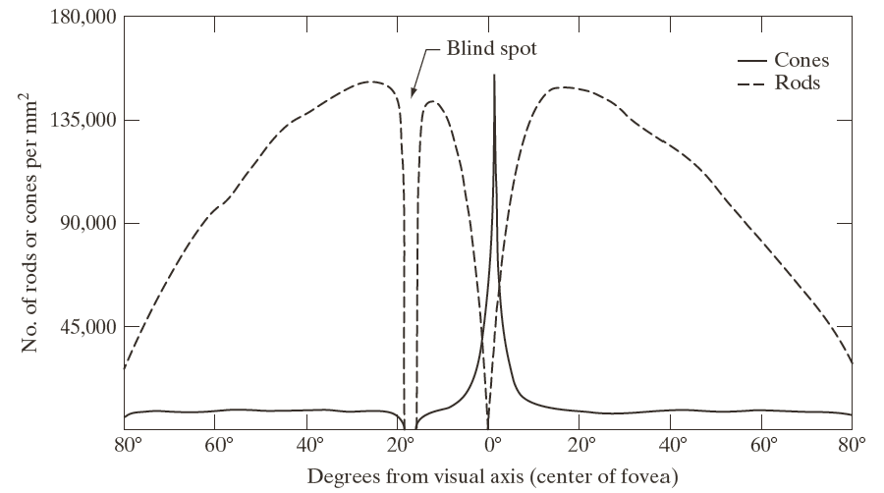
Structure of the Human Eye
Distribution of rods and cones in the retina
Notes:
Figure 2.2 shows the density of rods and cones for a cross section of the right eye, passing through the region where the optic nerve emerges from the eye. The absence of receptors in this area causes the so-called blind spot (see Fig. 2.1 ). Except for this region, the distribution of receptors is radially symmetric about the fovea. Receptor density is measured in degrees from the visual axis. Note in Fig. 2.2 that cones are most dense in the center area of the fovea, and that rods increase in density from the center out to approximately off axis. Then, their density decreases out to the periphery of the retina. The fovea itself is a circular indentation in the retina of about 1.5 mm in diameter, so it has an area of approximately As Fig. 2.2 shows, the density of cones in that area of the retina is on the order of 150,000 elements per Based on these figures, the number of cones in the fovea, which is the region of highest acuity in the eye, is about 265,000 elements. Modern electronic imaging chips exceed this number by a large factor. While the ability of humans to integrate intelligence and experience with vision makes purely quantitative comparisons somewhat superficial, keep in mind for future discussions that electronic imaging sensors can easily exceed the capability of the eye in resolving image detail.

Slide 7
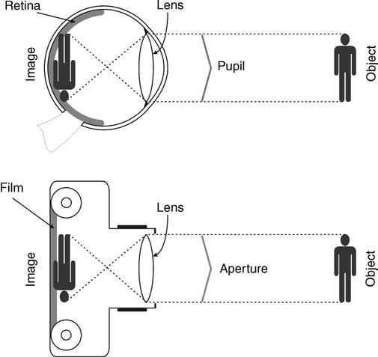
Image Formation in the Eye
Eye
Camera
The eye-camera analogy

Slide 8
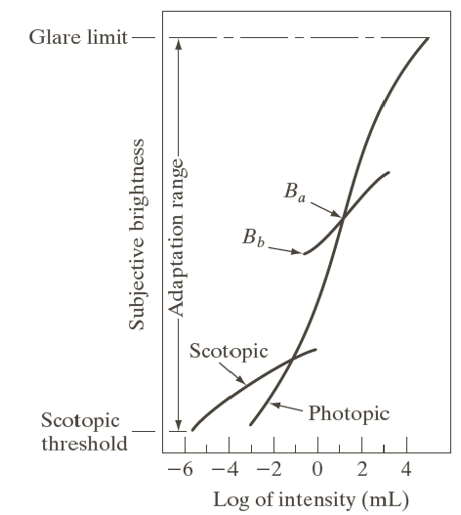
Brightness Adaptation
Dynamic range of human visual system: 10⁻⁶ ~ 10⁴, the system cannot accomplish this range simultaneously
The current sensitivity level: the brightness adaptation level
Scotopic vision: the vision of the eye under low-light conditions; Photopic vision: the vision of the eye under well-lit conditions
Glare: difficulty of seeing in the presence of bright light
Range of subjective brightness sensations showing a particular adaptation level, B_{a}
Notes:
The short intersecting curve represents the range of subjective brightness that the eye can perceive when adapted to this level. This range is rather restricted, having a level at Bb, and below which, all stimuli are perceived as indistinguishable blacks. The upper portion of the curve is not actually restricted but, if extended too far, loses its meaning because much higher intensities would simply raise the adaptation level higher than Ba.

Slide 9
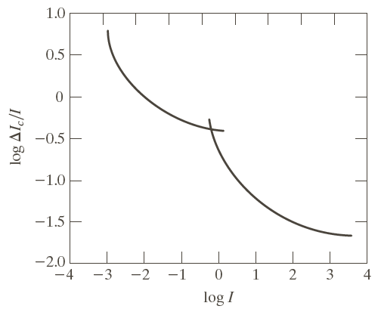
Brightness Discrimination
A typical plot of the Weber ratio as a function of intensity
Weber ratio: ∆I_{c}/I
I: the background illumination
∆I_{c}: the increment of illumination
Small Weber ratio indicates good discrimination
Larger Weber ratio indicates poor discrimination
Brightness discrimination: poor at low levels of illumination (large Weber ratio); significantly improved (small Weber ratio) as background illumination increases.

Slide 10
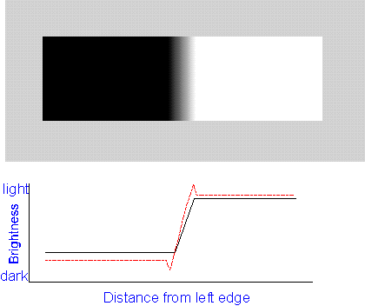
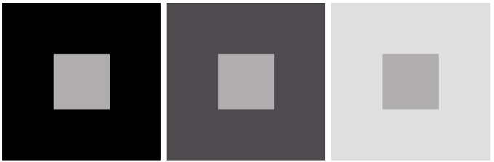
Psychovisual Effects
Perceived brightness: not a simple function of intensity
Mach band pattern
Simultaneous contrast

Slide 11
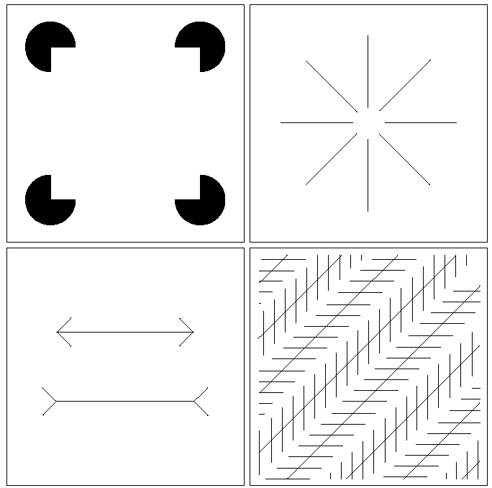
Optical Illusions
Optical Illusions
The eye fills in non-existing details or wrongly perceives geometrical properties of objects.
Notes:
In Fig. 2.9(a) , the outline of a square is seen clearly, despite the fact that no lines defining such a figure are part of the image. The same effect, this time with a circle, can be seen in Fig. 2.9(b) ; note how just a few lines are sufficient to give the illusion of a complete circle. The two horizontal line segments in Fig. 2.9(c) are of the same length, but one appears shorter than the other. Finally, all long lines in Fig. 2.9(d) are equidistant and parallel. Yet, the crosshatching creates the illusion that those lines are far from being parallel.

Slide 12
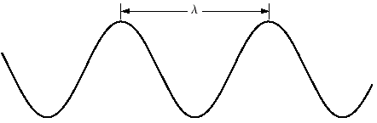
Light and the Electromagnetic Spectrum
Wavelength and frequency of light are related by the expression: c = λ.f = 3.10⁸ m/s
where c is the speed of light (m/s)
The energy of the various components of the electromagnetic spectrum is given by the expression: E = h.f (eV)
where h is Planck’s constant
Graphical representation of one wavelength λ

Slide 13
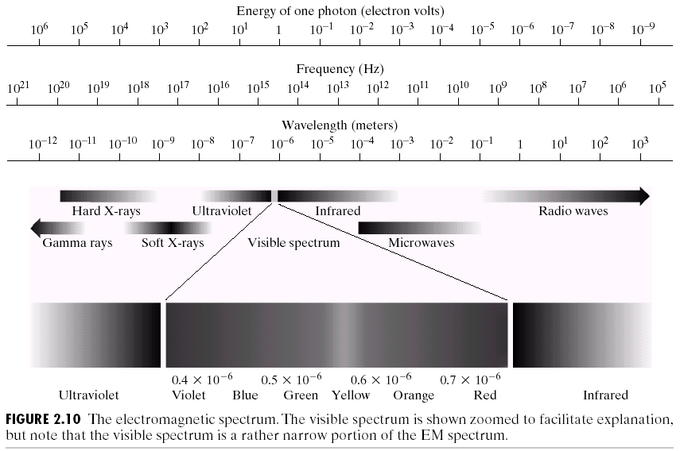
Light and the Electromagnetic Spectrum
The ElectroMagnetic - EM spectrum
The visible spectrum is shown zoomed to facilitate explanations, but note that it encompasses a very narrow range of the total EM spectrum.

Slide 14
Light and the Electromagnetic Spectrum
Light that is void of color is called monochromatic. It consists of a single wavelength of light or other radiation (lasers, for example, usually produce monochromatic light)
Gray level is used commonly to denote monochromatic intensity (intensity & gray level are used interchangeably hereafter)
The range of values of monochromatic light from black to white is usually called the gray scale, and monochromatic images are frequently referred to as grayscale images.

Slide 15
Light and the Electromagnetic Spectrum
Chromatic (color) light spans the electromagnetic energy spectrum from approximately 0.43 to 0.74 µm
3 quantities are used to describe a chromatic light source:
Radiance: the total amount of energy that flows from the light source, and it is usually measured in watts (W)
Luminance: measured in lumens (lm), gives a measure of the amount of energy an observer perceives from a light source. For example, light emitted from a source operating in the far infrared region of the spectrum could have significant energy (radiance), but an observer would hardly perceive it; its luminance would be almost zero
Brightness: a subjective descriptor of light perception that is practically impossible to measure

Slide 16
Reflected Light
Light is made up of wavelengths, the color we see is a result of which wavelengths are reflected back to our eyes.
When white light shines on a green object, all of the colors that form the white light are absorbed except green, which is reflected. This is why the object appears green.
White Light
Colours Absorbed
Green Light

Slide 17
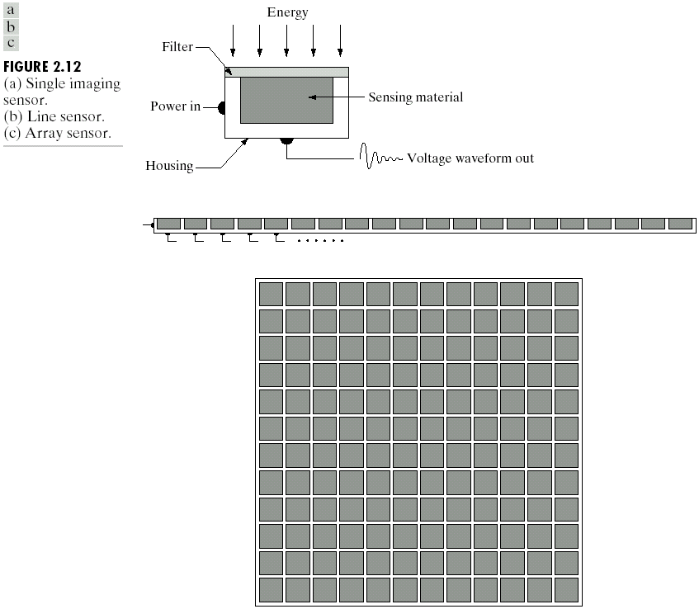
Image Sensing and Acquisition
Incoming energy is transformed into a voltage by a combination of the input electrical power and sensor material responsive to the type of energy being detected.
The output voltage waveform is the response of the sensor, and a digital quantity is obtained by digitizing that response
Imaging sensor
Line of image sensors
Array of image sensors

Slide 18
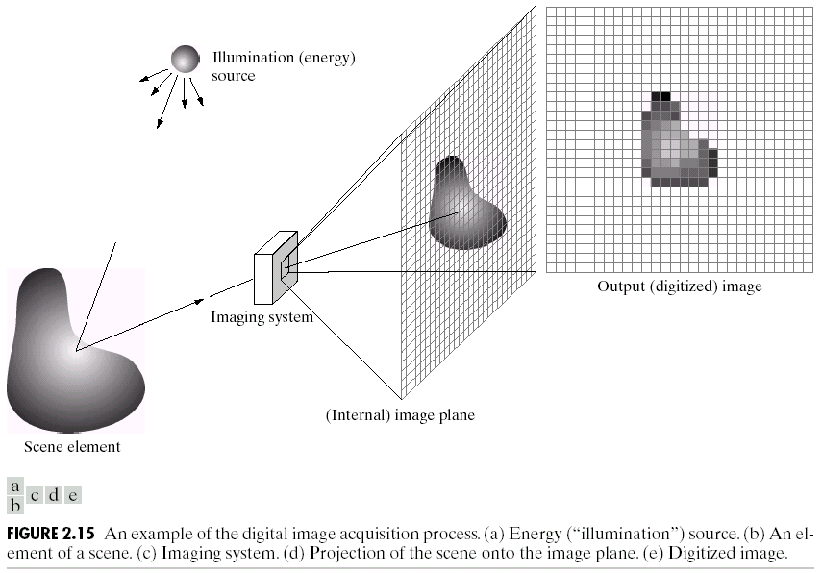
Image Sensing and Acquisition
The energy from an illumination source being reflected from a scene. The first function performed by the imaging system is to collect the incoming energy and focus it onto an image plane.
An example of digital image acquisition
Illumination (energy) source.
A scene.
Imaging system.
Projection of the scene onto the image plane.
Digitized image.

Slide 19
Image Sensing and Acquisition
The sensor array produces outputs proportional to the light received at each sensor. Digital & analog circuitry convert them to an analog signal, which is then digitized by another section of the imaging system. The output is a digital image.
An example of digital image acquisition
Illumination (energy) source.
A scene.
Imaging system.
Projection of the scene onto the image plane.
Digitized image.

Slide 20
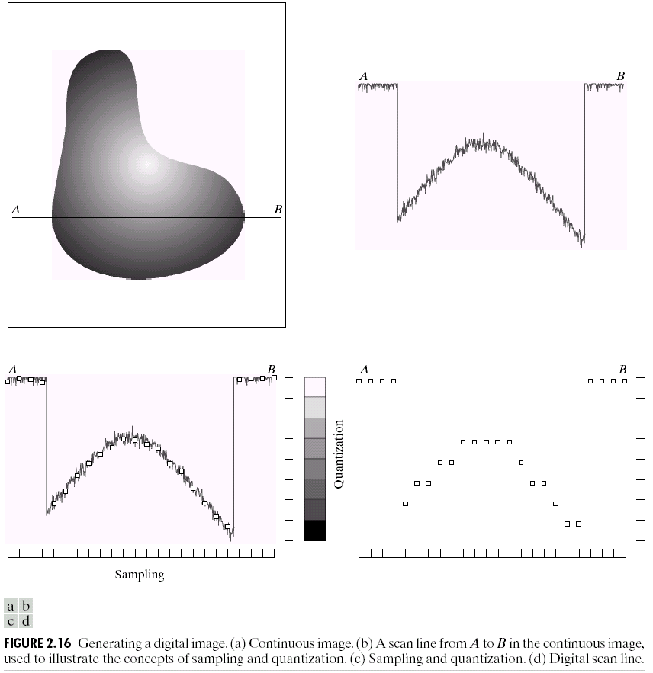

Image Sampling and Quantization
To digitize an image, we have to sample the 2D light intensity data in both coordinates and also in amplitude.
Digitizing the coordinate values is called sampling. Digitizing the amplitude values is called quantization.
(a) Continuous image. (b) A scan line showing intensity variations along line AB in (a). (c) Sampling & quantization. (d) Digital scan line

Slide 21
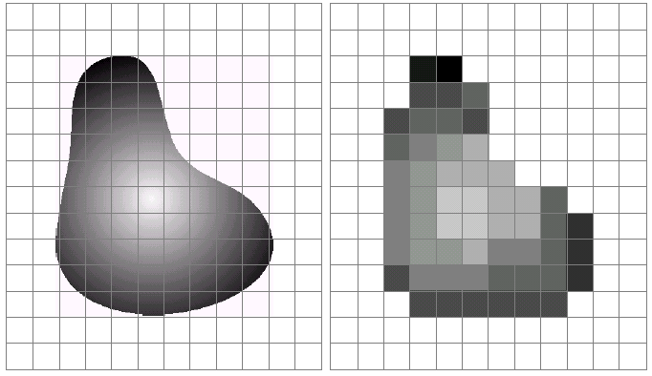
Image Sampling and Quantization
(a) Continuous image projected onto a sensor array. (b) Result of image sampling and quantization

Slide 22
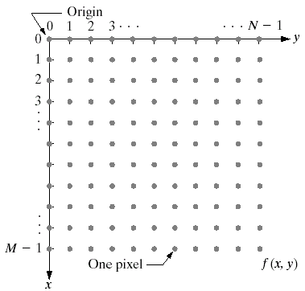

Representing Digital Images
A digital image is composed of M rows and N columns of pixels each storing a value
Pixel values are in the range 0-255 (black-white)
Images can easily be represented as matrices

Slide 23
Representing Digital Images
3 ways of representing an image f(x, y)
a plot of the function with two axes determining spatial location & the third axis being the values of f as a function of x & y.
shows f(x, y) as it would appear on a computer display or photograph. This type of representation includes color images, allows us to view results at a glance.

Slide 24
Representing Digital Images
3 ways of representing an image f(x, y)
c) shows the third representation with an array (matrix) composed of the numerical values of f(x, y), used for computer processing.
Each element of this array is called an image element, picture element, pixel, or pel.

Slide 25
Spatial and Intensity Resolution
Spatial Resolution: a measure of the smallest discernible detail in an image. Quantitatively, it can be stated as:
line pairs per unit distance
dots (pixels) per unit distance - a common measures.
Dots per unit distance, usually dots per inch (dpi), is a measure of image resolution used in the printing and publishing industry.
Intensity Resolution: Smallest discernible change in intensity level, number of bits used to quantize intensity.
The more samples in a fixed range, the higher the spatial resolution; the more bits, the higher the intensity resolution.

Slide 26
Resolution: How Much Is Enough?
The big question with resolution is always: How much is enough?
This all depends on what is in the image and what you would like to do with it
Key questions include:
Does the image look aesthetically pleasing?
Can you see what you need to see within the image?

Slide 27


Resolution: How Much Is Enough?
The picture on the right is fine for counting the number of cars, but not for reading the number plate.

