Slide 1
Digital Image Processing Chapter 4: Colour Models and Image Printing
Notes:
1

Slide 2
Contents
This part covers:
Computer graphics: vector and raster
Image file formats
Colour models
Image printing techniques
Notes:
“Con người trông bằng mắt và nhìn bằng não”
2

Slide 3
Bitmap and Raster Graphics

Slide 4
Introduction
The data structure used in computer graphics plays and important role on image display, printing, and processing.
Image requirements:
Memory saving
Reducing processing time

Slide 5
Introduction
Spatial data can represent:
Features of the real world with discrete boundaries (roads, buildings, lakes, rivers, administrative boundaries etc.)
Real-world phenomena with non-discrete boundaries (such as precipitation, nutrient levels, terrain etc.)
In computer graphics:
Vector graphics: represent the former
Raster or bitmap graphics: for the latter

Slide 6
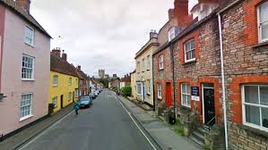
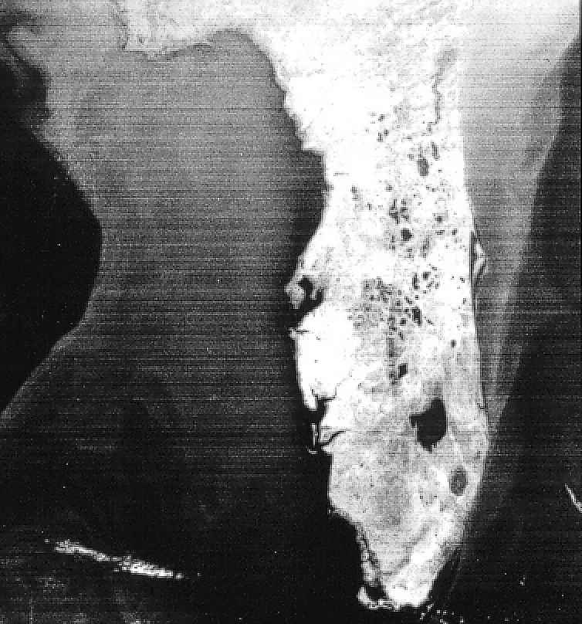
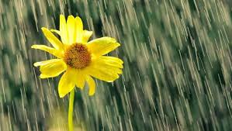
Introduction

Slide 7
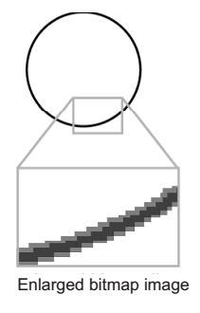
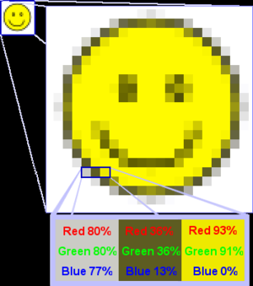
Bitmap Image
A bitmap is made up of pixels
When enlarged, individual pixels appear as squares. Zooming in further, they can be analyzed, with their colors constructed by adding the values for red, green and blue.
The higher the resolution, the better the image quality

Slide 8
Bitmap Image
Bitmaps are an image format suited for creation of:
Photo-realistic images.
Complex drawings.
Images that require fine detail.
Scanner and digital cameras' output is bitmap. Software like Photoshop can create bitmap image.
Bitmap file formats: PSD, TIFF, JPEG, PNG, GIF, PICT, BMP etc.

Slide 9
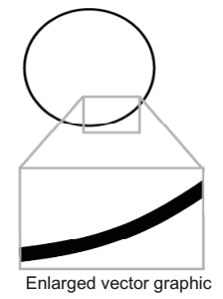

Vector graphics
A vector is a line that is described by the location of its two endpoints.
Vector drawing makes use of Cartesian co-ordinates.
Cartesian coordinates are numbers that describe a point in two or three-dimensional space as the intersection of X, Y, and Z axis.

Slide 10
Vector graphics
Vector-drawn images are used in the following areas:
Computer-aided design (CAD) programs
Graphic artists designing for the print media
3-D animation programs
Applications requiring drawing of graphic shapes
Vector graphics file formats: EPS, AI, SVG, DXF, DWG etc.

Slide 11
Bitmap vs Vector
Vector images use less memory space and have a smaller file size as compared to bitmaps.
For the Web, pages that use vector graphics in plug-ins such as Flash download faster, and when used for animation, draw faster than bitmaps.
Vector images cannot be used for photorealistic images.
Vector images require a plug-in for Web-based display.

Slide 12
Bitmap vs Vector
Bitmaps are not easily scalable and resizable.
Vectorization: bitmaps can be converted to vector images using techniques such as: auto-tracing, AI – artificial intelligent etc.
Rasterization: the opposite, vector to bitmap conversion, is straightforward

Slide 13
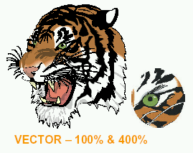
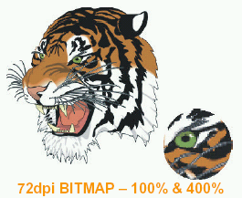
Bitmap vs Vector

Slide 14
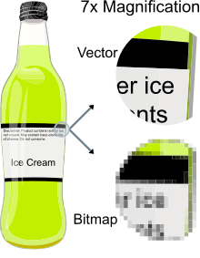
Bitmap vs Vector

Slide 15
Bitmap vs Vector
When to use a bitmap image?
Bitmap images are usually used for websites featuring products, restaurants, travel, tourism, and e-commerce because the images are more visually appealing.
In digital applications, bitmap high-quality images are used to create an instant likeness, prompting users to interact with the product etc.
When to use vector graphics?
Vector images are the primary choice for printing, logos, signs, illustrations, infographics, and creating animations. Vector images provide high-quality, scalable images while also conserving file size.
User Interface designers can edit vector graphics and quickly generate new ones to meet project requirements.

Slide 16
Different Image File Formats

Slide 17
Introduction
There are a number of image file formats, the most common and mainly used for cameras, printing, scanning, and internet use:
JPG - Joint Photographic Experts Group
TIFF - Tagged Image File Format
PNG - Portable Graphics Format
GIF - Graphics Interchange Format

Slide 18
Lossless vs lossy compressions
Lossless compression is a class of data compression that allows the original data to be perfectly reconstructed from the compressed data with no loss of information.
Lossless compression is possible because most real-world data exhibits statistical redundancy.
Lossy compression permits reconstruction only of an approximation of the original data.
Usually it has greatly improved compression rates, and therefore greatly reduces media size.

Slide 19
Number of Colors
The simplest image may contain only two colors (white & black) and requires only 1 bit to represent the intensity of each pixel.
More complex images can use 24 bits to represent the color of 1 pixel and are therefore capable of displaying 2²⁴ or 16 million colors.
Because it is difficult for the human eye to distinguish similar colors, 24 bits per pixel (16 million colors) is called “true color”.

Slide 20
TIFF
Lossless (including LZW compression option), considered to be the highest quality format for commercial work.
TIFF is the most versatile, except that web pages don't show TIF files. TIF does most of anything you might want, from 1-bit to 48-bit color, RGB, CMYK, etc.
Generally, TIFF is either uncompressed or compressed using lossless compression.
Note: TIFF can be lossy if the compression scheme is lossy such as JPG.

Slide 21
JPG
The most used image file format.
Digital cameras, web pages and many others use JPG files.
The compressed data size is considerably small at the cost of image quality. JPG uses lossy compressions. The compression degree can be selectable (with an option setting named JPG Quality in your editor), to be lower quality smaller files, or to be higher quality larger files.
JPG is used when small file size (for transfer or storage, web pages, email, memory cards, etc.) is more important than maximum image quality.

Slide 22
GIF
Widely used on the Internet due to its wide support and portability between applications and operating systems;
Support up to 8 bits per pixel for each image, allowing a single image to reference its own palette of up to 256 different colors chosen from the 24-bit RGB color space;
Supports animations and allows a separate palette of up to 256 colors for each frame;
Less suitable for reproducing color photographs and other images with color gradients;

Slide 23
GIF
Well-suited for simpler images such as graphics or logos with solid areas of color.
Always use the Lempel–Ziv–Welch (LZW) lossless data compression technique to reduce the file size without degrading the visual quality;
If the image has fewer than 256 colors, GIF can render the image exactly.

Slide 24
When should you use each?
TIFF
This is usually the best quality output from a digital camera. Digital cameras often offer around three JPG quality settings plus TIFF. Since JPG always means at least some loss of quality, TIFF means better quality. However, the file size is huge compared to even the best JPG setting, and the advantages may not be noticeable.
A more important use of TIFF is as the working storage format as you edit and manipulate digital images. You do not want to go through several load, edit, save cycles with JPG storage, as the degradation accumulates with each new save. One or two JPG saves at high quality may not be noticeable, but the tenth certainly will be. TIFF is lossless, so there is no degradation associated with saving a TIFF file.
Do NOT use TIFF for web images. They produce big files, and more importantly, most web browsers will not display TIFFs.

Slide 25
PNG
Uses lossless data compression; developed as an improved, non-patented replacement for GIF;
PNG supports palette-based images (with palettes of 24-bit RGB or 32-bit RGBA – RGB Alpha colors), grayscale images (with or without an alpha channel for transparency), and full-color non-palette-based RGB or RGBA images;
Designed the format for transferring images on the Internet, not for professional-quality print graphics; therefore non-RGB color spaces such as CMYK are not supported;
Has a single image; not allows animation like PNG.

Slide 26
When should you use each?
JPG
This is the format of choice for nearly all photographs on the web. You can achieve excellent quality even at rather high compression settings. I also use JPG as the ultimate format for all my digital photographs. If I edit a photo, I will use my software's proprietary format until finished, and then save the result as a JPG.
Digital cameras save in a JPG format by default. Switching to TIFF or RAW improves quality in principle, but the difference is difficult to see. Shooting in TIFF has two disadvantages compared to JPG: fewer photos per memory card, and a longer wait between photographs as the image transfers to the card. I rarely shoot in TIFF mode.
Never use JPG for line art. On images such as these with areas of uniform color with sharp edges, JPG does a poor job. These are tasks for which GIF and PNG are well suited. See JPG vs. GIF for web images.

Slide 27
When should you use each?
GIF
If your image has fewer than 256 colors and contains large areas of uniform color, GIF is a good choice, and at one time the only wise choice. The files will be small yet perfect. Here is an example of an image well-suited for GIF:
PNG or GIF for more than 256 colors
If you have an image with large areas of exactly uniform color, but contains more than 256 colors, use PNG. Its strategy is quite similar to that of GIF, but it supports 16 million colors, not just 256.
If you want to display a photograph exactly without loss on the web, PNG is your choice. Later generation web browsers support PNG, and PNG is the only lossless format that web browsers support.
PNG is superior to GIF in nearly every way. It produces smaller files and allows more colors. PNG also supports partial transparency. Partial transparency can be used for many useful purposes, such as fades and antialiasing of text. GIF's principal remaining use is for animations.

Slide 28
Summary
File type comparison of PNG, JPEG, GIF, and TIFF
 | Use | Example Uses | Don't Use
PNG | Graphics, small images that maintain original quality, transparency | Charts, diagrams, logos, photos | Sharing high-resolution photos on the web
GIF | Small, simple graphics with limited color | Ad banners, simple charts, buttons, animation | Photographs, detailed imagery
TIFF | Editing and storage | Storing photos that will be edited, print | Images on the web
JPG | Photos on the web | Photos in a slide deck, blog, or social media | Editing images, line graphics, or print

Slide 29
Color Models

Slide 30
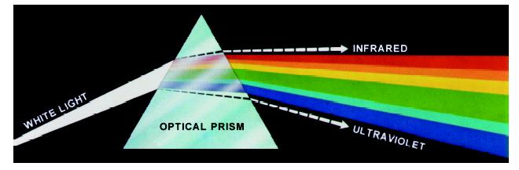
Color Fundamentals
In 1666 Sir Isaac Newton discovered that when a beam of sunlight passes through a glass prism, the emerging beam is split into a spectrum of colors

Slide 31
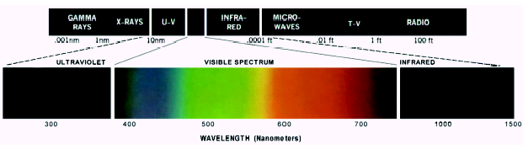
Color Fundamentals
Chromatic light spans the electromagnetic spectrum from approximately 400 to 700 nm.
Human color vision is achieved through 6 to 7 million cones in each eye.

Slide 32
Color Fundamentals
Three principal sensing groups of cones:
66% of these cones are sensitive to red light
33% to green light
2% to blue light.
Absorption curves for the different cones have been determined experimentally.
Strangely these do not match the CIE - International Commission on Illumination standards for red (700nm), green (546.1nm) and blue (435.8nm) light as the standards were developed before the experiments

Slide 33
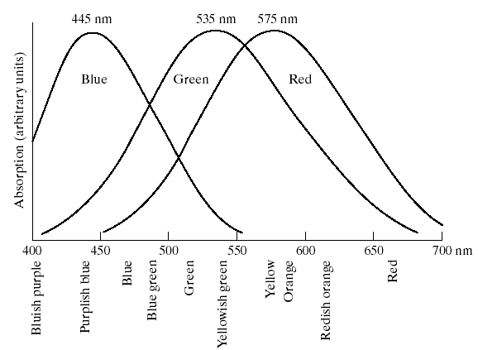
Human Color Perception
Absorption of light by the red, green, and blue cones in the human eye as a function of wavelength

Slide 34
Human Color Perception
The human eye sees colors as variable combinations of the so-called primary colors: Red (R), Green (G), and Blue (B)
The primary colors can be added to produce the secondary colors.
Mixing the three primaries produces white.
Mixing a secondary with its opposite primary produces white (e.g. red + cyan).

Slide 35
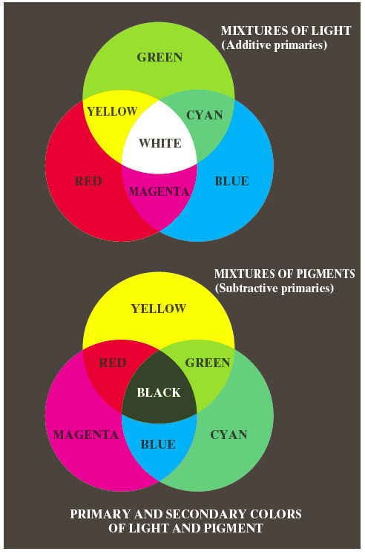
Human Color Perception
Important difference:
Primary colors of light (red, green, blue)
Primary colors of pigments (colorants)
A color that subtracts or absorbs a primary color of light and reflects the other two.
These are cyan, magenta and yellow (CMY).
A proper combination of pigment primaries produces black.

Slide 36
Human Color Perception
Distinguishing one color from another:
Brightness: the achromatic notion of intensity.
Hue: the dominant wavelength in a mixture of light waves (the dominant color perceived by an observer. When we call an object red, blue we refer to its hue).
Saturation: the amount of white light mixed with a hue. Pure colors are fully saturated.
Pink (red + white) is less saturated.
Hue and saturation are called chromaticity.
Any color is characterized by its brightness & chromaticity.

Slide 37
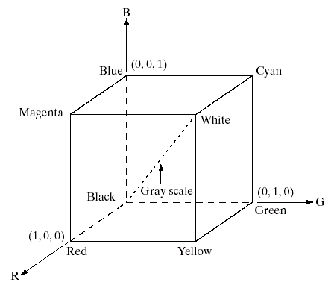
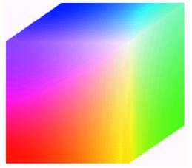
Color Models: RGB
RGB values are at 3 corners.
Cyan magenta and yellow are at three other corners.
Black is at the origin.
White is the corner furthest from the origin.
Different colors are points on or inside the cube represented by RGB vectors

Slide 38
Color Models: RGB
Images represented in the RGB color model consist of three component images – one for each primary color.
When fed into a monitor these images are combined to create a composite color image.
The number of bits used to represent each pixel is referred to as the color depth.
A 24-bit image is often referred to as a full-color image as it allows (2⁸)³ = 16,777,216 colors.

Slide 39
Color Models: CMY
Cyan, Magenta, and Yellow are the secondary colors of light or, alternatively, primary colors of pigments.
For example, when a surface coated with cyan pigment is illuminated with white light, no red light is reflected from the surface. That is, cyan subtracts red light from reflected white light, which itself is composed of equal amounts of red, green, and blue light.

Slide 40

Color Models: CMY
Most devices that deposit colored pigments on paper, such as color printers and copiers, require CMY data input or perform an RGB to CMY conversion internally. This conversion is performed using the simple operation → (where we assume all RGB color values have been normalized to the range [0, 1])

Slide 41
Color Models: HSI
RGB is useful for hardware implementations and is serendipitously related to the way in which the human visual system works.
However, RGB is not a particularly intuitive way to describe colors.
Rather when people describe colors they tend to use hue, saturation and brightness (intensity) → HSI.
RGB is great for color generation, but HSI is great for color description.

Slide 42
Color Models: HSI
Reminder:
Hue: A color attribute that describes a pure color (pure yellow, orange or red).
Saturation: Gives a measure of how much a pure color is diluted with white light.
Intensity: Brightness is nearly impossible to measure because it is so subjective. Instead we use intensity. Intensity is the same achromatic notion that we have seen in grey level images.

Slide 43
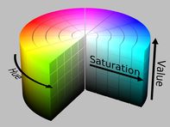
Color Models: HSI

Slide 44
Digital Halftoning

Slide 45
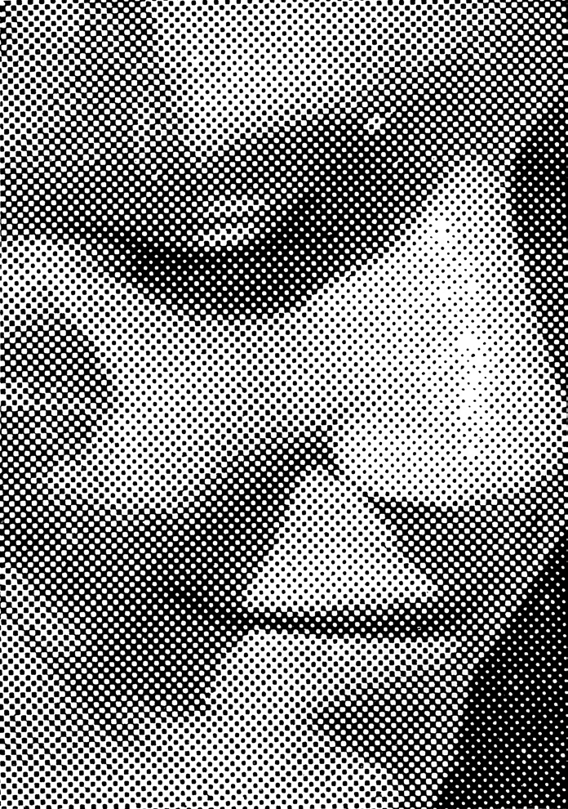

Slide 46
Introduction
Halftoning or analog halftoning is a process that simulates shades of gray by varying the size of tiny black dots arranged in a regular pattern.
This technique is used in printers, as well as the publishing industry.
Inspect a photograph in a newspaper, you will notice that the picture is composed of black dots even though it appears to be composed of grays.
This is possible because of the spatial integration performed by our eyes. Our eyes blend fine details and record the overall intensity.

Slide 47
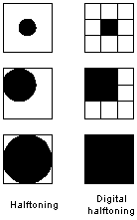
Introduction
Digital halftoning: same as halftoning. An image is decomposed into a grid of halftone cells.
Elements (or dots that halftoning uses in simulates shades of grays) of an image are simulated by filling the appropriate halftone cells.
The more number of black dots in a halftone cell, the darker the cell appears.
A sample of digital halftoning

Slide 48
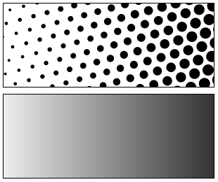
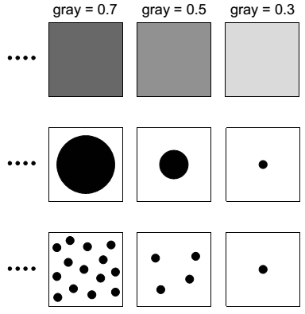
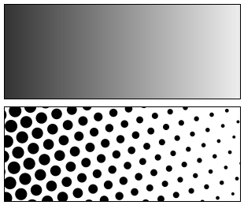
Introduction
Identical?

Slide 49
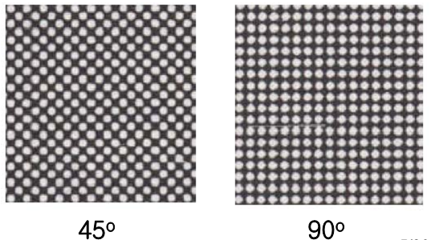
Halftoning Parameters
Shape of grid elements:
square, circle, ellipse, hexagon, cross, diamond, triangle, line
Screen frequency
Density of lines on the grid, specified in lines per inch (lpi)
Newspapers: 85 lpi, magazines: 200~300 lpi
Screen angle: most common angle is 45º
Human eye is less prone to notice the dots

Slide 50
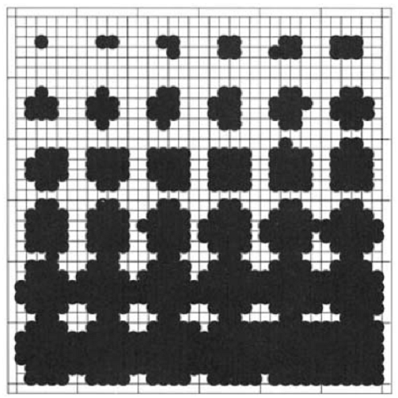
Halftoning Example
6x6 grid
Representing 37 brightness levels
from left to right, top to bottom

Slide 51
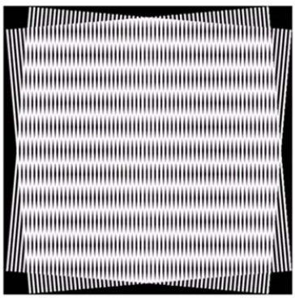
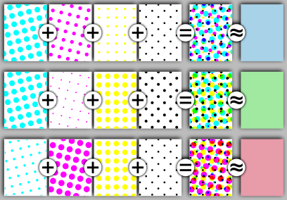
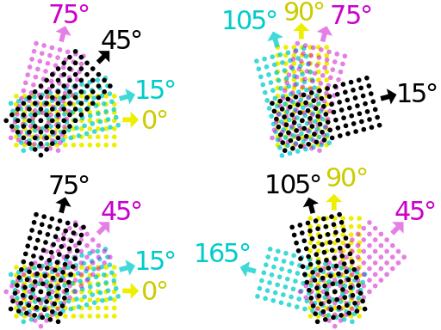
Halftoning for Color Images
4 halftone screens are used
cyan, magenta, yellow, black
each screen is placed at a different angle to eliminate Moiré patterns →
Yellow: 0º; Magenta: 75º; Black: 45º; Cyan: 15º

Slide 52
Methods
4 common methods for generating digital halftoning images:
Thresholding
Patterning
Dithering
Error diffusion

Slide 53
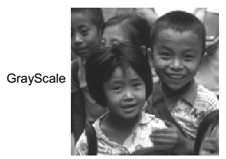

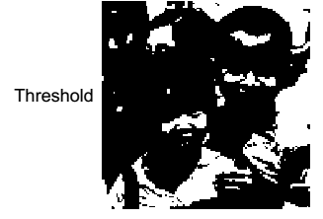
Thresholding
Assume that the image falls in the range of 0 to 255:
255 ⇒ Black and 0 ⇒ White
v
where T = 127
This produces a poor quality rendering of a continuous tone image.

Slide 54
Patterning
It generates an image that is of higher spatial resolution than the source image.
The number of halftone cells of the output image is the same as the number of pixels of the source image. However, each halftone cell is subdivided into a 4x4 grid. Each input pixel value is represented by a different number of filled squares in the halftone cell.
Since a 4x4 grid can only represents 17 different intensity levels, the source image must be quantized.

Slide 55
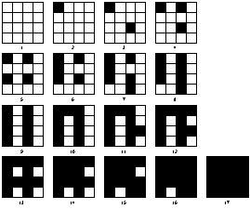
Patterning
Rylander's recursive patterning matrices

Slide 56
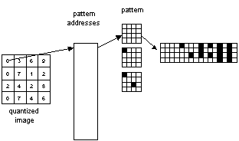
Patterning
The Patterning operation

Slide 57
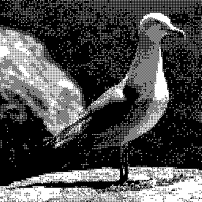
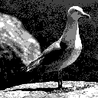
Patterning
Halftone image has higher resolution than the original one.
If the output resolution is sufficiently high, patterning yields acceptable result.
At lower resolution, output appears blocky and lack detail.
There is tradeoff between detail resolution and number of quantization levels.

Slide 58
Dithering
Unlike patterning, dithering creates an output image with the same resolution as that of the source image.
Dithering can be thought of as thresholding the source image with a dither matrix. The matrix is laid repeatedly over the source image. Wherever the pixel value of the image is greater than the value in the matrix, a dot on the output image is filled.
A well-known problem of dithering is that it produces artifacts of patterns introduced by fixed thresholding matrices.

Slide 59
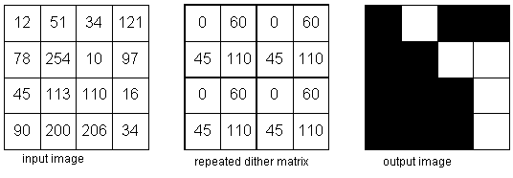
Dithering
The dithering operation

Slide 60
Error Diffusion
Sometimes it is called spatial dithering.
Error diffusion sequentially traverses each pixel of the source image. Each pixel is compared to a threshold. If the pixel value is higher than the threshold, a 255 is outputted; otherwise, a 0 is outputted.
The error - the difference between the input pixel value and the output value - is dispersed to nearby neighbors.
Error diffusion is a neighborhood operation since it operates not only on the input pixel, but also its neighbors.

Slide 61
Error Diffusion
Generally, neighborhood operations produce higher quality results than point operations.
Error diffusion, when compared to dithering, does not generate those artifacts introduced by fix thresholding matrices. However, since error diffusion requires neighborhood operations, it is very computationally intensive.

Slide 62
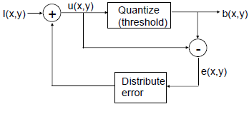
Error Diffusion
0 ≤ I(x,y) ≤ 1 → Threshold = 0.5; Black = 0; White = 1
0 ≤ I(x,y) ≤ 255 → Threshold = 127; Black = 0; White = 255

Slide 63
1D Error Diffusion
The image is read from left to right, top to bottom.
Decide for each image point whether to print or not
Take error between the desired output at that position and the printed level.
Distribute that error forward to pixels yet-to-be printed.

Slide 64
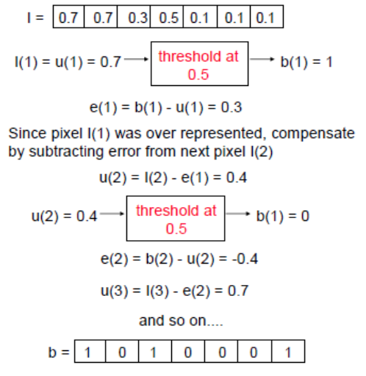
Error Diffusion: Example

Slide 65
Error Diffusion: Example
Carry out the error diffusion procedure for the image I below using a threshold of 127
Assume that I has 256 grey levels in the range [0, 255].

Slide 66
2D Error Diffusion
Disperses halftone quantization error to nearby four or more pixels
Error weights must sum to 1
Several error filters:

