Slide 1
Digital Image Processing Chapter 6: Image Compression

Slide 2
Image Compression
The storage and communication of video requirements are immense
Storage requirement for uncompressed video:
512pixel x 512 pixel x 3bytes/pixel x 30frame/sec
= 23.6MBytes/sec
Image compression: reducing the amount of data required to represent a digital image
Ex. 23.6MBytes =>187KBytes
Fundamentals of image compression
Reduce or eliminate the redundant data in the image or video

Slide 3
Image Compression
Application:
Digital TV broadcasting
VOD (Video on Demand)
Televideo-conferencing
Medical imaging
Facsimile transmission
or diverse Multi-media environment
=> mainly used for storages and transmissions
Evaluation of compression efficiency
Compression ratio
Compression ratio = original data/compressed data
The greater the compression ratio, the smaller the final image will be

Slide 4
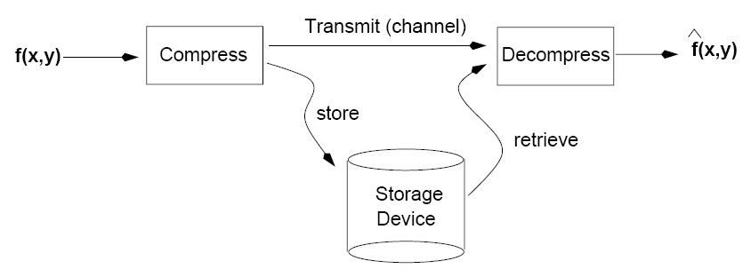
Image Compression

Slide 5
Image Compression
Selection criteria for image compression techniques:
Achievable compression ratio
Compression/decompression time
Complexity of algorithm
Cost of computational resources
Availability of computational resources
Adoption of standard or not
Lossy or lossless compression
The quality of decoded image when lossy compression is used

Slide 6
Fundamentals
Two basic types of image compression:
Lossless compression: encodes & decodes the data perfectly. Resulted image matches the original image exactly
Lossy compression : allows redundant and nonessential information to be lost
Data compression:
Process of reducing the amount of data required to represent a given quantity of information
Key idea: reducing the data redundancy
Three basic data redundancies in digital images
Coding redundancy
Interpixel redundancy
Psychovisual redundancy

Slide 7
Fundamentals
Elimination of coding redundancy:
Assigning fewer bits to the more probable data
Assigning longer bits to the less probable data
This process is referred to as variable length coding reduces the total number of encoded bits
Image data: assigning fewer bits to the gray levels with higher histogram

Slide 8
Fundamentals
Elimination of interpixel redundancy:
Use similarities between adjacent pixels
Use similarities between adjacent fields
Run-length encoding, DPCM, ADPCM, etc.
Terminologies for representing interpixel redundancy
Spatial redundancy
Geometric redundancy
Interframe redundancy

Slide 9
Fundamentals
Elimination of psychovisual redundancy:
Brightness of region depends on factors other than simply the light reflected by the regions
Certain information has less importance than other information in normal visual processing
This information is said to be psychovisual redundant
This redundancy can be eliminated without significantly impairing the quality of image perception
=> results in a loss of quantitative information
Related to the sampling, quantization

Slide 10
Fundamentals
Fidelity criteria:
Reproducible means of quantifying the nature and extent of information loss
Objective fidelity criteria
Subjective fidelity criteria
Objective fidelity criteria offer a simple and convenient mechanism for evaluating information loss
Sometimes, subjective evaluations by a human observer is more appropriate

Slide 11


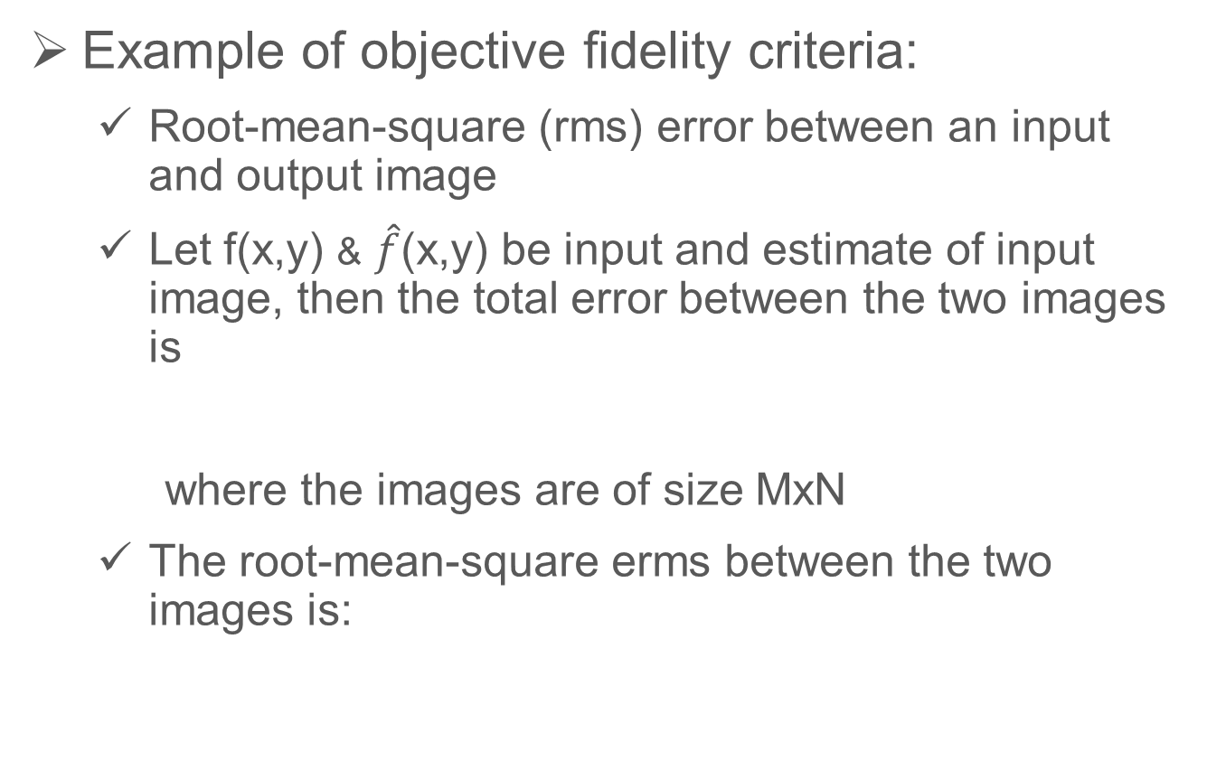
Fundamentals
Example of objective fidelity criteria:
Root-mean-square (rms) error between an input and output image
Let f(x,y) & $\hat{f}$(x,y) be input and estimate of input image, then the total error between the two images is
where the images are of size MxN
The root-mean-square erms between the two images is:

Slide 12
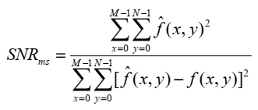
Fundamentals
Example of objective fidelity criteria:
Mean-square signal-to-noise ratio of the estimated image, denoted SNR_{ms} is:

Slide 13
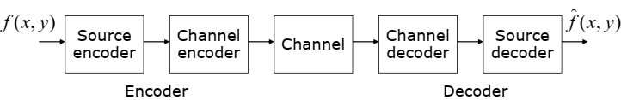
Image Compression Model
Image Compression System:
Two distinct structural blocks: Encoder and Decoder
Source encoder: removes input redundancies
Channel encoder: increases the noise immunity
Noise free environment, the channel encoder/decoder are omitted

Slide 14
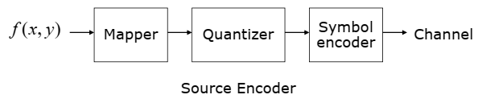
Image Compression Model
Source encoder:
Reduces or eliminates any coding, interpixel, psychovisual redundancies in the input image
Source encoding stages:
Mapper: reversible
Quantizer: irreversible
Symbol encoder: reversible

Slide 15
Image Compression Model
Mapper
Transforms the input data into a format designed to reduce interpixel redundancies in the input image
May or may not reduce the amount of data
Example: run-length coding
Transformed results : array of coefficients
Quantizer
Reduces the accuracy of the mapper’s output
Reduces the psychovisual redundancy
Must be omitted when error-free compression is desired
Symbol Encoder
Reduces the coding redundancy
Creates a fixed- or variable-length code

Slide 16
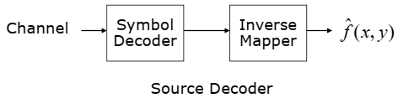
Image Compression Model
Source Decoder
Performs the inverse operations of the source encoder
Inverse quantizer block is not included in the general source decoder
Source Decoding stages:
Symbol decoder: inverse operations of the symbol encoder
Inverse mapper: inverse operations of the mapper

Slide 17
Error-Free Compression
Error-free compression
Means for data reduction
Reduces interpixel, coding redundancy
Application
Medical or business documents
Satellite imagery : cost of collecting the data
Digital radiography: for diagnostic accuracy
Normally provide compression ratios of 2 to 10
Error-free compression techniques
Variable-length coding
Arithmetic coding
Bit-plane coding: Run-length coding
Lossless predictive coding, etc.

Slide 18
Error-Free Compression
Variable-length coding
The simplest approach to error-free compression technique
Reduces coding redundancy only
Assigns the shortest possible code words to the most probable gray levels
Source symbol could be gray levels or pixel differences of an image, output of run-length encoding, etc.
Types of variable-length coding
Huffman coding
Truncated Huffman coding
Shift coding
Huffman shift coding, etc.

Slide 19
Lossless Compression

Slide 20
Run Length Coding - RLC
Run-length coding:
Reduces interpixel redundancy
Binary image compression methods
Applied each bit-plane of gray level image
Describe successive runs of black and white pixels
Standard compression approach in FAX coding
Compression technique in bmp file
Applied for 1, 2, 4-bit gray level image
Additional compression can be realized by variable-length
Coding the run lengths themselves
Input: AAAABBBBBCCCCCCCCDEEEE
Output: 4A5B8C1D4E
Compression ratio : 22/10 = 2.2

Slide 21
Run Length Coding - RLC
Notes for RLC:
If compression ratio is less than 1, send the original data, for example:
Input: MyDogHasFleas
Output: 1M1y1D1o1g1H1a1s1F1l1e1a1s
Compression ratio: 13/26 = 0.5
Use special prefix character (for example: +)
Input: ABCDDDDDDDDEEEEEEEEE
Output: ABC+8D+9E
Compression ratio: 19/9 = 2.11
It make sense to encode only runs of 3 or longer
If the special prefix character is found in the source: use 3 byte notation (run of length 1: + => +1+)

Slide 22
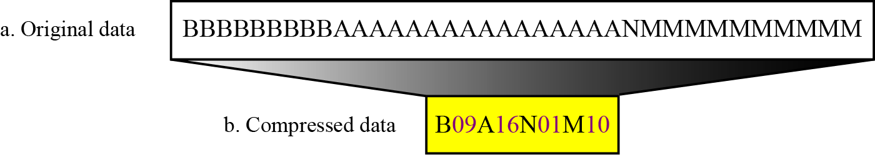
Run Length Coding - RLC

Slide 23
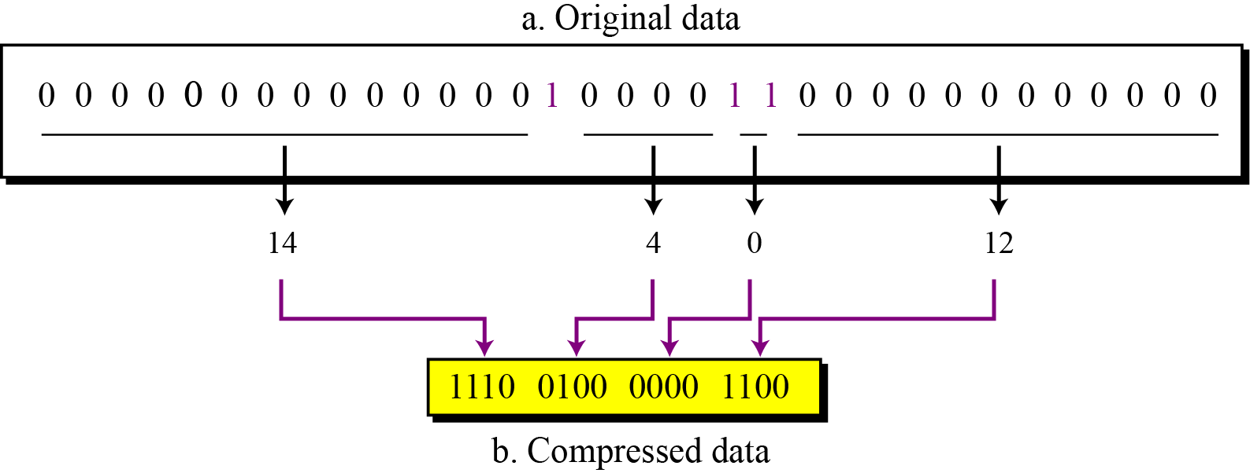
Run Length Coding - RLC
(I.e. the number of 0s in between two 1s)

Slide 24
Huffman Coding
Huffman coding:
In 1952, a paper by David Huffman was published
Variable length codes can achieve a higher data density than fixed length codes
Assigns short code for the most frequently occurring data
Yields the smallest possible number of code symbols per source symbol
Resulting code is optimal with constraint that the source symbols be coded one at a time

Slide 25
Huffman Coding
Huffman coding process:
1. Ordering the probabilities of symbols
2. Combining the lowest probability symbols into a single symbol. This process (steps 1 & 2) is repeated until a reduced source with two symbols is reached
3. To code each reduced source starting with the smallest source
4. Working back to the original source

Slide 26
Huffman Coding: Example 1

Slide 27
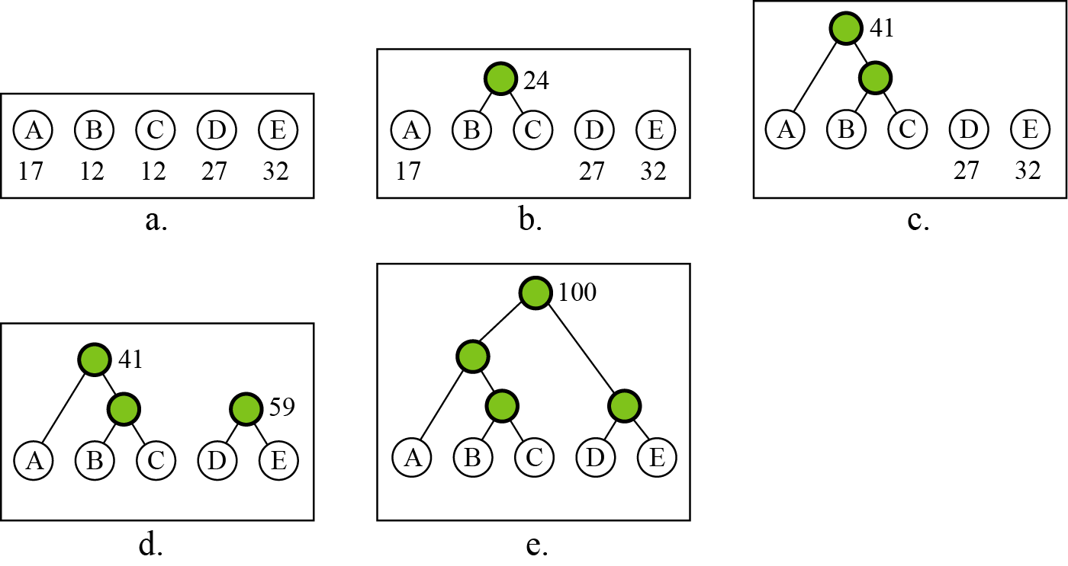
Huffman Coding: Example 1

Slide 28
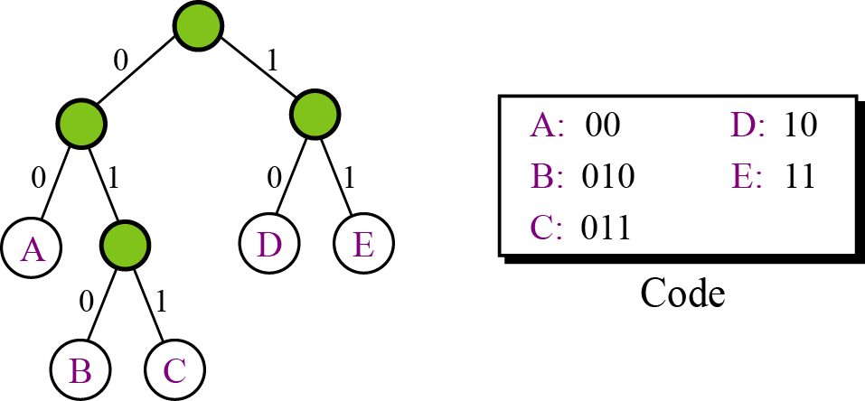
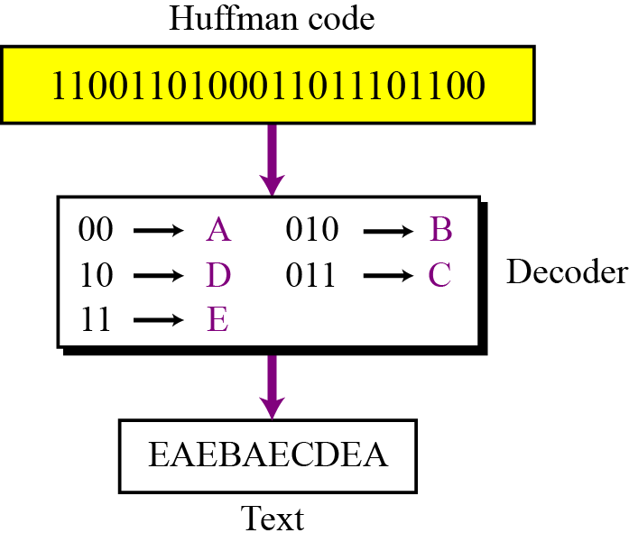
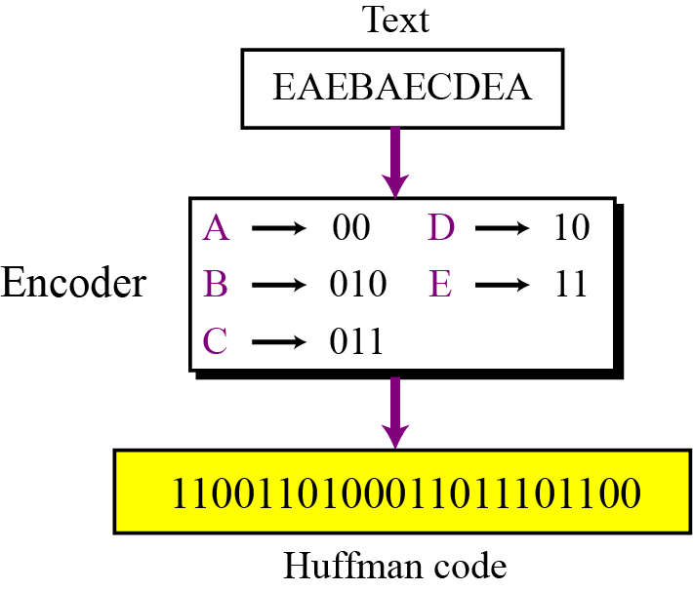
Huffman Coding: Example 1

Slide 29
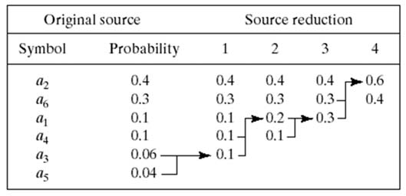
Huffman Coding: Example 2

Slide 30
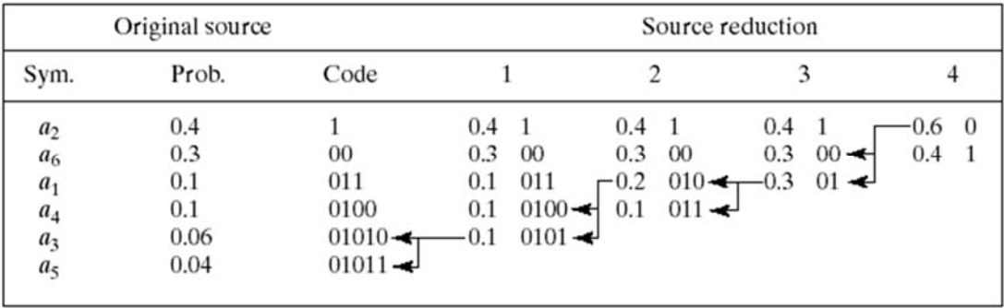
Huffman Coding: Example 2

Slide 31
Huffman Coding
Advantages:
Creates the optimal code for a set of symbols and probabilities
Coding/decoding is accomplished in a simple lookup table
Block code: each source symbol is mapped into a fixed sequence of code symbols
Can be decoded without referencing succeeding symbols
Disadvantages:
Encoding requires two nontrivial passes over the data (probability calculation, code table creation)
One corrupted bit will wipe out the rest of the data (disadvantage of variable length coding)
When a large number of symbols is decoded, the construction of the optimal code is an nontrivial case

Slide 32
Huffman Coding: Practice
Carry out Huffman coding for the following image I which composes of 2x2 data blocks as shown below.
Each data block is one coding unit, i.e. the same as one character in the previous examples.

Slide 33
LZW (Lempel-Ziv-Welch) Coding
LZW (Lempel-Ziv-Welch) coding:
Assigns fixed-length code words to variable length sequences of source symbols
For 8-bit images:
First 256 words of the dictionary are assigned to the gray values 0, 1, …, 255
Image sequences are added to the next code word (39-39 => 256, 39-126=>257, etc.)
Properties of LZW coding:
Requires no a priori knowledge of the probability
Codebook is created while the data are being encoded
Repeated source symbols such as “the”, “. “ are compressed effectively
Has been integrated into gif, tiff, pdf file format, etc.

Slide 34

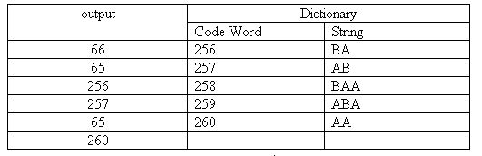
LZW (Lempel-Ziv-Welch) Coding
LZW coding of:
1. BA is not in the Dictionary; insert BA, output the code for its prefix: code(B)
2. AB is not in the Dictionary; insert AB, output the code for its prefix: code(A)
3. BA is in the Dictionary.
BAA is not in Dictionary; insert BAA, output the code for its prefix: code(BA)
4. AB is in the Dictionary.
ABA is not in the Dictionary; insert ABA, output the code for its prefix: code(AB)
5. AA is not in the Dictionary; insert AA, output the code for its prefix: code(A)
6. AA is in the Dictionary and it is the last pattern; output its code: code(AA)
The compressed message is: <66><65> <256><257><65> <260>

Slide 35

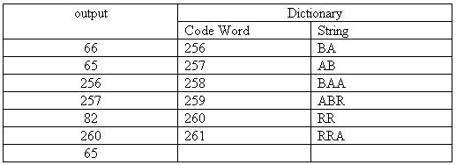
LZW (Lempel-Ziv-Welch) Coding
LZW coding of:
1. BA is not in the Dictionary; insert BA, output the code for its prefix: code(B)
2. AB is not in the Dictionary; insert AB, output the code for its prefix: code(A)
3. BA is in the Dictionary.
BAA is not in Dictionary; insert BAA, output the code for its prefix: code(BA)
4. AB is in the Dictionary.
ABR is not in the Dictionary; insert ABR, output the code for its prefix: code(AB)
5. RR is not in the Dictionary; insert RR, output the code for its prefix: code(R)
6. RR is in the Dictionary.
RRA is not in the Dictionary and it is the last pattern; insert RRA, output code for its prefix:
code(RR), then output code for last character: code(A)
The compressed message is: <66><65><256><257><82> <260> <65>

Slide 36
LZW (Lempel-Ziv-Welch) Coding
Uncompressed string: aaabbbbbbaabaaba
Number of bits = Total number of characters * 8
= 16 * 8
= 128 bits
Compressed string (codewords): <97><256><98><258><259><257><261>
Number of bits = Total number of codewords * 12
= 7 * 12
= 84 bits
Note: Each codeword is 12 bits to accommodate a 4096 word dictionary

Slide 37
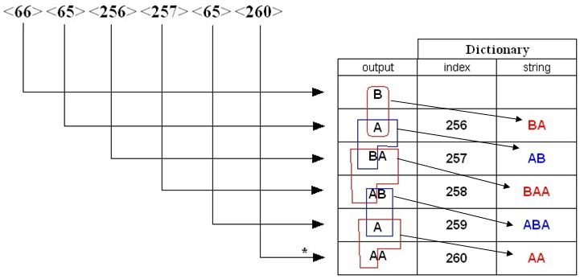
LZW (Lempel-Ziv-Welch) Decoding
<66> <65> <256> <257> <65> <260>
Decode the message:
66 is in Dictionary; output string(66) i.e. B
65 is in Dictionary; output string(65) i.e. A, insert BA
256 is in Dictionary; output string(256) i.e. BA, insert AB
257 is in Dictionary; output string(257) i.e. AB, insert BAA
65 is in Dictionary; output string(65) i.e. A, insert ABA
260 is not in Dictionary; output
previous output + previous output first character: AA, insert AA

Slide 38
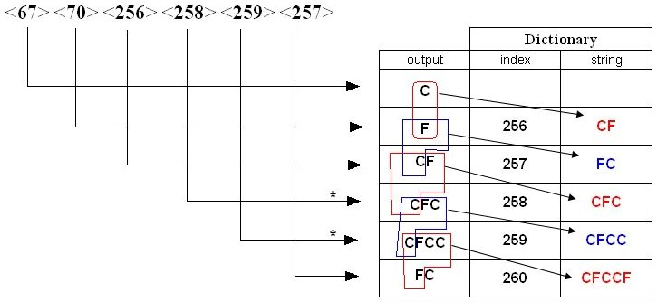
LZW (Lempel-Ziv-Welch) Decoding
<67> <70> <256> <258> <259> <257>
Decode the message:
67 is in Dictionary; output string(67) i.e. C
70 is in Dictionary; output string(70) i.e. F, insert CF
256 is in Dictionary; output string(256) i.e. CF, insert FC
258 is not in Dictionary; output previous output + C i.e. CFC, insert CFC
259 is not in Dictionary; output previous output + C i.e. CFCC, insert CFCC
257 is in Dictionary; output string(257) i.e. FC, insert CFCCF

Slide 39
LZW (Lempel-Ziv-Welch) Coding: Practice
Using the LZW algorithm, code and decode the image I below.
Consider the 1x2 bocks shown in the figure as the coding unit.

Slide 40
LZW (Lempel-Ziv-Welch) Coding: Practice
Using the LZW algorithm, code and decode the image I below.
39 39 126 126
39 39 126 126
39 39 126 126
39 39 126 126

Slide 41
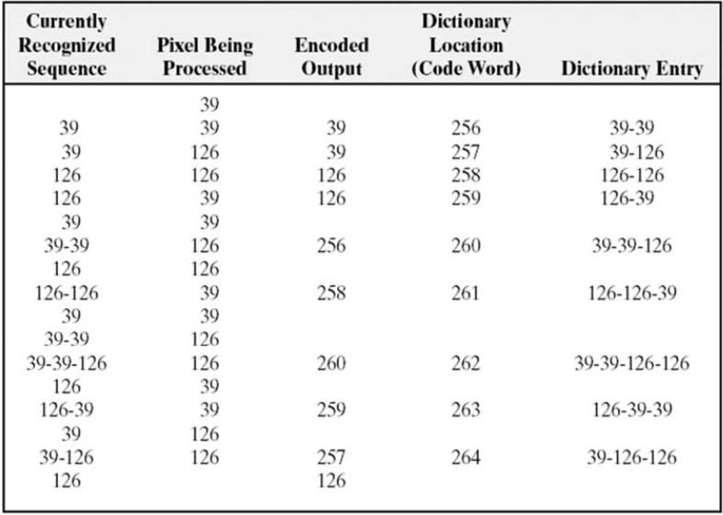
LZW (Lempel-Ziv-Welch) Coding: Example

Slide 42
LZW (Lempel-Ziv-Welch) Coding: Practice
Using the LZW algorithm, code and decode the image I below.
Consider the 1x3 bocks shown in the figure as the coding unit which can be assigned values 0 to 7 in the dictionary. The next codeword of the dictionary starts from 8.

Slide 43
Lossy Compression
— JPEG Encoding —

Slide 44
Lossy Compression Methods
Loss of information is not acceptable in a text file or a program file, but acceptable in an image, video, or audio file since our eyes and ears cannot distinguish subtle changes.
Use of lossy data compression method: cheaper, take less time and space, especially for images and videos, etc.
Several methods have been developed using lossy compression techniques:
JPEG (Joint Photographic Experts Group) encoding used to compress pictures and graphics,
MPEG (Moving Picture Experts Group) encoding: used to compress video, and MP3
MPEG audio layer 3 for audio compression.

Slide 45
Motivations of JPEG
Motivation:
The compression ratio of lossless methods (e.g., Huffman, Arithmetic, LZW) is not high enough for image and video compression, especially when the distribution of pixel values is relatively flat.
JPEG uses transform coding, it is largely based on the following observations:
Observation 1: A large majority of useful image contents change relatively slowly across images, i.e., it is unusual for intensity values to alter up and down several times in a small area, for example, within an 8 x 8 image block. Translate this into the spatial frequency domain, it says that, generally, lower spatial frequency components contain more information than the high frequency components which often correspond to less useful details and noises.
Observation 2: Pshchophysical experiments suggest that humans are more receptive to loss of higher spatial frequency components than loss of lower frequency components.

Slide 46
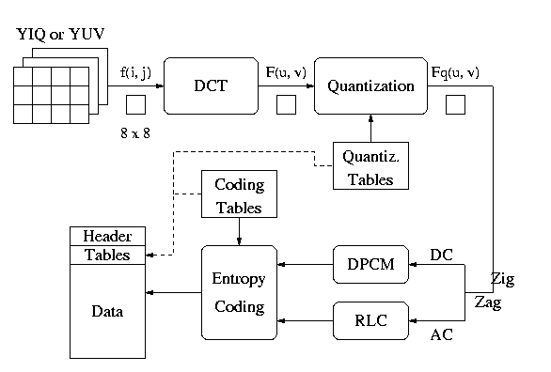
JPEG Encoding Diagram
Images (greyscale, color YIQ or YUV)
Decoding -- Reverse the order

Slide 47
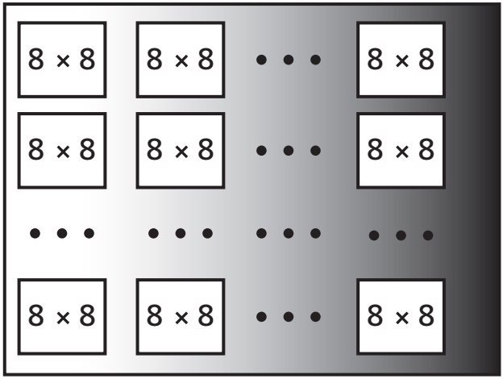
JPEG Encoding
In JPEG, a grayscale picture is divided into blocks of 8 × 8 pixel blocks.
The purpose of dividing the picture into blocks is to decrease the number of calculations.
The whole idea of JPEG is to change the picture into a linear (vector) set of numbers that reveals the redundancies. The redundancies (lack of changes) can then be removed using one of the lossless compression methods we studied previously.

Slide 48
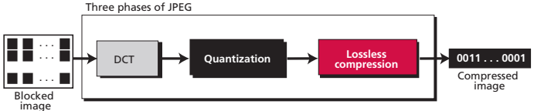
JPEG Encoding
The JPEG compression process

Slide 49
DCT – Discrete Cosine Transform
In this step, each block of 64 pixels goes through DCT transformation.
According to an important property of DCT, it changes the 64 values so that the relative relationships between pixels are kept but the redundancies are revealed.
Let P(x, y) define one value in the image block 8x8, while T (m, n) define the value in the transformed block.
T(0,0) is the average of the other values and is called the DC value (Direct Current).
The rest of the values, called AC values, in T(m, n) represent changes in the pixel values.

Slide 50
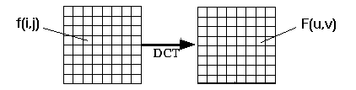
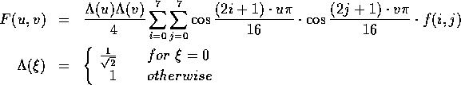
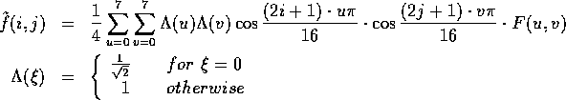
DCT – Discrete Cosine Transform

Slide 51
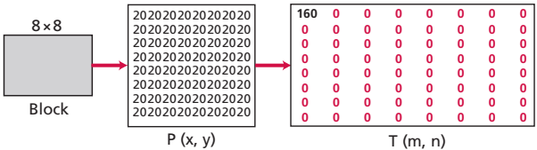
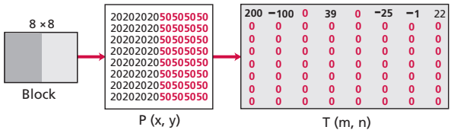
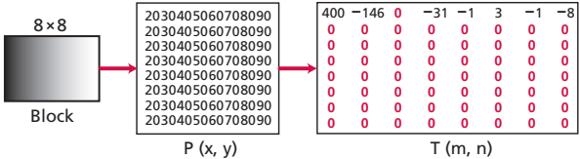
DCT – Discrete Cosine Transform
Case 1
Case 2
Case 3

Slide 52
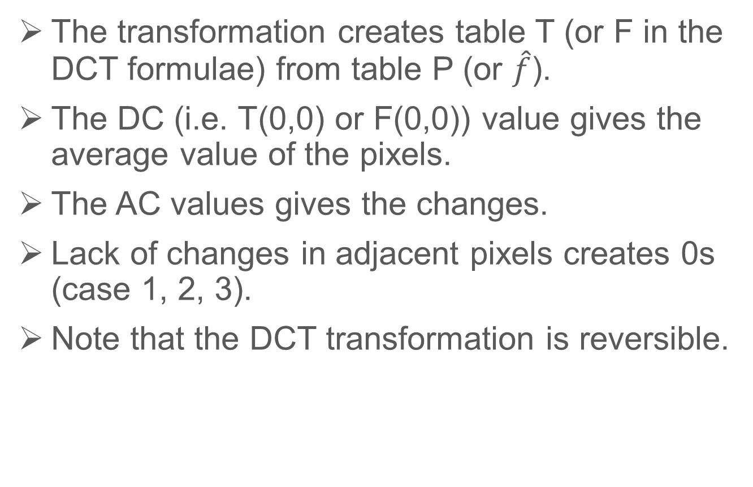
DCT – Discrete Cosine Transform
The transformation creates table T (or F in the DCT formulae) from table P (or $\hat{f}$).
The DC (i.e. T(0,0) or F(0,0)) value gives the average value of the pixels.
The AC values gives the changes.
Lack of changes in adjacent pixels creates 0s (case 1, 2, 3).
Note that the DCT transformation is reversible.

Slide 53
Quantization
Next the values of T are quantized to reduce the number of bits needed for encoding.
Quantization divides the number of bits by a constant and then drops the fraction. This reduces the required number of bits even more.
In most implementations, a quantizing table (8 by 8) defines how to quantize each value. The divisor depends on the position of the value in the T table. This is done to optimize the number of bits and the number of 0s for each particular application.
Note that the only phase in the process that is not reversible is the quantizing phase. You lose some information here that is not recoverable. The only reason that JPEG is a lossy compression method is because of the quantization phase.

Slide 54
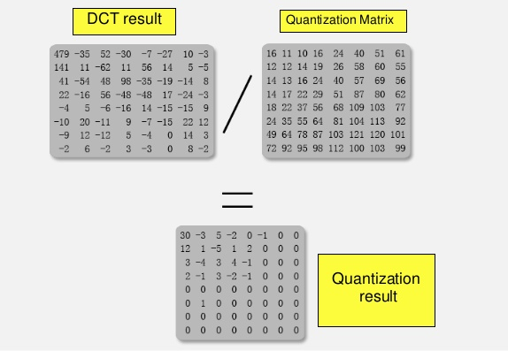
Quantization: Example

Slide 55
Compression
After quantization the values are read from the table, and redundant 0s are removed.
To cluster the 0s together, the process reads the table diagonally in a zigzag fashion rather than row by row or column by column. The reason is that if the picture does not have fine changes, the bottom right corner of the T table is all 0s.
JPEG usually uses run-length encoding at the compression phase to compress the bit pattern resulting from the zigzag linearization.

Slide 56
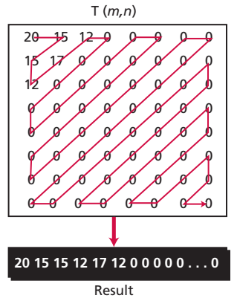
Compression

Slide 57
Compression
Differential Pulse Code Modulation - DPCM on DC component:
DC component is large and varied, but often close to previous value.
Encode the difference from previous 8 x 8 blocks -- DPCM
Run Length Encode - RLE on AC components
1 x 64 vector has lots of zeros in it
Keeps skip and value, where skip is the number of zeros and value is the next non-zero component.
Send (0,0) as end-of-block sentinel value.

Slide 58
Compression
DPCM
45
45
1x64
1x64
54
9
1x64
1x64
48
-6
.
.
.
1x64
1x64
.
.
.
32
12
1x64
1x64
36
4
1x64
1x64

Slide 59
Compression
Categorize DC values into SIZE (number of bits needed to represent) and actual bits.
------------------------------------
SIZE Value
------------------------------------
1 -1, 1
2 -3, -2, 2, 3
3 -7..-4, 4..7
4 -15..-8, 8..15
. .
. .
. .
10 -1023..-512, 512..1023
------------------------------------
Example: if DC value is 4, 3 bits are needed.

Slide 60
Compression
Send off SIZE as Huffman symbol, followed by actual 3 bits.
For AC components two symbols are used: Symbol_1: (skip, SIZE), Symbol_2: actual bits. Symbol_1 (skip, SIZE) is encoded using the Huffman coding, Symbol_2 is not encoded.
Huffman Tables can be custom (sent in header) or default.
. . .
0
0
0
0
0
1
1
0
0
0
0
0
0
0
2
0
. . .
1x64
5,1
7,2

