Slide 1
Digital Image Processing Chapter 8: Image Recognition (Object Recognition, Pattern Recognition, etc.)

Slide 2
Introduction
One of the most interesting aspects of the world is that it can be considered to be made up of patterns.
In image pattern recognition, we think of a pattern as a spatial arrangement of features. A pattern class is a set of patterns that share some common properties.
4 main stages involved in recognition: (1) sensing, (2) preprocessing, (3) feature extraction, and (4) classification.
Classification: using a set of features as the basis for assigning class labels to unknown input image patterns.
They are denoted by ω₁, ω₂,…, ω_{W}, W being the number of classes

Slide 3
Introduction
3 basic approaches used for image pattern classification:
(1) Classification based on matching unknown patterns against specified prototypes:
Objective: to make the features so unique and easily detectable that classification itself becomes a simple task.
(2) Optimum statistical classifiers:
Objective: to yield optimum classification performance in a statistical sense. Emphasis is placed on both the features used, and the design of the classifier.
(3) Neural networks
Neural networks can operate using engineered features. But they have the unique ability of being able to generate, on their own, representations (features) suitable for recognition. These systems can accomplish this using raw data, without the need for engineered features.

Slide 4
Supervised vs Unsupervised Learning
3 approaches are based on parameters that must be either specified or learned from patterns.
The patterns can be labeled, meaning that we know the class of each pattern:
Example of labeled data: the character recognition problem, in which a set of character samples is collected and the identity of each character is recorded as a label from the group 0 through 9 and a through z.
Or unlabeled:
An example of unlabeled data is when we are seeking clusters in a data set, with the aim of utilizing the resulting cluster centers as being prototypes of the pattern classes contained in the data.

Slide 5
Supervised vs Unsupervised Learning
When working with a labeled data, a given data set generally is subdivided into three subsets: a training set, a validation set, and a test set (a typical subdivision might be 50% training, and 25% each for the validation and test sets).
The process by which a training set is used to generate classifier parameters is called training. In this mode, a classifier is given the class label of each pattern, the objective being to make adjustments in the parameters if the classifier makes a mistake in identifying the class of the given pattern. At this point, we might be working with several candidate designs.
At the end of training, we use the validation set to compare the various designs against a performance objective. Typically, several iterations of training/validation are required to establish the design that comes closest to meeting the desired objective.

Slide 6
Supervised vs Unsupervised Learning
The final step is to determine how it will perform “in the field.” For this, we use the test set, which consists of patterns that the system has never “seen” before.
If the training and validation sets are truly representative of the data the system will encounter in practice, the results of training/validation should be close to the performance using the test set.
If training/validation results are acceptable, but test results are not, we say that training/validation “over fit” the system parameters to the available data, in which case further work on the system architecture is required.
Of course all this assumes that the given data are truly representative of the problem we want to solve, and that the problem in fact can be solved by available technology.

Slide 7
Supervised vs Unsupervised Learning
A system that is designed using training data is said to undergo supervised learning.
If we are working with unlabeled data, the system learns the pattern classes themselves while in an unsupervised learning mode.
Supervised learning covers a broad range of approaches, from applications in which a system learns parameters of features whose form is fixed by a designer, to systems that utilize deep learning and large sets of raw data sets to learn, on their own, the features required for classification.
Deep learning: Learning with the use of a multilayered neural network.
These systems accomplish this task without a human designer having to specify the features, a priori.

Slide 8
Pattern Classification Techniques
Introduction to basic techniques:
Decision theoretic techniques
Quantitative descriptors (e.g. area, length…).
Patterns arranged in vectors.
Structural techniques
Qualitative descriptors (relational descriptors for repetitive structures, e.g. staircase).
Patterns arranged in strings or trees.
Central idea: Learning from sample patterns.

Slide 9
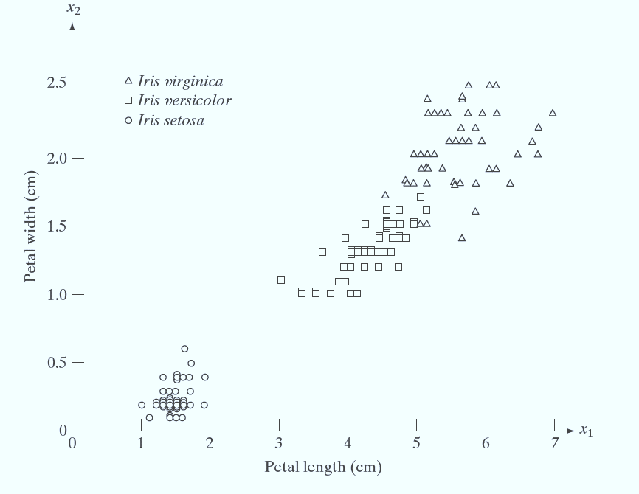
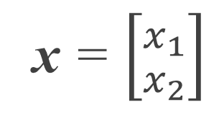
Pattern Vectors
Historical example:
Recognition of 3 types of iris flowers by the lengths and widths of their petals (Fisher 1936).
Variations between and within classes.
Class separability depends strongly on the choice of descriptors.
x = $\left[{x_{1} \atop x_{2}}\right]$

Slide 10
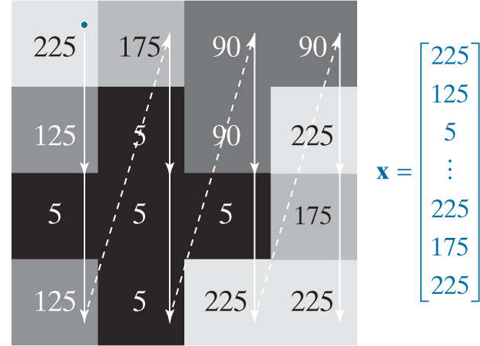
Pattern Vectors
Using linear indexing to vectorize a grayscale image.

Slide 11
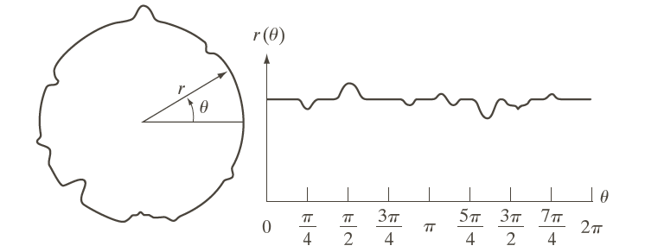
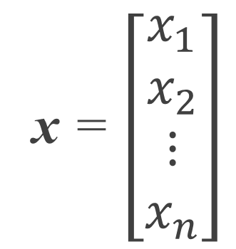
Pattern Vectors
Shape signature represented by the sampled amplitude values.
Cloud of n-dimensional points.
Other shape characteristics could have been employed (e.g. moments).
The choice of descriptors has a profound role in the recognition performance.
x = $\left[\begin{aligned}x_{1} \\ x_{2} \\ ⋮ \\ x_{n}\end{aligned}\right]$

Slide 12
String Descriptors
Description of structural relationships.
Example: fingerprint recognition.
Primitive components that describe fingerprint ridge properties.
Interrelationships of print features (minutiae).
Abrupt endings, branching, merging, disconnected segments,…
Relative sizes and locations of print features.

Slide 13
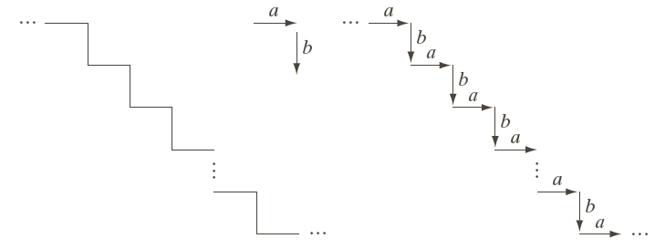
String Descriptors
Staircase pattern described by a head-to-tail structural relationship.
The rule allows only alternating pattern.
It excludes other types of structures.
Other rules may be defined.

Slide 14
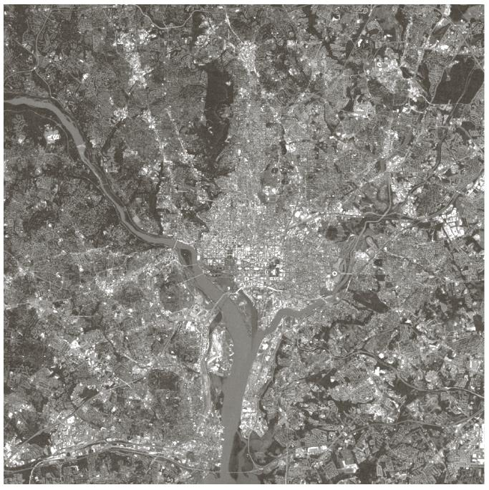
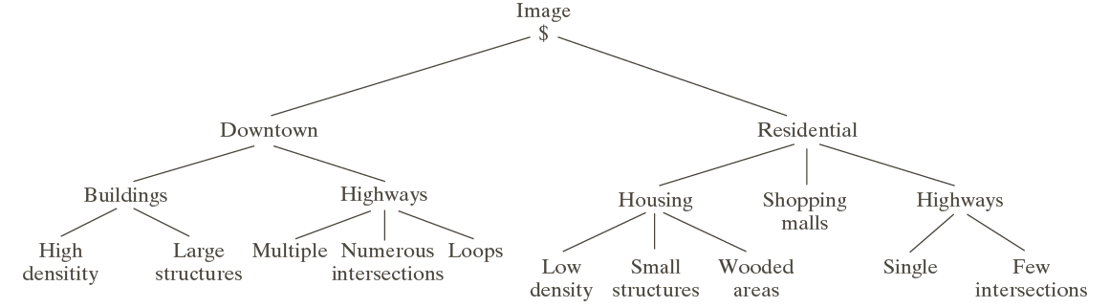
Tree Descriptors
Hierarchical ordering
In the satellite image example, the structural relationship is defined as: “composed of”

Slide 15

Decision-Theoretic Methods
They are based on decision (discriminant) functions.
Let x=[x₁, x₂,…, x_{n}]^{T} represent a pattern vector.
For W pattern classes ω₁, ω₂,…, ω_{W}, the basic problem is to find W decision functions d₁(x), d₂(x),…, d_{W} (x) with the property that if x belongs to class ω_{i}:

Slide 16
Decision-Theoretic Methods
Matching: an unknown pattern is assigned to the class to which it is closest with respect to a metric, i.e. a measurement outcome.
Minimum distance classifier
Computes the Euclidean distance between the unknown pattern and each of the prototype vectors.
Correlation
It can be directly formulated in terms of images
Optimum statistical classifiers
Neural networks

Slide 17


Minimum Distance Classifier
The prototype of each pattern class j is the mean vector:
Using the Euclidean distance as a measure of closeness:
We assign x to class ω_{j} if D_{j}(x) is the smallest distance. That is, the smallest distance implies the best match in this formulation.

Slide 18

Minimum Distance Classifier
Theoretically selecting the smallest distance is equivalent to evaluating the functions:
and assigning x to class ω_{j} if d_{j}(x) yields the largest numerical value.
This formulation agrees with the concept of a decision function.

Slide 19
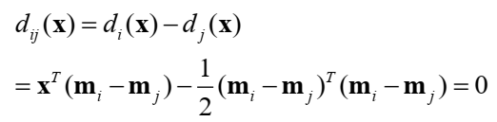
Minimum Distance Classifier
The decision boundary between classes ω_{i} and ω_{j} is given by:
The surface is the perpendicular bisector of the line segment joining m_{i} and m_{j}.
For n=2, the perpendicular bisector is a line, for n=3 it is a plane and for n>3 it is called a hyperplane.

Slide 20
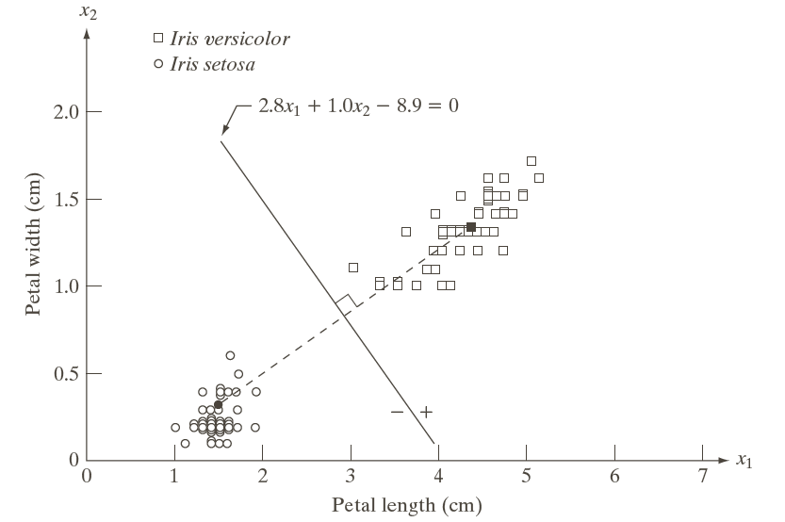
Minimum Distance Classifier

Slide 21
Minimum Distance Classifier
In practice, the classifier works well when the distance between means is large compared to the spread of each class.
This occurs seldom unless the system designer controls the nature of the input.
An example is the recognition of characters on bank checks
American Banker’s Association E-13B font character set.

Slide 22
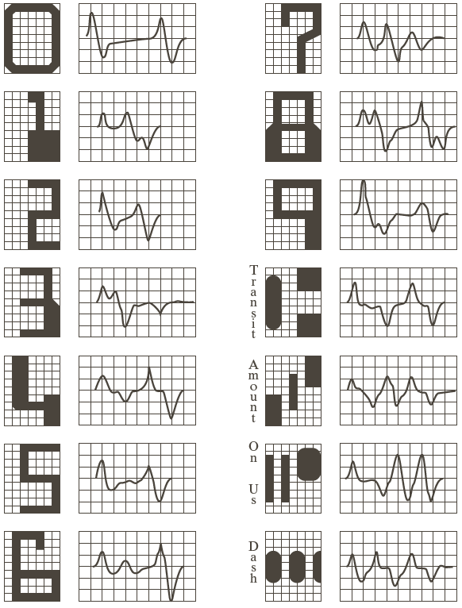
Minimum Distance Classifier
Characters designed on a 9x7 grid.
The characters are scanned horizontally by a head that is narrower but taller than the character which produces a waveform proportional to the rate of change of the quantity of the ink.
The waveforms (signatures) are different for each character.

Slide 23
Matching Shape Numbers
Structural approach
The degree of similarity, k, between two shapes is defined as the largest order for which their shape numbers still coincide.
Reminder: The shape number of a boundary is the first difference of smallest magnitude of its chain code (invariance to rotation).
The order n of a shape number is defined as the number of digits in its representation.

Slide 24
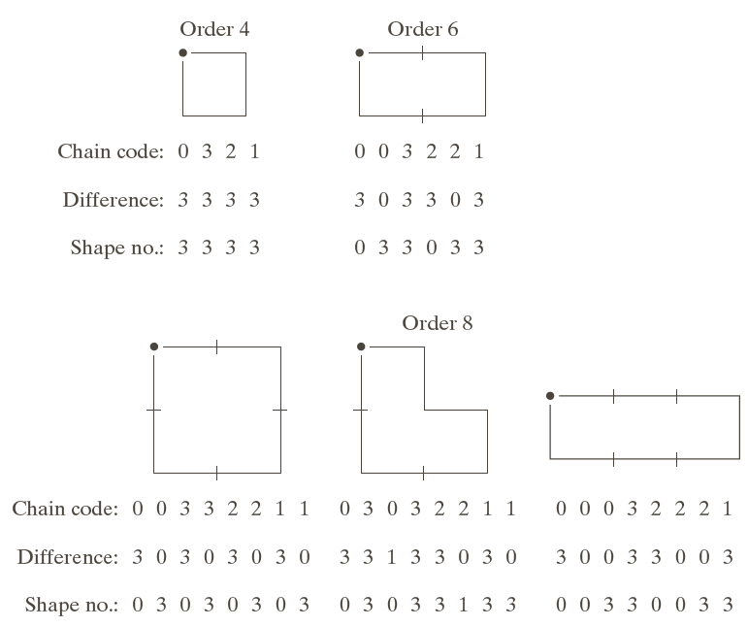
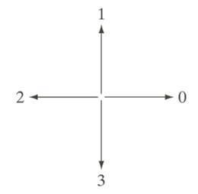
Matching Shape Numbers
Examples. All closed shapes of order n=4, 6 and 8.
First differences are computed by treating the chain as a circular sequence.
The first difference is obtained by counting the number of direction changes (counterclockwise) that separate two adjacent (left to right) elements of the code. Treat the code as a circular sequence, the first element of the difference is computed by using the transition between the last and first components of the chain. For instance, the first difference of the 4-directional chain code 10103322 is 3133030.

Slide 25

Matching Shape Numbers
Let a and b denote two closed shapes which are represented by 4-directional chain codes; and s(a) and s(b) their shape numbers.
The shapes have a degree of similarity, k, if:
This means that the first k digits should be equal.
The subscript indicates the order. For 4-directional chain codes, the minimum order for a closed boundary is 4.

Slide 26


Matching Shape Numbers
Alternatively, the distance between two shapes a and b is defined as the inverse of their degree of similarity:
It satisfies the properties:

Slide 27


String Matching
Structural approach
Region boundaries a and b are coded into strings denoted by a₁a₂a₃ …a_{n} and b₁b₂b₃ …b_{m}.
Let α represent the number of matches between the two strings.
A match at the k^{th} position occurs if a_{k}=b_{k}.
The number of symbols that do not match is:
A simple measure of similarity:

Slide 28
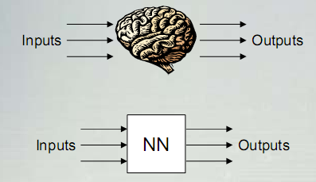
Pattern Classification by Neural Network
Neural Network – NN
An extremely simplified model of the human’s brain.
Transforms inputs into the best outputs (some neural networks are the universal function approximators).

Slide 29
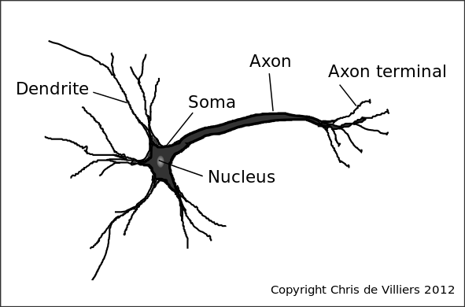
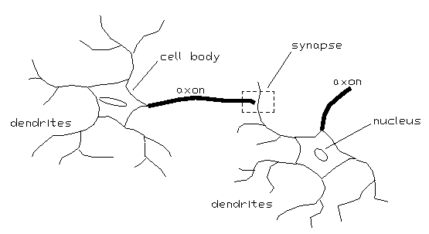
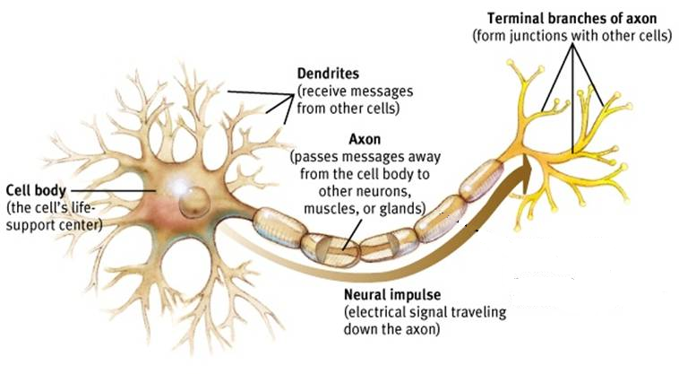
Pattern Classification by Neural Network
Biological
neuron

Slide 30
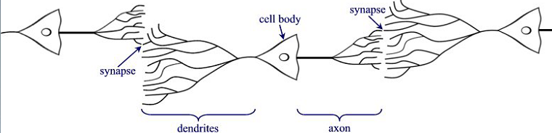
Biological Neuron
Many “neurons” co-operate to perform the desired function
Basic elements:
Axon
Dendrite
Synapse

Slide 31
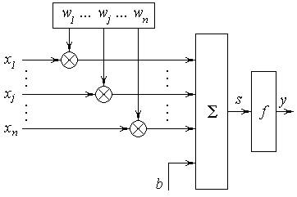
Artificial Neuron Structure
The output of a neuron is a function of the weighted sum of the inputs plus a bias
Artificial Neuron Network
ANN

Slide 32
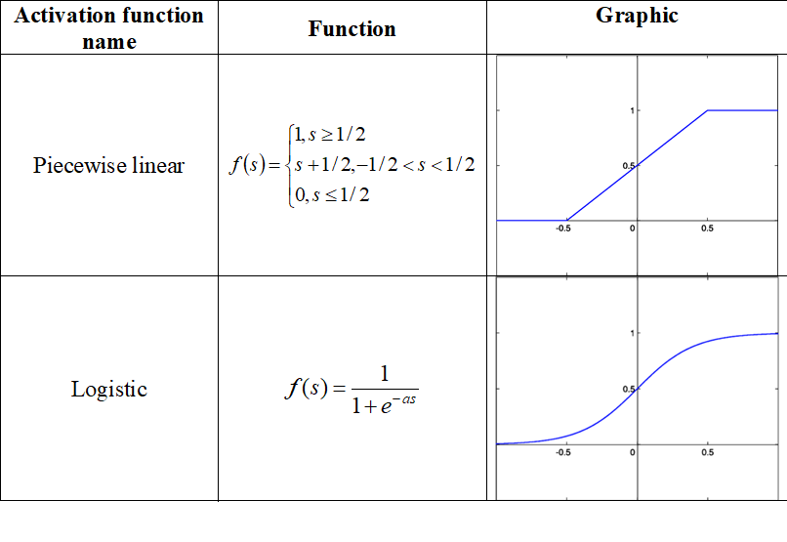
Common Activation Functions

Slide 33
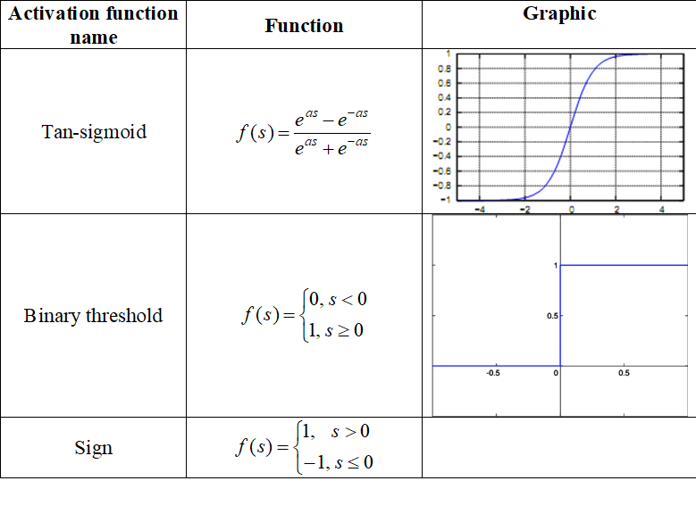
Common Activation Functions

Slide 34
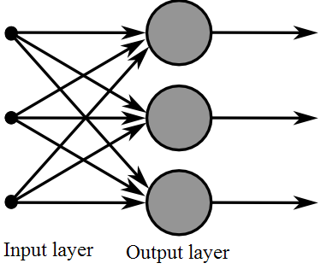
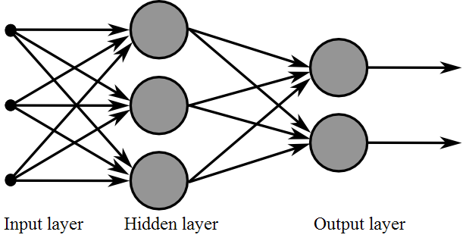
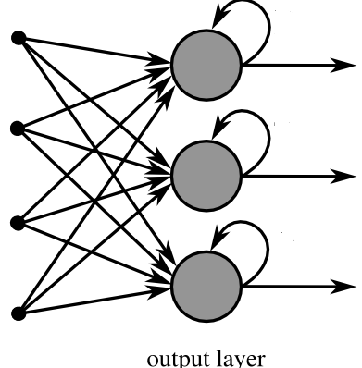
Examples of ANN Topologies
Single layer ANN
Multilayer ANN
ANN with one recurrent layer

Slide 35
Fundamentals of ANN Learning
A training pattern is an input vector p with the components x₁, x₂, . . . , x_{n} whose desired output is known.
By entering the training pattern into the network we receive an output that can be compared with the desired output.
The set of training patterns is called P. It contains a finite number of ordered pairs (p, t) of training patterns with corresponding desired output t.

Slide 36
Fundamentals of ANN Learning
Learning procedure:
1. Let P be the set of n training patterns p_{n}
2. For i=1 to n
Begin
Calculate output vector y_{i} for the training pattern p_{i}.
Compare y_{i} with desired output t_{i}, then calculate the error of output and make modification of weights.
End
3. If total error for the training set P more than some threshold then go to the step 2.

Slide 37

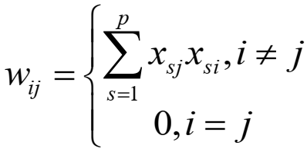
Hopfield Networks
Act as “auto-associative” memories to store patterns, and an error correction network
All neurons connected to each other:
Symmetric weights (w_{ij} = w_{ji}) and w_{ii} = 0
The activation function:
Completely connected

Slide 38
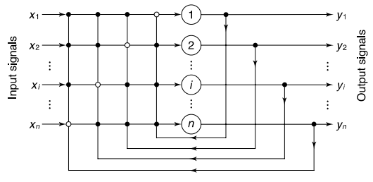
Hopfield Networks
Single-layer n-neuron Hopfield network

Slide 39

Hopfield Networks: Training
Step 1: Storage
The n-neuron Hopfield network is required to store a set of M fundamental memories, Y₁; Y₂; ...; Y_{M}. The synaptic weight from neuron i to neuron j is calculated as:
where y_{m,i} and y_{m,j} are the i^{th} and the j^{th} elements of the fundamental memory Y_{m}, respectively.

Slide 40
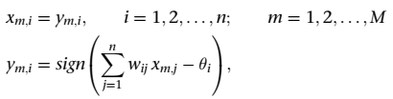
Hopfield Networks: Training
Step 2: Testing
We need to confirm that the Hopfield network is capable of recalling all fundamental memories. In other words, the network must recall any fundamental memory Y_{m} when presented with it as an input. That is:
where y_{m,i} is the i^{th} element of the actual output vector Y_{m}, and x_{m,j} is the j^{th} element of the input vector X_{m}.
If all fundamental memories are recalled perfectly we may proceed to the next step.
θ: threshold

Slide 41

Hopfield Networks: Training
Step 3: Retrieval
Present an unknown n-dimensional vector (probe), X, to the network and retrieve a stable state. Typically, the probe represents a corrupted or incomplete version of the fundamental memory, that is:

Slide 42
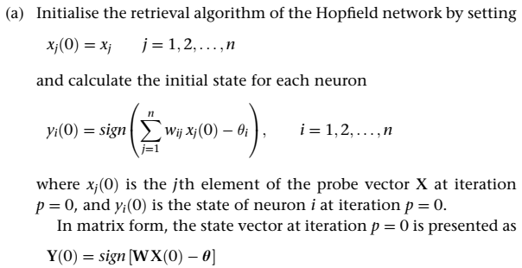
Hopfield Networks: Training
Step 3: Retrieval
…

Slide 43
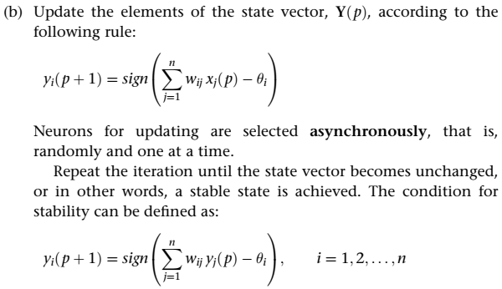
Hopfield Networks: Training
Step 3: Retrieval
…

Slide 44
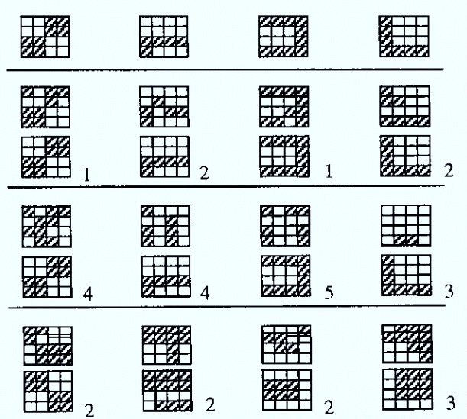
Hopfield Networks: Application
Original image
Image with noise at 2 pixels
Pattern classified by Hopfield network
Number of iterations
Image with noise at 5 pixels
Image with noise at 13 pixels
Patterns X1 X2 X3 X4

Slide 45
Kohonen Network
Self Organizing Map - SOM
Architecture
neuron i
Kohonen layer
w_{i}
Winning neuron
Input vector X
X=[x₁,x₂,…x_{n}] ∈ R^{n}
w_{i}=[w_{i1},w_{i2},…,w_{in}] ∈ R^{n}

Slide 46
Kohonen Network
Training of weights
1) The weights are initialized to random values (e.g. in the interval -0.1 to 0.1) and the neighborhood sizes set to cover over half of the network;
2) A m-dimensional input vector X_{s} enters the network;
3) The distances d_{i}(W_{i}, X_{s}) between all the weight vectors on the SOM and X_{s} are calculated by using (for instance):
where: W_{i} denotes the i^{th} weight vector; w_{j} and x_{j} represent the j^{th} elements of W_{i} and X_{i} respectively

Slide 47
Kohonen Network
Training of weights
…
4) Find the best matching neuron or “winning” neuron whose weight vector W_{k} is closest to the current input vector X_{i}
5) Modify the weights of the winning neuron and all the neuron in the neighborhood N_{k} by applying:
W_{jnew} = W_{jold} + α(X_{i} - W_{jold})
where α represents the learning rate;
6) Next input vector X_{(i+1)}, the process is repeated.

Slide 48
Kohonen Network
Training of weights: Linear
First neighborhood
Second neighborhood

Slide 49
Kohonen Network
Training of weights: Rectangle
First neighbourhood
Second neighbourhood

Slide 50
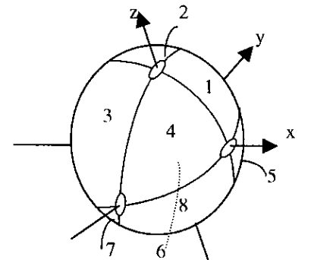
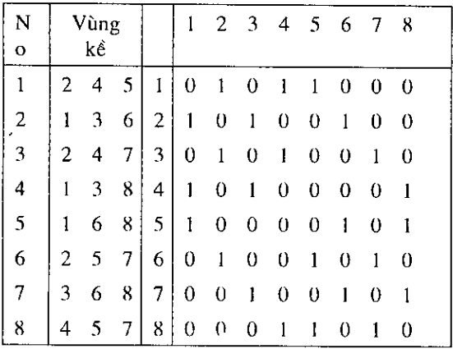
Kohonen Network: Application

Slide 51
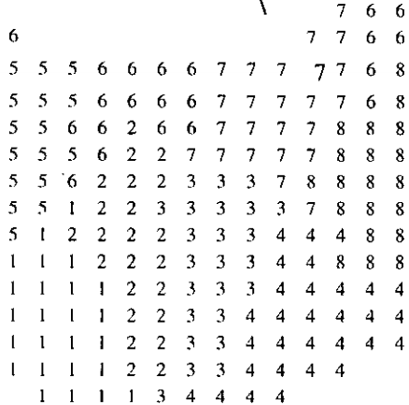
Kohonen Network: Application

