Slide 1

Cursor AI: Supercharging Your Code
You're already using Copilot, which is great. But what if you could have a coding assistant that understands your entire codebase and lets you work fluently with the AI assistant? That's Cursor.
We're going to cover setup, key features, and how to integrate it with your existing workflow.
We’ll also cover how to use local LLMs as assistants in an IDE
This is all about practical, hands-on tips."

Slide 2
Setup and Installation - Getting Started Quickly
First, download Cursor from cursor.sh. It's a separate editor, built on VS Code, so the interface will feel familiar.
Or use brew: brew install --cask cursor
You can install your favorite VS Code extensions, including the ones you use for your specific language.
Basically same keyboard shortcuts as vscode
Demo: open todo app project, ~/work/code/IDEs/cursorai/todo-app:]2017$ cursor .

Slide 3
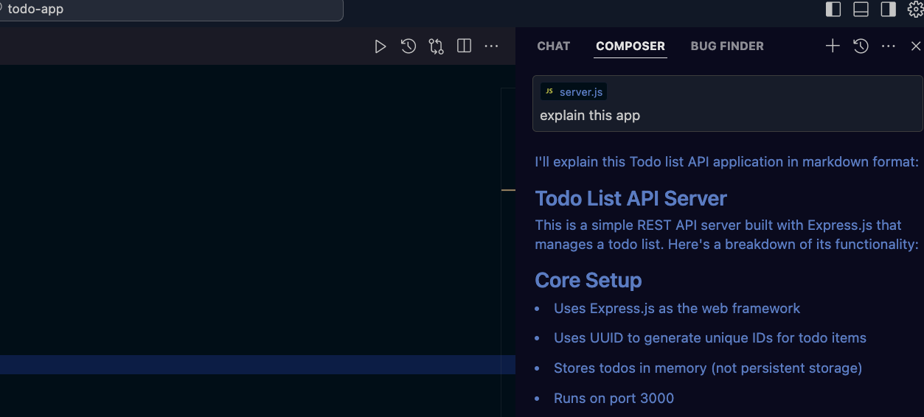
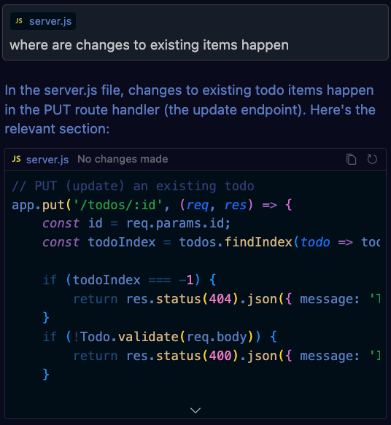
Demo slide – chat about project
Cmd + enter – scan project
Alt+cmd+b - Open AI panel
Ask about project in chat pannel
Demo full function auto complete

Slide 4
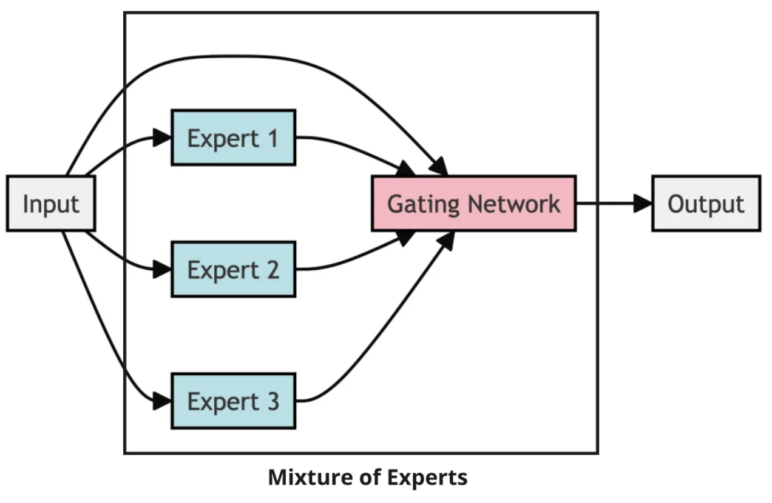
Why choose over co-pilot
Full comparison: https://docs.google.com/document/d/1W0t28VgCnX5sW2PgrITs94rexheNC_4kj7bDOqWtmn0/edit?tab=t.0
Better autocomplete scope suggest whole functions etc – learn more at https://appwrk.com/cursor-ai-features
Custom LLM Architecture: Allowing Long-context processing and MoE (Mixture of Experts), e.g. react expert, DB expert etc all work together
Diff-Aware Predictions – suggest predicted next code block as diff
Predictive Editing – predict the highest probability next change and offer it (tab to complete) – learn more at https://carlrannaberg.medium.com/cursor-ai-its-not-another-vscode-fork-5-key-features-that-set-it-apart-fa6c9be534dd

Slide 5
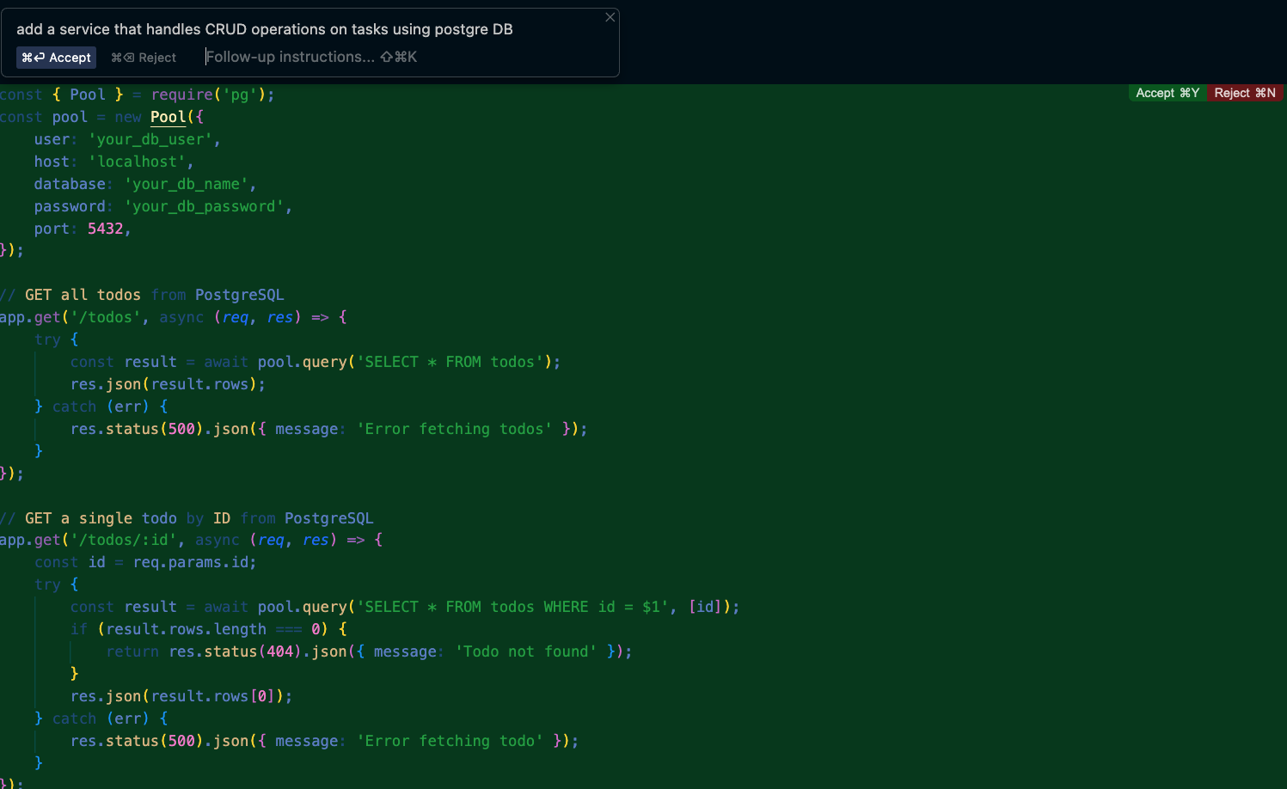

Why choose over co-pilot
Full file and or project generation based on text description
Example: demo
Learn more: https://www.google.com/search?q=cursor+ai+Multi-File+Editing+and+Application+Generation&oq=cursor+ai+Multi-File+Editing+and+Application+Generation&gs_lcrp=EgZjaHJvbWUyBggAEEUYOTIHCAEQIRigAdIBCDM4NDhqMGo0qAIAsAIB&sourceid=chrome&ie=UTF-8#fpstate=ive&vld=cid:7b65c207,vid:y_P4rBQXk0M,st:0

Slide 6
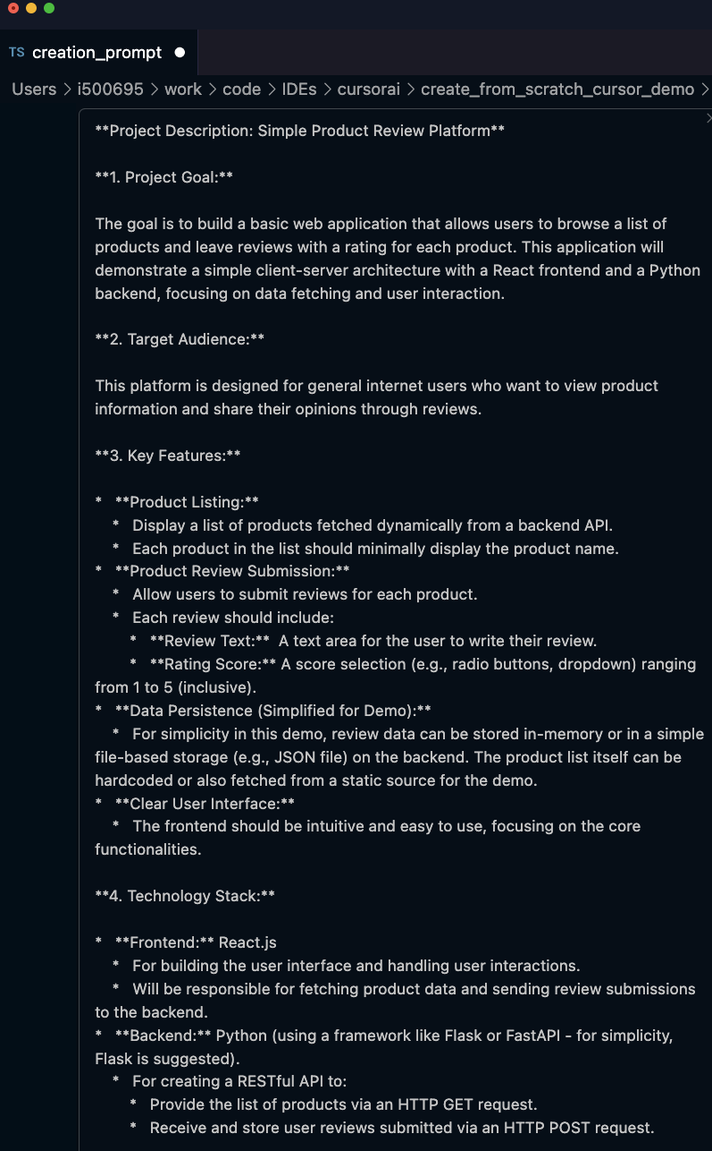
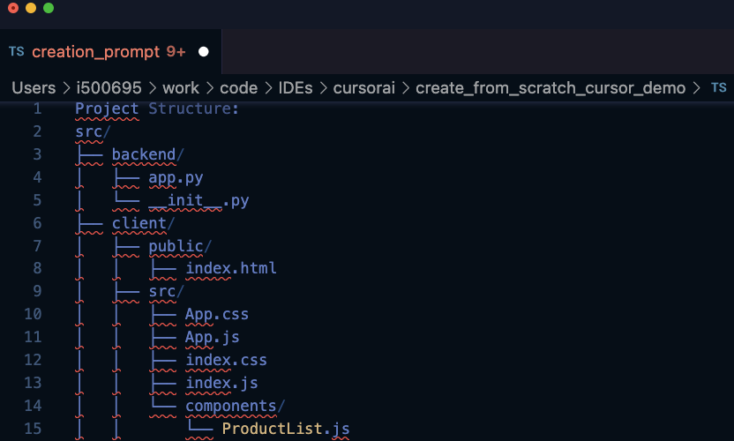
Why choose over co-pilot
Example: I created a generation prompt by providing a generation prompt to another AI model
Then I cmd+k in cursor and ask it to generate the project
Generate project structure etc

Slide 7
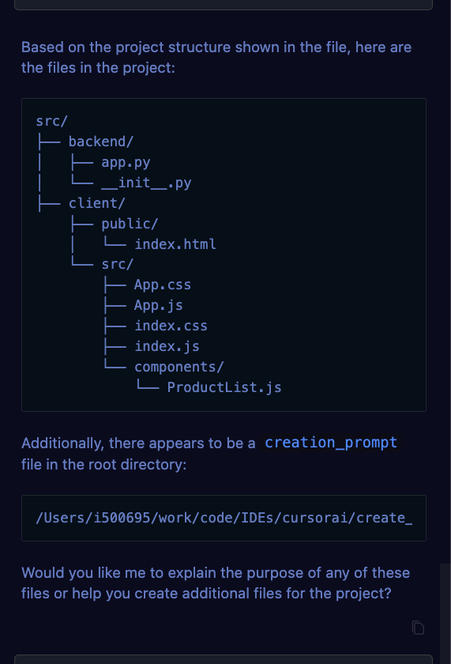
Agent
Cmd + L (chat). Supports, among else,
Pull in context automatically like try recommended, explain etc
Run terminal commands
Create and modify files
Do semantic code search
Handle file operations

Slide 8
Some more co-pilot weaknesses
Limited context window. Esp. felt in big projects. See: https://www.reddit.com/r/cursor/comments/1f7cku2/cursor_vs_vscodecopilot/, quote: “he difference is huge: VSCode+Copilot feels like a generation old. Cursor feels so more natural, it covers more stuff, the chat is more immediately useful, applying changes shows the difference. Even the ⌘K is better, with followup on the proposed code: with Copilot you have to accept it then change again.”
Occasional Inaccuracies: can sometimes generate incorrect or irrelevant code, requiring developers to review and validate the suggestions. Can be seen in many reviews: https://www.gartner.com/reviews/market/generative-ai-apps/vendor/github/product/github-copilot
Reliance on open ai models only. Can be a significant drawback since the competition between the AI companies is fierce and there are many non open ai models who are either cheaper or better in some areas.

Slide 9
Privacy
Privacy Mode: Cursor AI offers a "Privacy Mode" in its settings. When enabled, Cursor claims that:
  Zero data retention is enabled
  None of your code is stored or used for training by them or any third party
  Privacy Policy | Cursor - The AI Code Editor: www.cursor.com, https://www.cursor.com/privacy,
Workspace Trust (VS Code Feature): Cursor is built on VS Code, which has a "Workspace Trust" feature. This helps prevent potentially malicious code in projects from automatically running. So for extra protection make sure this is enabled in your Cursor settings: security.workspace.trust.enabled
This is the closest you'll get to a guarantee of local processing within Cursor itself 😅

Slide 10
Privacy
However, if it’s not enough for an extra sensitive project/s just use copilot or the excellent ollama and any of the top models available for free, such as llama 3.x, qwen, mistral and deepseek models. I’ll demo how to use deepseek-r1:32b with vscode.

