Slide 1

Cursor AI: Supercharging Your Code
You're already using Copilot, which is great. But what if you could have a coding assistant that understands your entire codebase, debugs with context, and even runs locally? That's Cursor.
We're going to cover setup, key features, and how to integrate it with your existing workflow, including both cloud and local LLMs.
This is all about practical, hands-on tips."

Slide 2
Setup and Installation - Getting Started Quickly
First, download Cursor from cursor.sh. It's a separate editor, built on VS Code, so the interface will feel familiar.
Or use brew: brew install --cask cursor
You can install your favorite VS Code extensions, including the ones you use for your specific language.
Basically same keyboard shortcuts as vscode
Demo: open todo app project, ~/work/code/IDEs/cursorai/todo-app:]2017$ cursor .

Slide 3
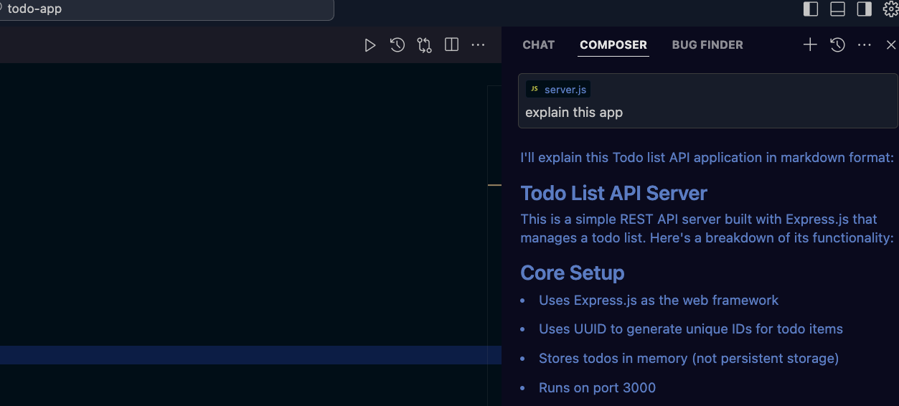
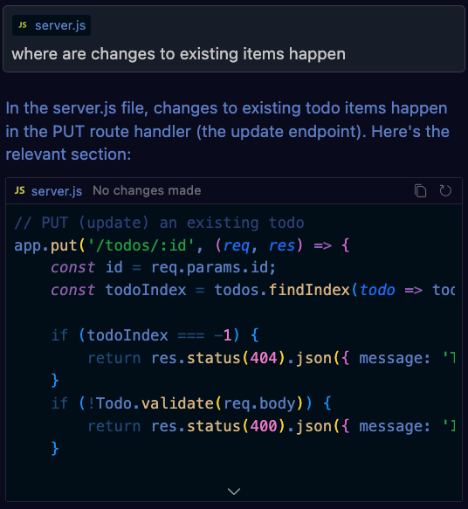
Demo slide – chat about project
Cmd + enter – scan project
Alt+cmd+b - Open AI panel
Ask about project in chat pannel
Demo full function auto complete

Slide 4
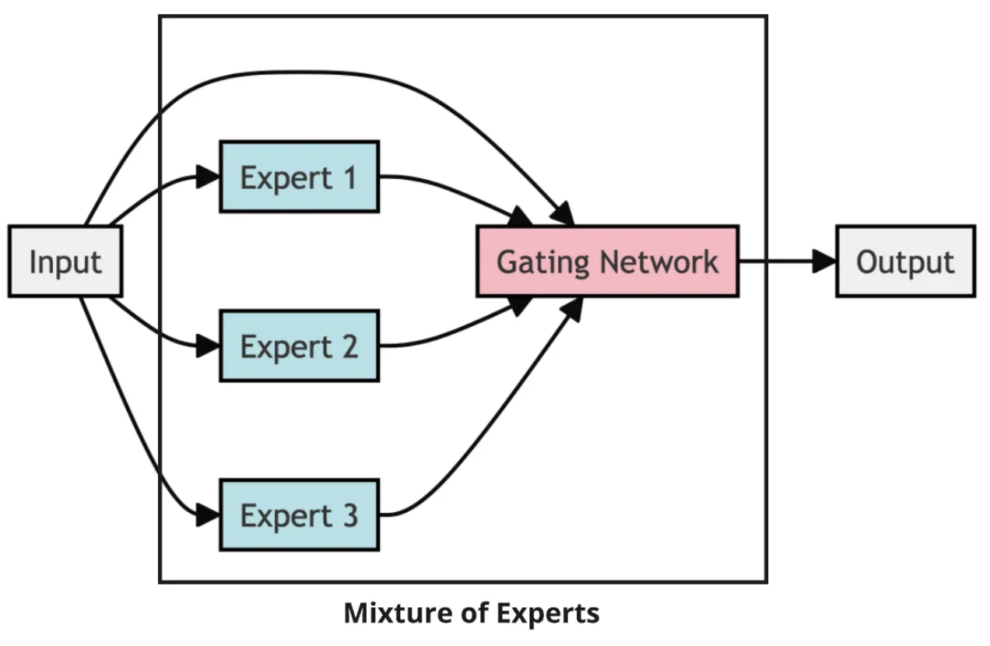
Why choose over co-pilot
Full comparison: https://docs.google.com/document/d/1W0t28VgCnX5sW2PgrITs94rexheNC_4kj7bDOqWtmn0/edit?tab=t.0
Better autocomplete scope suggest whole functions etc – learn more at https://appwrk.com/cursor-ai-features
Custom LLM Architecture: Allowing Long-context processing and MoE (Mixture of Experts), e.g. react expert, DB expert etc all work together
Diff-Aware Predictions – suggest predicted next code block as diff
Predictive Editing – predict the highest probability next change and offer it (tab to complete) – learn more at https://carlrannaberg.medium.com/cursor-ai-its-not-another-vscode-fork-5-key-features-that-set-it-apart-fa6c9be534dd

Slide 5
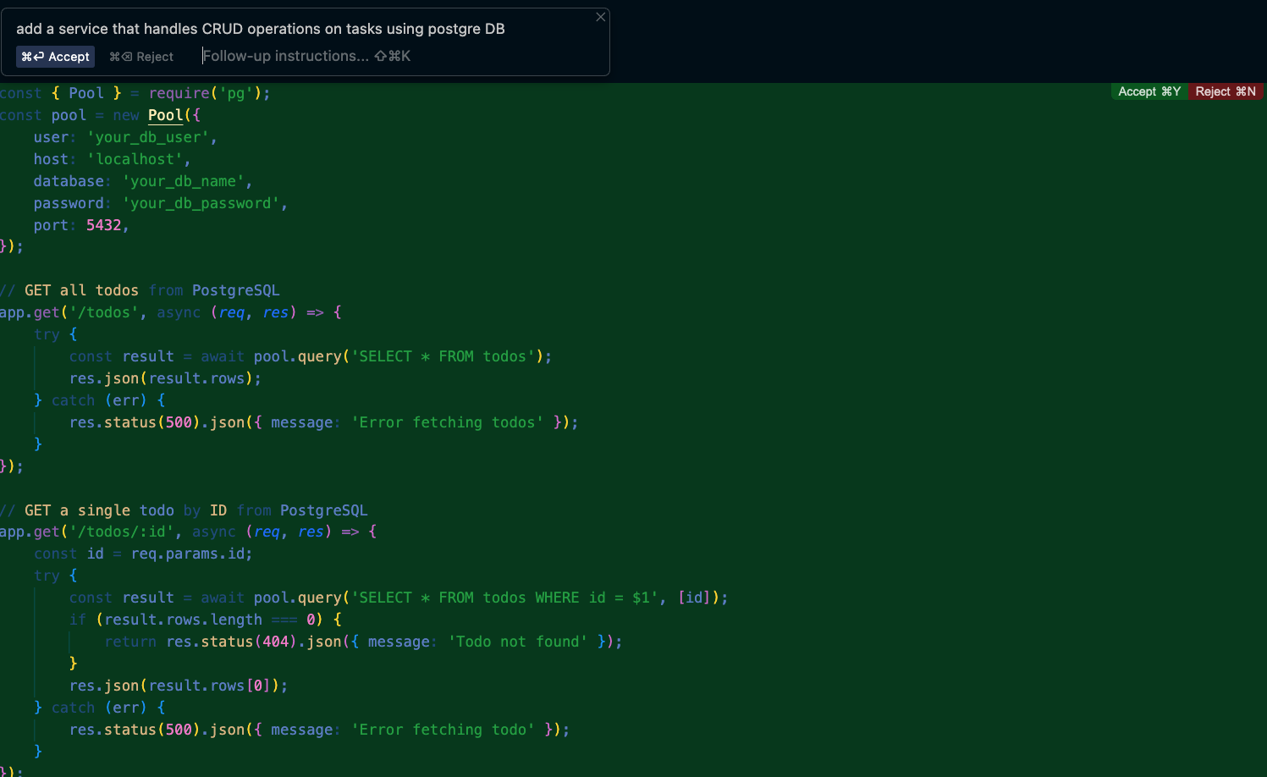

Why choose over co-pilot
Full file and or project generation based on text description
Example: demo
Learn more: https://www.google.com/search?q=cursor+ai+Multi-File+Editing+and+Application+Generation&oq=cursor+ai+Multi-File+Editing+and+Application+Generation&gs_lcrp=EgZjaHJvbWUyBggAEEUYOTIHCAEQIRigAdIBCDM4NDhqMGo0qAIAsAIB&sourceid=chrome&ie=UTF-8#fpstate=ive&vld=cid:7b65c207,vid:y_P4rBQXk0M,st:0

