Slide 1
Node JS – ES6
Amir Yahalom, SAP.

Slide 2
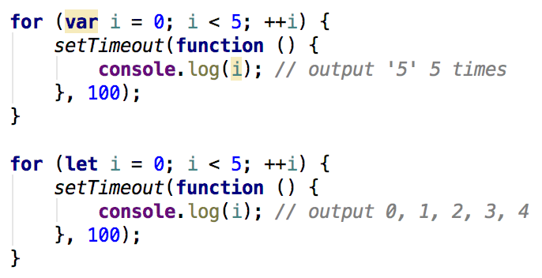
Let and Const
let and const are both block scope variables
  var is a function scope variable

Slide 3
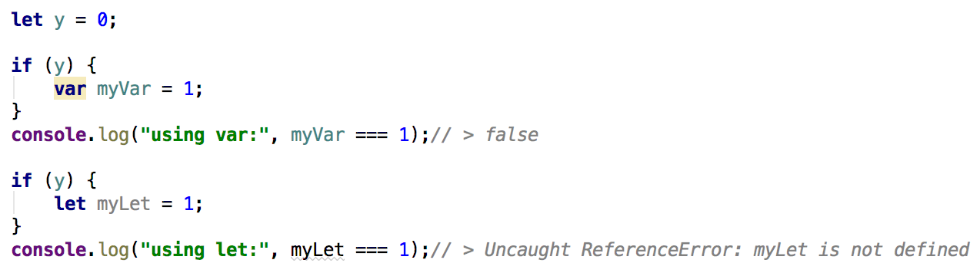
Let
let is the new block scoping var
let improves scoping options in JS, NOT replaces var
In legacy code, let should replace var only when var was already signaling block scoping stylistically
When NOT to replace - example:

Slide 4
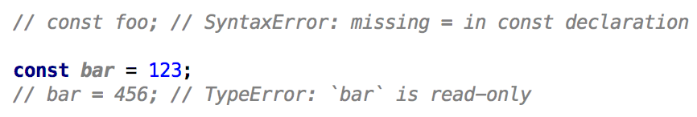
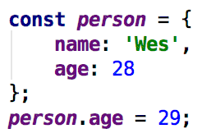
Const
creates a read-only reference to a value
NOT immutable, just cannot be reassigned

Slide 5
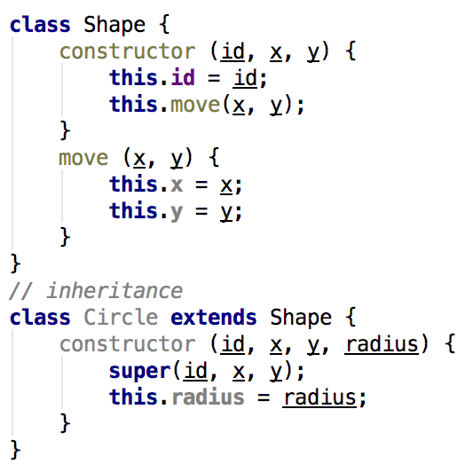
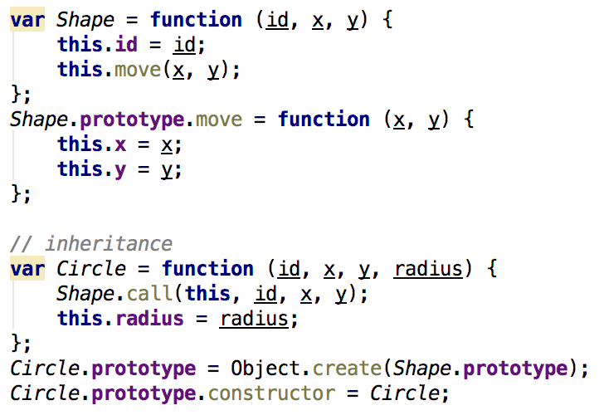
Class
Syntactical sugar over JavaScript's existing prototype-based inheritance

Slide 6
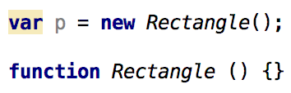
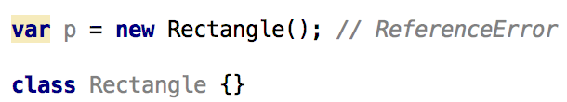
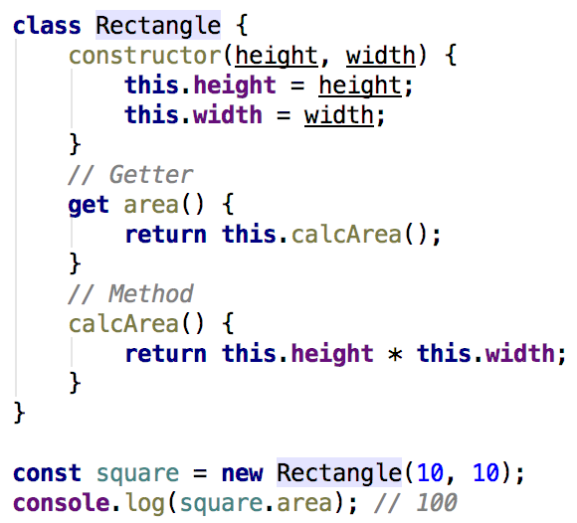
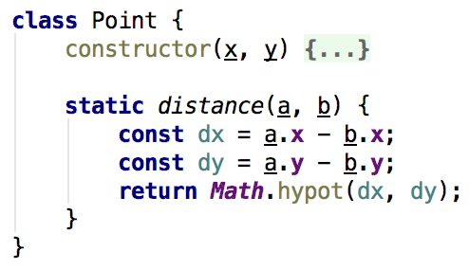
Class
function declarations are hoisted and class declarations are not
Each class can have
a constructor, getters/setters,
methods, static methods..

Slide 7
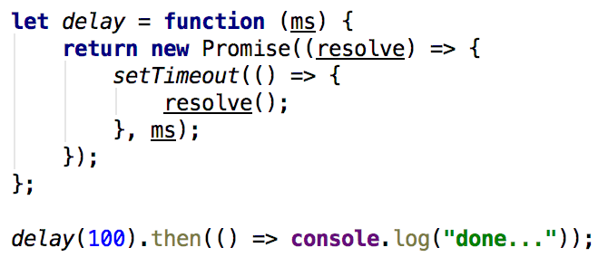
Native Promise
Native promises can be used instead of Promise libraries
Same principals, less methods than known libraries

Slide 8
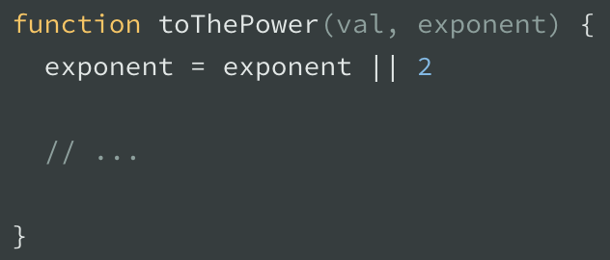
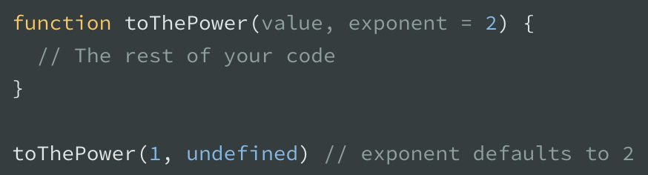
Defaulting function parameters
ES6 enables a default value to be set for function arguments
Turns to:

Slide 9
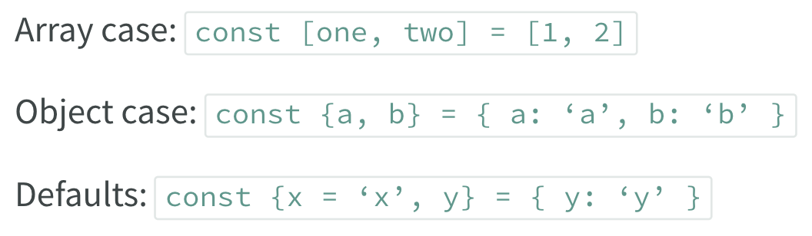
De-structuring
Destructs arrays or objects:
Using “…”:

Slide 10
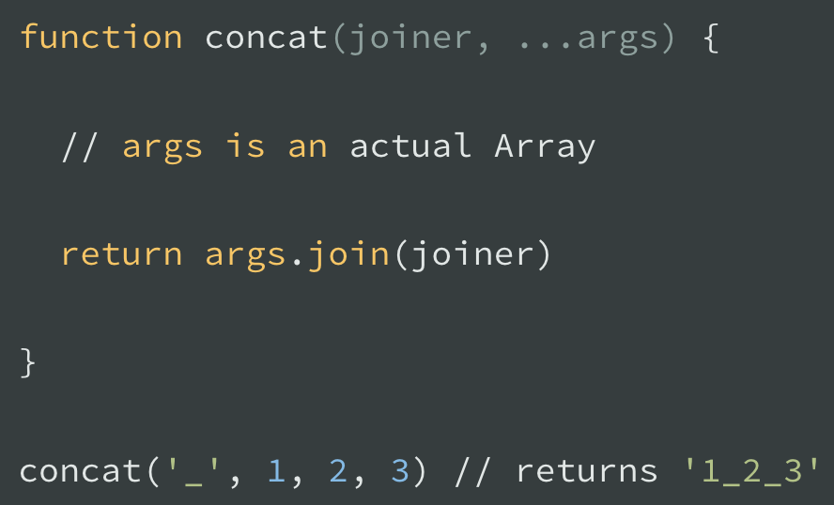
Extra arguments in a function
Using de-structuring syntax allows a more cleaner way than the “arguments” notion:

Slide 11
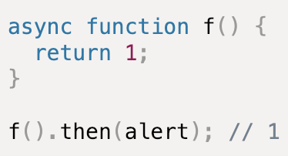
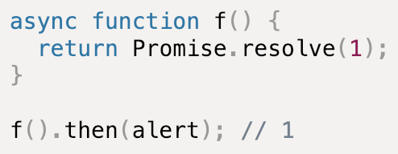
Async Await
Syntactic sugar on top of promises
“async” keyword applies on functions
“async” function returns a promise

Slide 12
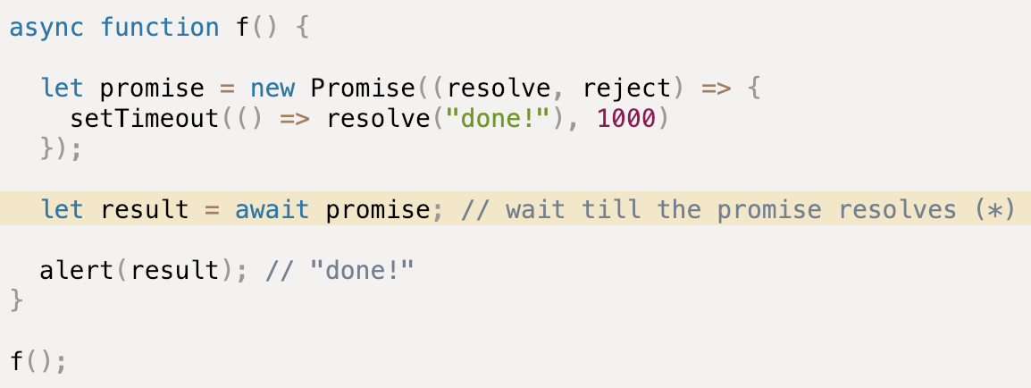
Async Await
“await” keyword could be used only within an async function
“await” makes JavaScript wait until that promise returns its result

Slide 13
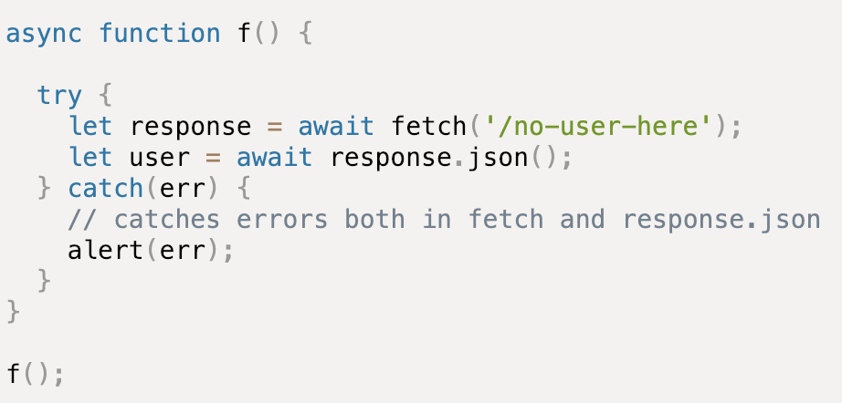
Async Await – Error Handling
Async await makes error handling “sync” as you can try catch it:

Slide 14
Exercise
Working directory: /exercise/es6
In this project, the integration tests are already written, and currently fail.
Make the tests green by implementing the TODOs in dirs-watcher.js
  The idea is to watch the given directory for file changes
  DO NOT change the code in test file
Run test cmd: npm test

Slide 15
Links
TypeScript vs ES6 vs ES2015
Node.js ES2015/ES6, ES2016 and ES2017 support
Better JavaScript with ES6, Pt. II: A Deep Dive into Classes
6 of the Most Exciting ES6 Features in Node.js v6 LTS
Exploring ES6 (book)
ES6, var vs let
6 Reasons Why JavaScript’s Async/Await Blows Promises Away
Async / Await

Slide 16
Thank You

