Slide 1
Node.js
Frameworks
Amir Yahalom, SAP.

Slide 2
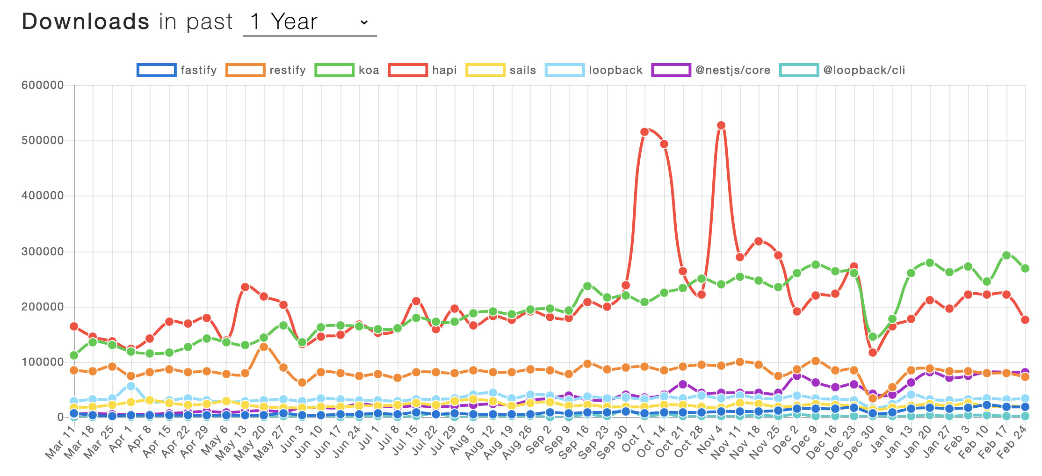
Comparison

Slide 3
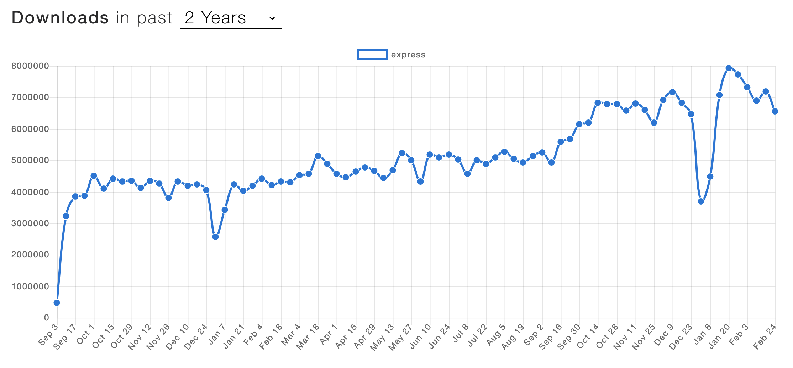
Express usage

Slide 4
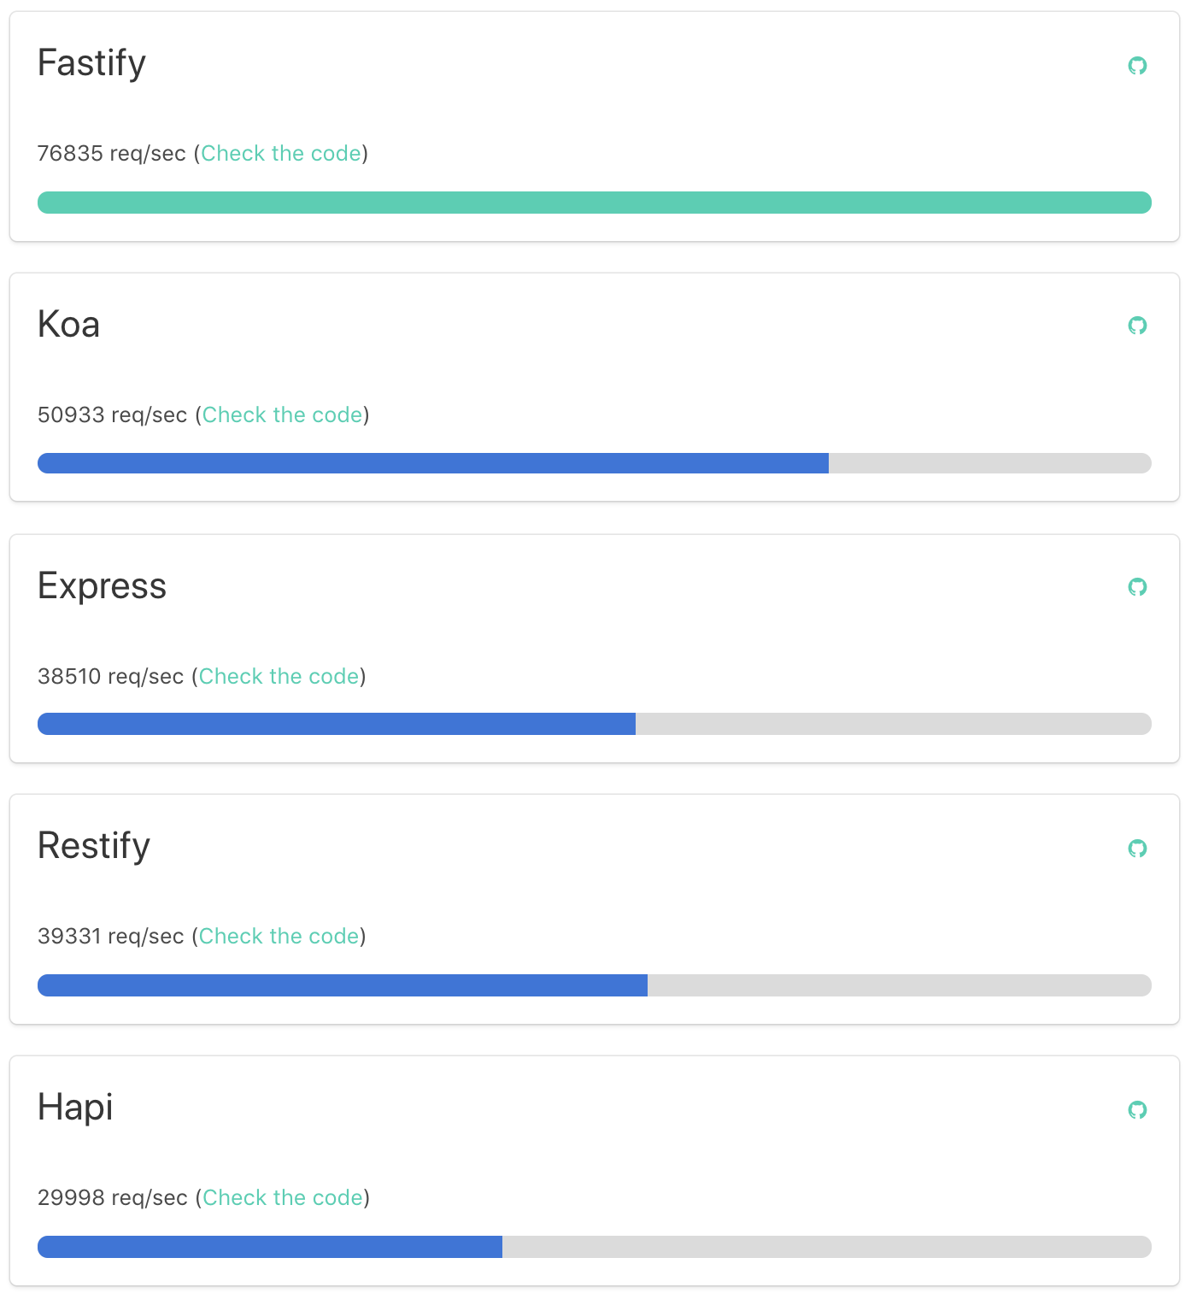
Comparison
HTTP benchmarks by fastify

Slide 5
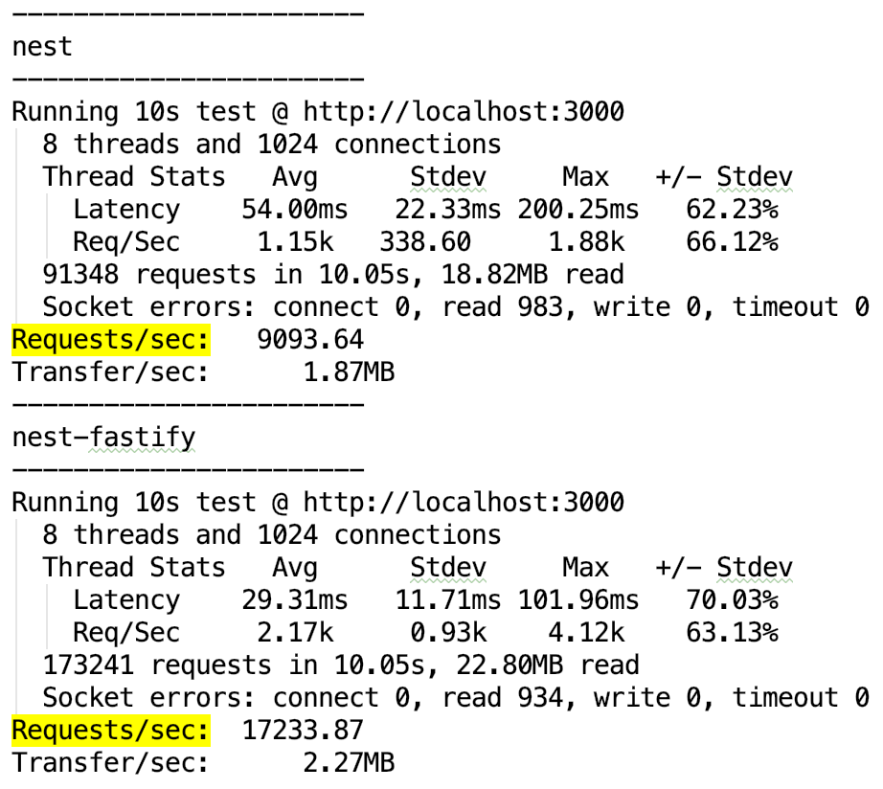
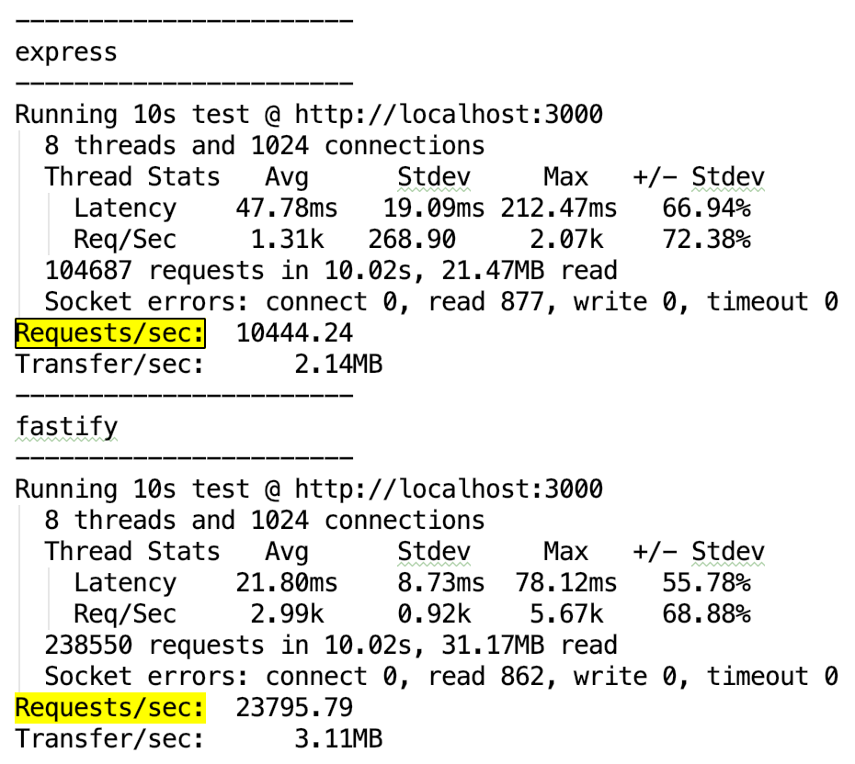
Comparison
Nest.js benchmarks

Slide 6
Links
Node Frameworks
Frameworks overview

Slide 7
Thank You

