Slide 1
Node JS – part 1
Intro, modules, npm
Amir Yahalom, SAP.

Slide 2
Node JS - Introduction
Cross-platform JavaScript runtime
Written back in 2009 for Linux
  2011 for Windows
Open source
Non-blocking I/O model
  Implemented with JS event loop & libuv evented I/O
Command line tool

Slide 3

Under The Hood
High performance evented I/O library (C/C++)
Additional libraries
libuv
V8
C/C++
JS
Google’s JavaScript Engine (C++)
Core modules

Slide 4
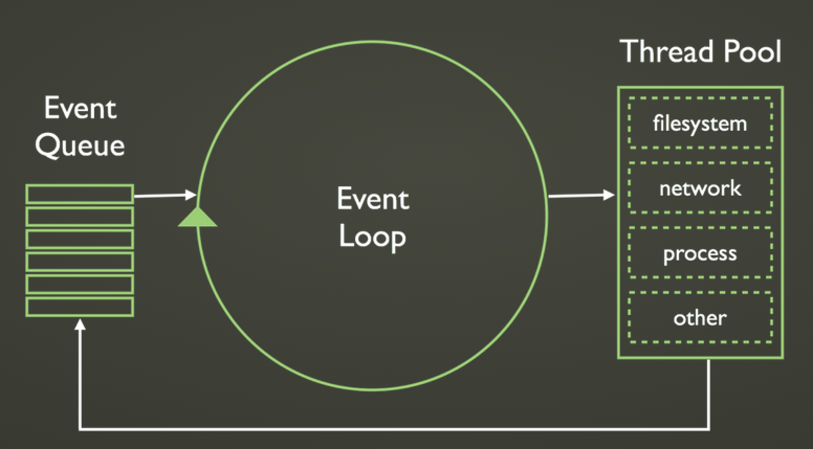
Processing model

Slide 5
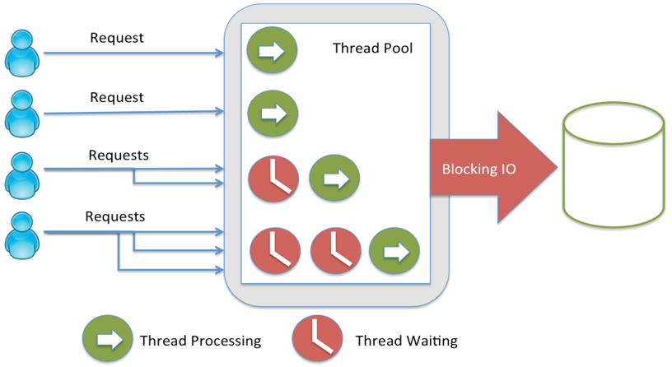
Multi Threaded Server
https://strongloop.com

Slide 6
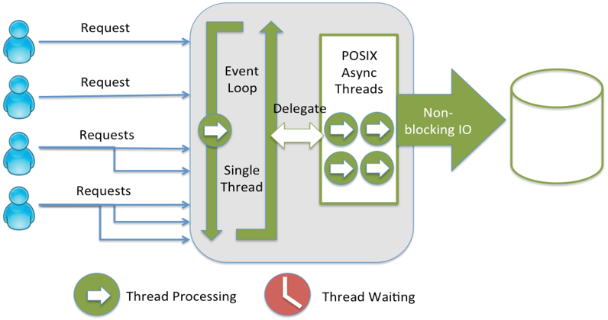
Node JS Server - Event-based Execution
https://strongloop.com

Slide 7
Modules
Node.js has a simple module loading system
Each module is a file / directory
Modules are imported with require(moduleName: string)
Types:
  Core modules – built-in Node
  NPM modules – loaded from repository
  Local modules – your code
Module caching

Slide 8
Local Modules
Export code using module.exports
Import with require():
  Imported module is in same dir → require(“./my-module”)
  Imported module is in parent dir → require(“../my-module”)
json files can be imported as well
Suffix is optional
  .js takes .json → add suffix in case of duplicated file name (x.js, x.json)
Cyclic dependency

Slide 9
Local Modules
examples/core-modules/local-module.js
examples/core-modules/use-local-module.js
let myVar;
module.exports = {
setVar: function (newVar) {
myVar = newVar;
},
getVar: function () {
return myVar;
}
};
const localModule = require('./local-module');
console.log(localModule.getVar()); // > undefined
localModule.setVar("Hello local module!");
console.log(localModule.getVar()); // > Hello local module!

Slide 10
Global Objects – process level
GLOBAL / global – is the main global object in node
process– env & program arguments, events, methods
  process.env.MY_ENV_VARIABLE – environment variable
  process.argv[2] – program variable:
  process.pid – process id
  process.nextTick()
  process.on() / process.emit() - events
console
setTimeout() / setImmediate()

Slide 11
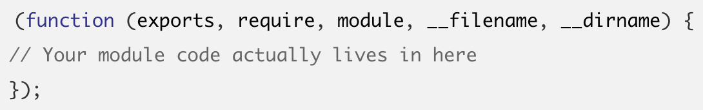
Global Objects – module level
__dirname - directory of the currently executing script
module – current module
exports – what your module expose (reference to module.exports)
require() – import other modules
Node wraps each module so it will have it’s own scope:

Slide 12
setTimeout, setImmediate, nextTick
setTimeout() / setInterval() – same as in browser
  setTimeout().unref() – the process can exit without function execution
setImmediate() – runs after I/O events, before** timers (setTimeout)
process.nextTick() - runs before I/O events & timers (+ setImmediate)
  When used in long running (& cpu intensive) code - I/O callbacks wouldn't get the chance to run between iterations
  → Async loops / recursion which use nextTick() might be an I/O killer
** Within main module context → non-deterministic execution

Slide 13
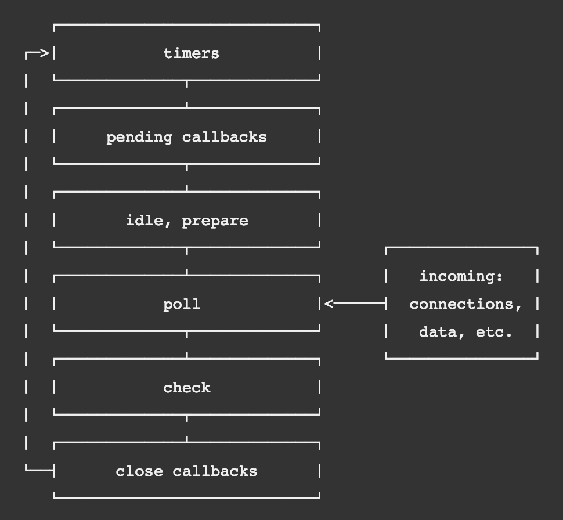
Event Loop deep dive

Slide 14
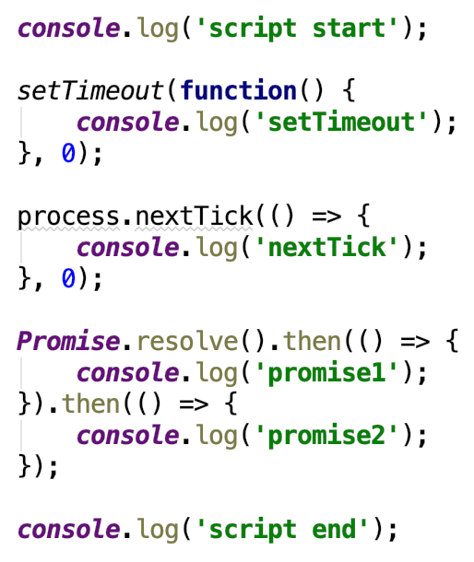
Event Loop deep dive
What’s the output?

Slide 15
Core Modules
Import with require(MODULE_NAME) – no path
  const fs = require(“fs”)
Common core modules:
  File System – fs → working with files
  Path – path → working with paths (cross os)
  Util – util
  HTTP – http → HTTP server and client
  Cluster – cluster → Allows a master process to spawn worker processes
  Events – events → holds EventEmitter class (event bus)
  Crypto – crypto → cryptographic functionality
  REPL - Read-Eval-Print-Loop → allows to evaluate input before output

Slide 16
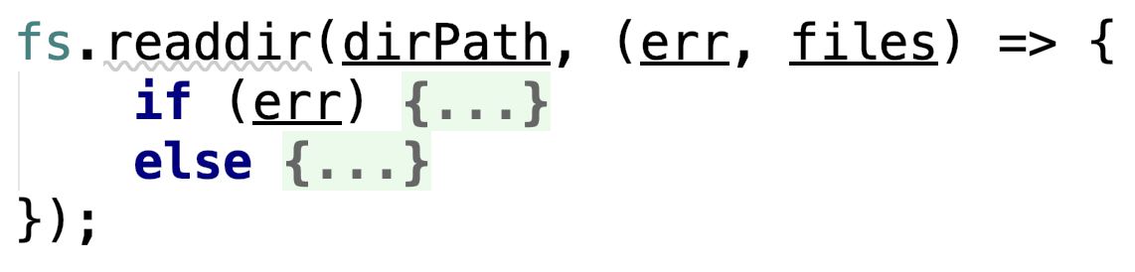
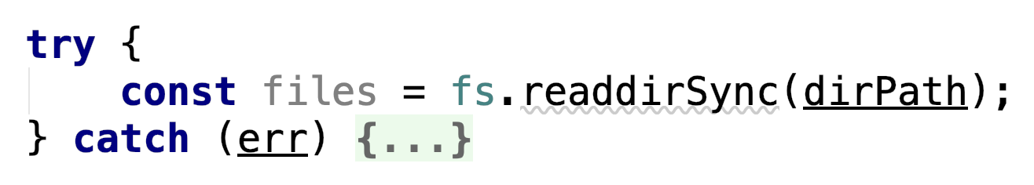
Core Modules - fs
Responsible for all the file I/O operations
All the methods have asynchronous and synchronous forms
  Async style with callback
  Sync style – blocks main thread

Slide 17
Exercise
Write a Node cmd program
main.js need to include the following logic:
  Read the desired directory (absolute path) and file pattern from program parameters
  Search for files in the given directory
    loop on each file in the given directory
    If a file match the pattern → print it in console
Run cmd: node main.js ”/Users/…/repos/cpv2/” “*.xml”
→ Print content of all the .xml files located in cpv2 directory (NOT recursively)
**Please follow the README file

Slide 18
Core Modules - http
Provides API for creating a low-level HTTP server or client
There is an equivalent module for HTTPS (same API + certificates)
Server:
const http = require('http');
const server = http.createServer(function (req, res) {
res.writeHead(200);
res.end("Hello Node js !!!");
});
server.listen(3000);

Slide 19
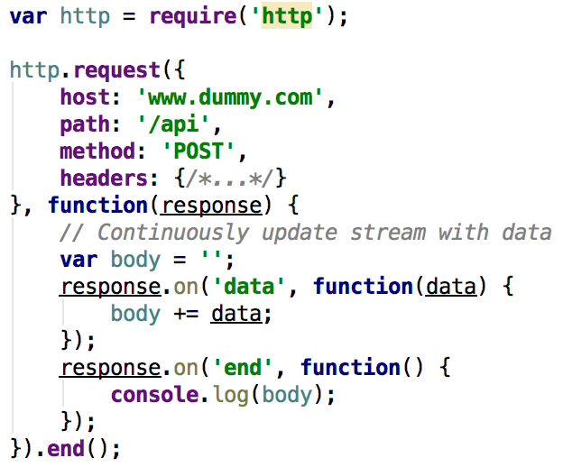
Core Modules - http
HTTP Client:

Slide 20
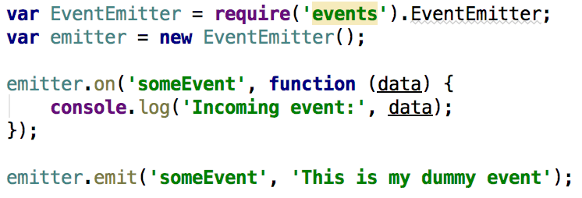
Core Modules – events
Allows us to create and handle custom events easily with events.EventEmitter class
Used widely in Node’s core API - all objects which emit events are instances of EventEmitter (streams, process, sockets, servers…)

Slide 21
Node Package Manager
Online repository for Node.js packages/modules (~380K)
Command line utility
  Install modules
  Version management
package.json is the module descriptor
  Dependencies, metadata, run commands
  Located in the project root – same as pom.xml

Slide 22
NPM– CLI
Initialize with: npm init
Install dependencies: npm install / npm i
Install + add to package.json: npm install MODULE_NAME –save
Install globally (cmd access): npm install MODULE_NAME –g
Behind corporate proxy: npm install --https-proxy=http://proxy:8080
Set as default proxy: npm config set https-proxy http://proxy:8080
  Now you can work w/o the –https-proxy=…
Clear default proxy: npm config delete https-proxy
You might need to set ‘proxy’ in addition to ‘https-proxy’

Slide 23
NPM– CLI
Link a module: npm link
Use a linked module from another module: npm link <linked_module_name>
Publish your module: npm publish
Update your module: npm version <update_type/version> and npm publish

Slide 24
NPM– Popular Modules
Underscore – utility-belt library for js
Lodash – inspired by underscore, and now is a superior solution
Moment – working with dates
Q / Bluebird– promise libraries
RxJS – Reactive Extensions library
Chai – assertion library
Supertest – HTTP assertions (api tests)
PM2 – production process manager
Commander - for Node.js command-line programs
Nodemon – auto reload after js change

Slide 25
Links
Running & Debugging on Intellij / Webstorm
Understanding node.js – old (2010) but well explained
The Event Loop and Non-Blocking I/O in Node.js
JavaScript Clean Coding Best Practices
10 Things I Regret About Node.js

Slide 26
Thank You

