Slide 1
Node JS - part 3 connect & express
Amir Yahalom, SAP.

Slide 2
Connect
Wraps the core http module
It is an extensible HTTP server framework (using plugins/middleware)
A middleware is a function that handles a request
  Filters - process the request and pass it on to the next handlers
    Logging, authentication, compression, parsers…
  Providers - handle the request and ends it
    Application API, static resources…
  Error handlers

Slide 3

Connect
connect() will return an instance
app.use([route : string, ]handler : function)
  add an handler to a given route (defaulting to “/”)
  function handler([err, ]req, res, next)

Slide 4
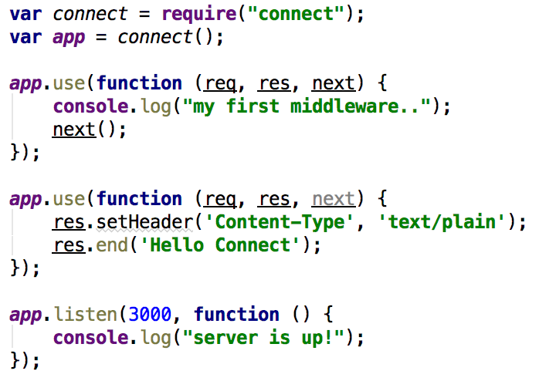
Connect
Simple usage:
For each request made to the server:
write a message into log
Respond with ‘Hello Connect’
Filter – pass the request
Provider – ends the request

Slide 5
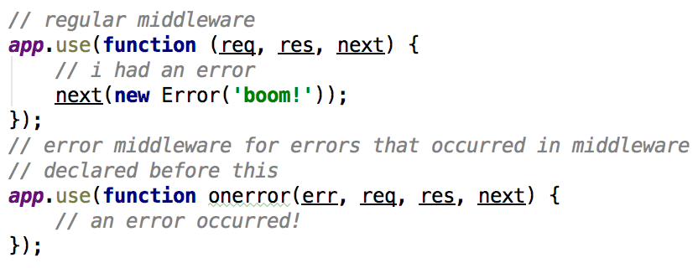
Connect
Error middleware will catch errors:
Error handler can end the request or forward it
Error handler recognized by accepting 4 args

Slide 6
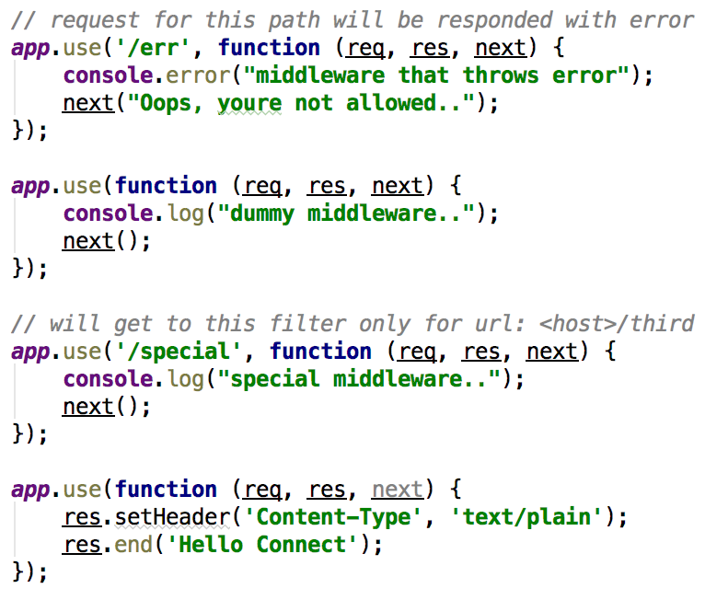
Connect
Only Error Middleware can be written after this one

Slide 7
Connect – middleware modules
body-parser - parse request bodies into req.body
compression - gzip/deflate outgoing responses
cookie-session - store session state in browser cookie
morgan – logging
response-time - records the response time, adds X-Response-Time header
csurf – CSRF token middleware
connect-query – parse query string
connect-route – mini-connect app
…

Slide 8
Connect – middleware

Slide 9
Express
Web framework designed for building web apps / APIs
It has all connect functionality, plus:
  routing mechanism
  view rendering
  application settings support
  top level verbs (get/post etc.)
you can still app.use(…) to add middleware
compatible with most of the plugins for connect

Slide 10
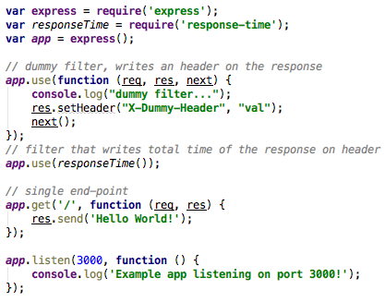
Express
An Hello world example:
Each response will have the following headers:
X-Dummy-Header: val
X-Response-Time: <number>ms

Slide 11

Express - Routing
Route path and http method defines an endpoints for requests
HTTP methods: get, post, put, head, delete, options, patch… and ”all”
Path is a string or regex:
  Strings: ”/v2/api”
  String patterns: “/v*/api” ( “/v/api”, “/v3/api/”,…)
  Regex: /.api/ (“/users/api”, “/groups/api”…)
Path Params marked with “:”, Query Params provided on req.query

Slide 12
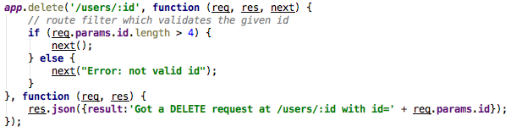
Express – Route Handlers
Each route can be provided with multiple callbacks that behave like middleware to handle a request, the last should end the response
    function handler([err, ]req, res[, next])
Can be provided with array

Slide 13
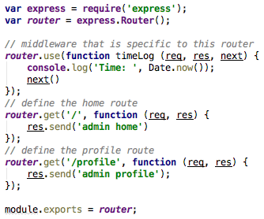
Express - Router
A Router instance is a complete middleware and routing system (mini-app)
You need to register your Router on desired path:
GET http://localhost:3000/admin
GET http://localhost:3000/admin/profile

Slide 14
Express
View/template engine - enables you to use static template files (like .jsp in java)
Debugging – depends on env variable
Application Settings can be modified using app.set(name, value)
  env, etag, view engine, view cache, strict routing…
Serve static files – images, js, css…
express-generator

Slide 15
Exercise
Build API of users
  GET /users → return all users
  GET /users/:id → return user by id
  POST /users → create user
  PUT /users/:id → edit user
  DELETE /users/:id → delete user
Use user base jsons from randomuser.me)
First phase:
  Write an in-memory key-value storage by loading the JSON:
    You can use modules like redis-mock
  const users = require(“./user-base.json”)
Second phase:
  Use Redis as your DB

Slide 16
Express – passport plugin
Authentication middleware, flexible and modular
Set of strategies for authentication:
  username and password, Facebook, Twitter, and more.
Three pieces need to be configured to use Passport for authentication:
  Authentication strategies
  Application middleware
  Sessions (optional)
Once those configured you can use passport as authentication filter

Slide 17
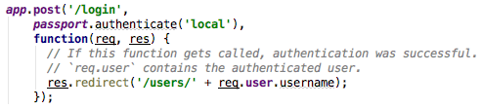

Express – passport authentication
Authenticating requests (login) is simply done by calling passport.authenticate(sStrategy) as a filter:
Verifying that user is authenticated:
Validates req.isAuthenticated() exposed by passport

Slide 18
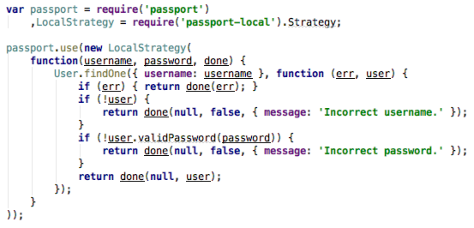
Express – passport strategies
Strategies used to authenticate requests, they can verify a username and password, delegate authentication (OAuth) or do federated authentication using OpenID
You can add strategies with: passport.use([name, ]strategy)

Slide 19

Express – passport Application Middleware
In a Connect or Express-based application, passport.initialize() is required
If your app persist login sessions, passport.session() middleware must also be used
  Be sure to use express-session before that:

Slide 20
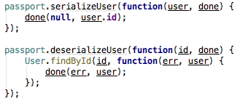
Express – passport Sessions
Session can be established once authentication succeeds, it is maintained via cookie set in the user's browser
Each subsequent request will contain the unique cookie that identifies the session
Passport need to serialize and deserialize user instances to and from the session

Slide 21
Exercise
Add authentication to the User API app: POST /login
Prevent from users to edit other users

Slide 22
Links
Anatomy of an HTTP Transaction
Express Template Engines
Process managers for Express apps
Production best practices: performance and reliability
Express + Redis with docker
Easy Node Authentication: Facebook
Example Express 4.x app using Passport for authentication with username/password
Express application architecture

Slide 23
Thank You

