Slide 1
Node JS - part 4
MongoDB
Amir Yahalom, SAP.

Slide 2
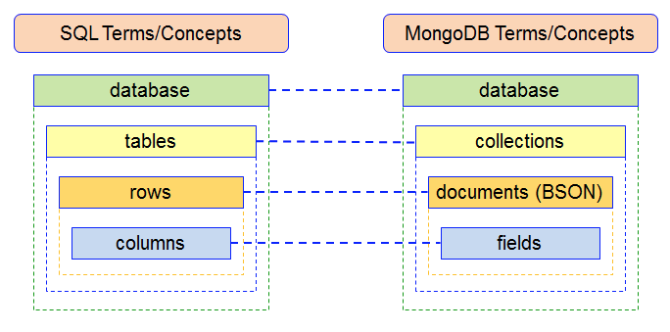
Mongo vs. SQL

Slide 3
MongoDB - Shell
An interactive JavaScript CLI to MongoDB
You can use the mongo shell to query and update data as well as perform administrative operations
Starting Mongo server: (cmd)
  [windows] cd <mongodb installation dir>/bin
  mongod –dbpath “<desired dir to store data>”
Starting Mongo client: (cmd)
  [windows] cd <mongodb installation dir>/bin
  mongo

Slide 4
MongoDB - Client Shell
Display current database(test as default db): db
To switch (or create) database: use <database>
List the available databases: show dbs
Show current database stats: db.stats()
More…
CRUD operations: db.COLLECTION.METHOD(…)
  COLLECTION - name of desired collection
  METHOD - method name (remove, insert, find, update/save)

Slide 5
MongoDB – Insert, Find
Insert:
  document – js object (JSON) or array of objects
  Example:
Find:
  SELECTOR - js object, describes the desired documents
  if SELECTOR is null, mongo will return all documents in the collection
  Examples:

Slide 6
MongoDB – query operators
$eq - matches documents where the value of a field equals specified value
  Similar: $gt, $ne, $lte
$or – joins array of query objects (selectors)
$in – matches any of the values specified in an array.

Slide 7
MongoDB – projection
You can pass to collection.find() second parameter, which defines the fields we want to get – the projection of result set:
  {FIELD_NAME: 1, ANOTHER_FIELD: 0,…} → {“name”: 1, “age”: 0}
  1 – return field
  0 – don’t return field (redundant, used to hide Mongo’s _id field which is the only field that is not 0 by default)
You can sort the results using sort()
Or limit size (select top) using limit()

Slide 8
MongoDB – Exercise
Create a new db with one collection (“posts”)
Insert the content of the file “posts.json”
  Insert in single cmd: db.posts.insert([...])
Implement the following queries:
  Get all the posts of Bob
  Get all posts where number of likes is less than 30
  Get all posts where number of followers is 14
  Get all posts where the post body contains the word “dummy”
  Get all posts where the keywords includes “MongoDB”

Slide 9
MongoDB –Update
SELECTOR – same as in other methods
UPDATED_DATA – object which describes the desired changes / updated document
OPTIONS – configuration
  upsert – insert or update (false by default)
  multi – whether to update multiple documents (false by default)

Slide 10
MongoDB – Update operators
Fields operators:
  $rename – change the field name
  $inc - Increments the value of the field by the specified amount
  $set - replaces the value of a field with the specified value
  $addToSet - adds a value to an array unless the value is already present
  $pop - removes the first (-1) or last (1) element of an array
  $push - appends a specified value to an array

Slide 11
MongoDB – Remove
SELECTOR – same as in other methods
Optional second parameter if you want to remove just one document (true/1)
if SELECTOR is null, mongo will remove all the documents in the collection
db.COLLECTION.drop() drops the entire collection

Slide 12
MongoDB - Indexing
Without indexes, MongoDB must perform a collection scan, i.e. scan every document in the collection
Indexes are special data structures that store a small portion of the collection’s data set in an easy to traverse form
  Text Index, Geo Index…
db.COLLECTION.createIndex()
  On multiple fields:
  Create index with specified name

Slide 13
MongoDB – Exercise
Drop and recreate the posts collection
Create index for fields: “userName” and “body” (text index)
List the collection indexes
Change userName for Bob’s posts to “Bobi”
Add keyword for all Bobi’s posts: “bobi”
Remove the last keyword in all documents
Remove all documents with less than 12 followers
Change field name: “followers” to “subscribers”

Slide 14
MongoDB with Node.js
There is an official module of mongodb (driver)
  It provides low-level API (like core modules) for interacting with mongo server
You can find multiple modules in npm:
  mongoskin – a light-weight wrapper of the driver
  mongoose – wraps the driver into a complete solution

Slide 15

Mongoose
Provides a schema-based modelling for your app data
It includes built-in type casting, validation, query building, business logic hooks and more
DB connection:
You can plug a Promise library
Connection reference is now on mongoose.connection
  It is an instance of EventEmitter so you can register on events:
  NOTE that this “connection” is actually a connection pool implemented in driver (c++)
  You can create more pools but it is not necessary (in most cases)

Slide 16


Mongoose - Schema
Schema describes the structure of data in a specific collection (Schema == collection)
Once we have a Schema, we can create a Model class
  Documents are instances of the Model class
Schema constructor accepts an Object with all the the desired fields:
Define schema with 1 field
Create Model class for Kitten
We can CRUD the Kitten instance (i.e. document)

Slide 17
Mongoose – Schema Model
Models are fancy constructors compiled from our Schema definitions
All document CRUD is handled by these models:
Model.find(conditions[, projection][, options][, callback])
Model.create(doc(s)[, callback])
Model.update(conditions, doc[, options][, callback])
Model.remove(conditions[, callback])
Model.prototype.save([options][, options.safe]
[, options.validateBeforeSave][, fn])
(each document has .save() method)
And more... All supports promise or callback syntax

Slide 18
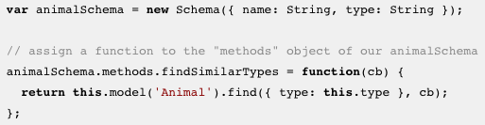
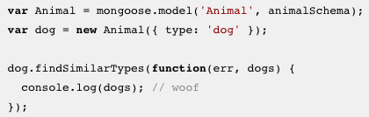
Mongoose - Schema
Schema can have functionality, which will be exposed by the Model class:
  Instance methods – will be available on Model.prototype

Slide 19
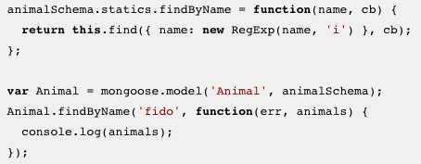
Mongoose - Schema
…
  Statics – will be available on Model (static methods)

Slide 20
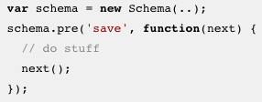

Mongoose – Schema Middleware
Middleware (also called pre and post hooks) are functions which are passed control during execution of asynchronous functions
Pre hooks
Post hooks:

Slide 21
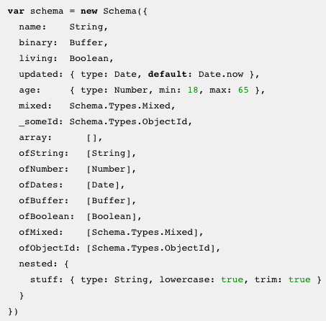
Schema Types
Each key in our schema defines a property
in our documents which will be cast to its
associated SchemaType
Available SchemaTypes:
  String
  Number
  Date
  Buffer
  Boolean
  Mixed
  ObjectId
  Array
You can create Custom SchemaType

Slide 22
Mongoose & express – Exercise
Create a new db with 2 collections:
  users
  posts
Implement Node app using express & mongoose:
Create schemas based on the posts.json & users.json content structure
Implement posts API:
  Add post
  Like/follow
  Add keyword
  Remove post
Implement CRUD API for users

Slide 23
Links
What is NoSQL
SQL vs NoSQL: The Differences
Atomicity and Transactions
Sharding
Replication
Mongo admin Uis

Slide 24
Thank You

