Slide 1
Node JS - part 5
Redis
Amir Yahalom, SAP.

Slide 2
Redis
Fast key-value database
Provides cool features such as:
  pub/sub messaging
  ttl for keys
Used as a database, cache or message broker
  connect-redis – session store for express/connect
  jwt-redis-session - JSON Web Token session middleware
  socket.io-redis – enables to run multiple Socket.io instances
Rich set of commands
CLI
Lua scripting

Slide 3
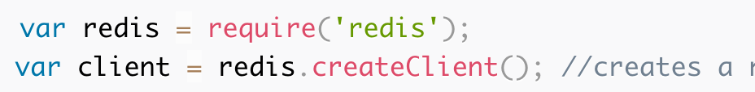
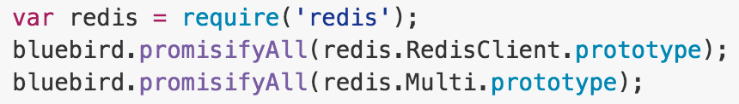
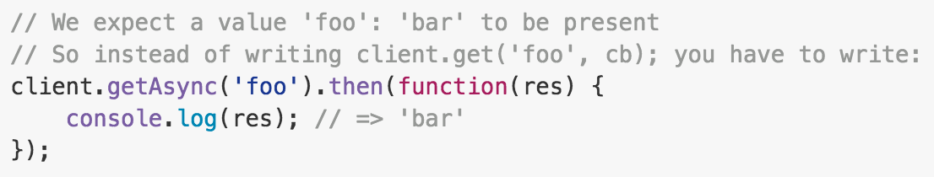
Redis – Node.js
node_redis is a Redis client for Node.js
The API is entirely asynchronous and includes all redis commands (lower cased) :
  node style → client.get(key, function (err, replies) {…})
  You can use q to promisify desired methods (or bluebird to promisifyAll)

Slide 4
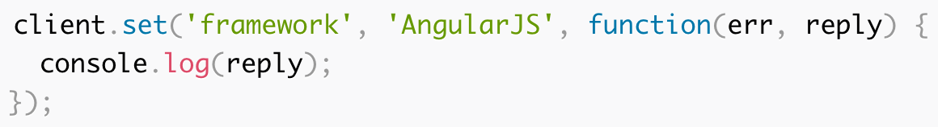
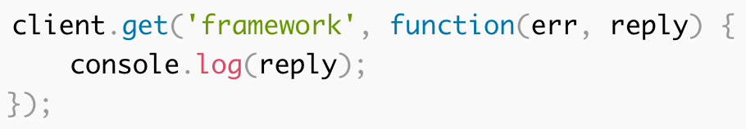
Redis – Storing Key-Value Pairs
Store Strings
  You can use both array or args to provide parameters
  If you want to get notified once the operation is completed
Retrieve value

Slide 5
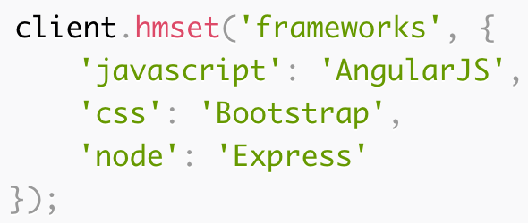
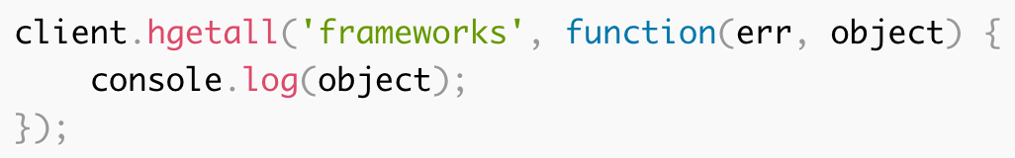
Redis – Storing Key-Value Pairs
Store Hashes
  Or
Retrieve the whole hash
Use hset() / hget()
for single hash property

Slide 6



Redis – Storing Key-Value Pairs
Store Lists
  RPUSH → append to list; LPUSH → prepend to list
  Retrieve elements from a list by start & end indexes, (-1 → all)
  LPOP → remove and get first element; RPOP → remove and get last element

Slide 7

Redis – Storing Key-Value Pairs
Store Sets
  SADD → add one or more members to a set
  SMEMBERS → get all members in a set
  SISMEMBER key member → determine if a given value is a member of a set

Slide 8



Redis – More Commands
EXISTS → determine if a key exists; HEXISTS → if a hash field exists
DEL → delete a key; HDEL → delete one or more hash fields
EXPIRE → set time to live (sec); PEXPIRE → same in ms

Slide 9
Redis – pub/sub
pub/sub is a messaging pattern. Publisher/s sending messages to multiple subscribers listening for messages on specific channels
var redis = require("redis");
var sub = redis.createClient(), pub = redis.createClient();
sub.on("subscribe", function (channel, count) {
pub.publish("a nice channel", "I am sending a message.");
});
sub.on("message", function (channel, message) {
console.log("sub channel " + channel + ": " + message);
});
sub.subscribe("a nice channel");

Slide 10
Links
Try Redis
Redis Commands
Using Redis with Node.js
Using Redis to handle Session in Node.js
Redis as a service (including free plans):
  REDIS TO GO, Redis Cloud
Understanding Garbage Collection and hunting Memory Leaks in Node.js

Slide 11
Thank You

