Slide 1
Fundamentals of Analogue Circuits
Hongling Cui

Slide 2


Fundamentals of Analogue Circuits
Chapter 10 Frequency Response
from Microelectronic Circuits Text
by Sedra and Smith
Oxford Publishing

Slide 3
Fundamentals of Analogue Circuits
Introduction
IN THIS CHAPTER YOU WILL LEARN:
  How coupling and bypass capacitors cause the gain of discrete-circuit ampliﬁers to fall off at low frequencies, and how to obtain an estimate of the frequency f_{L}.
  The internal capacitive effects present in the MOSFET and how to model these effects by adding capacitances to the hybrid-π or T model.
  The high-frequency limitation on the gain of the CS ampliﬁers, and how the gain fall off and the upper 3-dB frequency f_{H} are mostly determined by the small capacitance between the drain and gate.

Slide 4
Fundamentals of Analogue Circuits
Introduction
Previously assumed that gain is constant and independent of frequency.
  implied that bandwidth was infinite
  this is not true
Middle-frequency band (midband) is the range of frequencies over which device gain is constant.

Slide 5
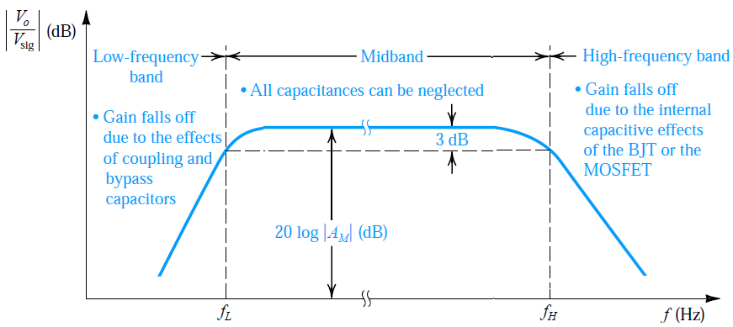
Fundamentals of Analogue Circuits
BW = f_{H} - f_{L}
Figure 10.1: Sketch of the magnitude of the gain of a discrete-circuit BJT or MOS amplifier versus frequency. The graph delineates the three frequency bands relevant to frequency-response determination.

Slide 6
Fundamentals of Analogue Circuits
Figure 10.1: Sketch of the magnitude of the gain of a discrete-circuit BJT or MOS amplifier versus frequency. The graph delineates the three frequency bands relevant to frequency-response determination.

Slide 7
Fundamentals of Analogue Circuits
Figure 10.1: Sketch of the magnitude of the gain of a discrete-circuit BJT or MOS amplifier versus frequency. The graph delineates the three frequency bands relevant to frequency-response determination.

Slide 8
Fundamentals of Analogue Circuits
BW = f_{H} - f_{L}
Figure 10.1: Sketch of the magnitude of the gain of a discrete-circuit BJT or MOS amplifier versus frequency. The graph delineates the three frequency bands relevant to frequency-response determination.

Slide 9
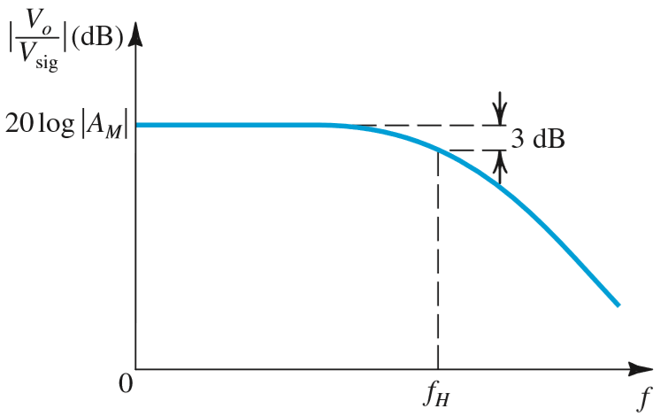
Fundamentals of Analogue Circuits
BW = f_{H}
The gain-bandwidth product: GB=│A_{M}│BW
Figure 10.2 Frequency response of a direct-coupled (dc) amplifier. Observe that the gain does not fall off at low frequencies, and the midband gain AM extends down to zero frequency.

Slide 10
Fundamentals of Analogue Circuits
BW = f_{H}
The gain-bandwidth product: GB=│A_{M}│BW
Figure 10.2 Frequency response of a direct-coupled (dc) amplifier. Observe that the gain does not fall off at low frequencies, and the midband gain AM extends down to zero frequency.

Slide 11
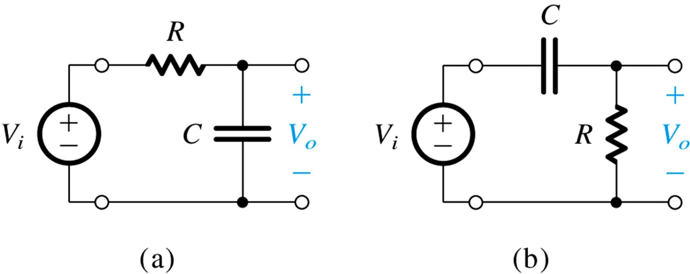
Fundamentals of Analogue Circuits
1.6.4 Single Time-Constant Networks
low pass filter (left) high pass filter (right)
Figure 1.22: Two examples of STC networks: (a) a low-pass network and (b) a high-pass network.

Slide 12
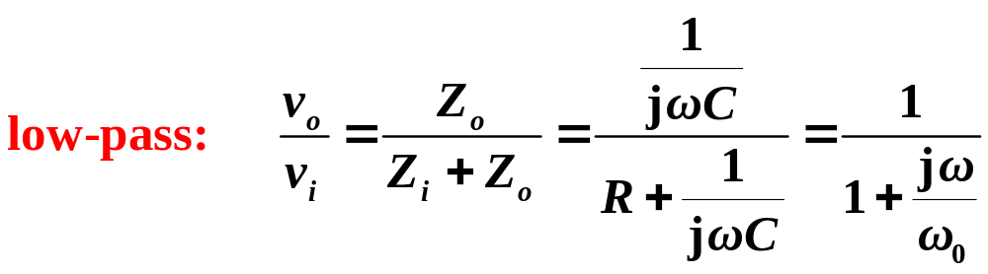
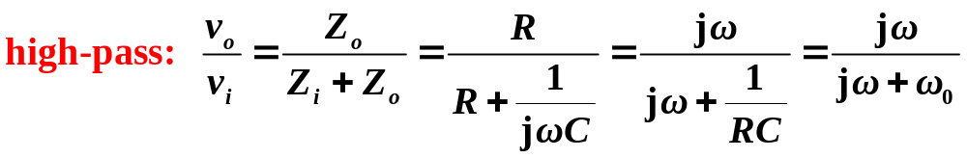
Fundamentals of Analogue Circuits

Slide 13
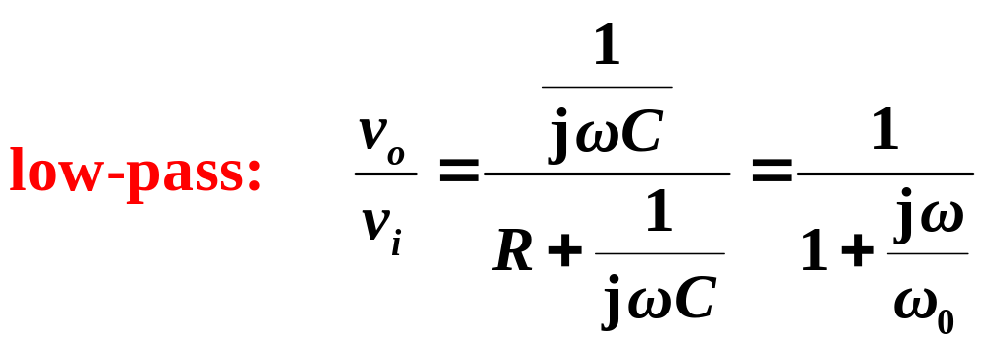
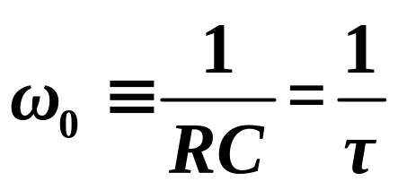
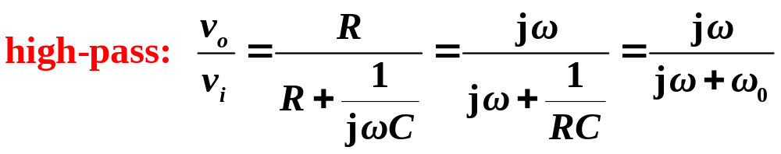
Fundamentals of Analogue Circuits

Slide 14
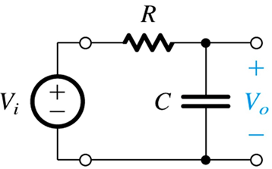
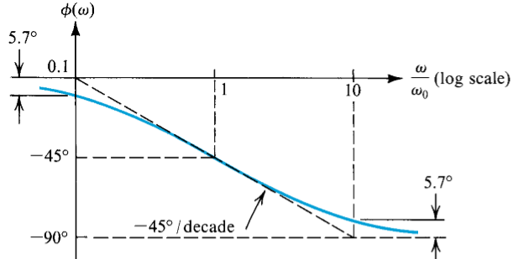
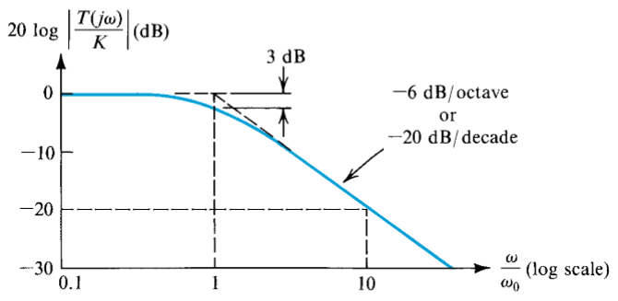
Fundamentals of Analogue Circuits
-20dB/decade drop, beginning from maximum gain at corner frequency

Slide 15
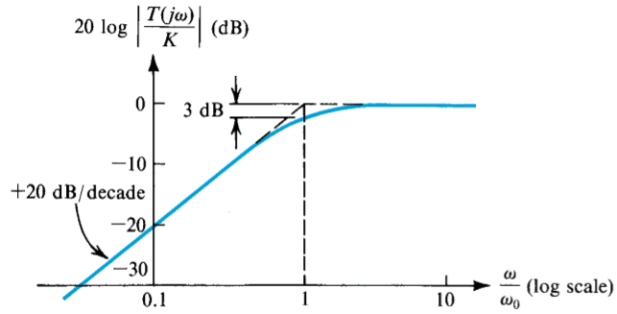
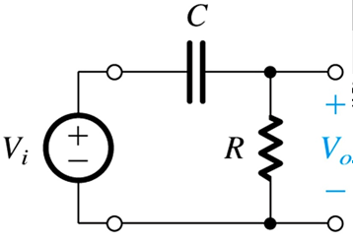
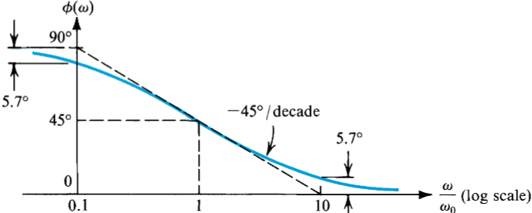
Fundamentals of Analogue Circuits
+20dB/decade incline, until maximum gain is reached at corner frequency

Slide 16
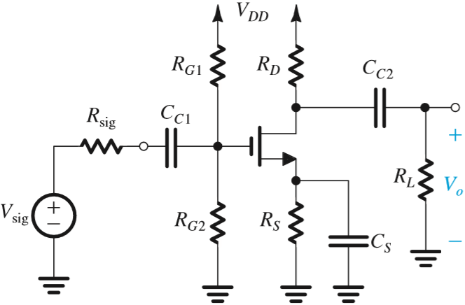
Fundamentals of Analogue Circuits
10.1 Low Frequency Response of
the Common-Source Amplifiers
Figure 10.3(a) shows a discrete-circuit, common-source amplifier.
  coupling capacitors C_{C1},C_{C2}
  bypass capacitor C_{S}
At low frequencies, their reactance (1/jωC) is high and gain is low.

Slide 17
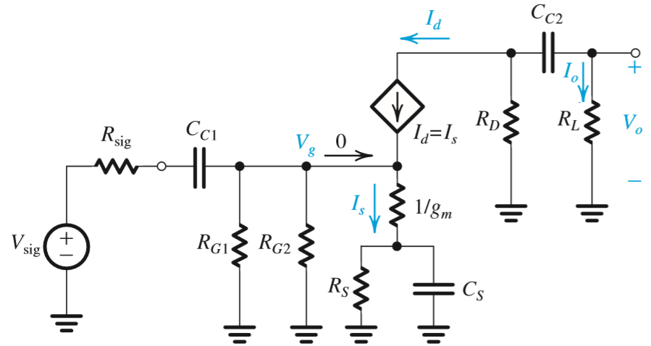
Fundamentals of Analogue Circuits
10.1.1. The CS Amplifier
determine the effect of these capacitances on V_{o}/V_{sig}
  figure illustrates this process
  circuit with dc sources eliminated
  small-signal analysis
  ignore r_{o}

Slide 18
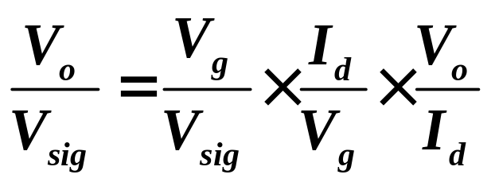
Fundamentals of Analogue Circuits

Slide 19
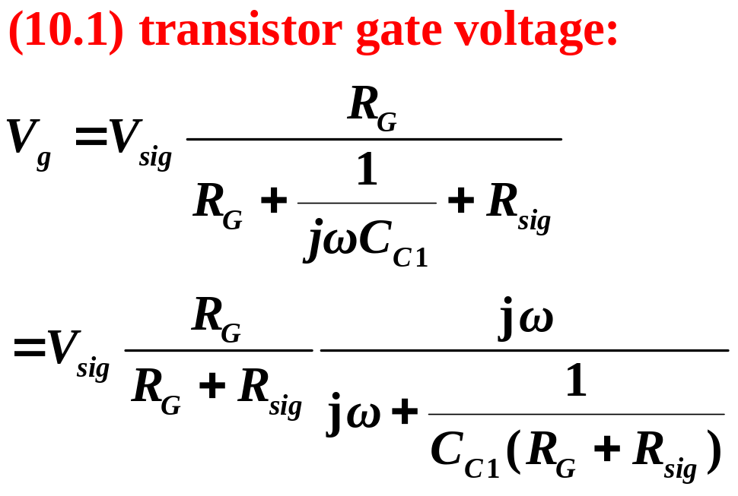
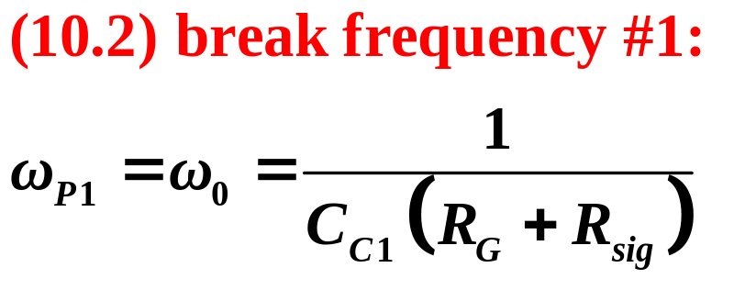
Fundamentals of Analogue Circuits

Slide 20
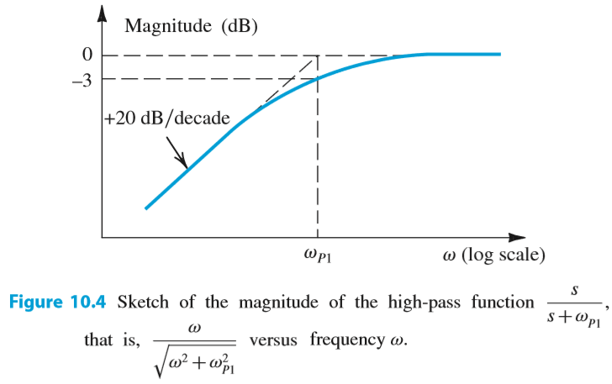
Fundamentals of Analogue Circuits

Slide 21
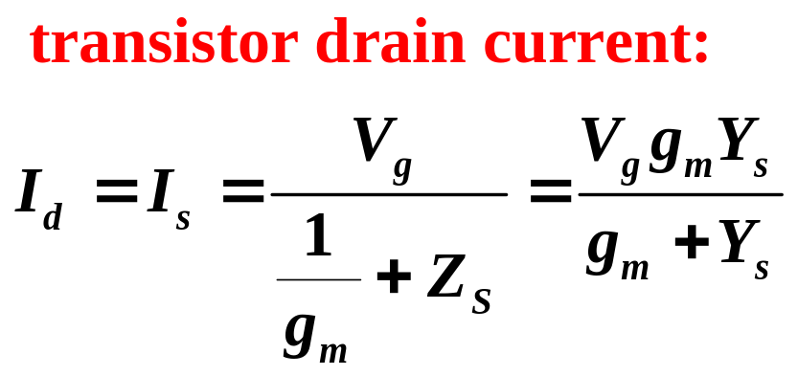
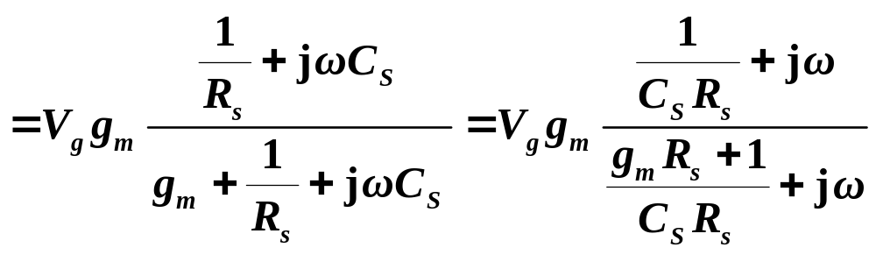
Fundamentals of Analogue Circuits

Slide 22
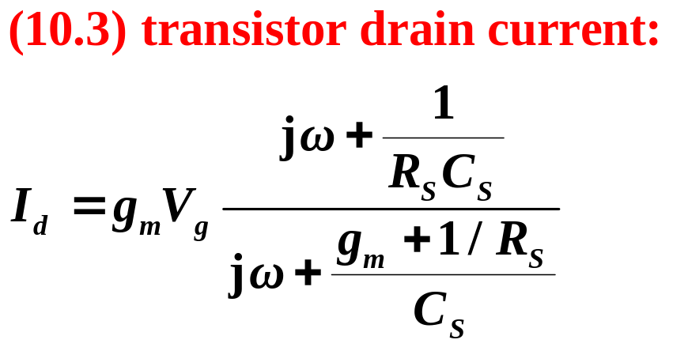
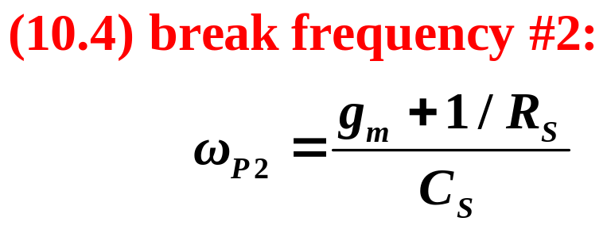
Fundamentals of Analogue Circuits

Slide 23
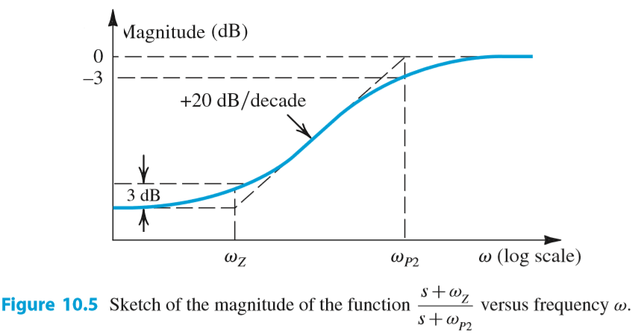
Fundamentals of Analogue Circuits

Slide 24
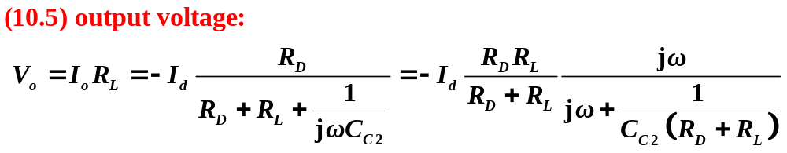
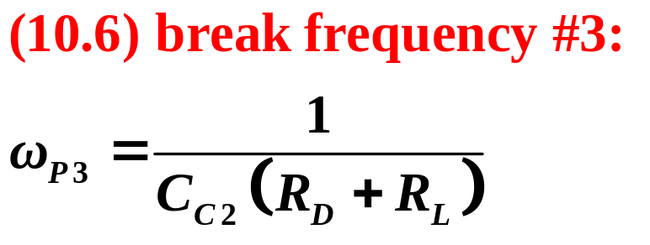
Fundamentals of Analogue Circuits

Slide 25
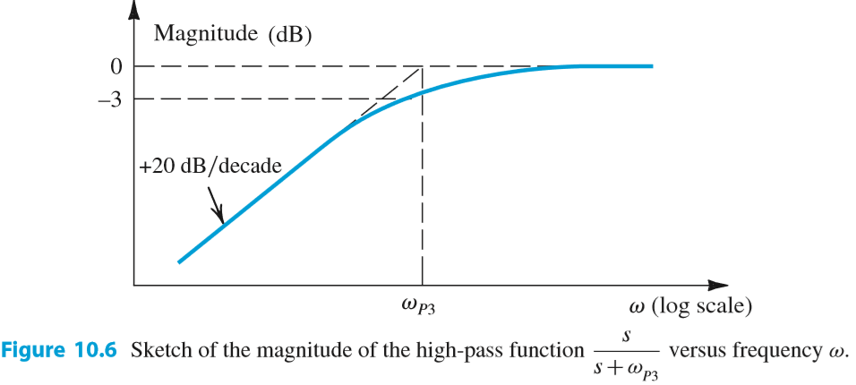
Fundamentals of Analogue Circuits

Slide 26
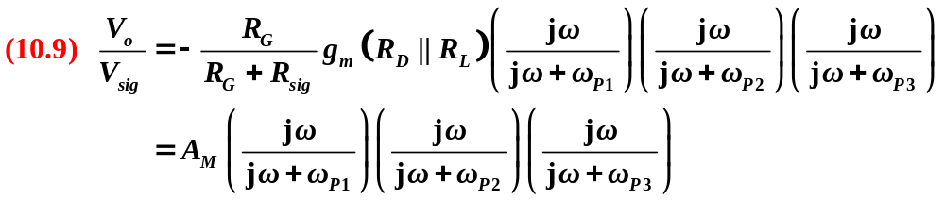
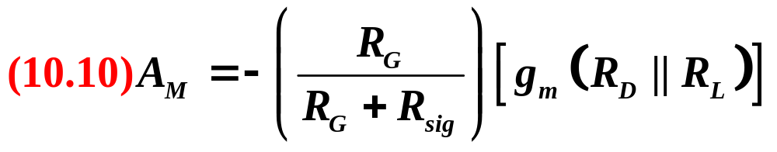
Fundamentals of Analogue Circuits

Slide 27
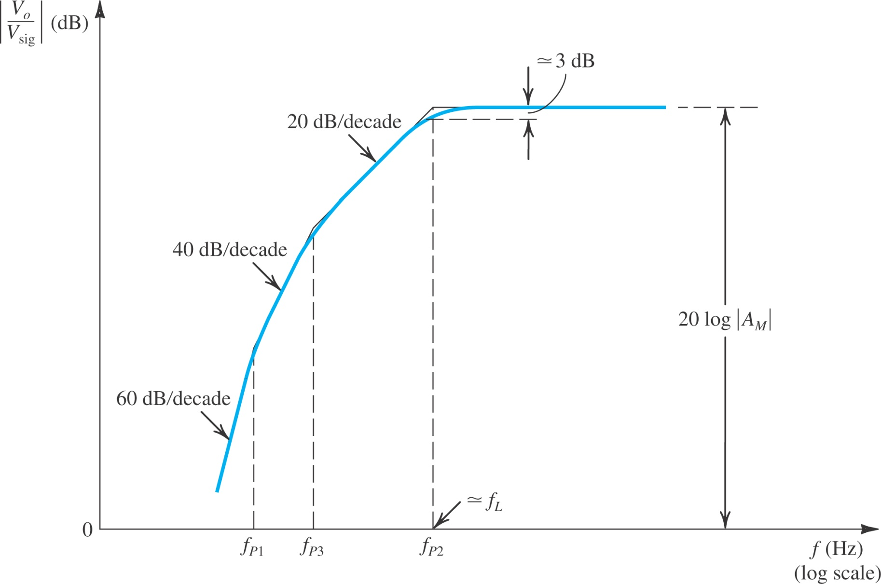
Fundamentals of Analogue Circuits
Figure 10.3: Sketch of the low-frequency magnitude response of a CS amplifier for which the three pole frequencies are sufficiently separated for their effects to appear distinct.

Slide 28
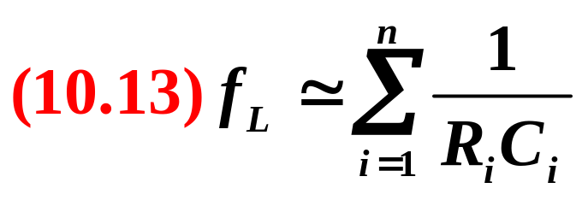
Fundamentals of Analogue Circuits
10.1.2 The Method of Short-Circuit Time Constants
Set the input signal V_{sig} =0.
Consider the capacitors one at a time. That is, while considering capacitor C_{i}, replace all the other capacitors with short circuits.
For each capacitor C_{i}, find the total resistance R_{i} seen by C_{i}.
Calculate the 3-dB frequency f_{L} using

Slide 29
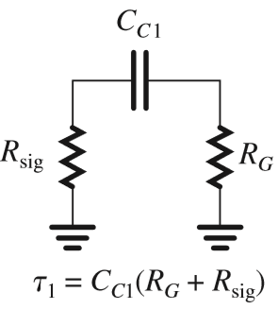
Fundamentals of Analogue Circuits

Slide 30
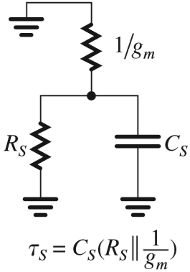
Fundamentals of Analogue Circuits

Slide 31
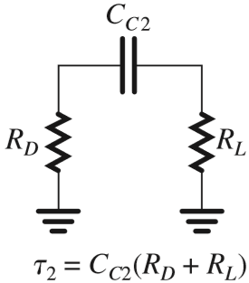
Fundamentals of Analogue Circuits

Slide 32
Fundamentals of Analogue Circuits
10.2 Internal Capacitive Effects and the High-
Frequency Model of the MOSFET
S
G
D
1.The gate capacitive effect: The gate electrode forms a parallel-plate capacitor with the channel.
u_{GS}
N⁺
N⁺
P
Body
2. The source-body and drain-body depletion-layer capacitances: These are the capacitances of the reverse-biased pn junctions formed.

Slide 33
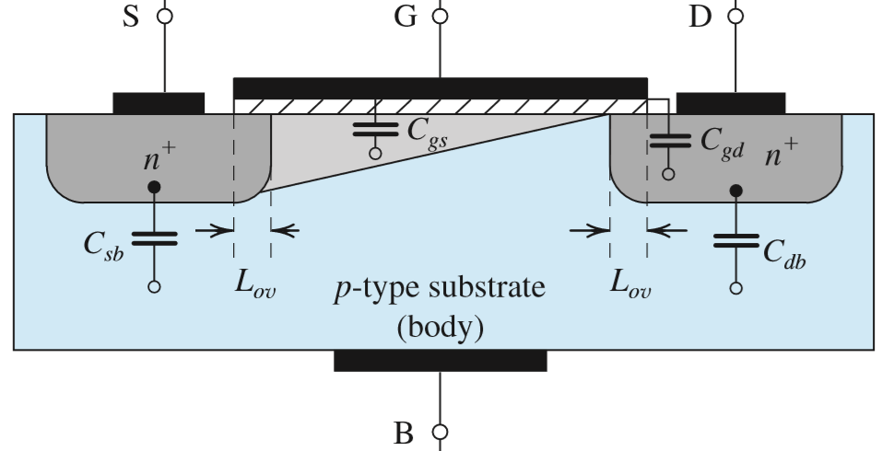


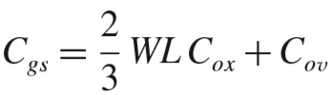
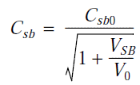

Fundamentals of Analogue Circuits
There will be four capacitances in total:
C_{gs}, C_{gd}, C_{sb}, C_{db},

Slide 34
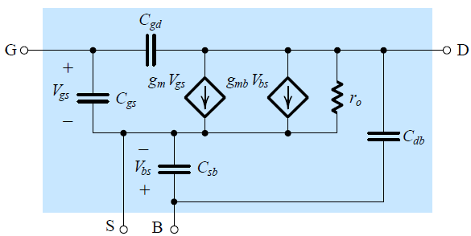
Fundamentals of Analogue Circuits
When the source is connected to the body, C_{sb}=0.
Capacitance C_{db} can usually be neglected, resulting in significant simplification of manual analysis.

Slide 35
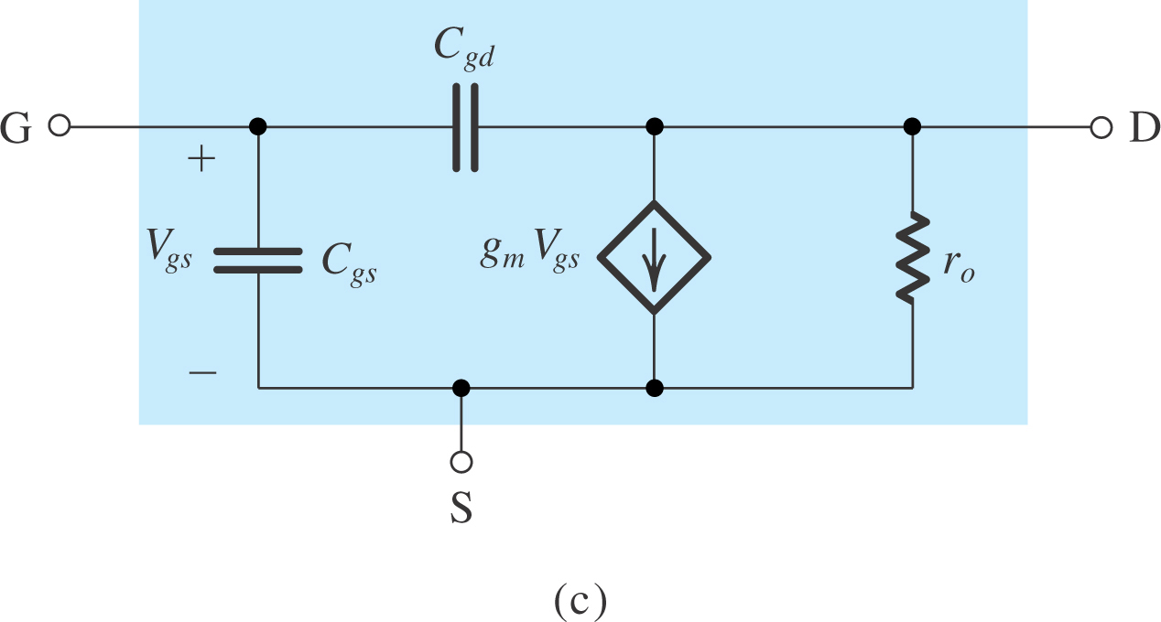
Fundamentals of Analogue Circuits
This is called the MOSFET hybrid-π model.
The transition frequency f_{T} is defined as the frequency at which the short-circuit current-gain of the common-source configuration becomes unity.

Slide 36
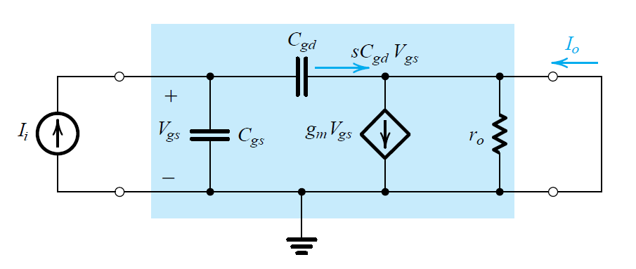
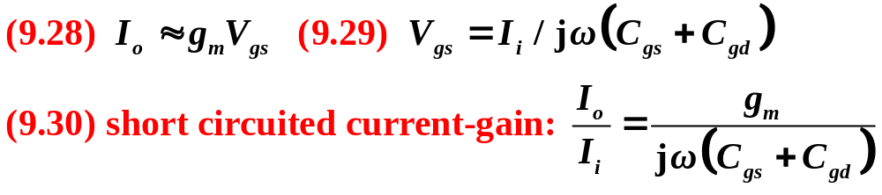
Fundamentals of Analogue Circuits
The MOSFET Unity-Gain Frequency (f_{T})

Slide 37
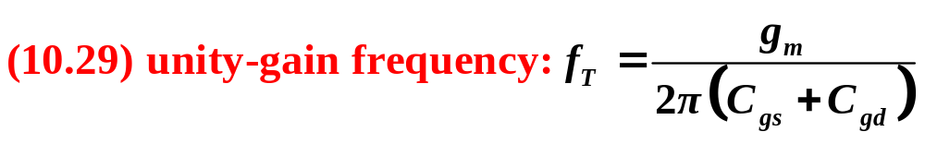
Fundamentals of Analogue Circuits
The MOSFET Unity-Gain Frequency (f_{T})
magnitude of the current gain becomes unity at this frequency

Slide 38
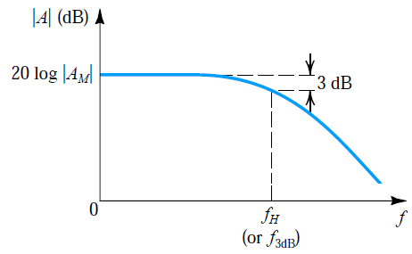
Fundamentals of Analogue Circuits
10.3 High-Frequency Response of the CS Amplifiers
Objective is to identify the mechanism that limits high-frequency performance.
  As well as fine A_{M}.
Figure 10.18: Frequency response of a direct-coupled (dc) amplifier. Observe that the gain does not fall off at low frequencies, and the midband gain A_{M} extends down to zero frequency.

Slide 39
Fundamentals of Analogue Circuits
9.3.1. The Common-Source Amplifier
Figure 10.13(a) shows high-frequency equivalent-circuit model of a CS amplifier.
MOSFET is replaced with model of Figure 10.6(c).
It may be simplified using Thevenin’s theorem.
Also, bridging capacitor (C_{gd}) may be redefined.
C_{gd} gives rise to much larger capacitance C_{eq}.
  The multiplication effect that it undergoes is known as the Miller Effect.

Slide 40
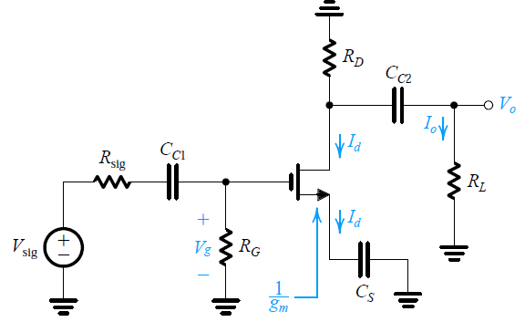
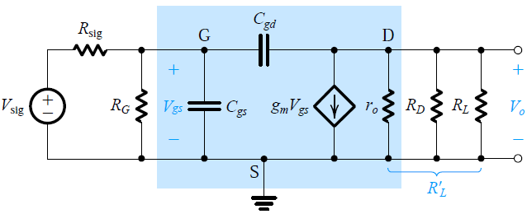
Fundamentals of Analogue Circuits

Slide 41
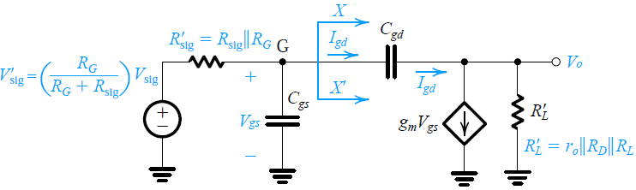
Fundamentals of Analogue Circuits

Slide 42
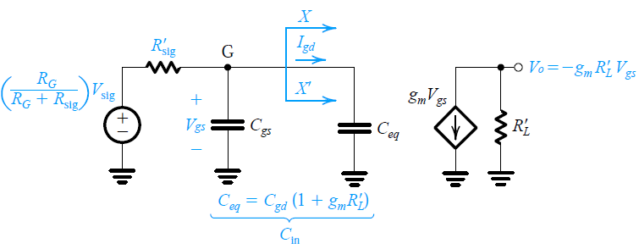

Fundamentals of Analogue Circuits

Slide 43
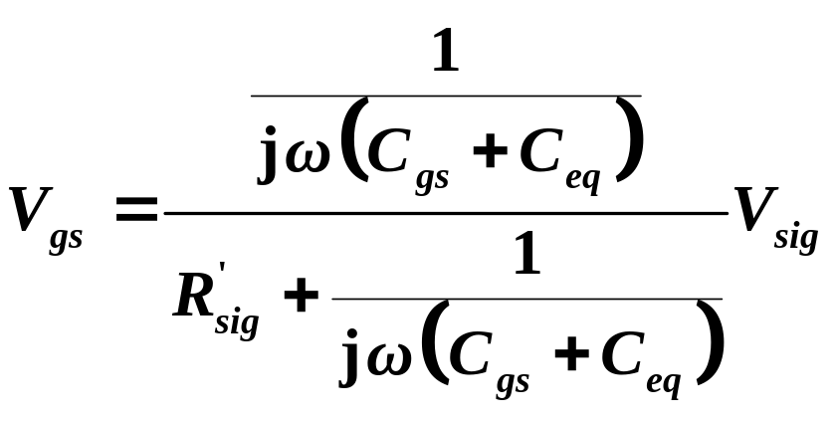
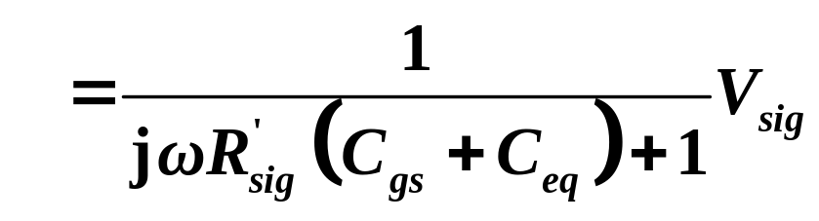

Fundamentals of Analogue Circuits

Slide 44




Fundamentals of Analogue Circuits

Slide 45


Fundamentals of Analogue Circuits

Slide 46

Fundamentals of Analogue Circuits

Slide 47
Fundamentals of Analogue Circuits

Slide 48



Fundamentals of Analogue Circuits
Example 10.3
Find the midband gain A_{M} and the upper 3-dB frequency f_{H} of a CS amplifier fed with a signal source having an internal resistance
R_{sig} =100kΩ. The amplifier has R_{G} =4.7MΩ, R_{D} =R_{L} =15 k Ω, g_{m} =1mA/V, r_{o} =150kΩ, C_{gs}=1pF, and C_{gd} =0.4pF. Also, find the frequency of the transmission zero.

Slide 49





Fundamentals of Analogue Circuits
R_{sig} =100kΩ, R_{G} =4.7MΩ, R_{D} =R_{L} =15 k Ω, g_{m} =1mA/V, r_{o} =150kΩ, C_{gs}=1pF, and C_{gd} =0.4pF.

Slide 50

Fundamentals of Analogue Circuits
K'_{n}(W/L)₁=K'_{P}(W/L)₂=1mA/V² and V_{t}_x0007_=0.5V The resistance R=1MΩ.
(a) For G and D open, what are the drain currents I_{D1} and I_{D2}?
(b) For r_{o} =∞, what is the voltage gain of the amplifier from G to D?
(c) For finite r_{o} (│V_{A}│_x0007_= 20V), what is the voltage gain from G to D and the input resistance at G?
(d) If G is driven (through a large coupling capacitor) from a source v_{sig} having a resistance of 20kΩ, find the voltage gain v_{d}/v_{sig}.
(e) For what range of output signals do Q1 and Q2 remain in the saturation region?

Slide 51
Fundamentals of Analogue Circuits
Summary
The coupling and bypass capacitors utilized in discrete-circuit amplifiers cause the amplifier gain to fall off at low frequencies. The frequencies of the low-frequency poles can be estimated by considering each of these capacitors separately and determining the resistance seen by the capacitor. The highest-frequency pole is that which determines the lower 3-dB frequency (f_{L}).

Slide 52
Fundamentals of Analogue Circuits
MOSFET has internal capacitive effects that can be modeled by augmenting the device hybrid-pi model with capacitances.
  MOSFET: f_{T} = g_{m}/2π(C_{gs}+C_{gd})
The internal capacitances of the MOSFET cause the amplifier gain to fall off at high frequencies.
An estimate of the amplifier bandwidth is provided by the frequency f_{H} at which the gain drops 3dB below its value at midband (A_{M}).

Slide 53
Fundamentals of Analogue Circuits

