Slide 1
Fundamentals of Analogue Circuits
Hongling Cui

Slide 2


Fundamentals of Analogue Circuits
Part Ⅱ Integrated-Circuit Amplifiers
from Microelectronic Circuits Text
by Sedra and Smith
Oxford Publishing

Slide 3
Fundamentals of Analogue Circuits
Introduction
IN THIS CHAPTER WE WILL LEARN
  The basic integrated-circuit (IC) design philosophy and how it differs from that for discrete-circuit design.
  The basic gain cells of IC amplifiers, namely, the CS amplifiers with current-source loads.
  How to increase the gain realized in the basic gain cells by employing the principle of cascoding.

Slide 4
Fundamentals of Analogue Circuits
8.1. Integrated Circuit Design Philosophy
Integrated-circuit fabrication technology imposes constraints on – and provides opportunities to – the circuit designer.
  large capacitors are not available, but very small capacitors are easy to fabricate
  To minimize the chip area, large and even moderate-size resistors are to be avoided.
One objective is to realize as many functions as possible using MOS transistors only.
Reduction of device size is of great concern.

Slide 5
Fundamentals of Analogue Circuits
8.2 IC Biasing – Current Sources, Current Mirrors,
and Current-Steering Circuits
Biasing in integrated-circuit design is based on the use of constant-current sources.
  On an IC chip with a number of amplifier stages, a constant dc current (reference current) is generated at one location and is then replicated at various other locations for biasing.
    This is known as current steering.
This approach has the advantage that the effort expended on generating a predictable and stable reference current need not be repeated.

Slide 6
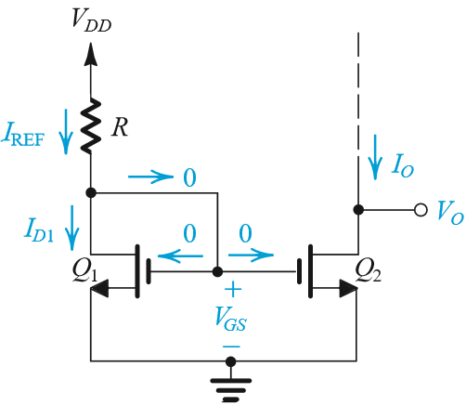
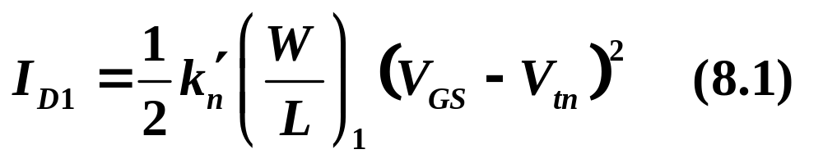
Fundamentals of Analogue Circuits
8.2.1 The Basic MOSFET Current Source
Figure 8.1 shows the circuit of a simple MOS constant-current source.
The heart of the circuit is transistor Q₁, the drain of which is shorted to the gate, thereby forcing it to operate in saturation mode.

Slide 7
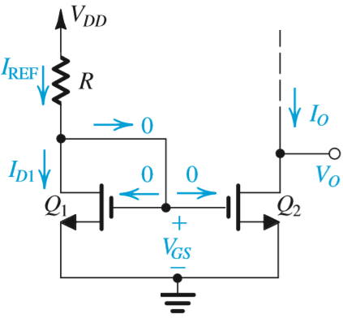
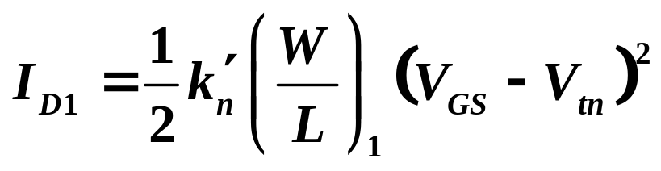
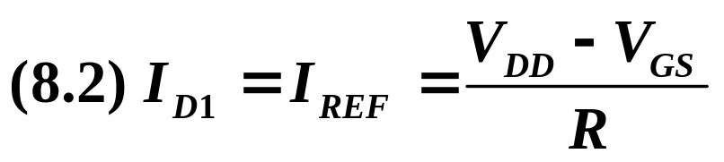
Fundamentals of Analogue Circuits
The drain current of Q₁ is supplied by V_{DD} through resistor R which in most cases is located outside of the IC chip.

Slide 8
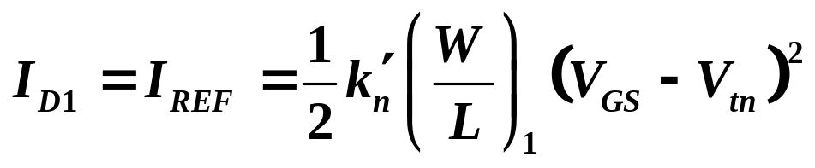
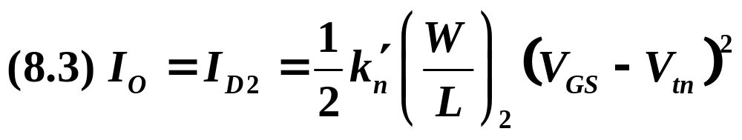
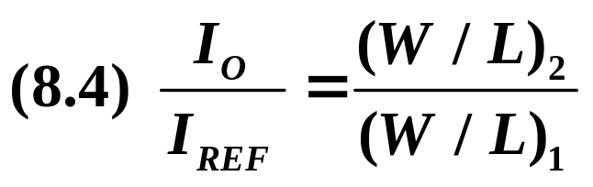
Fundamentals of Analogue Circuits
The drain current of Q₁ is supplied by V_{DD} through resistor R which in most cases is located outside of the IC chip.
If one considers transistor Q₂, it is realized that it has V_{GS} identical to Q₁ – thus...

Slide 9
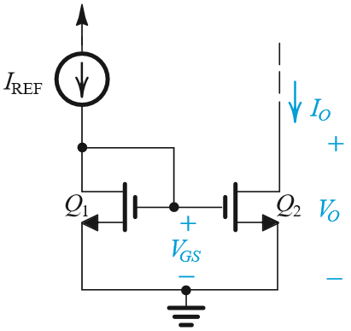
Fundamentals of Analogue Circuits
The combination of Q₁ and Q₂ is referred to as a current mirror.
Figure 8.2 depicts the current-mirror circuit with the input reference current shown as being supplied by a current source for both simplicity and generality.
The current gain or current transfer ratio of the mirror is given by (8.4).
Figure 8.2: Basic MOSFET current mirror.

Slide 10
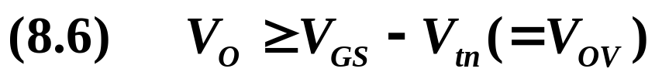
Fundamentals of Analogue Circuits
Once a constant current has been generated, it can be replicated to provide dc bias or load current for the various stages of the amplifier in an IC.
Current mirrors can be used to achieve this goal.
Figure 8.2: Basic MOSFET current mirror.

Slide 11
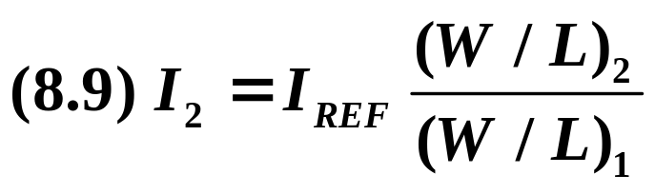
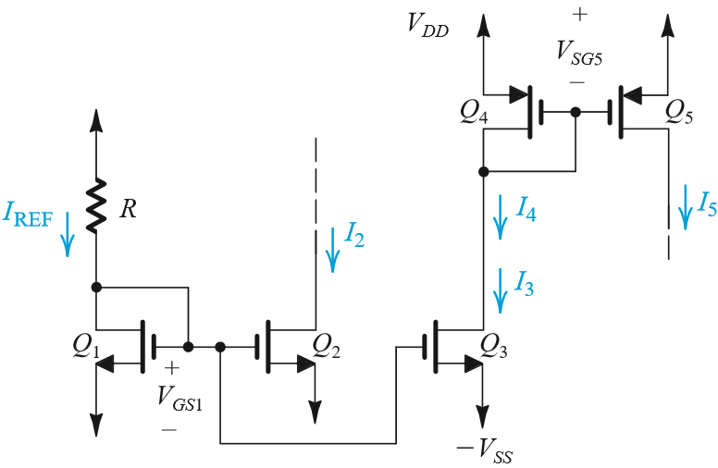
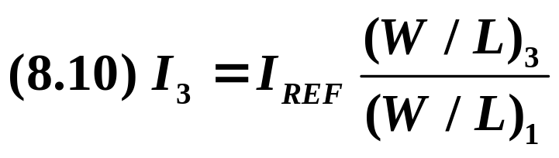
Fundamentals of Analogue Circuits
8.2.2 MOS Current-Steering Circuits

Slide 12
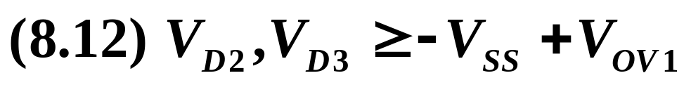
Fundamentals of Analogue Circuits

Slide 13
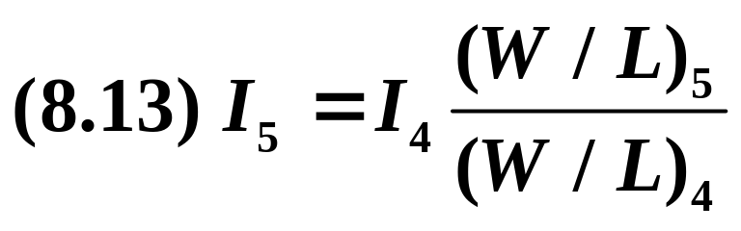
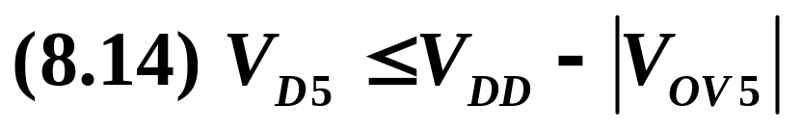
Fundamentals of Analogue Circuits
Where I₄ = I₃

Slide 14
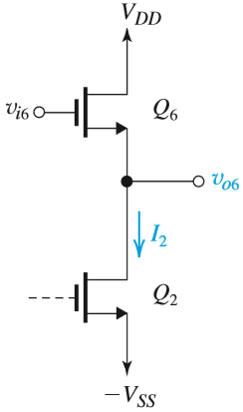
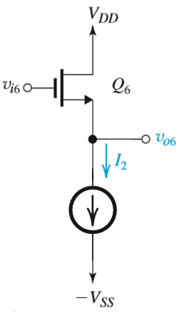
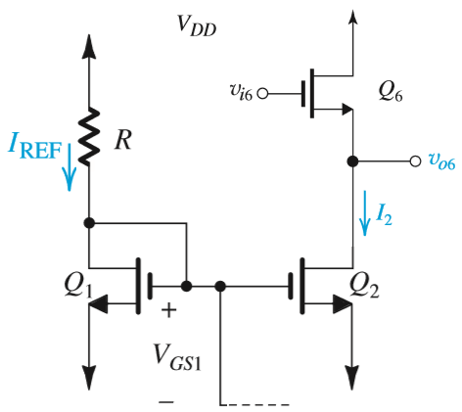
Fundamentals of Analogue Circuits
8.2.2 MOS Current-Steering Circuits
Figure 8.5: Application of the constant currents I2 generated in the current-steering circuit of Fig. 8.4. Constant-current I2 is the bias current for the source follower Q6.

Slide 15
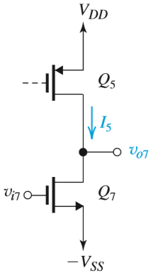
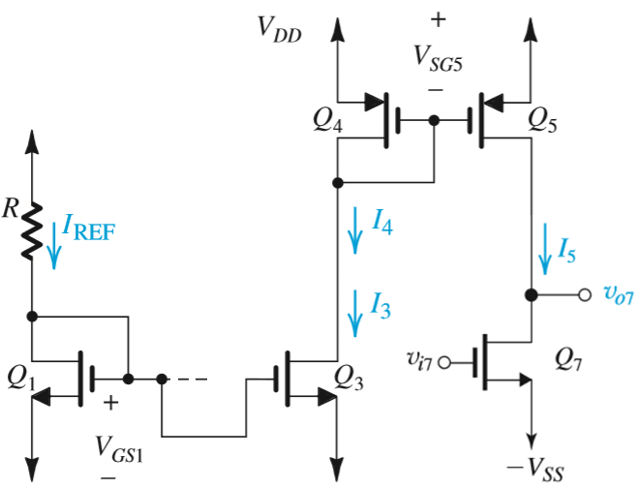
Fundamentals of Analogue Circuits
8.2.2 MOS Current-Steering Circuits
Figure 8.5: Application of the constant currents I5 generated in the current-steering circuit of Fig. 8.4. Constant-current I5 is the load current for the common-source amplifier Q7.

Slide 16
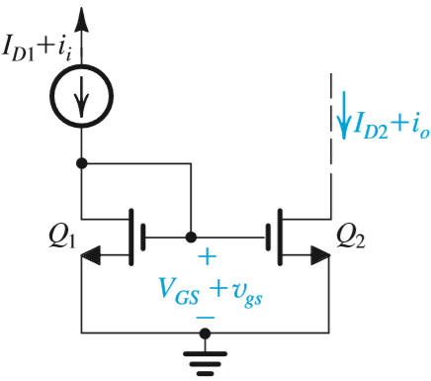
Fundamentals of Analogue Circuits
8.2.4 Small-Signal Operation of Current Mirrors
Current mirrors are sometimes employed as current amplifiers.

Slide 17
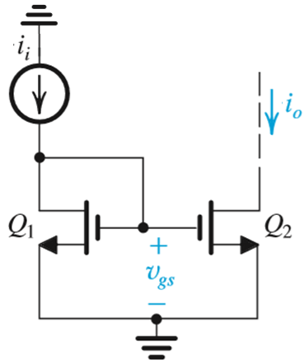

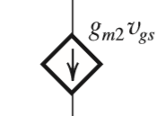

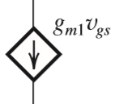
Fundamentals of Analogue Circuits
8.2.4 Small-Signal Operation of Current Mirrors
Current mirrors are sometimes employed as current amplifiers.
D₁,G_{1,2}

Slide 18
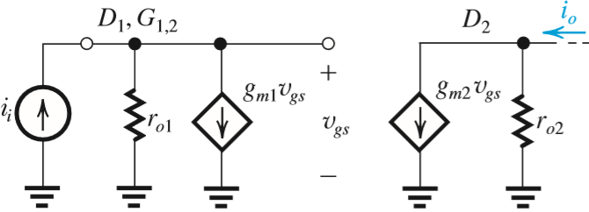
Fundamentals of Analogue Circuits
D₁,G_{1,2}

Slide 19
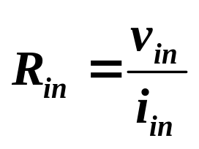
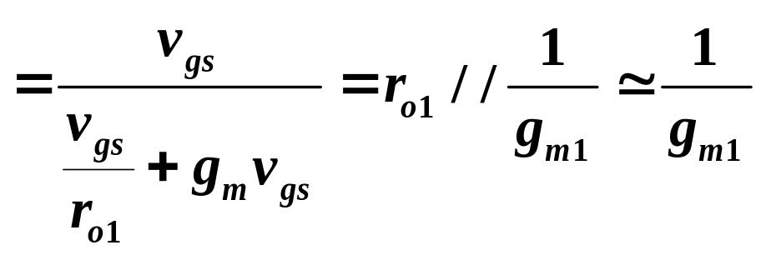
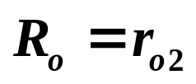
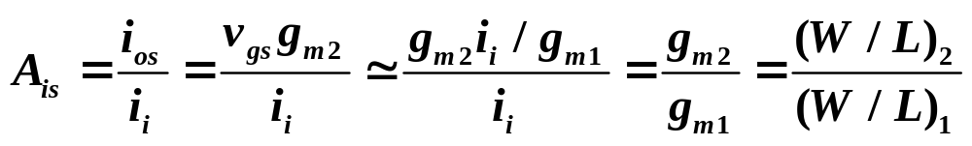
Fundamentals of Analogue Circuits

Slide 20
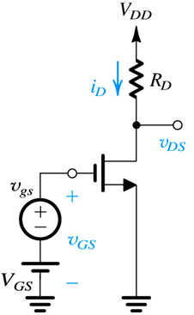
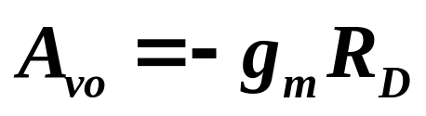
Fundamentals of Analogue Circuits
8.3 The Basic Gain Cell
basic gain cell is:
  Common-source (CS)
Both are loaded with constant-current source.
  This is done because of difficulties associated with fabrication of exact resistances.
  It also facilitates increased gain.
These circuits are referred to as current-source loaded / active loaded.

Slide 21
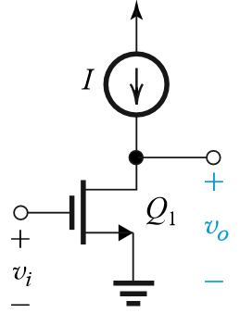
Fundamentals of Analogue Circuits
Figure 8.13 The basic gain cells of IC amplifiers

Slide 22
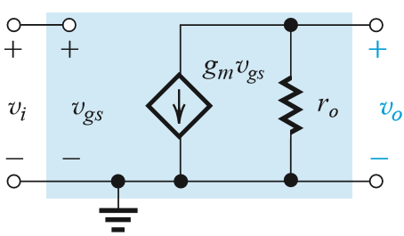
Fundamentals of Analogue Circuits
Figure 8.13 The basic gain cells of IC amplifiers

Slide 23
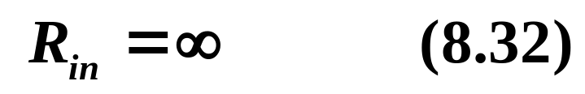
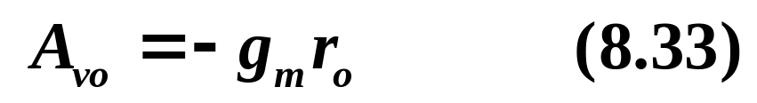
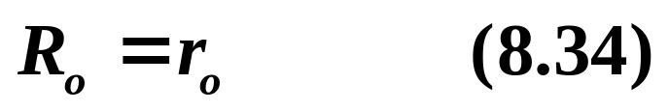
Fundamentals of Analogue Circuits

Slide 24
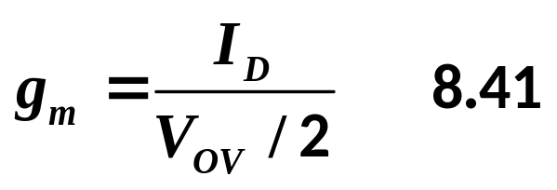
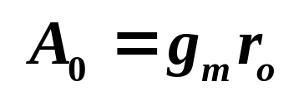
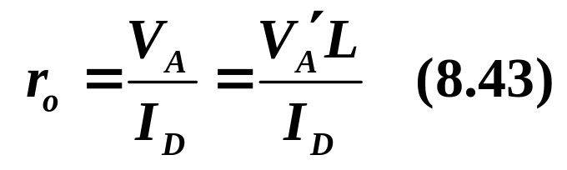
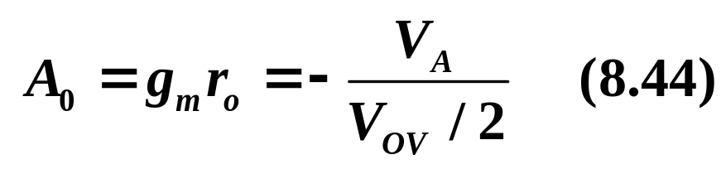
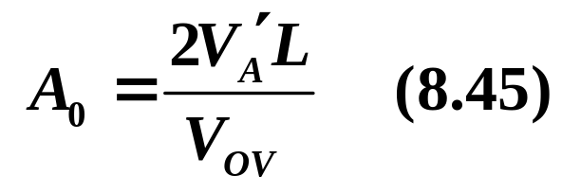
Fundamentals of Analogue Circuits
8.3.2 The Intrinsic Gain (for MOSFET)
There are three possible expressions for g_{m}, two are particularly useful here.

Slide 25
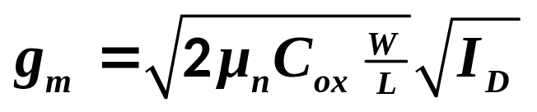
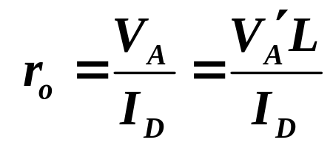
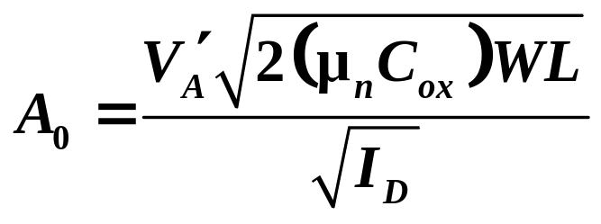
Fundamentals of Analogue Circuits
8.3.2 The Intrinsic Gain (for MOSFET)
There are three possible expressions for g_{m}, two are particularly useful here.

Slide 26
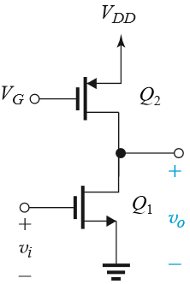
Fundamentals of Analogue Circuits
8.3.3 Effect of the Output Resistance of
the Current-Source Load
The current-source load of the CS amplifier in Figure 8.13(a) can be implemented using a PMOS transistor biased in the saturation region to provide the required current I, as shown in Figure 8.15(a).
Figure 8. 13(a)
Figure 8.15(a)

Slide 27
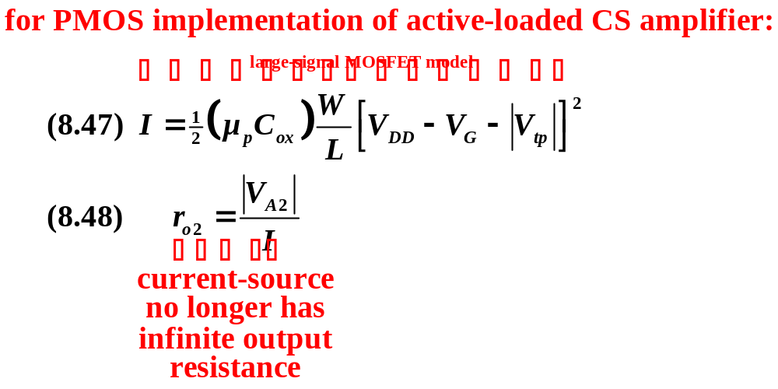
Fundamentals of Analogue Circuits

Slide 28
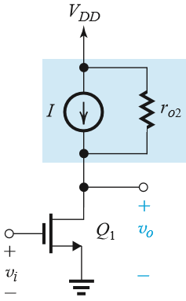
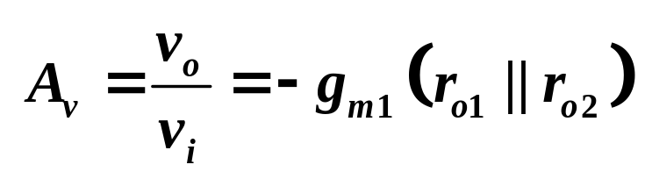
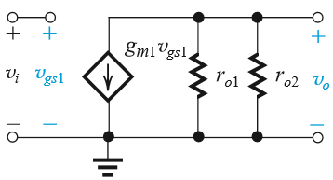
Fundamentals of Analogue Circuits

Slide 29
Fundamentals of Analogue Circuits
8.3.4. Increasing the Gain of the Basic Cell
Q: How can we increase the voltage gain obtained from basic gain cell?
  A: Find a way to raise the level of output resistance.
  A: Seek a circuit that passes the current g_{m}v_{i} provided by the amplifying transistor right through.
    thus increases the resistance from r_{o} to a much larger value.

Slide 30




Fundamentals of Analogue Circuits
Figure 8.17: To increase the voltage gain realized in the basic gain cell shown in (a), a functional block, shown as a black box in (b), is connected between d₁ and the load.

Slide 31
Fundamentals of Analogue Circuits
8.3.4. Increasing the Gain of the Basic Cell
The black box of Figure 8.17 is a current buffer – aka. a device which passes voltage but raises resistance level.
Two important observations should be made:
  It is not sufficient to raise output resistance of amplifying transistor only.
  Placing CG circuit on top of the CS amplifying transistor to implement the current-buffering action is called cascoding.

Slide 32


Fundamentals of Analogue Circuits
8.5 The Cascode Amplifier

Slide 33


Fundamentals of Analogue Circuits
8.5 The Cascode Amplifier

Slide 34
Fundamentals of Analogue Circuits
Homework:
8.1, 8.44, 8.47, 8.48

Slide 35
Fundamentals of Analogue Circuits
Summary
Integrated-circuit fabrication technology offers the circuit designer many exciting opportunities, the most important of which is the large number of inexpensive small-area MOS transistors. An overriding concern for IC designers, however, is the minimization of chip area or “silicon real estate.” As a result, large-valued resistors and capacitors are virtually absent.
The basic gain cell of IC amplifier is the CS (CE) amplifier with a current-source load. For an ideal current-source load (i.e. one with infinite output resistance), the transistor operates in an open-circuit fashion and thus provides the maximum gain possible: A_{vo} = -g_{m}r_{o} = -A₀.

Slide 36
Fundamentals of Analogue Circuits
The intrinsic gain A₀ is given by A₀ = V_{A} / V_{T} for a BJT and A₀ = V_{A}/(V_{OV}/2) for a MOSFET. For a MOSFET, A₀ is inversely proportional to I_{D}^{1/2}. See equation 7.15.
Simple current-source loads reduce the gain realized in the basic gain cell because of their finite resistance (usually comparable to the value of r_{o} of the amplifying transistor).
To raise the output resistance of the CS transistor, we stack a CG on top. This is cascoding. The CG or CB transistor in the cascode passes the current g_{m1}v_{i} provided by the CS or CE transistor.

Slide 37
Fundamentals of Analogue Circuits
Biasing in integrated circuits utilizes current sources. As well, current sources are used as load devices. Typically an accurate and stable reference current is generated and then replicated to provide bias current for the various amplifier stages on the chip. The heart of the current-steering circuitry utilized to perform this function is the current mirror.

Slide 38
Fundamentals of Analogue Circuits
The MOS current mirror has a current transfer ratio of (W/L)₂/(W/L)₁.
MOS mirrors of the basic type has a finite output resistance equal to r_{o} of the output device. Also, for proper operation, a voltage of at least 0.3V is required across the output transistor of a simple bipolar mirror (|V_{OV}| for the MOS case).
Cascoding can be applied to current mirrors to increase their output resistances.

