Slide 1
Fundamentals of Analogue Circuits
Hongling Cui

Slide 2


Fundamentals of Analogue Circuits
Chapter 9 Differential and
Multistage Amplifiers
from Microelectronic Circuits Text
by Sedra and Smith
Oxford Publishing

Slide 3
Fundamentals of Analogue Circuits
Introduction
IN THIS CHAPTER YOU WILL LEARN:
  The essence of the operation of the MOS differential amplifiers : how they reject common-mode noise or interference and amplify differential signals.
  The analysis and design of MOS differential amplifiers.
  Differential amplifier circuits of varying complexity; utilizing passive resistive loads, current-source loads.
  The structure, analysis, and design of ampliﬁers composed of two or more stages.

Slide 4
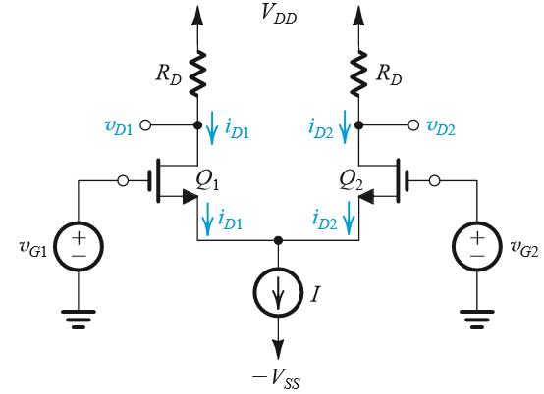
Fundamentals of Analogue Circuits
9.1 The MOS Differential Pair
Two matched transistors (Q₁ and Q₂) joined and biased by a constant current source I.
FET’s should not enter triode region of operation.
Figure 9.1: The basic MOS differential-pair configuration.

Slide 5
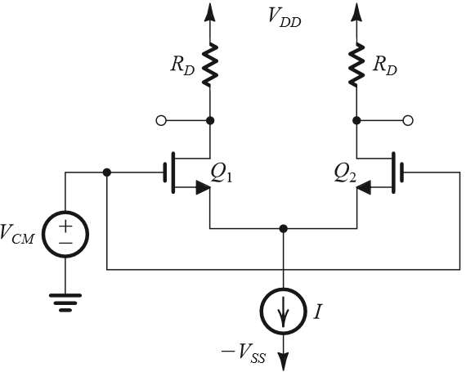
Fundamentals of Analogue Circuits
9.1.1 Operation with a Common-Mode Input Voltage
Consider case when two gate terminals are joined together.
  Connected to a common-mode voltage (V_{CM}).
  v_{G1} = v_{G2} = V_{CM}
Q₁ and Q₂ are matched.

Slide 6




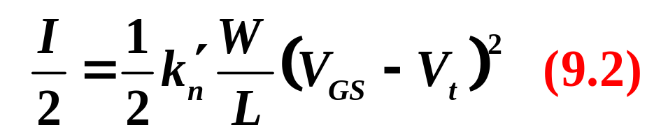
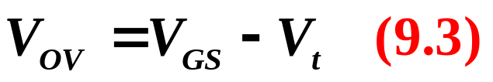
Fundamentals of Analogue Circuits
Current I will divide equally between the two transistors.
  I_{D1} = I_{D2} = I/2
  V_{S} = V_{CM} – V_{GS}
    where V_{GS} is the gate-to-source voltage corresponding
    to I/2.

Slide 7
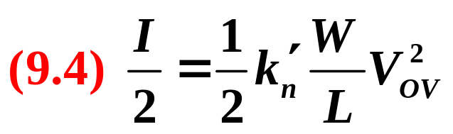

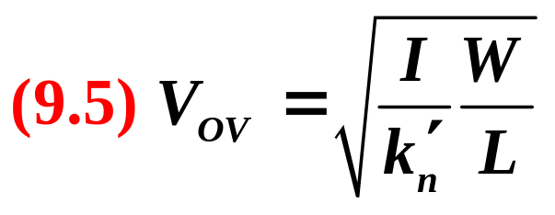
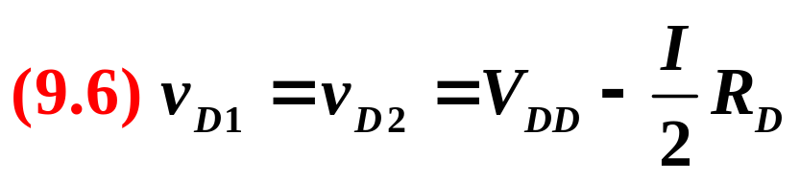
Fundamentals of Analogue Circuits
or in terms of the overdrive voltage
The voltage at each drain will be:
Thus the differential pair does not respond to (i.e., it rejects) common-mode input signals.

Slide 8
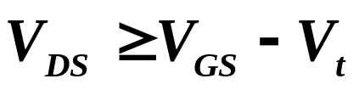
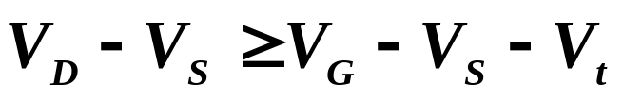
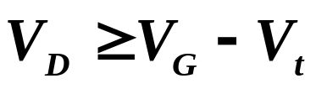
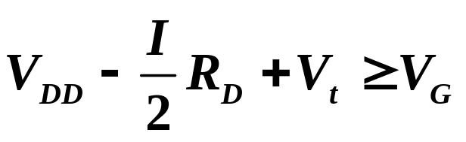
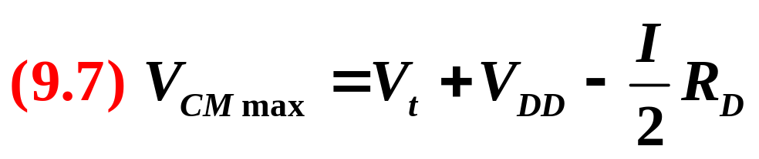
Fundamentals of Analogue Circuits
The highest value of V_{CM} is limited by the requirement that Q₁ and Q₂ remain in saturation:

Slide 9
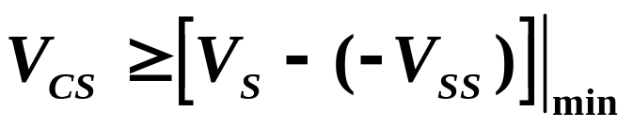
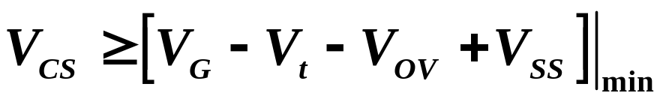
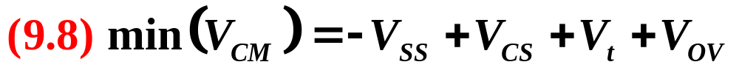
Fundamentals of Analogue Circuits
The lowest value of V_{CM} is determined by the need to allow for a sufficient voltage across the current source I for it to operate properly:

Slide 10
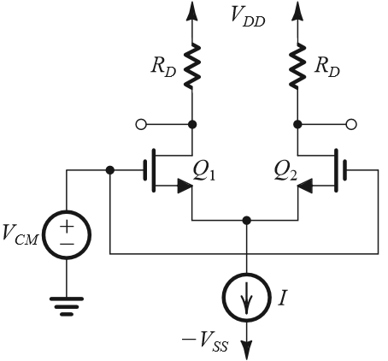
Fundamentals of Analogue Circuits
Conclude
Symmetry circuit.
Common-mode voltage.
Current I divides equally between two transistors.
The difference between two drains is zero.
The differential pair rejects the common-mode input signals.

Slide 11
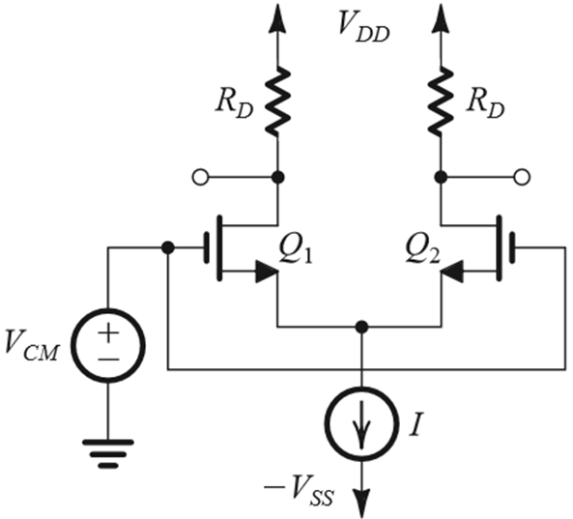
Fundamentals of Analogue Circuits
Example 9.1 P598
Let V_{DD} = V_{SS} = 1.5 V, k=4mA/V², V_{t} = 0.5 V,
I = 0.4 mA, R_{D}= 2.5kΩ, and neglect channel-length modulation. Assume that the current source I requires a minimum voltage of 0.4 V to operate properly.

Slide 12
Fundamentals of Analogue Circuits
Example 9.1 P598
let V_{DD} = V_{SS} = 1.5 V, k=4mA/V², V_{t} = 0.5 V, I = 0.4 mA,
R_{D}= 2.5kΩ, V _{CSmin} =0.4V.
Find V_{OV} and V_{GS} for each transistor.
(b) For V_{CM} = 0, find V_{S}, I_{D1}, I_{D2}, V_{D1}, and V_{D2}.
(c) Repeat (b) for V_{CM} = +1V.
(d) Repeat (b) for V_{CM} =−0.2V.
(e) What is the highest permitted value of V_{CM}?
(f) What is the lowest value allowed for V_{CM}?

Slide 13


Fundamentals of Analogue Circuits
let V_{DD} = V_{SS} = 1.5 V, k=4mA/V², V_{t} = 0.5 V, I = 0.4 mA,
R_{D}= 2.5kΩ, V_{CSmin} =0.4V.
Find V_{OV} and V_{GS} for each transistor.
Solution
(a) With v_{G1} = v_{G2}=V_{CM},
we see that V_{GS1} = V_{GS2}

Slide 14
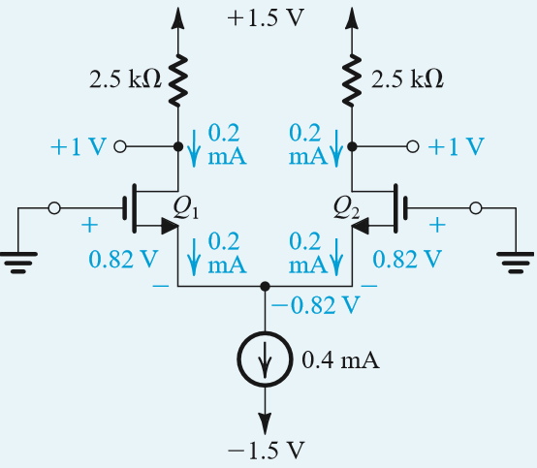

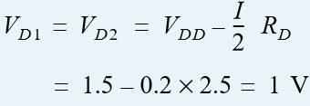

Fundamentals of Analogue Circuits
let V_{DD} = V_{SS} = 1.5 V, k=4mA/V², V_{t} = 0.5 V, I = 0.4 mA,
R_{D}= 2.5kΩ, V_{CSmin} =0.4V.
(b) For V_{CM} = 0, find V_{S}, I_{D1}, I_{D2}, V_{D1}, and V_{D2}.

Slide 15
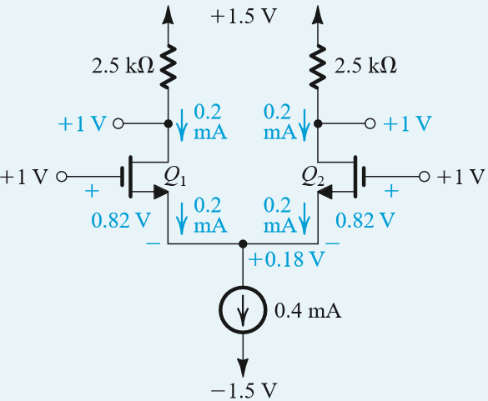



Fundamentals of Analogue Circuits
let V_{DD} = V_{SS} = 1.5 V, k=4mA/V², V_{t} = 0.5 V, I = 0.4 mA,
R_{D}= 2.5kΩ, V_{CSmin} =0.4V.
(c) For V_{CM} =1V, find V_{S}, I_{D1}, I_{D2}, V_{D1}, V_{D2}.

Slide 16
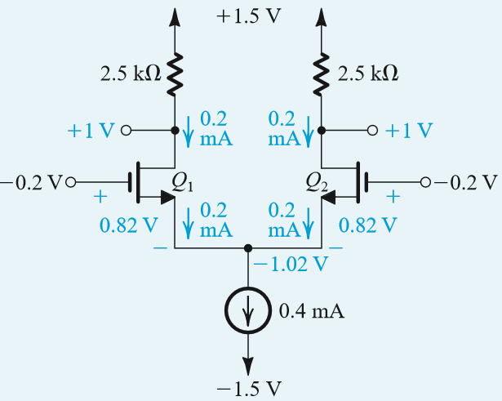




Fundamentals of Analogue Circuits
let V_{DD} = V_{SS} = 1.5 V, k=4mA/V², V_{t} = 0.5 V, I = 0.4 mA,
R_{D}= 2.5kΩ, V_{CSmin} =0.4V
(d) For V_{CM} =-0.2, find V_{S}, I_{D1}, I_{D2}, V_{D1}, V_{D2}.

Slide 17
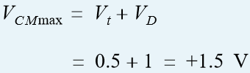

Fundamentals of Analogue Circuits
let V_{DD} = V_{SS} = 1.5 V, k=4mA/V², V_{t} = 0.5 V, I = 0.4 mA,
R_{D}= 2.5kΩ, V_{CSmin} =0.4V
(e) What is the highest permitted value of V_{CM}
(f) What is the lowest value allowed for V_{CM}?

Slide 18
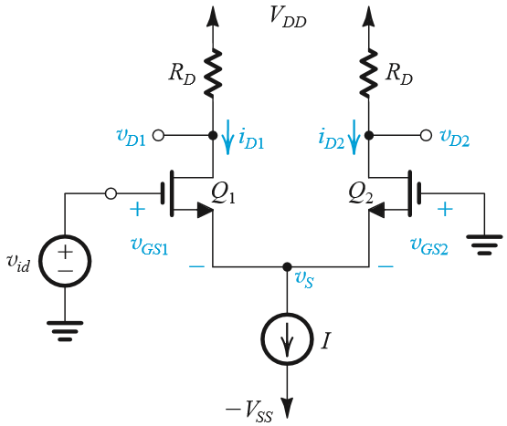
Fundamentals of Analogue Circuits
9.1.2 Operation with a Differential Input Voltage
If v_{id} is applied to Q₁ and Q₂ is grounded, following conditions apply:
  If v_{id} = v_{GS1} – v_{GS2} > 0 then i_{D1} > i_{D2}
  And v_{o} = v_{D2} – v_{D1} >0
The opposite applies if Q₁ is grounded etc.
The differential pair responds to a difference-mode or differential input signals.

Slide 19
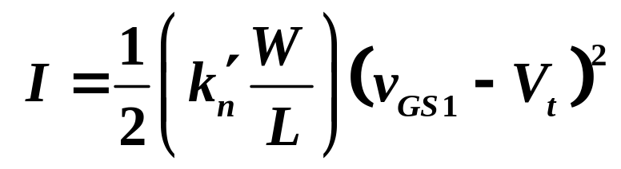
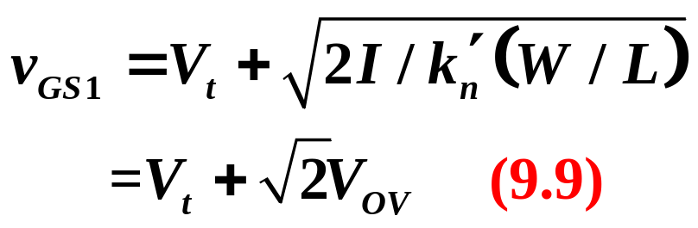
Fundamentals of Analogue Circuits
Q: What is maximum value of v_{id}
A: When i_{D1} = I, v_{S} = -V_{t}
V_{OV} is the overdrive voltage corresponding to a drain current of I/2

Slide 20
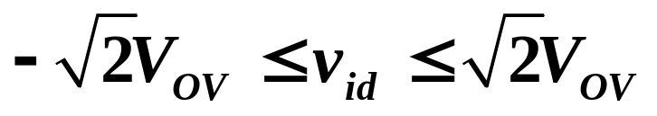
Fundamentals of Analogue Circuits
Range of differential-mode operation:

Slide 21
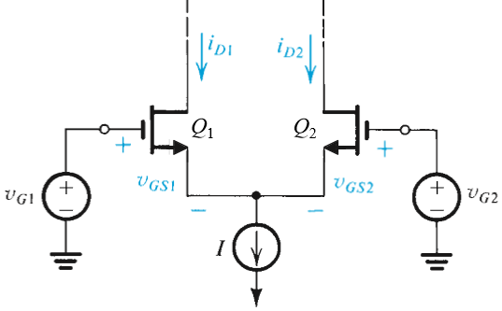
Fundamentals of Analogue Circuits
9.1.3 Large-Signal Operation
Objective is to derive expressions for drain current i_{D1} and i_{D2} in terms of differential signal v_{id} = v_{G1} – v_{G2}.
Assumptions:
  Perfectly Matched
  Channel-length Modulation is Neglected
  Load Independence
  Saturation Region

Slide 22
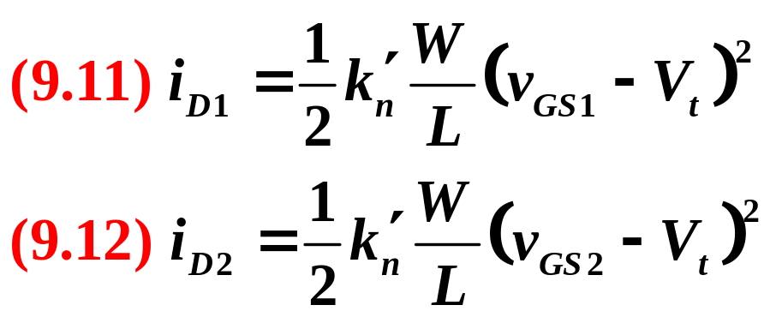
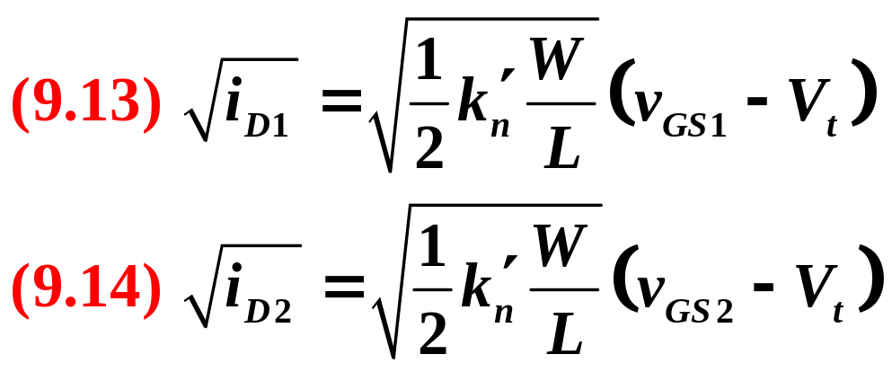
Fundamentals of Analogue Circuits
Step 1: Express drain currents for Q₁ and Q₂.
Step 2: Take the square roots of both sides of both (9.11) and (9.12)

Slide 23
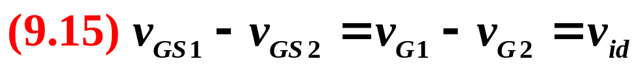
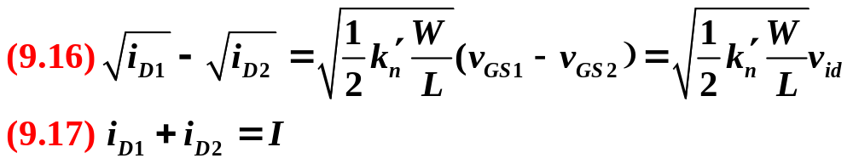
Fundamentals of Analogue Circuits
Step 3: Subtract (9.14) from (9.13) and substituting：
Step 4: results in (9.16).
Step 5: Incorporate the constant-current bias.

Slide 24
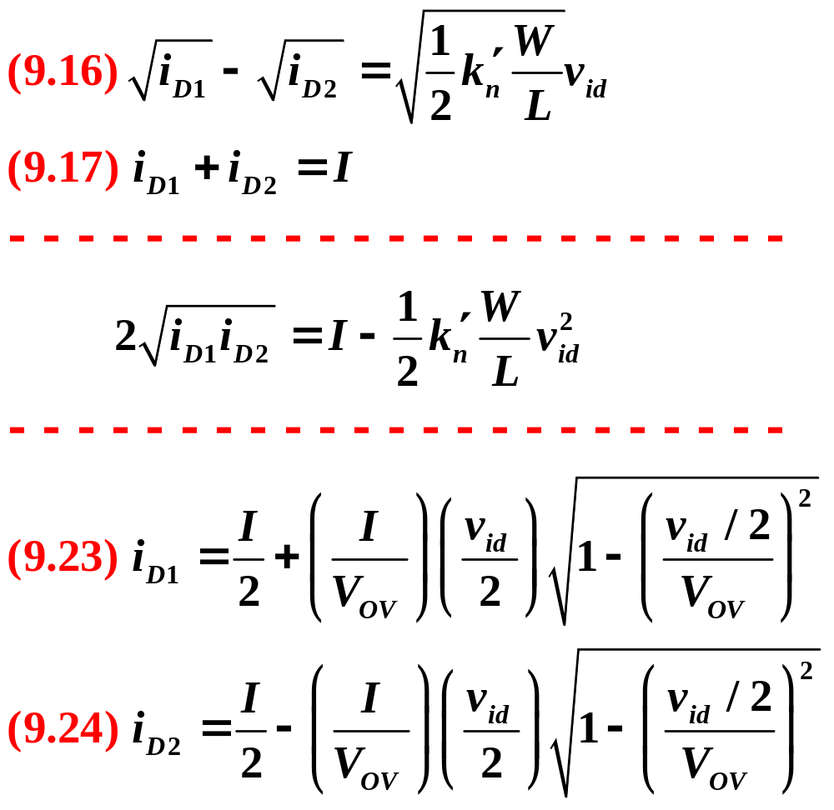
Fundamentals of Analogue Circuits
Step 6: Solve (9.16) and (9.17) for the two unknowns – i_{D1} and i_{D2}.
  Refer to (9.23) and (9.24).

Slide 25
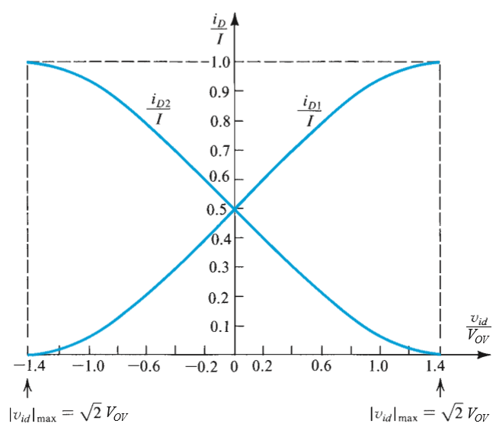
Fundamentals of Analogue Circuits
Figure 9.6 Normalized plots of the currents in a MOSFET differential pair.

Slide 26
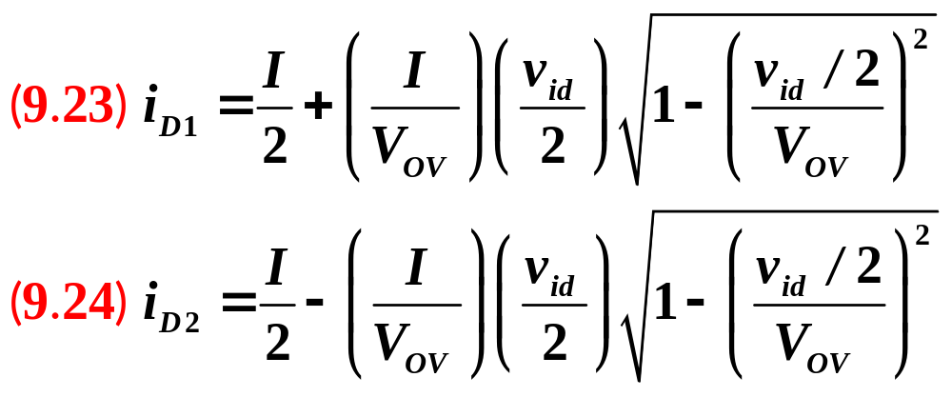
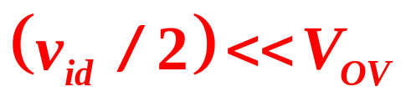
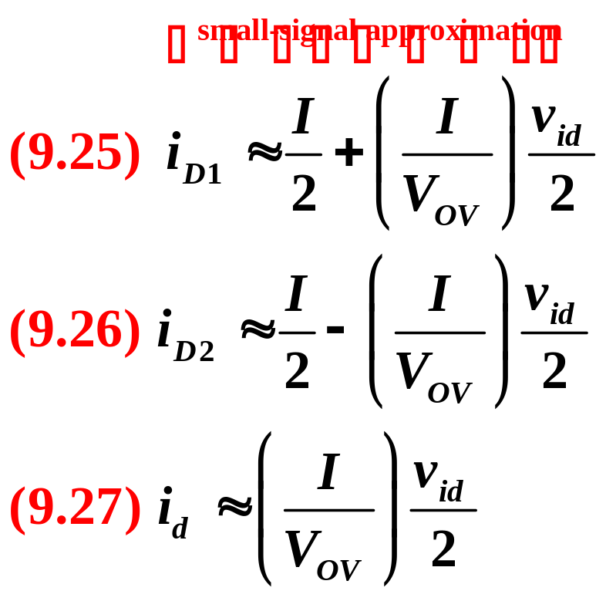
Fundamentals of Analogue Circuits
Transfer characteristics of (9.23) and (9.24) are nonlinear.
Linear amplification is desirable and v_{id} will be as small as possible.
For a given value of V_{OV}, the only option is to keep v_{id}/2 much smaller than V_{OV}.

Slide 27
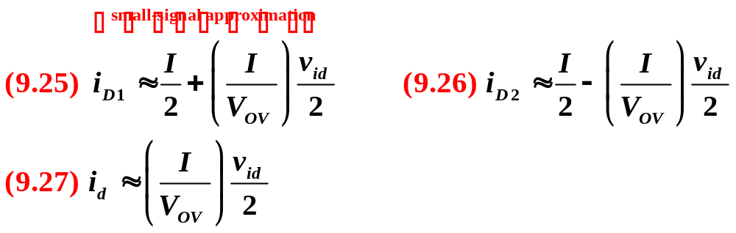
Fundamentals of Analogue Circuits
g_{m}
Note that for a given , linearity can be increased by increasing the overdrive voltage V_{OV} .
This can be done by using smaller ratios.
The price paid for the increased linearity is a reduction in gm and hence a reduction in gain.

Slide 28
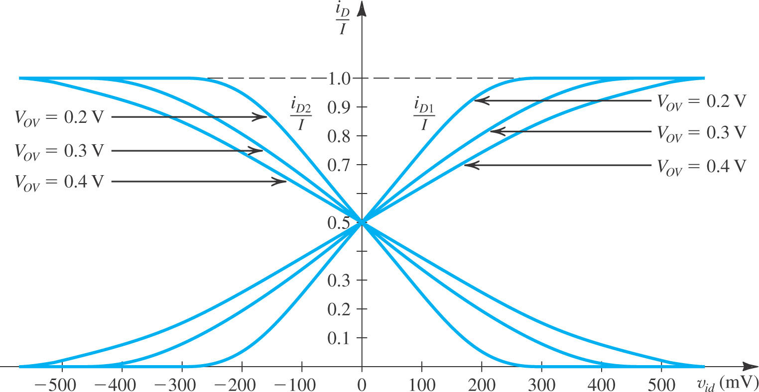
Fundamentals of Analogue Circuits
Figure 8.7: The linear range of operation of the MOS differential pair can be extended by operating the transistor at a higher value of V_{OV} .

Slide 29
Fundamentals of Analogue Circuits
9.1.4 Small-Signal Operation
Linear amplifier
Differential gain

Slide 30
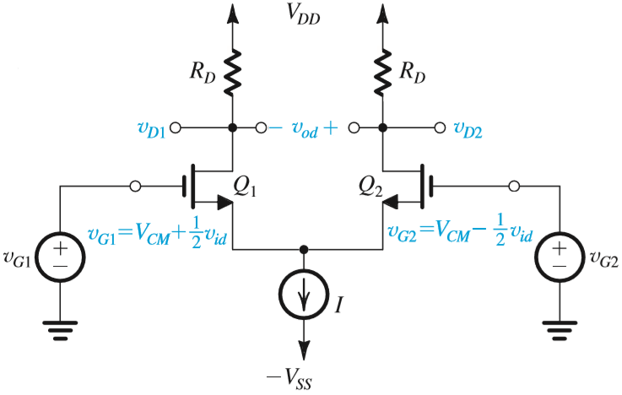
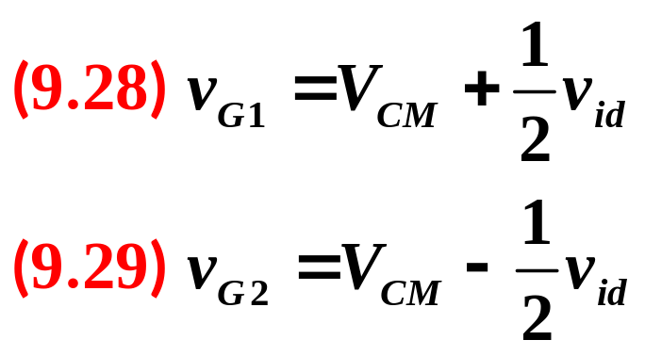
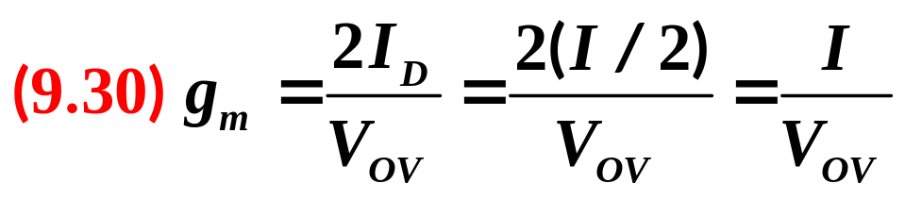
Fundamentals of Analogue Circuits
1. Differential Gain

Slide 31

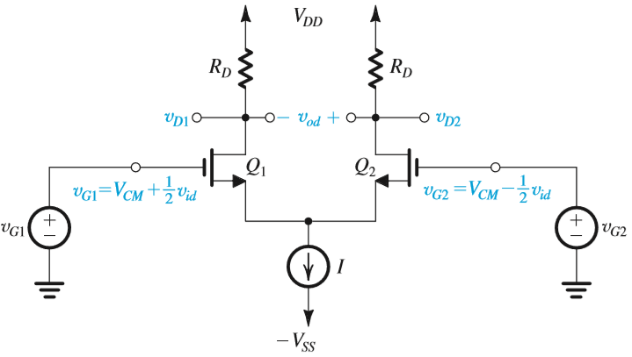
Fundamentals of Analogue Circuits
v_{i1} = V_{CM} + v_{id}/2 and v_{i2} = V_{CM} – v_{id}/2 causes a virtual signal ground to appear on the common-source connection.

Slide 32
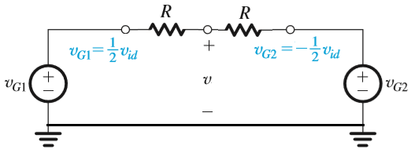
Fundamentals of Analogue Circuits

Slide 33
Fundamentals of Analogue Circuits
A signal ground is established at the source terminals without resorting to the use of a large bypass capacitor, clearly a major advantage of the differential-pair configuration.

Slide 34
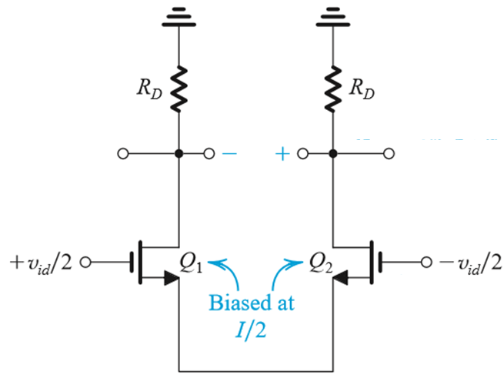
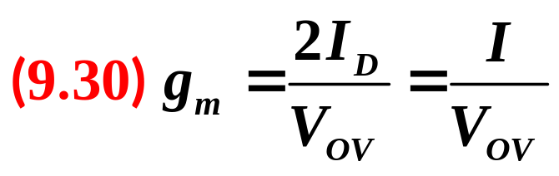
Fundamentals of Analogue Circuits
Current in Q₁ increases by g_{m}v_{id}/2 and the current in Q₂ decreases by g_{m}v_{id}/2.
g_{m}(v_{id}/2)
g_{m}(v_{id}/2)
+
+
v_{gs1}= v_{id}/2
v_{gs2}= -v_{id}/2
-
-
0

Slide 35
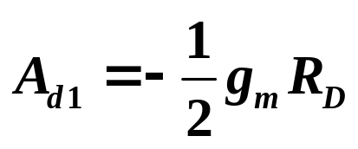
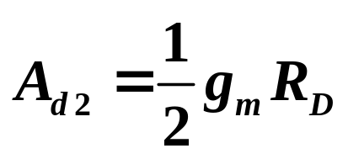
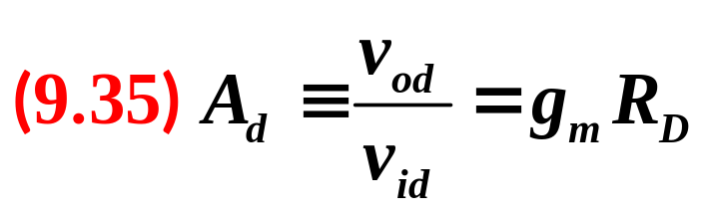
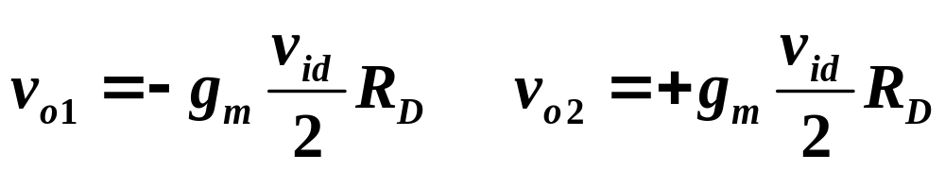
Fundamentals of Analogue Circuits
If output can be taken between one of the drains and ground.
v_{o}=g_{m}R_{D}v_{id}
v_{o1}
v_{o2}
g_{m}(v_{id}/2)
g_{m}(v_{id}/2)
+
+
v_{gs1}= v_{id}/2
v_{gs2}= -v_{id}/2
If output is taken differentially.
-
-
0

Slide 36
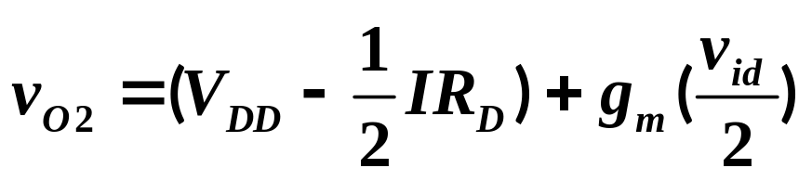
Fundamentals of Analogue Circuits
v_{o}=g_{m}R_{D}v_{id}
g_{m}(v_{id}/2)
g_{m}(v_{id}/2)
+
+
v_{gs1}= v_{id}/2
v_{gs2}= -v_{id}/2
-
-
0
If output can be taken between one of the drains and ground.

Slide 37



Fundamentals of Analogue Circuits

Slide 38


Fundamentals of Analogue Circuits

Slide 39


Fundamentals of Analogue Circuits
Notes:
.

Slide 40


Fundamentals of Analogue Circuits
2. The Differential Half-Circuit
Figure 9.10 (right): The equivalent differential half-circuit of the differential amplifier of Figure 9.9.
Here Q₁ is biased at I/2 and is operating at V_{OV}.
This circuit may be used to determine the differential voltage gain of the differential amplifier

Slide 41

Fundamentals of Analogue Circuits
Example 9.2 p610
Give the differential half-circuit of the differential amplifier shown in right Figure. Assume that Q₁ and Q₂ are perfectly matched. Neglecting r_{o}, determine the differential voltage gain A_{d}=v_{od}/v_{id}

Slide 42



Fundamentals of Analogue Circuits
R_{L}/2 R_{L}/2

Slide 43

Fundamentals of Analogue Circuits
R_{L}/2 R_{L}/2

Slide 44



Fundamentals of Analogue Circuits
-v_{od}/2
R_{L}/2
v_{id}/2

Slide 45


Fundamentals of Analogue Circuits
9.1.5 The Differential Amplifier
with Current-Source Loads
To obtain higher gain, the passive resistances (R_{D}) can be replaced with current sources.
A_{d} = g_{m1}(r_{o1}||r_{o3})
Figure 9.12: (a) Differential amplifier with current-source loads formed by Q₃ and Q₄. (b) Differential half-circuit of the amplifier in (a).

Slide 46


Fundamentals of Analogue Circuits
9.3 Common-Mode Rejection
Figure 9.13 (a) A MOS differential amplifier with a common-mode input signal v_{icm} superimposed on the input dc common-mode voltage V_{CM}

Slide 47


Fundamentals of Analogue Circuits

Slide 48



Fundamentals of Analogue Circuits
Equation (9.73) describes effect of common-mode signal (v_{icm}) on v_{o1} and v_{o2}.

Slide 49



Fundamentals of Analogue Circuits
where: 2R_{SS}≫1/g_{m}
Figure 8.13 (c) The amplifier circuit with the transistors replaced with their T model and r_{o} neglected.

Slide 50

Fundamentals of Analogue Circuits
Figure 8.13 (d) The circuit in (b) split into its two halves; each half is called the “CM half circuit.”

Slide 51



Fundamentals of Analogue Circuits
When the output is taken single-ended, magnitude of common-mode gain is defined:
Taking the output differentially results in the perfectly matched case, in zero A_{cm} (infinite CMRR).
Common-mode rejection ratio(CMRR)

Slide 52


Fundamentals of Analogue Circuits
Effect of R_{D} Mismatch
Mismatches between the two sides of the pair make A_{cm} finite even when the output is taken differentially.
If the load of Q₁ is R_{D} and that of Q₂ is R_{D}+ΔR_{D},
R_{D}+ΔR_{D}

Slide 53



Fundamentals of Analogue Circuits
Effect of R_{D} Mismatch
Mismatches between the two sides of the pair make A_{cm} finite even when the output is taken differentially.
If the load of Q₁ is R_{D} and that of Q₂ is R_{D}+ΔR_{D},

Slide 54


Fundamentals of Analogue Circuits
Effect of R_{D} Mismatch
Effect of R_{D} mismatch on CMRR is illustrated in (9.82)
where

Slide 55





Fundamentals of Analogue Circuits
R_{D1} and R_{D2} show a mismatch ΔR_{D}
the output voltages V_{D1} and V_{D2} will be

Slide 56






Fundamentals of Analogue Circuits
Effect of g_{m} mismatch on CMRR
Thus:

Slide 57







Fundamentals of Analogue Circuits

Slide 58




Fundamentals of Analogue Circuits

Slide 59
Fundamentals of Analogue Circuits
9.5 The Current-Mirror-Loaded MOS Differential Pair
Taking the output differentially has three major advantages:
It decreases the common-mode gain and thus increases the common-mode rejection ratio (CMRR).
It decreases the input offset voltage.
It increases the differential gain by a factor of 2 (6dB) because the output is the difference between two voltages of equal magnitude and opposite sign.

Slide 60

Fundamentals of Analogue Circuits
9.5.1 Differential-to-Single-Ended Conversion
The simplest, most basic approach for differential-to-single-ended conversion.
The drawback of this scheme is that we lose a factor of 2 in gain.
A much better approach is utilizing the current-mirror-load differential pair.

Slide 61


Fundamentals of Analogue Circuits
9.5.2 The Current-Mirror-Loaded MOS Differential Pair

Slide 62

Fundamentals of Analogue Circuits
The Current-Mirror-Loaded MOS Differential Pair

Slide 63



Fundamentals of Analogue Circuits
9.5.3 Differential Gain of The Current- Mirror-Loaded MOS Pair

Slide 64

Fundamentals of Analogue Circuits
Two-Stage CMOS Op-Amp Configuration
Figure 9.40 Two-stage CMOS op-amp configuration.

Slide 65


Fundamentals of Analogue Circuits
We just focus on the external characteristics of this two-stage CMOS op-amp.
Figure block-diagram of this Two-stage CMOS op-amp.

Slide 66

Fundamentals of Analogue Circuits
We just focus on the external characteristics of this two-stage CMOS op-amp.
v₋
i₋
R_{i}
R_{out}
Figure block-diagram of this Two-stage CMOS op-amp.
A_{vo}(v₊-v₋)
v₊
i₊

Slide 67
Fundamentals of Analogue Circuits
Summary
The differential-pair or differential-amplifier configuration is most widely used building block in analog IC designs. The input stage of every op-amp is a differential amplifier.
There are two reasons for preferring differential to single-ended amplifiers: 1) differential amplifiers are insensitive to interference and 2) they do not need bypass and coupling capacitors.
For a MOS pair biased by a current source I, each device operates at a drain current of I/2 and a corresponding overdrive voltage V_{OV} . Each device has g_{m}=1/V_{OV} .

Slide 68
Fundamentals of Analogue Circuits
With the two input terminals connected to a suitable dc voltage V_{CM}, the bias current I of a perfectly symmetrical differential pair divides equally between the two transistors of the pair, resulting in zero voltage difference between the two drains. To steer the current completely to one side of the pair, a difference input voltage v_{id} of at least 2^{1/2}V_{OV} is needed.
Superimposing a differential input signal v_{id} on the dc common-mode input voltage V_{CM} such that v_{I1} = V_{CM} + v_{id}/2 and v_{I2} = V_{CM} – v_{id}/2 causes a virtual signal ground to appear on the common-source connection.

Slide 69
Fundamentals of Analogue Circuits
The analysis of a differential amplifier to determine differential gain, differential input resistance, frequency response of differential gain, and so on is facilitated by employing the differential half-circuit which is a common-source transistor biased at I/2.
An input common-mode signal vicm gives rise to drain (collector) voltage signals that are ideally equal and given by –v_{icm}(R_{D}/2R_{SS}), where R_{SS} is the output resistance of the current source that supplies the bias current I.

