Slide 1
Tutorial 6 for CAD Sample Questions and Exercises

Slide 2
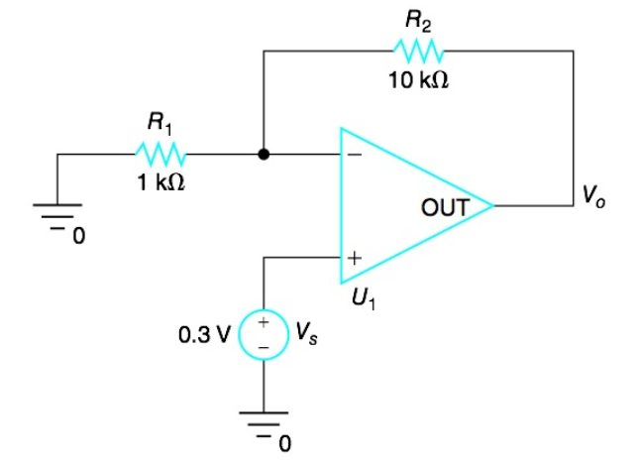
1 Ideal OP AMP
Find V0 in the circuit shown below

Slide 3
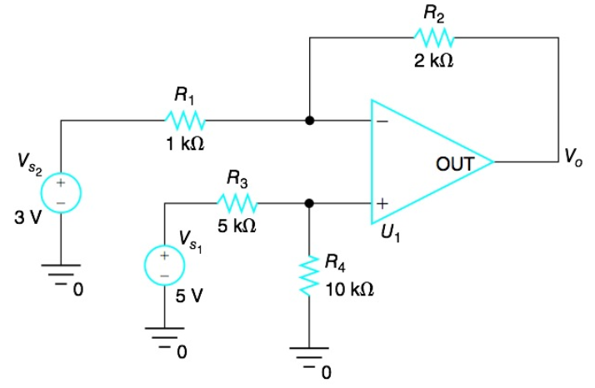
2 Sum and Difference
Find V0 in the circuit shown below

Slide 4
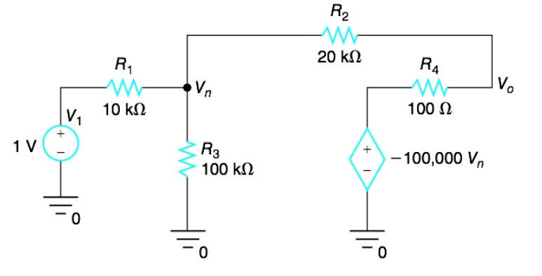
3 Inverting Configuration
Find V0 in the circuit shown below

Slide 5
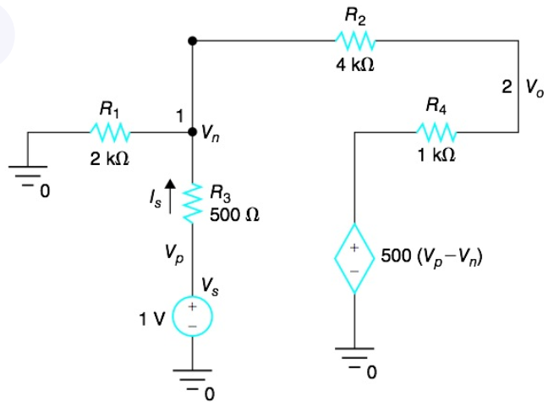
4 Noninverting Configuration
In the circuit below
(Questions are in the next page)

Slide 6
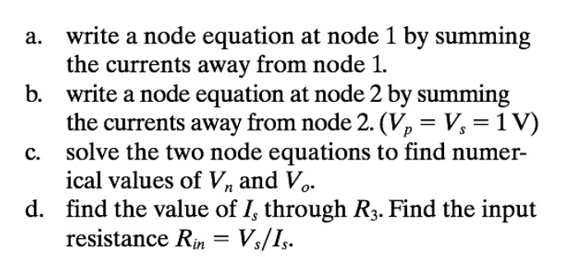
4 Noninverting Configuration

