Slide 1
Digital Logic Design and Application
Lab Course 2
Lecturer: 阎波
TA: 杜奇龙，蒋贤皓
Lab Room: 科B239

Slide 2
Grading
Assessment
Lab1 10% + Lab2 20% + Lab3 20% + Lab4 20% + Lab5 10% + Report1 5% + Repor2 15%
And for each lab:
Pre-Lab preparation and Performance in laboratory (65%)
Laboratory experimental reports (35%)

Slide 3
Requirements
1. Understand the working flow of CPU.
2. Consider about control signals needed in datapath module.
3. Finish the alu module based on the code given in txt.
4. Simulate and check the results.

Slide 4
Note
Please save the screenshots of the code, simulation result, etc.
You will need them to write the Lab_report.

Slide 5
Content
EDA tools
Datapath Design
Compose a specification for basic CPU: instruction set, etc;
Design ALU component;
Coding, Synthesis and simulate ALU component;
Controller Design
CPU Integration
CPU Verification and Improvement

Slide 6
Process to execute program
Fetch
Analysis
Execute
MOV 0x5C, R1
ADD R1, 0x2E, R1
Main memory
Address
Data
Decoder
1000
B0
④
④
④
④
1001
5C
Read
③
③
③
AB
③
1002
04
1003
2E
DB
Outside
Of CPU
⑤
⑤
⑤
⑤
Address Buffer
Data Buffer
Inside
of CPU
①
Internal CPU BUS
①
①
①
⑥
⑥
⑥
⑥
Program
Counter
Instruction
opcode, oprand
Register
File
R1
Temp
＋1
⑦
Instruction Decoder
ALU
②
②
②
②
Operation Controller
⑧
Status Register

Slide 7
CPU Organization
Datapath
ALU &
ALU MUX
CPU
Registers
Datapath
PC
Control
Unit
Control Unit
state_transition
IR

Slide 8
Top structure of our CPU
CPU
Data
path
Control
Unit
En_group, Reg_en
Regs control signals
Reg group
IR
Alu
Alu_in_sel Alu_in_sel
ALU control signals
Opcode
PC
State
transition
En_pc pc_ctrl
PC control signal
Alu_mux
Other signals

Slide 9
Instruction Set
Opcode | Rd | Rs | Imme | assembly | function
4bit | 2bit | 2bit | 8bit
0000 | 01 | xx | 00000010 | Mov R1 #02 | R1<= 2
0010 | 01 | xx | 00001000 | Add R1 #08 | R1<=(R1)+8
0101 | 01 | 10 | xxxxxxxx | Sub R1 R2 | R1<=(R1)-(R2)
0111 | 01 | 10 | xxxxxxxx | And R1 R2 | R1<= (R1) bit_and (R2)
1001 | 01 | 10 | xxxxxxxx | Or R1 R2 | R1<=(R1) bit_or (R2)
1010 | xx | xx | 00000001 | Jump #01 | PC<= 1
Opcode supports 16 instructions. So you can add other instructions, like shift, multiplication.
Rd and Rs can be expressed in 2 bits that means you can operate 4 registers.
Immediate data is expressed in 8 bits.

Slide 10
Instruction Set
Opcode | Rd | Rs | Imme | assembly | function
4bit | 2bit | 2bit | 8bit
0000 0001 | 01 10 | xx 01 | 00000010 xxxxxxxx | Mov R1 #02 Mov R2 R1 | R1<= 2 R2<=(R1)
0010 0011 | 01 01 | xx 10 | 00001000 xxxxxxxx | Add R1 #08 Add R1 R2 | R1<=(R1)+8 R1<=(R1)+(R2)
0101 | 01 | 10 | xxxxxxxx | Sub R1 R2 | R1<=(R1)-(R2)
0111 | 01 | 10 | xxxxxxxx | And R1 R2 | R1<= (R1) bit_and (R2)
1001 | 01 | 10 | xxxxxxxx | Or R1 R2 | R1<=(R1) bit_or (R2)
1010 | xx | xx | 00000001 | Jump #01 | PC<= 1
Opcode supports 16 instructions. So you can add other instructions, like shift, multiplication.
Rd and Rs can be expressed in 2 bits that means you can operate 4 registers.
Immediate data is expressed in 8 bits.

Slide 11
Datapath Design
pc_ctrl | pc_out
00 | pc_out
01 | pc_out + 1
10 | offset_addr

Slide 12
reg_group
rd/rs （read address） | rd_q/rs_q （read data）
00 | R0
01 | R1
02 | R2
03 | R3
reg_en （write address） | R0 | R1 | R2 | R3
0000 | R0 | R1 | R2 | R3
0001 | alu_out | R1 | R2 | R3
0010 | R0 | alu_out | R2 | R3
0100 | R0 | R1 | alu_out | R3
1000 | R0 | R1 | R2 | alu_out
others | error

Slide 13
ALU MUX
alu_in_sel | alu_a | alu_b
0 | Rd_q | offset
1 | Rd_q | Rs_q
alu_a can be get directly
always @( negedge rst or posedge clk )
begin
if(rst ==1'b0)
begin
alu_a <= xxx;
alu_b <= xxx;
en_out <= xxx;
end
else if(en_in == 1'b1)
begin
alu_a <= rd_q;
en_out <= 1'b1;
if(alu_in_sel ==1'b0)
alu_b <= xxx;
else
alu_b <= xxx; end
end

Slide 14
ALU
The function of ALU is determined by the instructions we have set.
alu_func | alu_out
000 | alu_b
001 | alu_a + alu_b
010 | alu_a - alu_b
011 | alu_a and alu_b
100 | alu_a or alu_b
case ( alu_fuction )
XXX
endcase

Slide 15
1. Create New Hardware Project
Follow the steps of lab1.ppt to create New Hardware Project

Slide 16
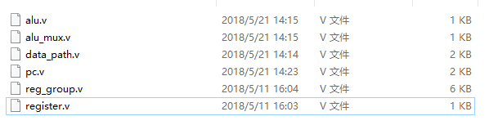
2. Create New Source File -step1
Add files in the code folder as following steps.

Slide 17
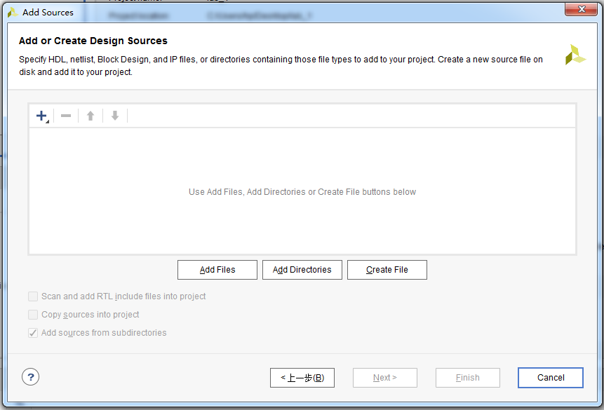
2. Create New Source File -step2
Click here

Slide 18
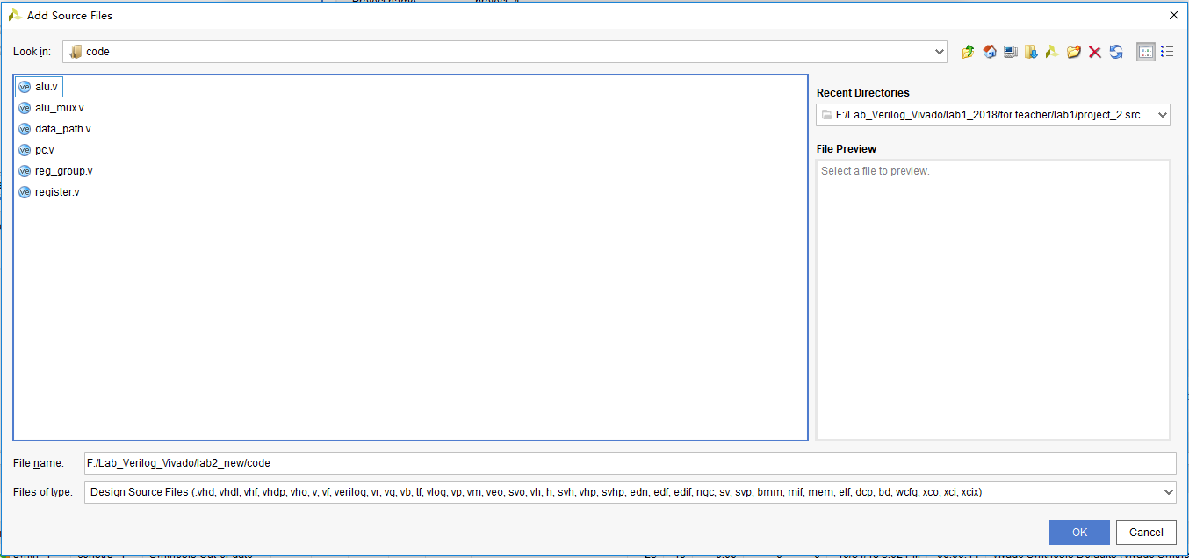
2. Create New Source File -step3
Find the code folder, and choose *.v file
Click here

Slide 19
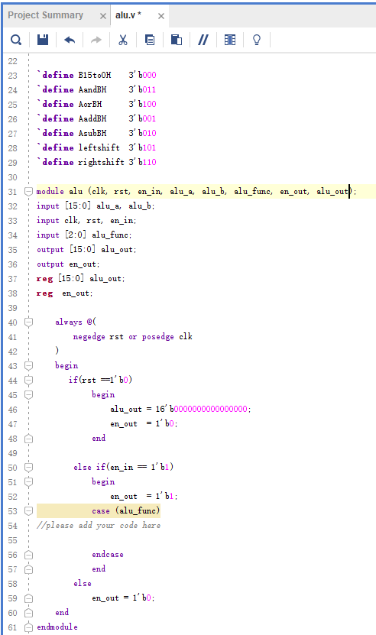
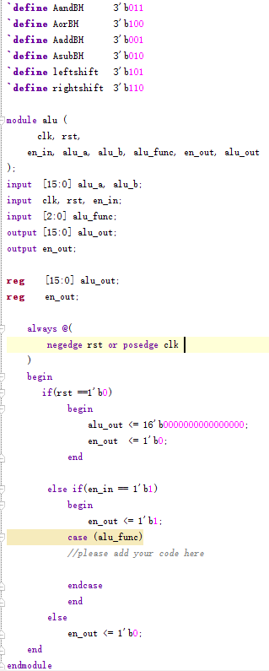
2. Create New Source File -step4
Complete the ALU module.

Slide 20
3. Do Synthesis and get the circuit
Follow the steps of lab1.ppt to do Synthesis and get the circuit

Slide 21
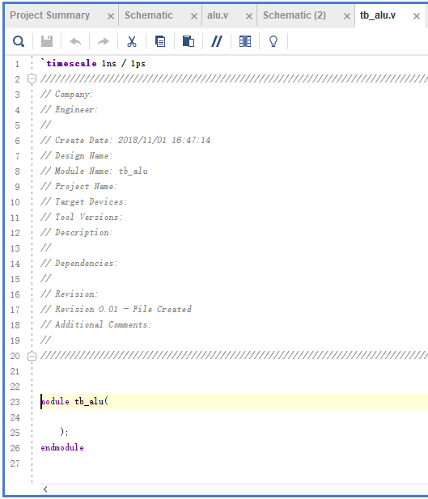
4. Create Simulation Source
File -step1
Copy the content in tb_alu.txt to this window, and complete the code

Slide 22
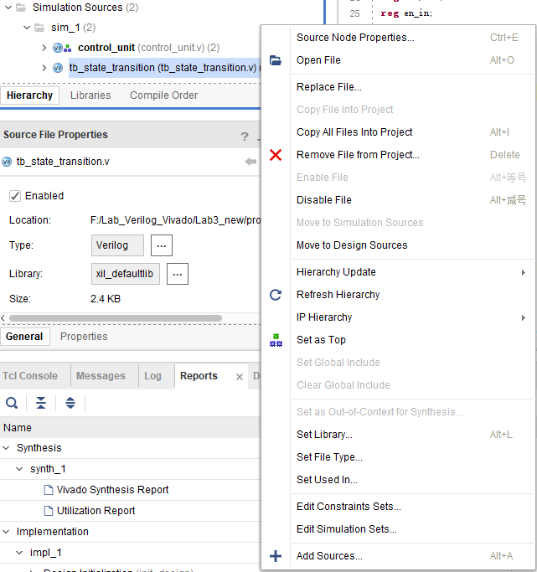
1.Right- click
4. Create Simulation Source
File
-step2
2.Click

Slide 23
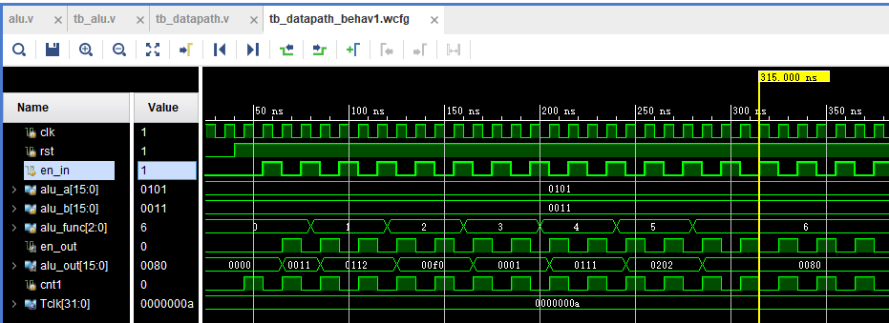
Observe the variation of signals. Make sure all of these are right.
4. Create Simulation Source
File
-step3

Slide 24
How to make a testbench
1、All the input should be given.
2、You need a clock, and how to create it?
3、With the time going, you can change your input.
4、Complete the testbench on the next page.

Slide 25
How to make a testbench
module tb_alu();
reg clk,rst,en_in;
reg [15:0] alu_a;
reg [15:0] alu_b;
reg [2:0] alu_func;
wire en_out;
wire [15:0] alu_out;
alu test_alu(
.clk (clk),
.rst (rst),
.en_in (en_in),
.alu_a (alu_a),
.alu_b (alu_b),
.alu_func (alu_func),
.en_out (en_out),
.alu_out (alu_out)
);
parameter Tclk = 10;
initial begin
clk=0;
forever #(Tclk/2) clk=~clk;
end
initial begin
rst=0;
#(Tclk*4) rst=1;
end
initial begin
alu_func = 3'b000 ;
#(Tclk*8) alu_func = 3'b001 ;
//please add rest code here
end
initial begin
alu_a = 16'b0000000100000001;
alu_b = 16'b0000000000010001;
end
reg cnt1;
always @ (posedge clk) begin
if(!rst)
cnt1 <= 1'd0;
else
cnt1 <= cnt1+1;
end
always @ (posedge clk) begin
if(!rst)
en_in <= 1'b0;
else if (cnt1==1'd1)
en_in <= 1'b1;
else
en_in <= 1'b0;
end
initial begin
#(Tclk*40) $stop;
end
endmodule

Slide 26
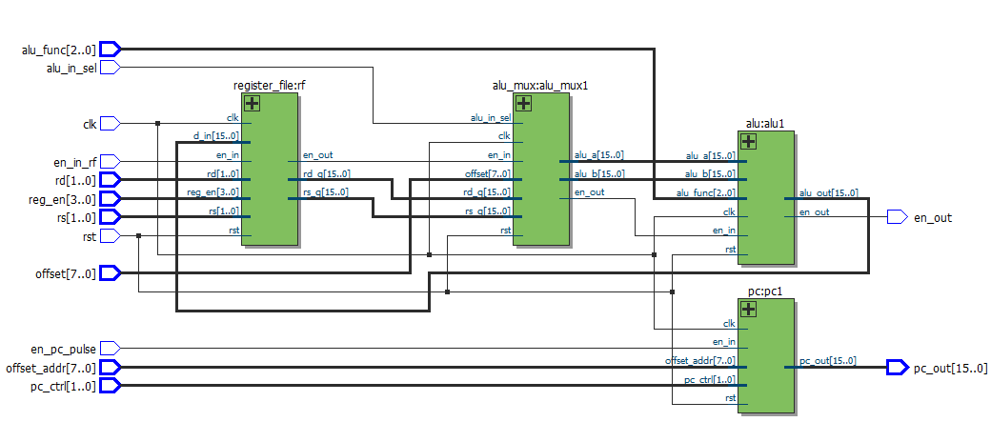
RTL of Datapath

Slide 27
Next Class
Finish the state_transition module based on the instruction set .
Do Simulation and check results.
Try to add some new instructions and complete the state state_transition module

Slide 28
Digital Logic Design and Application
Lab Course 2
~~End~~

