Slide 1
Digital Logic Design and Application
Lab Course 3
Lecturer:
TA:
Lab Room:

Slide 2
Requirements
1. Understand the function of the control unit in CPU.
2. Consider about the controller’s STG according to the ISA.
3. Finish the state_transition module based on the given codes .
4. Simulate and check the results.

Slide 3
Note
  Please save the screenshots of the code, simulation result, etc.
  You will need them to write the Lab_report.

Slide 4
Content
EDA tools
Datapath Design
Controller Design
  Understand the STG for control_unit ;
  Design state_transition component;
  Coding, Synthesis and simulate state_transition component;
CPU Integration
CPU Design Improvement

Slide 5
CPU Organization
Datapath
ALU &
ALU MUX
CPU
Registers
Datapath
PC
Control
Unit
Control Unit
state_
transition
IR

Slide 6
Top structure of our CPU
CPU
Data
path
Control
Unit
En_group, Reg_en
Regs control signals
Reg group
IR
Alu
Alu_in_sel Alu_in_sel
ALU control signals
Opcode
PC
State
transition
En_pc pc_ctrl
PC control signal
Alu_mux
Other signals

Slide 7
Instruction Set
Opcode | Rd | Rs | Imme | assembly | function
4bit | 2bit | 2bit | 8bit
0000 | 01 | xx | 00000010 | Mov R1 #02 | R1<= 2
0010 | 01 | xx | 00001000 | Add R1 #08 | R1<=(R1)+8
0100 | 01 | 10 | xxxxxxxx | Sub R1 R2 | R1<=(R1)-(R2)
0101 | 01 | 10 | xxxxxxxx | And R1 R2 | R1<= (R1) bit_and (R2)
0110 | 01 | 10 | xxxxxxxx | Or R1 R2 | R1<=(R1) bit_or (R2)
0111 | xx | xx | 00000001 | Jump #01 | PC<= 1
Opcode supports 16 instructions. So you can add other instructions, like shift, multiplication.
Rd and Rs can be expressed in 2 bits that means you can operate 4 registers.
Immediate data is expressed in 8 bits.

Slide 8
Instruction Set
Opcode | Rd | Rs | Imme | assembly | function
4bit | 2bit | 2bit | 8bit
0000 0001 | 01 10 | xx 01 | 00000010 xxxxxxxx | Mov R1 #02 Mov R2 R1 | R1<= 2 R2<=(R1)
0010 0011 | 01 01 | xx 10 | 00001000 xxxxxxxx | Add R1 #08 Add R1 R2 | R1<=(R1)+8 R1<=(R1)+(R2)
0100 | 01 | 10 | xxxxxxxx | Sub R1 R2 | R1<=(R1)-(R2)
0101 | 01 | 10 | xxxxxxxx | And R1 R2 | R1<= (R1) bit_and (R2)
0110 | 01 | 10 | xxxxxxxx | Or R1 R2 | R1<=(R1) bit_or (R2)
0111 | xx | xx | 00000001 | Jump #01 | PC<= 1
Opcode supports 16 instructions. So you can add other instructions, like shift, multiplication.
Rd and Rs can be expressed in 2 bits that means you can operate 4 registers.
Immediate data is expressed in 8 bits.

Slide 9
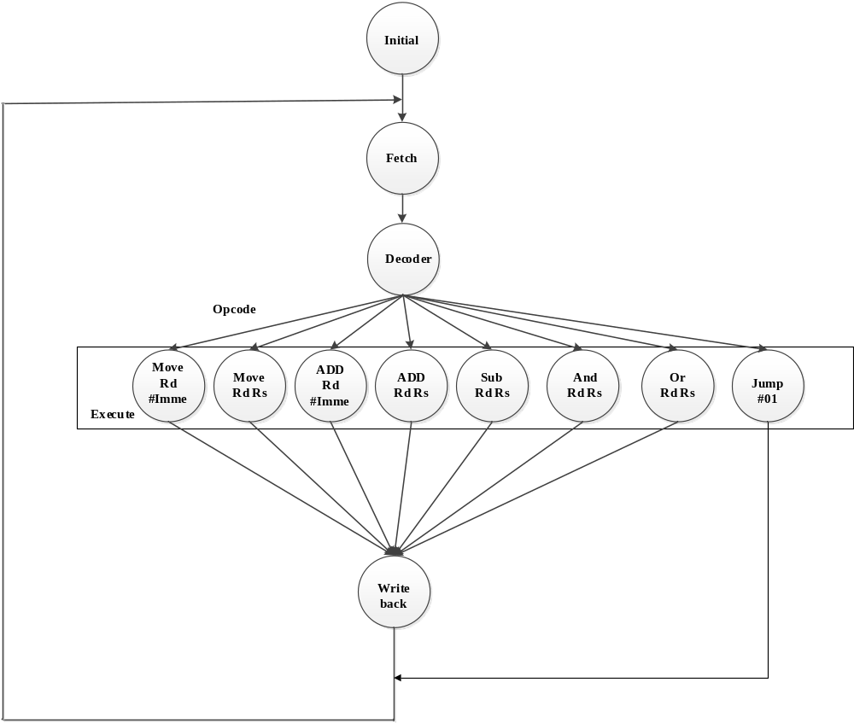
State transition

Slide 10
Control signals & state signal meaning
Control signals
Reg_group
en_group: enable signal, whether get datas from register group
reg_en: enable signal, means whether enable 4 registers to store datas to registers
Alu_mux
alu_in_sel: think about in the previous class
Alu
alu_in_func: think about in the previous class
PC
en_pc: enable signal, whether enable pc unite
pc_ctrl: mux signal, if pc_ctrl = 00 means pc_out <= pc_out ;
if pc_ctrl = 01 means pc_out <= pc_out +1;
if pc_ctrl = 10 means pc_out <= offset;
State signal
en_alu: enable signal, whether the datapath is completed

Slide 11
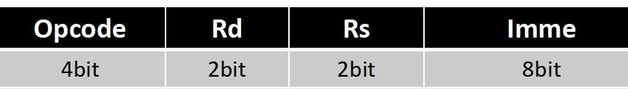
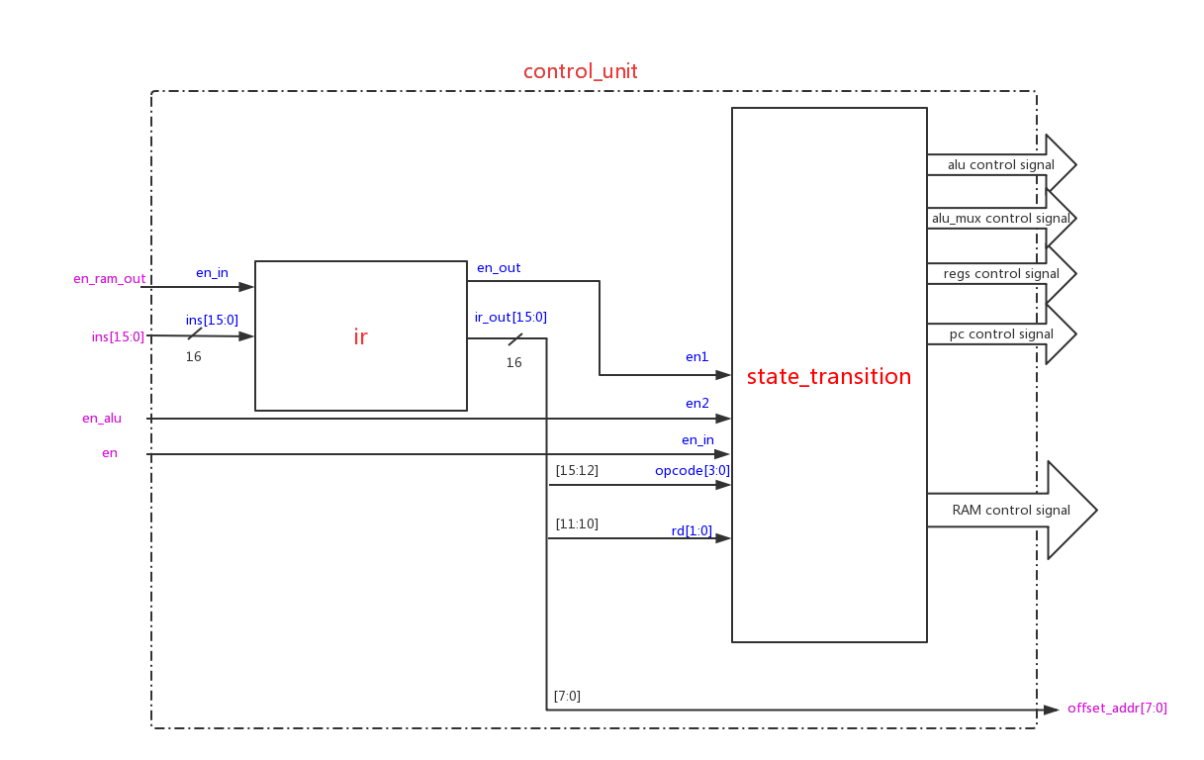
Controller Design

Slide 12
1. Create New Hardware Project
Follow the steps of lab1.ppt to create New Hardware Project

Slide 13

2. Create New Source File
-step1
Add files in the code folder as following steps.

Slide 14
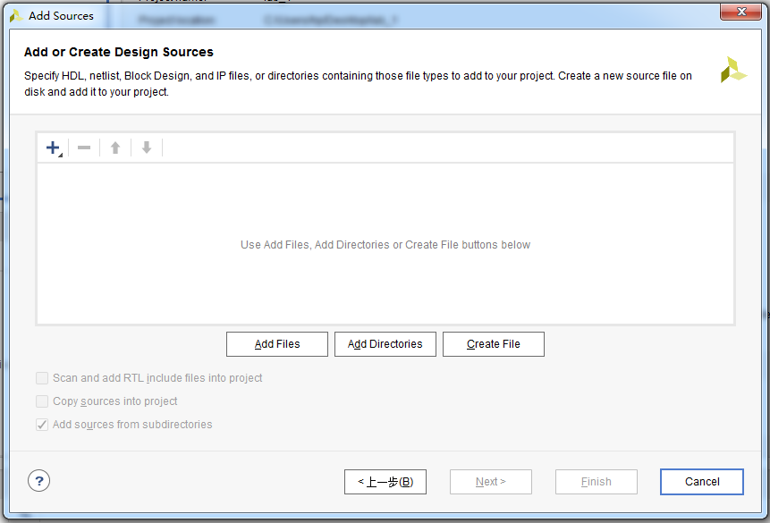
2. Create New Source File
-step2
Click here

Slide 15
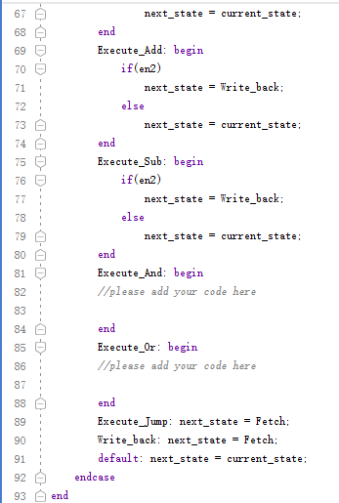
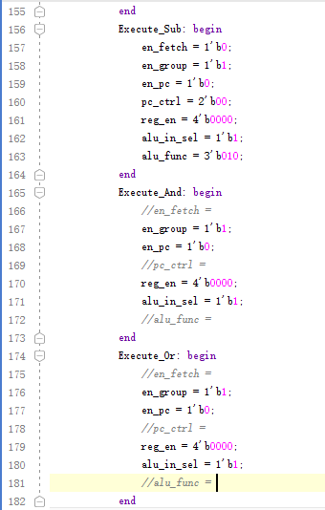
2. Create New Source File
-step3
Refer to the next page to complete the state_transition module.

Slide 16
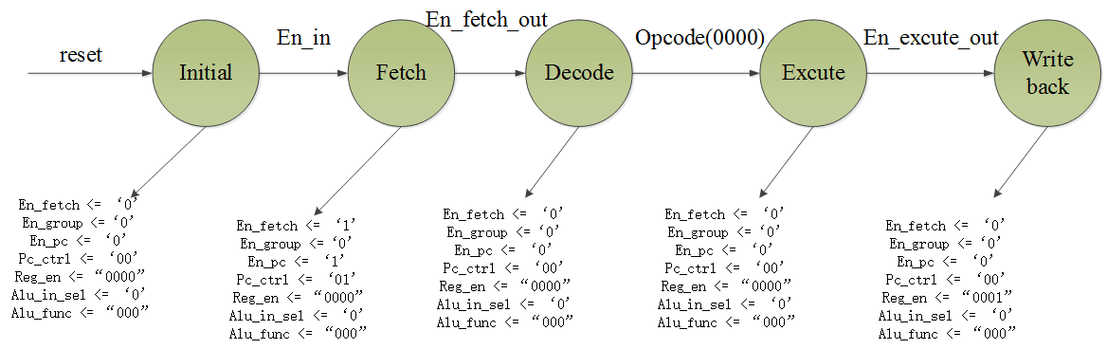
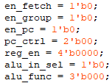
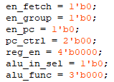
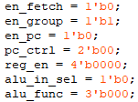
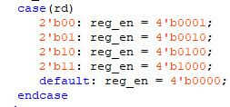
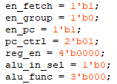
2. Create New Source File
-step4
en_in
en1
en2

Slide 17
3. Do Synthesis and get the circuit
Follow the steps of lab1.ppt to do Synthesis and get the circuit

Slide 18
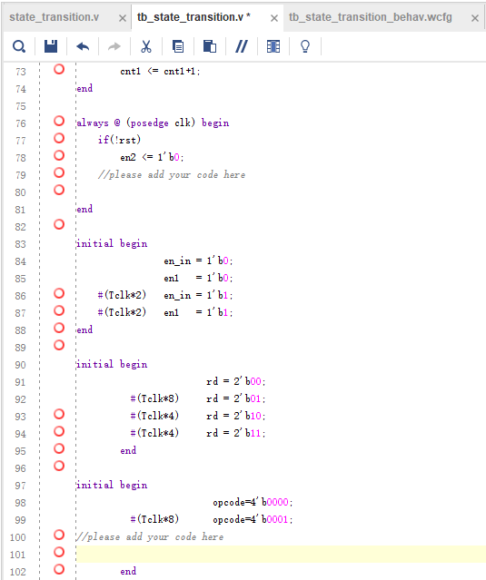
4. Create Simulation Source
File
-step1
Copy the content in tb_state_transition.txt to this window, and complete the code

Slide 19
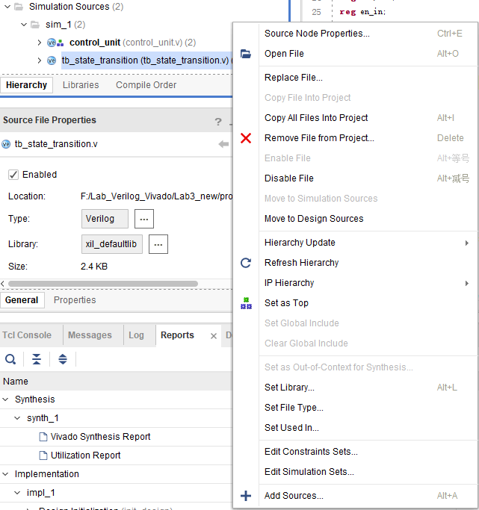
1.Right- click
4. Create Simulation Source
File
-step2
2.Click

Slide 20
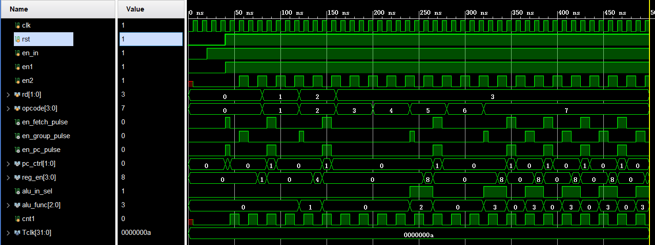
Run simulation and observe the variation of signals. Make sure all of these are right.
4. Create Simulation Source
File
-step3

Slide 21
Digital Logic Design and Application
Lab Course 3
~~End~~

