Slide 1
Digital Logic Design and Application
Lab Course 4
Lecturer: 阎波
TA: 杜奇龙，蒋贤皓
Lab Room: 科B239

Slide 2
Grading
Assessment
Lab1 10% + Lab2 20% + Lab3 20% + Lab4 20% + Lab5 10% + Report1 5% + Repor2 15%
And for each lab:
Pre-Lab preparation and Performance in laboratory (65%)
Laboratory experimental reports (35%)

Slide 3
Note
Please save the screenshots of the code, simulation result, etc.
You will need them to write the Lab_report.

Slide 4
Content
EDA tools ( testbench)
Datapath Design
Controller Design
CPU Integration
Combine the datapath and the controller;
Synthesis;
Compose the testbench and do simulation.
CPU Verification and Improvement

Slide 5
CPU Organization
Datapath
ALU
CPU
Registers
Datapath
PC
Control
Unit
Control Unit
state_transition
IR

Slide 6
Top structure of our CPU
CPU
Data
path
Control
Unit
En_group, Reg_en
Regs control signals
module cpu(....);
input XXXX
output XXXX
wire XXXX
reg XXXX
data_path data_path1 (XXXX);
control_unit1(XXXX);
endmodule
Reg group
IR
Alu
Alu_in_sel Alu_in_sel
ALU control signals
Opcode
PC
State
transition
En_pc pc_ctrl
PC control signal
Alu_mux
Other signals

Slide 7
Instruction Set
Opcode | Rd | Rs | Imme | assembly | function
4bit | 2bit | 2bit | 8bit
0000 | 01 | xx | 00000010 | Mov R1 #02 | R1<= 2
0010 | 01 | xx | 00001000 | Add R1 #08 | R1<=(R1)+8
0101 | 01 | 10 | xxxxxxxx | Sub R1 R2 | R1<=(R1)-(R2)
0111 | 01 | 10 | xxxxxxxx | And R1 R2 | R1<= (R1) bit_and (R2)
1001 | 01 | 10 | xxxxxxxx | Or R1 R2 | R1<=(R1) bit_or (R2)
1010 | xx | xx | 00000001 | Jump #01 | PC<= 1
Opcode supports 16 instructions. So you can add other instructions, like shift, multiplication.
Rd and Rs can be expressed in 2 bits that means you can operate 4 registers.
Immediate data is expressed in 8 bits.

Slide 8
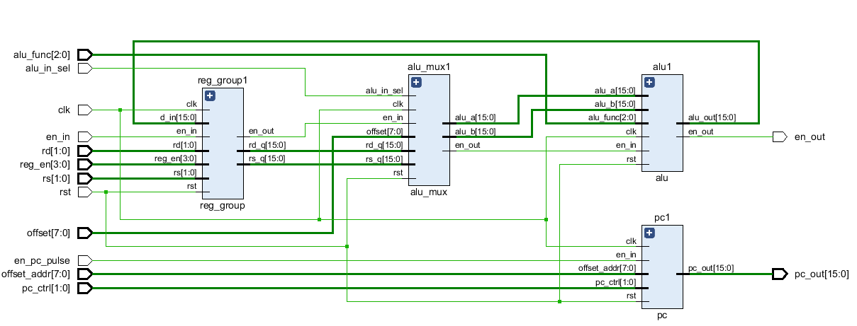
Block design for Datapath

Slide 9
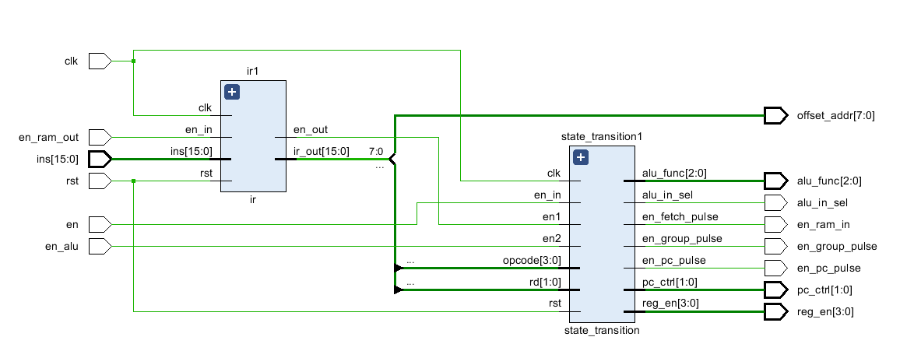
Block design for Control_unit

Slide 10
1. Create New Hardware Project
Follow the steps of lab1.ppt to create New Hardware Project

Slide 11
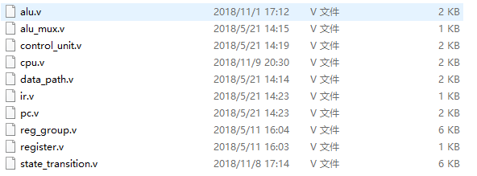
Follow the steps of lab2.ppt to add files in the code folder
2. Create New Source File -step1

Slide 12
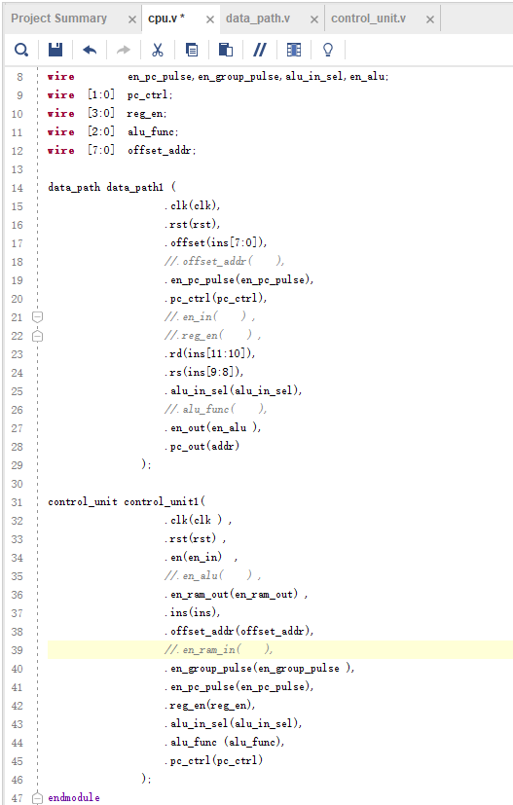
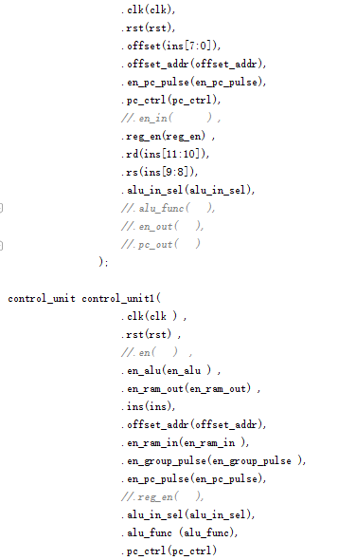
Refer to the next page to combine data_path and control_unit in cpu.v
2. Create New Source File -step2

Slide 13
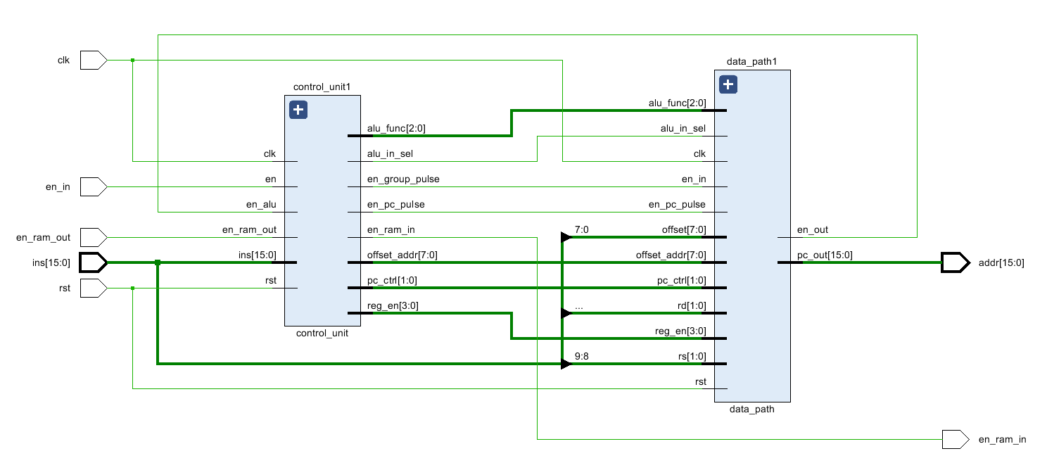
2. Create New Source File -step3

Slide 14
3. Do Synthesis and get the circuit
Follow the steps of lab1.ppt to do Synthesis and get the circuit

Slide 15
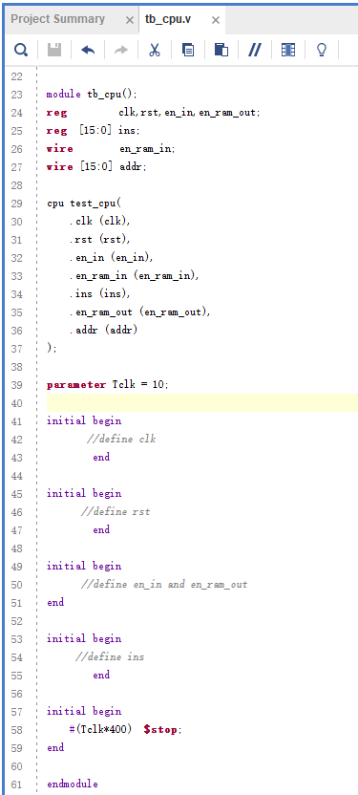
4. Create Simulation Source
File -step1
Copy the content in tb_cpu.txt to this window, and complete the code.
You can refer to previous test bench.

Slide 16
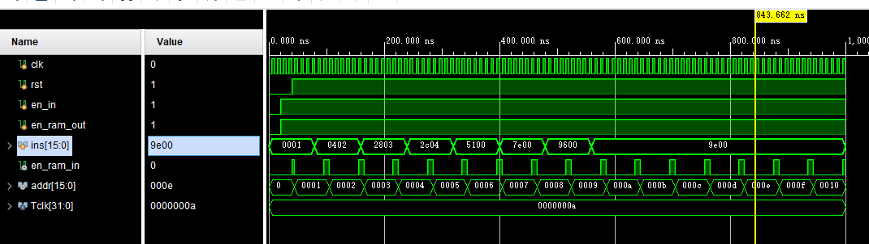
Run simulation and observe the variation of signals. Make sure all of these are right.
4. Create Simulation Source
File
-step2

Slide 17
Digital Logic Design and Application
Lab Course 4
~~End~~

