Slide 1
Digital Logic Design and Application
Lab Course 5
Lecturer:
TA:
Lab Room:

Slide 2
Laboratory Grading
Assessment:
Lab1 15% + Lab2 25% + Lab3 25% + Lab4 25% + Lab5 10%
And for each lab:
Pre-Lab preparation and Performance in laboratory (65%)
Laboratory experimental reports (35%)

Slide 3
Content
EDA tools
Datapath Design
Controller Design
CPU Integration
CPU Design Improvement
Verify the CPU on the FPGA board;
Add the instruction and check the results.

Slide 4
CPU Organization
Datapath
ALU
CPU
Registers
Datapath
PC
Control
Unit
Control Unit
state_transition
IR

Slide 5
Top structure of our CPU
CPU
Data
path
Control
Unit
En_group, Reg_en
Regs control signals
Reg group
IR
Alu
Alu_in_sel Alu_in_sel
ALU control signals
Opcode
PC
State
transition
En_pc pc_ctrl
PC control signal
Alu_mux
Other signals

Slide 6
Minimum CPU system
Stored program instructions
Provide clock signal
signal | direction | width | fucnation
clk | I | 1 | clock signal
rst | I | 1 | active-low reset
addr | I | 16 | address signal
en_ram_in | I | 1 | active-high
ins | O | 16 | data signal
en_ram_out | O | 1 | active-high
signal | direction | fucnation
clk_in1 | I | input clock signal
resetn | I | active-low reset
clk_out1 | O | output clock signal
locked | O | output clock signal valid

Slide 7
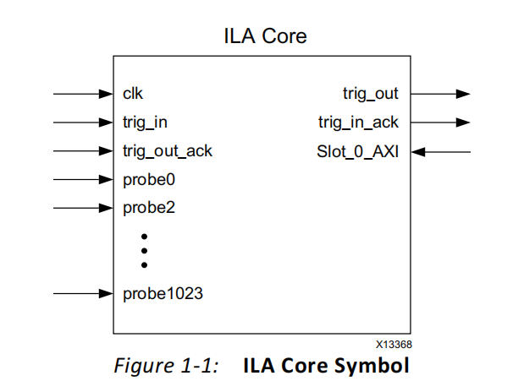
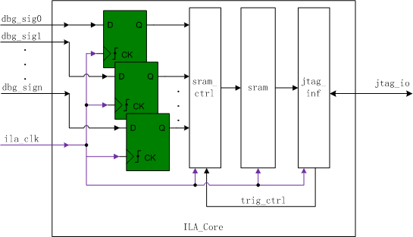
ILA-Integrated logic analyzer

Slide 8
ILA-Integrated logic analyzer
FPGA

Slide 9
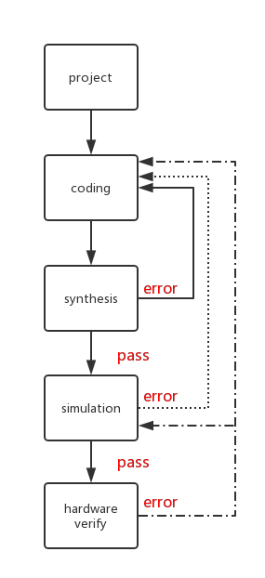
FPGA Design Flow

Slide 10
1. Create New Hardware Project
Follow the steps of lab1.ppt to create New Hardware Project.

Slide 11
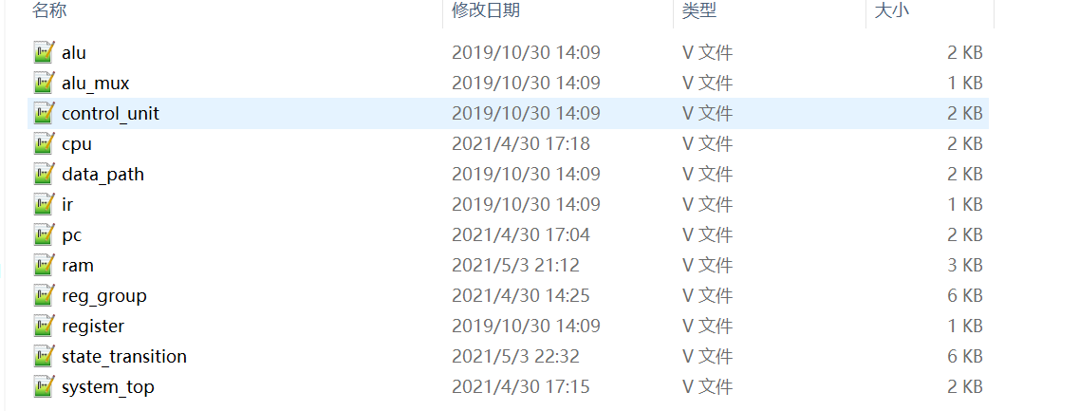
Follow the steps of lab2.ppt to add files in the code folder
2. Create New Source File -step1

Slide 12
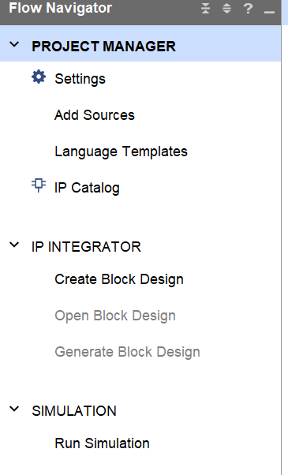
3. ADD
IP CORE
-step1-1
1. Left-click

Slide 13
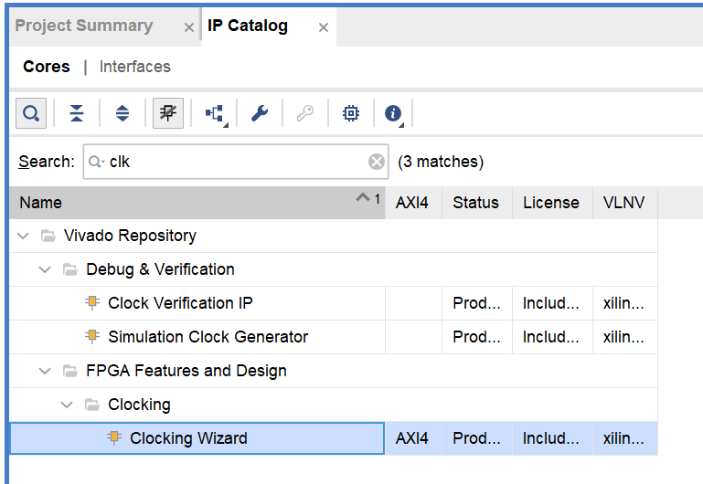
3. ADD
IP CORE
-step1-2
1. Input name to search IP cores
2. Double click

Slide 14
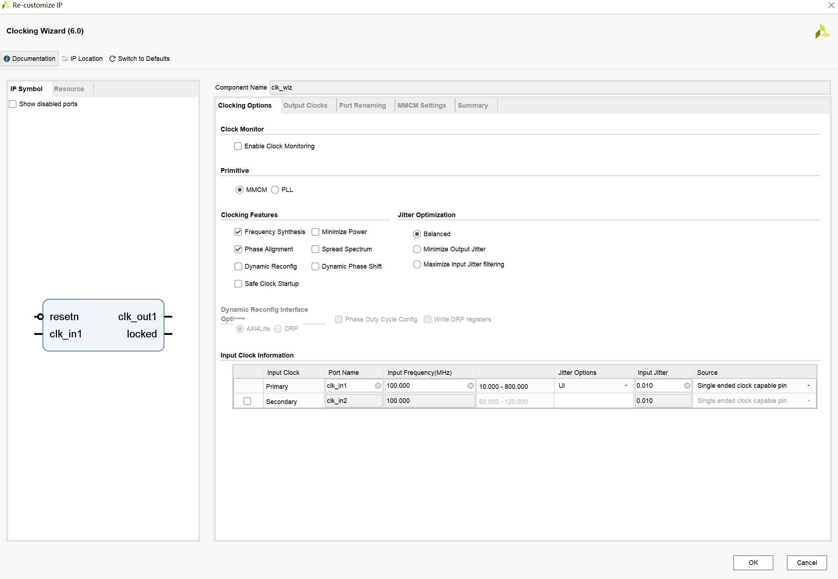
1. Module’s name
3. ADD
IP CORE
-step1-3
2. Input clock

Slide 15
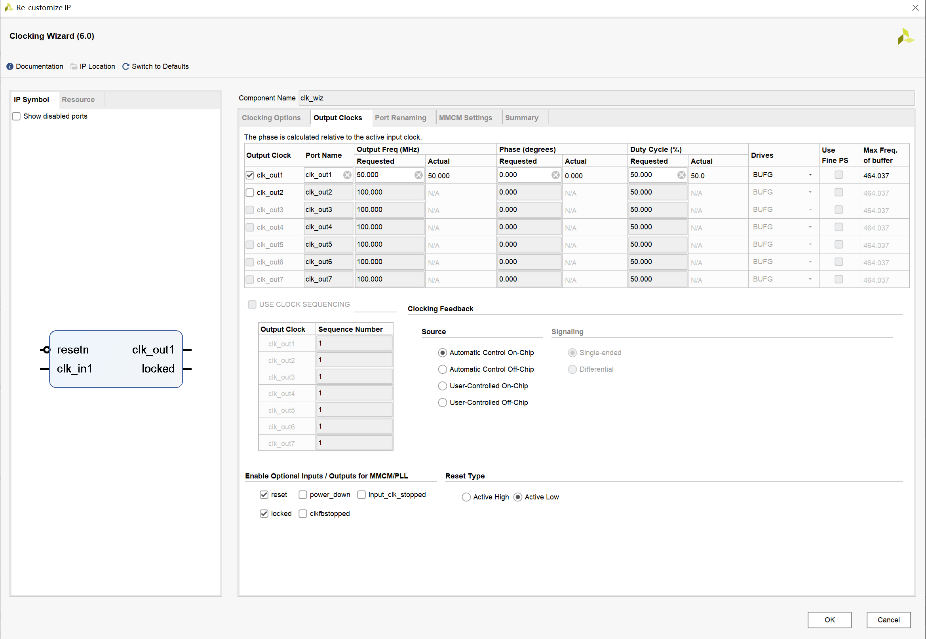
3. ADD
IP CORE
-step1-4
1. Output clock
2. Active-low
3. Click ok

Slide 16
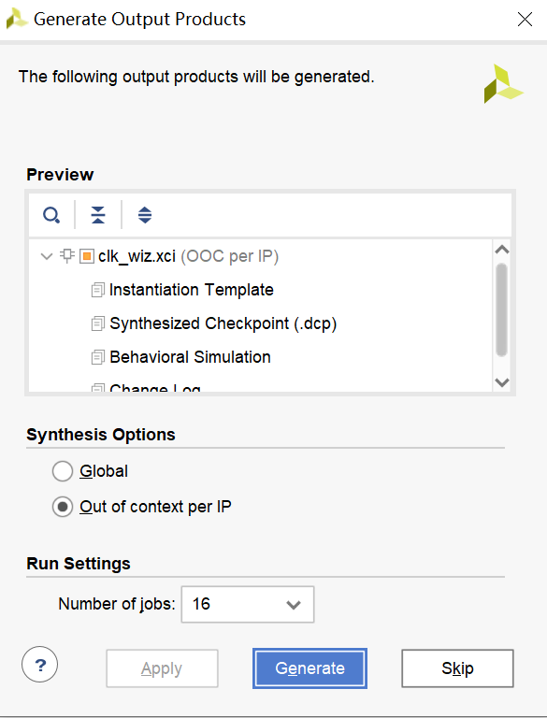
3. ADD
IP CORE
-step1-5
1. Generate the IP core

Slide 17
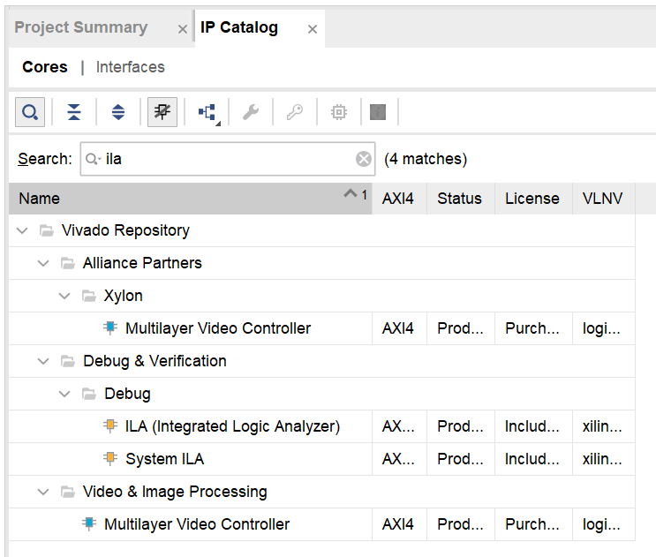
3. ADD
IP CORE
-step2-1
1. Input name to search IP cores
2. Double click

Slide 18
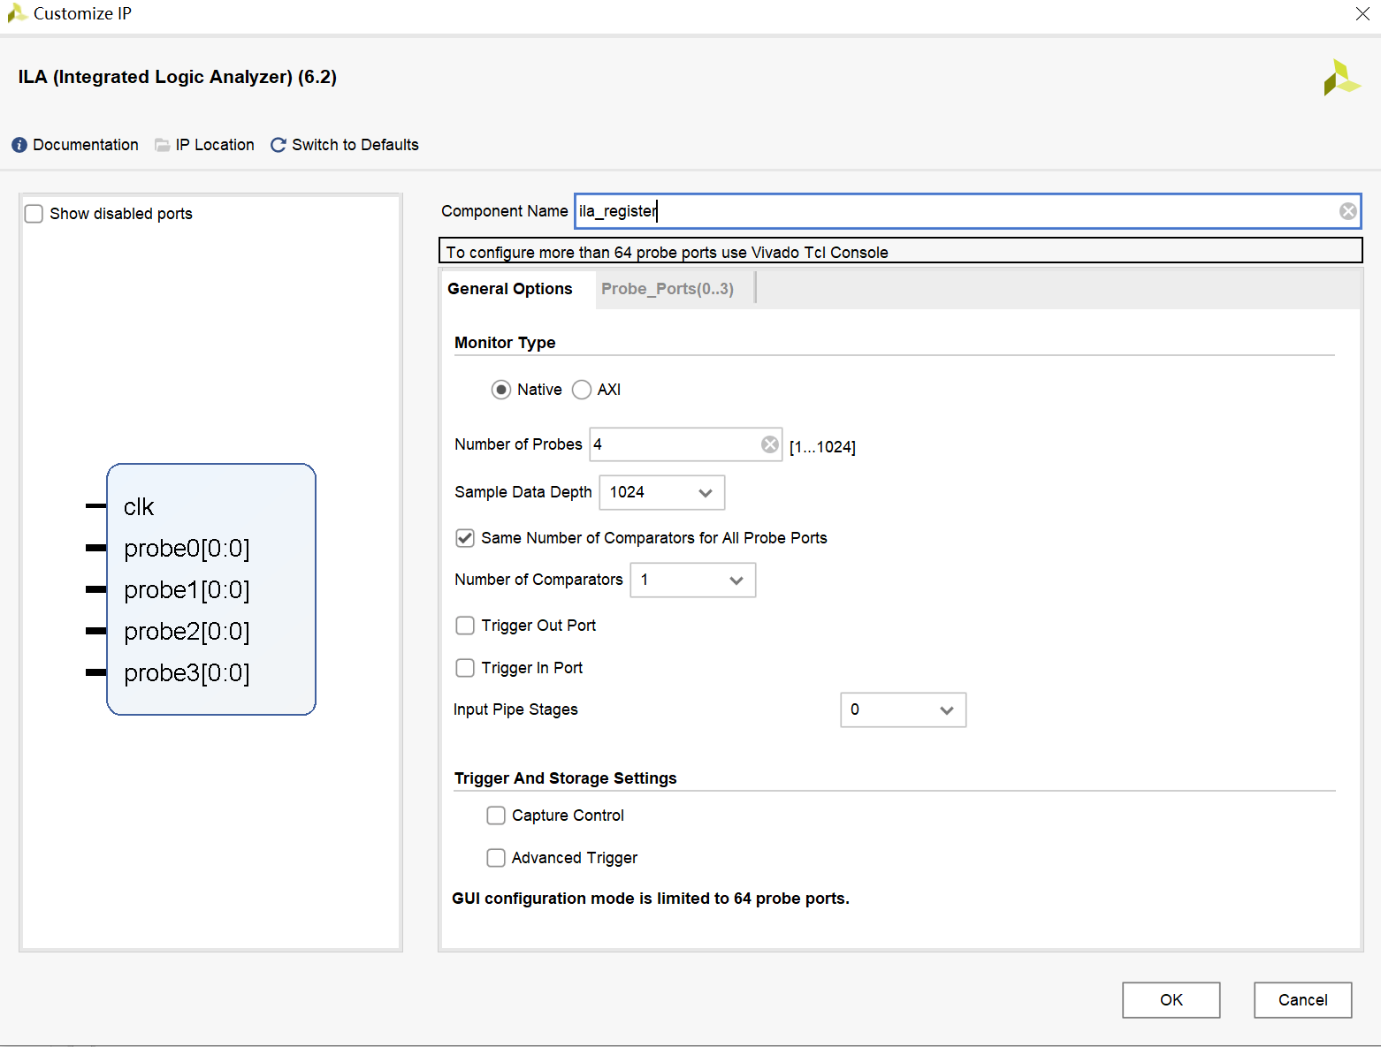
1. Module’s name
3. ADD
IP CORE
-step2-2
2. Input parameter

Slide 19
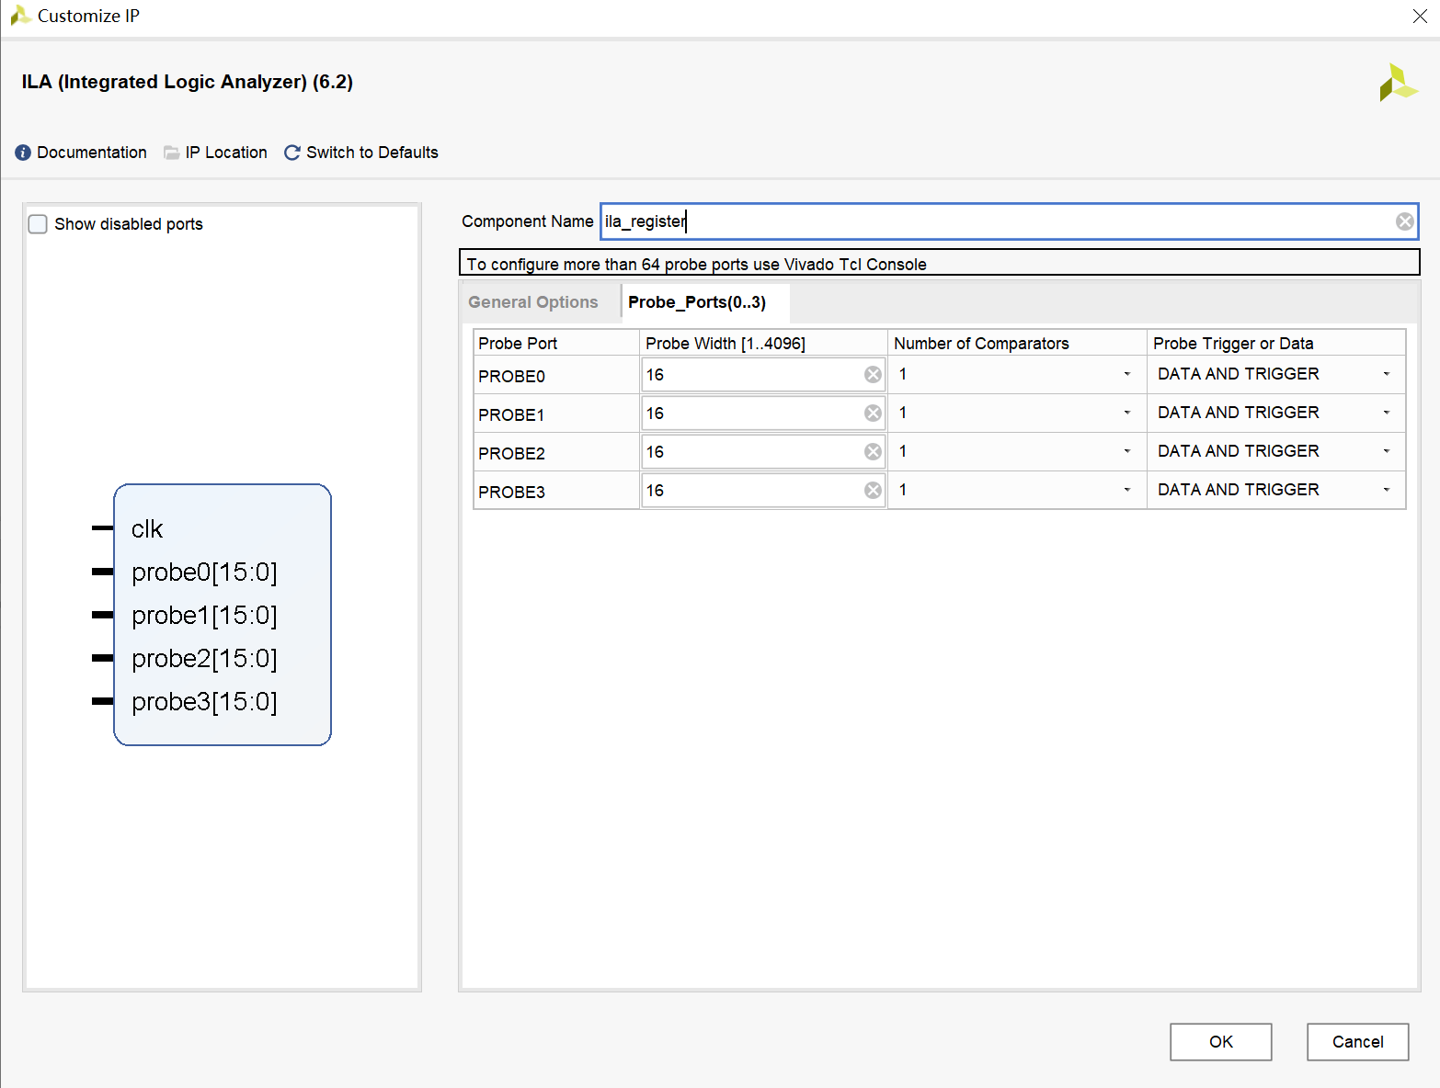
3. ADD
IP CORE
-step2-3
1. Input parameter
2. Click ok

Slide 20
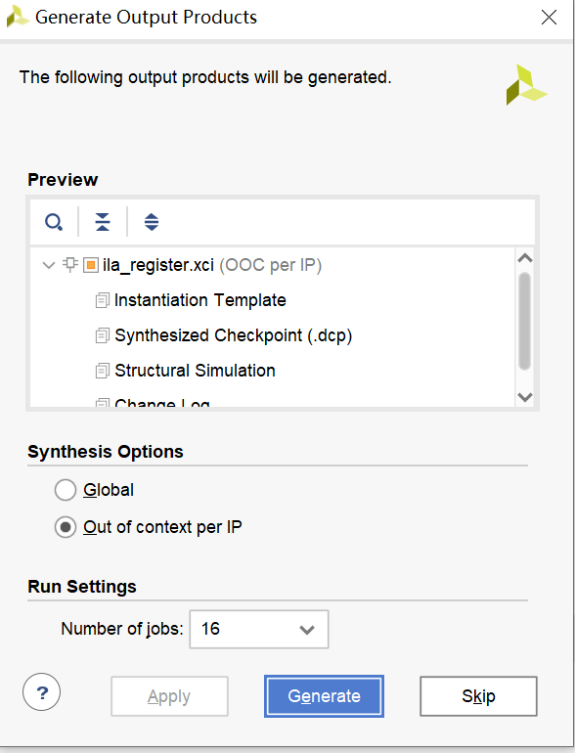
3. ADD
IP CORE
-step2-4
1. Generate the IP core

Slide 21
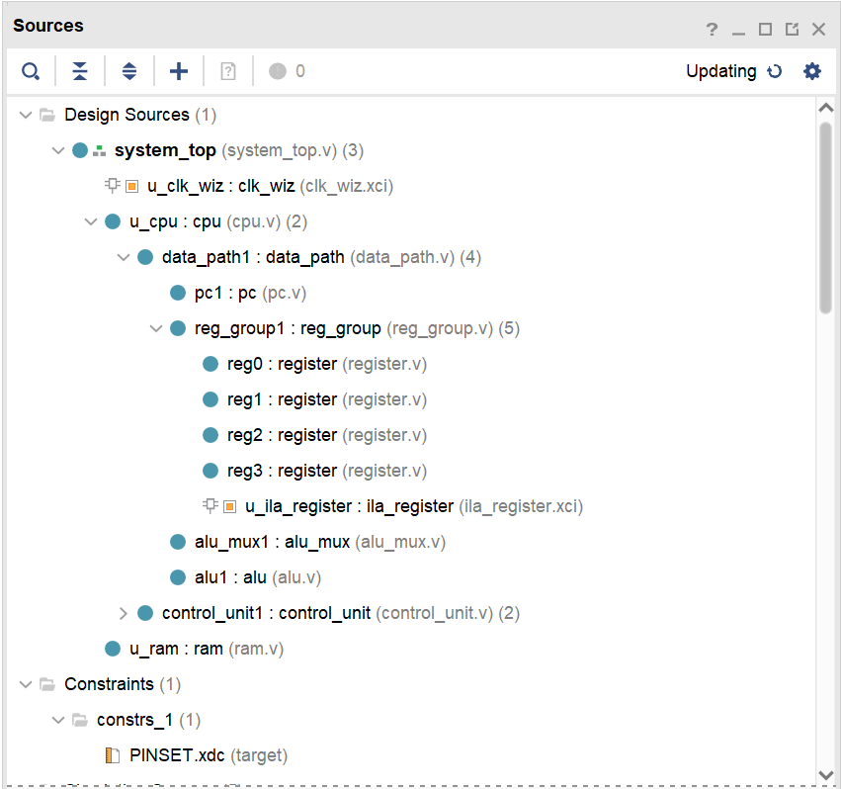
4. Verify
Design Sources

Slide 22
4. Do Synthesis and get the circuit
Follow the steps of lab1.ppt to do Synthesis and get the circuit.

Slide 23
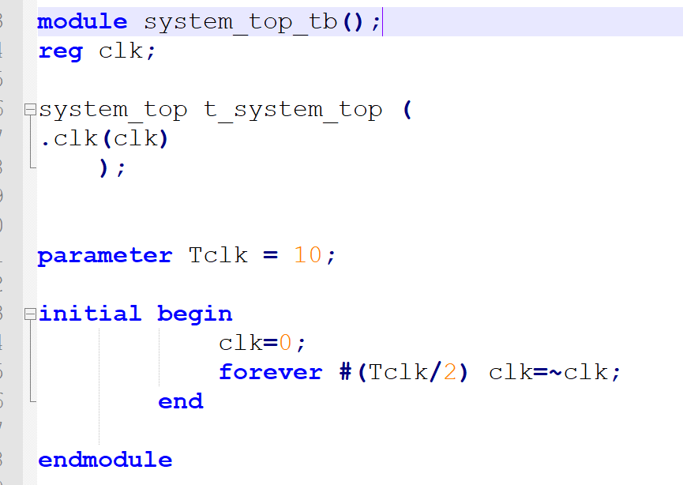
Copy the content in system_top_tb.v
5. Create Simulation Source
File
-step1

Slide 24
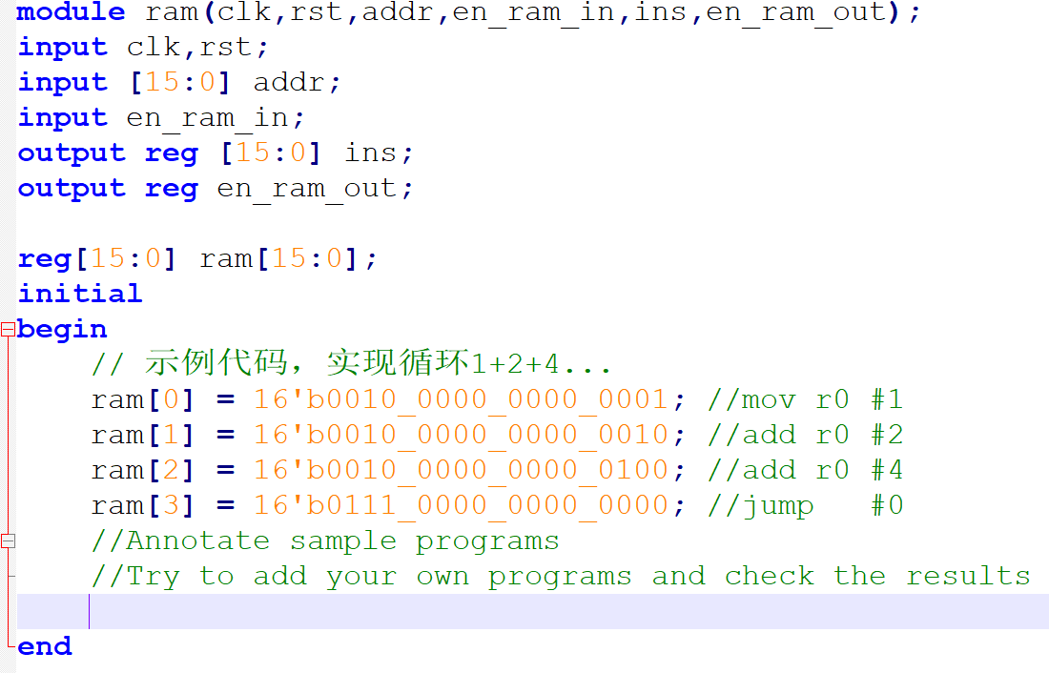
Run the sample program or your own program
5. Create Simulation Source
File -step2

Slide 25
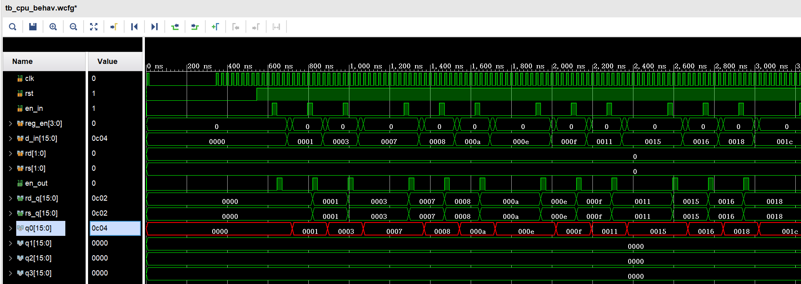
Run simulation and observe the variation of signals. Make sure all of these are right.
5. Do the simulation and debug.

Slide 26
FPGA Design Flow

Slide 27
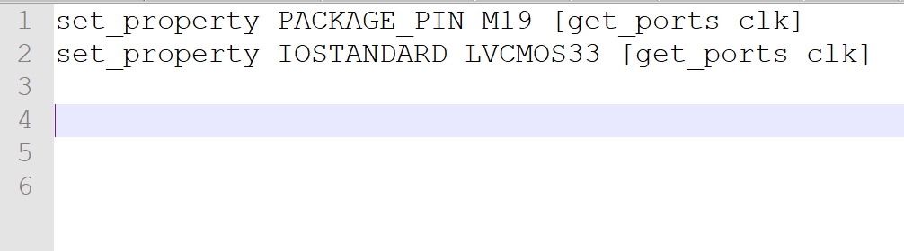
6. Create Constraint Source
File
Follow the steps of lab1.ppt

Slide 28
7. Generate Bitstream
File for FPGA
Follow the steps of lab1.ppt

Slide 29
8.Connect FPGA Target Board With Computer and program device
Follow the steps of lab1.ppt

Slide 30
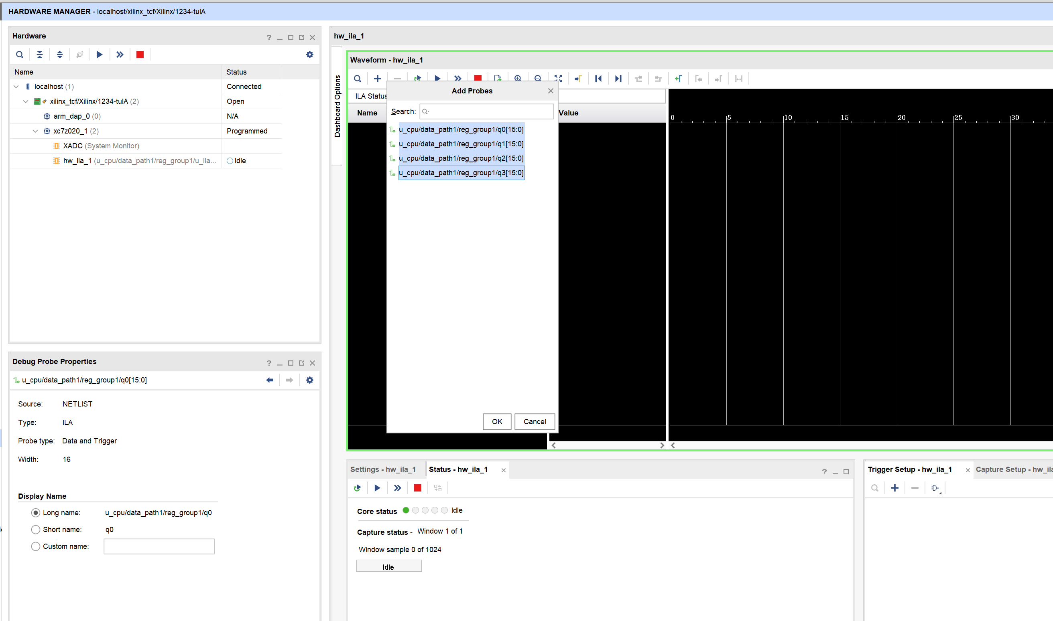
2. Add signals
9. Run ila to see the data in the registers
-step1
1. Select the ila
3. Select all
4. Click ok

Slide 31
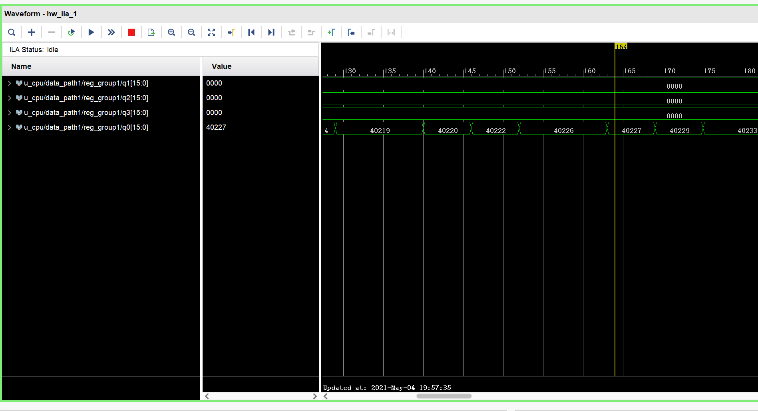
1. Run the ila
9. Run ila to see the data in the registers
-step2
2. See the data in register q0

Slide 32
EXPAND
Try to add one of the following instructions and simulate
Opcode 4bit | Rd 2bit | Rs 2bit | Imme 8bit | Assemble Instruction | Example
0001 | 10 | 01 | xxxxxxxx | 00011001xxxxxxxx | R2<=(R1)
0011 | 01 | 10 | xxxxxxxx | 00110110xxxxxxxx | R1<=(R1)+(R2)
1000 | 01 | xx | 00001010 | 100001xx00001010 | R1<=R1 bit_or Im
1001 | 10 | 01 | xxxxxxxx | 11011001xxxxxxxx | R2<=R2 xor R1

Slide 33
Add the instruction and simulate
· Implement the Instruction
add new state in state_transition
Add function in alu
· Design your own testBench
· Simulate that and check the results

Slide 34
Digital Logic Design and Application
Lab Course 5
~~End~~

