Slide 1


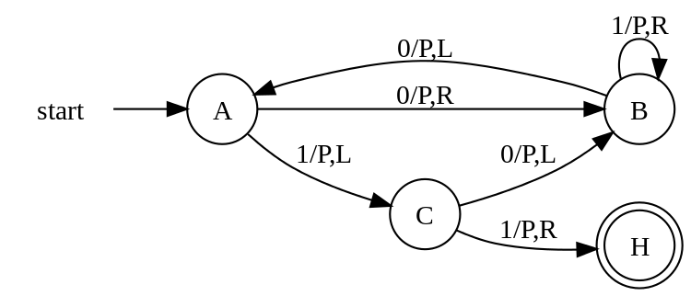
Digital Logic Design and Application
Review Yan Bo
School of Information & Communication Engineering, UESTC
Email: yanboyu@uestc.edu.cn

Slide 2
Grading
Homework: 5%
Lab 20%
Final examination: 75%
Date: ？Jun 2021
Time: ？
Content: 25’ * 4 Questions
Q1 Multiple choice questions
Q2~Q4 Analysis & Design

Slide 3
Key Points
Analogue system & digital system
Numerical system and Logical Operation
Digital/logic design, including combinational circuits, sequential circuits, and timing analysis
Verilog Hardware Description Language
Electronic Design Automation tools
Von Neumann Computer architecture
CPU architecture, including datapath and controller
CPU design & implement , including specification, partition& verification

Slide 4
From Boolean Algebra to CPU
Specification： define ISA
Top-design：
Port
Datapath＋Controller＋Interconnect
Submodule-design according to ISA
Testbench, performance assessment
Central Process Unit
TEST
Datapath
(ALU, MUX…)
Controller
(State Machine)
STG, State transition/Output table
Design for Sequential Circuit
F/F＋Combinational circuit
On-shelf chips: shift register, counter
HDL & EDA
Analysis for Sequetial Circuit
Analogy feature：
key path，setup time, hold time
Combinational Circuit
Sequential
Circuit
Truth table, K-map, logic expression
Design for Combinational circuit
Gates
On-shelf chip: Decoder, MUX
HDL & EDA
Analysis for Combination Circuit
Analogy feature: hazard
Gates
1.Basic gates
2.Mninal complete set
3.Analogy feature:noise margin,fan in/out
Boolean Algebra
1.Notation of number, base conversion
2. Laws of Boolean algebra

Slide 5
From Boolean Algebra to CPU
Central Process Unit
规格定义： 指令集ISA
顶层设计：
Port，
Datapath＋Controller＋Interconnect
子模块设计：根据ISA分别设计
设计验证：testbench设计，性能评估
TEST
Datapath
(ALU, MUX…)
Controller
(State Machine)
Sequential
Circuit
基本描述方法：STG, 状态转移/输出表
时序电路设计方法
用DFF＋组合电路实现
用已有模块搭建：移位寄存器，计数器
HDL语言描述，综合
时序电路分析方法
电路模拟特性：关键路径, 建立/保持时间
Combinational Circuit
基本描述方法：真值表，K图，逻辑式
组合电路设计方法
用门电路实现
用已有模块搭建：级联，译码器，复用器
HDL语言描述，综合
组合电路分析方法
电路模拟特性：竞争冒险
Gates
1.基本门；
2.最小完全集：电路形式的变换；
3.门的模拟特性：噪声容限，扇入，扇出
Boolean Algebra
1.数的表示法，不同进制之间的转换；
2.布尔代数的公理、常用定理；

Slide 6
Digital system & Analogue system: review the base conversion
Binary to Decimal
Expanded form of polynomial representation
Homework chap2
Perform the following expression.
1101 1110₂ -0011 0010₂ = (1010 1100) ₂ = ( AC ) ₁₆ = ( 254 ) ₈ = ( -84 )decimal signed number
Carry/Borrow bit= ( 0 )
Overflow bit= ( 0 )
(1101.01)₂ = ( )₁₀
13.25
= 1x2³ + 1x2² + 0x2¹ + 1x2⁰ + 0x2⁻¹ + 1x2⁻²
= (8)₁₀ + (4)₁₀ + 0 + (1)₁₀ + 0 + (0.25)₁₀
Decimal to Binary
Radix Divide for integer part
Radix Multiply for fraction part
.101
(13.625)₁₀＝ ( )₂
1101
0.625
2
13
1
×
2
2
6
0
1.250
Remainder
Integer
×
2
2
3
1
0.500
2
1
1
×
2
8421BCD, Gray……?
0
integer
fraction
1.000
Notes:
Positional Notation--Each bit has a value based on its position
Polynomial Notation (Series Representation)
二进制-十进制
二进制-其它进制

Slide 7
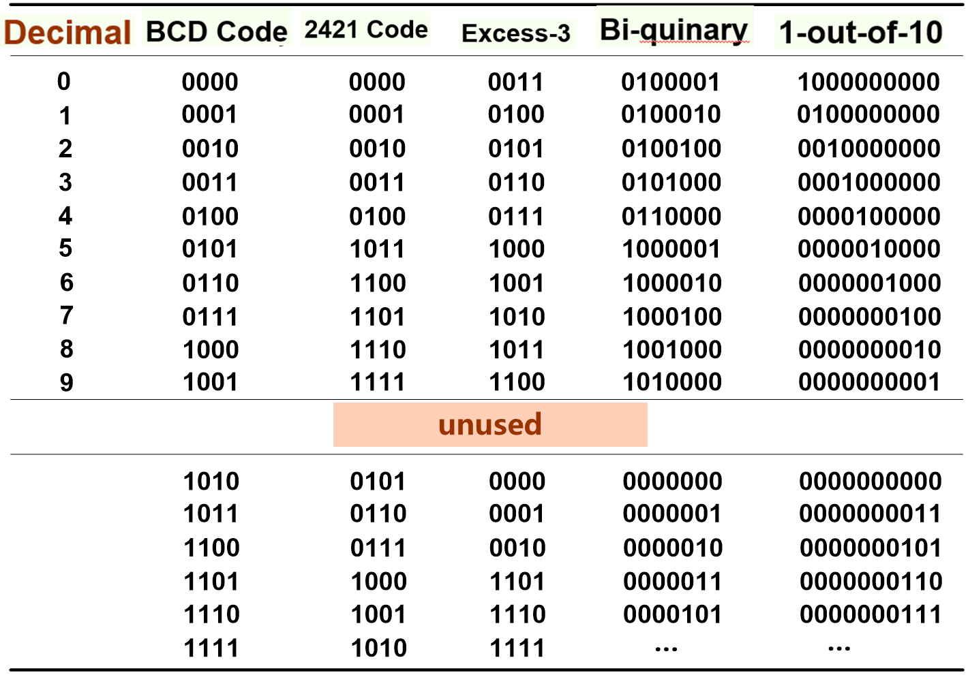
BCD code
2021-05-11

Slide 8
From Binary code to Gray code
Gray-code
Decimal
Binary
0
0
0
0
0
0
0
1
0
1
2
3
4
5
6
7
000
001
010
011
100
101
110
111
1
1
1
0
0
Binary: 1 0 0 1 1 1 0 1
1
1
1
1
1
1
0
1
Gray-code:
1
1
0
1
0
0
1
1
0
0
1
0
Reflecting
from 1-bit to n-bit
XOR
from right to left
2021-05-11
7

Slide 9
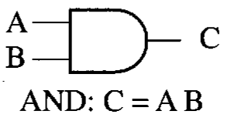
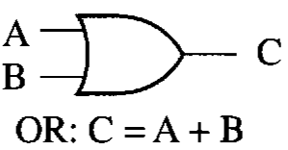
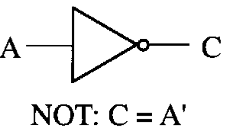
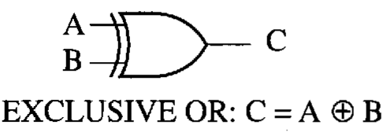
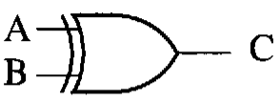

Gates and Logic: other gates
N
N
N
N
XN
X
XN

Slide 10
Minterm List vs. Maxterm List
Homework chap2
_{0,2,3,4,6}
_{1,3,4,5,7}
_{0,2,3,4,6}
₁
_{1,3}
Notes:
1、SOP →POS, justΣ→Π and j≠I
2、Give F，F’=? JustΣ→Π and j=i
3、 Give F，F_{D}=? JustΣ→Π and j=[i]_{n}
F1+F2，F1*F2

Slide 11
Gates and Logic: Duality vs. DeMorgan’s Law
Dual of a logic expression
F^{D}(X₁ , X₂ , … , X_{n} ,0,1, + , · )
= F(X₁ , X₂ , … , X_{n} ,1,0, · , + )
Complement of a logic expression
F’ (X₁ , X₂ , … , X_{n} ,0,1, + , · )
= F(X₁ ’ , X₂ ’ , … , X_{n} ’ ,1,0, · , + )
Chap2.7.2，2.7.3
X is not changed !!
X is inverted !!

Slide 12
Exercise
a
a'
a
F(a,b,c)
F’(a,b,c)
F^{D}(a,b,c)
b
b'
b
c
c'
c
Positive logic
Change variables
Circle ruler
a
F(a,b,c)
a'
Negative logic
F’(a,b,c)
b
b'
c
c'
DeMorgan’s
ruler
DeMorgan’s
ruler
a
a
F’(a,b,c)
F(a,b,c)
F(a,b,c)
b
b
Homework
Chap2、Chap3
c
c
Notes:
Duality （对偶定理）

Slide 13
Digital system & Analogue system: Digital signals versus Analog signals
V_{CC}＝3.3V
Logic 1
V_{max}＝3.5V
Logic 1
V_{OH} ＝2.6V
Invalid
Noise Margin
Invalid
V_{IH} ＝2.0V
V_{IL}＝0.8V
V_{OL}＝0.35V
Noise Margin
Logic 0
Logic 0
V_{min} ＝-0.3V
V_{SS}＝0V
Output
Input
A particular inverter has:
V_{ILmax} = 0.8 V, V_{IHmin} = 2.0 V, V_{OLmax}=0.35V, V_{OHmin}=2.6V.
Then the DC noise margin is (0.6) V in the HIGH state and (0.45)V in the LOW state is.
Notes:
threshold
Electronic Aspects of Digital Design
Digital circuits deal with analog voltages and currents and are built with analog components
How to realize Logic 0 and 1 in a Real circuit?
What is the range of analog value with each logic value(0 or 1) ?
How to produce and figure out the signal in a proper range?
The association between Digital and Analog

Slide 14
Digital system & Analogue system: Digital signals versus Analog signals
Noise margin : A measure of how much noise it takes to corrupt a worst-case output voltage into a value that may not be recognized properly by an input.
Noise margin can ensure that the output signal can be reliably interpret by the following input under different conditions of power-supply voltage, temperature, and output loading
Fan-in : The number of inputs that a gate can have.
As the number of input is increased, designers have to increase the size of series transistors to reduces their resistance and the corresponding switching delay. So, typically, the fan-in of CMOS gates is 4 for NOR gates and 6 for NAND gates.
Fan-out : The number and type of inputs that are connected to a given output.
Too many inputs connected to an output may affect the speed at which the output changes from one state to another, and also destroy the noise margins.
Notes:
threshold
Electronic Aspects of Digital Design
Digital circuits deal with analog voltages and currents and are built with analog components
How to realize Logic 0 and 1 in a Real circuit?
What is the range of analog value with each logic value(0 or 1) ?
How to produce and figure out the signal in a proper range?
The association between Digital and Analog

Slide 15
Digital Logic Circuits: Different Types
Input
Output
Output logic
(COMBINATIONAL)
Combinational Logic
Input
Excitation
STATE-HOLDING
ELEMENTS
Output
Input logic
(COMBINATIONAL)
States
Output logic
(COMBINATIONAL)
CLK
Moore FSM
Input
Excitation
Input logic
(COMBINATIONAL)
STATE-HOLDING
ELEMENTS
Output logic
(COMBINATIONAL)
Output
CLK
States
Mealy FSM
Notes:
Moore vs Mealy

Slide 16
Digital Logic Circuits: Design & Analysis
Combinational Circuit
No storage devices
The output only depends on the current inputs
The most basic component
gates: NAND, NOR
The most commonly used modules
Decoder/Encoder, MUX/DeMUX, ALU, and so on
Parity Check circuit, commonly used in communication system
Sequential Circuit
Combinational circuit + storage devices
The output depends on the current as well as past inputs(STATE)
Mealy state machine: the output depends on current input and STATE
Moore state machine: the output only depends on the STATE
The most basic component
Flip/Flop: DFF
The most commonly used modules
Register, Counter, and so on
Serial Signal Detector, Serial Signal Generator
Homework Chap4
Homework
Chap5
Notes:
Decoder vs Encoder
Priority Encoder

Slide 17
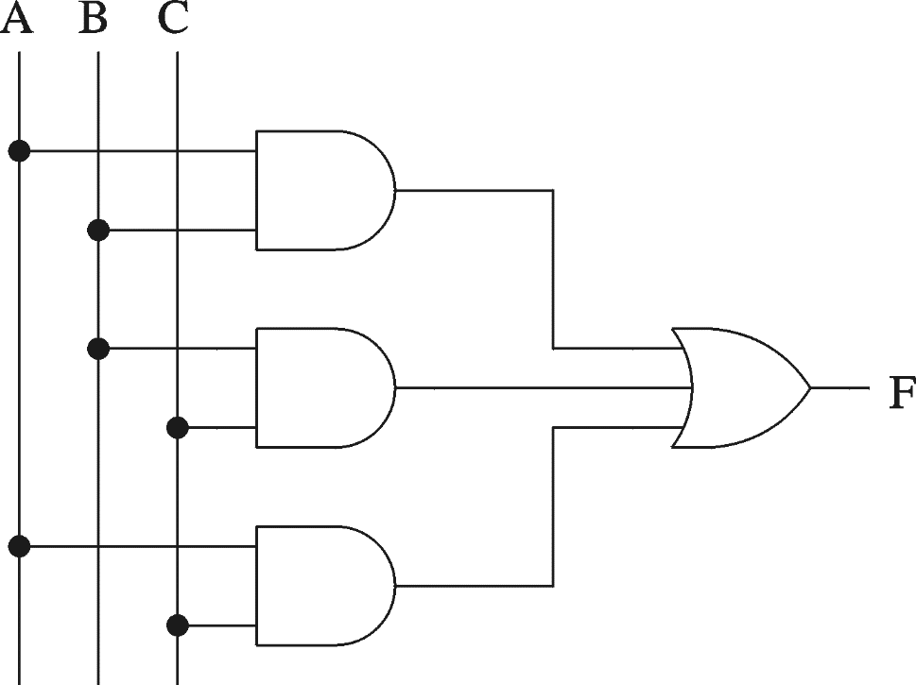
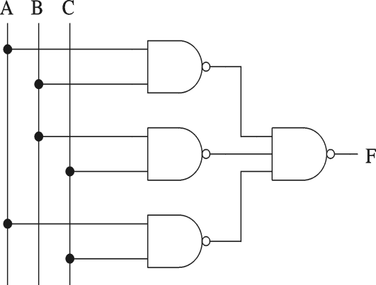
Combinational Digital Circuit Design
1.Description: 3-input Majority function, which output is 1 whenever majority of inputs is 1.
3.K map
5.Circuit schematic
2.Truth table
A B C F
0 0 0
0 0 1
0 1 0
0 1 1
1 0 0
1 0 1
1 1 0
1 1 1
AB
C
00 01 11 10
0
0
0
0
1
1
1
1
0
0
0
1
0
1
0
1
1
1
4.Logical expression
F = AB + BC + AC
Notes:
K图化简

Slide 18
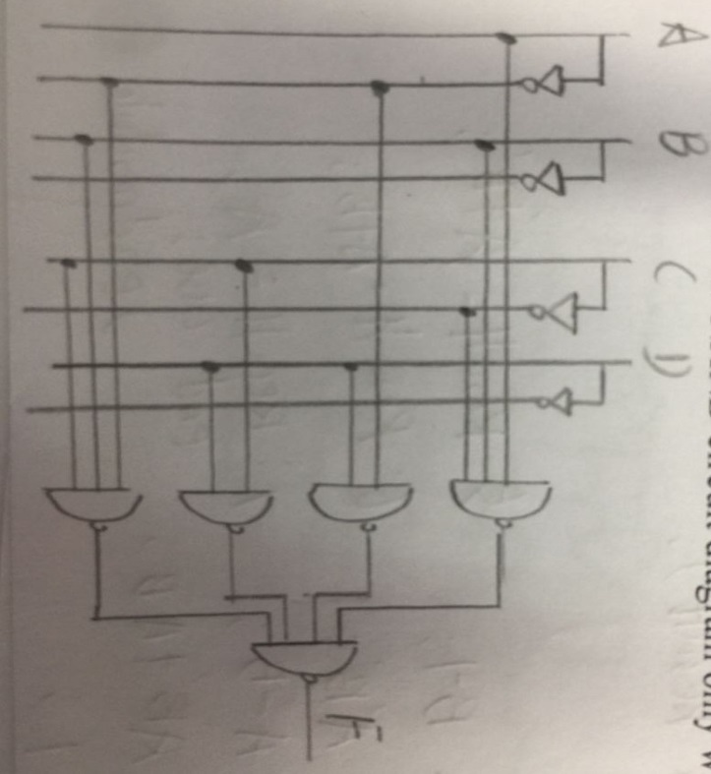
Combinational Digital Circuit
AB
00
01
11
10
CD
00
1
01
d
1
d
11
1
d
1
1
10
1
F=CD+ BD +A’BC+ABC’
Notes:
带‘d’的化简

Slide 19
Logic design with MUX
F(A,B,C) = m0 + m2 + m6 + m7
1
0
A
B
C
F
0
1
0
0
0
1
1
2
F
C’
C’
0
F
0
8:1
0
0
1
0
3
0
1
0
1
C’
1
4:1
0
4
MUX
C’
0
2
MUX
0
5
0
1
1
0
1
3
1
6
1
0
0
0
S1 S0
1
7
S2 S1 S0
0
1
0
1
0
A
B
A
B
C
1
1
0
1
1
1
1
1
1
Lookup Table
2^{n-1}:1 MUX can implement any function of less than n variables
Notes:
151

Slide 20
Logic design with Decoder and Gates
F1 = ∑_{(X,Y,Z)} (0,3,6,7)
While enable input asserted, Yi = m_{i}’=Mi
+5V
74x138
G1
G2A
G2B
Y0
Y1
Y2
Y3
Y4
Y5
Y6
Y7
F2
F1
Z
Y
X
LSB
MSB
A
B
C
F2 = ∏ _{(X,Y,Z)} ( 1, 2, 4, 5 )
= M₁ · M₂ · M₄ · M₅
= m₁’ · m₂’ · m₄’ · m₅’

Slide 21
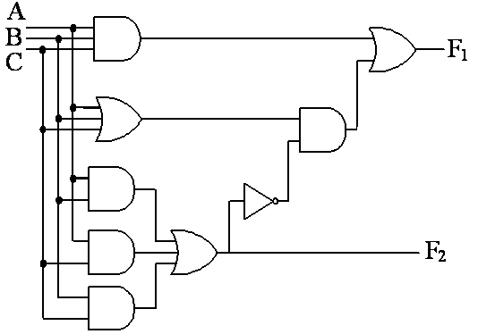
Combinational Circuits Analysis
Find a simplified logic for the following circuit :
1.Circuit schematic
3. Truth table
4. K map
ABC
A | B | C | F1 | F2
0 | 0 | 0 | 0 | 0
0 | 0 | 1 | 1 | 0
0 | 1 | 0 | 1 | 0
0 | 1 | 1 | 0 | 1
1 | 0 | 0 | 1 | 0
1 | 0 | 1 | 0 | 1
1 | 1 | 0 | 0 | 1
1 | 1 | 1 | 1 | 1
AB
F1
C
00 01 11 10
A+B+C
0
0
1
0
1
1
1
0
1
0
F1=ABC+A’B’C+A’BC’+AB’C’
AB+BC+AC
AB
F2
C
00 01 11 10
0
0
0
1
0
2.Logical expression
1
0
1
1
1
F1=ABC+(A+B+C)(AB+BC+AC)’
F2=AB+BC+AC
F2=AB+BC+AC
Parity Generator/Checker
（Even Checker）
Majority circuit
5.Description: What’s the circuit’s function?

Slide 22
Basic Verilog Modeling
module is a most basic building block of a design.
port declarations describes the interface of the component, i.e. input and output ports.
circuit functionality describes an implementation of the corresponding module.
port_mode port_name1;
port_mode port_name2;
…………
module module_name (port_name1,_port_name2, …);
port declarations
wire interconnect_name1;
wire interconnect_name1;
…………
Interconnect declarations
assign statements;
always @(sensitive signals list)
begin
functionality code
end
circuit functionality
endmodule

Slide 23
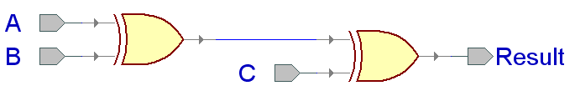
Verilog Design Styles
Testbenches
module dataflow (Result, A, B, C);
output Result;
input A, B, C;
assign Result = (A XOR B) XOR C;
endmodule
structural
dataflow
behavioral
(sequential)
Components and
interconnects
Concurrent statements
Subset most suitable for synthesis
module behavioral (Result, A, B, C);
output reg Result;
input A, B, C;
always @ (A, B, C)
begin
Result = (A XOR B) XOR C;
end
endmodule
module structural (Result, A, B, C);
output Result;
input A, B, C;
wire U1_OUT;
xor U1(U1_OUT,A,B); xor U2(Result,U1_OUT,C);
endmodule
U1_OUT
I1
I1
Y
Y
I2
I2

Slide 24
Verilog for Combinational Circuit
module Code42( F, I ) ;
endmodule;
output [ 1:0 ] F;
input [ 3:0 ] I;
reg [1:0] t;
assign F = t ；
I₀
always @ ( I )
begin
end
I₁
F1
I₂
F0
always @ ( I )
begin
if (I[3]) t= 2’b11 ;
else if (I[2]) t = 2’b10 ;
else if (I[1]) t = 2’b01 ;
else t = 2’b00 ;
end
I₃
case ( I )
1: t = 0 ;
2: t = 1 ;
4: t = 2 ;
8 : t = 3 ;
default: t = 0 ;
endcase
No priority
Priority!

Slide 25
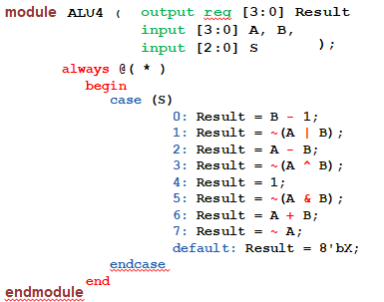
Verilog for Combinational Circuit

Slide 26
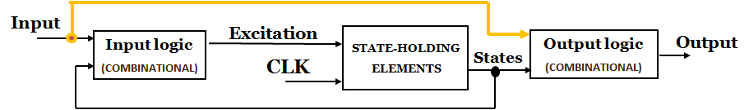
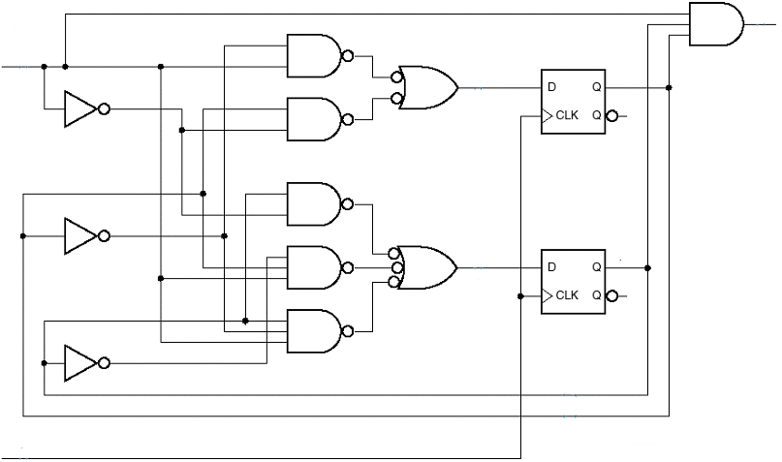
Design & Analysis of Sequential Circuits
Analysis Steps:
Input logic equations
Output logic equations
State transition equations
State transition/output table
State transition diagram, waveform, etc.
step3
step1
step2
Input logic
State F/F
Output logic
EN
Q0
MAX
Q1
state
Design Steps:
State transition graph
State transition/output table
State minimization & coding
Chose Storage device (DFF)
Excitation equations
Output equations
Logic circuit diagram
Excitation
CLK
Notes:
状态数和DFF的数目
基本步骤：
确定下一状态函数F 和输出函数G
将F代入触发器的特征方程得到下一状态Q*
利用Q*、G构造状态/输出表
画出状态图、波形图（可选）
检查电路是否可以自启动
描述电路功能
State Diagram or State/output table
State minimization
State assignment(coding)
Transition/output table
Chose Storage device (DFF)
Excitation equations
Draw a Logic Diagram
Synchronous
- we now have a way to store information on an edge (i.e., a flip-flop)
- we can use these storage elements to build "Synchronous Circuitry"
- Synchronous means that events occur on the edge of a clock
State Machine
- a generic name given to sequential circuit design
- it is sequential because the outputs depend on : 1) the current inputs 2) past inputs
state machines are the basis for all modern digital electronics
State Memory
- a set of flip-flops that store the Current State of the machine
- the Current State is due to all of the input conditions that have existed since the machine started
- if there are "n" flip-flops, there can be 2^{n} states
- a state contains everything we need to know about all past events
- we define two unique states in a machine 1) Current State 2) Next State
Current State
- the state that the machine is currently in
- this is found on the outputs of the flip-flops (i.e., Q)
Next State
- the state that the machine "will go to" upon a clock edge
- this is found on the inputs of the flip-flops (i.e., D)
- the Next State depends on - the Current State - any Inputs - we call the Next State Logic "F"
State Transition
- upon a clock edge, the machine changes from the "Current State" to the "Next State"
- After the clock edge, we reassign back the names (i.e., Q=Current State, Q*= Next State)

Slide 27
FSM Analysis
D0
Q0
D1
Q1
1). Excitation equations
4). State transition /output table
5). STG
D0 = Q1+Q0’
D1 = X·Q1’
X=0
S
X
0 1
Q
00/0
X=0
01/1
2). Output equations
Q = Q1+Q0
0 0
0 1
1 0
1 1
00
10
10
01
00
0
1
1
1
X=1
00
11/1
X=1
3). State transition equations
01
00
Q0+ =D0
Q1+ =D1
=Q1+Q0’
10/1
=X·Q1’
Q1Q0
Q1+Q0+
It is a Moore machine:
if X=1 then the state transits between 01 and 10, the output Q should be 1;
if X=0 then the state reset to 00, the output Q should be 0.
2021-05-11

Slide 28
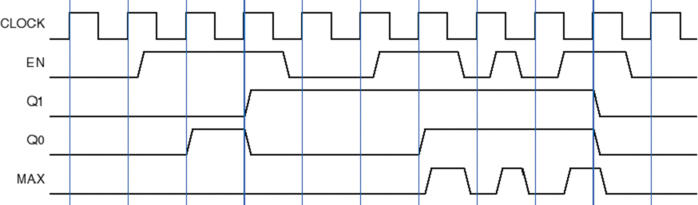
FSM Analysis
1. Excitation equations from input logic
D0 = Q0·EN’ + Q0’·EN
EN
EN
Q0
D0
MAX
D1 = Q1·EN’ + Q1’·Q0·EN + Q1·Q0’·EN
EN’
2. Output equations
MAX = Q1·Q0·EN
Q0
3. State transition equations
Q0’
D1
Q1
Q0+ =D0
Q1+ =D1
=Q0·EN’ + Q0’·EN
=Q1·EN’ + Q1’·Q0·EN+ Q1·Q0’·EN
Q1
Q1’
4. State transition /output table
5. State diagram
CLK
EN
0 1
EN=0
MAX=0
EN=1
MAX=0
EN=0
MAX=0
S
00
01
6. Timing Diagram
0 0
0 1
1 0
1 1
00
,0
01, 0
10, 0
11, 0
00, 1
EN=1
MAX=1
EN=1
MAX=0
01
,0
10, 0
11, 0
EN=1
MAX=0
EN=0
MAX=0
11
10
EN=0
MAX=0
Q1Q0
Q1+Q0+, MAX
2-bit Add-up Counter with Enable
Notes:
Analysis Steps:
Input logic equations
Output logic equations
State transition equations
State transition/output table
State transition diagram, waveform, etc.
Excitation equation (激励方程或驱动方程）
Express the excitation signals as functions of the current state and input.
Next state = F (current state, input)
Output equation (输出方程）
Output = G (current state, input)
Transition equation (转移方程）
turn a "Characteristic Equation" into an "Excitation Equation"

Slide 29
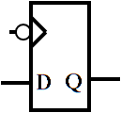
FSM Design
Design a Serial Data Detector of 101 (Mealy machine)
Chap6.4，6.5
Input X=010110100110101110…… Output Z=000100100000101000……
1. Mealy STG
2. State /output table
3. State minimization & coding
1/0
X
0 1
X
0 1
X
0 1
0/0
S0
S1
S
S
S
1/0
1/0
S0
S1
S2
S3
S0
,0
S1, 0
S1, 0
S3, 1
S1, 0
S0
S1
S2
S3
S0
,0
S1, 0
S1, 0
S3, 1
S1, 0
S0
S1
S2
0 0
0 1
1 0
00
,0
01, 0
01, 0
01, 1
X/Z
0/0
0/0
S2
,0
S2
,0
10
,0
0/0
S0, 0
S2, 0
S0, 0
S2, 0
S1
00, 0
S3
S2
1/1
S+, Z
S+, Z
Q2Q1
Q2+Q1+, Z
4. Excitation equations
5. Output equations
6.Logic circuit diagram (DFF)
Q2Q1
Q2+
Q2Q1
Z
X
00 01 11 10
X
00 01 11 10
Z
0
0
1
0
X
X
0
0
0
0
0
0
X
X
0
1
X
1
0
1
0
Q2
Q2Q1
Q1+
X
00 01 11 10
Q2+=X’Q1
CLK
0
0
0
1
X
X
0
1
Z=Q2X
Q1
Q1+=X
1
1

Slide 30
Verilog Design Styles: Sequential circuit/FSM
Testbenches
Chap6.4，6.5
state
X
0 1
0/0
0/1
0 0
0 1
1 0
01
,0
S0
S1
structural
dataflow
behavioral
(sequential)
S0
S1
S2
10, 0
10, 0
10, 1
01
,1
1/0
1/0
0/0
Components and
interconnects
Concurrent
statements
01, 0
S2
Y1Y0
Y1+Y0+, z
x/z
Subset most suitable for synthesis
Registers
State machines
Decoders
1/1
case （state）
S0 : if (x==0) begin --PRESENT STATE/INPUT
next_state=S1; z=0; --NEXT STATE/OUTPUT
end
else begin
next_state=S2; z=0;
end
S1: if (x==0) begin
next_state=S1; z=1; end
else begin
next_state=S2; z=0;
end
S2: if (x==0) begin
next_state=S1; z=0;
end
else begin
next_state=S2; z=1;
end
default: begin
next_state=S0; z=0;
end
end case;
state <= next_state;
module behavioral
#( parameter S0=0,S1=1,S2=2 )
(output reg z, input x, clk);
reg [1:0] state, next_state;
always @ ( )
begin
end
always @ ( )
begin
end
endmodule
negedge clk
Q1: Is it a Moore or Mealy machine?
Q2: What’s the meaning of default branch?
Update State (Sequential circuit)
state or x
Next state &Output (Combinational )circuit

Slide 31
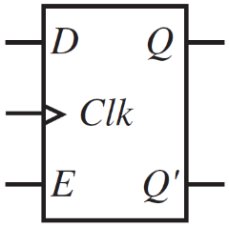
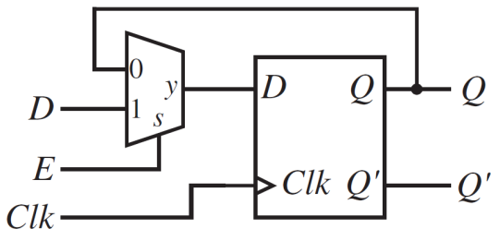
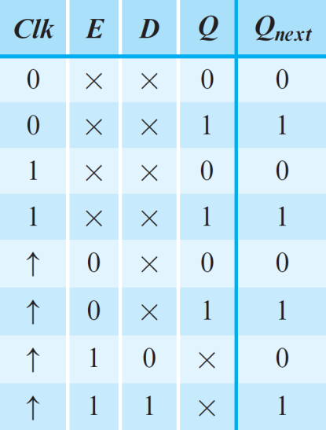
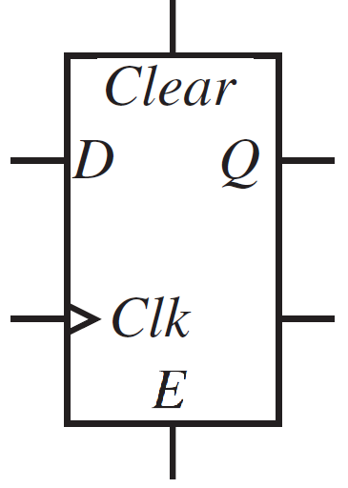
D-type Flip-Flops with other inputs
Verilog code
Logic Symbol
module DFF1 (
);
always@ ( )
begin
end
endmodule
E,
Clear,
input CLK, D,
output reg Q
posedge CLK
or posedge Clear
Circuit
if ( Clear )
else
Q <= 0 ;
if ( E )
Logic Symbol
Q <= D ;
Function table
A D flip-flop with asynchronous Clear
& synchronous Enable

Slide 32
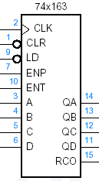
Design circuit by Counter
Please design a modulo-11 counter by 74x163.
1100
1011
1010
1001
1000
1100
1011
1010
1001
1000
1101
0111
1101
0111
1110
0110
1110
0110
QD QC QB QA
QD QC QB QA
1111
0101
1111
0101
0000
0001
0010
0011
0100
0000
0001
0010
0011
0100
1
1
1
1
1
1
1
0
1
MSB
0

Slide 33
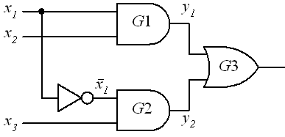
Static hazard in Combinational Circuits
x₂
x₃
Z = X1+X1’
x₁
x₁’
y₁
y₂
z
Static 1 hazard
glitch
t_{pd}
t_{pd}
X1X2
X3
00 01 11 10
0
1 1
To remove the hazard
1
1 1
This is NOT a Minimal Sum, but it is Hazard Free.
Adjacent means hazard

Slide 34
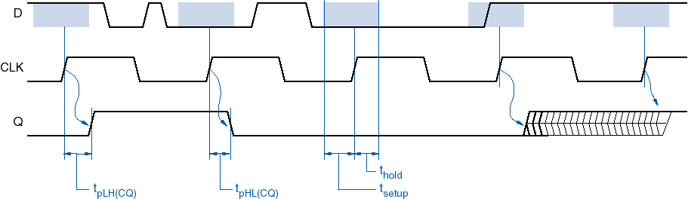
Timing in Sequential Circuit (DFF)
Propagation delay:
t_{pLH(CQ)} , t_{pHL(CQ)}
The amount of time from the CLK changed to the output Q changed.
Setup time:
t_{setup}
The minimum amount of time BEFORE the CLK’s active edge during which the data must be stable.
Hold time:
t_{hold}
The minimum amount of time AFTER the clock’s active edge by which the data must be stable.
Data must be stable
Timing violation
Data couldn’t
be storage
correctly
CLK’s active edge
Notes:
Setup time is defined as the minimum amount of time BEFORE the clock’s active edge by which
the data must bestable for it to be latched correctly. Any violation in this minimumrequired
time causes incorrect data to be captured and is known assetup violation.
Hold time is defined as the minimumamount of time AFTER the clock’s active edge during
which the data mustbe stable. Any violation in this required time causes incorrect data tobe
latched and is known as hold violation.
The setup time in a design determines the maximumfrequency at which the chip can run
without any timing failures.Factors affecting the setup analysis are the clock period Tclk,
Clockto Q propagation delay of the launch flop Tck->q, negative clockskew Tskew, required
setup time of the capture flop Tfs and combinational logic delay Tcomb between the two flops
being timed. Thefollowing condition must be satisfied.

Slide 35
ISA of our CPU
ISA | 15 | 14 | 13 | 12 | 11 | 10 | 9 | 8 |  | 7 | 6 | 5 | 4 | 3 | 2 | 1 | 0 | Example
 | Opcode |  |  | *1 | *2 | Rs1/Rd |  | Rs2 |  |  | #imm/offset
MOV <Rd>, <Op2> ;Rd ← Op2 | 0 | 0 | 0 | 0 | x | Rd |  | Rs2 |  |  | x | x | x | x | x | x | x | MOV R0 , R1
 | 0 | 0 | 0 | 1 | x | Rd |  | x |  | x | #imm |  |  |  |  |  |  | MOV R0 , #0x22
ADD <Rs1/Rd> ,<Op2> ; Rd ← Rs1+ Op2 | 0 | 0 | 1 | 0 | 0 | Rs1/Rd |  | Rs2 |  |  | x | x | x | x | x | x | x | ADD R0 , R1
 | 0 | 0 | 1 | 1 | 0 | Rs1/Rd |  | x |  | x | #imm |  |  |  |  |  |  | ADD R0 , #0x22
ADDC <Rs1/Rd> ,<Op2> ; Rd ← Rs1+ Op2+C | 0 | 0 | 1 | 0 | 1 | Rs1/Rd |  | Rs2 |  |  | x | x | x | x | x | x | x | ADDC R0 , R1
 | 0 | 0 | 1 | 1 | 1 | Rs1/Rd |  | x |  | x | #imm |  |  |  |  |  |  | ADDC R0 , #0x22
SUB <Rs1/Rd> ,<Op2> ; Rd ← Rs1- Op2 | 0 | 1 | 0 | 0 | 0 | Rs1/Rd |  | Rs2 |  |  | x | x | x | x | x | x | x | SUB R0 , R1
 | 0 | 1 | 0 | 1 | 0 | Rs1/Rd |  | x |  | x | #imm |  |  |  |  |  |  | SUB R0 , #0x22
SUBB <Rs1/Rd> ,<Op2> ; Rd ← Rs1-Op2-C | 0 | 1 | 0 | 0 | 1 | Rs1/Rd |  | Rs2 |  |  | x | x | x | x | x | x | x | SUBB R0 , R1
 | 0 | 1 | 0 | 1 | 1 | Rs1/Rd |  | x |  | x | #imm |  |  |  |  |  |  | SUBB R0 , #0x22
AND <Rs1/Rd> ,<Rs2> ; Rd ← Rs1· Rs2 | 0 | 1 | 1 | 0 | x | Rs1/Rd |  | Rs2 |  |  | x | x | x | x | x | x | x | AND R0 , R1
NOT <Rs1/Rd> ;Rs1← !Rs1 | 1 | 0 | 0 | 0 | x | Rs1/Rd |  | x | x |  | x | x | x | x | x | x | x | NOT R0
JMP <Rs> ;PC ← Rs | 1 | 0 | 1 | x | 0 | x | x | Rs |  |  | x | x | x | x | x | x | x | JMP R0
JZ <offset> ;PC ← PC+offset (ZF=1) | 1 | 0 | 1 | 0 | 1 | x | x | x |  | x | offset |  |  |  |  |  |  | JZ XXX
JC <offset> ;PC ← PC+offset(CF=1) | 1 | 0 | 1 | 1 | 1 | x | x | x |  | x | offset |  |  |  |  |  |  | JC XXX
LDR <Rd>, <Rs> ;Rd ← [Rs] | 1 | 1 | 0 | x | x | Rd |  | Rs |  |  | x | x | x | x | x | x | x | LAD R0, R1
STR <Rd>, <Rs> ;[Rd] ←Rs | 1 | 1 | 1 | x | X | Rd |  | Rs |  |  | x | x | x | x | x | x | x | STR R0, R1
*1: <op2> is in a register (bit12=0 )
or a imm/offset ( bit12=1 )
*2: FLAG register is unused (bit11=0 )
or used (bit11=1)

Slide 36
ISA of Lab CPU
Opcode | Rd | Rs | Imme | assembly | function
4bit | 2bit | 2bit | 8bit
0000 0001 | 01 10 | xx 01 | 00000010 xxxxxxxx | Mov R1 #02 Mov R2 R1 | R1<= 2 R2<=(R1)
0010 0011 | 01 01 | xx 10 | 00001000 xxxxxxxx | Add R1 #08 Add R1 R2 | R1<=(R1)+8 R1<=(R1)+(R2)
0100 | 01 | 10 | xxxxxxxx | Sub R1 R2 | R1<=(R1)-(R2)
0101 | 01 | 10 | xxxxxxxx | And R1 R2 | R1<= (R1) bit_and (R2)
0110 | 01 | 10 | xxxxxxxx | Or R1 R2 | R1<=(R1) bit_or (R2)
0111 | xx | xx | 00000001 | Jump #01 | PC<= 1
Opcode supports 16 instructions. So you can add other instructions, like shift,
multiplication.
Rd and Rs can be expressed in 2 bits that means you can operate 4 registers.
Immediate data is expressed in 8 bits.

Slide 37
TOP-DOWN Design
Digital circuit
Top-level module
port-function
Control Module
PART 1
(combination)
Datapath Module
PART 1
(combination)
PART 4
(Register)
PART 3
(sequential
FSM)
module
port-function
module
port-function
module
port-function
module
port-function
PART 2
(combination)
PART 2
(combination)
PART 5
(Counter)
Interconnect
module
port-function
module
port-function
PART 4
(sequential
FSM)
module
port-function
PART 3
(combination)
module
port-function
Interconnect
module
port-function
Interconnect

Slide 38
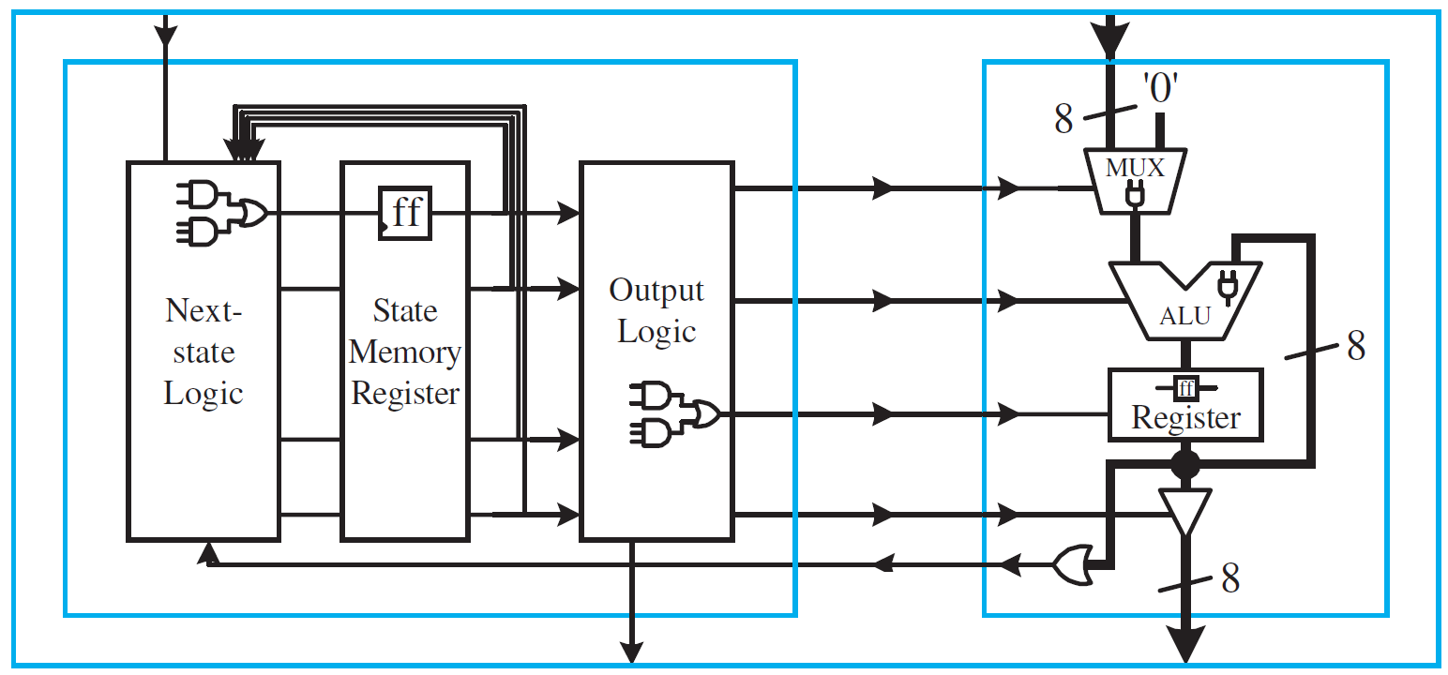
Organization of Center Processor Unit
Control Inputs
(Instruction)
Data Inputs
Controller
Datapath
Control Signals
Status Signals
Control Outputs
Data Outputs
2021-05-11
37

Slide 39
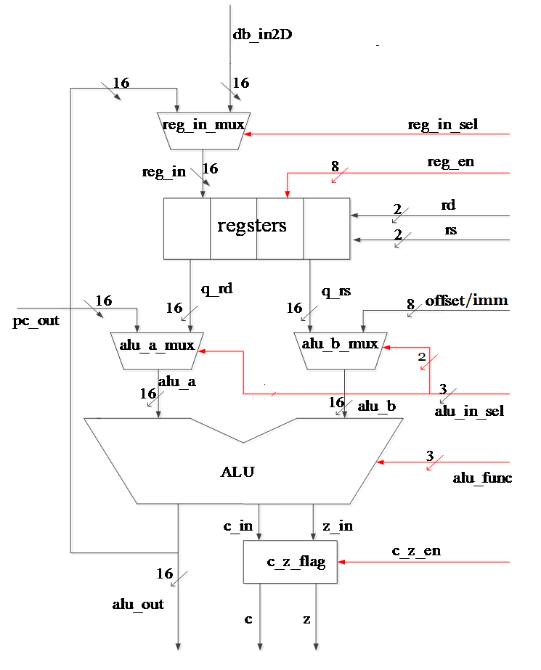

Datapath depends on ISA
MOV R0 , R1
MOV R0 , #0x22
ADD R0 , R1
ADD R0 , #0x22
ADDC R0 , R1
ADDC R0 , #0x22
SUB R0 , R1
SUB R0 , #0x22
SUBB R0 , R1
SUBB R0 , #0x22
AND R0 , R1
NOT R0
JMP R0
JZ XXX
JC XXX
LAD R0, R1
STR R0, R1

Slide 40
STG for Control unit

Slide 41
TestBench Anatomy
module My_tb; --TestBench module has no ports
reg ……….; --Local signals and constants
wire ……….;
Instantiating module; -- Instantiations of DUT
initial begin ……… end -- Input stimuli: reset
always begin ……… end -- Input stimuli: clock
initial begin ……… end -- Input stimuli: other signals
always @ ( posedge clock ) begin
……… -- Compare results
end
always @ ( posedge clock ) begin
……… -- Display results
end
endmodule
TestBench Module
Stimulus Generater
Apply Inputs
Design Module
Design Under Test
Response Monitor
Observe Outputs

Slide 42
A Simple Tester
`timescale 1ns/100ps
module Detector110Tester;
reg aa, clock, rst;
wire ww;
Detector110 UUT (aa, clock, rst, ww);
initial begin
aa = 0; clock = 0; rst = 1;
end
initial repeat (44) #7 clock = ~clock;
initial repeat (15) #23 aa = ~aa;
initial begin
#31 rst = 1;
#23 rst = 0;
end
always @(ww) if (ww == 1)
$display ("A 1 was detected on w at time = %t", $time);
endmodule
Time unit
No input or output ports
Inputs & Outputs of DUT
The Instantiation of DUT (Detector110 Module)
An initial statement
Generates a periodic signal :
repeats (44) times with (7time steps) delay,
Generates a no-periodic signal
A Verilog System Task: reports the Times at which the ww Variable becomes 1

Slide 43
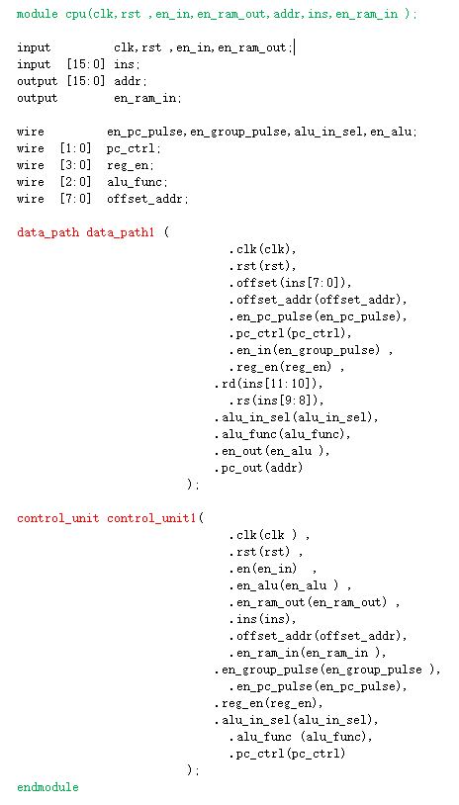
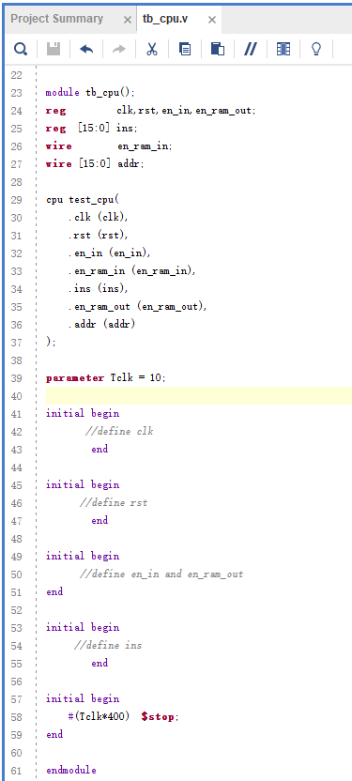
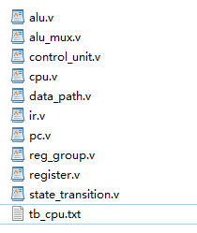
Design & Implement for CPU

Slide 44
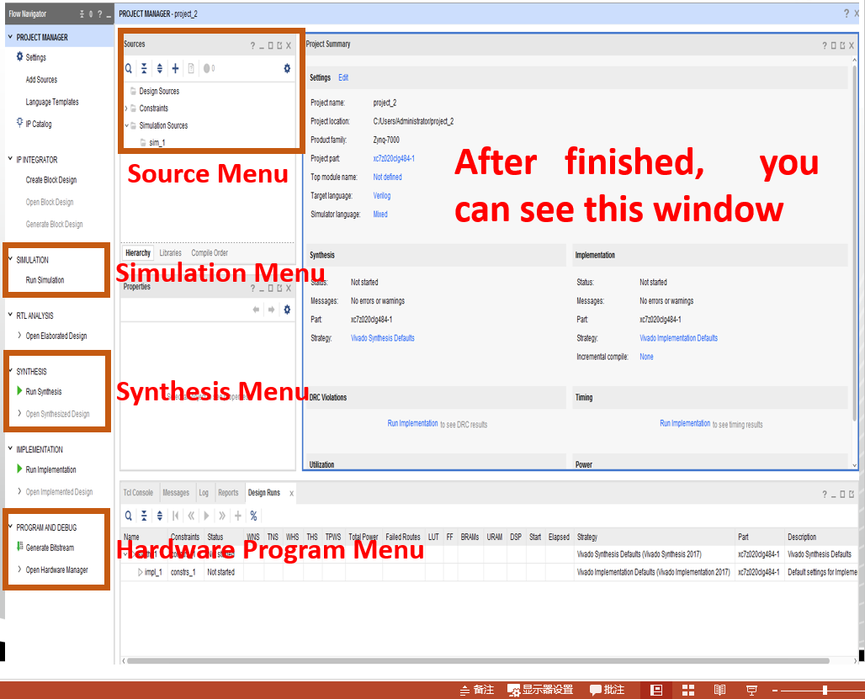
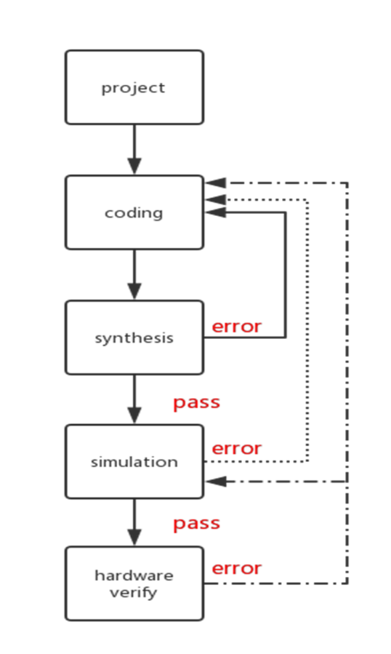
EDA tools & flow

Slide 45
PERFORMANCE ASSESSMENT
Consider the execution of a program which results in the execution of 2 million instructions on a 400-MHz processor. The program consists of four major types of instructions. The instruction mix and the CPI for each instruction type are given below based on the result of a program trace experiment. Please give out the average CPI , the corresponding MIPS and the tunning time T when the program is executed on a uniprocessor .
Instruction Type | CPI | Instruction Mix
Arithmetic and logic | 1 | 60%
Load/store with cache hit | 2 | 18%
Branch | 4 | 12%
Memory reference with cache miss | 8 | 10%
CPI = 0.6 + (2 * 0.18) + (4 * 0.12) + (8 * 0.1) = 2.24
MIPS =(400 * 10⁶) / (2.24 * 10⁶) = 178
T= 2* 10⁶ *2.24/(400 * 10⁶) = 0.012 (s)
Notes:
假设一台计算机的时钟频率是100 MHz(每秒百万周期)，具有4种类型的指令，它们的使用率和CPI分别如下表所示。求该计算机的MIPS值以及运行一个具有10⁷条指令的程序所需的CPU时间。

