Slide 1
Chapter4
Discrete-time Systems

Slide 2
1
Classification of Discrete Systems
2
Impulse and Step Response
3
LTI Discrete-time Systems
4
Phase and Group Delay

Slide 3

4.1 Discrete-Time Systems Examples
A discrete-time system processes a given input sequence x[n] to generate an output sequence y[n] with more desirable properties
In most applications, the discrete-time system is a single-input, single-output system:
x[n]
Discrete-Time
System
y[n]=H(x[n])
Input sequence
Output sequence

Slide 4
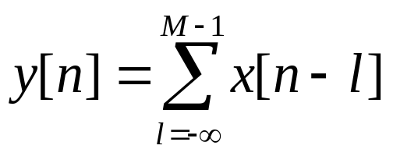
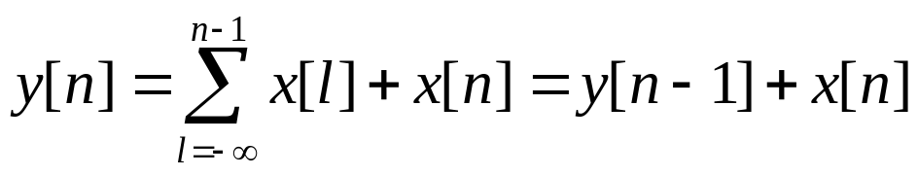
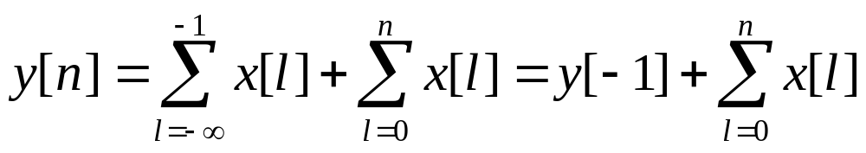
4.1 Discrete-Time Systems Examples
Accumulator
In another form
*

Slide 5
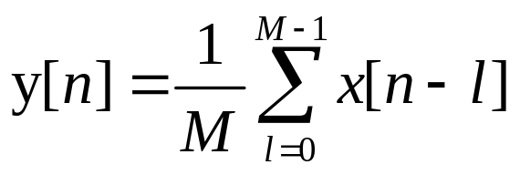
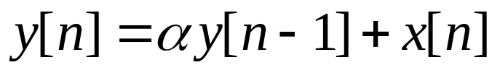
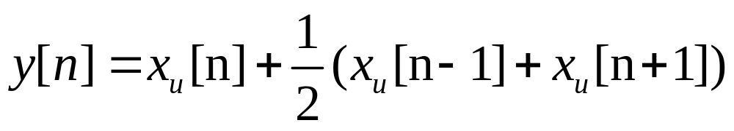
4.1 Discrete-Time Systems Examples
Moving-Average filter
Exponentially Weighted Running Average filter
Linear Interpolator
*

Slide 6
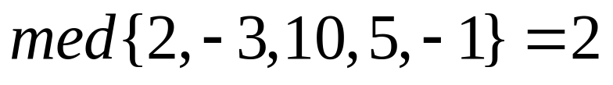
4.1 Discrete-Time Systems Examples
Median filter
The median filter is implemented by sliding a window of odd length over the input sequence {x[n]} one sample at a time.
*

Slide 7
4.2 Classification of Discrete-Time Systems
Linear System
Shift-Invariant System
Causal System
Stable System
Passive and Lossless Systems

Slide 8
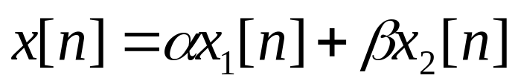
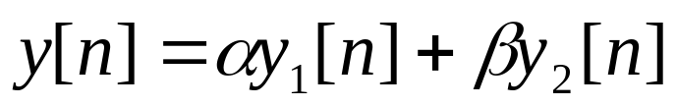
4.2 Classification of Discrete-Time Systems
Linear System
    Definition
    For an input signal
    The response is given by
    If superposition property hold for any arbitrary constants, α and β, and for all possible input signals ,the system can be called as linear system

Slide 9
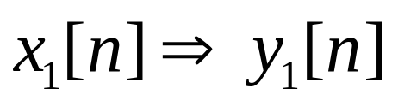
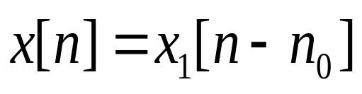
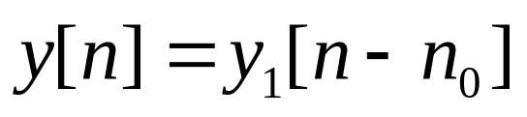
4.2 Classification of Discrete-Time Systems
  Shift-Invariant System
    Definintion
    For an input signal
    The response is given by
    If
    property hold for any n₀ can be given, the system is called as shift-invariant system

Slide 10
4.2 Classification of Discrete-Time Systems
  Causal System
Definition :
In addition to the above two properties, the n₀th output sample y[n₀] depends only on input samples x[n] for n ≤n₀ and does not depend on input samples for n＞n_{0.}
This system is called as causal system

Slide 11
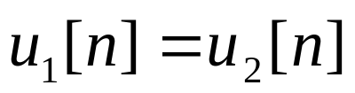

4.2 Classification of Discrete-Time Systems
For a causal system
If for n＜N
Implies also that for n＜N
Note:
The definition of causality given above can be applied only to discrete-time systems with the same sampling rate for the input and the output.

Slide 12
4.2 Classification of Discrete-Time Systems
  Stable Sytem
Definition: If and only if, for every bounded input, the output is also bounded, the system can be called as stable system
This type of stability is usually referred to as bounded-input, bounded-output (BIBO) staility.

Slide 13
4.2 Classification of Discrete-Time Systems
For a BIBO system, if the response to x[n] is the sequence y[n].
While |x[n]|＜B_{x},for all values of n
Then: |y[n]|＜B_{y.} for all values of n
where B_{x} and B_{y} are finite constants.

Slide 14
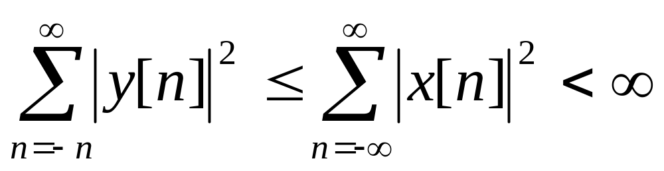
4.2 Classification of Discrete-Time Systems
Passive and Lossless Systems
A discrete-time system is said to be passive if, for every finite energy input sequence x[n], the output sequence y[n]has, at most, the same energy, i.e.
If the above inequality is satisfied with an equal sign for every input sequence, the discrete-time system is said to be lossless.

Slide 15
4.2 Classification of Discrete-Time Systems
The passivity and the losslessness properties are crucial to the design of discrete-time systems with very low sensitivity to changes in the filter coefficients

Slide 16
4.3 Impulse and Step Responses
Definition:The response of a digital system to a unit sample sequence {δ[n]} is called the unit sample response, or simply, the impulse response, and is denoted as {h[n]}.
The response of a discrete-time system to a unit step sequence {μ[n]}, denoted as {s[n]}, is its unit step response or simply, the step response.
A linear time-invariant digital system can be completely characterized in the time-domain by its impulse response or its step response

Slide 17
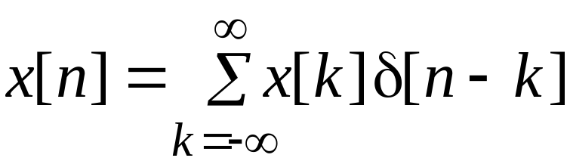
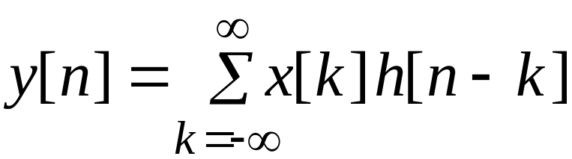
4.4 Time-Domain Characterization of LTI Discrete-Time System
Input-Output Relationship
Because
The response of the LTI system to an input x[k]δ[n-k] will be x[k]h[n-k]
will be

Slide 18
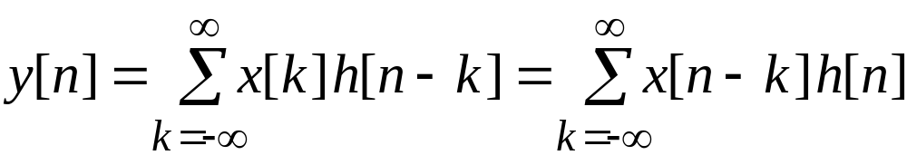
4.4 Time-Domain Characterization of LTI Discrete-Time System
The summation
is called the convolution sum of the sequences x[n] and h[n] and represented compactly as
y[n] = x[n] h[n]
*

Slide 19
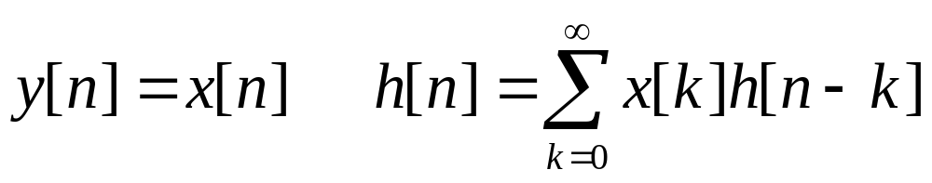
Convolution Sum
Example: Develop the sequence y[n] generated by the convolution of the sequences x[n] and h[n] :
x[n] = h[n] = δ[n] + δ[n-1] + δ[n-2]
*

Slide 20
x[n] = h[n] = δ[n] + δ[n-1] + δ[n-2]
x[k]
x[k]
x[k]
x[k]
x[k]
x[k]
h[k]
h[-k]
h[1-k]
h[2-k]
h[3-k]
h[4-k]
y[0]
y[1]
y[2]
y[3]
y[4 ]
y[n]=δ[n]+2δ[n-1]+3δ[n-2]+2δ[n-3]+δ[n-4]

Slide 21
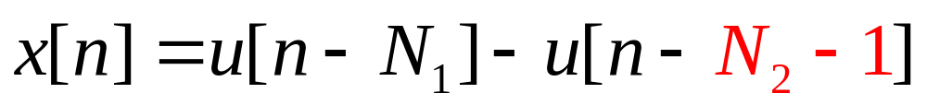
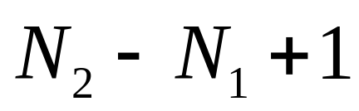
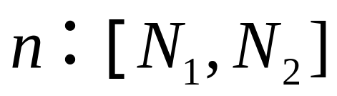
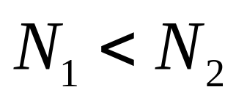
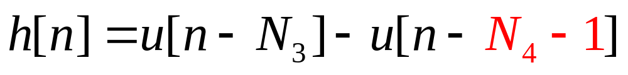
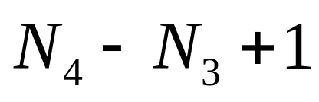
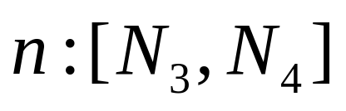
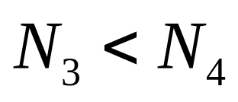
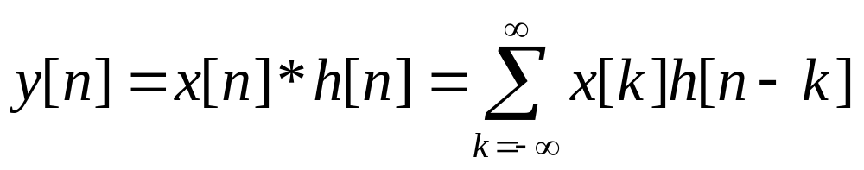
4.4 Time-Domain Characterization of LTI Discrete-Time System
Example
Length
Length

Slide 22
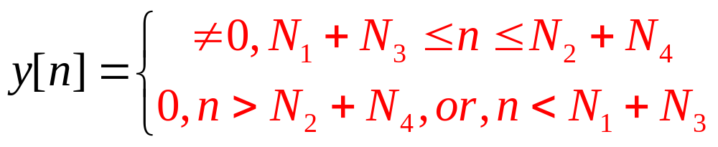
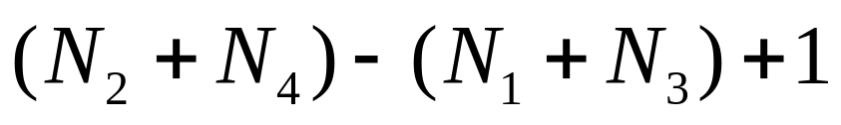
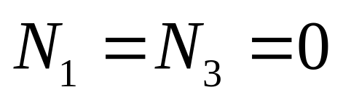
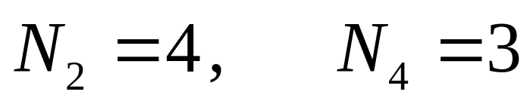
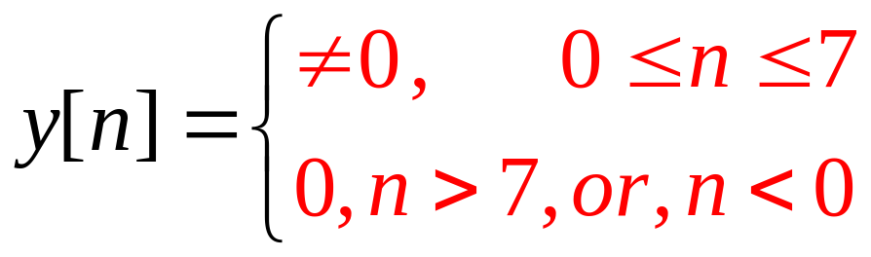
4.4 Time-Domain Characterization of LTI Discrete-Time System
Length
So

Slide 23
Properties Of Convolution
1.Commutative property
y[n]=x[n] * h[n]=h[n] * x[n]
2.Associative property
    x[n] * h₁[n] * h₂[n]=[x[n] * h₁[n]] * h₁[n]
    =x[n] * [h₁[n] * h₂[n]]=[x[n] * h₂[n]] * h₁[n]
3.Distributive property
x[n] * [h₁[n]+h₂[n]] = x[n] * h₁[n]+x[n] * h₂[n]

Slide 24
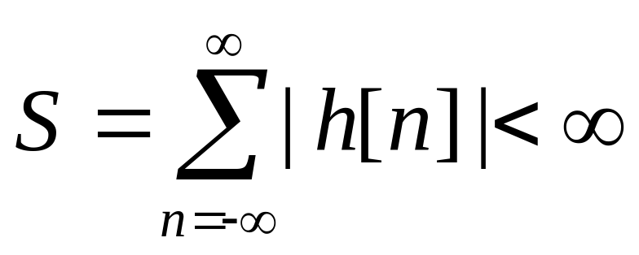
4.4 Time-Domain Characterization of LTI Discrete-Time System
Stability System Condition
  If and only if the output sequence y[n] of the system remains bounded for all bounded input sequence x[n], a discrete-time is defined to be BIBO stable

Slide 25
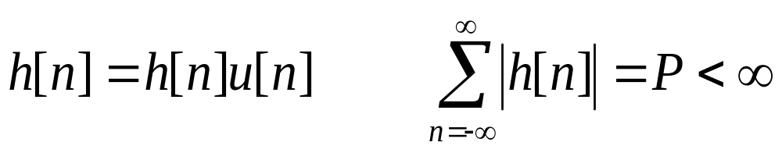
4.4 Time-Domain Characterization of LTI Discrete-Time System
Causality System Condition
If and only if the response sequence {h[n]} of a LTI discrete-Time system is satisfying the condition of Equation below, it is causal:
  h[k]=0, for k<0
Causality & Stability System Condition

Slide 26
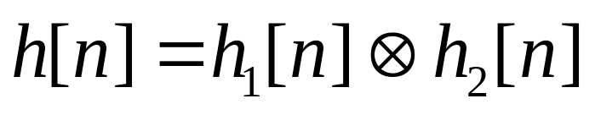
4.5 Simple Interconnection Schemes
1. Cascade connection
Definition: If the second LTI systems’ input is connected to the first systems’ output,we say the two system are connected in cascade.the overall impulse response h[n] of the two cascaded-systems is given below:
(see Figure 4.8)

Slide 27
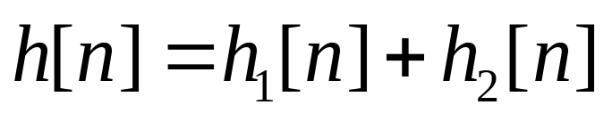
4.5 Simple Interconnection Schemes
2.Parallel connection
Definition: If the two LTI systems’ output are added to form the new output while the same input is fed to both system, we say the two system are connected in Parallel (see Figure 4.9 ). The overall impulse response h[n] is given below:

Slide 28
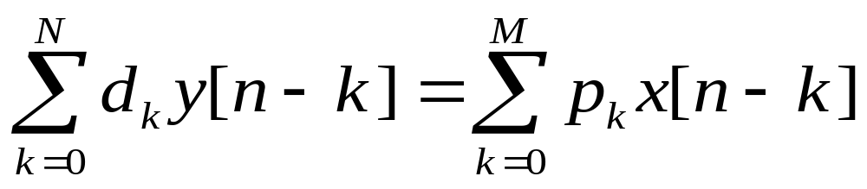
4.6 Finite-dimensional LTI discrete-time system
Definition:If for the LTI system ,the relation between input x[n] and output y[n] is given as below:
Here, d_{k}, p_{k} are constant. The order of the system is given by max(N,M).

Slide 29
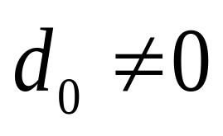
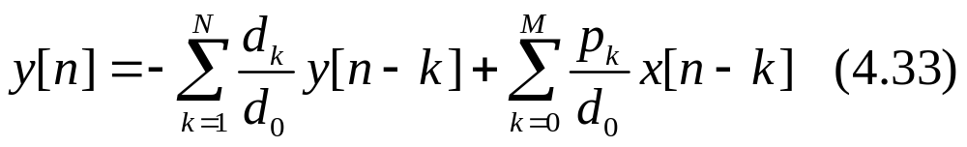
4.6 Finite-dimensional LTI discrete-time system
If we assume the system to be causal and ,then we can rewrite the equation 4.32 as below:
Then ,the output y[n] can be computed for all n>=n₀ knowing x[n] and initial conditions y[n₀-1], y[n₀-2],…, y[n₀-N].

Slide 30
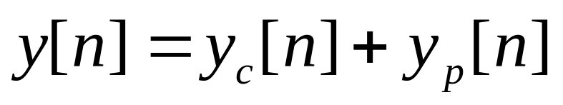
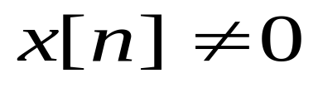
4.6 Finite-dimensional LTI discrete-time system
Total solution calculation
We may divided the answer of Eq(4.34) into two parts as below:
Here ,y[n] is called total solution .y_{c}[n] is the solution of Eq(4.34) with the input x[n]=0,which is called complementary solution. y_{p}[n] is the solution of Eq(4.34) with the input , which is called particular solution.
Self-Study

Slide 31
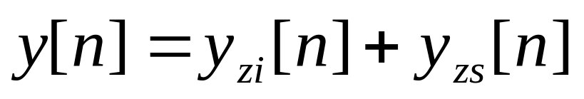
4.6 Finite-dimensional LTI discrete-time system
Zero-input response and zero-state response
We may also divided the answer of Eq(4.33) into the two parts as below:
Here ,the zero-input response y_{Zi}[n] is obtained by solving Eq(4.33) by setting the input x[n]=0,the zero-state response y_{Zs}[n] is obtained by solving Eq(4.33) by applying the specified input with all initial conditions set to zero.
Self-Study

Slide 32
4.6 Finite-dimensional LTI discrete-time system
Example 4.32 Known the difference equation as bellow:
For a step input x[n]=8µ[n] and with initial conditions y[-1]=1 and y[-2]=-1,the total response y[n] are wanted.
First, determine the eigen value of the difference equation
Setting x[n]=0 and y[n]=λ^{n} in the difference equation we arrive at
Self-Study

Slide 33
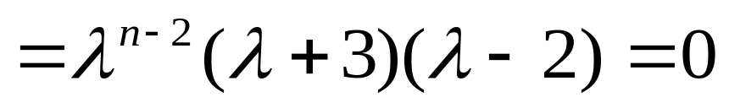
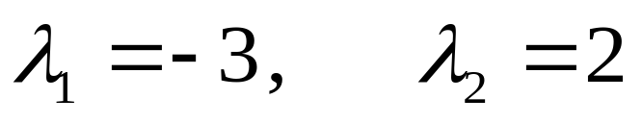
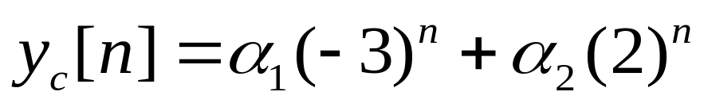
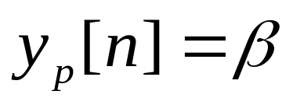
4.6 Finite-dimensional LTI discrete-time system
And hence its eigen value (roots) are:
Therefore we can get the complementary solution as below:
For the particular solution we assume
Self-Study

Slide 34
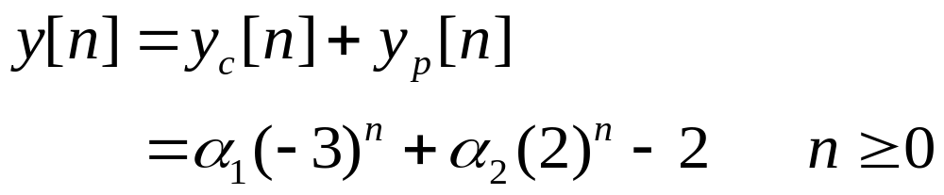
4.6 Finite-dimensional LTI discrete-time system
The y_{p}[n] is also satisfies the difference equation, so we arrive at:
The total response is the form
Consider the initial conditions we get
Self-Study

Slide 35
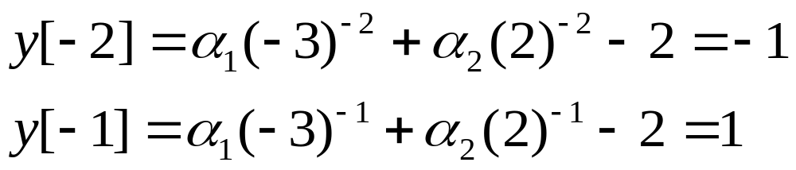
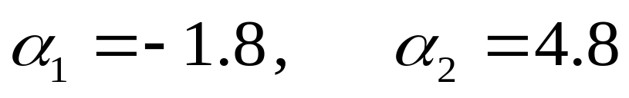
4.6 Finite-dimensional LTI discrete-time system
So we arrive at
Thus
Read and exercise example 4.23 and 4.24 by yourself!!
Self-Study

Slide 36
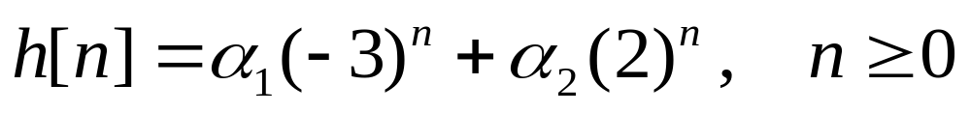
4.6 Finite-dimensional LTI discrete-time system
Impulse response calculation
We may get the Impulse response by set x[n]=δ[n], usually it has the form as y_{c}[n]
Example 4.25 Known the difference equation as bellow:
its h[n] is wanted.
From example 4.22 we get
Self-Study

Slide 37




4.6 Finite-dimensional LTI discrete-time system
Substituting from the difference equation we get
So
For any other input x[n] ,we can get the total solution y[n] according to formula as bellow:
Self-Study

Slide 38
4.6 Finite-dimensional LTI discrete-time system
Impulse and Step Response computation Using Matlab
p=[0.8 -0.44 0.36 0.02];
d=[1 0.7 -0.45 -0.6];
[h,m] = impz(p,d,41];
[s,m] = stepz(p,d,41];
Self-Study

Slide 39
4.7 Classification of LTI Discrete-time system
Based on impulse response length
If h[n] is finite length,we call it finite impulse response(FIR) system,otherwise, we call it infinite impulse response(IIR) system.
Based on the output calculation process
If the output can be calculated just by present and past input the system is called nonrecursive system,otherwise is called recursive system.

Slide 40
4.8 Frequency-Domain representations of LTI Discrete-Time systems
Most discrete-time signals encountered in practice can be represented as a linear combination of sinusoidal discrete-time signals of different angular frequencies
Thus, knowing the response of the LTI system to a single sinusoidal signal, we can determine its response to more complicated signals by making use of the superposition property

Slide 41
4.8 Frequency-Domain representations of LTI Discrete-Time systems
An important property of an LTI system is that for certain types of input signals, called eigen functions, the output signal is the input signal multiplied by a complex constant
We consider here one such eigen function as the input

Slide 42


4.8.1 Frequency Response
Consider the LTI discrete-time system with an impulse response {h[n]} shown below
Its input-output relationship in the time-domain is given by the convolution sum

Slide 43




4.8.1 Frequency Response
Definition
According to Eq(4.66),if we set
The output of an LTI system is
Where

Slide 44
4.8.1 Frequency Response
Obviously , for a complex exponential input signal e^{jωn}, the output of an LTI discrete-time system is also the same signal multiplied by a complex constant H(e^{jω}).
Here ,e^{jωn} is called an eigen function of the LTI discrete-time system.
H(e^{jω}) is called the frequency response of the LTI discrete-time system , it provides a frequency-domain description of the system and is precisely the DTFT of the impulse response h[n] of the system.

Slide 45


4.8.1 Frequency Response
Obviously, that H(e^{jω}) can completely characterizes the LTI discrete-time system in the frequency domain.
Just like any other DTFT , H(e^{jω}) is usually also a complex function of ω with a period 2π and can be expressed in terms of its real and imaginary parts or its magnitude and phase.
Where

Slide 46


4.8.1 Frequency Response
The quantity |H(e^{jω})| is called the magnitude response and the quantity θ(ω) is called the phase response of the LTI discrete-time system.
The gain function:
Attenuation or loss function.

Slide 47

4.8.1 Frequency Response
In engineering, The gain function commonly use another definition as below:
For a discrete-time system characterized by a real impulse response h[n] (real system) should note:
1. |H(e^{jω})| and H_{re} (e^{jω}) are even functions.
2. θ(ω) and H_{im} (e^{jω}) are odd functions.

Slide 48


4.8.2 Frequency-Domain characterization LTI Discrete-Time systems
If we applying the convolution theorem to the Eq.(4.66), we arrive at
Where the Y(e^{jω}) and X(e^{jω}) denote the DTFT of y[n] and x[n].
So

Slide 49


4.8.3 Frequency Response of LTI Discrete-Time systems
Frequency Response of LTI FIR Discrete-Time Systems
Frequency Response of LTI IIR Discrete-Time Systems

Slide 50

4.8.4 Frequency Response Computation Using MATLAB
Example 4.31 For
The frequency response is wanted.

Slide 51





4.8.4 Frequency Response Computation Using MATLAB
Solution:

Slide 52
Frequency Response Computation (Using MATLAB )
The function freqz(h,1,w) can be used to determine the values of the frequency response vector h at a set of given frequency points w
From h, the real and imaginary parts can be computed using the functions real and imag, and the magnitude and phase functions using the functions abs and angle
Program 4_3.m can be used to generate the magnitude and phase responses of an M-point moving average filter as shown on next-page

Slide 53


4.8.4 Frequency Response Computation Using MATLAB
Magnitude responses of the moving-average filters of length 5 and 14
Phase responses of the moving-average filters of length 5 and 14

Slide 54
Frequency Response Computation (Using MATLAB )
The phase response of a discrete-time system when determined by a computer may exhibit jumps by an amount 2π caused by the way the arctangent function is computed
The phase response can be made a continuous function of ω by unwrapping the phase response across the jumps

Slide 55
Frequency Response Computation (Using MATLAB )
To this end the function unwrap can be used, provided the computed phase is in radians
The jumps by the amount of 2π should not be confused with the jumps caused by the zeros of the frequency response as indicated in the phase response of the moving average filter

Slide 56



4.8.5 Steady-state and transient Response
For a periodic signal x[n],we should represented it as
So the response of an LTI system is

Slide 57



4.8.5 Steady-state and transient Response
That is shown, for every frequency-part of x[n], the response of an LTI system is also a complex exponential signal of the same frequency multiplied by a complex constant H(e^{jlωo}).
The response of an LTI system of a periodic input is commonly called the steady-state response.
The transient Frequency response of the LTI system:

Slide 58




4.8.6 Response to a Causal Exponential Sequence
While the input of the LTI system is a causal exponential sequence :

Slide 59





4.8.6 Response to a Causal Exponential Sequence
The steady-state response:
The transient response:

Slide 60
4.8.7 Concept of Filtering
Concept of Filtering
One application of an LTI discrete-time system is to pass certain frequency components in an input sequence without any distortion (if possible) and to block other frequency components.
Such systems are called digital filters and are one of the main subjects of discussion in this text.

Slide 61

4.8.7 Concept of Filtering
The key to the filtering process is
It expresses an arbitrary input as a linear weighted sum of an infinite number of exponential sequences, or equivalently, as a linear weighted sum of sinusoidal sequences

Slide 62

4.8.7 Concept of Filtering
Thus, by appropriately choosing the values of the magnitude function |H(e^{jω})| of the LTI digital filter at frequencies corresponding to the frequencies of the sinusoidal components of the input, some of these components can be selectively heavily attenuated or filtered with respect to the others
Example (4.33) known

Slide 63



4.8.7 Concept of Filtering
Design a Filter to pass the high-frequency component(x₂[n]) but block the low-frequency component(x₁[n]) of x[n].
Solution :For simplicity we assume the filter to be an FIR filter of length 3 with an impulse response :

Slide 64





4.8.7 Concept of Filtering
The magnitude function
The phase function
In order to stop the low-frequency component from appearing at the output of the filter, the magnitude function at ω=0.1 should be equal to zero. Similarly, the magnitude function at ω =0.4 must equal to 1. So

Slide 65
4.8.7 Concept of Filtering
Thus the output-input relation of the
FIR filter is given by
y[n] = - 6.76195(x[n]+x[n-2])+13.456335x[n-1]
where the input is
x[n] = {cos(0.1n) + cos(0.4n)}μ[n]
Program 4_4.m can be used to verify the filtering action of the above system

Slide 66

4.8.7 Concept of Filtering

Slide 67

4.8.7 Concept of Filtering
The first seven samples of the output are shown below

Slide 68
4.8.7 Concept of Filtering
From this table, it can be seen that, neglecting the least significant digit,
y[n] = cos(0.4(n-1)) for n ≥ 2
Computation of the present value of the output requires the knowledge of the present and two previous input samples
Hence, the first two output samples, y[0] and y[1], are the result of assumed zero input sample values at n = -1 and n = -2

Slide 69
4.8.7 Concept of Filtering
Therefore, first two output samples constitute the transient part of the output
Since the impulse response is of length 3, the steady-state is reached at n = N = 2
Note also that the output is delayed version of the high-frequency component cos(0.4n) of the input, and the delay is one sample period

Slide 70







4.9 Phase and Group Delays
Definitions: If the input is a sinusioidal signal of frequency but lagging in phase by radians, as demonstrated in Eq.(4.86):

Slide 71


4.9 Phase and Group Delays
From example 4.32 we can see that the output signal y[n] of an LTI discrete-time system exhibits some delay relative to the input signal x[n] caused by the nonzero phase response of the system.
We can rewrite Eq.(4.86) as
indicating a time delay, more commonly known as phase delay at ω= ω₀ given by

Slide 72




4.9 Phase and Group Delays
While input is
Where
x[n] is a narrowband signal .
In this situation ,we can derivate the output signal as below:
group delay or envelope delay

Slide 73






4.9 Phase and Group Delays
phase delay
An example of group delay and phase delay is shown in Figure 4.15
The waveform of the underlying continuous-time output shows distortion when the τ_{g} of the LTI system is not constant over the bandwidth of x[n]. A delay equalizer is usually cascaded with the LTI system

Slide 74

4.9 Phase and Group Delays
The figure(4.16) below illustrates the effects of the two delays on an amplitude modulated sinusoidal signal

Slide 75
4.10 Phase Delay and Group Delay Computation using MATLAB
Read and exercise by yourself !!
Phase delay can be computed using the function phasedelay
Group delay can be computed using the function grpdelay

Slide 76
Reference Homework
Read textbook from p277 to 319
Problems
4.3, 4.4, 4.5, 4.8, 4.10, 4.12, 4.23, 4.30, 4.35, 4.61, 4.62,4.69
M4.1, M4.2, M4.5
*

