Slide 1
Chapter 2
Discrete-Time Signals in the Time Domain

Slide 2
§2 Discrete-Time Signals In the Time-Domain
§2.1 Time-Domain Representation
Discrete-time signals x[n]--represented as sequences with argument n being an integer in the range -∞< n <∞
The nth sample value of sequence x[n] is also denoted as x[n]
values of argument n--defined only for integer and undefined for noninteger values of n
Discrete-time signal represented by {x[n]}

Slide 3
§2 Discrete-Time Signals In the Time-Domain
Discrete-time signal may also be written as a sequence of numbers inside braces:
{x[n]}={…,-0.2,2.2,1.1,0.2,-3.7,2.9,…}
↑
The arrow is placed under the sample at time index n = 0
In the above, x[-1]= -0.2, x[0]=2.2, x[1]=1.1, etc.

Slide 4
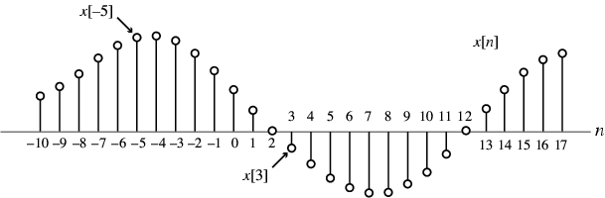
§2 Discrete-Time Signals In the Time-Domain
Graphical representation of a discrete-time signal with real-valued samples is as shown below:

Slide 5
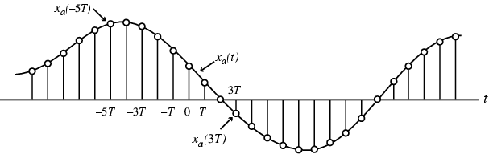
§2 Discrete-Time Signals In the Time-Domain
In some applications, a discrete-time sequence {x[n]} may be generated by periodically sampling a continuous-time signal x_{a}(t) at uniform intervals of time

Slide 6

§2 Discrete-Time Signals In the Time-Domain
Here, n-th sample is given by
x[n]=x_{a}(t) |_{t=nT}=x_{a}(nT), n=…,-2,-1,0,1,…
The spacing T between two consecutive samples is called the sampling interval or sampling period
Reciprocal of sampling interval T, denoted as F_{T} , is called the sampling frequency:
F_{T}=1/T

Slide 7
§2 Discrete-Time Signals In the Time-Domain
Unit of sampling frequency is cycles per second, or hertz (Hz), if T is in seconds
Whether or not the sequence {x[n]} has been obtained by sampling, the quantity x[n] is called the n-th sample of the sequence
{x[n]} is a real sequence, if the n-th sample x[n] is real for all values of n
Otherwise, {x[n]} is a complex sequence

Slide 8
§2 Discrete-Time Signals In the Time-Domain
A complex sequence {x[n]} can be written as
{x[n]}={x_{re}[n]}+j{x_{im}[n]} (2.4)
where x_{re}[n] and x_{im}[n] are the real and imaginary parts of x[n]
The complex conjugate sequence of {x[n]} is given by
{x*[n]}={x_{re}[n]} - j{x_{im} [n]}
Often the braces are ignored to denote a sequence if there is no ambiguity

Slide 9
§2 Discrete-Time Signals In the Time-Domain
Example - {x[n]}={cos0.25n} is a real sequence
{y[n]}={e^{j0.3n}} is a complex sequence
We can write
{y[n]}={cos0.3n + jsin0.3n}
= {cos0.3n} + j{sin0.3n}
where {y_{re}[n]}={cos0.3n}
{y_{im}[n]}={sin0.3n}

Slide 10
§2 Discrete-Time Signals In the Time-Domain
Two types of discrete-time signals:
- Sampled-data signals in which samples are continuous-valued
- Digital signals in which samples are discrete-valued
Signals in a practical digital signal processing system are digital signals obtained by quantizing the sample values either by rounding or truncation

Slide 11
§2 Discrete-Time Signals In the Time-Domain
Example
Amplitude
Amplitude
Time,t
Time,t
Boxedcar signal
Digital signal

Slide 12
§2 Discrete-Time Signals In the Time-Domain
2.1.1 Length of a discrete-time signal
A discrete-time signal may be a finite-length or an infinite-length sequence
Finite-length (also called finite-duration or finite-extent) sequence is defined only for a finite time interval: N₁≤ n ≤ N₂
where - ∞< N₁ and N₂ < ∞ with N₁≤ N₂
Length or duration of the above finite-length sequence is N= N₂ - N₁+ 1
Zero-padding—append with zero-valued samples.
x[n]=[x[0] x[1] … x[N-1]]
Vector form
^{t}

Slide 13
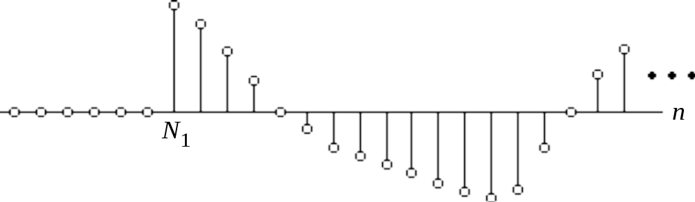
§2 Discrete-Time Signals In the Time-Domain
A right-sided sequence x[n] has zero-valued samples for n < N₁
A right-sided sequence
If N₁≥ 0, a right-sided sequence is called a causal sequence.

Slide 14
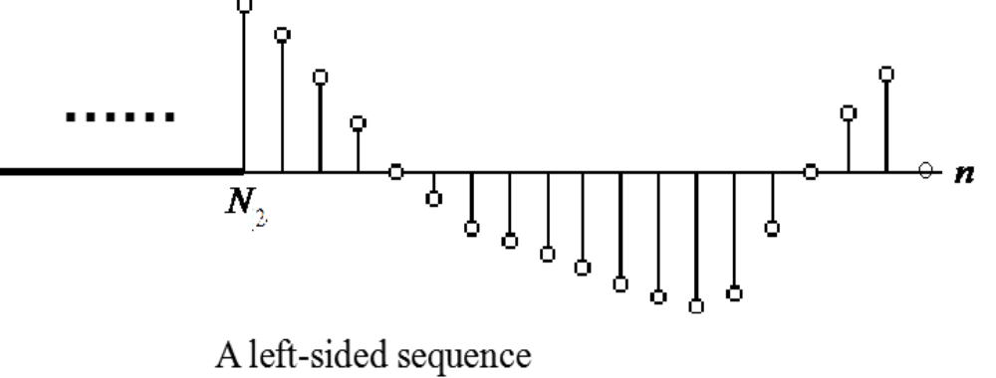


§2 Discrete-Time Signals In the Time-Domain
A left-sided sequence x[n] has zero-valued samples for n > N₂
If N₂≤ 0, a left-sided sequence is called a anticausal sequence.

Slide 15
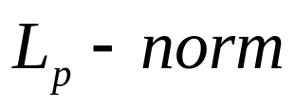
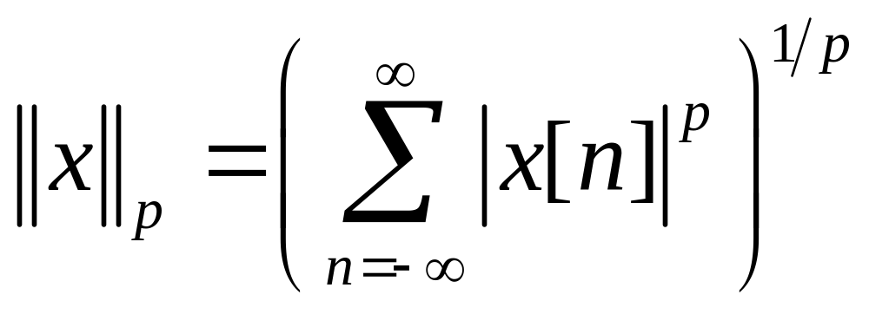

§2 Discrete-Time Signals In the Time-Domain
2.1.2 Strength of a Discrete-Time Signal
The strength of a DT Signal usually is given by its norm.
of {x[n]} is defied by
(2.9)
p is a positive integer.
In practice, the value of p used is typically 1 or 2 or .

Slide 16
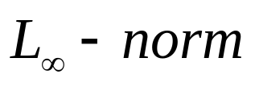
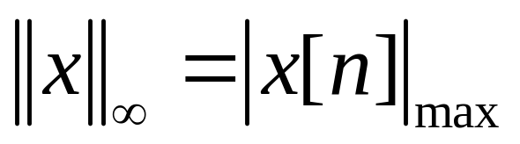
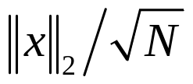

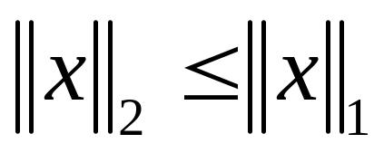
§2 Discrete-Time Signals In the Time-Domain
Peak absolute value
(2.10)
For a length-N seqence,
is the root-mean-squared(rms) value of {x[n]}, and
is the mean absolute value of {x[n]}.
It can be shown that
M-file in MATLAB
norm(x,1)
norm(x,2)
norm(x,inf)

Slide 17
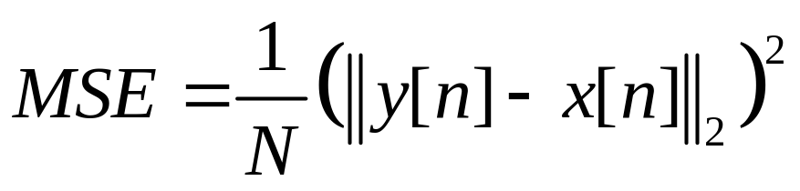
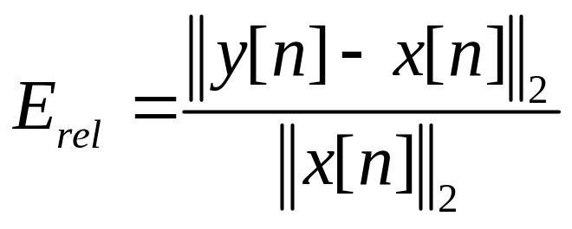
§2 Discrete-Time Signals In the Time-Domain
One application of the norm is in estimating the error in approximation of a DT signal by another DT signal in some sense.
For example, a length-N seqence y[n], and another x[n],
0≤ n ≤N-1
mean-squared error(MSE)
(2.11)
relative error
(2.12)

Slide 18
§2 Discrete-Time Signals In the Time-Domain
§2.2 The Basic Operations On Sequences
2.2.1 Elementary Operations
modulator(product or windowing)
x
[
n
]
w
[
n
]
=
x
[
n
]
y
[
n
]
x
[
n
]
w
[
n
]
=
Ax
[
n
]
1
2
y
[
n
]
multipler
modulator

Slide 19
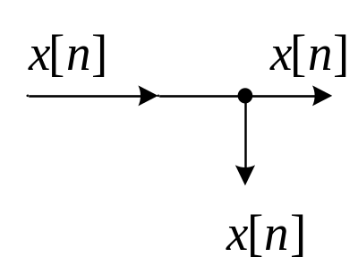
§2 Discrete-Time Signals In the Time-Domain
x
[
n
]
w
[
n
]
=
x
[
n
]
+
y
[
n
]
3
addition(subtraction)
y
[
n
]
adder
w
[
n
]
=
x
[
n
−
1
]
w
[
n
]
=
x
[
n
+
1
]
x
[
n
]
4
x
[
n
]
5
Z
−
1
Z
unit delay
unit advance
pick-off node
time-reversal (folding operation)
x[-n]

Slide 20
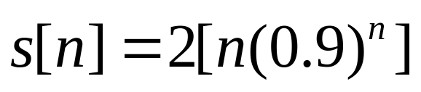
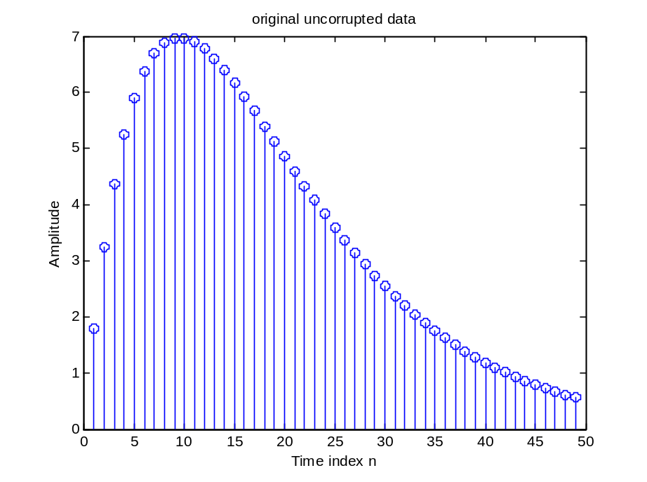
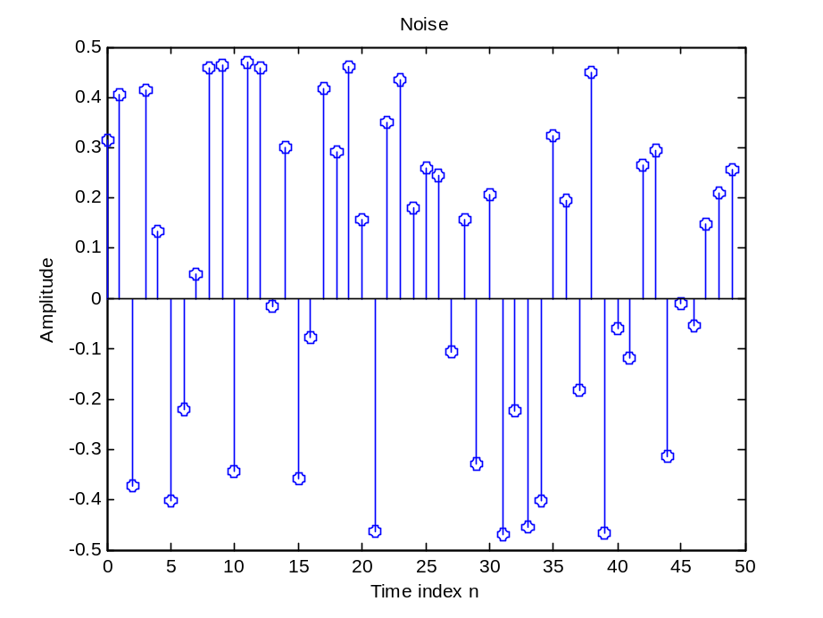
§2 Discrete-Time Signals In the Time-Domain
Example 2.1 Ensemble average
original uncorrupted data
Noise

Slide 21
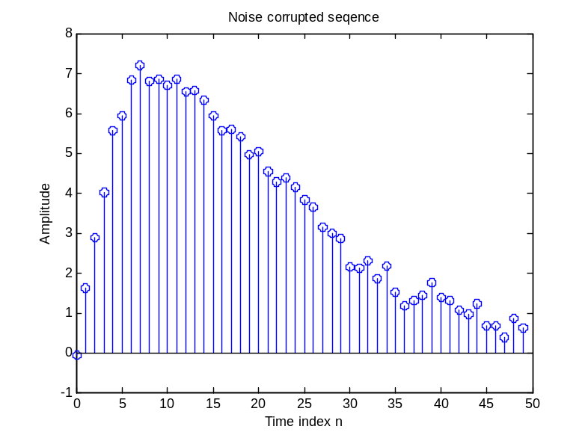
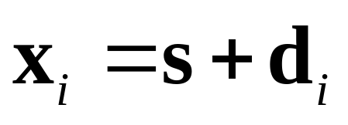
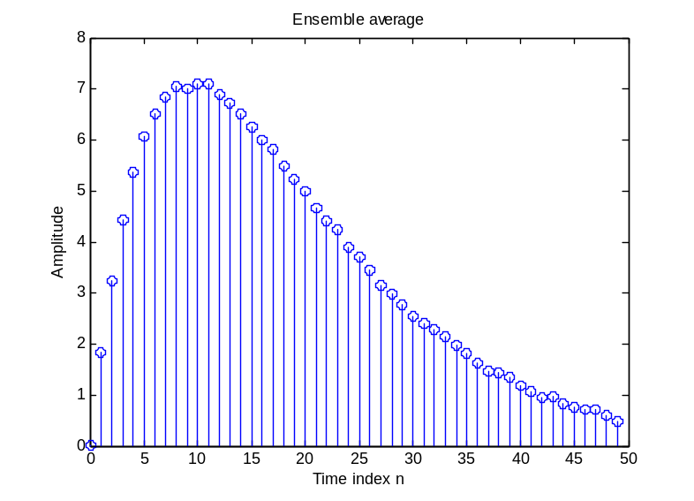
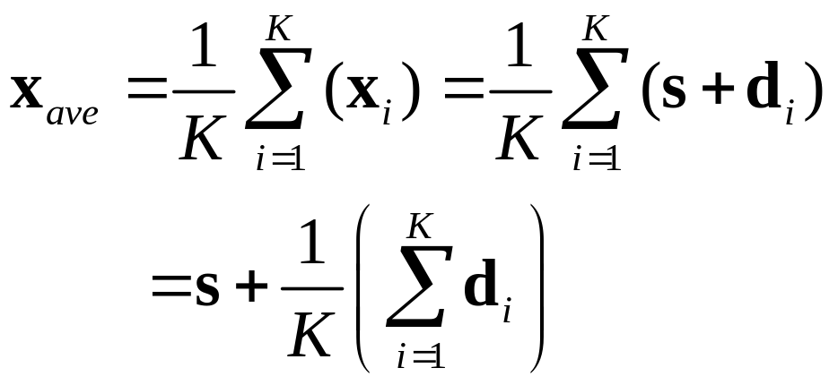
§2 Discrete-Time Signals In the Time-Domain
Vector form
t
s=[s[0] s[1] … s[N-1]]
The i-th measurement of data vector
Ensemble average

Slide 22
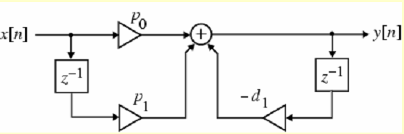
§2 Discrete-Time Signals In the Time-Domain
2.2.2 Combination of Elementary Operations

Slide 23
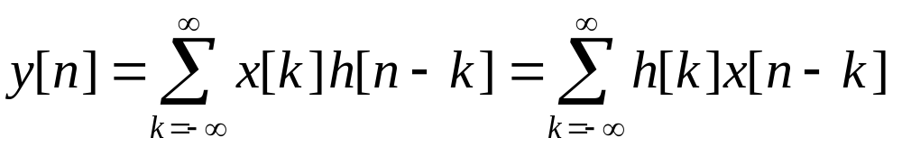
2.2.3 Convolution Sum
§2 Discrete-Time Signals In the Time-Domain
is called the convolution sum of the sequences x[n] and h[n] and represented compactly as
y[n] = x[n] h[n]
*

Slide 24
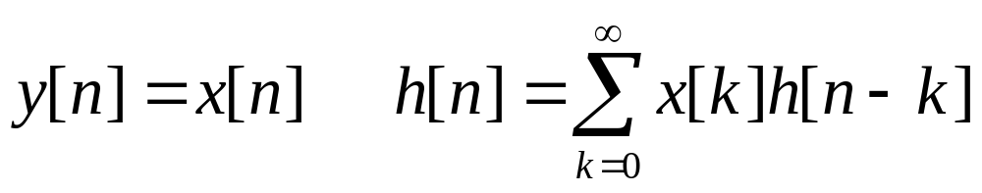
§2 Discrete-Time Signals In the Time-Domain
Example Develop the sequence y[n] generated by the convolution of the sequences x[n] and h[n] :
x[n] = h[n] = δ[n] + δ[n-1] + δ[n-2]
*
y[n]=δ[n]+2δ[n-1]+3δ[n-2]+2δ[n-3]+δ[n-4]

Slide 25
§2 Discrete-Time Signals In the Time-Domain
x[n] = h[n] = δ[n] + δ[n-1] + δ[n-2]
x[k]
x[k]
x[k]
x[k]
x[k]
x[k]
1
h[k]
h[-k]
h[1-k]
h[2-k]
h[3-k]
h[4-k]
1
X[k]h[-k]
X[k]h[1-k]
X[k]h[2-k]
X[k]h[3-k]
X[k]h[4-k]
k
k
k
k
k
∑X[k]h[-k]
=1
∑X[k]h[1-k]
=2
∑X[k]h[2-k]
=3
∑X[k]h[3-k]
=2
∑X[k]h[4-k]
=1

Slide 26
§2 Discrete-Time Signals In the Time-Domain
y[n ]
3
2
2
1
1
n
0
1
2
3
4
In general, if the lengths of the two sequences being convolved are M and N, then the sequence generated by the convolution sum is of length M+N-1
Read example 2.5 and 2.6 by yourself.

Slide 27





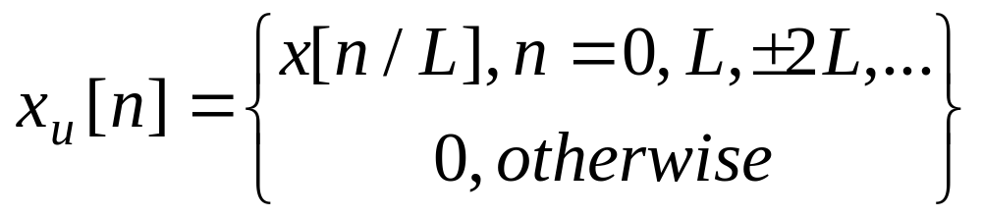
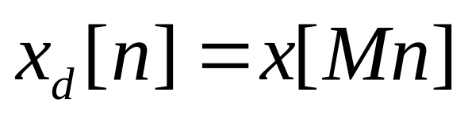
2.2.4 Sampling rate alteration
§2 Discrete-Time Signals In the Time-Domain
Up-sampling
Down-sampling

Slide 28
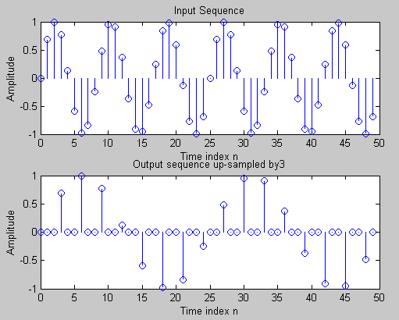
§2 Discrete-Time Signals In the Time-Domain
Up-sampling (L=3)

Slide 29
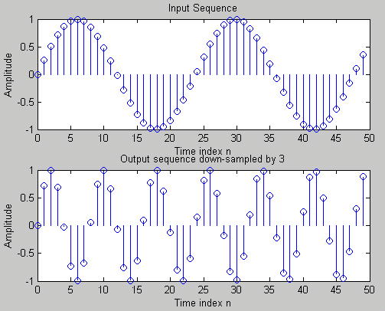
§2 Discrete-Time Signals In the Time-Domain
Down-sampling (M=3)

Slide 30
§2 Discrete-Time Signals In the Time-Domain
§ 2.3 Operations on Finite-length Sequences
Some of the operations on sequences described
in previous section are not applicable to finite-
length sequencs.
Consider length-N sequences x[n] defined for
0≤n≤N-1
Sample values of such sequences are equal to zero for values of n < 0 and n≥N
x[– n] is defined for the range –(N-1) ≤n≤ 0.

Slide 31
§2 Discrete-Time Signals In the Time-Domain
for any arbitrary integer n₀ , x₁[n] = x[n – n₀]
is no longer defined for the range 0≤n≤N-1
We thus need to define another type of operation that will always keep the operated sequence defined for the range 0≤n≤N-1.
for any arbitrary integer n₀ , x₁[n] = x[n – n₀]
is no longer defined for the range 0≤n≤N-1

Slide 32
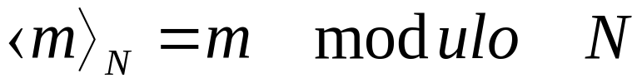

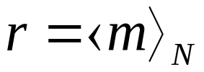
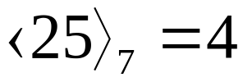
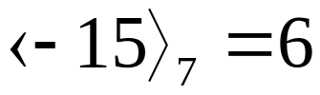
§2 Discrete-Time Signals In the Time-Domain
2.3.1 circular time-reversal operation
Modulo operation
Integer m
Integer r:[0, N-1]
residue
Example
Thus,
Thus,

Slide 33
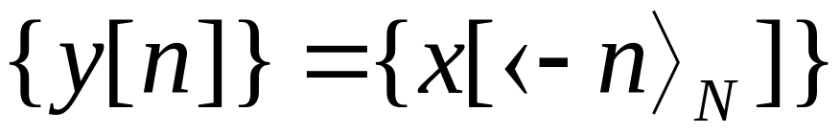
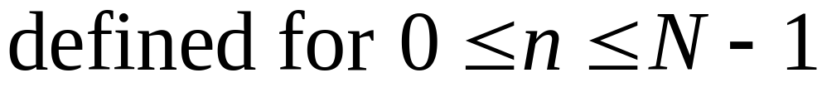
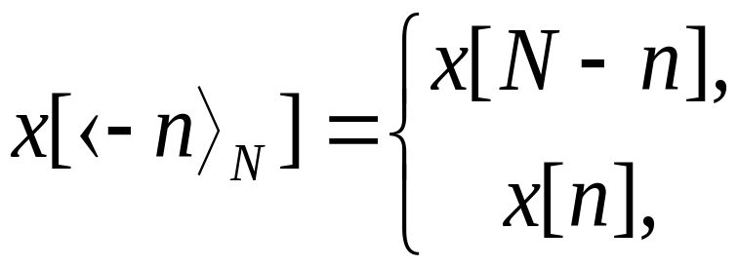
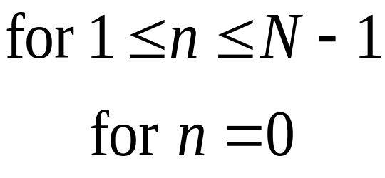
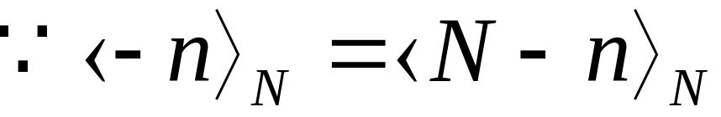
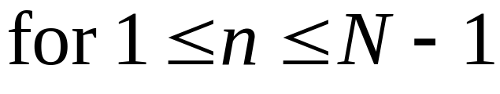
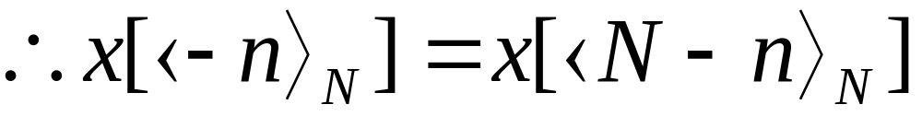
§2 Discrete-Time Signals In the Time-Domain
circular time-reversal operation

Slide 34
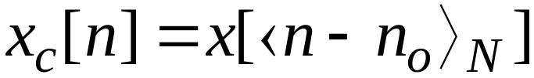
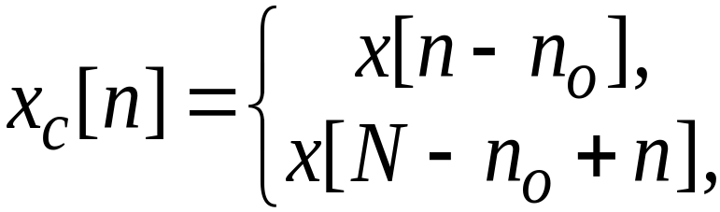
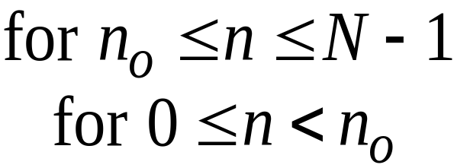
§2 Discrete-Time Signals In the Time-Domain
2.3.2 Circular Shift of a Sequence
the circular shift, is defined using a modulo operation:
For n₀>0 (right circular shift), the above equation implies

Slide 35
§2 Discrete-Time Signals In the Time-Domain
2.3.3 Classification of Sequences
1. Classification based on Symmetry
complex sequence x[n]
real x[n]
Even
x[n]=x[-n]
Conjugate-symmetry sequence
x*[n] = x[-n]
Conjugate-antisymmetry sequence
x*[n] = -x[-n]
Odd
x[n]=-x[-n]

Slide 36
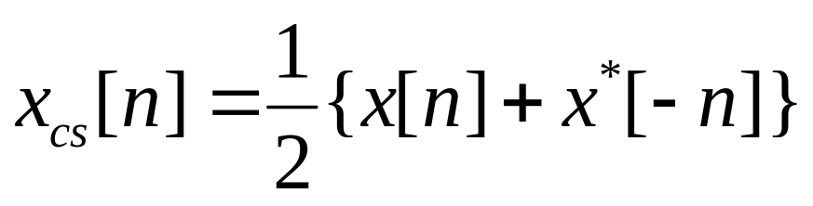
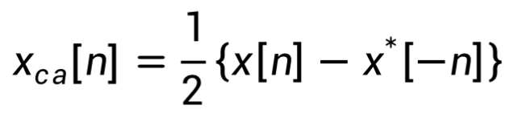
§2 Discrete-Time Signals In the Time-Domain
x[n] is complex sequence,
Conjugate-symmetry part
Conjugate-antisymmetry part

Slide 37
§2 Discrete-Time Signals In the Time-Domain
Example 2.8 A length-7 sequence(n:[-3,3]):
{g[n]} = {0, 1+j4, -2+j3, 4-j2, -5-j6, -j2, 3}
↑
{g﹡[n]}={0, 1-j4, -2-j3, 4+j2, -5+j6, j2, 3}
↑
{g﹡[-n]}={3, j2, -5+j6, 4+j2, -2-j3, 1-j4, 0}
↑
{gcs [n]}={1.5,0.5+j3,-3.5+j4.5,4,-3.5-j4.5,0.5-j3,1.5}
↑
{gca [-n]}={-1.5,0.5+j,1.5-j1.5,-j2,-1.5-j1.5,-0.5+j,1.5}
↑

Slide 38
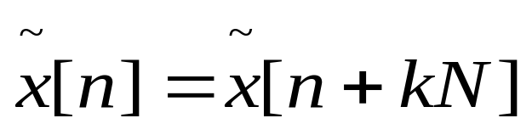
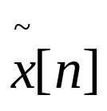
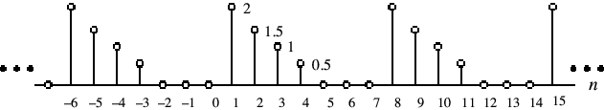
2.Classification of Sequences based on periodicity
§2 Discrete-Time Signals In the Time-Domain
A sequence satisfying the periodicity condition
is called an periodic sequence
for all n
Example

Slide 39
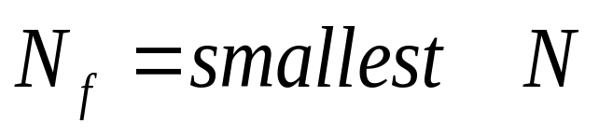
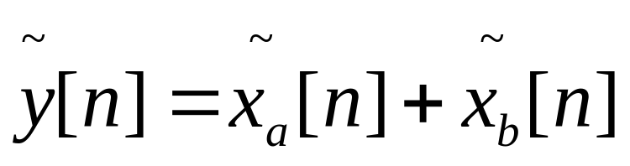
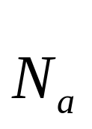
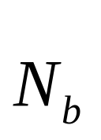

§2 Discrete-Time Signals In the Time-Domain
fundamental periods
Adding two periodic sequences with different fundamental periods
The fundamental period：
LCM( )---least common multiple
GCD( )---greatest common divider

Slide 40

§2 Discrete-Time Signals and Systems
Example
Its fundamental period is 48, because the GCD of 16 and 12 is 4.

Slide 41


3. Energy and Power Signals
§2 Discrete-Time Signals In the Time-Domain
Total energy of a sequence x[n] is defined by
The average power of a sequence is defined by
Energy signal: a finite energy signal with zero average power.

Slide 42


§2 Discrete-Time Signals In the Time-Domain
Example - Power signal: an infinite energy signal with finite average power.
Note: x[n] has infinite energy
Its average power is given by

Slide 43


4. Other Types of Classification
§2 Discrete-Time Signals In the Time-Domain
A sequence x[n] is said to be bounded if
Example - The sequence x[n]=cos(0.3πn) is a bounded sequence as

Slide 44



§2 Discrete-Time Signals In the Time-Domain
A sequence x[n] is said to be absolutely summable if
Example - The sequence
is an absolutely summable sequence as

Slide 45


§2 Discrete-Time Signals In the Time-Domain
A sequence x[n] is said to be square-summable if
Example - The sequence
is square-summable but not absolutely summable

Slide 46





§2 Discrete-Time Signals In the Time-Domain
Example - The sequence obtained by
adding an absolutely summable sequence
with its replicas shifted by integer multiples of N,
is called an N-periodic extension of .
It is neither absolutely summable nor square-summable .

Slide 47




§2 Discrete-Time Signals In the Time-Domain
§ 2.4 Typical Sequences and Representation
2.4.1 Basic Sequences
Unit sample sequence
Unit step sequence

Slide 48

2.4.3 Representation of an Arbitrary Sequence by impulses
§2 Discrete-Time Signals In the Time-Domain
An arbitrary sequence can be represented in the time-domain as a weighted sum of some basic sequence and its delayed (advanced) versions

Slide 49


§2 Discrete-Time Signals In the Time-Domain
Example

Slide 50


§2 Discrete-Time Signals In the Time-Domain
Rectangular Window Sequence
Box-car sequence
(2.56)
Windowing
(2.57)

Slide 51

§2 Discrete-Time Signals In the Time-Domain
Sinusoidal Sequence
where A is the amplitude, ω₀ is the normalized angular frequency, and φ is the phase of x[n].
The unit of ω₀ and φ is radians/sample
Often in practice, ω₀ is expressed as
ω₀=2πf₀
Where f₀ is normalized frequency in cycles/sample.

Slide 52





§2 Discrete-Time Signals In the Time-Domain
Sinusoidal Sequence
  We can write as
  is the in-phase components of x[n] and
  is the quadrature components of x[n].

Slide 53



§2 Discrete-Time Signals In the Time-Domain
Exponential Sequence
(2.51)
when A and are real or complex numbers.
By expressing

Slide 54


§2 Discrete-Time Signals In the Time-Domain
The Complex Exponential Sequence
we can rewrite
(2.52a)
(2.52b)
And

Slide 55



§2 Discrete-Time Signals In the Time-Domain
The complex sinusoidal sequence

Slide 56


§2 Discrete-Time Signals In the Time-Domain
Real Exponential Sequence
when A and are real numbers, it’s a real exponential sequence.
α=1.2
α=0.9

Slide 57
§2 Discrete-Time Signals In the Time-Domain
* The periodicity of sinusoidal and exponential sequence *
If 2π/ω₀ is an rational number, the sequence x[n]=Acos(ω₀n+φ) is periodic.
Otherwise, it’s aperiodic.
Why?
How to determine the fundamental period?
To verify the above fact, consider
x₁ [n]= Acos(ω₀n+φ)
x₂ [n]= Acos(ω₀(n+N)+φ)

Slide 58
§2 Discrete-Time Signals In the Time-Domain
x₂ [n]= cos(ω₀( n+N) + φ)
= cos(ω₀n + φ)cos ω₀N - sin(ω₀n + φ)sinω₀N
which will be equal to cos(ω₀n+ φ)=x₁[n]
only if sin ω₀N= 0 and cos ω₀N = 1.
These two conditions are met if and only if
ω₀N= 2πr (2.53a)
or 2π / ω₀ = N/r (2.53b)
where N and r are positive integers.
Smallest value of N satisfying ω₀N=2πr
is the fundamental period of the sequence.

Slide 59

§2 Discrete-Time Signals In the Time-Domain
Example - x[n]=sin(3n) is an aperiodic sequence.
y[n]=cos(0.1π n) is a periodic sequence.
ω₀ = 0.1π
Hence N= 2πr/ω₀
= 20 for r = 1
Read Example 2.11 and 2.12 by yourself.

Slide 60
§2 Discrete-Time Signals In the Time-Domain
Two Properties of Sinusoidal Sequence
1. Consider: x₁[n]=Acos(ω₁n+φ), x₂[n]= Acos(ω₂n+φ)
Where, 0≤ ω₁<2π, and 2πk ≤ ω₂<2π(k+1)
k is an any positive integer.
If
ω₂ = ω₁+2πk
(2.55)
Then x₂[n] = Acos((ω₁+2πk) n+φ) = x₁[n]
ω₂ is equivalent to ω_{1·}
(indistinguishable)

Slide 61
§2 Discrete-Time Signals In the Time-Domain
i.e, ω₁ is equivalent to ω₂ modulo 2π.
ω₂ = ω₁+2πk
{range 0≤ ω₁<2π}
folding frequency
2.The highest ω of Sinusoidal Sequence is π.
Observate the Oscillation of Sinusoidal Sequence

Slide 62

§2 Discrete-Time Signals In the Time-Domain

Slide 63

2.4.2 Sequence Generation Using MATLAB
§2 Discrete-Time Signals In the Time-Domain
Example -
n=0:40;
K=1;
c=(-1+j*pi)/12;
x=K*exp(c*n);

Slide 64


§2 Discrete-Time Signals and Systems
stem(n, real(x));
title('Real part');
stem(n, imag(x));
title('Imaginary part');

Slide 65
§2 Discrete-Time Signals In the Time-Domain
§ 2.5 The Sampling Process
Often, a discrete-time sequence x[n] is developed by uniformly sampling a continuous-time signal x_{a}(t) as indicated below
x[n]=x_{a}(t)|_{t=nT}=x_{a}(nT), n=…, -2, -1, 0, 1, 2, …

Slide 66




§2 Discrete-Time Signals In the Time-Domain
Time variable t of x_{a}(t) is related to the time variable n of x[n] only at discrete-time instants t_{n} given by
Here:
---sampling frequency
---sampling angular frequency

Slide 67



§2 Discrete-Time Signals In the Time-Domain
Sampling a continuous-time Sinusoidal signal
The corresponding discrete-time signal is
where
is the normalized digital angular frequency of x[n]

Slide 68
§2 Discrete-Time Signals In the Time-Domain
The unit of sampling period T is in seconds
The unit of ω₀ is radians/sample
Note: The Ambiguity in the DT Representation of CT Signals
Example 2.15
Three continuous-time signals
of frequencies 3 Hz, 7 Hz, and 13 Hz,
While sample distance T=0.1sec, the derived sequences are:

Slide 69
§2 Discrete-Time Signals In the Time-Domain
Plots of these sequences (shown with circles) and their parent time functions :
1
0.5
Amplitude
0
-0.5
-1
0
0.2
0.4
0.6
0.8
1
time
Note that each sequence has exactly the same sample value for any given n

Slide 70
§2 Discrete-Time Signals In the Time-Domain
This fact can also be verified by observing that
As a result, all three sequences are identical and it is difficult to associate a unique continuous-time function with each of these sequences.
Why?

Slide 71
§2 Discrete-Time Signals In the Time-Domain
The above phenomenon of a continuous-time signal of higher frequency acquiring the identity of a sinusoidal sequence of lower frequency after sampling is called aliasing.
Recall ω0=2πΩ0/ΩT
Thus if ΩT>2Ω0, then ω₀ of the discrete-time signal obtained by sampling the parent continuous-time sinusoidal signal will be in the range -π<ω<π.
No aliasing

Slide 72
§2 Discrete-Time Signals In the Time-Domain
On the other hand, if Ω_{T} < 2Ω₀ , the normalized digital angular frequency will fold over into a lower digital frequency
ω₀ = ( 2 π Ω₀ / Ω_{T})_{2π} in the range -π<ω<π because of aliasing
Hence, to prevent aliasing, the sampling frequency Ω_{T} should be greater than 2 times the frequency Ω₀ of the sinusoidal signal being sampled ( sampling theorem, Section 3.8.1)

Slide 73
Homework
Reference problems：
2.3, 2.4(a) (b), 2.5, 2.9, 2.19, 2.21, 2.27, 2.28, 2.47, 2.51;
M2.2，M2.3, M2.4

