Slide 1
Chapter 3 Discrete-Time Signals in the Frequency Domain

Slide 2
Outline
The Continuous-Time Fourier Transform
(CTFT Review)
The Discrete-Time Fourier Transform
(DTFT)
Definition、Properties、Symmetry Relations
Theorems
Computation by Matlab, Unwrap function
Digital Processing of Continuous-Time Signals (Sampling, Recovery, Band-pass )

Slide 3
How to Represent the Discrete-Time Signal?
Time-domain →
(a weighted linear combination of delayed unit sample sequences.)
Frequency-domain →
Description of a sequence in terms of complex exponential sequences of the form{ }.
Notes:
The best approach is to represent the signal as a combination of some kind of the simplest signals which will pass through the system and produce a response. Combine the responses of all simplest signals, which is the system response for the original signal.

Slide 4
3.1 The Continuous-Time Fourier Transform
CTFT – continuous in time, continuous in frequency
x(t)
MOOC
t

Slide 5
Normally, is a complex function.
In polar form:
-----magnitude spectrum
-----phase spectrum
MOOC

Slide 6
Dirichlet conditions: exists if
Finite number of finite discontinuities and a finite number of maxima and minima in any finite interval.
(b) Absolutely integrable
(3.3)
a milder condition of (3.3)
(3.6)
Notes:
However, the CTFT may exists for a finite-energy continuous-time signal that is not absolutely integrable. Ex: ideal LPF;
The CTFT can also be defined using ideal impulses for some funtions that do not satisfy either (3.3) or (3.6).

Slide 7
FS- periodicity in time, discrete in frequency
Where:
x(t)
T0

Slide 8


Example of CTFT
x_{a}(t)
1
t
|X_{a}(jΩ)|
1/α
Ω

Slide 9
Unit impulse δ(t)
δ(t)
Δ(jΩ)
1
0
t
0
Ω
1 ←→ 2πδ(ω)
This result could be got directly based on the symmetry of Fourier Transform.
Notes:
Unit impulse has uniform frequency density in whole frequency range, that means it has infinite wide band.
Constant 1 represents direct current signal, and its spectrum is non-zero only at 𝛺=0.

Slide 10
sin and cos
F[e^{jω0t}]
F[cosω₀t]= F[(e^{jω0t} + e^{-jω0t)}/2]= π[δ(ω + ω₀) + δ(ω - ω₀)]
F[sinω₀t] = F[(e^{jω0t} - e^{-jω0t)}/2j]= jπ[δ(ω+ ω₀) - δ(ω - ω₀)]
F[cos ω₀t]
F[sin ω₀t]
(π)
(π)
(jπ)
ω₀
-ω₀
ω₀
-ω₀
(-jπ)

Slide 11
The total energy of x_{a}(t):
Parseval’s Theorem
Energy Density Spectrum:
The energy over frequency range is:

Slide 12
3.2 Discrete-Time Fourier Transform 3.2.1 Definition
The discrete-time Fourier transform of a sequence is defined by :
It’s inverse transform:
MOOC
Discrete in time, periodicity in frequency

Slide 13
IDTFT Proof :
The order of integration and summation can be interchanged if the summation inside the brackets converges uniformly, i.e. X(e^{jω}) exists.
Then,

Slide 14
Now
Hence,

Slide 15
So, DTFT is discrete in time, periodicity in frequency
The DTFT X(e^{jω}) of a sequence x[n] is a continuous function of ω
It is also a periodic function of ω with a period 2π:
MOOC

Slide 16
Therefore
represents the Fourier series representation of the periodic function.
As a result, the Fourier coefficients x[n] can be computed from X(e^{jω}) using the Fourier integral
MOOC

Slide 17
Example
The DTFT of the unit sample sequence δ[n] is given by

Slide 18
3.2.2 Basic Properties
In general, X(e^{jω}) is a complex function of the real variable w and can be written in rectangular form as:
X(e^{jω}) = X_{re}(e^{jω}) + j X_{im}(e^{jω})
Where, X_{re}(e^{jω}) and X_{im}(e^{jω}) are, respectively, the real and imaginary parts of X(e^{jω}), and are real functions of w.
X_{re}(e^{jω}) = ½{X(e^{jω}) + X*(e^{jω})}
X_{im}(e^{jω}) = ½{X(e^{jω}) - X*(e^{jω})}
MOOC

Slide 19
X(e^{jω}) can alternately be expressed in polar form as
X(e^{jω}) = | X(e^{jω}) |e^{jθ(ω)} (3.19)
where
θ(ω) = arg{X(e^{jω}) } (3.20)
| X(e^{jω}) | is called the magnitude function
θ(ω) is called the phase function
Both quantities are real functions of ω.
MOOC
Notes:
In many applications, the DTFT is called the Fourier spectrum.
Likewise, | X(e^{jω}) | and θ(ω) are called the magnitude and phase spectra.

Slide 20
The relations between the rectangular and polar forms of X(e^{jω}) are given by:
X_{re}(e^{jω}) = | X(e^{jω})|cosθ(ω)
X_{im}(e^{jω}) = | X(e^{jω})|sinθ(ω)
|X(e^{jω})|² = X(e^{jω})X* (e^{jω}) = X²_{re}(e^{jω}) + X²_{im}(e^{jω})
tanθ(ω) = X_{im}(e^{jω}) / X_{re}(e^{jω})
For a real sequence x[n], | X(e^{jω}) | and X_{re}(e^{jω}) are even functions of ω, whereas, θ(ω) and X_{im}(e^{jω}) are odd functions of ω.

Slide 21
Note: X(e^{jω}) = | X(e^{jω}) |e^{j[θ(ω)+2πk]}
= | X(e^{jω}) |e^{jθ(ω)}
for any integer k.
The phase function θ(ω) cannot be uniquely specified for any DTFT.
Unless otherwise stated, we shall assume that the phase function θ(ω) is restricted to the following range of values:
-π≤ θ(ω) ≤ π
called the principal value (wrapped phase).
The continuous function of ω is derived from the original phase function by removing the discontinuities of 2π is called unwrapped phase.

Slide 22
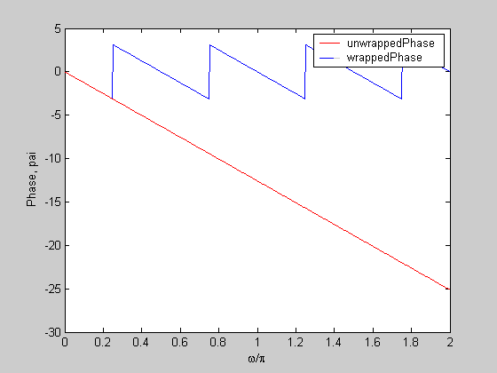
Wrapped Phase and Unwrapped Phase
Example:
Ө (ω)= - 4ω
MOOC

Slide 23
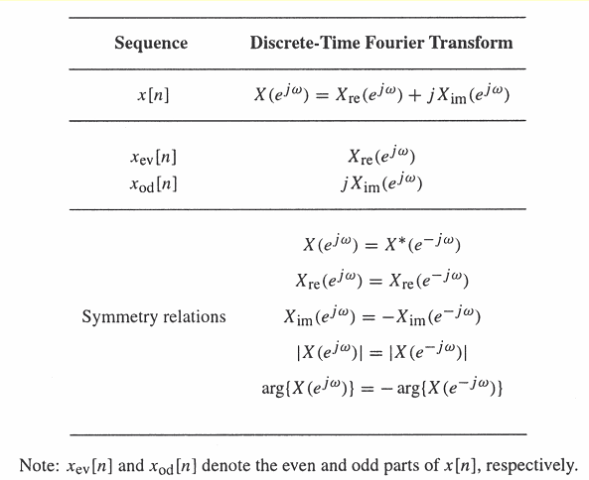
Symmetry relations of the DTFT of a real sequence
3.2.3 Symmetry Relations
MOOC

Slide 24
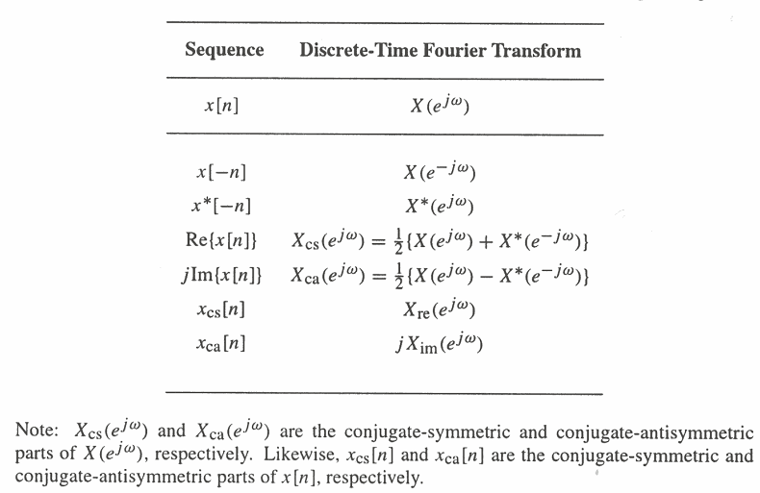
x[n] is a complex sequence
MOOC

Slide 25
Example - Consider the causal sequence
as

Slide 26
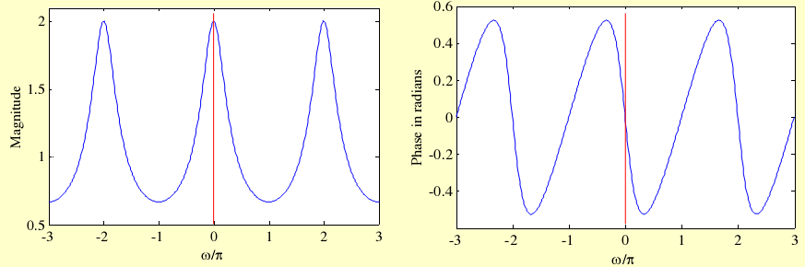
The magnitude and phase of the
X(e^{jω}) = 1/(1 – 0.5e^{-jω}) are shown below:
|X(e^{jω})|= |X(e^{-jω})|
θ(ω)=-θ(-ω)

Slide 27
3.2.4 Convergence Condition
If we denote:
The uniform convergence of X(e^{jω}):
The mean-square convergence of X(e^{jω}):
MOOC

Slide 28
Now, if x[n] is an absolutely summable sequence, i.e., if:
Then
for all values of ω.
Thus, the absolute summability of x[n] is a sufficient condition for the existence of the DTFT X(e^{jω}).
MOOC

Slide 29
Since
an absolutely summable sequence has always a finite energy.
However, a finite-energy sequence is not necessarily absolutely summable.
MOOC

Slide 30
Uniform convergence
Absolutely summable sequence.
Mean-square convergence
Finite-energy sequence

Slide 31
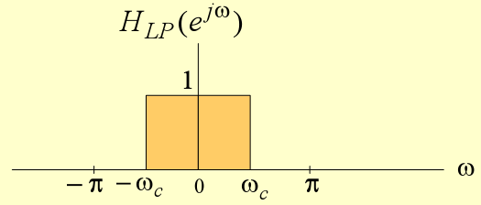
Example 3.8
MOOC
does not converge uniformly for all values of ω, but converge in the mean-square sense.

Slide 32
As a result
Does not uniformly converge to H_{LP}(e^{jω}) for all values of ω, but converges to H_{LP}(e^{jω}) in the mean-square sense

Slide 33
The mean-square convergence property of the sequence h_{LP}[n] can be further illustrated by examining the plot of the function
For various values of K as shown in next slide

Slide 34
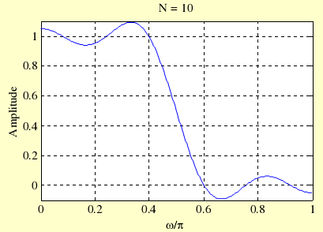
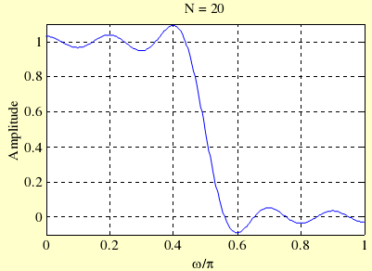
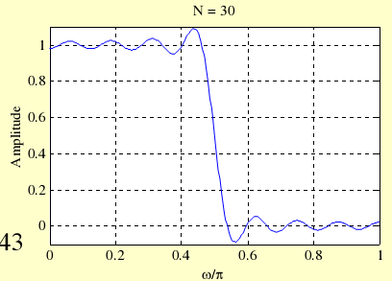
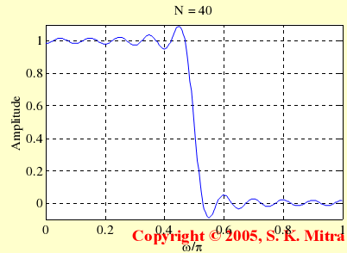
K = 10
K = 20
K = 30
K = 40

Slide 35
As can be seen from these plots, independent of the value of K there are ripples in the plot of H_{LP,K}(e^{jω}) around both sides of the point ω = ω_{c}
The number of ripples increases as K increases with the height of the largest ripple remaining the same for all values of K

Slide 36
As K goes to infinity, the condition
holds indicating the convergence of H_{LP,K}(e^{jω}) approximation H_{LP}(e^{jω}) in the mean-square sense at a point of discontinuity is known as the Gibbs phenomenon.

Slide 37
The DTFT can also be defined for a certain class of sequences which are neither absolutely summable nor square summable.
Examples of such sequences are the unit step sequence μ[n], the sinusoidal sequence cos(ω₀n+φ) and the exponential sequence Aα^{n}
For this type of sequences, a DTFT representation is possible using the Dirac Delta function δ(ω)

Slide 38
A Dirac Delta function δ(ω) is a function of ω with infinite height, zero width, and unit area
It is the limiting form of a unit area pulse function p_{Δ}(ω) as Δ goes to zero satisfying:
ω
MOOC

Slide 39
Example3.9 - Consider the complex exponential sequence
Its DTFT is given by
where δ(ω) is an impulse function of ω and
MOOC

Slide 40
The function
is a periodic function of w with a period 2π and is called a periodic impulse train or impulse train.
To verify that X(e^{jω}) given above is indeed the DTFT of x[n]=e^{jω0n} we compute the inverse DTFT of X(e^{jω})
MOOC

Slide 41
Thus
where we have used the sampling property of the impulse function δ(ω)
MOOC

Slide 42
Commonly Used DTFT Pairs (Table 3.3 Page 105)
MOOC

Slide 43
3.2.5 Strength of a DTFT
The strength of a DT FT is given by its norm.
The Lp-norm of X(e^{jω}) is defined by:
p is a positive integer.
In practice, the value of p is typically 1 or 2 or .
M-file filternorm can be used to determine norms.

Slide 44
3.3 DTFT Theorems (Table 3.4)
Linearity
Time-shifting
Frequency-shifting
Differentiation- in-frequency
Convolution
Modulation
MOOC
Parseval’s relation
Notes:
There are a number of important theorems of the DTFT that are useful in signal processing applications.
These are listed here without proof; Their proofs are quite straightforward.

Slide 45
Application of Above Properties
Compute DTFT of sequences conveniently
Ex. 3.10, 3.11, 3.12
Compute linear convolution:
IDTFT
MOOC

Slide 46
Example 3.13
Determine the DTFT Y(e^{jω}) of y[n]=(n+1)α^{n}μ[n], |α|<1
Let x[n]=α^{n}μ[n], |α|<1
We can therefore write
y[n]=nx[n] + x[n]
The DTFT of x[n] is given by

Slide 47
Using the differentiation property of the DTFT, we observe that the DTFT of nx[n] is given by
Next using the linearity property of the DTFT, we have:
MOOC

Slide 48
Example 3.14 Convolution Sum Computation Using DTFT
MOOC

Slide 49
3.4 Energy Density Spectrum of a Discrete-Time Sequence
The total energy of a finite-energy sequence g[n] is given by
E
From Parseval’s relation we observe that
E
MOOC

Slide 50
The energy density spectrum:
The area under this curve in the range -π≤ω≤π divided by 2π is the energy of the sequence.
MOOC

Slide 51
Example 3.15 Compute the energy of the sequence
h_{LP}[n]=sinω_{c}n/πn, -∞<n<∞
Where,
Hence, h_{LP}[n] is a finite-energy lowpass sequence.

Slide 52
Example 3.16
Compute the energy of the exponential sequence
From Parseval’s relation

Slide 53
3.1.3 Band-Limited Continuous-Time Signals
An ideal band-limited signal has a spectrum that is zero outside a frequency range
0<Ω_{a}≤| Ω |≤Ω _{b}<∞, that is
Band-limited signals are classified according to the frequency range where most of the signal’s energy is concentrated.

Slide 54
A lowpass continuous-time signal has a spectrum occupying the frequency range
0<|Ω|≤ Ω _{p}< ∞ ,where Ω _{p} is called the bandwidth of the signal.
A highpass contnuous-time signal has a spectrum occupying the frequency range
0< Ω_{p}≤|Ω|< ∞ and has a bandwidth from
ω_{p} to ∞.
A bandpass contnuous-time signal has a spectrum occupying the frequency range 0<Ω_{L}≤|Ω|≤Ω_{H}< ∞ and has a bandwidth of
Ω_{H} ~ Ω_{L}
Notes:
However,an ideal band-limited signal can not be generated in practice, and, for practical purposes, it is sufficient to ensure that the signal energy is sufficiently small outside the specified frequency range.

Slide 55
A precise definition of the bandwidth depends on applications.
As can be seen from Figure3.2(a), the signal in example 3.1 is a lowpass signal. It can be shown that 80% energy of this signal is contained in the frequency range 0≤|Ω|≤0.4898π
Hence, we can define the 80% bandwidth to be 0.4898 π

Slide 56
3.5 Band-Limited Discrete-Time Signals
Since the spectrum of a discrete-time signal is a periodic function of ω with a period 2π, a full-band signal has a spectrum occupying the frequency range -π≤ω≤π.
A band-limited discrete-time signal has a spectrum that is limited to a portion of the frequency range -π≤ω≤π.

Slide 57
An ideal band-limited signal is defined as:
An ideal band-limited discrete-time signal cannot be generated in practice.
In practice, we can make the signal energy be very small outside the specified frequency range to get band-limited signal.

Slide 58
A lowpass discrete-time real signal has a spectrum occupying the frequency range 0<|ω|≤ω_{p}<π and has a bandwidth of ω_{p} ;
A highpass discrete-time real signal has a spectrum occupying the frequency range 0<ω_{p}≤|ω|<π and has a bandwidth of π- ω_{p};
A bandpass discrete-time real signal has a spectrum occupying the frequency range 0<ω_{L}≤|ω|≤ω_{H}<π and has a bandwidth of ω_{H}-ω_{L;}

Slide 59
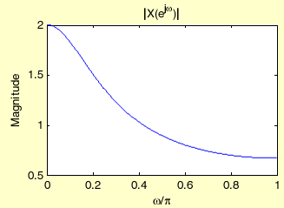
Example:
Consider the sequence
x[n]=(0.5)^{n}μ[n]
Its DTFT is given below on the left along with its magnitude spectrum shown below on the right

Slide 60
It can be shown that 80% of the energy of this lowpass signal is contained in the frequency range 0≤|ω|≤0.5081π
Hence, we can define the 80% bandwidth to be 0.5081π

Slide 61
3.7 The Unwrapped Phase Function
In numerical computation, when the computed phase function is outside the range [-π, π], the phase is computed modulo 2π, to bring the computed value to this range.
Thus, the phase functions of some sequences exhibit discontinuities of 2π radians in the plot.

Slide 62
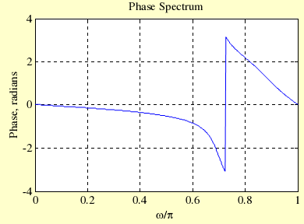
For example, there is a discontinuity of 2π at ω=0.72 in the phase response below:

Slide 63
In such cases, often an alternate type of phase function that is continuous function of ω is derived from the original phase function by removing the discontinuities of 2π.
Process of discontinuity removal is called unwrapping the phase.
The unwrapped phase function will be denoted as θ_{c}(ω).
In Matlab, this can be done by using unwrap.

Slide 64
The conditions under which the phase function will be continuous function of ω.
X(e^{jω}) = | X(e^{jω}) |e^{jθ(ω)}
Where, θ(ω) = arg{X(e^{jω}) }
θ(ω) can be defined unequivocally by its derivative

Slide 65
Unwrapped phase:
With constraint:
will be continuous function of ω.
Moreover, if
will be odd function of ω.

Slide 66
3.6 DTFT Computation Using MATLAB
The function freqz ,abs, angle, unwrap can be used to compute the values of the DTFT of a sequence, described as a rational function in the form of
at a prescribed set of discrete frequency points ω=ω_{λ}

Slide 67
For example, the statement
H = freqz(num, den, w)
returns the frequency response values as a vector H of a DTFT defined in terms of the vectors num and den containing the coefficients {p_{i}} and {d_{i}}, respectively at a prescribed set of frequencies between 0 and 2π given by the vector ω.
There are several other forms of the function freqz
With the functions of real, imag, abs, angle, it computes the real and imaginary parts, and the magnitude and phase of the DTFT.

Slide 68
Example
Plots of the real and imaginary parts, and the magnitude and phase of the DTFT

Slide 69
% Program 3_1: Discrete-Time Fourier Transform Computation
% Generate the filter coefficients
num = [0.008 -0.033 0.05 -0.033 0.008];
den = [1 2.37 2.7 1.6 0.41];
w = 0:pi/255:pi;
h = freqz(num, den, w); % Compute the frequency responses
subplot(2,2,1)
plot(w/pi,real(h));grid
title('Real part'); xlabel('\omega/\pi'); ylabel('Amplitude')
subplot(2,2,2)
plot(w/pi,imag(h));grid
title('Imaginary part'); xlabel('\omega/\pi'); ylabel('Amplitude')
subplot(2,2,3)
plot(w/pi,abs(h));grid
title('Magnitude Spectrum'); xlabel('\omega/\pi'); ylabel('Magnitude')
subplot(2,2,4)
plot(w/pi,angle(h));grid
title('Phase Spectrum'); xlabel('\omega/\pi'); ylabel('Phase, radians')
figure, plot(w/pi,unwrap(angle(h)));
title('unwrapped Phase Spectrum'); xlabel('\omega/\pi'); ylabel('Phase, radians')

Slide 70
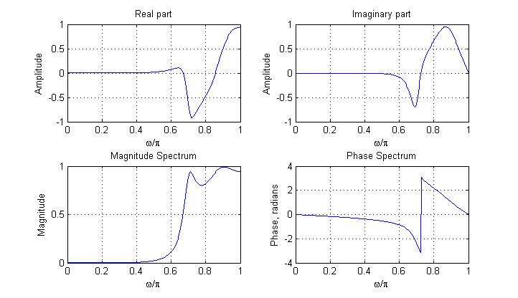

Slide 71
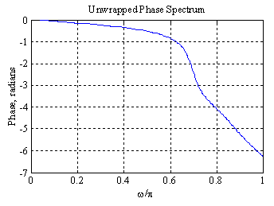
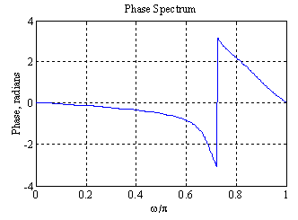
The phase spectrum displays a discontinuity of 2π at ω = 0.72
This discontinuity can be removed using the function unwrap as indicated below:

