Slide 1
3.8 Digital Processing of Continuous-Time Signals
  Sampling of Continuous-Time Signals
  Recovery of the Analog Signal
  Implications of the Sampling Process
3.9 Sampling of Band-pass Signals

Slide 2
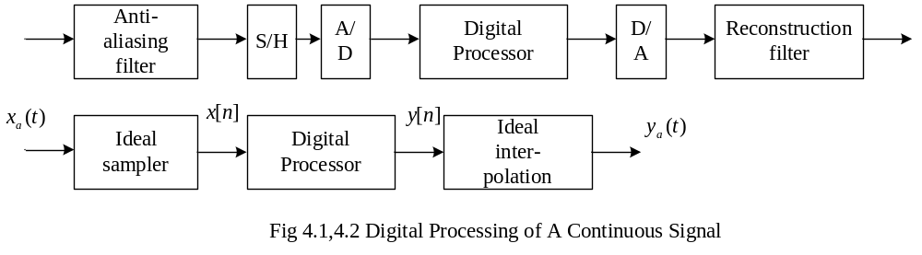



Some concepts:
1. ADC: Analog-to-Digital Converter
2. DAC: Digital-to-Analog Converter
3. S/H : Sample-and-Hold (circuit).
4. Anti-aliasing filter.
5. Reconstruction or interpolation filter.

Slide 3







3.8.1 Effect of Sampling in the Frequency-Domain
(a)
Ideal sampling
(b)
t
t
0
0
t
t
0
0
T
T
t
t
0
0

Slide 4
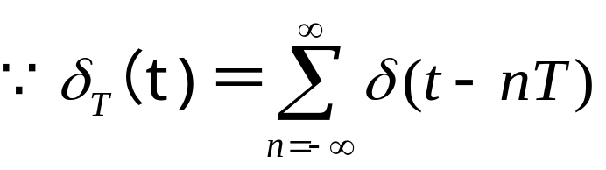
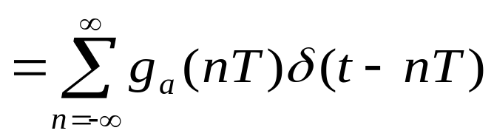
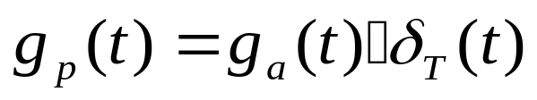
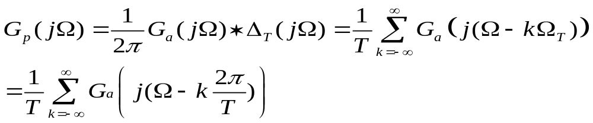
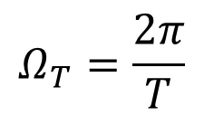
When τ« T, p(t) ~δ_{T}(t);
so we firstly discuss ideal sampling:
The output of ideal sampling is:
(1)In time domain:
(2)In frequency domain:

Slide 5
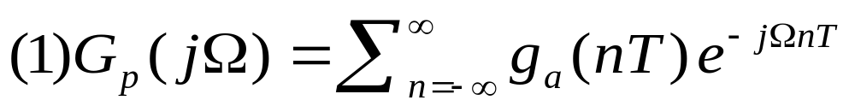
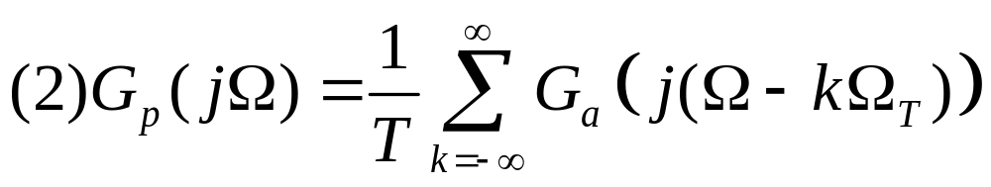
There are two different forms of G_{p}(jΩ):
G_{p}(jΩ) is a periodic function of Ω consisting of a sum of shifted and scaled replicas of G_{a}(jΩ) , shifted by integer multiples of Ω_{T} and scaled by 1/T.

Slide 6
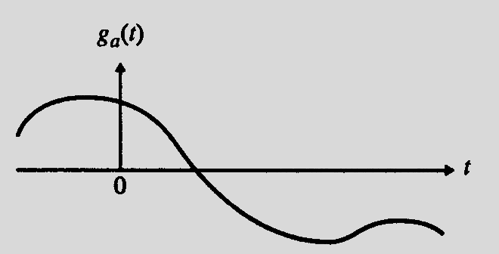
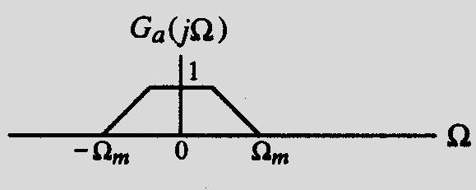
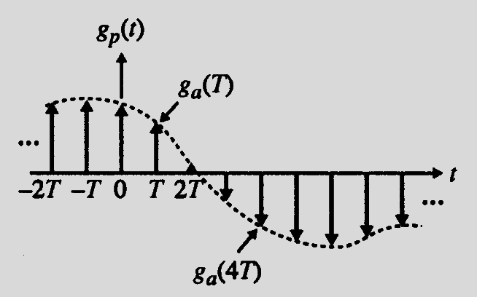
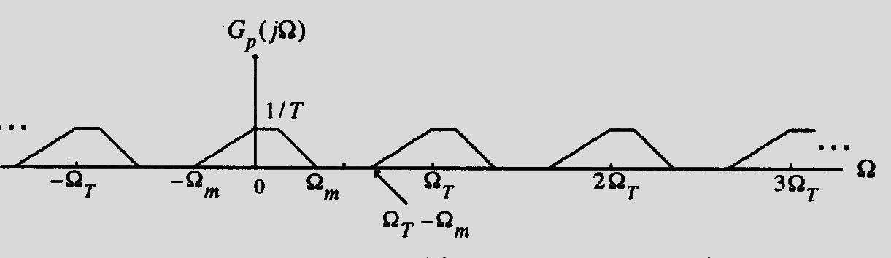
The Discretization The periodization
In time Domain In Frequency Domain

Slide 7
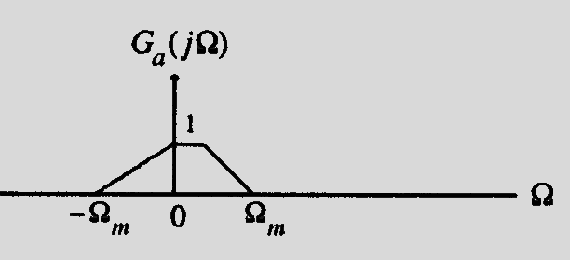
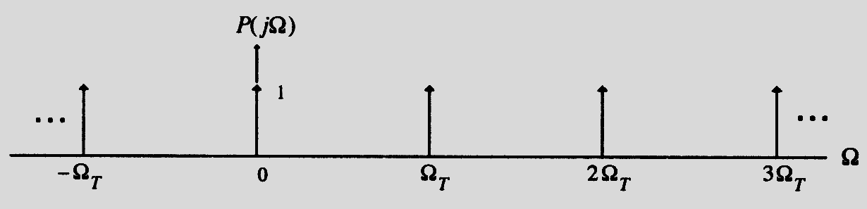
The frequency procedure of sampling
Assume g_{a}(t) is a band-limited signal with a CTFT G_{a}(jΩ) as shown below:
The spectrum P(jΩ) of p(t) having a sampling period T=2π/Ω_{T} is indicated below:

Slide 8
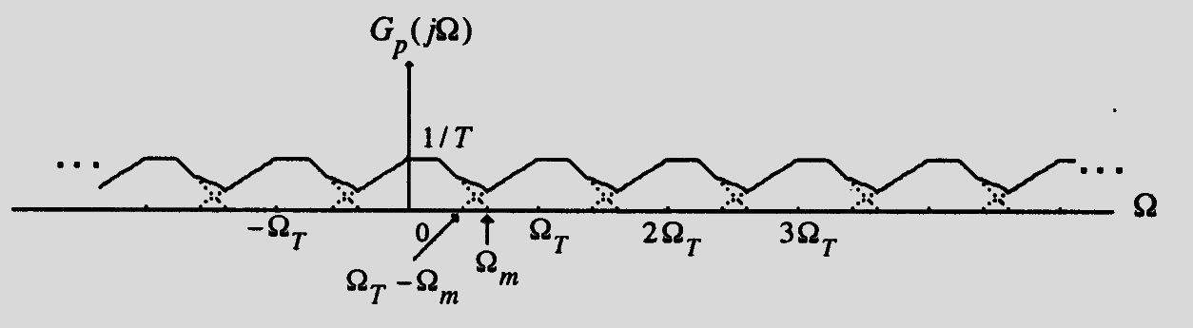
Two possible spectra of G_{p}(jΩ) are shown below:
Ω_{T}>2 Ω_{m}
no overlap
Ω_{T}<2 Ω_{m}
overlap/
aliasing

Slide 9
Sampling Theorem
Let g_{a}(t) be a band-limited signal with CTFT G_{a}(jΩ)=0 for | Ω|> Ω_{m} ,
Then g_{a}(t) is uniquely determined by its samples g_{a}(nT) , -∞≤n≤∞ if
Ω_{T} ≥ 2 Ω_{m} , where Ω_{T}=2π/T
The condition Ω_{T} ≥ 2 Ω_{m} is often referred to as the Nyquist condition.
The frequency Ω_{T}/2 is usually referred to as the folding frequency.

Slide 10
The highest frequency Ω_{m} contained in g_{a}(t) is usually called the Nyquist frequency since it determines the minimum sampling frequency Ω_{T} =2Ω_{m} that must be used to fully recover g_{a}(t) from its sampled version.
The frequency 2Ω_{m} is called the Nyquist rate.

Slide 11
Oversampling - The sampling frequency is higher than the Nyquist rate;
Undersampling - The sampling frequency is lower than the Nyquist rate;
Critical sampling - The sampling frequency is equal to the Nyquist rate;
Note: A pure sinusoid may not be recoverable from its critically sampled version.

Slide 12
Nyquist frequency Examples:
In digital telephony, a 3.4 kHz signal bandwidth is acceptable for telephone conversation;
Here, a sampling rate of 8 kHz, which is greater than twice the signal bandwidth, is used.
In high-quality music signal processing, a bandwidth of 20 kHz has been determined to preserve the fidelity;
Hence, in compact disc (CD) music systems, a sampling rate of 44.1 kHz, which is slightly higher than twice the signal bandwidth, is used.

Slide 13
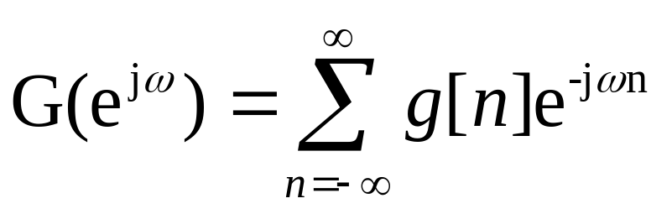
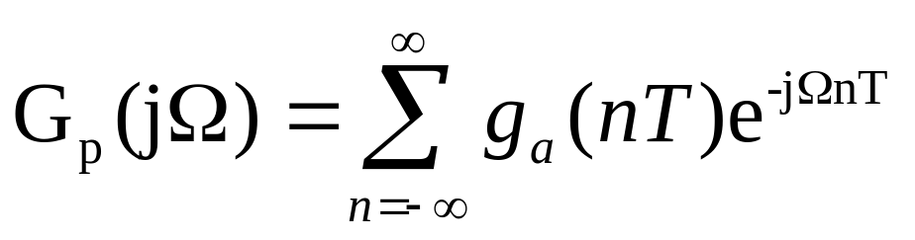
The Relationship Between G(e^{jω}) and G_{p}(jΩ)
We now derive the relation between the DTFT of g[n] and the CTFT of g_{p}(t)
To compare:
with
And make use of g[n]=g_{a}(nT), -∞<n<∞

Slide 14
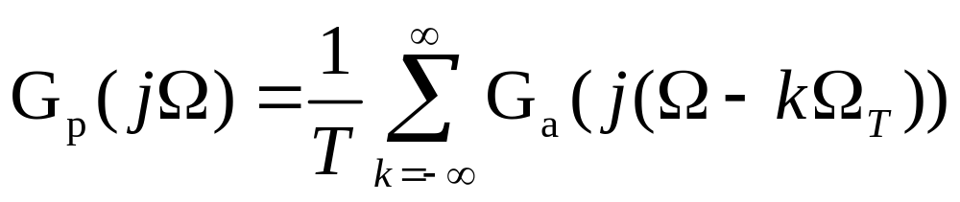
The Relationship Between G(e^{jω}) and G_{p}(jΩ)
Observation: We have
G(e^{jω})=G_{p}(jΩ)|_{Ω=ω/T}
Or, equivalently,
G_{p}(jΩ)= G(e^{jω})|_{ω=ΩT}
From the above observation and

Slide 15
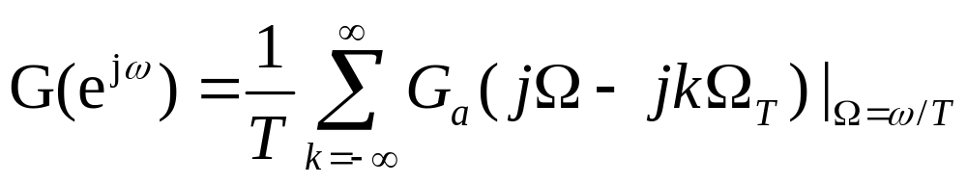
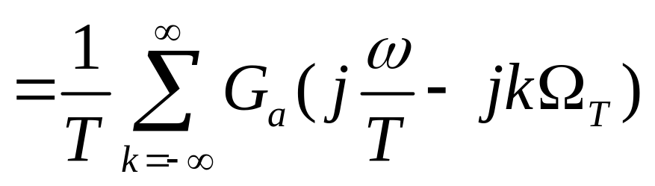
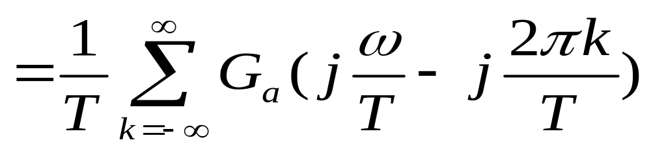
The Relationship Between G(e^{jω}) and G_{p}(jΩ)
We arrive at the desired result:

Slide 16
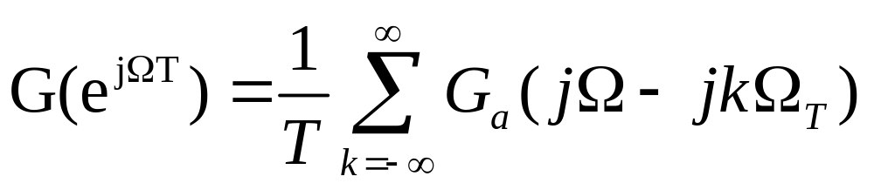
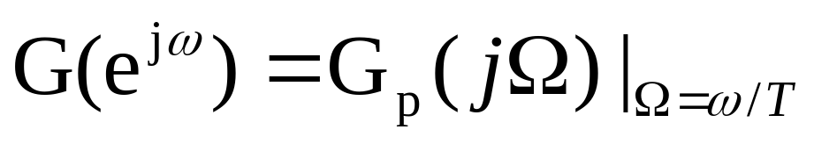
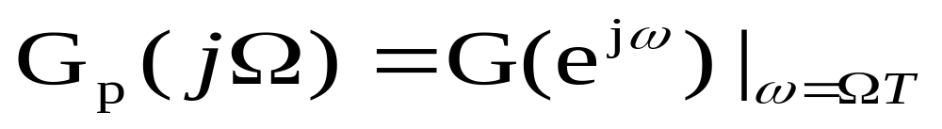
The Relationship Between G(e^{jω}) and G_{p}(jΩ)
The relation derived on the previous slide can be alternately expressed as
From
Or from
It follows that G(e^{jω}) is obtained from G_{p}(jΩ) by applying the mapping Ω=ω/T

Slide 17
Now, the CTFT G_{p}(j Ω) is a periodic function of Ω with a period Ω_{T} = 2π/T
Because of the mapping, the DTFT G(e^{jω}) is a periodic function of ω with a period 2π

Slide 18
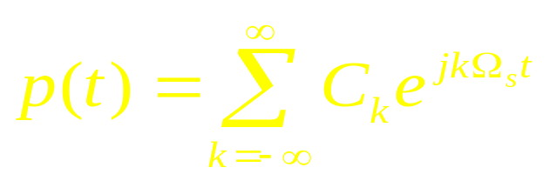
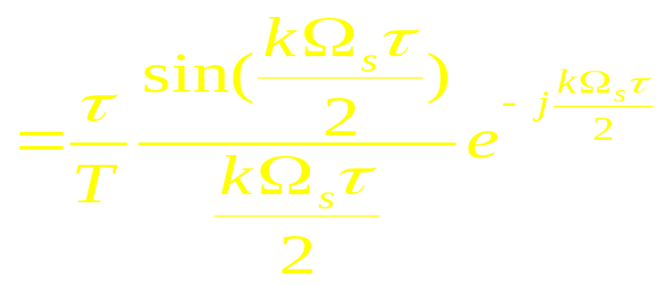
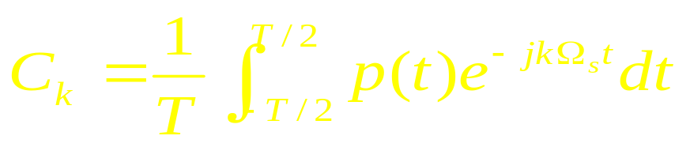
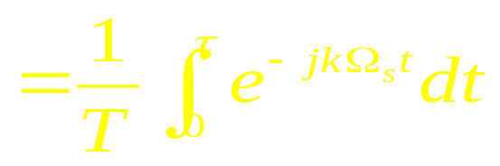
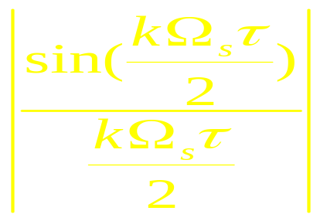
Supplement: The practical sampling
In practical condition, p(t) is a periodic rectangle impulse with τ-width .
If the τ and T are fixed, then when k varies, the magnitude of C_{k} varies with:

Slide 19
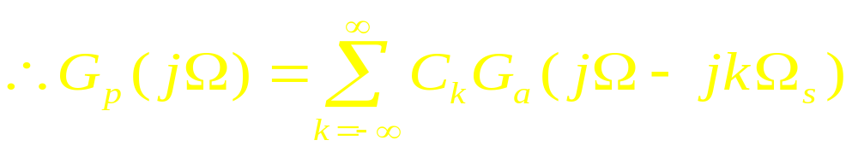



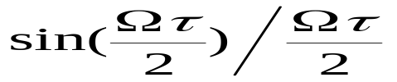



Supplement: The practical sampling
So we can see, in practical sampling, use C_{k} to substitute A_{k}, but C_{k} is varying.
0
0

Slide 20
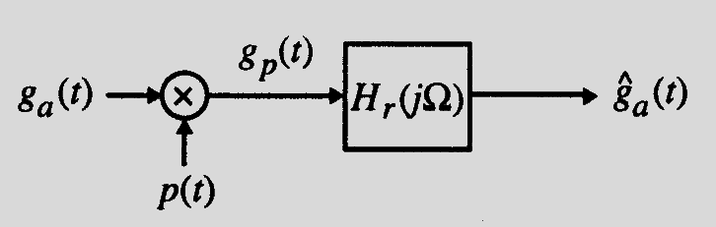
3.8.2 Recovery of the Analog Signal
By filtering in frequency domain or interpolation in time domain, the continuous signal can be recovered from The Sampled Discrete time signal.
Here, the filter is called reconstruction filter or interpolation filter or smoothing filter.

Slide 21
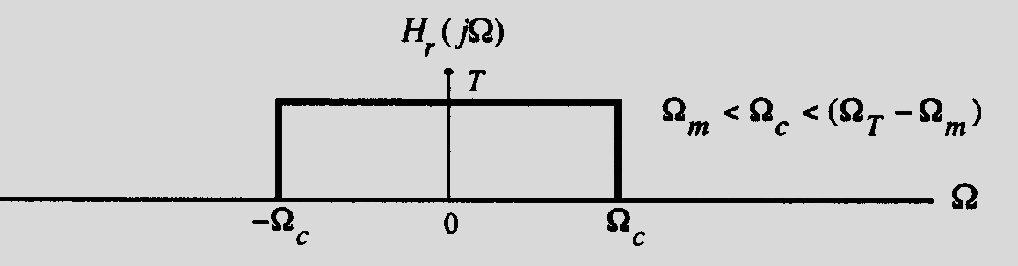
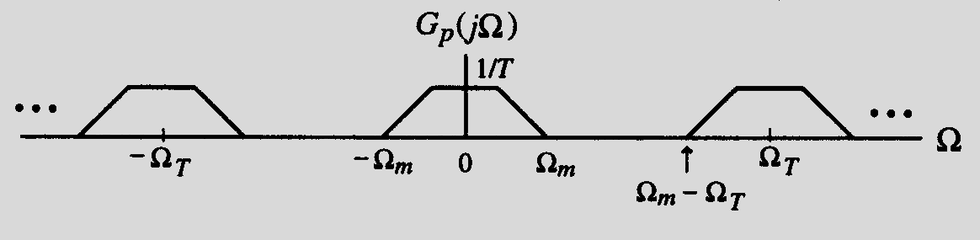
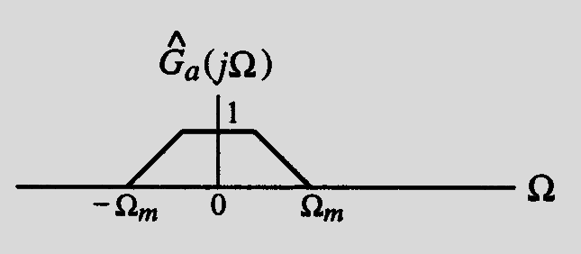
The spectra of the filter and pertinent signals are shown below:

Slide 22
If Ω_{T}>2 Ω_{m} , g_{a}(t) can be recovered exactly from g_{p}(t) by passing it through an ideal lowpass filter H_{r}(jΩ) with a gain T and a cutoff frequency Ω_{c} greater than Ω_{m} and less than Ω_{T} - Ω_{m};
On the other hand, if Ω_{T}< 2 Ω_{m} , due to the overlap of the shifted replicas of G_{a}(jΩ) , the spectrum G_{p}(jΩ) cannot be separated by filtering to recover G_{a}(jΩ). The distortion caused by a part of the replicas outside the baseband folded back or aliased into the baseband.

Slide 23
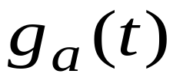
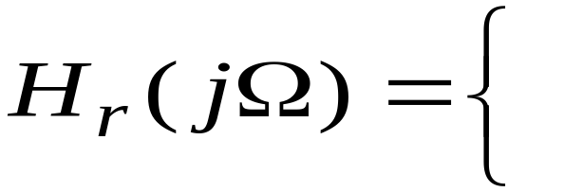
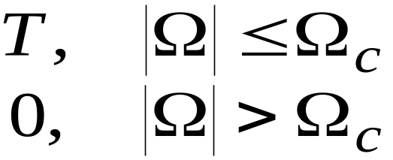
^
We now derive the expression for the output of the ideal lowpass reconstruction filter H_{r}(jΩ) as a function of the samples g[n].
The impulse response h_{r}(t) of the ideal lowpass reconstruction filter is obtained by taking the inverse DTFT of H_{r}(jΩ)

Slide 24
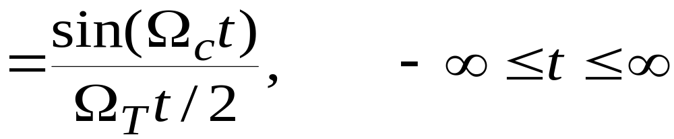
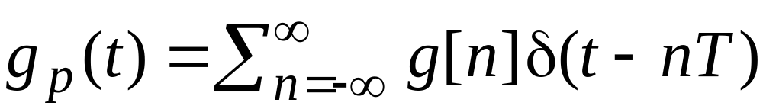
Thus, the impulse response is given by
The input to the lowpass filter is the impulse train g_{p}(t):

Slide 25
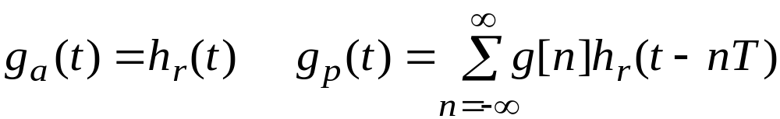
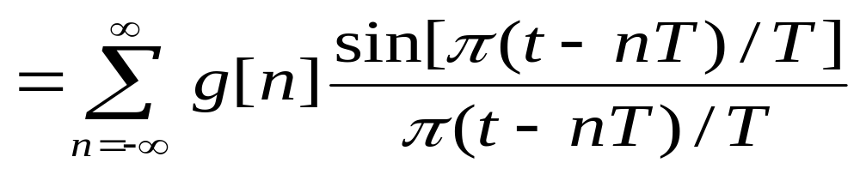
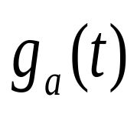
^
Therefore, the output of the ideal lowpass filter is given by:
^
*
Applying h_{r}(t)=sin(Ω_{c}t)/(Ω_{T}t/2), and assuming:
Ωc= ΩT/2= π/T , we get:
^

Slide 26
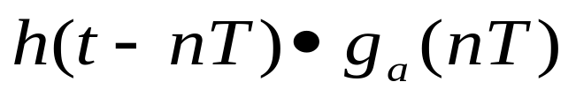


^
is called Poisson sum formula or interpolation formula.

Slide 27
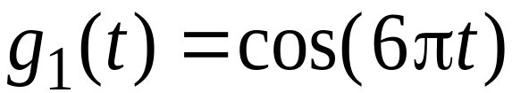
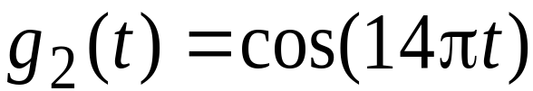

3.8.3 Implications of the Sampling Process
Example: Consider the three continuous time sinusoidal signals:
Their corresponding CTFTs are:

Slide 28

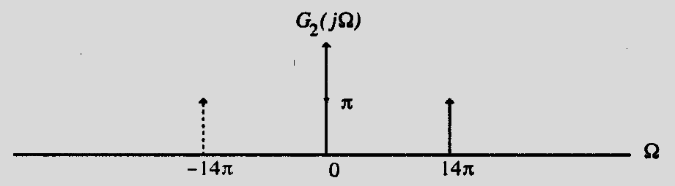
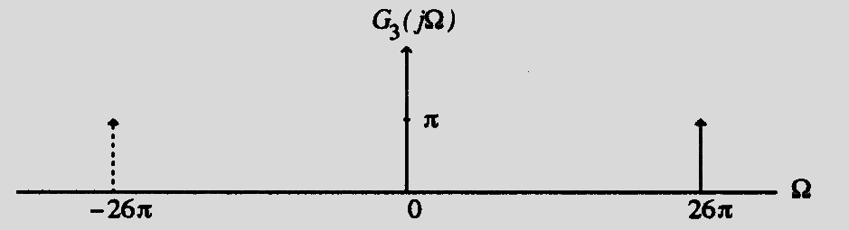
These three transforms are plotted below

Slide 29
These continuous-time signals sampled at a rate of T = 0.1 sec, i.e., with a sampling frequency Ω_{T} =20π rad/sec
The sampling process generates the continuous-time impulse trains, g_{1p}(t), g_{2p}(t) , and g_{3p}(t)
Their CTFTs are given by:

Slide 30
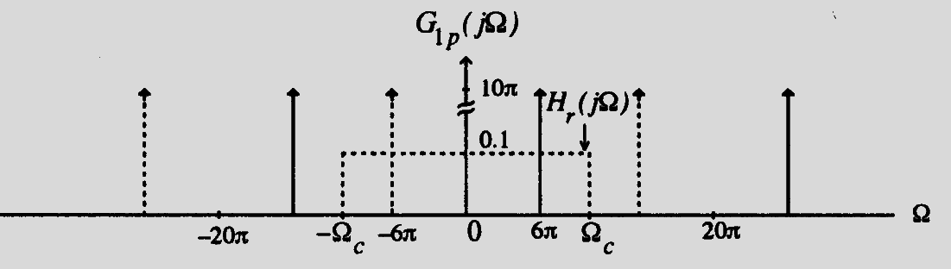
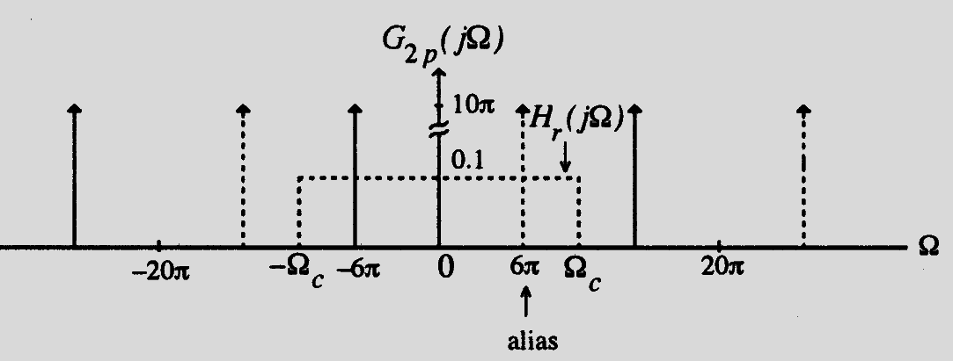

Plots of the 3 CTFTs are shown below:

Slide 31

These figures also indicate by dotted lines the frequency response of an ideal lowpass filter with a cutoff at Ω_{c}=Ω_{T}/2=10π and a gain T=0.1.
In fact, the 3 discrete-time sinusoidal signals are:
And

Slide 32




If reconstruction filter
If reconstruction filter

Slide 33
3.9 Sampling of Band-pass Signals
The conditions developed earlier for the unique representation of a continuous-time signal by the discrete-time signal obtained by uniform sampling assumed that the continuous-time signal is bandlimited in the frequency range from DC to Ω_{m} --- lowpass signal.
There are continuous-time signals which are bandlimited to a higher frequency range Ω_{L}≤ |Ω| ≤ Ω_{H} with Ω_{L} >0 --- bandpass signals.

Slide 34
To prevent aliasing a bandpass signal can of course be sampled at a rate greater than twice the highest frequency, i.e. by ensuring Ω_{T} ≥2 Ω_{H}
However, due to the bandpass spectrum of the continuous-time signal, the spectrum of the discrete-time signal obtained by sampling will have spectral gaps with no signal components present in these gaps.
Moreover, if Ω_{H} is very large, the sampling rate also has to be very large which may not be practical in some situations.

Slide 35
Let ΔΩ= Ω_{H} - Ω_{L} define the bandwidth of the bandpass signal.
Assume: Ω_{H} = M(ΔΩ)
We choose the sampling frequency Ω_{T} to satisfy the condition:
Ω_{T} = 2(ΔΩ) = 2Ω_{H}/M
Ω_{T} is smaller than 2Ω_{H} , the Nyquist rate
undersampling

Slide 36


As before, G_{p}(jΩ) consists of a sum of G_{a}(jΩ) and replicas of G_{p}(jΩ) shifted by integer multiples of twice the bandwidth Δω and scaled by 1/T;
The amount of shift for each value of k ensures that there will be no overlap between all shifted replicas.
no aliasing

Slide 37







Figures below illustrate the idea:
0
(M=3)
no aliasing
0

Slide 38
Figures below illustrate the idea:
0
(M=4)
no aliasing
0

Slide 39

Discuss:
(1)If g_{a}(t) is bandlimited with its frequency band in (f_{L}, f_{H}) .
(2)If using sampling rate:
Where, n is a maximum integer which meets fs≥2(f_{H}-f_{L})=2B (n = 0,1,2……)
Then, the sampled signal g_{a}(nT_{s}) can be used to represent original signal g_{a}(t).

Slide 40

Note:
Before band-sampling, the signal in only one frequency-band can be permitted.
For lowest sampling rate, that is f_{s}=2B, the signal center frequency f₀ should be:

Slide 41

The band-sampling result is moving the signal in the frequency band of (nB, (n+1)B)(n=0,1,2,…) to the frequency band of (0, B).
When n is odd number, the relationship between them is reversal; while n is even, the relationship is opposite.

Slide 42
As can be seen, g_{a}(t) can be recovered from g_{p}(t) by passing it through an ideal bandpass filter with a passband given by Ω_{L}≤ |Ω| ≤ Ω_{H} and a gain of T.
Note: Any of the replicas in the lower frequency bands can be retained by passing through bandpass filters with passbands
Ω_{L}- k(ΔΩ) ≤ |Ω| ≤ Ω_{H} - k(ΔΩ) , 1 ≤ k ≤ M-1 providing a translation to lower frequency ranges.

Slide 43
Reference Homework
3.11,3.17, 3.18(a)(c)(e), 3.25, 3.58, 3.62, 3.63, 3.66
M3.1, M3.2

