Slide 1
Chapter5 Discrete Fourier Transform
—— DFT

Slide 2
Outline
Orthogonal Transforms
The Definition of DFT
The Relationship Between DFT and DTFT
The Computation of Finite-Length Sequences
Classifications of Finite-Length Sequences
DFT Properties and Theorems
Fourier-Domain Filtering
Computation of the DFT of Real sequences
Linear Convolution Using DFT

Slide 3
5.1 Orthogonal Transforms
General form of the orthogonal transform pair:
analysis equation
synthesis equation
ψ[k,n] --- basis sequences, are also length-N sequences in both domains, which satisfy:
Notes:
Mooc没讲

Slide 4
DFS
A periodic sequence ( is integer, is period) can be represented as a Fourier series.
The orthogonal functions set is：
The orthogonal functions set is：
…(A)
…(B)
(kernel)
Notes:
Mooc没讲

Slide 5
Note:
① has period N, is DC component, is the th-harmonic.
②
③
Notes:
Mooc没讲

Slide 6
④ The equation (A) and (B) are expressed as
or
Notes:
Mooc没讲

Slide 7
Typical DFS Pair
δ_{T}(t) ←→ Ω_{T}δ_{ΩT}(Ω)
δ_{T}(t)
Ω_{T} = 2π/T
Ω_{ΩT}δ_{ΩT}(Ω)
←→
-2T
-T
0
T
2T
t
-2Ω_{T}
- Ω_{T}
Ω_{T}
2Ω_{T}
Ω
0
The signals in both sides are periodical, so the processing could be in one period, which is important because：
(1) the number of calculation is limited, which is necessary for computer;
(2) all of the signal information could be kept in one period, which is necessary for accurate processing.
Notes:
Mooc没讲

Slide 8
Make a Signal Discrete and Periodical
The engineering signals are often continuous and aperiodical. If we want to process the signals with DFT, we have to make the signals discrete and periodical.
Sampling to make the signal be discrete.
Make the signal periodical by periodical expanding.
If x[n] is a limited length N-point sequence, see it as one period of a periodical signal;
If x[n] is an infinite length sequence, cut-off its tail to make a N-point sequence, then do the periodic extending. The truncation will introduce distortion. ---- windowing
Notes:
Mooc没讲

Slide 9
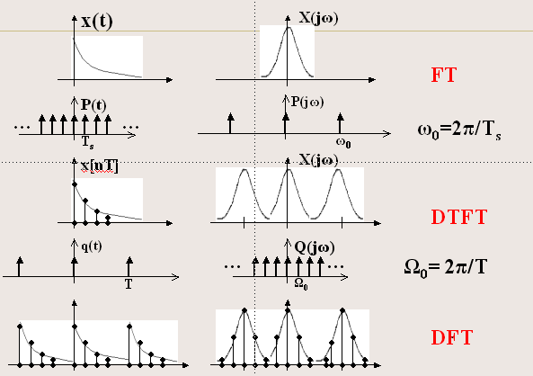
Make a signal discrete and periodical
Notes:
Mooc没讲

Slide 10
5.2 The Definition of DFT
Where:
MOOC
Notes:
Note: X[k] is also a length-N sequence in the frequency domain.

Slide 11
Verify:
m an integer
Hence,
MOOC

Slide 12
Example: Consider the length-N sequence
Its N-point DFT is given by:
MOOC

Slide 13
Example: Consider the length-N sequence
Using a trigonometric identity we can write:
MOOC

Slide 14
Making use of the identity:
m an integer
we get:
MOOC

Slide 15
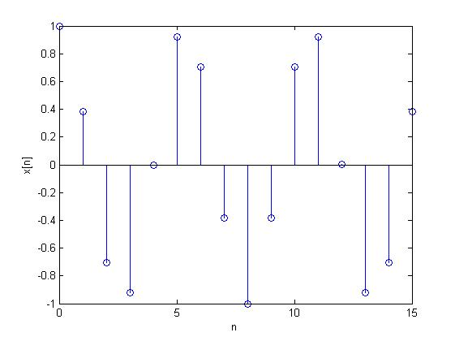
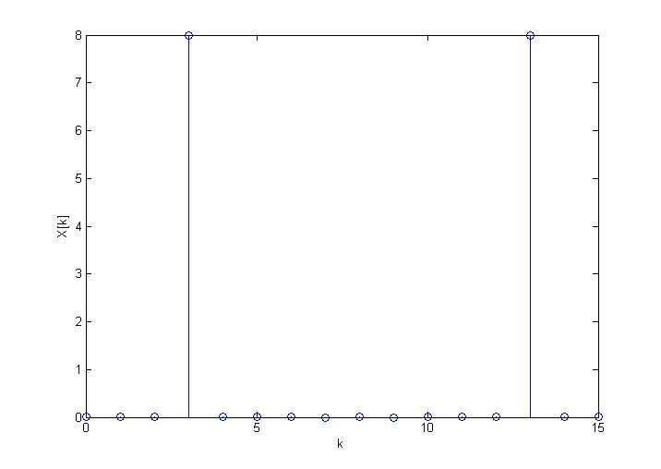
When N=16, r=3
MOOC

Slide 16
Matrix Relations
The DFT samples defined by:
Can be expressed in matrix form as X=D_{N}x
Where,
X=[x[0] x[1] … X[N-1]]^{T}
x=[x[0] x[1] … x[N-1]]^{T}
MOOC

Slide 17
Matrix Relations
And D_{N} is the N×N DFT matrix given by:
MOOC

Slide 18
Matrix Relations
Likewise, the IDFT relation is given by:
can be expressed in matrix form as x=D_{N}⁻¹X,
where D_{N}⁻¹ is the N×N IDFT matrix.
MOOC

Slide 19
Matrix Relations
Note: D_{N}⁻¹ = (D_{N}*) / N
MOOC

Slide 20
DFT Computation Using MATLAB
The functions to compute the DFT and the IDFT are FFT and IFFT.
These functions make use of FFT algorithms which are computationally highly efficient compared to the direct computation.
From O(n²) to O(nlog₂n)
Programs 5_1.m and 5_2.m illustrate the use of these functions.
Notes:
Mooc没讲

Slide 21
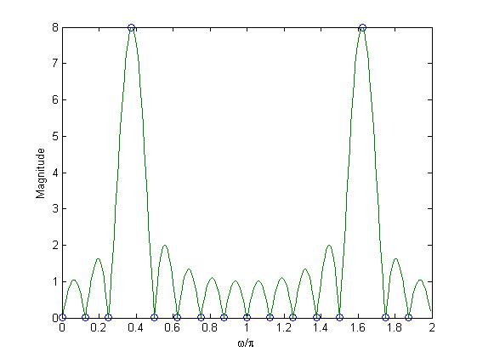
Example - Program 5_3.m can be used to compute the DFT and the DTFT of the sequence:
fft(x, 16)
indicates DFT samples
Notes:
Mooc没讲

Slide 22
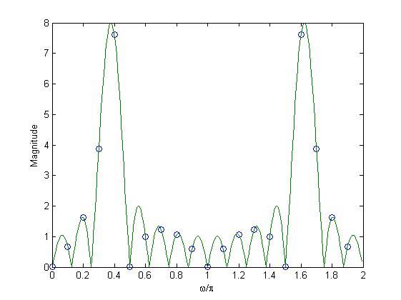
fft(x, 20)
Why？
Notes:
Mooc没讲

Slide 23
5.3 The Relationship Between DFT and DTFT
From DTFT to get DFT
DTFT from DFT by Interpolation
Sampling the DTFT
Notes:
此部分为难点和重点，需补充频率分辨力、泄露和栅栏效应等概念

Slide 24
From DTFT to get DFT
Sampling the DTFT of a N points sequence with the space is 2π/N to get N frequency points, that is DFT.
MOOC

Slide 25
From DTFT to get DFT
DTFT: discrete in time domain, continuous in frequency domain.
Sampling the DTFT of sequences to get N frequency points to research, that is DFT.
2
1
3
4
Re[z]
k=0
5
7(k=N-1)
6
Notes:
Mooc没讲

Slide 26
Numerical Computation of the DTFT Using the DFT
How to compute the DTFT of a length-N sequence x[n] by using computer?
1. Sampling the X(e^{jw}) to get a length-M sequence, M>>N. Each frequency component is X(e^{j2π/M}).
2. If the DFT of a sequence is length-M, the sequence must be a length-M sequence. So we build a length-M sequence use x[n].
The function freqz employs this approach to evaluate the frequency response at a prescribed set of frequencies of a DTFT expressed as a rational function in e^{-jω}.
Notes:
Mooc没讲

Slide 27
We can see above equation is the DFT of a length-M sequence. Because M>>N, it can be seen as an approach of the DTFT of a length-N sequence.
Notes:
Mooc没讲

Slide 28
DTFT from DFT by Interpolation
Given the N-point DFT X[k] of a length-N sequence x[n], its DTFT X(e^{jω}) can be uniquely determined from X[k].
How？
MOOC

Slide 29
DTFT from DFT by Interpolation
MOOC

Slide 30
DTFT from DFT by Interpolation
Therefore:
It is interpolated in frequency domain.
MOOC

Slide 31
Sampling the DTFT
Consider a sequence x[n] with DTFT X(e^{jω})
We sample X(e^{jω}) at N equally spaced points ω_{k}=2πk/N, 0≤k≤N-1 developing the N frequency samples {X(e^{jωk})}
These N frequency samples can be considered as an N-point DFT Y[k] whose N-point IDFT is a length-N sequence y[n].
What’s relationship between y[n] and x[n]?
MOOC

Slide 32
Sampling the DTFT
Thus:
IDFT of Y[k] yields:
MOOC

Slide 33
Sampling the DTFT
Making use of the identity:
We have:
MOOC

Slide 34
Sampling the DTFT
To apply：
to finite-length sequences.
If x[n] is a length-M sequence with M≤N, then y[n] = x[n] for 0≤n≤N-1.
If M>N, there is a time-domain aliasing of samples of x[n] in generating y[n], and x[n] cannot be recovered from y[n].
MOOC
Notes:
Thus y[n] is obtained from x[n] by adding an infinite number of shifted replicas of x[n], with each replica shifted by an integer multiple of N sampling instants, and observing the sum only for the interval 0≤n≤N-1.

Slide 35
Example: Let {x[n]}={0 1 2 3 4 5}
↑
By sampling its DTFT X(e^{jω}) at ω_{k}=2πk/4, 0≤k≤3 and then applying a 4-point IDFT to these samples, we arrive at the sequence y[n] given by:
i.e. {y[n]}={4 6 2 3}
↑
{x[n]} cannot be recovered from {y[n]}
MOOC

Slide 36
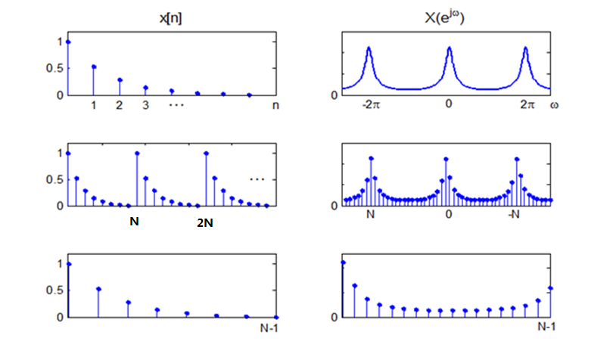
Processing a signal in discrete frequency
DTFT
DFS
DFT
MOOC

Slide 37
Make a signal discrete and periodical
Time domain Frequency domain
Continuous Aperiodical ←CTFT→ Continuous Aperiodical
Continuous Periodical ← FS → Aperiodical Discrete
Discrete Aperiodical ← DTFT→ Periodical Continuous
Discrete & Periodical ← DFS → Periodical & Discrete
MOOC

Slide 38
5.4 The Computation of Finite-Length Sequences
Circular Shift
Circular reversal
Circular convolution

Slide 39
Circular Shift
Circular Shift of length-N sequence x[n]:
< • >_{N} —— modulo operation
MOOC
Notes:
Consider length-N sequences defined for 0≤n≤N-1,
For any arbitrary integer n₀ , the shifted sequence x₁[n] = x[n – n₀] is no longer defined for the range 0≤n≤N-1.
We thus need to define another type of a shift that will always keep the shifted sequence in the range 0≤n≤N-1.

Slide 40
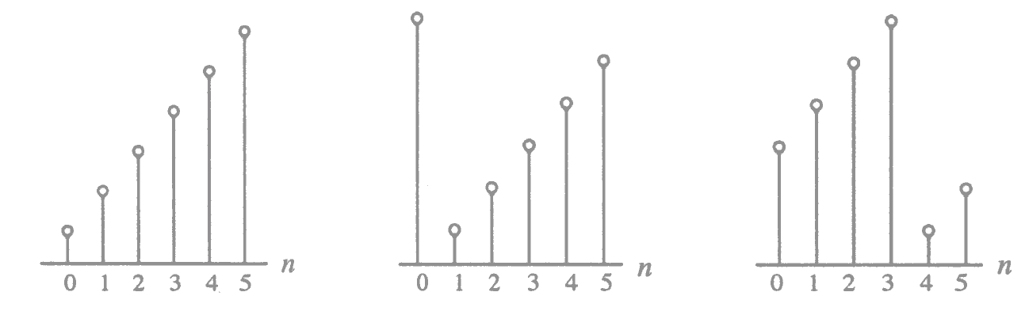
Circular Shift
Illustration of the concept of a circular shift:
MOOC

Slide 41
Circular Shift of a Sequence
Non-circular shift
circular shift
x[n]
x[n-1]
MOOC
Notes:
There are two ways to perform Circular Shift:
(1) Using the “modulo” operation;
(2) Using period expand.

Slide 42
Circular reversal
Circular reversal of length-N sequence x[n]:
x[n]
x[<-n>_{N}]
MOOC
0
N-1
0
N-1

Slide 43
Circular convolution
To develop a convolution-like operation resulting in a length-N sequence y_{C}[n], we need to apply circular time-reversal and circular time-shift operations.
Circular convolution defined as:
= g[n] h[n] = g[n] h[n]
MOOC
N
N

Slide 44
The N-point circular convolution can be written in matrix form as:
The elements of each diagonal of the N×N matrix are equal
Such a matrix is called a circulant matrix
MOOC

Slide 45
Example - Determine the 4-point circular convolution of the two length-4 sequences:
as sketched below:
n
n
The result is a length-4 sequence y_{C}[n] given by:
4
MOOC

Slide 46
g[k]
g[k]
g[k]
g[k]
g[k]
h[k]
h[<-k>_{N}]
h[<1-k>_{N}]
h[<2-k>_{N}]
h[<3-k>_{N}]
y[0]
y[1]
7
y[2]
y[3]
6
6
5
MOOC
y_{c}[n]=6δ[n]+7δ[n-1]+6δ[n-2]+5δ[n-3]

Slide 47
From the above we observe:
Notes:
Mooc没讲

Slide 48
y[n]=6δ[n]+7δ[n-1]+6δ[n-2]+5δ[n-3]
Notes:
Mooc没讲

Slide 49
Tabular Method in Circular convolution
Example: We want to obtain the convolution sum y_{c}[n] by the following step: y_{c}[n]=g[n]③h[n]
n: 0 1 2 3 4 5
g[n]: g[0] g[1] g[2]
h[n]: h[0] h[1] h[2]
g[0]h[0] g[1]h[0] g[2]h[0]
g[0]h[1] g[1]h[1]
g[0]h[2]
y_{c}[n]: y_{c}[0] y_{c}[1] y_{c}[2]
g[2]h[1]
g[2]h[1]
g[1]h[2] g[2]h[2]
g[1]h[2] g[2]h[2]
MOOC

Slide 50
The comparison of linear convolution & circular convolution
The circular convolution:
The linear convolution:
Please look at Fig5.6
Notes:
Mooc没讲

Slide 51
5.5 Classifications of Finite-Length Sequences
The circular conjugate-symmetric sequence and circular conjugate-antisymmetric sequence;
The geometric symmetric sequence and geometric antisymmetric sequence;
Four types of geometric symmetry sequences.
Notes:
Mooc没讲

Slide 52
5.5.1 Classification Based on Conjugate Symmetry
circular conjugate-symmetry:
circular conjugate-antisymmetry:
MOOC

Slide 53
A complex length-N sequence x[n] can be expressed as:
Where, x_{cs}[n] is its circular conjugate-symmetric part, and x_{ca}[n] is its circular conjugate-antisymmetric part, defined by:
MOOC

Slide 54
For a real sequence x[n], it can be expressed as:
Where, x_{ev}[n] is its circular even part, and x_{ca}[n] is its circular odd part, defined by:
MOOC

Slide 55
5.5.2 Classification Based on Geometric Symmetry
Two types of geometric symmetries are usually defined:
(1) Symmetric sequence:
(2) Antisymmetric sequence:
Since the length N of a sequence can be either even or odd, four types of geometric symmetry are defined.
Notes:
Mooc没讲

Slide 56
Four types of geometric symmetry sequences
Type1: Symmetric impulse response with odd length.
Type2: Symmetric impulse response with even length.
Type3: Antisymmetric impulse response with odd length.
Type4: Antisymmetric impulse response with even length.
Notes:
Mooc没讲；重点内容，可应用到后面FIR滤波器设计

Slide 57
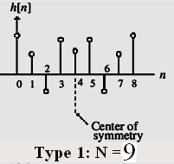
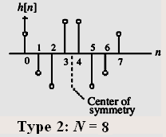
In the general case for Type1 & Type2 FIR filters, the phase function is of the form:
Notes:
Mooc没讲

Slide 58
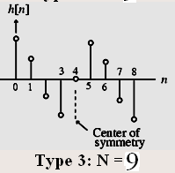
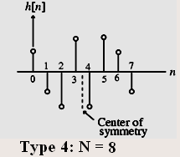
In the general case for Type3 & Type4 FIR filters, the phase function is of the form:
Notes:
Mooc没讲

Slide 59
5.6 DFT Properties Table5.1: Symmetric Relations 1
Length-N Sequence | N-point DFT
x[n] | X[k]
x*[n] | X*[<-k>_{N}]
x*[<-n>_{N}] | X*[k]
Re{x[n]} | Xcs[k]={X[<k>_{N}]+X*[<-k>_{N}]}/2
jIm{x[n]} | Xca[k]={X[<k>_{N}]-X*[<-k>_{N}]}/2
x_{cs}[n] | Re{X[k]}
x_{ca}[n] | jIm{X[k]}
MOOC
Note: x[n] is a complex sequence. x_{cs}[n] and x_{ca}[n] are the circular conjugate-symmetric and antisymmetric parts of x[n], respectively.

Slide 60
Table5.2: Symmetric Relations 2
Length-N Sequencec | N-point DFT
Real x[n] | X[k]=Re{X[k]}+jIm{X[k]}
x_{ev}[n] | Re{X[k]}
x_{od}[n] | jIm{X[k]}
Symmetry relations | X[k]=X*[<-k>_{N}]
 | ReX[k]=ReX[<-k>_{N}]
 | ImX[k]=-ImX[<-k>_{N}]
 | |X[k]|=|X[<-k>_{N}]|
 | argX[k]=-argX[<-k>_{N}]
Note: x[n] is a real sequence. x_{ev}[n] and x_{od}[n] are the circular even and odd parts of x[n], respectively.
MOOC

Slide 61
Example: Consider the length-14 real sequence
has 14-point DFT .
If
Then
(N=14)
MOOC

Slide 62
5.7 DFT Theorems
Type of Property length-N sequence N-point DFT
g[n] G[k]
h[n] H[k]
Linearity ag[n]+bh[n] aG[k]+bH[k]
Circular Time-shifting g[⟨n-n₀⟩_{N}] W_{N}^{kn0}G[k]
Frequency-shifting W_{N}^{-k0n}g[n] G[⟨k-k₀⟩_{N}]
Duality G[n] N[g⟨-k⟩_{N}]
Circular Convolution
G[k]H[k]
Modulation g[n]h[n]
MOOC
Parseval’s relation

Slide 63
Example: Consider the length-N sequence
MOOC

Slide 64
Example - Consider the two length-4 sequences:
4
We can use DFT to compute the y_{c}[n].
The two 4-point DFTs of g[n] and h[n] can be computed using the matrix relation.
MOOC

Slide 65
MOOC
D₄ is the 4-point DFT matrix.

Slide 66
If Y_{C}[k] denotes the 4-point DFT of y_{C}[n], then:
Y_{C}[k] = G[k]H[k], 0≤k≤3
Thus:
MOOC

Slide 67
So y_{C}[n] is 4-point IDFT of Y_{C}[k]:
MOOC

Slide 68
5.8 Fourier-Domain Filtering
Often one is interested in removing the components of a finite-length discrete-time signal in one or more frequency bands.
A straightforward approach to remove the unwanted components from a signal is to implement the filtering in the Fourier domain.
The Fourier-domain filtering is usually implemented using DFT. However, the DFT-based filtering will always lead to some small ripples in the filtered response.
Please look at P232, Fig5.10
Notes:
本节Mooc没讲，主要解释思路

Slide 69
Fourier-Domain Filtering
Based on DTFT convolution theorem:
In practical condition, g[n] and h[n] are real-valued signal, so the imaginary parts of the samples of the IDTFT of the product of their FT will be theoretically all zeros.
In practice, the imaginary parts are very small numbers due to computational errors.
The real part of the IDTFT of the product -- y[n] is kept as the filtered response.
MOOC

Slide 70
5.9 Computation of the DFT of Real sequences
In most practical applications, sequences are real.
In DFT definition, the sequence is assumed to be complex.
The DFTs of two N-point real sequences can be computed from a length-N complex sequences.
And a 2N-point DFT of a length-2N real sequence can be determined from a length-N complex sequences.
Notes:
此节Mooc没讲，主要作用为引出FFT思想

Slide 71
5.9.1 N-point DFTs of two real sequence using a single N-point DFT
Let g[n] and h[n] be two real sequences of length N each, with G[K] and H[k] denoting their N-point DFTs.
We build:
Then, we have:

Slide 72
5.9.2 2N-Point DFT of a Real Sequences Using a Single N-Point DFT
Let v[n] be a real sequence of length 2N with V[k] denoting its 2N-point DFT.
We can define two real sequences g[n] and h[n] of length N each as:
So,

Slide 73
5.10 Linear Convolution Using DFT
Linear convolution is a key operation in many signal processing applications.
Since a DFT can be efficiently implemented using FFT algorithms, it is of interest to develop methods for the implementation of linear convolution using the DFT.
How to do?
Linear Convolution of Two Finite-Length Sequences;
Linear Convolution of a Finite-Length Sequence with an Infinite-Length Sequence.
MOOC

Slide 74
5.10.1 Linear Convolution of Two Finite-Length Sequences
Example: Given two length-4 sequences:
n
n
Let’s extended the two length-4 sequences to length 7 by appending each with three zero-valued samples, i.e.
MOOC

Slide 75
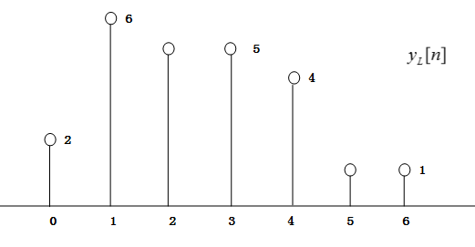
Now determine the 7-point circular convolution of g_{e}[n] and h_{e}[n]:
As can be seen: y_{c}[n] is same as the sequence y_{L}[n], which is the linear convolution of g[n] and h[n].
MOOC

Slide 76
Let g[n] and h[n] be two finite-length sequences of length N and M, respectively.
Define two length-L (L=N+M-1) sequences:
Then y_{L}[n] = g[n]*h[n] = g_{e}[n] h_{e}[n]
MOOC
L

Slide 77
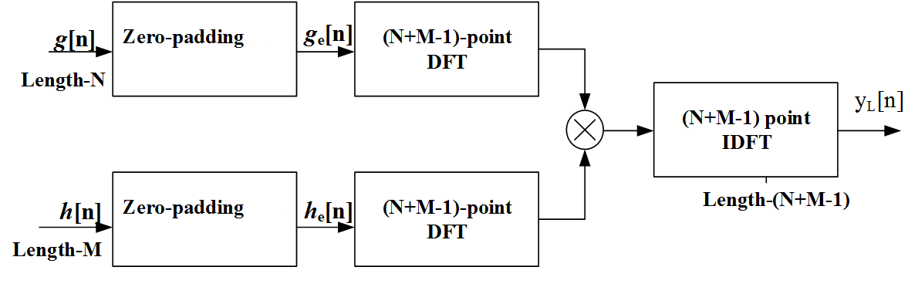
Linear Convolution Using DFT
The corresponding implementation scheme is:
MOOC

Slide 78
5.10.2 The Cyclic Prefix
In some applications, it is required to compute only a portion of the sequence {y[n]} of length N.
Using an N-point DFT and IDFT by appending the longer sequence with a subsequence called the cyclic prefix.
The cyclic prefix plays an important role in multicarrier-based digital communication.
Example 5.18
Notes:
Mooc没讲，了解，自学

Slide 79
5.10.3 Linear Convolution of a Finite-Length Sequence with an Infinite-Length Sequence
Consider the DFT-based implementation of:
*
where h[n] is a finite-length sequence of length M and x[n] is an infinite length (or a finite length sequence of length much greater than M ).
There are two methods to solve this problem:
Overlap-Add
Overlap-Save
Notes:
难点

Slide 80
Overlap-Add Method
Segment x[n] into a set of contiguous finite-length subsequences x_{m}[n] of length N each:
Then:
*
where
*
Notes:
X[n] assumed to be a causal sequence here without any loss of generality,

Slide 81
Overlap-Add Method
As a result, the desired linear convolution has been broken up into a sum of infinite number of short-length linear convolutions of length N+M-1 each:
*
*
These short convolutions can be implemented using the DFT-based approach.
There is an overlap of M - 1 samples between these two short linear convolutions.
Notes:
The first convolution is of length N+M-1 and is defined for 0 ≤ n ≤ N + M – 2.
The second convolution is also of length N+M-1 but is defined for N ≤ n ≤ 2N + M – 2.
In general, there will be an overlap of M-1 samples between the samples of these short convolutions for (r-1)N≤ n ≤ rN + M – 2.

Slide 82
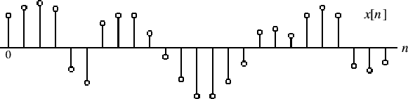
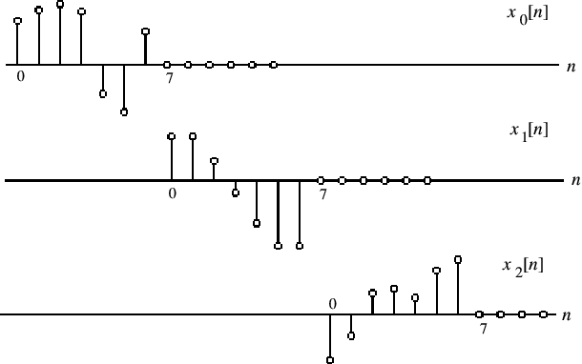
Segment x[n] into subsequences

Slide 83
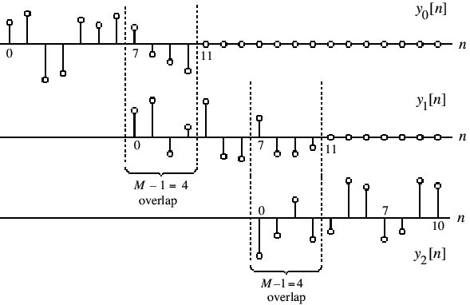
This figure illustrate Overlap-Add method for M = 5 and N = 7
Add
Add
•
•
•

Slide 84
Overlap-Add Method
The above procedure is called the overlap-add method since the results of the short linear convolutions overlap and the overlapped portions are added to get the correct final result.
The function fftfilt can be used to implement the above method.
Program 5_5 illustrates the use of fftfilt in the filtering of a noise-corrupted signal using a length-3 moving average filter.

Slide 85
Overlap-Save Method
At first, to segment x[n] into overlapping blocks x_{m}[n] .
Keeping the terms of the circular convolution of h[n] with x_{m}[n] that corresponds to the terms obtained by a linear convolution of h[n] and x_{m}[n].
Throwing away the other part of the circular convolution.
Please look at P244, Fig5.16
Notes:
Mooc没讲

Slide 86
Other Transforms
5.11 STFT
5.12 DCT
5.13 Haar Transform
Notes:
了解

Slide 87
Homework
5.4, 5.8 (a) (b), 5.13, 5.20, 5.25, 5.32, 5.36, 5.39, 5.40, 5.53, 5.64, 5.69, 5.76
M5.2, M5.10, M5.11

