Slide 1
Chapter11 DSP Algorithm Implementation
Structure Simulation and Verification by MATLAB
Computation of DFT
Fast Fourier Transformation —— FFT
DFT and IDFT Computation Using MATLAB
Number Representation
Notes:
没提到的内容不要求

Slide 2
11.2 Structure simulation Using MATLAB
Program:
direct2.m, 11_1.m, 11_2.m, 11_3.m,
11_4.m, 11_5.m, 11_6.m, 11_7.m
11.3 Computation of the DFT
11.3.1 Goertzel’s Algorithm
Notes:
Mooc没讲

Slide 3
11.3.2 Cooley-Tukey FFT Algorithms
FFT--Fast Fourier Transformation, not a new transformation, but a fast algorithm to calculate the DFT.
J.W.Cooley and J.W.Tukey are given credit for bringing the FFT to the world in their paper :“An algorithm for the machine calculation of complex Fourier Series”, Mathematics Computation, Vol.19, 1965.
IEEE electroacoustic journal published an album on fast Fourier transform algorithms in 1967, starting the history of fast transform.
Magazine in January 1992 and IEEE ICASSP 92 have featured articles or reports on commemorating the release of FFT albums.
In April 1994, the album "Understanding Fourier Technique" is published with the purpose of popularizing and promoting FFT technology
Notes:
Mooc补充材料

Slide 4
Development of FFT
The traditional fast Fourier transform algorithm is recursive decomposition algorithm, including basis 2, basis 4, basis 8 and split basis FFT.
The radix K-FFT (also known as convolutional FFT algorithm C-FFT) proposed by Stasinisik is a new development of other radix FFT algorithms.
Frigo and Johnson developed the FFTW free library in 2005 to provide a solution for running the FFT algorithm on a variety of hardware platforms.
......
Notes:
11.4节有进一步的介绍

Slide 5
DFT and IDFT definition:
Where,
Direct computation of all N samples of {X[k]} requires N² complex multiplications and N(N-1) complex additions.
Notes:
We can see that the same values of W_{N} are calculated many times during the DFT,
since W_{N} is a periodic function with a limited number of distinct values.
The aim of the FFT and its inverse, the IFFT, is to use this redundancy to reduce the number of calculation.

Slide 6
The properties of twiddle factor W_{N}:
Symmetry:
Periodicity:
Reduction:

Slide 7
Decimation-in-Time FFT
Given a sequence x[n] whose length is N=2^{k}, k is an integer.
Divided the sequence into even index sequences and odd index sequences:
Since x[n] is first decimated to form a set of subsequences before the DFT is computed, this computation schemes are called decimation-in-time (DIT) FFT algorithms.

Slide 8
Decimation-in-Time FFT
We get:
Where X₀[k] and X₁[k] is N/2-point DFT, so we get only first half N/2-point result of X[k].

Slide 9
Decimation-in-Time FFT
Based on the periodicity of W_{N}, we can get:
And:
So:

Slide 10
Block-diagram interpretation:
x[n]
x₀[n]=x[2n]
↓2
x[n]
x[n+1]
x₁[n]=x[2n+1]
z
↓2
N/2-point
DFT
↓2
z
N/2-point
DFT
↓2

Slide 11
Decimation-in-Time FFT
The computation of N-point DFT by two methods:
DFT computation | Complex Addition | Complex Multiplication
Direct computation | N²-N≈N² | N²
DIT to two N/2-point DFT | (N²/2)+N | (N²/2)+N

Slide 12
Decimation-in-Time FFT
Continuing the process we can express X₀[k] and X₁[k] as a weighted combination of two (N/4)-point DFTs.
where X₀₀[k] and X₀₁[k] are the (N/4)-point DFTs of the (N/4)-length sequences:
x₀₀[n]= x₀[2n] and x₀₁[n]= x₀[2n+1]

Slide 13
Decimation-in-Time FFT
Likewise, we can express
where X₁₀[k] and X₁₁[k] are the (N/4)-point DFTs of the (N/4)-length sequences：
x₁₀[n] = x₁[2n] and x₁₁[n] = x₁[2n+1]

Slide 14
Decimation-in-Time FFT
The following figure shows the time domain decomposition used in the FFT:
1 signal of 8 points
0 1 2 3 4 5 6 7
2 signal of 4 points
0 2 4 6
1 3 5 7
4 signals of 2 points
0 4
2 6
1 5
3 7

Slide 15
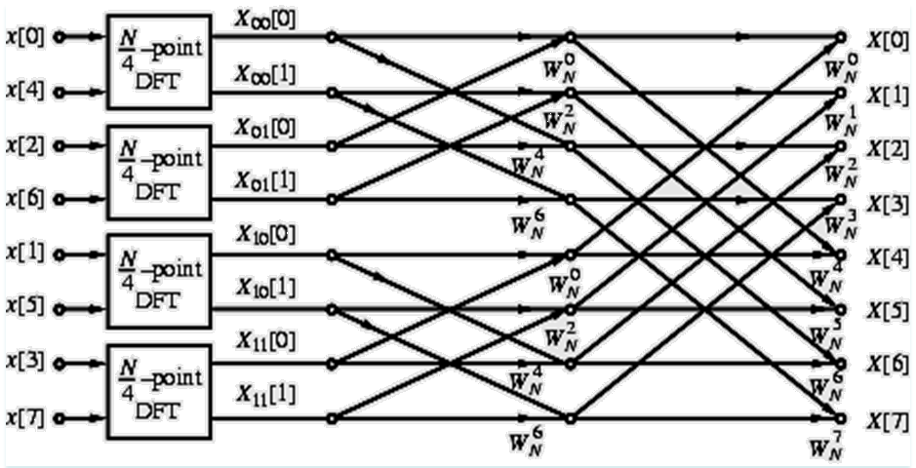
Decimation-in-Time FFT
Flow-graph representation
Notes:
In the flow-graph shown N =8；
Hence, the (N/4)-point DFT here is a 2-point DFT and no further decomposition is possible.
The four 2-point DFTs, X_{ij}[k], i, j=0, 1 can be easily computed.

Slide 16
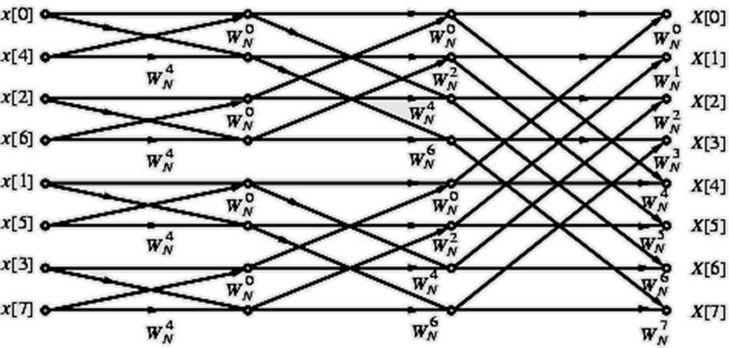
Complete flow-graph of the 8-point DFT is shown below
Each stage of the DFT computation process employs the same basic computational module which is called a butterfly computation.
Notes:
The flow-graph consists of 3 stages:
First stage computes the four 2-point DFTs
Second stage computes the two 4-point DFTs
Last stage computes the desired 8-point DFT

Slide 17
Decimation-in-Time FFT
Total number of complex multiplications and additions to compute all 8 DFT samples is equal to 8 + 8 + 8 = 24 = 8×3.
In the general case when N=2^{k} , number of stages for the computation of the (2^{k} )-point DFT in the fast algorithm will be k=log₂N.
Total number of complex multiplications to compute all N DFT samples is N( log₂N)/2
Total number of complex additions to compute all N DFT samples is N( log₂N)

Slide 18
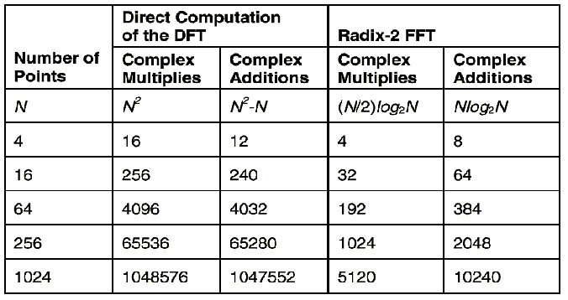
Decimation-in-Time FFT
Notes:
The fast algorithm described assumes that the length of x[n] is a power of 2;
If it is not, the length can be extended by zero-padding and make the length a power of 2;
the smallest DFTs are 2-point DFTs→radix-2

Slide 19
Decimation-in-Time FFT
In developing the count, multiplications with and have been assumed to be complex
We have not taken advantage of the symmetry property:
These properties can be exploited to reduce the computational complexity further.

Slide 20
Decimation-in-Time FFT
The FFT algorithm described here also is efficient with regard to memory requirements;
At the end of computation at any stage, output variables can be stored in the same registers previously occupied by the corresponding input variables;
This type of memory location sharing is called in-place computation resulting in significant savings in overall memory requirements.

Slide 21
Decimation-in-Time FFT
In the DFT computation scheme outlined, the DFT samples X[k] appear at the output in a sequential order while the input samples x[n] appear in a different order;
Thus, a sequentially ordered input x[n] must be reordered appropriately before the fast algorithm described by this structure can be implemented.
bit-reversed order
if n=( b₂b₁b₀ ) represents the index of x[n], then m=( b₀b₁b₂ )
is the correct index for FFT input samples. i.e.
n: 000 001 010 011 100 101 110 111
m: 000 100 010 110 001 101 011 111

Slide 22
original original bit-reversed bit-reversed
order address address order
0 000 000 0
1 001 100 4
2 010 010 2
3 011 110 6
4 100 001 1
5 101 101 5
6 110 011 3
7 111 111 7

Slide 23
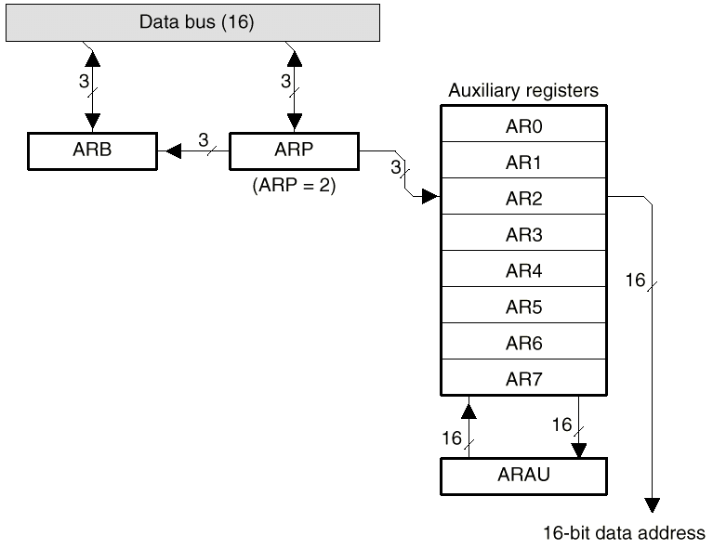
Indirect Addressing in DSP
Bit-reversed addressing enhances execution speed and program memory for FFT.

Slide 24
Decimation-in-frequency FFT
Given a sequence x[n] whose length is N=2^{L}, L is an integer. And dividing the sequence into two half sequences and compute its DFT:

Slide 25
Decimation-in-frequency FFT
Because , and , then:
When k is even number:
When k is odd number:

Slide 26
Decimation-in-frequency FFT
Based on , above formula equals to:
Process is continued until the smallest DFTs are 2-point DFTs.

Slide 27
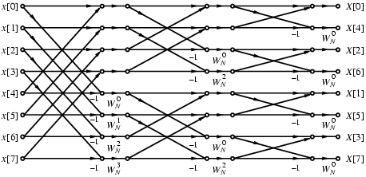
Decimation-in-frequency FFT
Complete flow-graph of the DIF FFT computation scheme for N = 8.

Slide 28
Decimation-in-frequency FFT
Computational complexity of the radix-2 DIF FFT algorithm is same as that of the DIT FFT algorithm.
Various forms of DIF FFT algorithm can similarly be developed.
It can be easily seen that the flow-graph of DIF FFT is the transpose of the flow-graph of DIT FFT, and vice-versa.

Slide 29
Inverse DFT Computation
An FFT algorithm for computing the DFT samples can also be used to calculate the inverse DFT (IDFT) efficiently.
Consider a length-N sequence x[n] with an N-point DFT X[k]:

Slide 30
Inverse DFT Computation
Multiplying both sides by N and taking the complex conjugate we get:
Right-hand side of above is the N-point DFT of X*[k].
Desired IDFT x[n] is then obtained as:

Slide 31
Inverse DFT Computation
Inverse DFT computation is shown below:
Re{X[k]}
Re{x[n]}
N-point
DFT
Im{X[k]}
Im{x[n]}

Slide 32
11.5 DFT and IDFT Computation Using MATLAB
Program 11_10.m
Spectral Analysis
Program 11_11.m
Linear Convolution
11.8 Number Representation
Notes:
11.8是有限字长分析的基础，要求自学。

