Slide 1
z-Transform
--Definition
--ROC (Region of Converges)
--z-Transform Properties
--Transfer Function

Slide 2
z-Transform
In continuous signal system, we use S-Transform and FT as the tools to process problems in the transform domain; so in discrete signal system, we use z-Transform and DFT.
z-Transform can make the solution for discrete time systems very simple.

Slide 3
z-Transform
The DTFT provides a frequency-domain representation of discrete-time signals and LTI discrete-time systems
Because of the convergence condition, in many cases, the DTFT of a sequence may not exist.
MOOC

Slide 4
6.1 Definition and Properties
key point
DTFT defined by：
leads to the z-transform。
z-transform may exist for many sequences for which the DTFT does not exist。

Slide 5
6.1 Definition and Properties
key point
For a given sequence g[n], its z-transform G(z) is defined as:
where z= Re(z) + jIm(z) is a complex variable.
MOOC

Slide 6
6.1 Definition and Properties
key point
If we let z=re^{jω}, then the z-transform reduces to:
For r = 1 (i.e., |z| = 1), z-transform reduces to its DTFT, provided the latter exists。The contour |z| = 1 is a circle in the z-plane of unity radius and is called the unit circle。
MOOC

Slide 7
6.1 Definition and Properties
key point
Like the DTFT, there are conditions on the convergence of the infinite series：
For a given sequence, the set R of values of z for which its z-transform converges is called the region of convergence (ROC)
MOOC

Slide 8
6.1 Definition and Properties
key point
From our earlier discussion on the uniform convergence of the DTFT, it follows that the series：
converges if {g[n]r-n} is absolutely summable, i.e., if：
MOOC

Slide 9
6.1 Definition and Properties
key point
In general, the ROC of a z-transform of a sequence g[n] is an annular region of the z-plane:
where
Note: The z-transform is a form of a Laurent series and is an analytic function at every point in the ROC。
MOOC

Slide 10
6.1 Definition and Properties
key point
Example - Determine the z-transform X(z) of the causal sequence x[n]=α^{n}μ[n] and its ROC.
Now
The above power series converges to:
ROC is the annular region |z| > |α|.
MOOC

Slide 11
6.1 Definition and Properties
key point
Example - The z-transform μ(z) of the unit step sequence μ[n] can be obtained from:
by setting a = 1,
MOOC
ROC is the annular region .

Slide 12
6.1 Definition and Properties
key point
Example - Consider the anti-causal sequence:
Its z-transform is given by:
MOOC
ROC is the annular region

Slide 13
6.1 Definition and Properties
key point
Note: The unit step sequence μ[n] is not absolutely summable, and hence its DTFT does not converge uniformly.
Note: Only way an unique sequence can be associated with a z-transform is by specifying its ROC.

Slide 14
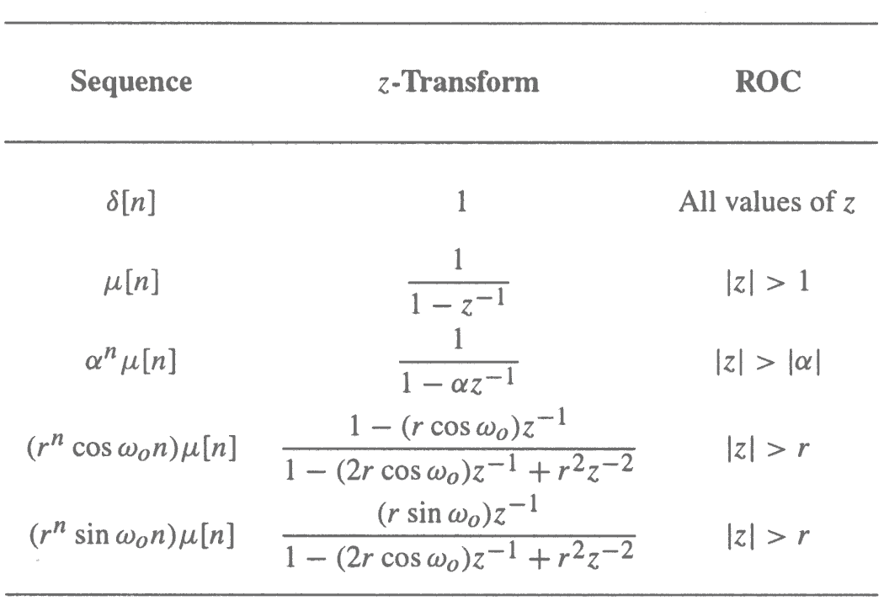
Commonly Used z-transform
MOOC

Slide 15
6.2 Rational z-Transform
In the case of LTI discrete-time systems we are concerned with in this course, all pertinent z-transforms are rational functions of z⁻¹.
That is, they are ratios of two polynomials in z⁻¹ :
MOOC

Slide 16
6.2 Rational z-Transform
A rational z-transform can be alternately written in factored form as:
MOOC

Slide 17
6.2 Rational z-Transform
At a root z=ξ_{l} of the numerator polynomial G(ξ_{l})=0 and as a result, these values of z are known as the zeros of G(z).
At a root z= λ_{l} of the denominator polynomial G(λ_{l})→∞, and as a result, these values of z are known as the poles of G(z).
MOOC

Slide 18
6.2 Rational z-Transform
Consider:
Note G(z) has M finite zeros and N finite poles:
If N > M there are additional N - M zeros at z = 0 (the origin in the z-plane)
If N < M there are additional M - N poles at z = 0.
MOOC

Slide 19
6.2 Rational z-Transform
A physical interpretation of the concepts of poles and zeros can be given by plotting the log-magnitude 20log₁₀|G(z)| as shown on next figure for:

Slide 20
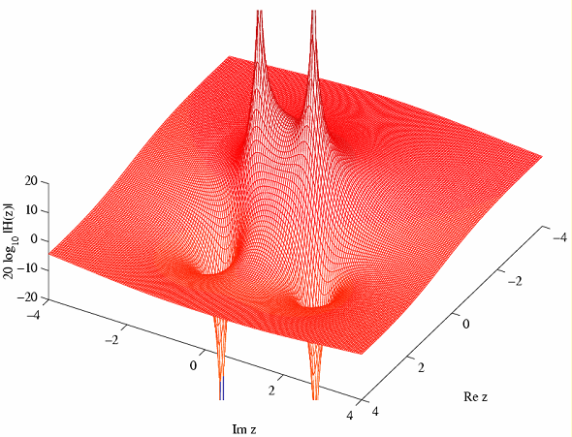
6.2 Rational z-Transform
poles z=0.4±j0.6928, zeros z=1.2±j1.2.

Slide 21
6.3 ROC of a Rational z-transform
ROC of a z-transform is an important concept.
Without the discussion of the ROC, there is no unique relationship between a sequence and its z-transform.
Hence, the z-transform must always be specified with its ROC.

Slide 22
6.3 ROC of a Rational z-transform
Moreover, if the ROC of a z-transform includes the unit circle, the DTFT of the sequence is obtained by simply evaluating the z-transform on the unit circle.
ROC of z-transform of the impulse sequence of a causal, stable LTI discrete time system.

Slide 23
6.3 ROC of a Rational z-transform
The ROC of a rational z-transform is bounded by the locations of its poles.
To understand the relationship between the poles and the ROC, it is instructive to examine the pole-zero plot of a z-transform.
MOOC

Slide 24
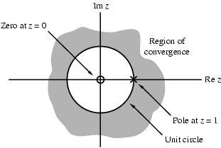
6.3 ROC of a Rational z-transform
Consider again the pole-zero plot of the z-transform μ(z) .
MOOC

Slide 25
6.3 ROC of a Rational z-transform
A sequence can be one of the following types: finite-length, right-sided, left-sided and two-sided.
In general, the ROC depends on the type of the sequence of interest.
MOOC

Slide 26
6.3 ROC of a Rational z-transform
The ROC of a rational z-transform is bounded by the locations of its poles.
To understand the relationship between the poles and the ROC, it is instructive to examine the pole-zero plot of a z-transform.
MOOC

Slide 27
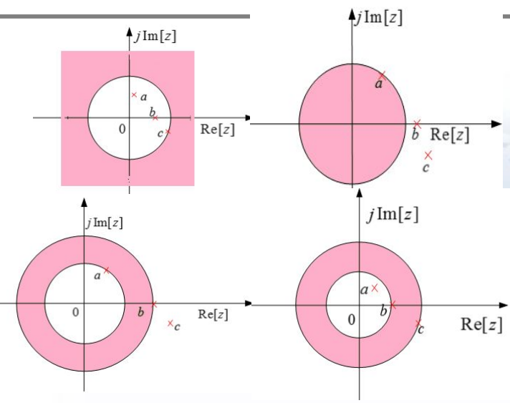
6.3 ROC of a Rational z-transform
Three poles and possible ROCs
MOOC

Slide 28
6.3 ROC of a Rational z-transform
The ROC of a rational z-transform can be easily determined using MATLAB
[z, p, k] = tf2zp(num, den)
determines the zeros, poles, and the gain constant of a rational z-transform with the numerator and denominator coefficients specified by the vector num and den, respectively.

Slide 29
6.3 ROC of a Rational z-transform
[num,den] = zp2tf(z, p, k) implements the reverse process.
The factored form of the z-transform can be obtained using
sos = zp2sos(z, p, k)
The above statement computes the coefficients of each second-order factor given as an L×6 matrix sos.

Slide 30
6.3 ROC of a Rational z-transform

Slide 31
6.3 ROC of a Rational z-transform
The pole-zero plot is determined using the function zplane.
The z-transform can be either described in terms of its zeros and poles: zplane(zeros,poles).
or, it can be described in terms of its numerator and denominator coefficients: zplane(num,den) .
Please look at P287-288 examples about z-transform using MATLAB .

Slide 32
6.4 The Inverse z-Transform
key point
General Expression
Inverse z-Transform by Table Look-up Method
Inverse z-Transform by Partial-Fraction Expansion
Inverse z-Transform via Long Division
MATALB Computation

Slide 33
6.4.1 General Expression
key point
Inverse ZT is given as:
where C’ is a counterclockwise contour of integration defined by |z|=r.

Slide 34
6.4.1 General Expression
key point
But the contour integral is difficult to calculate.
The contour integral can be evaluated using the Cauchy’s residue theorem resulting in:

Slide 35
General Expression
key point
Based on the residue theorem, if
is continuous in the contour C, and there are K poles inside C, M poles outside C.
Then:
C is counterclockwise.
Or:
C is clockwise.

Slide 36
6.4.1 General Expression
key point
Inverse z-Transform Expression:
Where C is counterclockwise.

Slide 37
How To Solve the Residue at Any Pole z_{r}?
If z_{r} is a single pole, then:
If z_{r} is a multiple pole( M order), then:

Slide 38
Other Caculation Methods
key point
Table Look-up Method
Partial Fraction Expansion
Inverse z-Transform via Long Division
MOOC

Slide 39
6.4.2 Table Look-up Method
Illustrate this method in Example 6.12:
From table 6.1, we get:
MOOC
So:

Slide 40
6.4.3 Partial-Fraction Expansion
In practical application, the X(z) is the rational fraction of z.
Where A(z),B(z) are polynomials of z.
So:
Note:you must make each X_{k}(z) easy to solve its IZT, and pay attention to it’s ROC.
MOOC

Slide 41
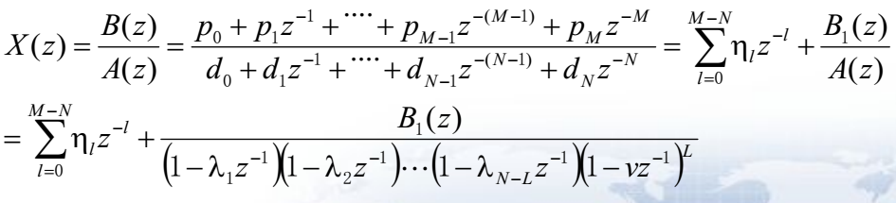
6.4.3 Partial-Fraction Expansion
If:
Then X(z) is expanded as partial-fraction:
Where v is a L-order poles of X(z) , each λ_{l} is a single pole of X(z)(k=1,2,…,N-L).
MOOC

Slide 42
6.4.3 Partial-Fraction Expansion
η_{l}: when M≥N,it exists ; M<N, it equals to 0.
ρ_{l}: based on residue theorem, we get
l=1,2,…N-L.
γ_{i}:
MOOC

Slide 43
6.4.3 Partial-Fraction Expansion
Example - Consider
By long division we arrive at:
MOOC

Slide 44
6.4.3 Partial-Fraction Expansion
Example - Let the z-transform H(z) of a causal sequence h[n] be given by:
A partial-fraction expansion of H(z) is then of the form:
MOOC

Slide 45
6.4.3 Partial-Fraction Expansion
Now:
and:
MOOC

Slide 46
6.4.3 Partial-Fraction Expansion
Hence
The inverse transform of the above is therefore given by:
MOOC

Slide 47
MOOC

Slide 48
MOOC

Slide 49
6.4.4 Partial-Fraction Expansion MATALB Computation
[r,p,k]= residuez(num,den) develops the partial-fraction expansion of a rational z-transform with numerator and denominator coefficients given by vectors num and den.
Vector r contains the residues.
Vector p contains the poles.
Vector k contains the constants.

Slide 50
6.4.4 Partial-Fraction Expansion MATALB Computation
[num,den]=residuez(r,p,k) converts a z-transform expressed in a partial-fraction expansion form to its rational form.
P293-294 Examples.

Slide 51
6.4.5 Inverse z-Transform via Long Division
Because in common condition, X(z) is a rational fraction, we can divide numerator polynomial by denominator polynomial to get the expansion of the power series.
Note: When we use long division methods, we must first estimate the ROC of x[n], then expand X(z) into appropriate x[n].

Slide 52
Solution：Roc of X(z) is annular，so x[n] is a two-sided sequence
pole z=1/4 relates to right-sided sequence, pole z=4 relates to left-sided sequence
Expand X(z) into Partial-Fraction Expansion

Slide 55
6.4.6 Inverse z-Transform Using MATLAB
The function impz can be used to find the inverse of a rational z-transform G(z).
The function computes the coefficients of the power series expansion of G(z).
The number of coefficients can either be user specified or determined automatically.

Slide 56
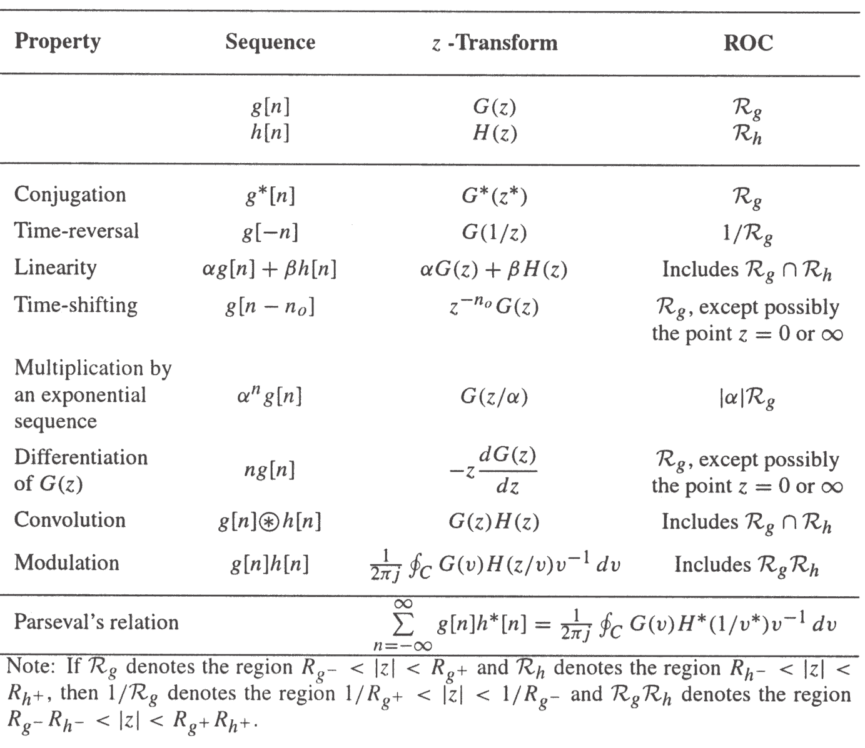
6.5 z-Transform Properties
key point
MOOC

Slide 57
6.5 z-Transform Properties
1.Initial value theorem
For a causal sequence x[n], exist:
2.Terminal value theorem
For a causal sequence x[n], and the pole of X(z)=Z(x[n]) inside the unit cycle (in unit cycle there are at best single poles), then:

Slide 58
6.6 Computation of the Convolution Sum of Finite-Length Sequences
Tabular methods for the computation of the linear and circular convolution have been outlined.
Now, we describe alternate methods for the computation of the linear and circular convolution that based on the multiplication of two polynomial.

Slide 59
6.6.1 Linear Convolution
Let x[n] and h[n] be two sequences of lengths L+1 and M+1, respectively. Their z-transforms, X(z) and H(z) be:
So, the z-transform of linear convolution sequence y[n] is Y(z):
And its coefficient is y[n].

Slide 60
6.6.2 Circular Convolution
Let x[n] and h[n] both be two sequences of degree N-1, Their z-transforms, X(z) and H(z) be:
So, the z-transform of linear convolution sequence y[n] is Y(z):
$$Y_{L}(z)=y_{L}[0]+y_{L}[1]z{}^{−1}+y_{L}[2]z{}^{−2}+⋯+y_{L}[2N−2]z{}^{−(2N−2)}$$

Slide 61
6.6.2 Circular Convolution
Let Y_{c}(z) denote the polynomial of degree N-1 whose coefficients is y_{c}[n] , it can be shown that (Problem 6.17) :
The modulo operation with respect to z^{-N}=1 in above equation of Y_{L}(z).
Please look at P331 about the process example.

Slide 62
6.7 The Transfer Function
The z-transform of the impulse response of an LTI system, called the transfer function, is a polynomial in z⁻¹.
In most practical cases, the LTI digital filter of interest is characterized by a linear different equation with constant and real coefficient, so it’s transfer function is rational z-transform.

Slide 63
6.7.1 Definition
Origin:
In time domain, use unit sample response h[n] to represent a LTI system:
To do ZT for both sides, we get:
Then:
It’s the transfer function of a LTI system.
MOOC

Slide 64
6.7.2 Transfer Function Expression
FIR Digital Filter
In the case of an LTI FIR digital filter, with it’s impulse response h[n] defined for N₁ ≤n≤N₂, and thus, h[n]=0 for n＜N₁ and n＞N₂. Therefore, the transfer function is given by:

Slide 65
6.7.2 Transfer Function Expression
Finite-Dimension Linear Time-Invariant IIR Discrete-Time System
Consider an LTI discrete-time system characterized by a difference equation
Its transfer function is obtained by taking the z-transform of both sides of the above equation, Thus:

Slide 66
6.7.2 Transfer Function Expression
1. are the finite zeros, and
are the finite poles of H(z).
2.If N>M, there are additional (N-M) zeros at z=0 ; if N＜M, there are additional (M-N) poles at z=0.
3.For a causal IIR filter, the ROC of the transfer function H(z) is:

Slide 67
6.7.3 Frequency Response from Transfer Function
The relationship between H(z) and H(e^{jω}).
Because:

Slide 68
6.7.4 Geometric Interpretation of FR Computation
Use zero-vectors and pole-vectors in z-plane to interpret the frequency response.

Slide 69
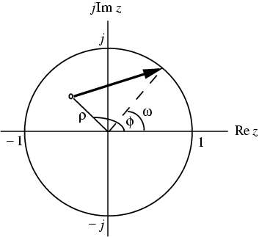
6.7.4 Geometric Interpretation of FR Computation
As shown below in the z-plane the factor represents a vector starting at the point and ending on the unit circle at

Slide 71
lowpass
highpass

Slide 72
bandpass
bandstop

Slide 73
allpass
multiband

Slide 74
Given
so, the frequency response
Amplitude：
Phase：

Slide 75
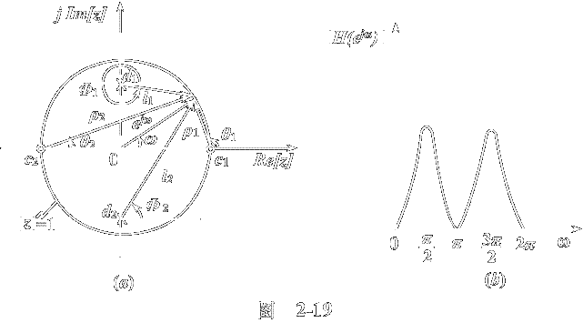
Position of zeros will affect the position and depth of dips
Zeros at the unit cycle, the amplitude of dips will be zero
Zeros tend to the unit cycle, the amplitude of dips tend to zero
Position of poles will affect the position and depth of peaks
Poles tend to the unit cycle, the amplitude of peaks tend to infinite
Poles is outside the unit cycle, the system is unstable

Slide 76
6.7.5 Stability Condition in Term of Pole Locations
Before the digital filter is implemented, we need to ensure that the transfer function derived will lead to a stable structure.
An LTI digital filter is BIBO stable if and only if:

Slide 77
6.7.5 Stability Condition in Term of Pole Locations
So, the ROC of the transfer function H(z) of a BIBO stable LTI digital filter should contains the unit circle.
The causal LTI digital filter is stable with all its poles are inside the unit cycle.

Slide 78
6.7.5 Stability Condition in Term of Pole Locations
For a causal LTI FIR digital filter, the stability is always satisfied.
For a causal LTI IIR digital filter, it may be unstable if not designed properly.
In addition, due to the unavoidable quantization of all coefficients, an originally stable IIR filter may also become unstable.(P319 Eg6.41)

Slide 79
Homework
Read textbook from p277 to 319
Problems
6.6, 6.7,6.12,6.18,6.42
6.44,6.47,6.65,6.66,6.81
M6.1, M6.2, M6.3

Slide 80
THANKS

