Slide 1
Chapter7 LTI Discrete-Time Systems in the Transform Domain
--Transfer Function Classification
--Types of Linear-Phase Transfer Functions
--Simple Digital Filters

Slide 2

Types of Transfer Functions
The time-domain classification of a digital transfer function based on the length of its impulse response sequence:
- Finite impulse response (FIR) transfer function.
- Infinite impulse response (IIR) transfer function.

Slide 3
Types of Transfer Functions
In the case of digital transfer functions with frequency-selective frequency responses, there are two types of classifications:
(1) Classification based on the shape of the magnitude function |H(e^{iω})|.
(2) Classification based on the form of the phase function θ(ω).

Slide 4
7.1 Transfer Function Classification Based on Magnitude Characteristics
Digital Filters with Ideal Magnitude Responses
Bounded Real Transfer Function
Allpass Transfer Function

Slide 5
7.1.1 Digital Filters with Ideal Magnitude Responses
A digital filter designed to pass signal components of certain frequencies without distortion should have a frequency response equal to 1 at these frequencies, and should have a frequency response equal to 0 at all other frequencies.

Slide 6
7.1.1 Digital Filters with Ideal Magnitude Responses
The range of frequencies where the frequency response takes the value of 1 is called the passband.
The range of frequencies where the frequency response takes the value of 0 is called the stopband.

Slide 7
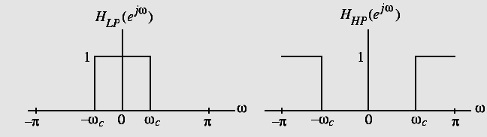
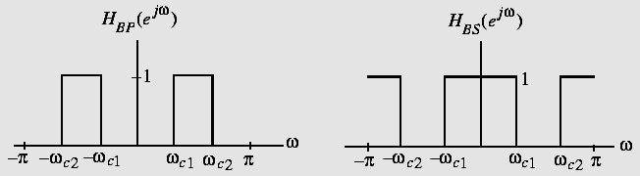
7.1.1 Digital Filters with Ideal Magnitude Responses
Magnitude responses of the four popular types of ideal digital filters with real impulse response coefficients are shown below:

Slide 8
7.1.1 Digital Filters with Ideal Magnitude Responses
The frequencies ω_{c}, ω_{c1}, and ω_{c2} are called the cutoff frequencies.
An ideal filter has a magnitude response equal to 1 in the passband and 0 in the stopband, and has a 0 phase everywhere.

Slide 9
7.1.1 Digital Filters with Ideal Magnitude Responses
Earlier in the course we derived the inverse DTFT of the frequency response H_{LP}(e^{jω})of the ideal lowpass filter:
h_{LP}[n]=sin(ω_{c}n)/(πn), - ∞ <n< ∞
We have also shown that the above impulse response is not absolutely summable, and hence, the corresponding transfer function is not BIBO stable.

Slide 10
7.1.1 Digital Filters with Ideal Magnitude Responses
Also, h_{LP}[n] is not causal and is of doubly infinite length.
The remaining three ideal filters are also characterized by doubly infinite, noncausal impulse responses and are not absolutely summable.
Thus, the ideal filters with the ideal “brick wall” frequency responses cannot be realized with finite dimensional LTI filter.

Slide 11
7.1.1 Digital Filters with Ideal Magnitude Responses
To develop stable and realizable transfer functions, the ideal frequency response specifications are relaxed by including a transition band between the passband and the stopband.
This permits the magnitude response to decay slowly from its maximum value in the passband to the 0 value in the stopband.

Slide 12
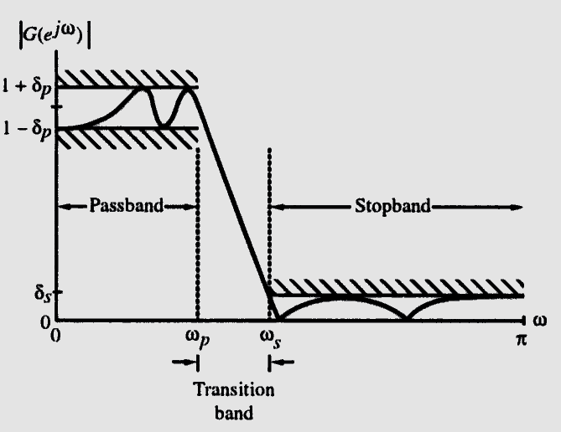
7.1.1 Digital Filters with Ideal Magnitude Responses
Moreover, the magnitude response is allowed to vary by a small amount both in the passband and the stopband.
Typical magnitude
response specifications
of a lowpass filter
are shown as:

Slide 13
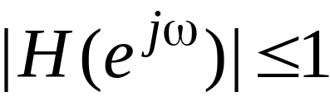
7.1.2 Bounded Real Transfer Functions
A causal stable real-coefficient transfer function H(z) is defined as a bounded real (BR) transfer function if:
for all values of ω
Let x[n] and y[n] denote, respectively, the input and output of a digital filter characterized by a BR transfer function H(z) with X(e^{jω}) and Y(e^{jω}) denoting their DTFTs.

Slide 14
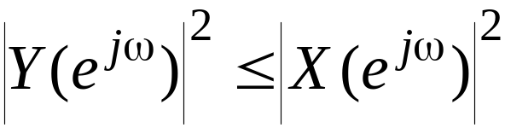
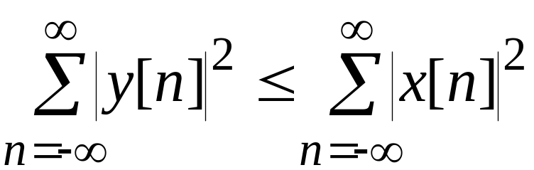
7.1.2 Bounded Real Transfer Functions
Then the condition implies that:
Integrating the above from-π to π, and applying Parseval’s relation we get:

Slide 15
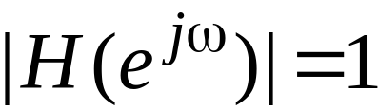
7.1.2 Bounded Real Transfer Functions
Thus, for all finite-energy inputs, the output energy is less than or equal to the input energy.
It implies that a digital filter characterized by a BR transfer function can be viewed as a passive structure.
If , then the output energy is equal to the input energy, and such a digital filter is therefore a lossless system.

Slide 16
7.1.2 Bounded Real Transfer Functions
A causal stable real-coefficient transfer function H(z) with is thus called a lossless bounded real (LBR) transfer function.
The BR and LBR transfer functions are the keys to the realization of digital filters with low coefficient sensitivity.

Slide 17
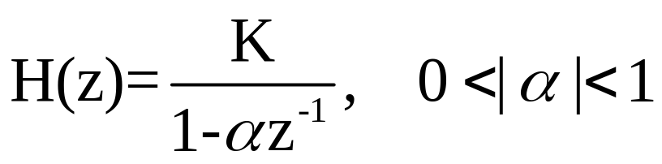
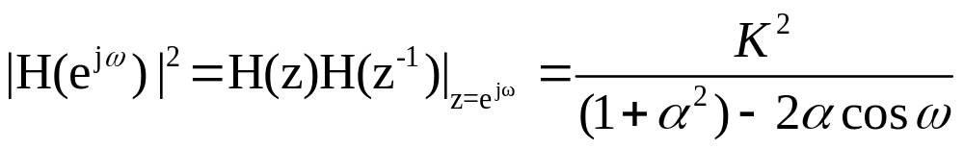
7.1.2 Bounded Real Transfer Functions
Example: Consider the causal stable IIR transfer function:
where K is a real constant.
Its square-magnitude function is given by:

Slide 18
7.1.2 Bounded Real Transfer Functions
Thus, for α>0,
( |H(e^{jω})|² )_{max} = K²/(1- α)² | _{ω=0}
( |H(e^{jω})|² ) _{min} = K²/(1+ α)² | _{ω=π}
On the other hand, for α<0,
(2αcosω )_{max} = -2α | _{ω= π}
(2αcosω )_{min} = 2α | _{ω=0}
Here, ( |H(e^{jω})|² )_{max} = K²/(1+ α)² | _{ω= π}
( |H(e^{jω})|² )_{min} = K²/(1- α)² | _{ω= 0}

Slide 19
7.1.2 Bounded Real Transfer Functions
Hence,
is a BR function for K≤±(1-α),
Plots of the magnitude function for α=±0.5 with values of K chosen to make H(z) a BR function are shown on the next page.

Slide 20
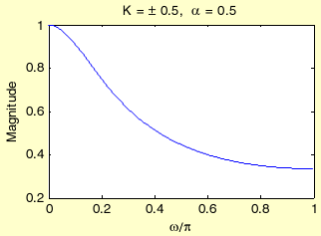
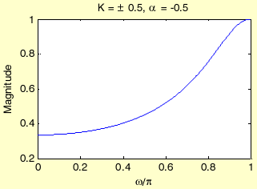
7.1.2 Bounded Real Transfer Functions
Lowpass filter
Highpass filter

Slide 21
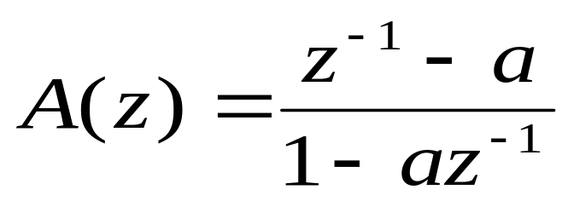
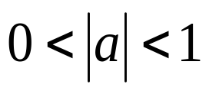
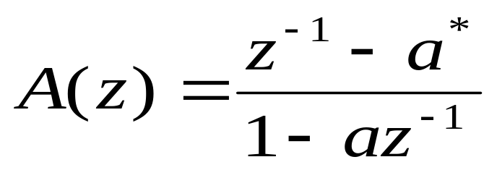
7.1.3 Allpass Transfer Function difficulty
The magnitude response of allpass system satisfies: |A(e^{jω})|²=1,for all ω.
The H(z) of a simple 1th-order allpass system is:
Where a is real, and .
Or a is complex ,the H(z) should be:

Slide 22

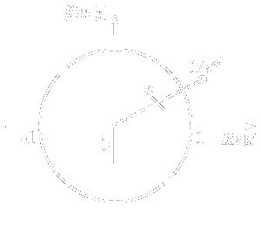
7.1.3 Allpass Transfer Function difficulty
one real pole
one complex pole

Slide 23
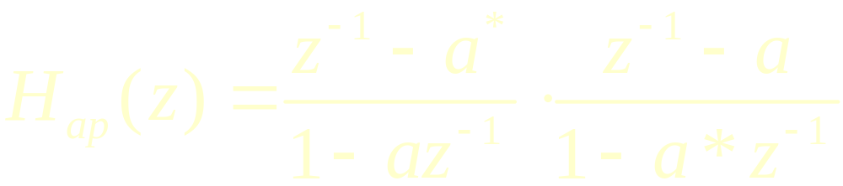
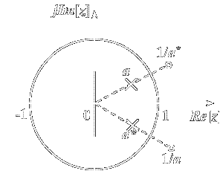


7.1.3 Allpass Transfer Function difficulty
Two order allpass transfer function
ploes：
zeros：

Slide 24
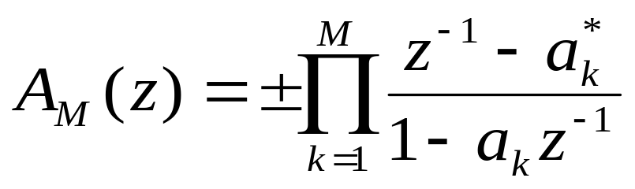
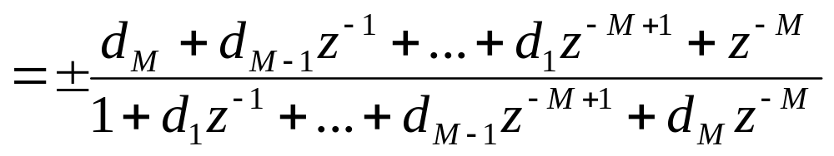
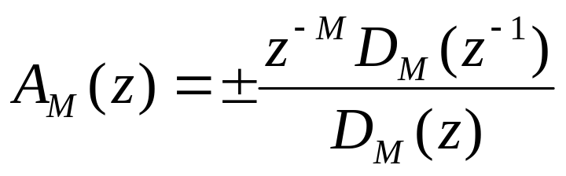
7.1.3 Allpass Transfer Function difficulty
Generalize, the Mth-order allpass system is:
If we denote polynomial:
So:

Slide 25
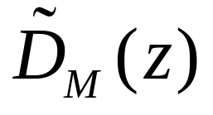
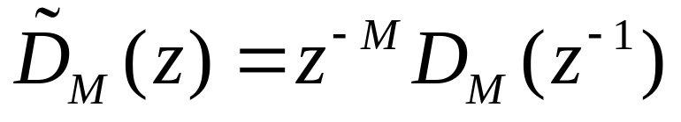
7.1.3 Allpass Transfer Function difficulty
The numerator of a real-coefficient allpass transfer function is said to be the mirror-image polynomial of the denominator, and vice versa.
We shall use the notation to denote the mirror-image polynomial of a degree-M polynomial D_{M}(z) , i.e.,

Slide 26
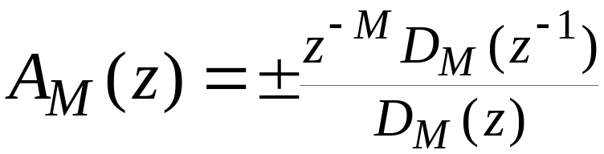
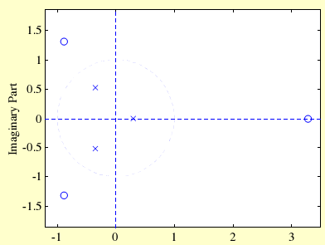
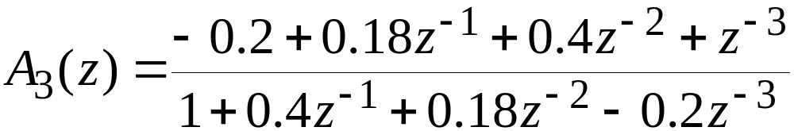
7.1.3 Allpass Transfer Function difficulty
The expression
implies that the poles and zeros of a real-coefficient allpass function exhibit mirror-image symmetry in the z-plane.

Slide 27
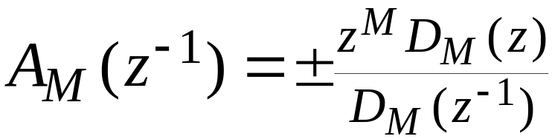
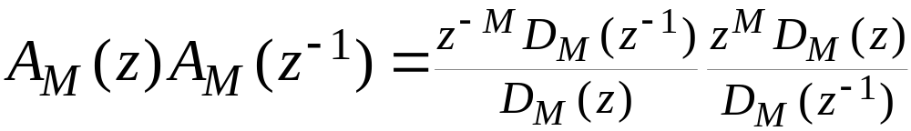
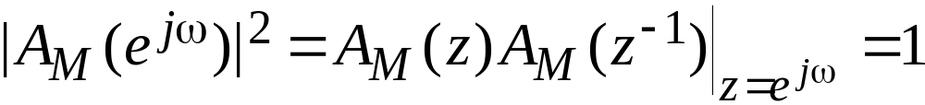
7.1.3 Allpass Transfer Function difficulty
To show that |A_{M}(e^{jω})|=1 we observe that:
Therefore:
Hence:

Slide 28
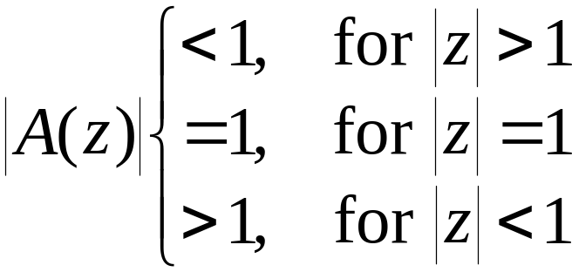
7.1.3 Allpass Transfer Function difficulty
Properties:
A causal stable real-coefficient allpass transfer function is a lossless bounded real (LBR) function or, equivalently, a causal stable allpass filter is a lossless structure.
The magnitude function of a stable allpass function A(z) satisfies:

Slide 29
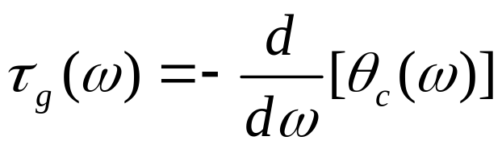
7.1.3 Allpass Transfer Function difficulty
(3) Let τ_{g}(ω) denote the group delay function of an allpass filter A(z), i.e.,
The unwrapped phase function θ_{c}(ω) of a stable allpass function is a monotonically decreasing function of ω so that τ_{g}(ω) is everywhere positive in the range 0 < ω < π.

Slide 30
Application of allpass system difficulty
Any causal stable system can be denoted as: H(z)=H_{min}(z)A(z)
Where H_{min}(z) is a minimum phase-delay system.
Use allpass system to help design stable filters.
Use allpass system to help design linear phase system.
A simple example.(P313,Fig7.7)

Slide 31

7.2 Transfer Function Classification Based on Phase Characteristic
1、The phase delay will cause the change of signal waveform
幅度
原始信号
时间 t
幅度
相移90º
时间 t
幅度
相移 180º
时间 t

Slide 32
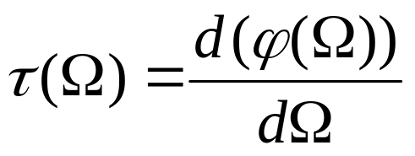
2、The nonlinearity of system phase delay will cause the signal distortion
Time delay of signal is depended on system
phase characteristic
ϕ(ω)
时延
f1 f2
f
f1 f2
f
ϕ(ω)
时延
f1 f2
f
f1 f2
f

Slide 33
3、If we ignore the phase information, then
输入波形
DFT变换
忽略相位信息
IDFT变换
输出波形

Slide 34
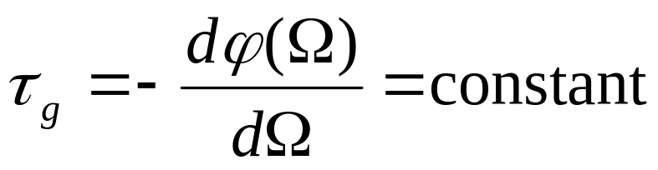
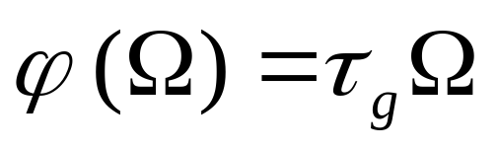
4、The linear phase FIR filter design
linear phase requirement：
---- group delay

Slide 35
7.2 Transfer Function Classification Based on Phase Characteristic
Zero-Phase Transfer Function
Linear-Phase Transfer Function
Minimum-Phase and Maximum-Phase Transfer Functions

Slide 36
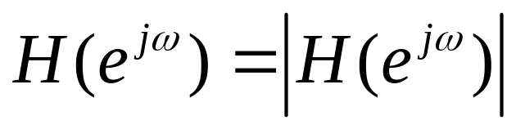
7.2.1 Zero-Phase Transfer Function
One way to avoid any phase distortions is to make the frequency response of the filter real and nonnegative,to design the filter with a zero phase characteristic.
But for a causal digital filter it is impossible.

Slide 37
7.2.1 Zero-Phase Transfer Function
Only for non-real-time processing of real-valued input signals of finite length, the zero phase condition can be met.
Let H(z) be a real-coefficient rational z-transform with no poles on the unit cycle, then F(z)=H(z)H(z⁻¹) has a zero phase on the unit cycle.

Slide 38
7.2.1 Zero-Phase Transfer Function
Please look at book P362.
x[n]
H(z)
v[n]
u[n]
H(z)
w[n]
u[n]=v[-n], y[n]=w[-n]
The function filtfilt implements the above zero-phase filtering scheme.
Please look at book P403—P7.25.

Slide 39
7.2.2 Linear-Phase Transfer Function
key point
The phase distortion can be avoided by ensuring that the transfer function has a unity magnitude and a linear-phase characteristic, that is:
H(e^{jω})=e^{-jωD}
How to perform the linear-phase filter?
y[n]=x[n-D]➔Y(e^{jω})= e^{-jωD}X(e^{jω})
➔H(e^{jω})= Y(e^{jω})/ X(e^{jω})= e^{-jωD}

Slide 40
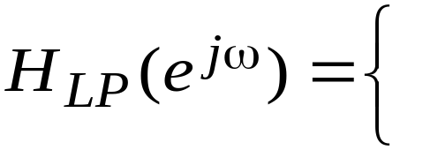
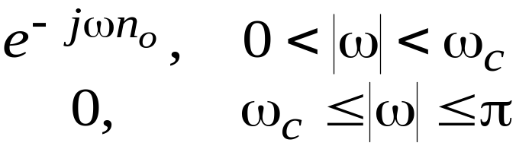
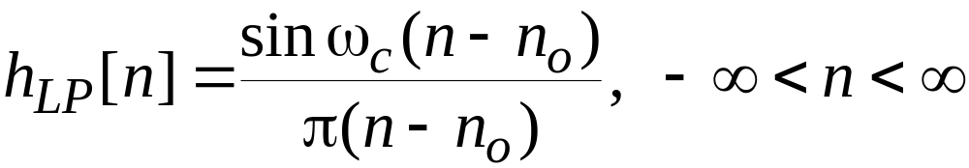
7.2.2 Linear-Phase Transfer Function
key point
Example - Determine the impulse response of an ideal lowpass filter with a linear phase response:
Applying the time-shifting property of the DTFT to the impulse response of an ideal zero-phase lowpass filter we arrive at:

Slide 41
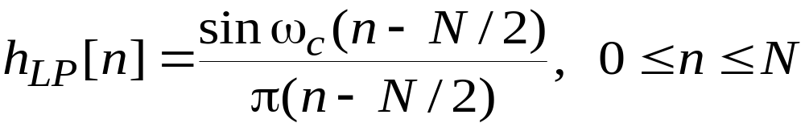
7.2.2 Linear-Phase Transfer Function
key point
By truncating the impulse response to a finite number of terms, a realizable FIR approximation to the ideal lowpass filter can be developed.
The truncated approximation may or may not exhibit linear phase, depending on the value of n₀ chosen.
If we choose n₀= N/2 with N a positive integer, the truncated and shifted approximation:
^

Slide 42
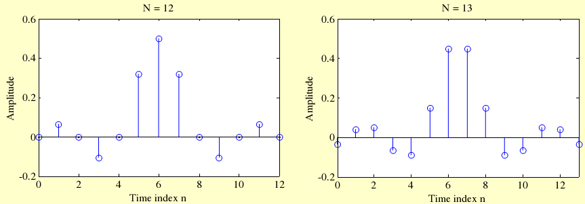
7.2.2 Linear-Phase Transfer Function
key point
Figure below shows the filter coefficients obtained using the function sinc for two different values of N.

Slide 43
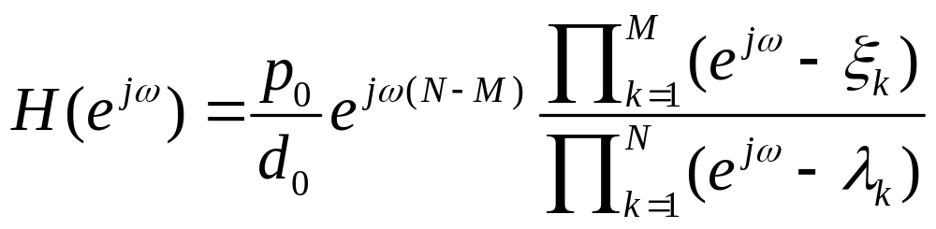
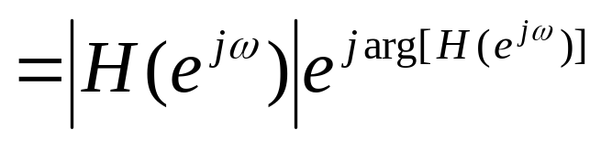
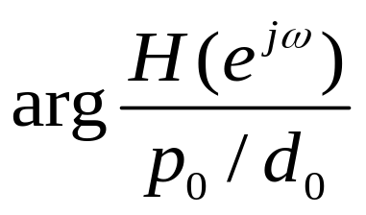
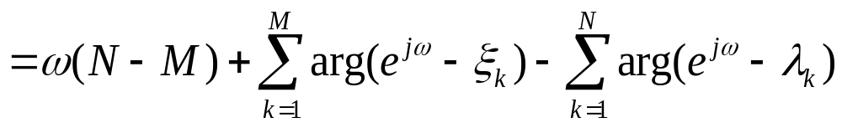
7.2.3 Minimum-Phase and Maximum-Phase Transfer Function difficulty
Based on the expression:
The phase function is:
Where, ξ_{k} andλ_{k} are zeros and poles, respectively.

Slide 44
7.2.3 Minimum-Phase and Maximum-Phase Transfer Function difficulty
We define the expression (e^{jω}- ξ_{k} )and (e^{jω} - λ_{k} ) as zero vectors and pole vectors.
When ξ_{k} and λ_{k} are inside the unit circle,
and ωchange from 0 to 2π, the change of phase of the zero (pole) vectors are 2π.
When ξ_{k} and λ_{k} are outside the unit circle,
and ωchange from 0 to 2π, the change of phase of the zero (pole) vectors are 0.

Slide 45
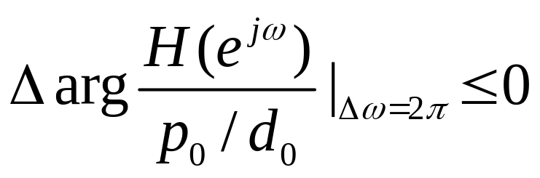

7.2.3 Minimum-Phase and Maximum-Phase Transfer Function difficulty
So, only zeros or poles inside the unit circle can affect phase function of H(e^{jω}).
For causal stable system, we can deduce:
So, it’s the phase delay (lag) system.
When all zeros are all inside the unit circle, we get:
It’s the minimum phase delay system.

Slide 46
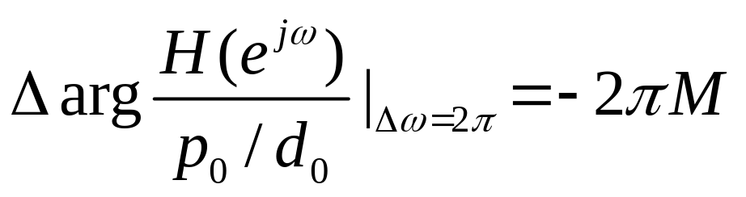
7.2.3 Minimum-Phase and Maximum-Phase Transfer Function difficulty
When all zeros are all outside the unit circle, we get:
Where M is the number of zeros.
And it’s the maximum phase delay system.
A transfer function with zeros inside and outside the unit circle is called a mixed-phase transfer function.
Example7.4(P348).

Slide 47
7.3 Types of Linear-Phase FIR Transfer Functions
It is nearly impossible to design a linear-phase IIR transfer function.
It is always possible to design an FIR transfer function with an exact linear-phase response.
We now develop the forms of the linear-phase FIR transfer function H(z) with real impulse response h[n].

Slide 48
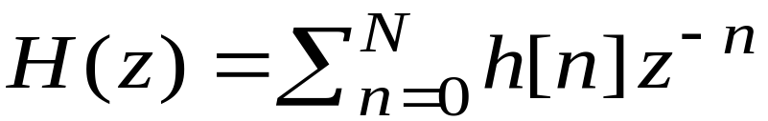
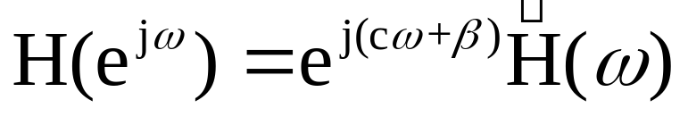
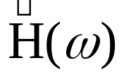
7.3 Types of Linear-Phase FIR Transfer Functions
Consider a causal FIR transfer function H(z) of length N+1, i.e., of order N:
If H(z) is to have a linear-phase, its frequency response must be of the form
Where c and βare constants, and , called the amplitude response, also called the zero-phase response, is a real function of ω .

Slide 49
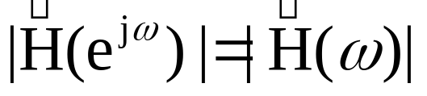
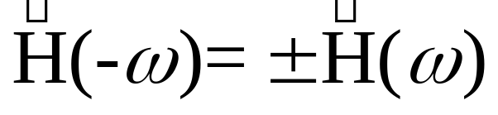
7.3 Types of Linear-Phase FIR Transfer Functions
For a real impulse response, the magnitude response |H(e^{jω})| is an even function of , i.e., |H(e^{jω})| = |H(e^{-jω})|
Since , the amplitude response is then either an even function or an odd function of ω, i.e.

Slide 50


7.3 Types of Linear-Phase FIR Transfer Functions
The frequency response satisfies the relation H(e^{jω})=H*(e^{-jω}), or equivalently, the relation
If is an even function, then the above relation leads to e^{jβ}=e^{-jβ} implying that either β=0 or β=π

Slide 51



7.3 Types of Linear-Phase FIR Transfer Functions
From
We have
Substituting the value of β in the above we get

Slide 52


7.3 Types of Linear-Phase FIR Transfer Functions
Replacing ω with –ω in the previous equation we get
Making a change of variable l=N-n, we rewrite the above equation as

Slide 53

7.3 Types of Linear-Phase FIR Transfer Functions
As , we have
h[n]e^{-jω(c+n)}= h[N-n]e^{jω(c+N-n)}
The above leads to the condition when c=-N/2
h[n]=h[N-n], 0≤n≤N
Thus, the FIR filter with an even amplitude response will have a linear phase if it has a symmetric impulse response.

Slide 54




7.3 Types of Linear-Phase FIR Transfer Functions
If is an odd function of ω, then from
We get e^{jβ}= -e^{-jβ} as
The above is satisfied if β=π/2 or β=- π/2 ，Then
Reduces to

Slide 55



7.3 Types of Linear-Phase FIR Transfer Functions
The last equation can be rewritten as:
As , from the above we get

Slide 56


7.3 Types of Linear-Phase FIR Transfer Functions
Making a change of variable l=N-n, we rewrite the last equation as:
Equating the above with
We arrive at the condition for linear phase as:

Slide 57
7.3 Types of Linear-Phase FIR Transfer Functions
h[n]=-h[N-n], 0≤n≤N
with c=-N/2
Therefore a FIR filter with an odd amplitude response will have linear-phase response if it has an antisymmetric impulse response.

Slide 58
7.3 Types of Linear-Phase FIR Transfer Functions
Since the length of the impulse response can be either even or odd, we can define four types of linear-phase FIR transfer functions
For an antisymmetric FIR filter of odd length, i.e., N even
h[N/2] = 0
We examine next the each of the 4 cases

Slide 59


7.3 Types of Linear-Phase FIR Transfer Functions
Type 1: N = 8
Type 2: N = 7
Type 3: N = 8
Type 4: N = 7

Slide 60

7.3 Types of Linear-Phase FIR Transfer Functions
Type 1: Symmetric Impulse Response with Odd Length
In this case, the degree N is even
Assume N = 8 for simplicity
The transfer function H(z) is given by

Slide 61


7.3 Types of Linear-Phase FIR Transfer Functions
Because of symmetry, we have h[0]=h[8], h[1] = h[7], h[2] = h[6], and h[3] = h[5]
Thus, we can write

Slide 62
7.3 Types of Linear-Phase FIR Transfer Functions
The corresponding frequency response is then given by
The quantity inside the braces is a real function of ω, and can assume positive or negative values in the range 0≤|ω|≤π.

Slide 63


7.3 Types of Linear-Phase FIR Transfer Functions
The phase function here is given by
where β is either 0 or π, and hence, it is a linear function of ω in the generalized sense
The group delay is given by
indicating a constant group delay of 4 samples

Slide 64




7.3 Types of Linear-Phase FIR Transfer Functions
In the general case for Type 1 FIR filters, the frequency response is of the form
~
where the amplitude response , also called the zero-phase response, is of the form
~

Slide 65
7.3 Types of Linear-Phase FIR Transfer Functions
Type 2: Symmetric Impulse Response with even Length
Type 3: Antisymmetric Impulse Response with odd Length
Type 4: Antisymmetric Impulse Response with even Length
P371-372 about these FIR transfer functions.

Slide 66

Four Types of Linear Phase Filter

Slide 67

Four Types of Linear Phase Filter

Slide 68
7.3 Types of Linear-Phase FIR Transfer Functions
Example - Consider
which is seen to be a slightly modified version of a length-7 moving-average FIR filter
The above transfer function has a symmetric impulse response and therefore a linear phase response

Slide 69
7.3 Types of Linear-Phase FIR Transfer Functions
A plot of the magnitude respons of H₀(z) along with the 7-point moving-average filter is shown below
1
modified filter
0.8
moving-average
0.6
Magnitude
0.4
0.2
0
0
0.2
0.4
0.6
0.8
1
ω
/
π

Slide 70
7.3 Types of Linear-Phase FIR Transfer Functions
Note the improved magnitude response obtained by simply changing the first and the last impulse response coefficients of a moving-average (MA) filter
It can be shown that we can express
which is seen to be a cascade of a 2-point MA filter with a 6-point MA filter
Thus, H₀(z) has a double zero at z=-1, i.e., (ω = π)

Slide 71
7.3.1 Zero Locations of Linear-Phase FIR Transfer Functions
The zeros of the real-coefficient h[n] is in mirror-image pairs.
Moreover, for a FIR filter with a real impulse response, the zeros occur in complex conjugate pairs.
Particularly, zeros position for different linear-phase types:

Slide 72
7.3.1 Zero Locations of Linear-Phase FIR Transfer Functions
(1)Type 1 :Either an even number or no zeros at z=1& z=-1.
(2)Type 2 :Either an even number or no zeros at z=1,and an odd number of zeros at z=-1.
(3)Type 3 :An odd number of zeros at z=1& z=-1.
(4)Type 4 :An odd number of zeros at z=1, and either an even number or no zeros at z=-1.

Slide 73
7.4 Simple Digital Filters
Simple FIR Digital Filters
Lowpass; Highpass
Simple IIR Digital Filters
Lowpass; Highpass; Bandpass; Bandstop
Comb Filters
FIR Comb Filters; IIR Comb Filters

Slide 74
Homework
Read the textbook from p.351 to 378
Problems
7.4, 7.10, 7. 21, 7.28, 7.41,7.43,7.60, 7.69
M7.3, M7.5, M7.6

Slide 75
THANKS

