Slide 1
Electronic System Design 3 Lecture 7.1: Instrumentation Amps and Common Mode Rejection
Dr Duncan Bremner

Slide 2
…From previous lecture
Common-Mode Rejection
Problem with previous circuit is that ground is a signal level...
And a sewer for random stray currents
Use PLAN B
Measure the difference between the two leads and let them vary with respect to "Ground” however they like

Slide 3
Common-Mode Rejection (2)
= Instrumentation Amplifier
Component X
• Has a big gain (O/P is big, so no more problems)
• Doesn't care what ground potential “???” Is
= Common-mode rejection
• Produces an output voltage with respect to
an explicit third (output ground) input

Slide 4
Perfect Instrumentation Amplifier
• Gain is finite (e.g. 100, 1000..)
• Gain is pure differential (Function of In(+)–In(–) only)
• Gain is ideally ZERO for pure common-mode signals
• "Sense" is feedback connection.
‘Ref’ is usually Ground
If "Sense" connected to "O/P”
(Where A_{V} is the differential voltage gain and A_{CM} is the common-mode voltage gain)
Only if ‘Perfect’ Inst Amp; Acm = 0

Slide 5
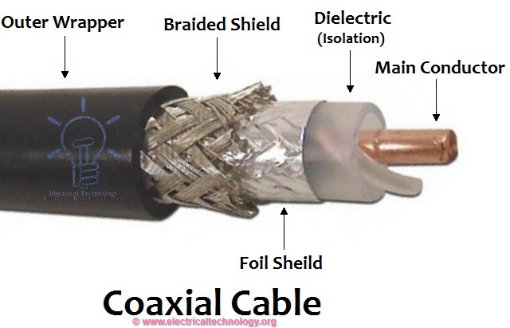
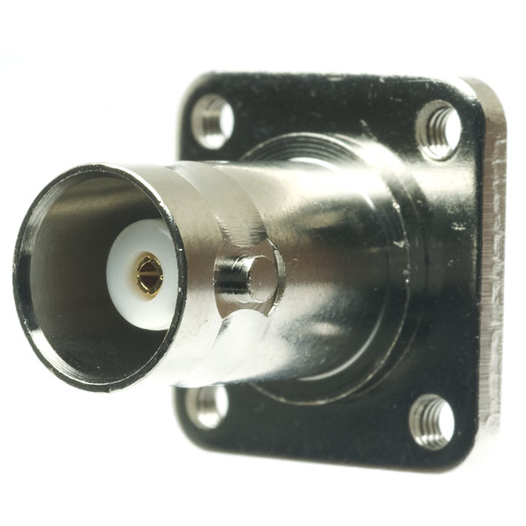
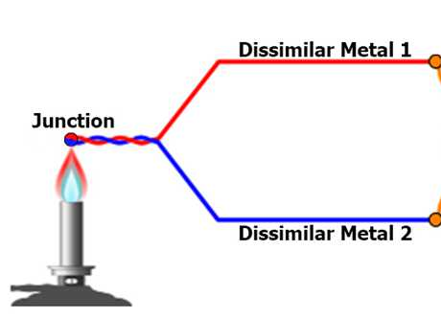
Instrumentation Amplifier (2)
Application
Instrumentation amp (INA) is connected to thermocouple by
a twisted pair, to avoid magnetic pickup.
Ref is connected to the ground of the O/P connector
=> Voltage between inner & outer of coaxial cable is O/P
R is a large resistor to bleed away bias current (see later)
Circuit is immune to voltage present on "ground"

Slide 6
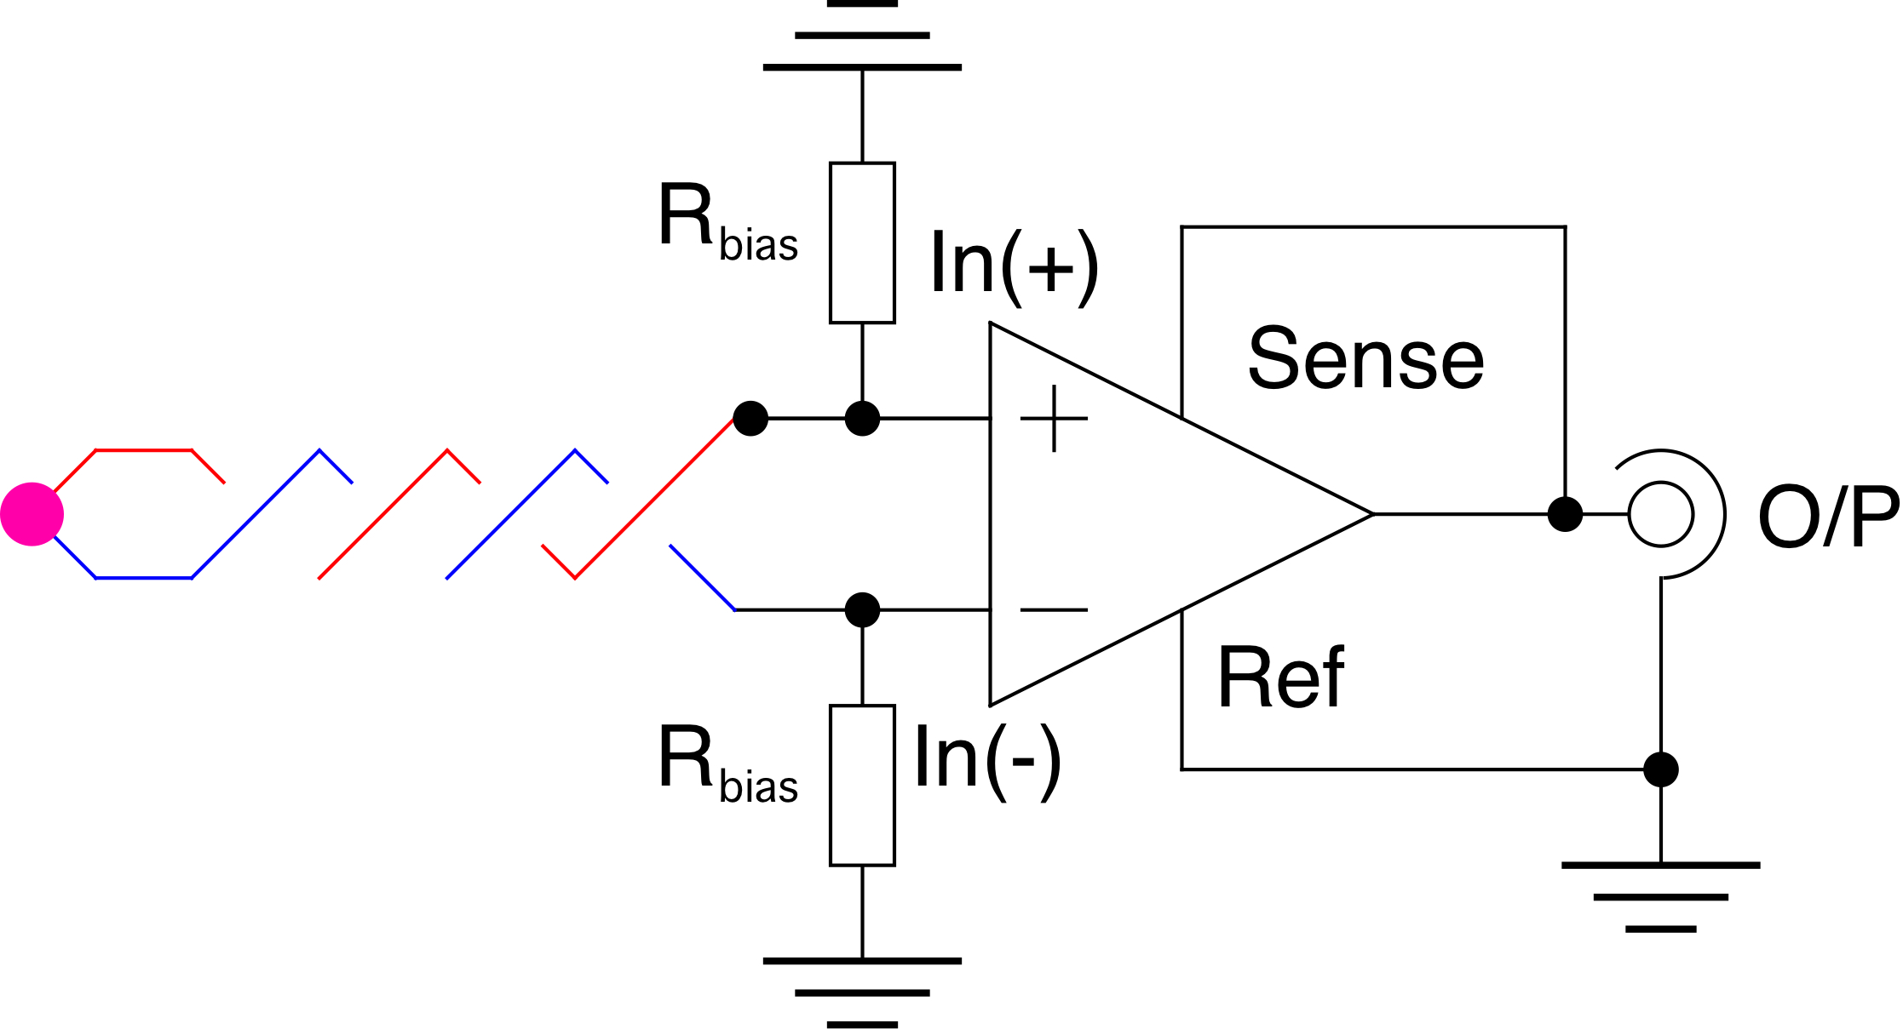
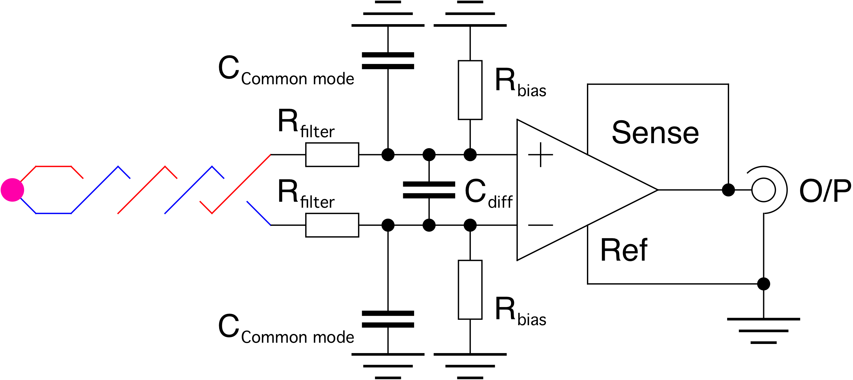
Instrumentation Amplifier (3)
Improved:
Since the name of the game is rejecting the average voltage;
symmetry is always a good idea.
Adding a low pass filter (symmetrical) to eliminate radiofrequency interference is a good practical move

Slide 7
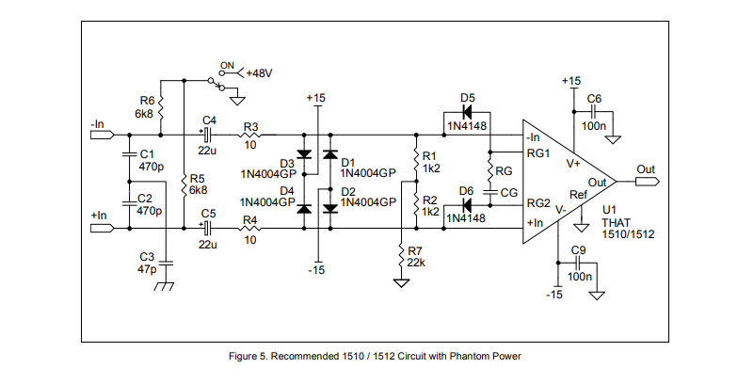
THAT 1510 Microphone Preamp

Slide 8
Common-Mode Rejection Ratio (CMRR)
Perfect instrumentation amplifier
has a “common-mode” gain =0
In practice no instrumentation amp is perfect: A change in the average (common-mode) voltage will give a change in output
Hambley §9.2

Slide 9
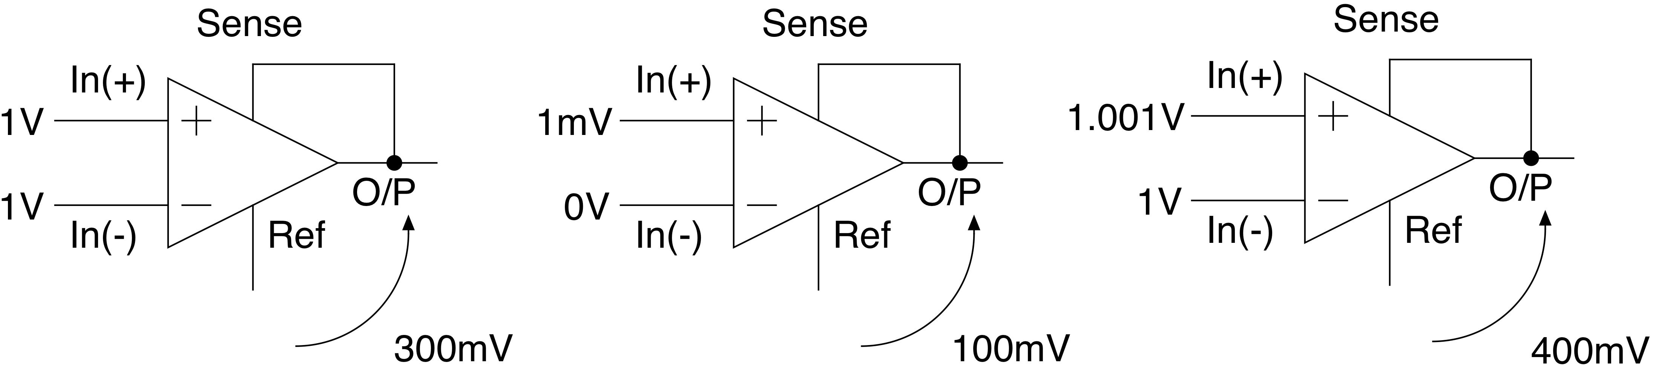
CMRR(2)
Thus if A_{v} = 100 and A_{CM} = 0.30 (so CMRR = 333 = 50.4dB):
So an input of 333mV on both inputs gives Exactly the same output as 1mV difference between both inputs: With a CMRR of 333 the minimum voltage difference you can detect is 1mV for a common - mode voltage of 300mV.
If the common mode voltage is 1V the minimum detectible differential voltage is 3mV.
Important: minimum detectable signal is assumed when the ‘error’ signal is the same as the ‘real or wanted’ signal.

Slide 10

Thank you
谢谢

